Slide 1
CS323 Operating Systems
File System
Yuanyuan Zhou
Lecture 23
3/19/2003

Slide 2
Content of this lecture
Administrative announcements
Disk scheduling
File systems basic concepts
Summary
The hardest question:
  Using swap to implement mutex

Slide 3
Administatives
Regrading Period
  MP1: until this Friday, 3/21 5pm
  Midterm1: until Friday, 3/21 5pm
    Pick/up your midterm from TA’s office
  Submit written request to TA
  After this deadline, no regrading request will be granted!!
Quiz3
Dropping class: talk with college (206)
3/31 & 4/2 lectures
  Given by TA: Jeff

Slide 4
Review
Power management
  Power-down after idle for some time

Slide 5
Input/Output Summary
I/O Hardware
I/O software
Clock/timers
Power management
Others (read textbook)
  Disks (merged into file systems)
  Character terminals
  GUI
  Network terminals

Slide 6
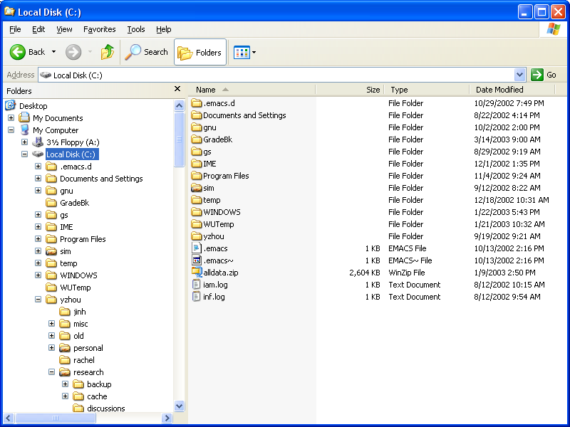
File Systems

Slide 7
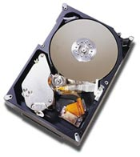
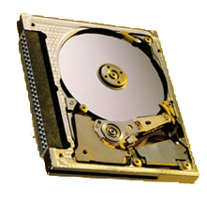
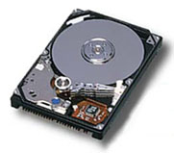
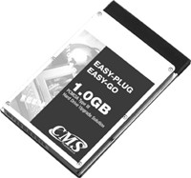
Disks First, Then File Systems
Form factor:
.5-1”× 4”× 5.7”
Storage:
18-73GB
Form factor:
.4-.7” × 2.7” × 3.9”
Storage:
4-27GB
Form factor:
.2-.4” × 2.1” × 3.4”
Storage:
170MB-1GB

Slide 8
Magnetic Disk Capacity
80%/year
100,000
3.5”
10,000
2.5”
1,000
8-14”
1.8”
100
MBytes
10
5.25”
1
80
84
88
92
96
00

Slide 9
Disk Technology Trends
Disks are getting smaller for similar capacity
  Spin faster, less rotational delay, higher bandwidth
  Less distance for head to travel (faster seeks)
  Lighter weight (for portables)
Disk data is getting denser
  More bits/square inch
  Tracks are closer together
  Doubles density every 18 months
Disks are getting cheaper ($/MB)
  Factor of ~2 per year since 1991
  Head close to surface

Slide 10
Disk Organization
Disk surface
  Circular disk coated with magnetic material
Tracks
  Concentric rings around disk surface, bits laid out serially along each track
Sectors
  Each track is split into arc of track (min unit of transfer)
sector

Slide 11
Disk Organization As Fiction
Fixed arc implies inefficiency
  short inner sectors, long outer sectors
Reality
  More sectors on outer tracks
  Disks map transparently
sector

Slide 12
More on Disks
CD’s and floppies come individually, but magnetic disks come organized in a disk pack
Cylinder
  Certain track of the platter
Disk arm
  Seek the right cylinder
seek a cylinder

Slide 13
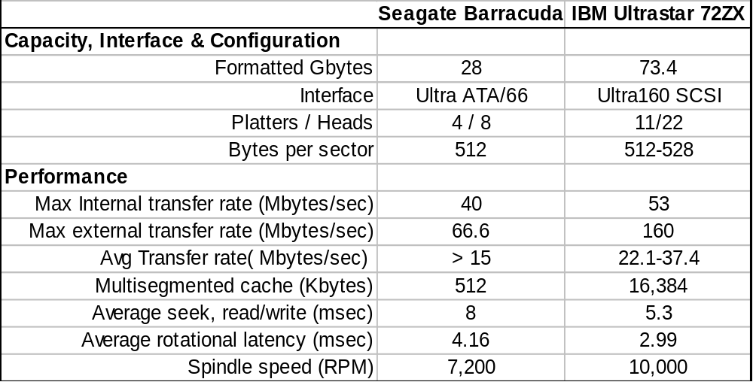
Disk Examples (Summarized Specs)

Slide 14
Disk Performance
Seek
  Position heads over cylinder, typically 5.3 − 8 ms
Rotational delay
  Wait for a sector to rotate underneath the heads
  Typically 8.3 − 6.0 ms (7,200 – 10,000RPM) or ½ rotation takes 4.15-3ms
Transfer bytes
  Average transfer bandwidth (15-37 Mbytes/sec)
Performance of transfer 1 Kbytes
  Seek (5.3 ms) + half rotational delay (3ms) + transfer (0.04 ms)
  Total time is 8.34ms or 120 Kbytes/sec!
What block size can get 90% of the disk transfer bandwidth?
Notes:
8.3*25*10=1660KB

Slide 15
Disk Behaviors
There are more sectors on outer tracks than inner tracks
  Read outer tracks: 37.4MB/sec
  Read inner tracks: 22MB/sec
Seek time and rotational latency dominates the cost of small reads
  A lot of disk transfer bandwidth are wasted
  Need algorithms to reduce seek time
Block Size (Kbytes) | % of Disk Transfer Bandwidth
1Kbytes | 0.5%
8Kbytes | 3.7%
256Kbytes | 55%
1Mbytes | 83%
2Mbytes | 90%

Slide 16
Observations
Getting first byte from disk read is slow
  high latency
Peak bandwidth high, but rarely achieved
Need to mitigate disk performance impact
  Do extra calculations to speed up disk access
    Schedule requests to shorten seeks
  Move some disk data into main memory – file system caching

Slide 17
Disk Scheduling
Which disk request is serviced first?
  FCFS
  Shortest seek time first
  Elevator (SCAN)
  C-SCAN (Circular SCAN)
Look familiar?

Slide 18
FIFO (FCFS) order
Method
  First come first serve
Pros
  Fairness among requests
  In the order applications expect
Cons
  Arrival may be on random spots on the disk (long seeks)
  Wild swing can happen
Analogy:
  Can elevator scheduling use FCFS?
0
53
199
98, 183, 37, 122, 14, 124, 65, 67

Slide 19
SSTF (Shortest Seek Time First)
Method
  Pick the one closest on disk
  Rotational delay is in calculation
Pros
  Try to minimize seek time
Cons
  Starvation
Question
  Is SSTF optimal?
  Can we avoid starvation?
Analogy: elevator
0
53
199
98, 183, 37, 122, 14, 124, 65, 67
(65, 67, 37, 14, 98, 122, 124, 183)

Slide 20
Elevator (SCAN)
Method
  Take the closest request in the direction of travel
  Real implementations do not go to the end (called LOOK)
Pros
  Bounded time for each request
Cons
  Request at the other end will take a while
0
53
199
98, 183, 37, 122, 14, 124, 65, 67
(37, 14, 65, 67, 98, 122, 124, 183)

Slide 21
C-SCAN (Circular SCAN)
Method
  Like SCAN
  But, wrap around
  Real implementation doesn’t go to the end (C-LOOK)
Pros
  Uniform service time
Cons
  Do nothing on the return
0
53
199
98, 183, 37, 122, 14, 124, 65, 67
(65, 67, 98, 122, 124, 183, 14, 37)

Slide 22
History of Disk-related Concerns
When memory was expensive
  Do as little bookkeeping as possible
When disks were expensive
  Get every last sector of usable space
When disks became more common
  Make them much more reliable
When processor got much faster
  Make them appear faster

Slide 23
Disk Versus Memory
Memory
Latency in 10’s of processor cycles
Transfer rate 300+MB/s
Contiguous allocation gains ~10x
Disk
Latency in milliseconds
Transfer rate 5-50MB/s
Contiguous allocation gains ~1000x

Slide 24
On-Disk Caching
Method
  Put RAM on disk controller to cache blocks
    Seagate ATA disk has .5MB, IBM Ultra160 SCSI has 16MB
    Some of the RAM space stores “firmware” (an OS)
  Blocks are replaced usually in LRU order
Pros
  Good for reads if you have locality
Cons
  Expensive
  Need to deal with reliable writes

Slide 25
Why Files?
Physical reality
  Block oriented
  Physical sector #s
  No protection among users of the system
  Data might be corrupted if machine crashes
Filesystem model
  Byte oriented
  Named files
  Users protected from each other
  Robust to machine failures

Slide 26
Group Discussion
What functions should file systems provide?

Slide 27
File System Requirements
Users must be able to:
  create, modify, and delete files at will.
  read, write, and modify file contents with a minimum of fuss about blocking, buffering, etc.
  share each other's files with proper authorization
  transfer information between files.
  refer to files by symbolic names.
  retrieve backup copies of files lost through accident or malicious destruction.
  see a logical view of their files without concern for how they are stored.

Slide 28
File Concepts
Files
Directory structures
Partitions (possible)
File Concept: OS abstracts from the physical properties of its storage device to define a logical storage unit, called file. Files are mapped by the OS onto physical devices.

Slide 29
File Attributes
Name: symbolic file name, the only information kept in human-readable form. Many OS support two part file names (name.extension)
Type: needed for systems that support different types.
  Regular files - user information, regular files are generally either ASCII or binary files.
  Directories - system files for maintaining the structure of the file system
  Character special files - related to input/output and used to model serial I/O devices such as terminals, printers, and networks
  Block special files - used to model disks
Location: pointer to a device and to the location of the file on that device.
Size: current size and maximal possible size
Protection: Access-control information.
Time, date, user identification: creation time, last modification, last use.

Slide 30
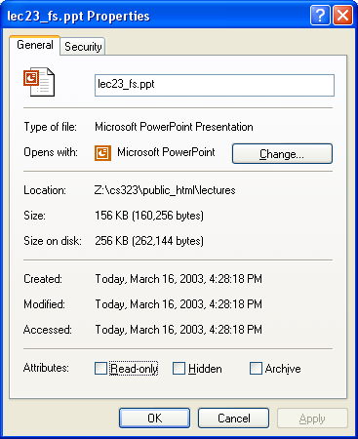
Example: Windows NTFS File Atributes

Slide 31
File Operations
Create a file
Write a file
Read a file
Reposition within a file
Delete a file
Append to a file
Copy a file

Slide 32
File Structures
Byte sequence
  Read or write a number of bytes
  Unstructured or linear
Record sequence
  Fixed or variable length
  Read or write a number of records
Tree
  Records with keys
  Read, insert, delete a record (typically using B-tree)

Slide 33
File Structures Today
Stream of bytes
  Simplest to implement in kernel
  Easy to manipulate in other forms
  Little performance loss
More complicated structures
  Hardware assist fell out of favor
  Special-purpose hardware slower, costly

Slide 34
File Types
ASCII – plain text
A Unix executable file
  header: magic number, sizes, entry point, flags
  Text (code)
  Data
  relocation bits
  symbol table
Devices
Everything else in the system

Slide 35
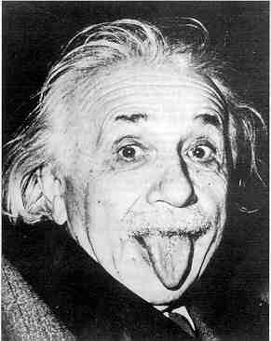
So What Makes Filesystems Hard?
Files grow and shrink in pieces
Little a priori knowledge
6 orders of magnitude in file sizes
Overcoming disk performance behavior
Desire for efficiency
Coping with failure

Slide 36
Reminder

