Slide 1
CS323 Operating Systems
File System II
Yuanyuan Zhou
Lecture 24
3/21/2003

Slide 2
Content of this lecture
Administrative announcements
File systems basic concepts
Summary

Slide 3
Administatives
Regrading Period
  MP1: until this Friday, 3/21 5pm
  Midterm1: until Friday, 3/21 5pm
    Pick/up your midterm from TA’s office
  Submit written request to TA
  After this deadline, no regrading request will be granted!!
Quiz3 closes today.
3/31 & 4/2 lectures
  Given by TA: Jeff

Slide 4
Review
Disk scheduling
  FCFS
  Shortest seek time first
  Elevator (SCAN)
  C-SCAN

Slide 5
Disk Versus Memory
Memory
Latency in 10’s of processor cycles
Transfer rate 300+MB/s
Contiguous allocation gains ~10x
Disk
Latency in milliseconds
Transfer rate 5-50MB/s
Contiguous allocation gains ~1000x

Slide 6
On-Disk Caching
Method
  Put RAM on disk controller to cache blocks
    Seagate ATA disk has .5MB, IBM Ultra160 SCSI has 16MB
    Some of the RAM space stores “firmware” (an OS)
  Blocks are replaced usually in LRU order
  Good for reads if you have locality
Cons
  Expensive
  Need to deal with reliable writes

Slide 7
Why Files?
Physical reality
  Block oriented
  Physical sector #s
  No protection among users of the system
  Data might be corrupted if machine crashes
Filesystem model
  Byte oriented
  Named files
  Users protected from each other
  Robust to machine failures

Slide 8
Group Discussion
What functions should file systems provide?
Pick a representative to come to the front to demonstrate the function (as long as you don’t crash the system)

Slide 9
File System Requirements
Users must be able to:
  create, modify, and delete files at will.
  read, write, and modify file contents with a minimum of fuss about blocking, buffering, etc.
  share each other's files with proper authorization
  transfer information between files.
  refer to files by symbolic names.
  retrieve backup copies of files lost through accident or malicious destruction.
  see a logical view of their files without concern for how they are stored.

Slide 10
File Concepts
Files
Directory structures
Partitions (possible)
File Concept: OS abstracts from the physical properties of its storage device to define a logical storage unit, called file. Files are mapped by the OS onto physical devices.

Slide 11
File Attributes
Name: symbolic file name, the only information kept in human-readable form. Many OS support two part file names (name.extension)
Type: needed for systems that support different types.
  Regular files - user information, regular files are generally either ASCII or binary files.
  Directories - system files for maintaining the structure of the file system
  Character special files - related to input/output and used to model serial I/O devices such as terminals, printers, and networks
  Block special files - used to model disks
Location: pointer to a device and to the location of the file on that device.
Size: current size and maximal possible size
Protection: Access-control information.
Time, date, user identification: creation time, last modification, last use.

Slide 12
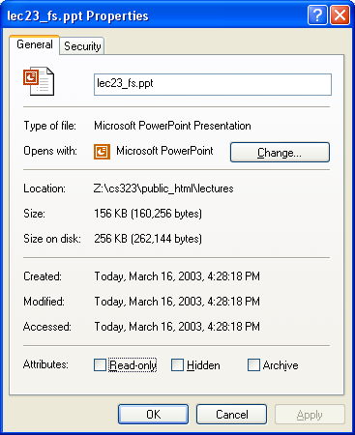
Example: Windows NTFS File Atributes

Slide 13
File Operations
Create a file
Write a file
Read a file
Reposition within a file
Delete a file
Append to a file
Copy a file

Slide 14
File Structures
Byte sequence
  Read or write a number of bytes
  Unstructured or linear
Record sequence
  Fixed or variable length
  Read or write a number of records
Tree
  Records with keys
  Read, insert, delete a record (typically using B-tree)

Slide 15
File Structures Today
Stream of bytes
  Simplest to implement in kernel
  Easy to manipulate in other forms
  Little performance loss
More complicated structures
  Hardware assist fell out of favor
  Special-purpose hardware slower, costly

Slide 16
File Types
ASCII – plain text
A Unix executable file
  header: magic number, sizes, entry point, flags
  Text (code)
  Data
  relocation bits
  symbol table
Devices
Everything else in the system

Slide 17
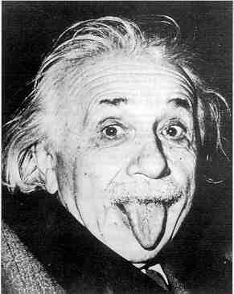
So What Makes Filesystems Hard?
Files grow and shrink in pieces
Little a priori knowledge
6 orders of magnitude in file sizes
Overcoming disk performance behavior
Desire for efficiency
Coping with failure

Slide 18
File System Components
Disk management
  Arrange collection of disk blocks into files
Naming
  User gives file name, not track or sector number, to locate data
Security
  Keep information secure
Reliability/durability
  When system crashes, lose stuff in memory, but want files to be durable
User
File
Naming
File
access
Disk
management
Disk
drivers

Slide 19
Some Definitions
File descriptor (fd)
  an integer used to represent a file – easier than using names
Metadata
  data about data - bookkeeping data used to eventually access the “real” data
Open file table
  system-wide list of descriptors in use

Slide 20
Kinds of Metadata
inode – index node, or a specific set of information kept about each file
  Two forms – on disk and in memory
Directory – names and location information for files and subdirectories
  Note: stored in files in Unix
Superblock – contains information to describe the file system, disk layout
Information about free blocks/inodes on disk

Slide 21
Contents of an Inode
Disk inode:
  File type, size, blocks on disk
  Owner, group, permissions (r/w/x)
  Reference count
  Times: creation, last access, last mod
  Inode generation number
  Padding & other stuff
128 bytes on classic Unix

Slide 22
Directories in Unix
Stored like regular files
  Contents are file names and inode #s
  Names are nul-terminated strings
Logic
  Separates file from location in tree
  File can appear in multiple places
What are the drawbacks?

Slide 23
Effects of Corruption
inode – file gets “damaged”
  Maybe some “free” block gets viewed
Directory – “lose” files/directories
  Might get to read deleted files
Superblock – can’t figure out anything
  This is why we replicate the superblock

Slide 24
Data Structures for A Typical File System
Process
control
block
Open file
table
(systemwide)
Memory Inode
Disk
inode
Open
file
pointer
array
.
.
.

Slide 25
Opening A File
File name lookup and authentication
Copy the file metadata into the in-memory data structure, if it is not in yet
Create an entry in the open file table (system wide) if there isn’t one
Create an entry in PCB
Link up the data structures
Return a pointer to user
fd = open( FileName, access)
PCB
Allocate & link up
data structures
Open
file
table
File name lookup
& authenticate
Metadata
File system on disk

Slide 26
Open-file Table Information
File Pointer
  current file position pointer
File Open Count
  counter which tracks the number of opens and closes. If files are closed, the OS must reuse the space in open-file table. Because multiple processes may open the same file, OS must wait until the last file closes before removing the entry.
Disk Location
  information needed to locate the file on disk.

Slide 27
Reading And Writing
What happens when you…
read 10 bytes from a file?
write 10 bytes into an existing file?
write 4096 bytes into a file?
Disk works on blocks (sectors)
Can have temporary (ephemeral) buffers
Longer lasting buffers = disk cache

Slide 28
Reading A Block
read( fd, userBuf, size )
PCB
Open
file
table
Get physical block to sysBuf
copy to userBuf
Metadata
read( device, phyBlock, size )
Buffer
cache
Logical → phyiscal
Disk device driver

Slide 29
Other File Issues
Memory Mapping a File
  Associate a part of the VM space with a section of a file.
  Reads and writes to that memory region are then treated as reads and writes to the file.
Internal File Structure
  mapping between logical record and physical record
  packing a number of logical records into physical blocks.
  The logical record size, physical block size and packing technique determine how many logical records are in each physical block.
Consistency Semantics
  important criterion for evaluation of any file system that supports sharing of files.

Slide 30
A Disk Layout for A File System
Boot
block
Super
block
File metadata
(i-node in Unix)
File data blocks
Superblock defines a file system
  size of the file system
  size of the file descriptor area
  free list pointer, or pointer to bitmap
  location of the file descriptor of the root directory
  other meta-data such as permission and various times
For reliability, replicate the superblock

Slide 31
File Usage Patterns
How do users access files?
  Sequential: bytes read in order
  Random: read/write element out of middle of arrays
  Whole file or partial file
How are files used?
  Most files are small
  Large files use up most of the disk space
  Large files account for most of the bytes transferred
Bad news
  Need everything to be efficient

Slide 32
Data Structures for Disk Management
A “header” for each file (part of the file meta-data)
  Disk sectors associated with each file
A data structure to represent free space on disk
  Bit map
    1 bit per block (sector)
    blocks numbered in cylinder-major order, why?
  Linked list
  Others?
How much space does a bit map need for a 4G disk?

Slide 33
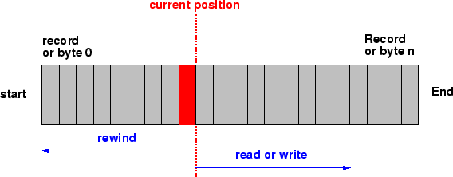
Sequential File Organization: Tape
Organized like a tape; can be on a tape or direct access device.
The records are stored and also retrieved in physical order.
The ``next'' record physically follows the current one.
Inserting a record means rewriting the file

Slide 34
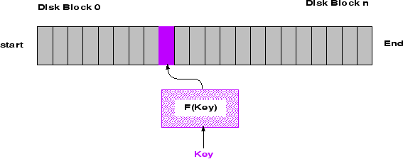
Directed File Access Organization: Disk
User maps key into disk address
Access in physical order or random
No notion of next record

Slide 35
File Allocation
Contiguous
Non-contiguous (linked)
Tradeoffs?

Slide 36
Linked Files
File header points to 1st block on disk
Each block points to next
Pros
  Can grow files dynamically
  Free list is similar to a file
Cons
  random access: horrible
  unreliable: losing a block means losing the rest
File header
. . .
null

Slide 37
Contiguous Allocation
Request in advance for the size of the file
Search bit map or linked list to locate a space
File header
  first sector in file
  number of sectors
Pros
  Fast sequential access
  Easy random access
Cons
  External fragmentation
  Hard to grow files

Slide 38
Reminder

