Slide 1
CS323 Operating Systems
File System III
Yuanyuan Zhou
Lecture 25
3/31/2003

Slide 2
Content of this lecture
Administrative announcements
File systems basic concepts
Summary

Slide 3
Directories in Unix
Stored like regular files
  Contents are file names and inode #s
  Names are nul-terminated strings
Logic
  Separates file from location in tree
  File can appear in multiple places
What are the drawbacks?

Slide 4
Directory Structure Organization
maps symbolic names into logical file names
  search
  create file
  list directory
  backup, archival, file migration

Slide 5
Directory Contents
file name symbolic name
file type indicates format of file
location device and location
size
protection
creation, access, and modification date
owner identification

Slide 6
Directory Contents
the following items may be stored on a per file, process basis
  current read, write position
  usage count

Slide 7
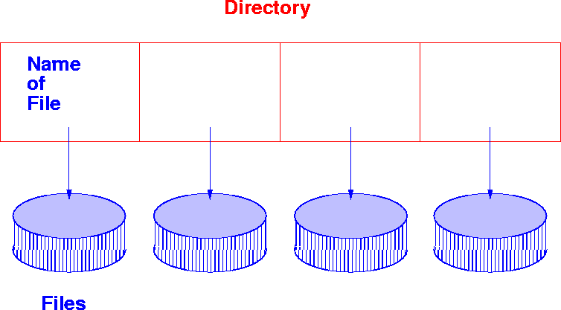
Single Level Directory

Slide 8
Problems With Single Level Directory
more than one user
large file systems
moving files from one system to another
name clashes
modularity

Slide 9
Two-level Directory
introduced to remove naming problems between users
first level contains list of user directories
second level contains user files
system files kept in separate directory or level 1
sharing accomplished by naming other users files

Slide 10
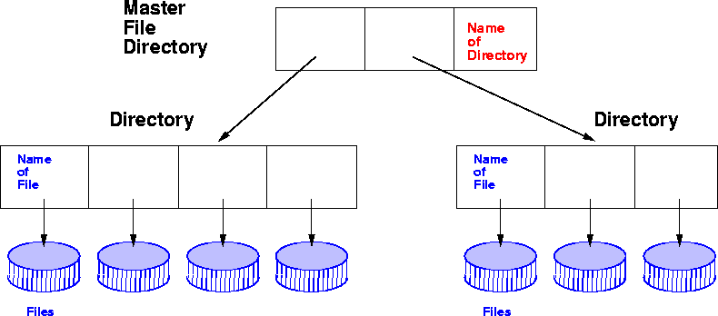
Two-level Directory

Slide 11
Tree Structured Directories
arbitrary depth of directories
leaf nodes are files
interior nodes are directories
path name lists nodes to traverse to find node
use absolute paths from root
use relative paths from current working directory pointer

Slide 12
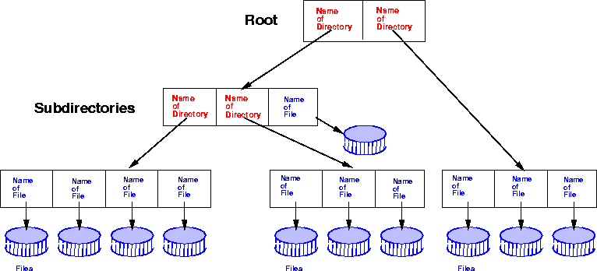
Tree Structured Directories

Slide 13
Acyclic Graph Structured Directories
Acyclic graphs allow sharing
two users can name same file
implementation by links - use logical names of files (file system and file)
implementation by symbolic links map pathname into a new pathname
duplicate paths complicates backup copies
need reference counts for hard links

Slide 14
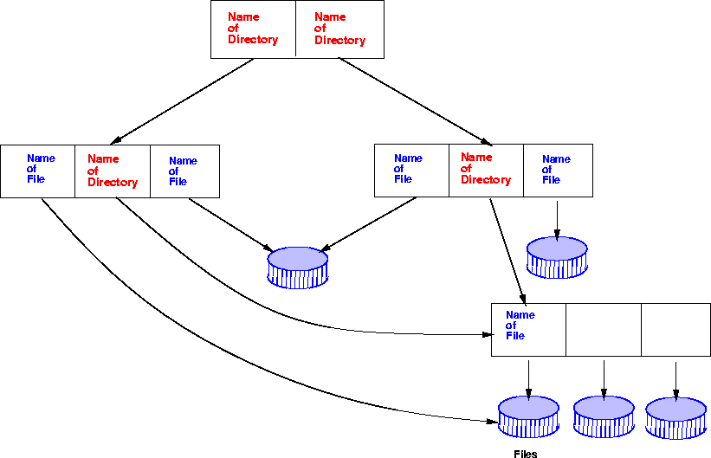
Acyclic Graph Structured Directories

Slide 15
General Graph Structured Directories
cycles
more flexible
more costly
need garbage collection (circular structures)
must prevent infinite searches

Slide 16
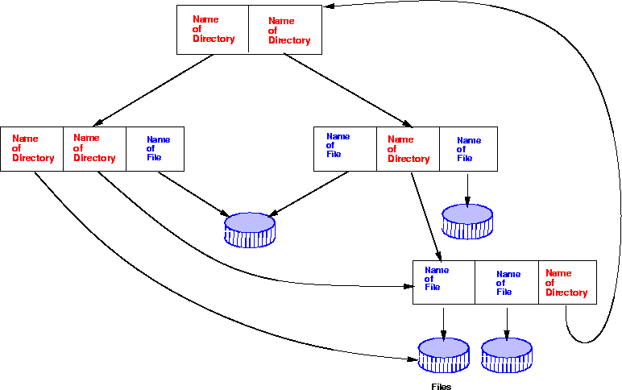
General Graph Structured Directories

Slide 17
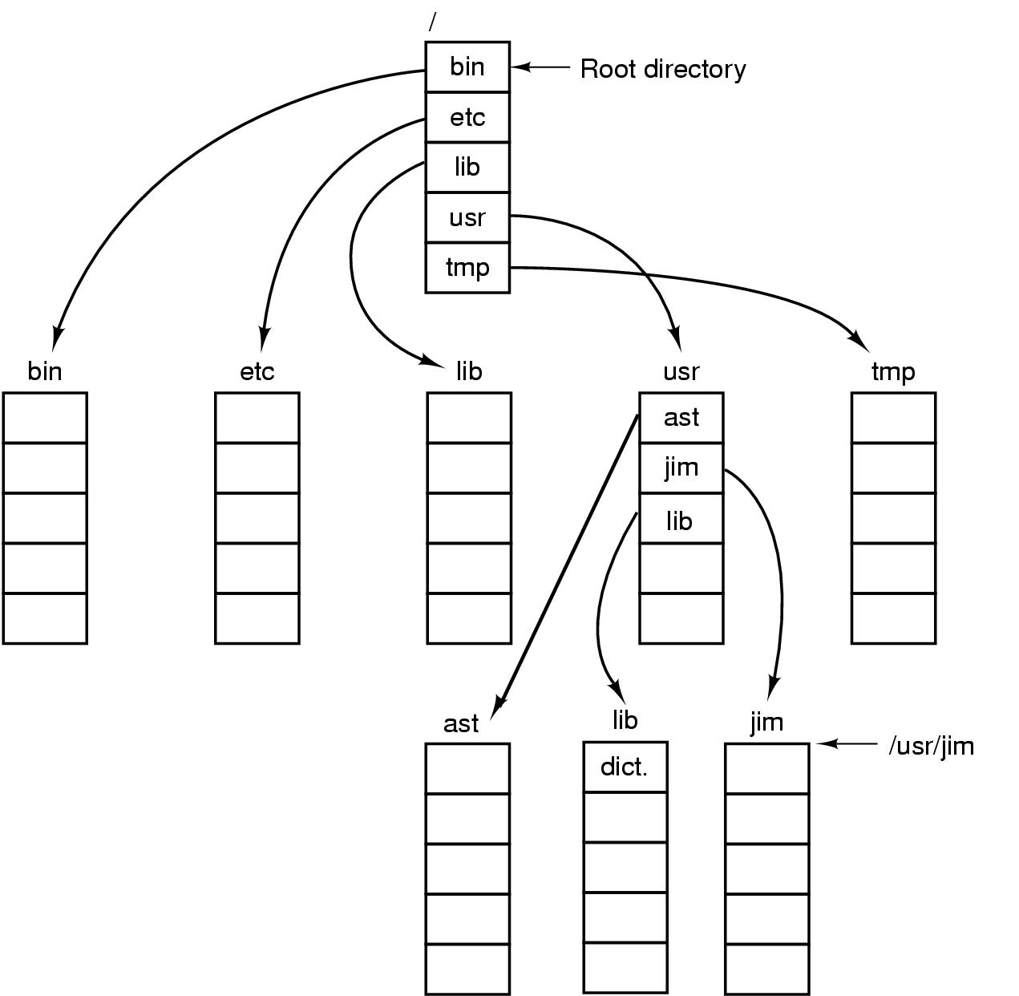
Path Names

Slide 18
Directory Operations
Create
Delete
Opendir
Closedir
Readdir
Rename
Link
Unlink

Slide 19
Effects of Corruption
inode – file gets “damaged”
  Maybe some “free” block gets viewed
Directory – “lose” files/directories
  Might get to read deleted files
Superblock – can’t figure out anything
  This is why we replicate the superblock

Slide 20
Data Structures for A Typical File System
Process
control
block
Open file
table
(systemwide)
Memory Inode
Disk
inode
Open
file
pointer
array
.
.
.

Slide 21
Opening A File
File name lookup and authentication
Copy the file metadata into the in-memory data structure, if it is not in yet
Create an entry in the open file table (system wide) if there isn’t one
Create an entry in PCB
Link up the data structures
Return a pointer to user
fd = open( FileName, access)
PCB
Allocate & link up
data structures
Open
file
table
File name lookup
& authenticate
Metadata
File system on disk

Slide 22
Open-file Table Information
File Pointer
  current file position pointer
File Open Count
  counter which tracks the number of opens and closes. If files are closed, the OS must reuse the space in open-file table. Because multiple processes may open the same file, OS must wait until the last file closes before removing the entry.
Disk Location
  information needed to locate the file on disk.

Slide 23
Reading And Writing
What happens when you…
read 10 bytes from a file?
write 10 bytes into an existing file?
write 4096 bytes into a file?
Disk works on blocks (sectors)
Can have temporary (ephemeral) buffers
Longer lasting buffers = disk cache

Slide 24
Reading A Block
read( fd, userBuf, size )
PCB
Open
file
table
Get physical block to sysBuf
copy to userBuf
Metadata
read( device, phyBlock, size )
Buffer
cache
Logical → phyiscal
Disk device driver

Slide 25
Other File Issues
Memory Mapping a File
  Associate a part of the VM space with a section of a file.
  Reads and writes to that memory region are then treated as reads and writes to the file.
Internal File Structure
  mapping between logical record and physical record
  packing a number of logical records into physical blocks.
  The logical record size, physical block size and packing technique determine how many logical records are in each physical block.
Consistency Semantics
  important criterion for evaluation of any file system that supports sharing of files.

Slide 26
A Disk Layout for A File System
Boot
block
Super
block
File metadata
(i-node in Unix)
File data blocks
Superblock defines a file system
  size of the file system
  size of the file descriptor area
  free list pointer, or pointer to bitmap
  location of the file descriptor of the root directory
  other meta-data such as permission and various times
For reliability, replicate the superblock

Slide 27
File Usage Patterns
How do users access files?
  Sequential: bytes read in order
  Random: read/write element out of middle of arrays
  Whole file or partial file
How are files used?
  Most files are small
  Large files use up most of the disk space
  Large files account for most of the bytes transferred
Bad news
  Need everything to be efficient

Slide 28
Data Structures for Disk Management
A “header” for each file (part of the file meta-data)
  Disk sectors associated with each file
A data structure to represent free space on disk
  Bit map
    1 bit per block (sector)
    blocks numbered in cylinder-major order, why?
  Linked list
  Others?
How much space does a bit map need for a 4G disk?

Slide 29
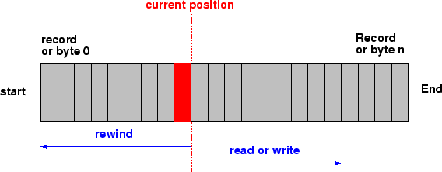
Sequential File Organization: Tape
Organized like a tape; can be on a tape or direct access device.
The records are stored and also retrieved in physical order.
The ``next'' record physically follows the current one.
Inserting a record means rewriting the file

Slide 30
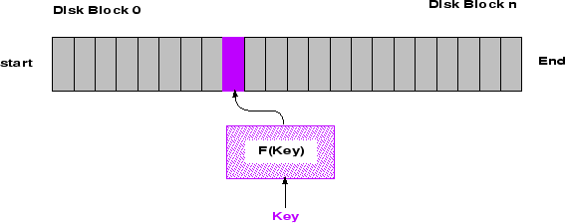
Directed File Access Organization: Disk
User maps key into disk address
Access in physical order or random
No notion of next record

Slide 31
File Allocation
Contiguous
Non-contiguous (linked)
Tradeoffs?

Slide 32
Linked Files
File header points to 1st block on disk
Each block points to next
Pros
  Can grow files dynamically
  Free list is similar to a file
Cons
  random access: horrible
  unreliable: losing a block means losing the rest
File header
. . .
null

Slide 33
Contiguous Allocation
Request in advance for the size of the file
Search bit map or linked list to locate a space
File header
  first sector in file
  number of sectors
Pros
  Fast sequential access
  Easy random access
Cons
  External fragmentation
  Hard to grow files

