Slide 1
CS323 Operating Systems
File System IV
Yuanyuan Zhou
Lecture 26
4/2/2003

Slide 2
Content of this lecture
Administrative announcements
File systems implementation
Summary

Slide 3
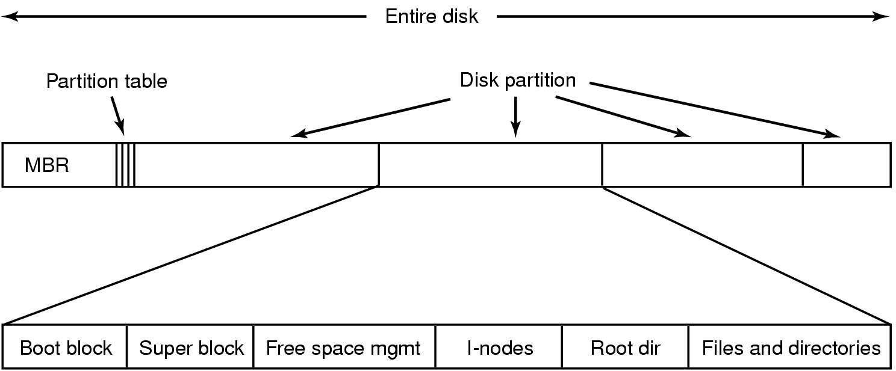
File System Implementation
A possible file system layout

Slide 4
Allocation of Disk Space
Low level access methods depend upon the disk allocation scheme used to store file data
  Contiguous allocation
  Linked list allocation
  Block allocation

Slide 5
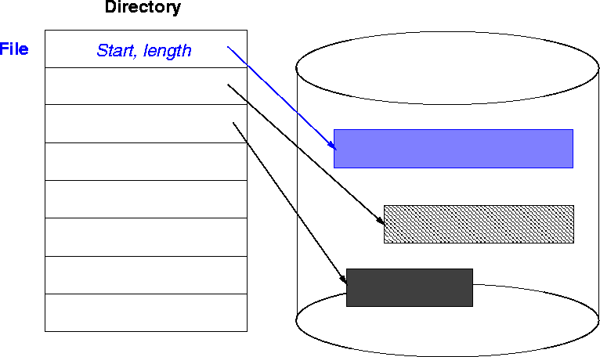
Contiguous Allocation

Slide 6
Contiguous Allocation Issues
Access method suits sequential and direct access
Directory table maps files into starting physical address and length
Easy to recover in event of system crash
Fast, often requires no head movement and when it does, head only moves one track

Slide 7
Contiguous Allocation Issues
File is allocated large contiguous chunks
User knows size of the file
Expanding the file requires copying
Dynamic storage allocation - first fit, best fit
External fragmentation occurs on disk
Users tend to overestimate space => internal fragmentation

Slide 8
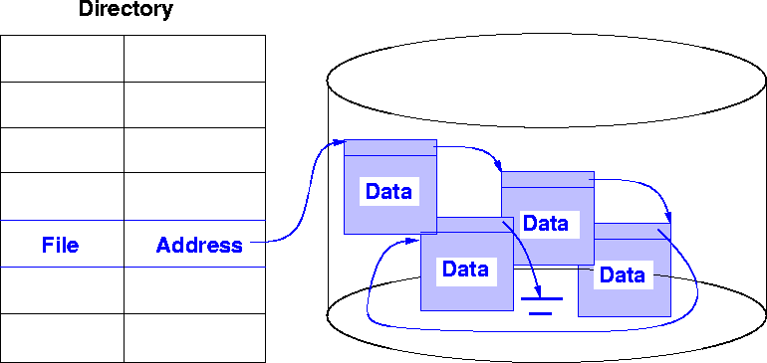
Linked Allocation

Slide 9
Linked List Allocation Issues
Each file is a linked list of chunks
Pointers in list are not accessible to user
Directory table maps files into head of list for a file
A node in the list can be a fixed size physical block or a contiguous collection of blocks
Easy to use - no estimation of size necessary

Slide 10
Linked List Allocation Issues
Can grow in middle and at ends
Space efficient, little fragmentation
Slow - defies the principle of locality. Need to read through linked list nodes sequentially to find record of interest blocks
Suited for sequential access but not direct access

Slide 11
Linked List Allocation Issues
Disk space must be used to store pointers (if disk block is 512 bytes, and disk address requires 4 bytes, then the user sees blocks of 508 bytes)
Not very reliable. System crashes can scramble files being updated
Important variation on linked allocation method: `file-allocation table' (FAT) - OS/2 and MS-DOS

Slide 12
Linked List Allocation Issues
Summary: linked allocation solves the external fragmentation and size-declaration problems of contiguous allocation,
However, it can't support efficient direct access

Slide 13
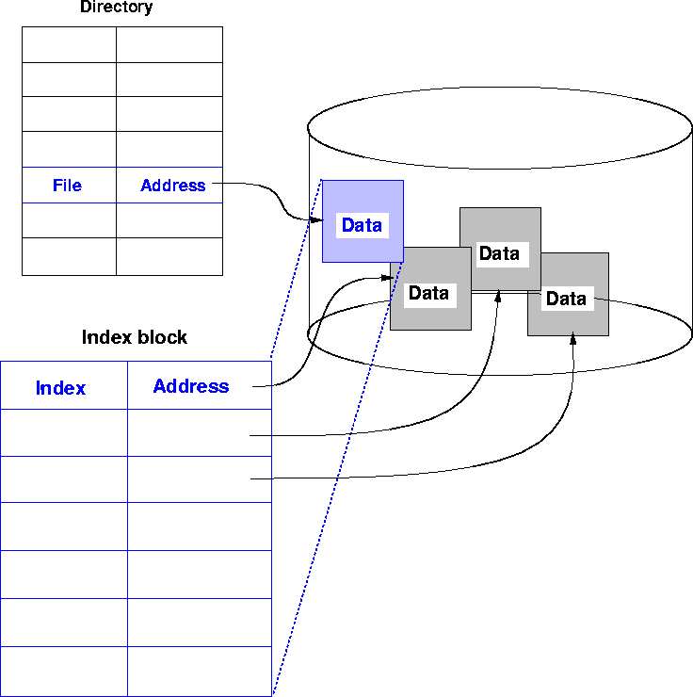
Indexed Allocation

Slide 14
Indexed Allocation
Solves external fragmentation
Supports sequential, direct and indexed access
Access requires at most one access to index block first. This can be cached in main memory

Slide 15
Indexed Allocation
File can be extended by rewriting a few blocks and index block
Requires extra space for index block, possible wasted space
Extension to big files issues

Slide 16
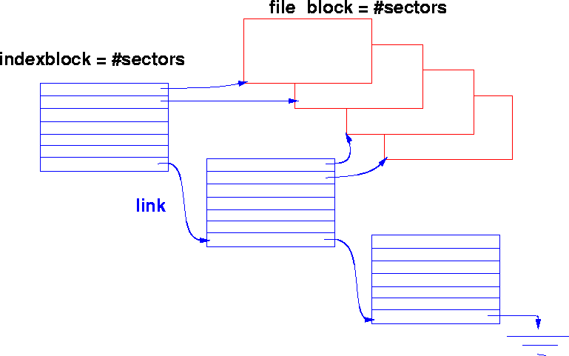
Other Forms of Indexed File
Linked
Link full index blocks together using last entry.

Slide 17
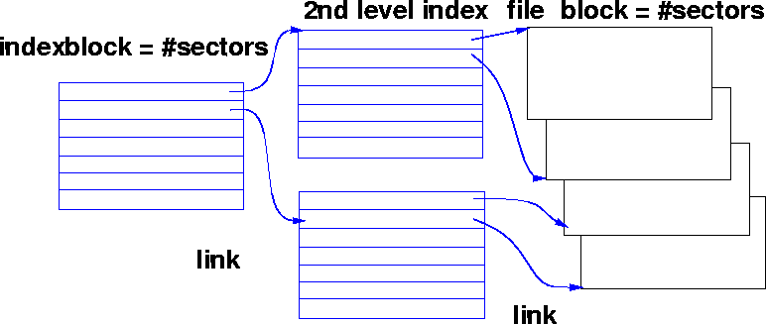
Other Forms of Indexed File - Multilevel Index
Multiple levels of index blocks

Slide 18
Discussion
Tradeoff between
  Contiguous
  Linked allocation
  Indexed allocation

Slide 19
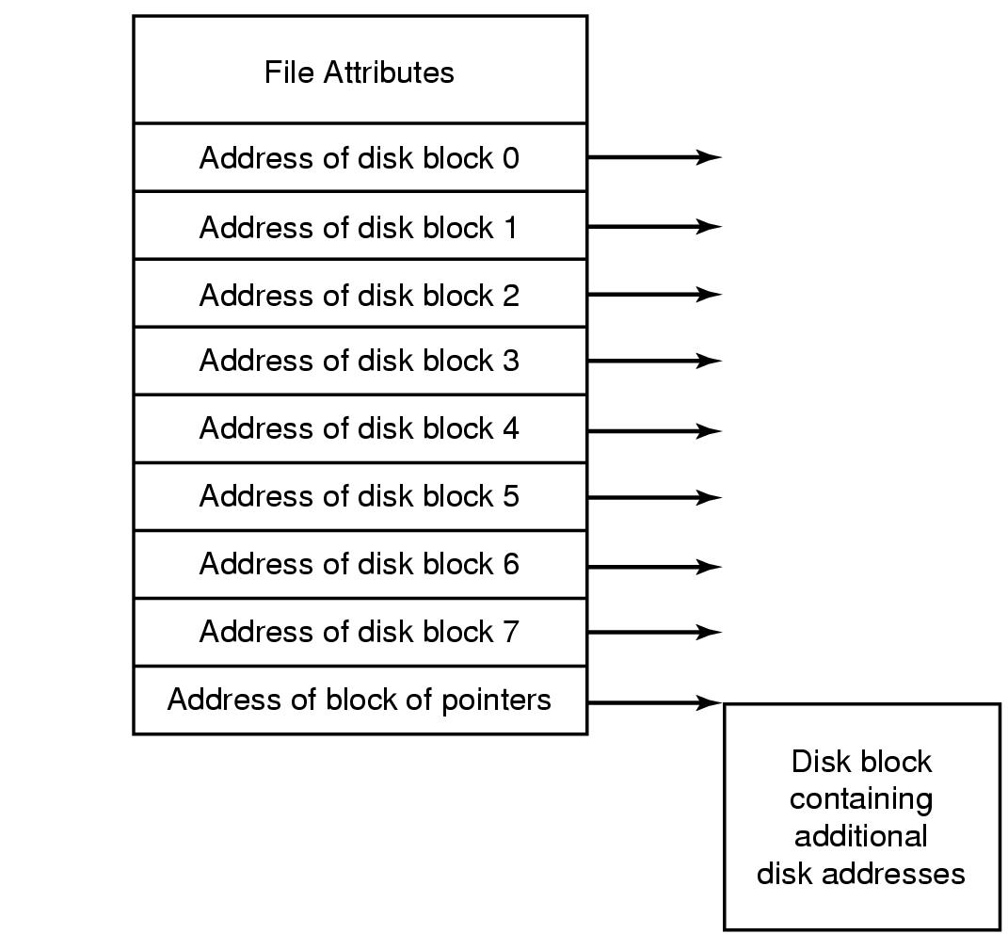
Implementing Files
UNIX I Node

Slide 20
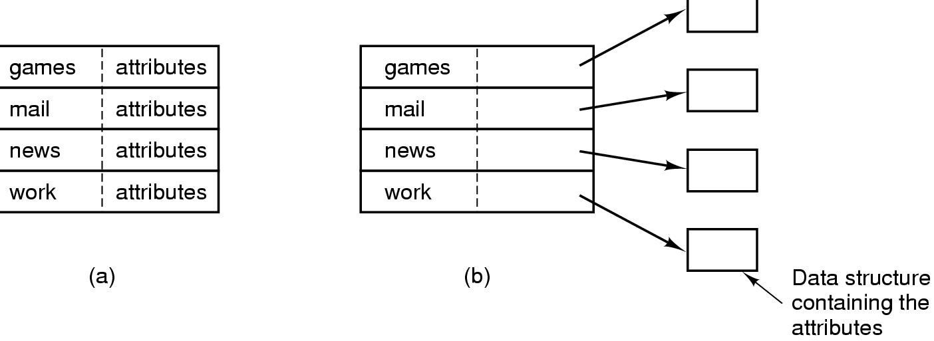
Implementing Directories (1)
(a) A simple directory
  fixed size entries
  disk addresses and attributes in directory entry
(b) Directory in which each entry just refers to an i-node

Slide 21
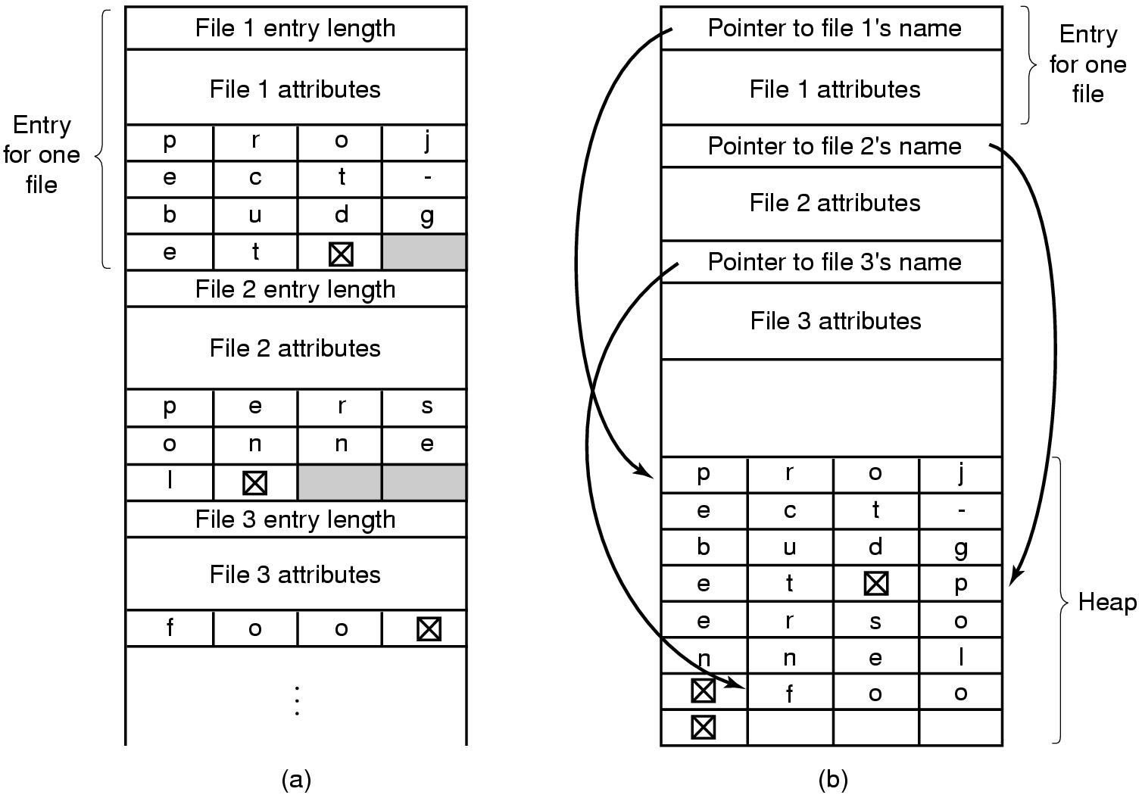
Implementing Directories (2)
Two ways of handling long file names in directory
  (a) In-line or (b) In a heap

Slide 22
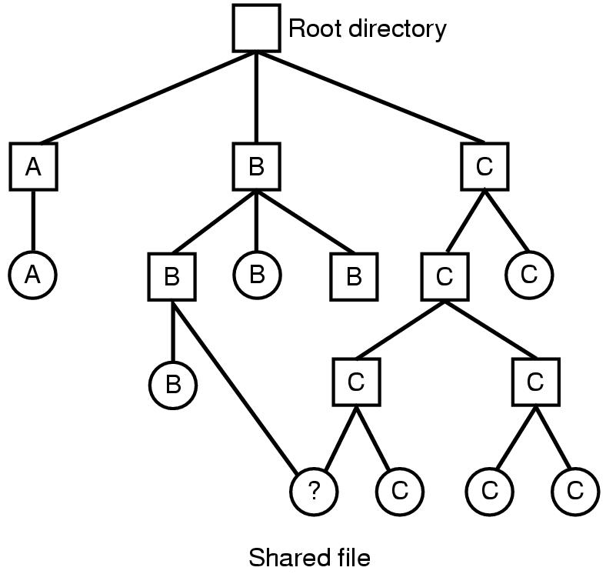
Shared Files (1)
File system containing a shared file

Slide 23
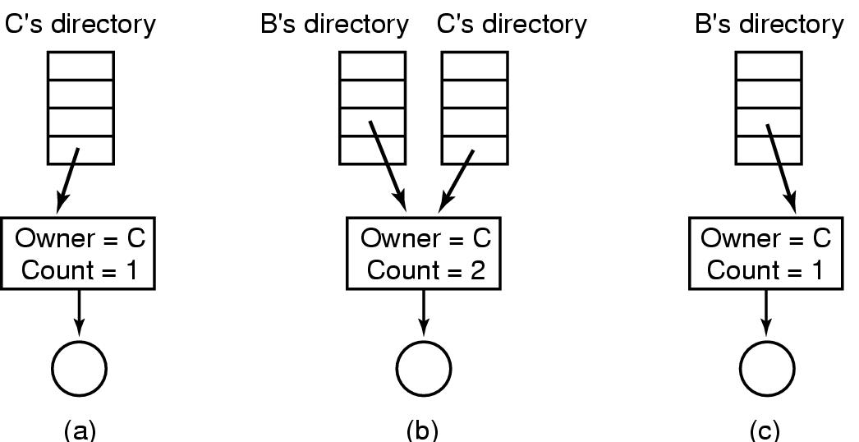
Shared Files (2)
(a) Situation prior to linking
(b) After the link is created
(c)After the original owner removes the file

Slide 24
Free Space Management
Bit vector
  A bit map is kept of free blocks
  Each bit in a vector represents one block
  If the block is free, the bit is zero
  Simple to find n consecutive free blocks
  Overhead is bit map
  Example BSD file system

Slide 25
Free Space Management
Free list
  Keep a linked list of free blocks
  Not very efficient because linked list needs traversal
  Example system V R1

Slide 26
Free Space Management
Linked list of indices
  A linked list of index blocks is kept
  Each index block contains addresses of free blocks and a
  Pointer to the next index block
A large number of free blocks can be found quickly

Slide 27
Free Space Management
Linked list of contiguous blocks that are free
  The free list node consists of a pointer and the number of free blocks starting from that address
  Blocks are joined together into larger blocks as necessary

Slide 28
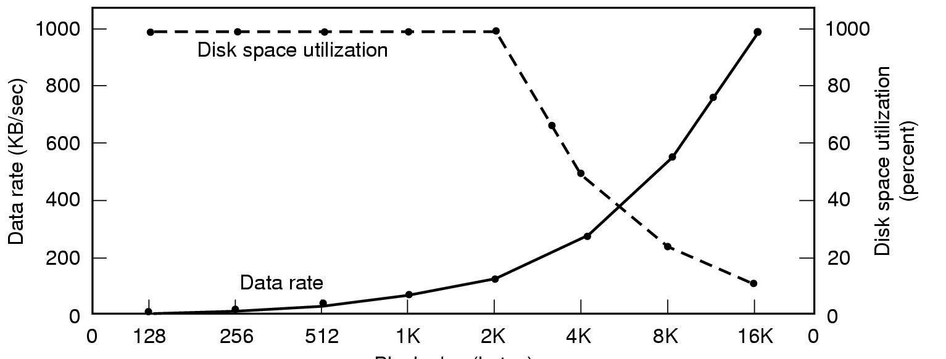
Disk Space Management (1)
Block size
Dark line (left hand scale) gives data rate of a disk
Dotted line (right hand scale) gives disk space efficiency
All files 2KB

Slide 29
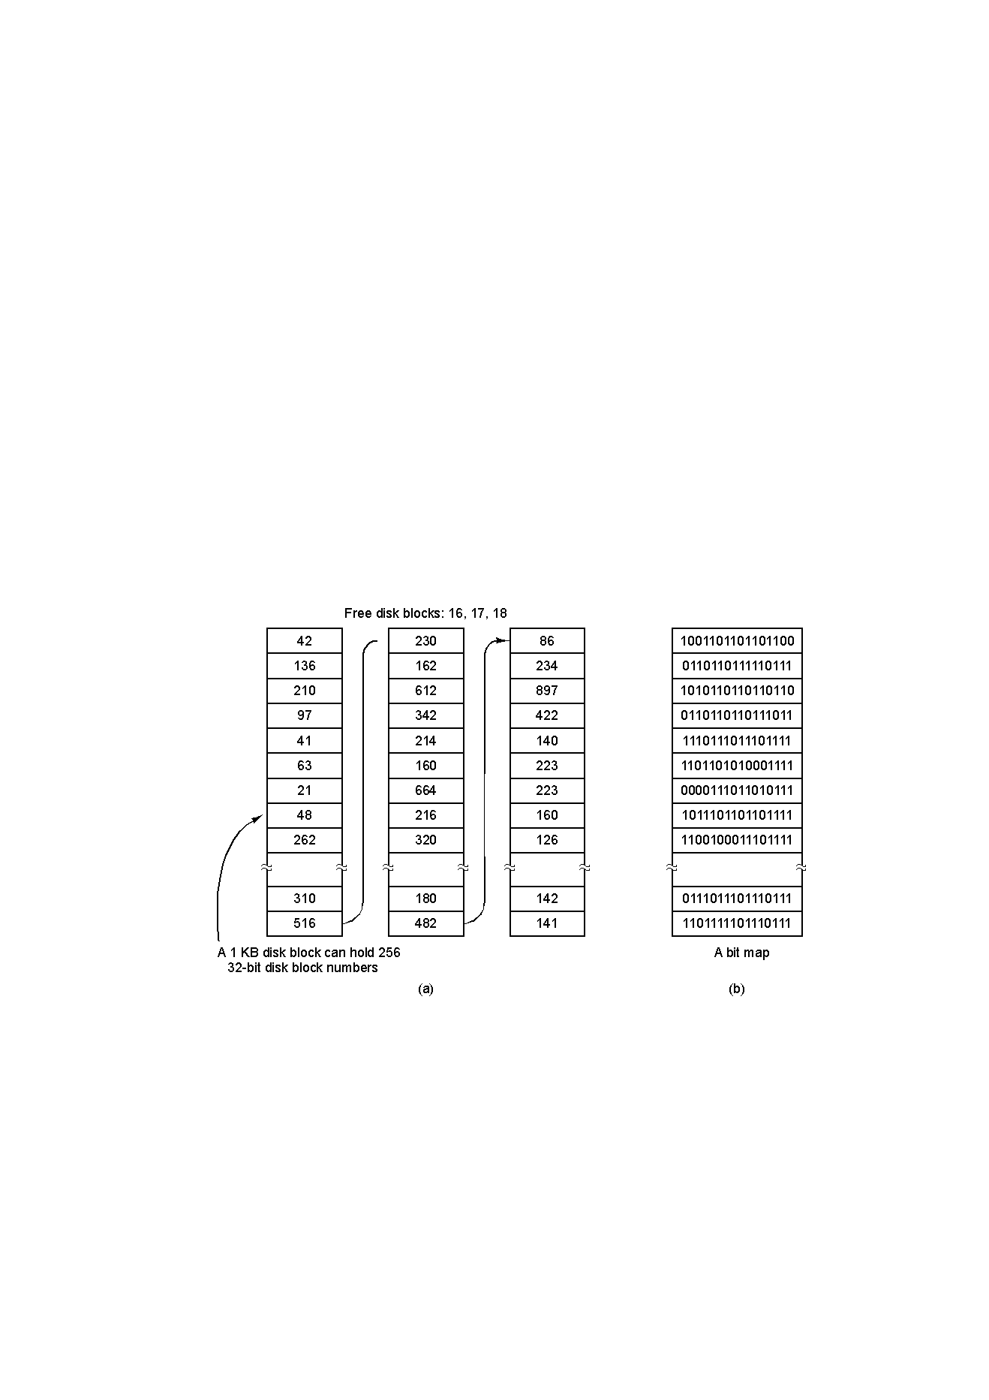
Disk Space Management (2)

Slide 30
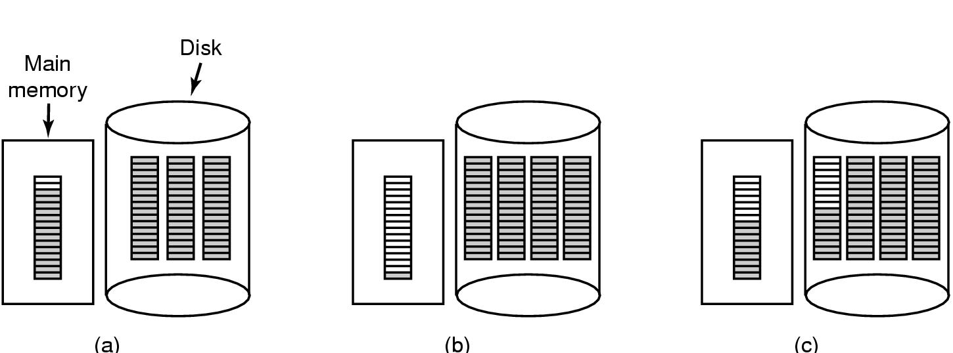
Disk Space Management (3)
(a) Almost-full block of pointers to free disk blocks in RAM
  - three blocks of pointers on disk
(b) Result of freeing a 3-block file
(c) Alternative strategy for handling 3 free blocks
  - shaded entries are pointers to free disk blocks

Slide 31
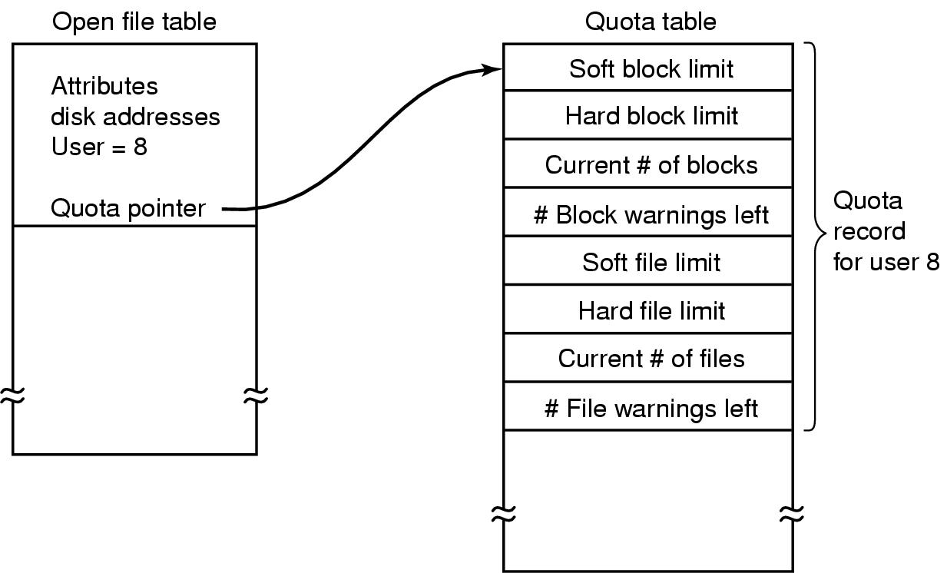
Disk Space Management (4)
Quotas for keeping track of each user’s disk use

