Slide 1
CS323 Operating Systems
File System V
Yuanyuan Zhou
Lecture 27
4/4/2003

Slide 2
Content of this lecture
Administrative announcements
File systems performance and reliability
Summary

Slide 3
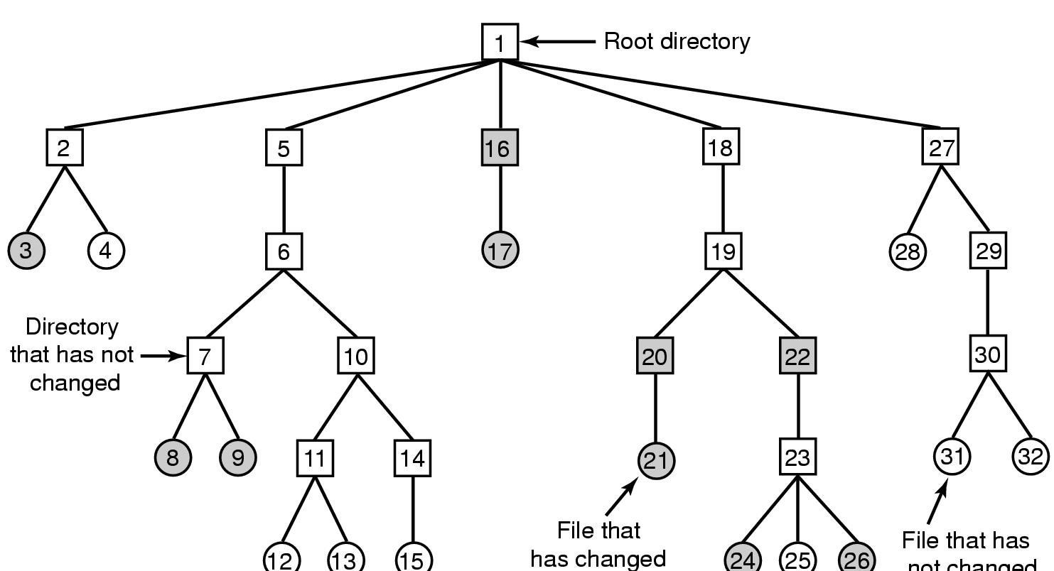
File System Reliability (1)
File that has
not changed
A file system to be dumped
  squares are directories, circles are files
  shaded items, modified since last dump
  each directory & file labeled by i-node number

Slide 4
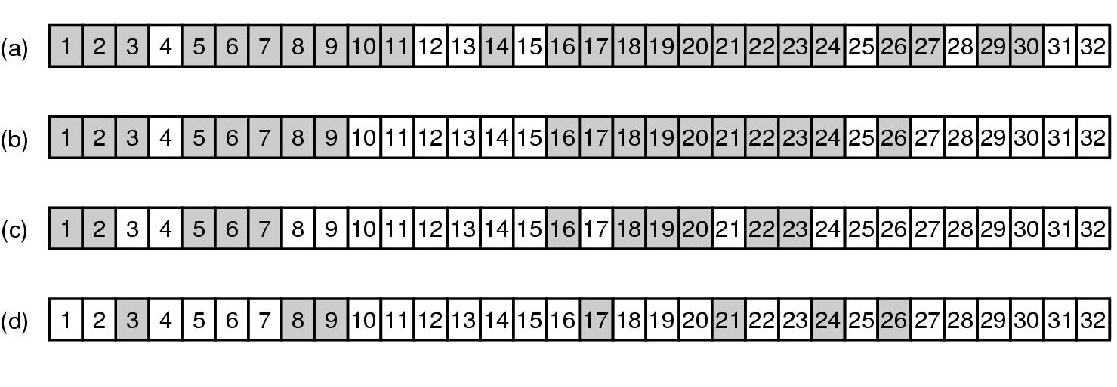
File System Reliability (2)
Bit maps used by the logical dumping algorithm

Slide 5
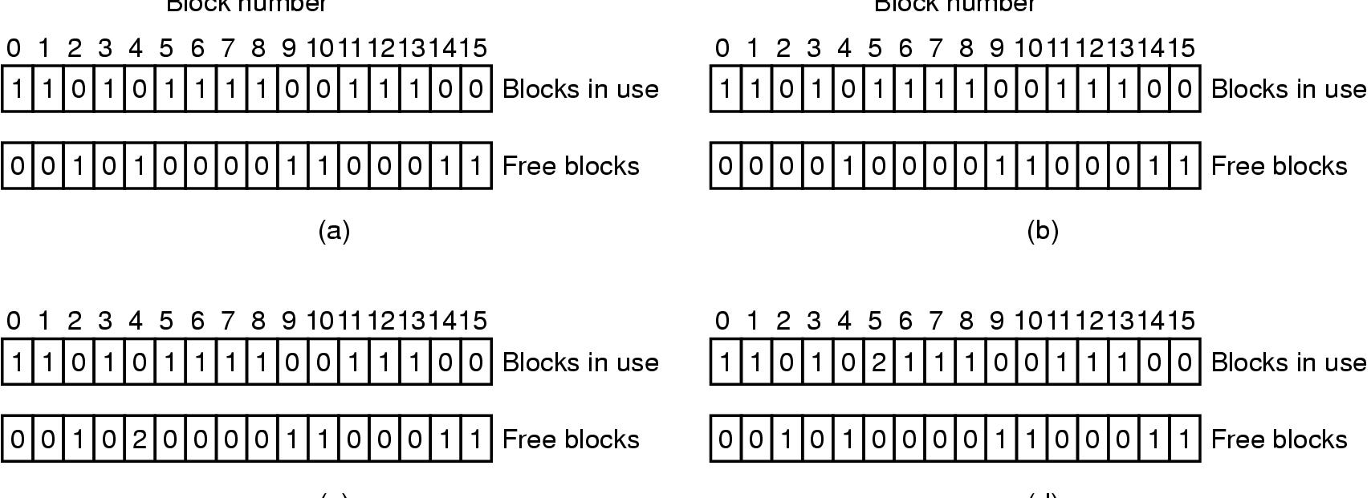
File System Reliability (3)
File system states
  (a) consistent
  (b) missing block
  (c) duplicate block in free list
  (d) duplicate data block

Slide 6
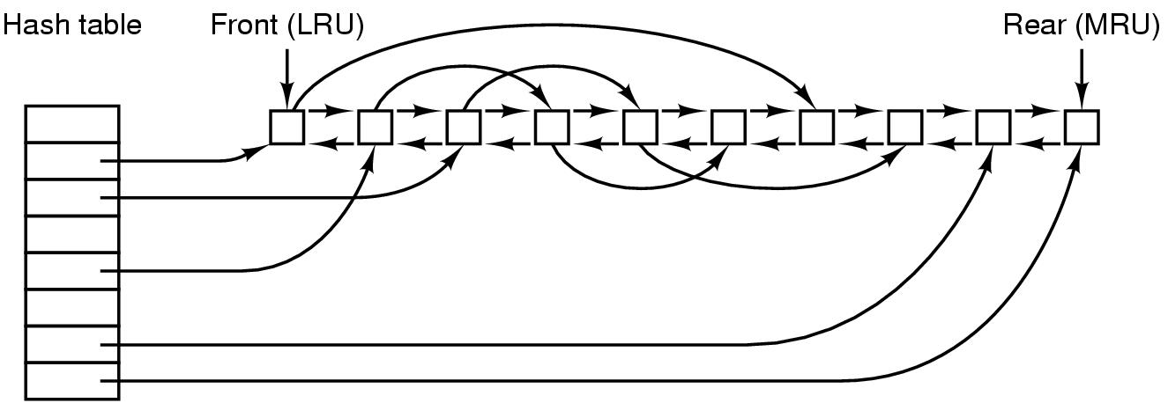
File System Performance (1)
The block cache data structures

Slide 7

File System Performance (2)
I-nodes placed at the start of the disk
Disk divided into cylinder groups
  each with its own blocks and i-nodes

Slide 8
Log-Structured File Systems
With CPUs faster, memory larger
  disk caches can also be larger
  increasing number of read requests can come from cache
  thus, most disk accesses will be writes
LFS Strategy structures entire disk as a log
  have all writes initially buffered in memory
  periodically write these to the end of the disk log
  when file opened, locate i-node, then find blocks

Slide 9
Comparison
Write block A;
write block B;
Write block A;
Write block C

Slide 10
Discussion: Tradeoffs
Traditional file system
Log structured file system

Slide 11
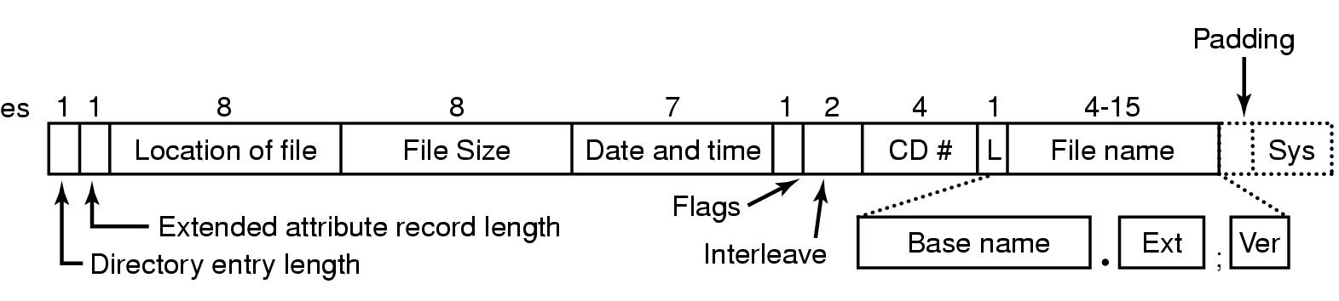
Example File Systems
CD-ROM File Systems
The ISO 9660 directory entry

Slide 12
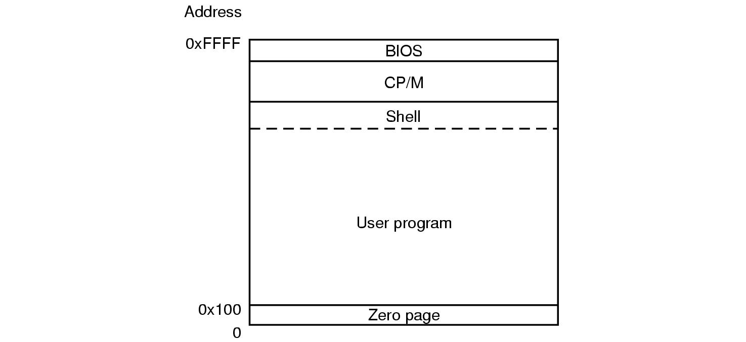
The CP/M File System (1)
Memory layout of CP/M

Slide 13
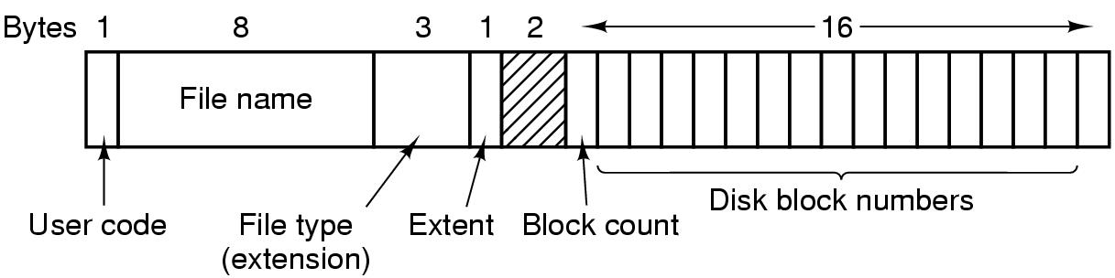
The CP/M File System (2)
The CP/M directory entry format

Slide 14
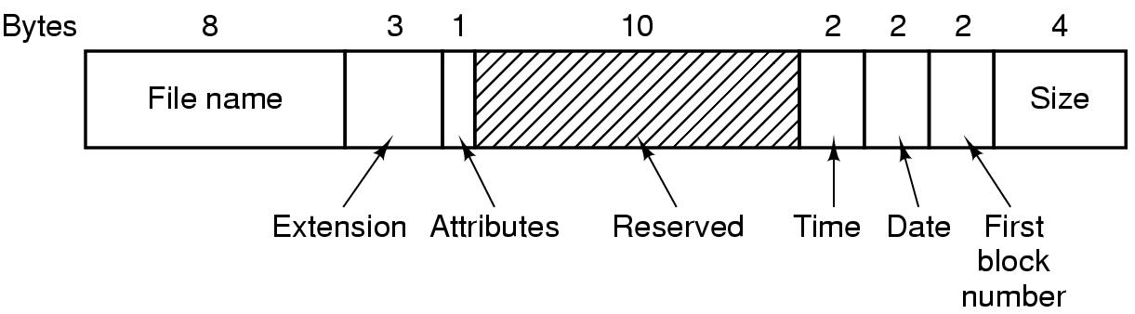
The MS-DOS File System (FAT-16)
The MS-DOS directory entry
Disadvantage?

Slide 15
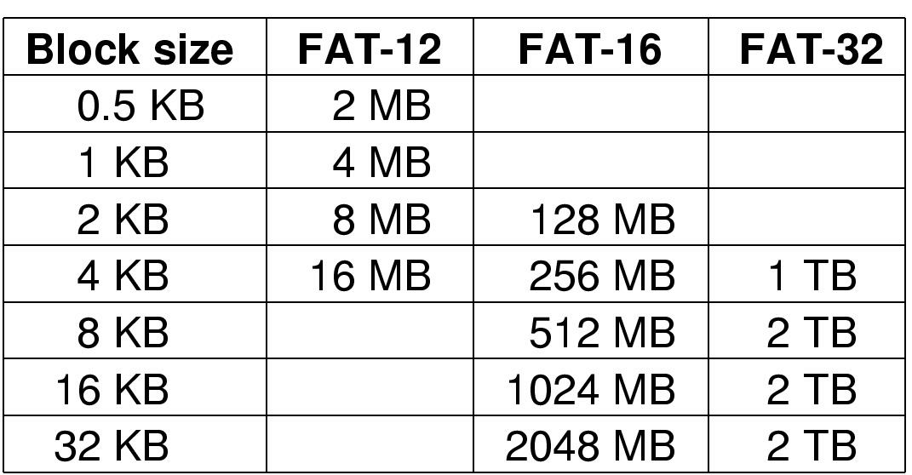
The MS-DOS File System (2)
Maximum partition for different block sizes
The empty boxes represent forbidden combinations

Slide 16
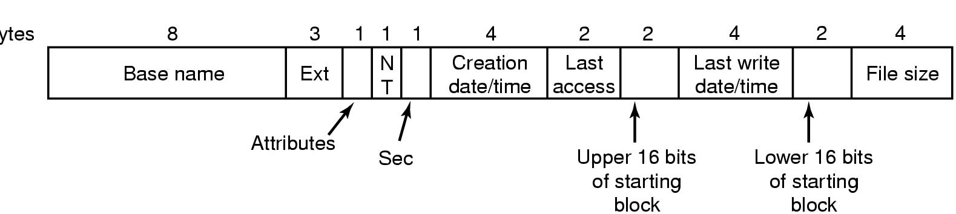
The Windows 98 File System (1)
Bytes
The extended MOS-DOS directory entry used in Windows 98

Slide 17
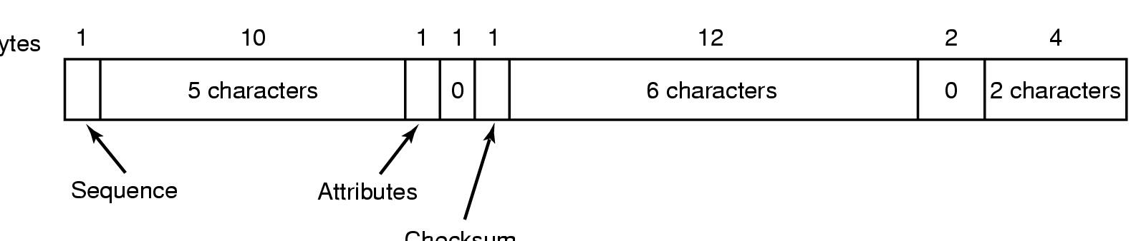
The Windows 98 File System (2)
Bytes
Checksum
An entry for (part of) a long file name in Windows 98

Slide 18
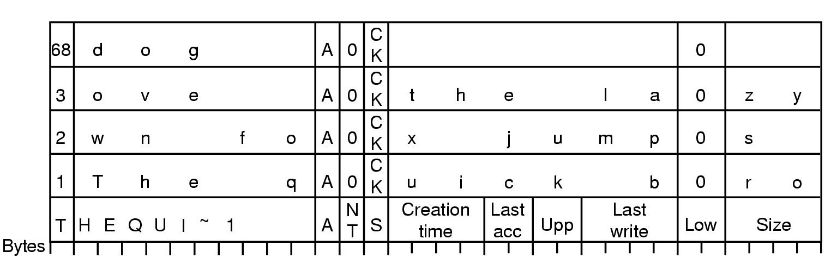
The Windows 98 File System (3)
An example of how a long name is stored in Windows 98

Slide 19
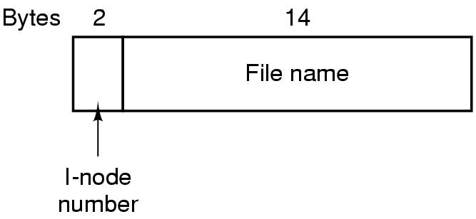
The UNIX V7 File System (1)
A UNIX V7 directory entry

Slide 20
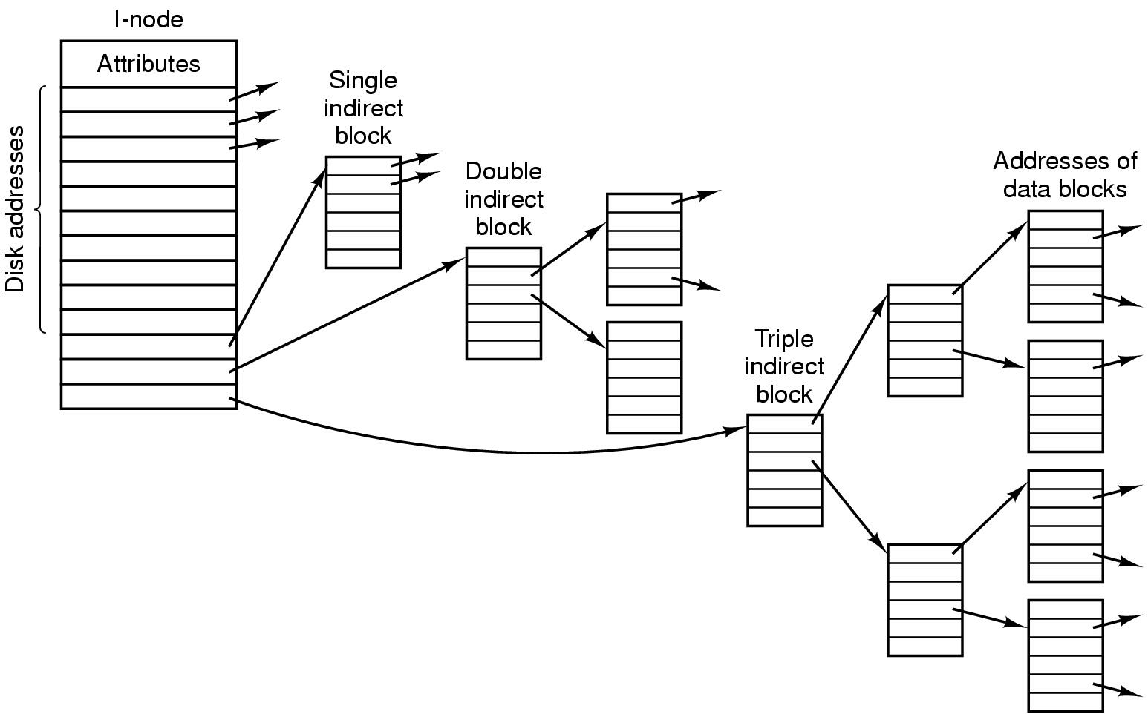
The UNIX V7 File System (2)
A UNIX i-node

Slide 21
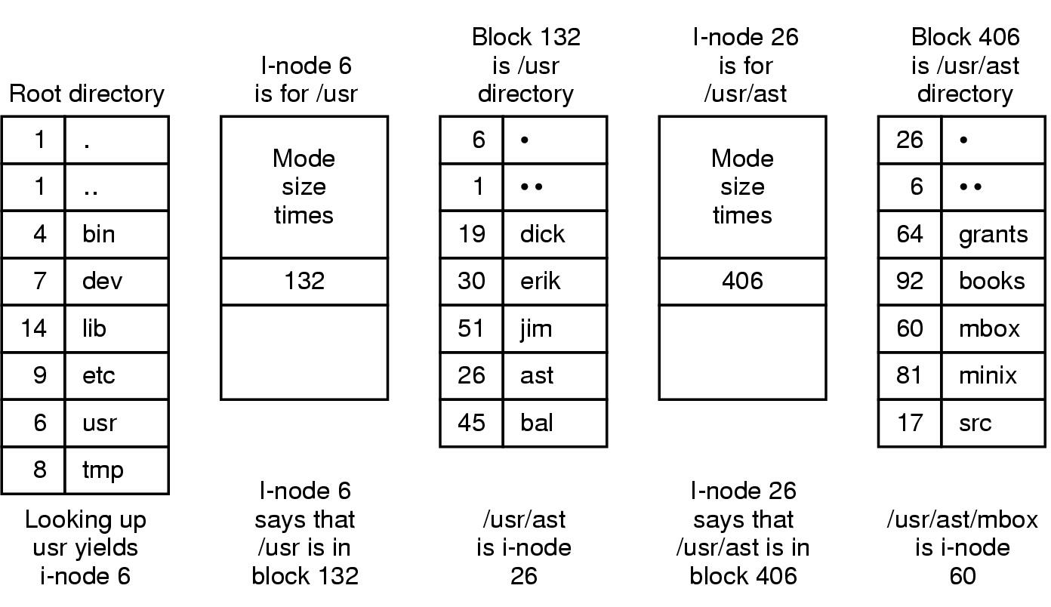
The UNIX V7 File System (3)
The steps in looking up /usr/ast/mbox

Slide 22
Levels of Access Methods
device level read and write sectors or tracks from disk
the i/o is written at the level of a sequence of transfer commands to the controller
this is often performed as if the access path is a channel

Slide 23
Levels of Access Methods
block level access to a file is in terms of blocks or physical records within a file
the user must do his own buffering. Access methods include:
  Read(file, block_no)
  Write(file, block_no)
  Wait(file, block_no)

Slide 24
Levels of Access Methods Continued
file level access to the file is in terms of acquiring access to a copy of the file that is stored in primary memory
queued or buffered level access to the file is in terms of logical records that depend on software interpretation. for example, read and write chars in UNIX. buffering is used to provide logical record abstraction and maps i/o into physical records

Slide 25
Levels of Access Methods Continued
memory mapped file level
  the file is mapped into virtual memory
  file access is at the instruction level
  page faults may read a page of file data from disk to memory
  an address of a logical record within a file is given by a virtual memory address offset of that record from the beginning of the file

Slide 26
Levels of Access Methods Continued
persistent object
  the file is mapped into virtual memory and
  access to the contents of the file is provided by an abstract data type interface that is determined by
  the type of the data stored in the file

Slide 27
Protection
in file systems, protection is needed from physical damage (reliability) and improper access (protection)
reliability (chapter 12) is generally provided by duplicate copies of files

Slide 28
Protection
protection - various mechanisms for single-user system and multi-user systems
  removing the floppy disk,
  prohibiting access to files of other users

Slide 29
Types - Controlled Access
read - possible access to read from file
write - possible access to write to a file
execute - load file and execute it
append - write new information at the end of a file
delete - delete file and free its space for possible reuse
list - list name and attributes of a file

Slide 30
Access Lists and Groups
associate each file and directory with access list
problem with access list: length
solution: condensed version of the access list
  owner - user who created the file
  group - a set of users who are sharing the file and need similar access
  universe - all other users

Slide 31
Access Lists Example
UNIX - 3 fields of length 3 bits are used. fields are
user(u),group(g),others(o), bits are read(r), write(w), execute(x) -
example
% Chmod go+rw file

Slide 32
Other Protection Approaches
associate a password with each file
protect directories - listing of file names might be a protected operation
encryption

Slide 33
Consistency Semantics
UNIX
Session Semantics
Immutable-Shared File Semantics

Slide 34
UNIX Files
writes to file immediately visible to other users reading from file
can share current location into file through open file tables

Slide 35
Session Semantics
writes to open file by user not visible immediately – only to new opens.
closing a write file doesn’t make contents visible if applications have file open already

Slide 36
Immutable-shared Files
files, once shared, never change
name may not be reused
good in distributed system

Slide 37
Summary
file concepts - file attributes, operations, structures
directory systems - single-level, two-level, tree structure, acyclic structure, general structure
access methods - sequential, direct, indexed
protection - possible access protection, access lists

