Slide 1
CS323 Operating Systems
File System V
Yuanyuan Zhou
Lecture 28
4/7/2003

Slide 2
Content of this lecture
Administrative announcements
  Quiz4 released, due this Friday 4/11 5pm
File system case studies
Summary

Slide 3
Review
File system reliability
  Data availability, integrity, consistency
  Full vs. incremental backups
Log structured file systems
  Idea
  Tradeoff with traditional file systems

Slide 4
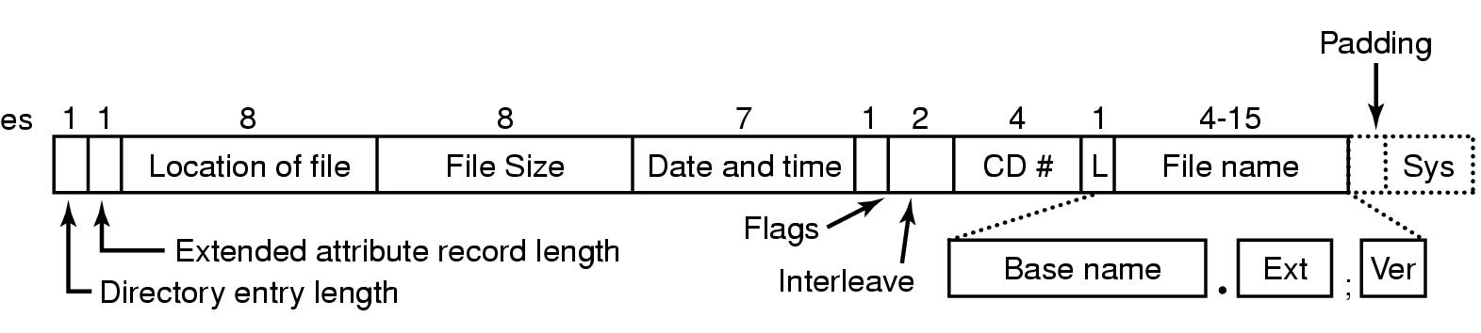
Example File Systems
CD-ROM File Systems
The ISO 9660 directory entry

Slide 5
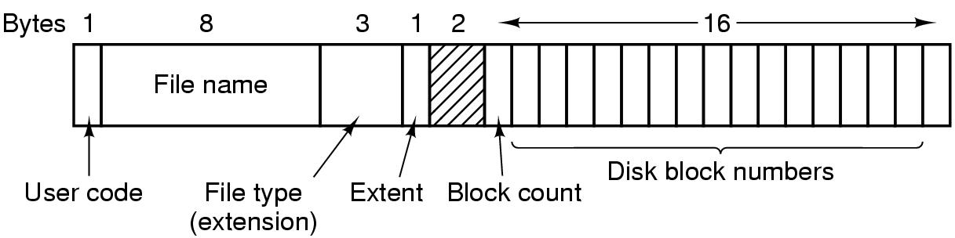
The CP/M File System: ancestor of MS-DOS
The CP/M directory entry format

Slide 6
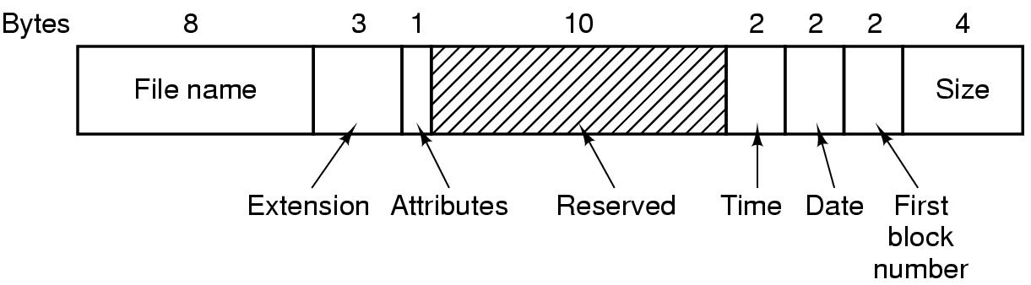
The MS-DOS File System (FAT-16)
The MS-DOS directory entry
Why is it called FAT-16?
Disadvantage?

Slide 7
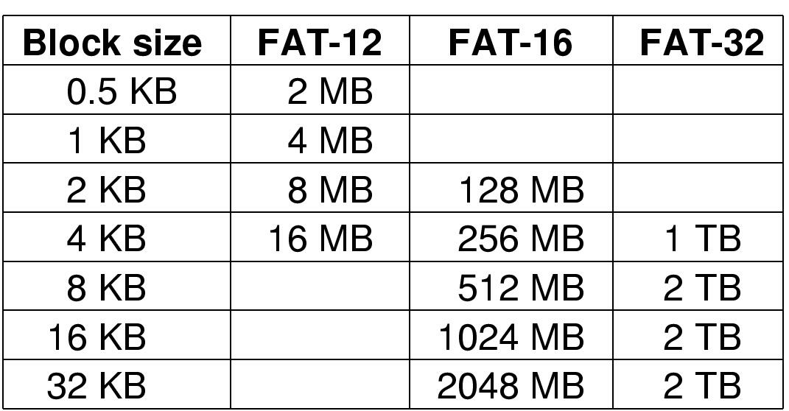
The MS-DOS File System (2)
Maximum partition for different block sizes
The empty boxes represent forbidden combinations

Slide 8
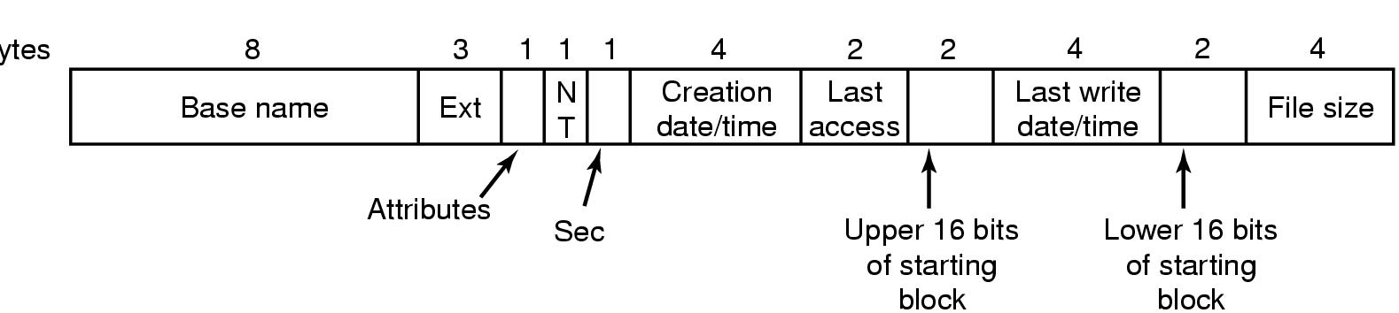
The Windows 98 File System (1)
Bytes
The extended MOS-DOS directory entry used in Windows 98

Slide 9
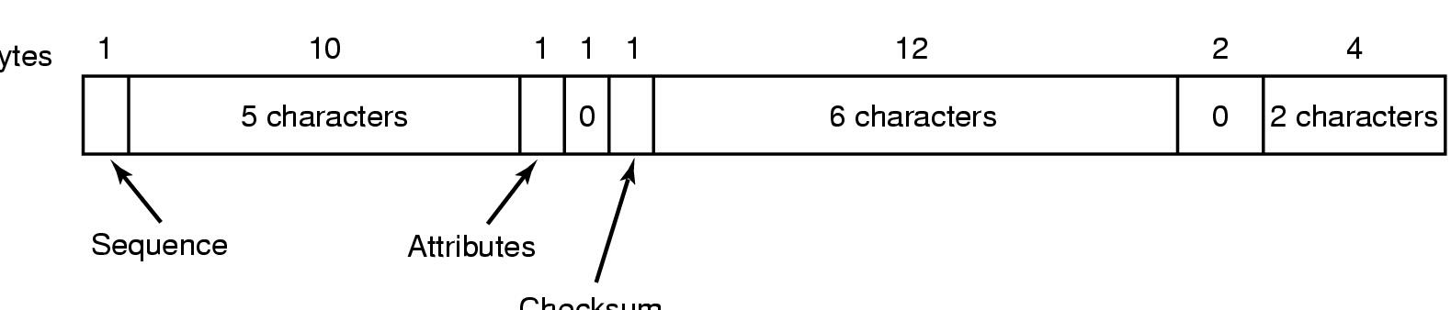
The Windows 98 File System (2)
Bytes
Checksum
An entry for (part of) a long file name in Windows 98

Slide 10
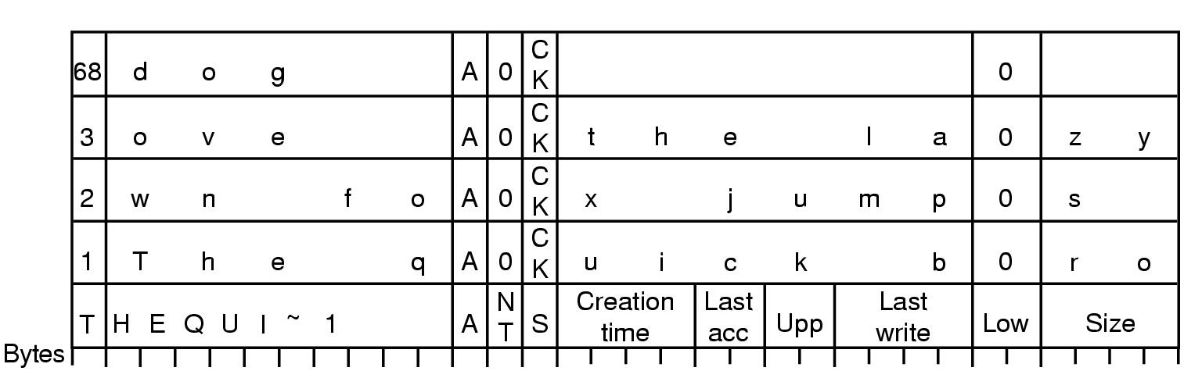
The Windows 98 File System (3)
An example of how a long name is stored in Windows 98

Slide 11
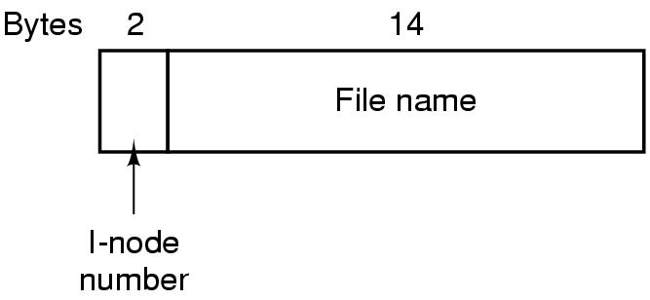
The UNIX V7 File System (1)
A UNIX V7 directory entry

Slide 12
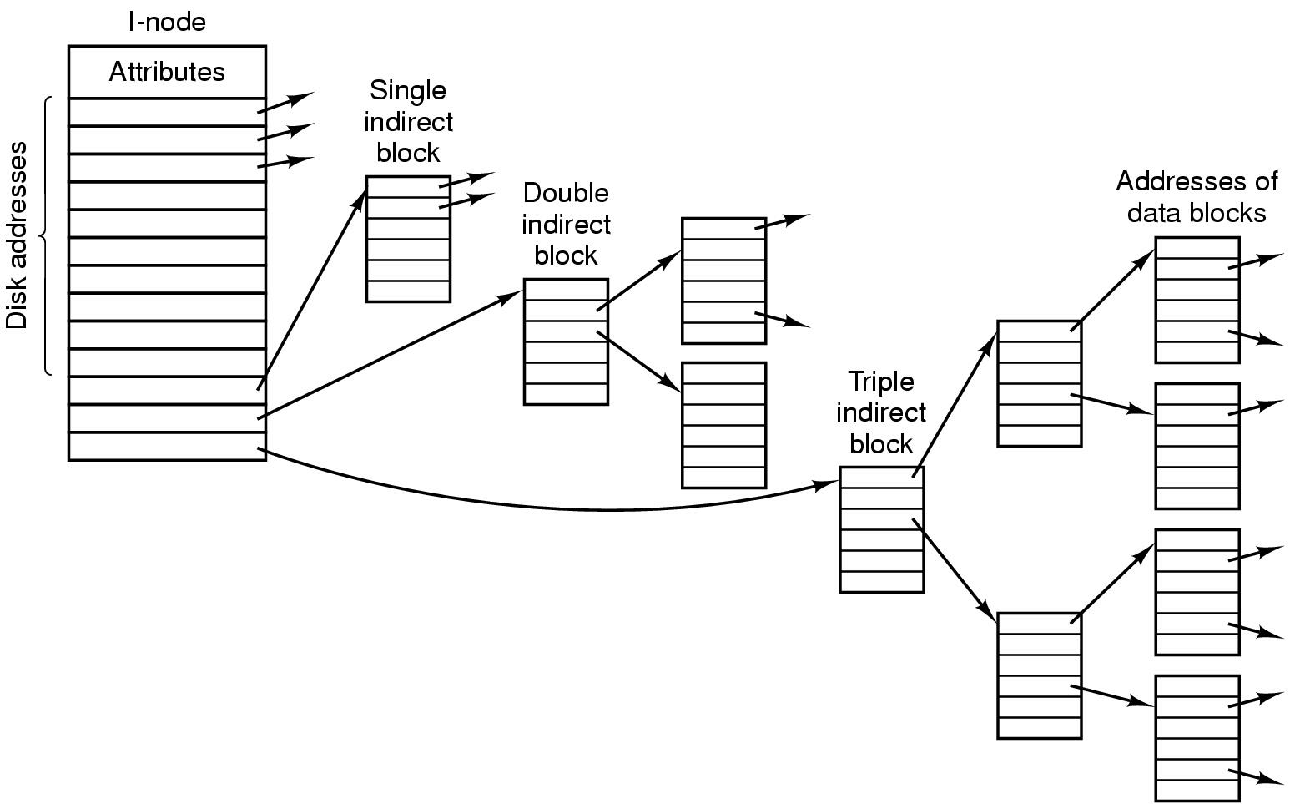
The UNIX V7 File System (2)
A UNIX i-node
Difference from FAT?
Advantage? Disadvantage?

Slide 13
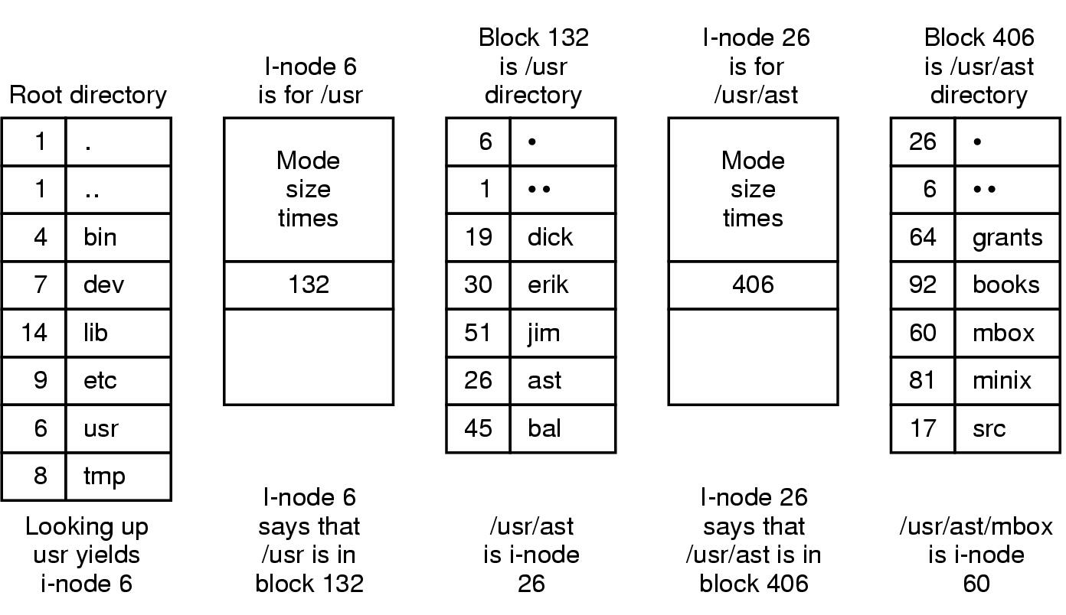
The UNIX V7 File System (3)
The steps in looking up /usr/ast/mbox

Slide 14
Group discussion
If ONLY the root inode is in memory, what is the minimum number of disk accesses to read the first block of
  /home/bob/mbox ?

Slide 15
Levels of Access Methods
device level read and write sectors or tracks from disk
the i/o is written at the level of a sequence of transfer commands to the controller
this is often performed as if the access path is a channel

Slide 16
Levels of Access Methods
block level access to a file is in terms of blocks or physical records within a file
the user must do his own buffering. Access methods include:
  Read(file, block_no)
  Write(file, block_no)
  Wait(file, block_no)

Slide 17
Levels of Access Methods Continued
file level access to the file is in terms of acquiring access to a copy of the file that is stored in primary memory
queued or buffered level access to the file is in terms of logical records that depend on software interpretation. for example, read and write chars in UNIX. buffering is used to provide logical record abstraction and maps i/o into physical records

Slide 18
Levels of Access Methods Continued
memory mapped file level
  the file is mapped into virtual memory
  file access is at the instruction level
  page faults may read a page of file data from disk to memory
  an address of a logical record within a file is given by a virtual memory address offset of that record from the beginning of the file

Slide 19
Levels of Access Methods Continued
persistent object
  the file is mapped into virtual memory and
  access to the contents of the file is provided by an abstract data type interface that is determined by
  the type of the data stored in the file

Slide 20
Protection
in file systems, protection is needed from physical damage (reliability) and improper access (protection)
reliability (chapter 12) is generally provided by duplicate copies of files

Slide 21
Protection
protection - various mechanisms for single-user system and multi-user systems
  removing the floppy disk,
  prohibiting access to files of other users

Slide 22
Types - Controlled Access
read - possible access to read from file
write - possible access to write to a file
execute - load file and execute it
append - write new information at the end of a file
delete - delete file and free its space for possible reuse
list - list name and attributes of a file

Slide 23
Access Lists and Groups
associate each file and directory with access list
problem with access list: length
solution: condensed version of the access list
  owner - user who created the file
  group - a set of users who are sharing the file and need similar access
  universe - all other users

Slide 24
Access Lists Example
UNIX - 3 fields of length 3 bits are used. fields are
user(u),group(g),others(o), bits are read(r), write(w), execute(x) -
example
% Chmod go+rw file

Slide 25
UNIX Protection Scheme Detail
setuid if file is executed, execution assumes the user id
setgid if file is executed, it execution the group id
rwx read, write, execute owner permission.
rwx read, write, execute group permission.
rwx read, write, execute other permission.
Files can be hidden from ``group and others'' by creating a directory that is executed but not readable ``chmod 711 hidefiles'' and creating the file in that directory. Users in the group or in others may access the file if they know the filename.

Slide 26
Other Protection Approaches
associate a password with each file
protect directories - listing of file names might be a protected operation
encryption

Slide 27
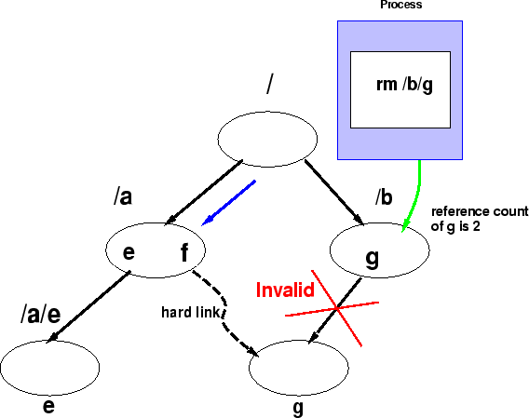
Hard links
Hard links are reference counted and can only be within the same file system.

Slide 28
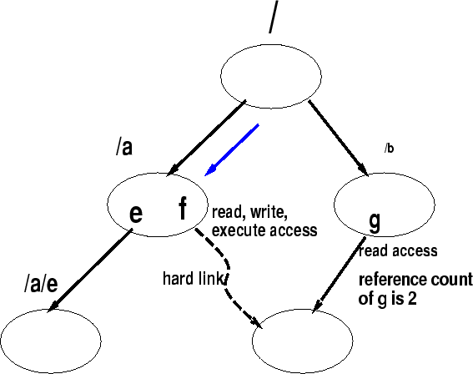
Access Rights and Links
Permissions along a path may prevent access but hard links can circumvent permissions.
Depending upon the access path, a process may be able to get different access rights for a file.

Slide 29
Symbolic Links
Allow sharing of files and support any graph directory structure topologies.
Access rights through a symbolic link do not depend upon the user access path:
  the path that counts is the one thats stored in the symbolic link (ln -s xyxz link -- ls -l).
A file at the end of a symbolic link can be removed and leaves a dangling pointer.
Cyclic file directories can be created
  tar and other tools can be confused by symbolic links -- use the right options.

Slide 30
Consistency Semantics
UNIX
Session Semantics
Immutable-Shared File Semantics

Slide 31
UNIX Files
writes to file immediately visible to other users reading from file
can share current location into file through open file tables

Slide 32
Session Semantics
writes to open file by user not visible immediately – only to new opens.
closing a write file doesn’t make contents visible if applications have file open already

Slide 33
Immutable-shared Files
files, once shared, never change
name may not be reused
good in distributed system

Slide 34
Summary
file concepts - file attributes, operations, structures
directory systems - single-level, two-level, tree structure, acyclic structure, general structure
access methods - sequential, direct, indexed
protection - possible access protection, access lists

