Slide 1
CS323
Operating Systems
Overview
Yuanyuan Zhou
Lecture 2
Jan 24, 2003

Slide 2
Content of this lecture
Announcements and reminders
Hardware overview
A peek at Unix
Criteria to evaluate an OS
Overview of OS components
Design tradeoffs

Slide 3
Announcement
Have you subscribe uiuc.class.cs323?
Have you visited the web page?
Nacho tutorial date:
Reading assignment:
  Chapter 2.1 & 2.4
My slides = your notes (sorry, no easy life)
  Active learning
Clarification
  Starting from Fall 2004, cs323 is very likely to split into 2 courses: cs323 and cs241
  So don’t panic!

Slide 4
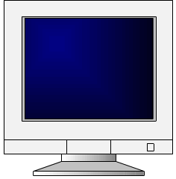
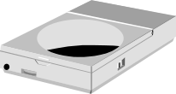

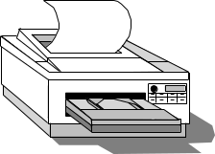

A Typical Computer from a Hardware Point of View
CPU
. . .
CPU
Memory
Chipset
I/O bus
Network

Slide 5

Pentium System: can you read it?
Structure of a large Pentium system

Slide 6
A Typical Computer System (black box)
Memory
CPU
Programs and data
.
.
.
Operating System Software
CPU
OS
Network
Apps
Data

Slide 7
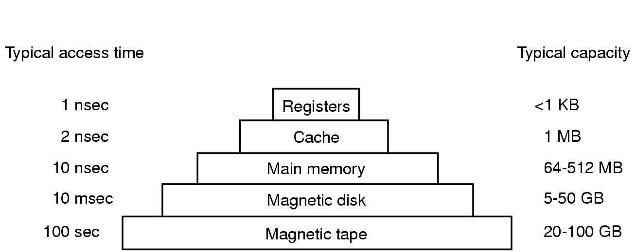
Memory-Storage Hierarchy
Real life analogy?
company personnel management pyramid, the “workers” know all the information
Human, the younger the faster, the older the richer

Slide 8
A peek into Unix
Application
Libraries
User space/level
Portable OS Layer
Kernel space/level
Machine-dependent layer
User/kernel modes are
supported by hardware
Some systems do not have
clear user-kernel boundary

Slide 9
Unix: Application
Application
(E.g., emacs)
  Written by programmer
  Compiled by programmer
  Uses function calls
Libraries
Portable OS Layer
Machine-dependent layer

Slide 10
Unix: Libraries
Application
  Written by elves
  Provided pre-compiled
  Defined in headers
  Input to linker (compiler)
  Invoked like functions
  May be “resolved” when program is loaded
Libraries (e.g., stdio.h)
Portable OS Layer
Machine-dependent layer

Slide 11
Typical Unix OS Structure
Application
Libraries
Portable OS Layer
Machine-dependent layer
  system calls (read, open..)
  All “high-level” code

Slide 12
Typical Unix OS Structure
Application
  Bootstrap
  System initialization
  Interrupt and exception
  I/O device driver
  Memory management
  Kernel/user mode switching
  Processor management
Libraries
Portable OS Layer
Machine-dependent layer

Slide 13

Steps in Making a System Call
Example:
read (fd, buffer,nbytes)

Slide 14
Another Look: Unix “Onion”
Applications
User and Kernel
boundary
OS Service
Device
Driver
Hardware

Slide 15
OS Service Examples
Examples that are not provided at user level
  System calls: file open, close, read and write
  Control the CPU so that users won’t stuck by running
    while ( 1 ) ;
  Protection:
    Keep user programs from crashing OS (sorry, not include windows)
    Keep user programs from crashing each other
Examples that can be provided at user level
  Read time of the day

Slide 16
Criteria to evaluate an OS?
(Criteria to evaluate a government?)
2 minutes group discussions

Slide 17
Is Any OS Complete?
government
Portability
Security
Fairness
Robustness
Efficiency
Interfaces
Not bound by land
Home-land security
Created equal
Against war and terrorism
No Corruption!
Service (be nice!)

Slide 18
OS Major Components
Process and thread management
Resource management
  CPU
  Memory
  Device
File system
Bootstrapping

Slide 19

Process: a running program
A process includes
  Address space
  Process table entries (state, registers)
A process tree
  A created two child processes, B and C
  B created three child processes, D, E, and F

Slide 20
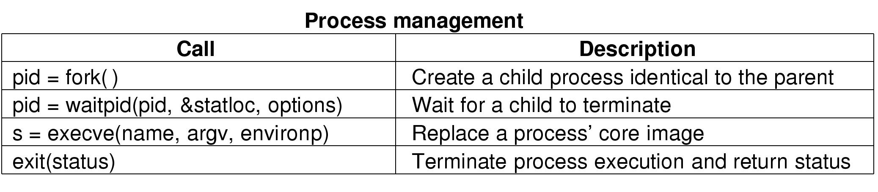
Some System Calls For Process Management

Slide 21
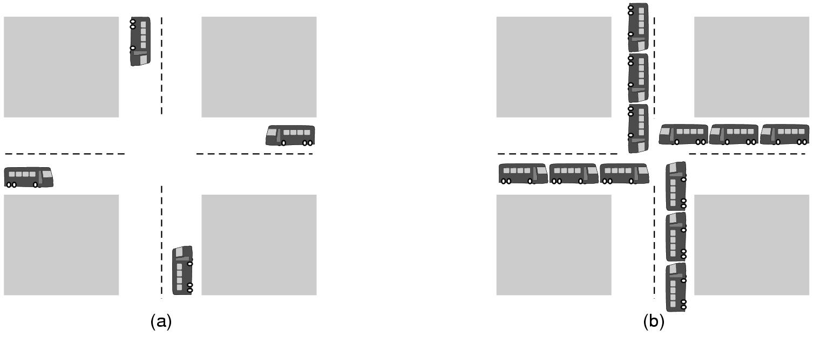
Deadlock
(a) A potential deadlock. (b) an actual deadlock.

Slide 22
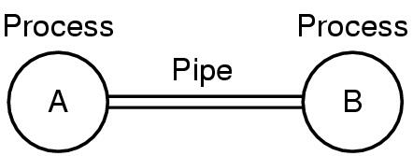
Process communication
Two processes connected by a pipe

Slide 23
Processor (CPU) Management
Goals
  Time sharing
  Multiple CPU allocations
Issues
  Do not waste CPU resources
  Synchronization and mutual exclusion
  Fairness
  deadlock free
Analogy: Video Games

Slide 24
Memory Management
Goals
  Support programs to run
  Allocation and management
  Transfers from and to secondary storage
Issues
  Efficiency & convenience
  Fairness
  Protection
Register
L2 10x
Memory 200x
Disk 10Mx
Tape 100Mx

Slide 25
I/O Device Management
Goals
  Interactions between devices and applications
  Ability to plug in new devices
Issues
  Efficiency
  Fairness
  Protection and sharing
User 1
User n
. . .
Library support
Driver
Driver
I/O
device
I/O
device
. . .

Slide 26
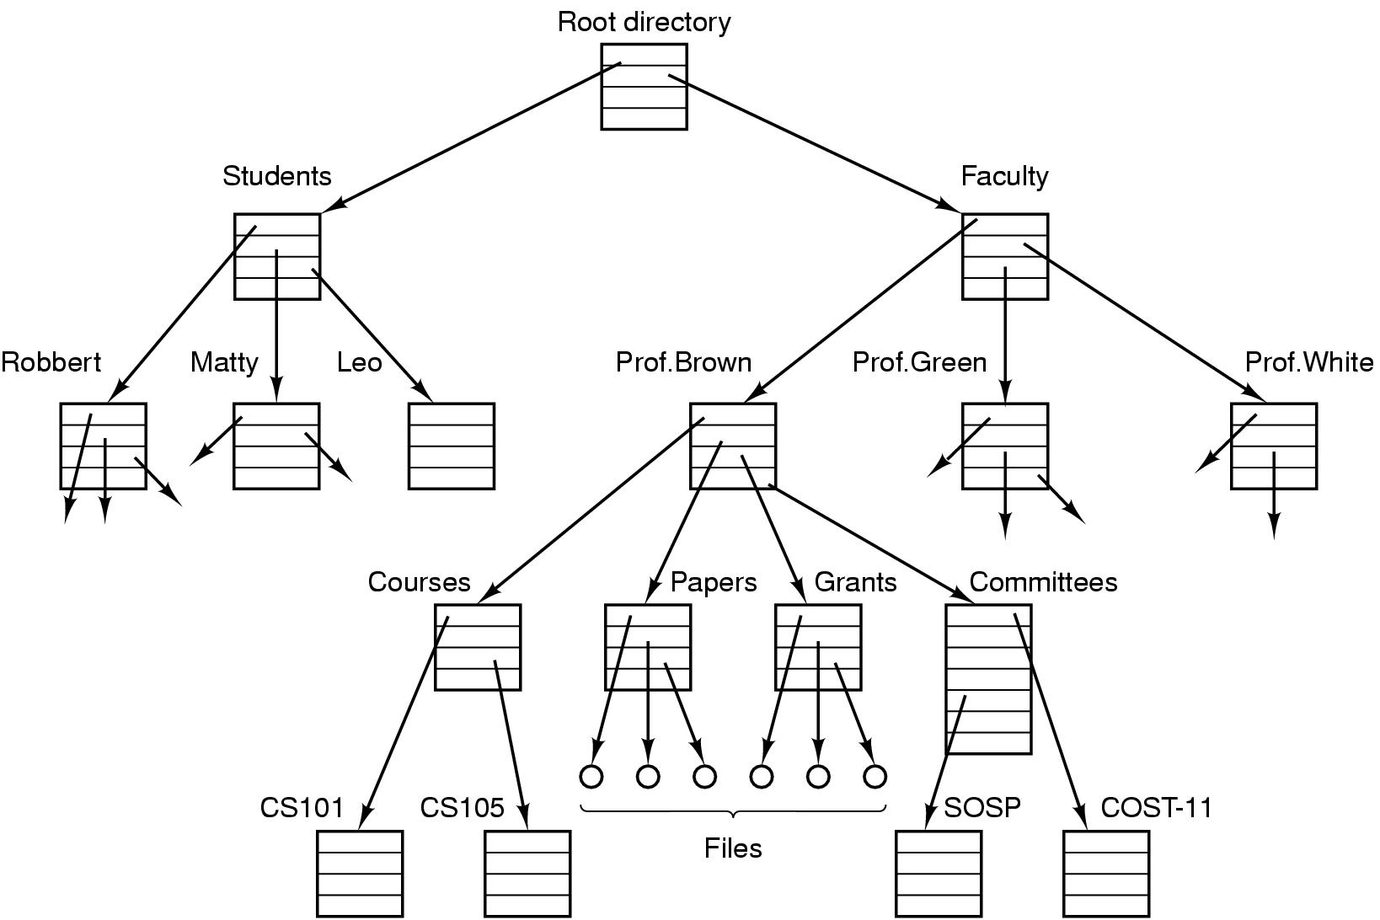
File System Example
File system for a university department

Slide 27
File System
A typical file system
  Open a file with authentication
  Read/write data in files
  Close a file
Can the services be moved to user level?
User 1
User n
. . .
File system services
File
File
. . .

Slide 28
Bootstrapping
Power up a computer
Processor reset
  Set to known state
  Jump to ROM code
Load in the boot loader from stable storage
Jump to the boot loader
Load the rest of the operating system
Initialize and run
Boot
loader
Boot
loader
OS
sector 1
OS
sector 2
.
.
.
OS
sector n

Slide 29
Design Tradeoffs
All in the kernel (Windows)
  Pros: efficient?
  Cons: difficult to develop new services
All at user level
  Pros: easy to develop new apps
  Cons: protection
Split between user and kernel (Unix)
  Kernel: display driver and mouse driver
  User: the rest

Slide 30
May You Live in Interesting Times…
Processors double in 18 months
Disk doubling every 12 months
Global bandwidth every 6 months
“Sweet spot” constantly decaying
What will the future OS be?
(If population doubles every year, or people can move twice faster every year, what does the government do?)

Slide 31
Summary
Hardware overview
A peek at Unix
Criteria to evaluate an OS
Overview of OS components
Design tradeoffs
Next lecture: Process (Chapter 2)

Slide 32
Reminder
Nacho Tutorial, 27th
Read Chapter 2
Test Quiz

