Slide 1
CS323 Operating Systems
Multimedia II
Yuanyuan Zhou
Lecture 30
4/11/2003

Slide 2
Content of this lecture
Reminder
  Quiz4 is due today
  Conflict exam: signup before 4/14 Noon unless documented medical or family emergency
Multimedia Scheduling
  Traditional RT Scheduling
  System Model of RT Scheduling
  Rate Monotonic Algorithm
  Earliest Deadline First Algorithm

Slide 3
Multimedia: Real-Time Processing Requirements
Occurs in predetermined - usually periodic – intervals
Compete at certain deadlines.
RT process manager
  performs admission control
  determines a schedule
  gives processing guarantees.
Problem: how to find a feasible schedule.

Slide 4

Group Discussion
Tasks of a day-trader (8am -8pm)
  Walk the dog: once every 12 hours, each time takes 30 minutes
  Call friends: once every 6 hours, each time takes 15 minutes
  Eat: once every 4 hours, each time takes 1 hour
  Trade stocks: once every 3 hours, each time takes 1 hour
How can you schedule these tasks?

Slide 5
Goals of Multimedia Scheduling
non-RT process should not starve when RT process is running
RT process should not be subject to priority inversion.
  (what is priority inversion?)

Slide 6
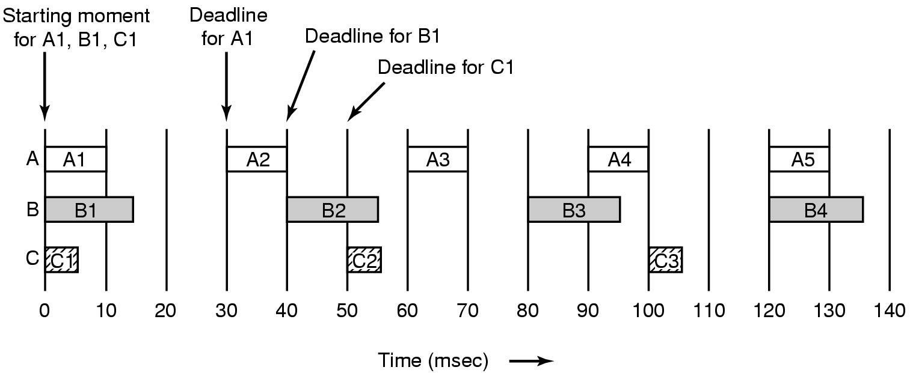
Multimedia Process Scheduling
Periodic processes displaying a movie
Frame rates and processing requirements may be different for each movie

Slide 7
Discussion
Does the following scheduler have the same goals?
Scheduler for traditional time-sharing computers
Traditional RT scheduler
Multimedia scheduler

Slide 8
Scheduling Environments
Traditional scheduling on time-sharing computers
  optimal throughput, optimal resource utilization, and fair queueing.
Traditional RT scheduling in operation research
  guarantee hard deadlines with no adaptation to changes of the workload.
Multimedia scheduling
  Guarantee soft deadlines,i.e., work in a dynamic environment with adaptation to changes of the workload in bounds of timing requirements

Slide 9
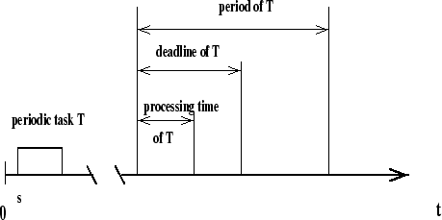
System Model in RT Scheduling
Task is the schedulable unit of the system.
Task is characterized by (1) timing constraints and resource requirements.

Slide 10
Assumptions and Notation
Assumptions : periodic tasks are mutually independent.
Time Constraints : (s, e, d, p) where s is starting point, e is processing time, d is deadline, and p is period.
If the period at (k-1) step is equal to ready(start) time of period k, then we get congestion avoidance deadline.
Tasks : can be preemptive or non-preemptive.
Multimedia Scheduling Algorithm : must determine sharing of the resource used by different tasks so that all of them can meet their deadlines.

Slide 11

Schedulability Test - Performance Metric
Scheduling algorithm guarantees a newly arrived task a deadline if the algorithm can find a feasible schedule.
Guarantee ratio := number of guaranteed tasks/total number of tasks
Another performance metric is process utilization with .

Slide 12
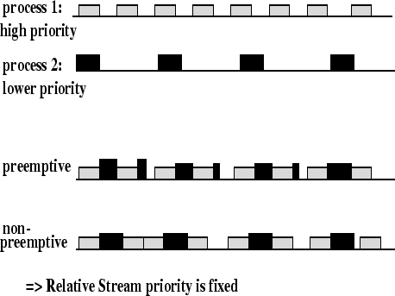
Rate-Monotonic Scheduling
Process priority is determined by the task rate
Higher priority process can preempt lower priority process

Slide 13
What is the result of RMS?
Tasks of a day-trader (8am -8pm)
  Walk the dog: once every 12 hours, each time takes 30 minutes
  Call friends: once every 6 hours, each time takes 15 minutes
  Eat: once every 4 hours, each time takes 1 hour
  Trade stocks: once every 3 hours, each time takes 1 hour
How can you schedule these tasks?

Slide 14
Rate Monotonic Scheduling
This algorithm was designed and proved correct by C.L. Liu and Layland in 1973.
This algorithm is static and optimal, priority-driven for preemptive periodic jobs.
  Optimal means that there is no other static algorithm that is able to schedule a task set which can't be scheduled by the rate-monotonic algorithm.
The algorithm was proven under the following assumptions:
  tasks are periodic
  each task must be completed before the next request occurs
  all tasks are independent
  run-time of each task request is constant
  any non-periodic task in the system has no required deadlines

Slide 15
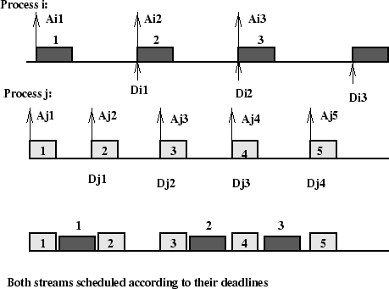
Deadline-Based Scheduling
Process priority is determined by the process deadline.

Slide 16
Earliest Deadline First Algorithm
One of the best known algorithms for RT processing
It is an optimal dynamic algorithm. It produces a valid schedule whenever one exists.
Upper bound of process utilization is 100 %.
If priorities should be used, then the earliest deadline gets the highest priority.

Slide 17
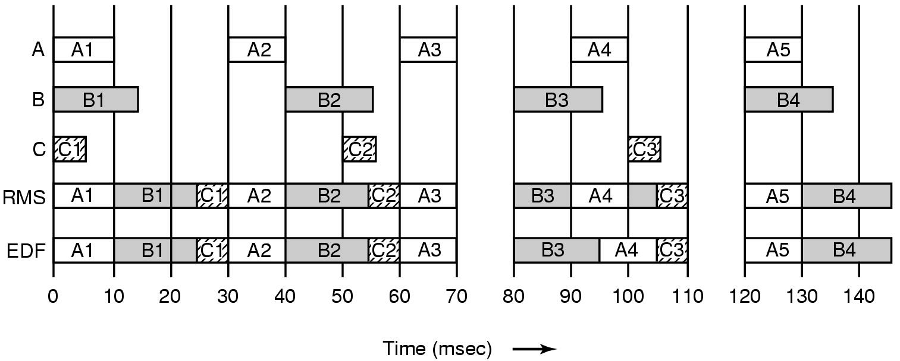
Earliest Deadline First Scheduling (1)
Real Time Scheduling algorithms
  RMS
  EDF

Slide 18
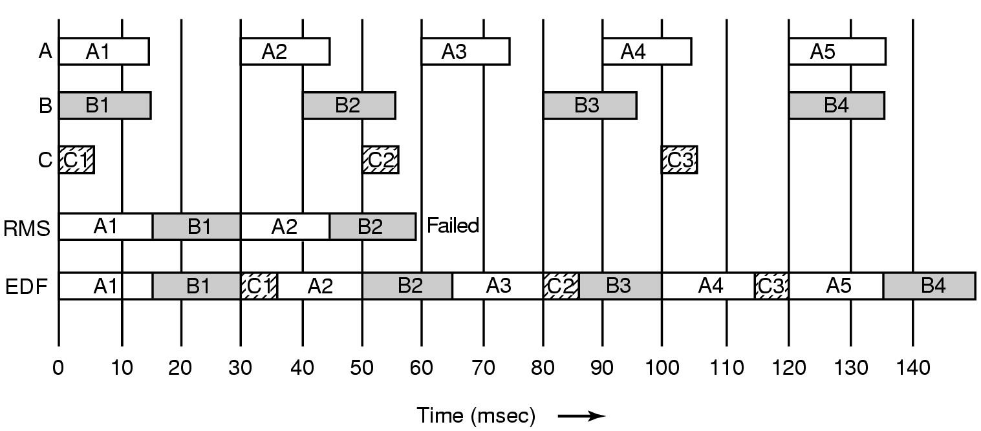
Earliest Deadline First Scheduling (2)
Another example of real-time scheduling with RMS and EDF

Slide 19
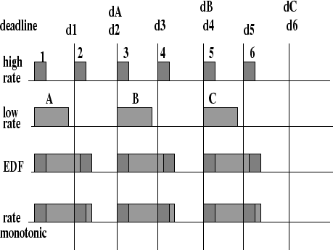
Comparison of RMS and EDF
In terms of context switching, the EDF is better if more than one stream are processed concurrently

Slide 20




Admission Control
Process utilization for RM algorithm is upper bounded by (Liu and Layland condition).
The schedulability test is then
With EDF algorithm, the 100% utilization can be achieved :
The schedulability test is then

