Slide 1
CS323 Operating Systems
Multimedia III
Yuanyuan Zhou
Lecture 31
4/14/2003

Slide 2
Content of this lecture
Reminder:
  Midterm 4/21, no class in the morning
  Conflict exam signup: 4/4 noon
    Exam data: Wed 4/23 5-6pm, room TBA

Slide 3
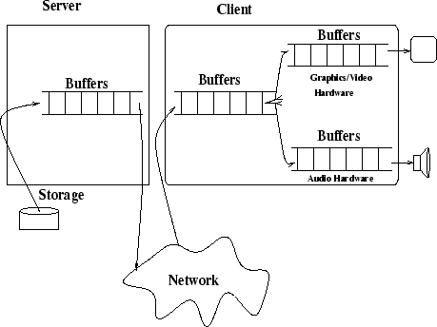
Data Flow for a Multimedia Server

Slide 4
Requirements
Real-time Storage and Retrieval CM recording devices generate continuous stream of media quanta that must be stored in real time.
Playback is a reverse operation of recording. The media quanta must be presented using the same timing sequence with which they were captured.
Media components can be combined in fashion requiring synchronization.
Multimedia file servers must act like VCRs (start, stop, fast forward, rewind, pause)
Multimedia file servers need to support streaming and push the data at the user, hence they are called push servers.
High Data Transfer Rate and Large Storage Space Examples are:
  HDTV quality 1280x720 pixels/frame 24 bits/pixel yield 81 Mbytes per second
  NTSC quality 640x48 pixels/frame 24bits/pixels yield 27 MBytes per second

Slide 5
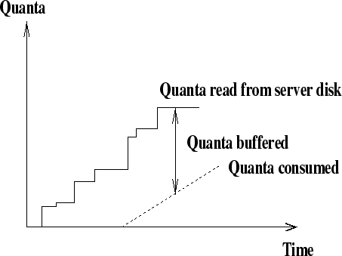
Continuous Media Recording and Playback
  Server's challenge is to ensure continuous retrieval of a media stream from the disk.

Slide 6
Playback
Single-stream Playback Continuous playback can be assured simply by buffering the entire stream before initiating playback. However, this solution is not efficient.
In order to efficiently service a single stream, there are three problems to solve:
  preventing starvation
  minimizing the buffer space requirement
  minimizing the initiation latency
Multi-stream Playback MM server must process retrieval requests for several streams simultaneously. One solution is to dedicate a disk head to each stream and treat each disk head as a single stream. This solution is not efficient. Another solution is to multiplex streams per disk.
MM server must process multiple retrieval requests for the same stream.
We need new multimedia file systems.

Slide 7
Support of Continuous Media
Provide a constant and timely retrieval of data.
Proper management of multimedia disk storage.
  Special disk scheduling algorithms

Slide 8
Management Multimedia Disk Storage
Optimally place data blocks on the disk.
Use multiple disks.
Add tertiary storage to gain additional capacity.
Build storage hierarchies.

Slide 9
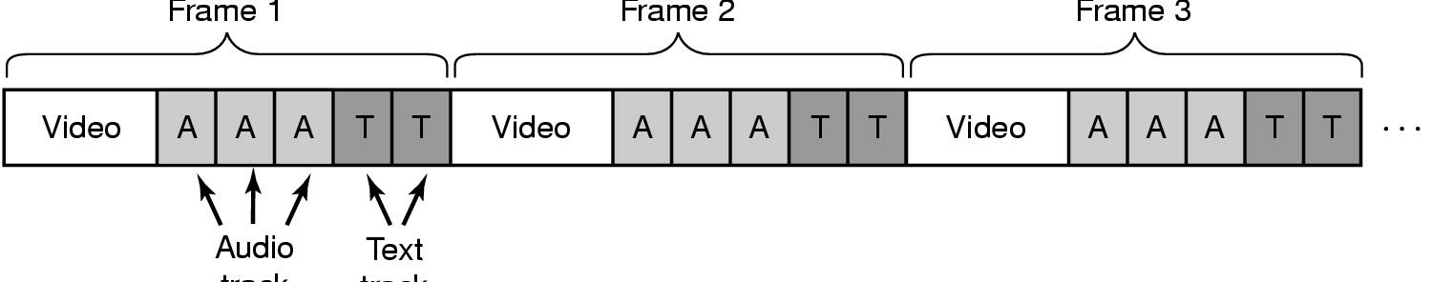
Single Disk File Placement
Frame 1
Frame 2
Frame 3
Audio
Frame
Text
Frame
Placing a File on a Single Disk
Interleaving
  Video, audio, text in single contiguous file per movie
  Why?

Slide 10
Placement of Data Blocks of a File on a Single Disk
Discussion
  What are the advantages and disadvantages of continuous placement?

Slide 11
Tradeoff
Continuous Placement
  Pros
    simple to implement
    When reading a file, only 1 seek is needed
      Scattered placements may require a seek for each blockhead---Intrafile seek.
      Does this advantage still hold for
        Multi-stream
        Video editing
  Cons
    Fragmentation
    Copying overhead for insertion and deletion to maintain continuity

Slide 12
Intrafile Seek
Intrafile seek can be avoided in scattered layout if the amount read from a stream always evenly divides a block.
Solution to intra-file seek: Select a sufficient large block and read one block in each round.
If more than one block is required to prevent starvation prior to the next read, intra-file seek is necessary.
Instead of avoiding intra-file seeks, reduce them to a reasonable bound, which leads to Constraint Placement Approach.

Slide 13
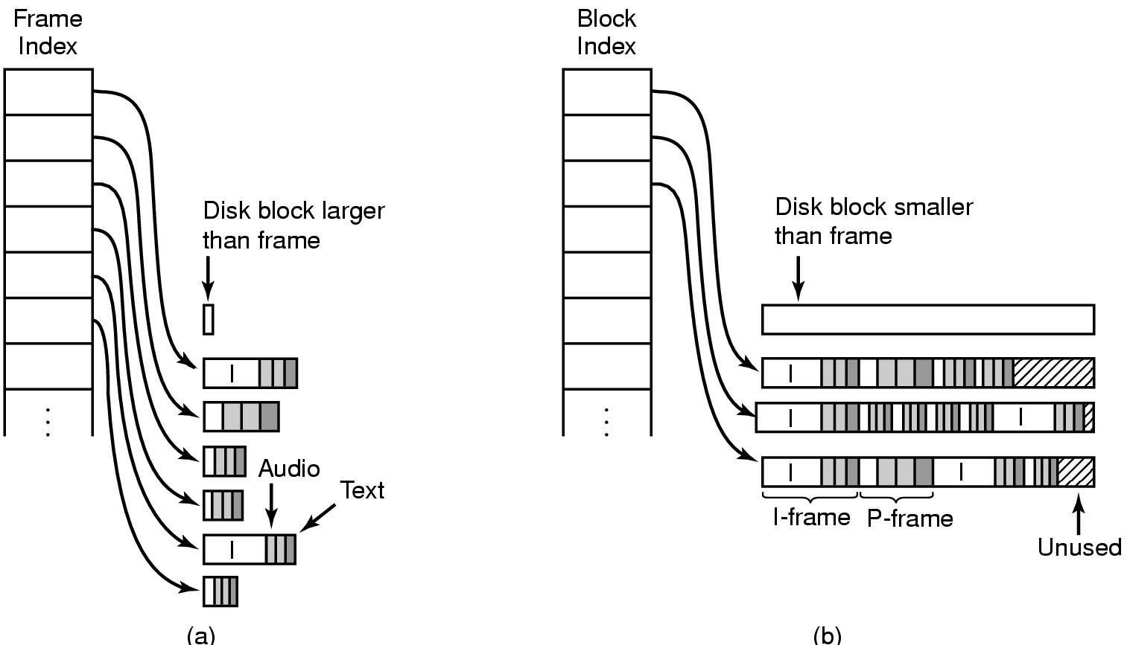
Two Alternative File Organization Strategies (1)
Noncontiguous Movie Storage
  (a) small disk blocks
  (b) large disk blocks

Slide 14
File Organization Strategies
Small-block Organization, called also constant time length, uses small disk blocks and organizes all data per frame. This organization uses a frame index per movie, where each entry points to the start of the frame. Each frame consists of video, audio, text tracks for that frame.
Large-block Organization, called also constant data length, uses large disk blocks, and puts several frames into one block. This organization uses block index to point to each block.
Comparison: Large-block organization suffers from internal fragmentation, small-block organization yields little waste of disk space. On the other hand, large-block organization has smaller index than the small-block organization.

Slide 15
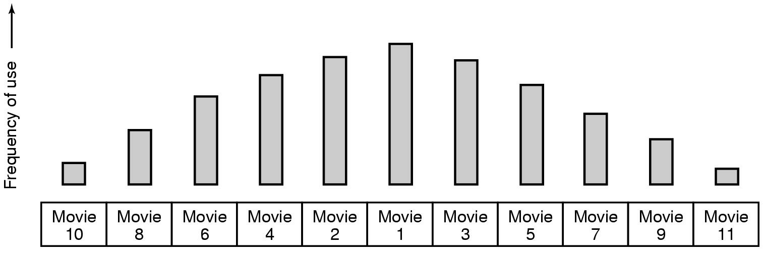
Placing Multiple files on a Single Disk (2)
Organ-pipe distribution of files on server
  most popular movie in middle of disk
  next most popular either on either side, etc.

Slide 16
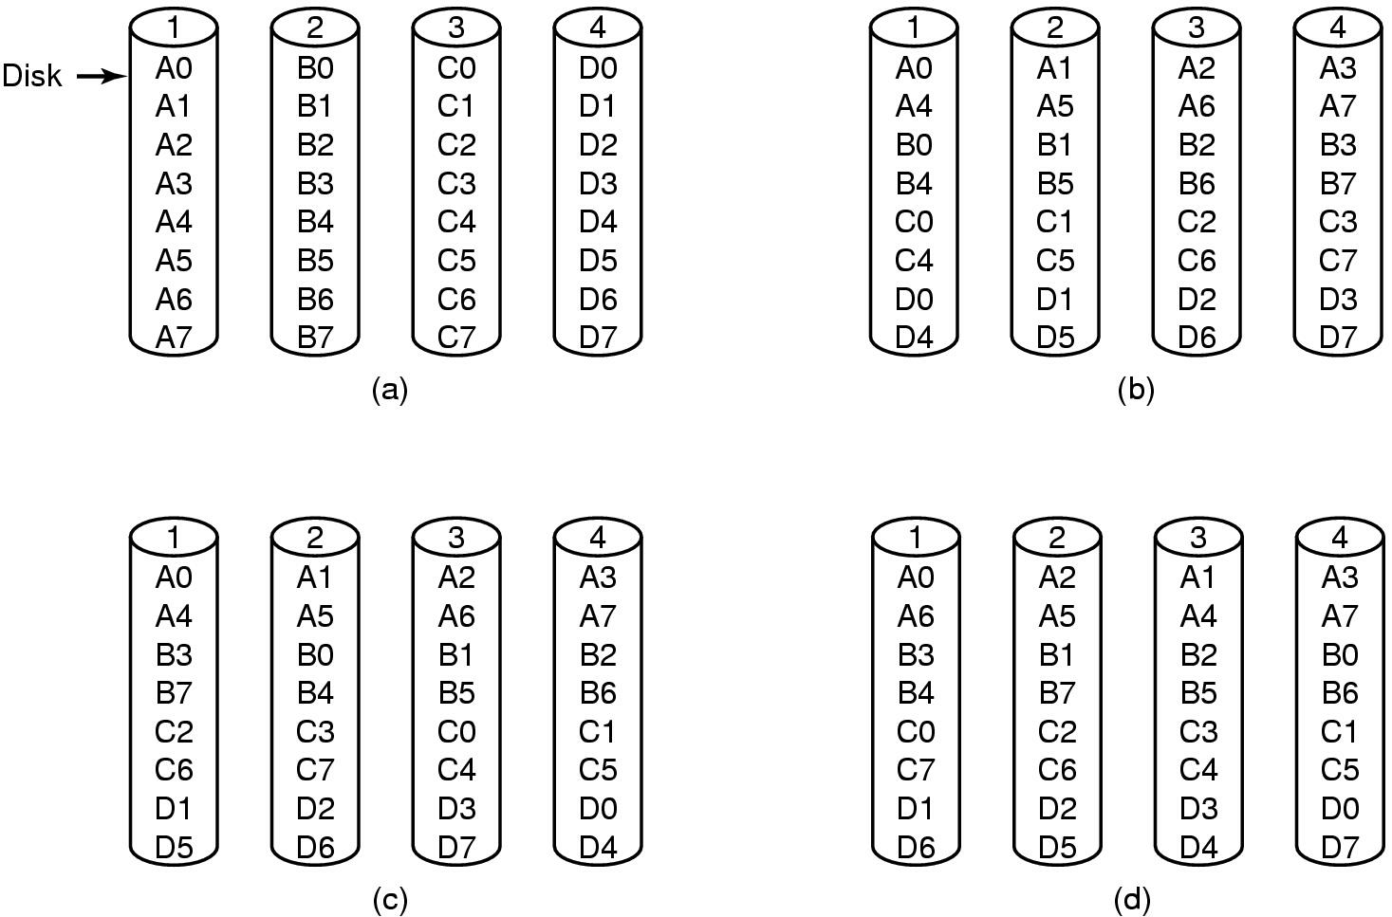
Placing Files on Multiple Disks
Organize multimedia files on multiple disks
(a) No striping
(b) Same striping pattern for all files
(c) Staggered striping
(d) Random striping

Slide 17
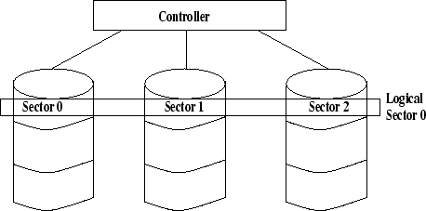
Data Striping
Data striping means to scatter data across multiple disks using RAID (redundant arrays of inexpensive disks).
The disks are spindle synchronized and operate in lock-step parallel mode.
Physical and logical blocks have identical access time, and transfer rate increases.
Striping improves bandwidth requirements, but does not improve seek and rotational latency.

Slide 18
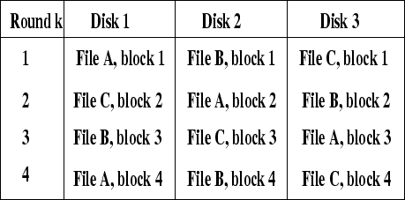
Data Interleaving
Blocks are interleaved across the disk array with successive file blocks stored on different disks.
A simple interleaved pattern stores blocks cyclically across an array of N disks.
Difference to striped data: interleaved data are not spindle synchronized.
Data interleaving operates independently.

Slide 19
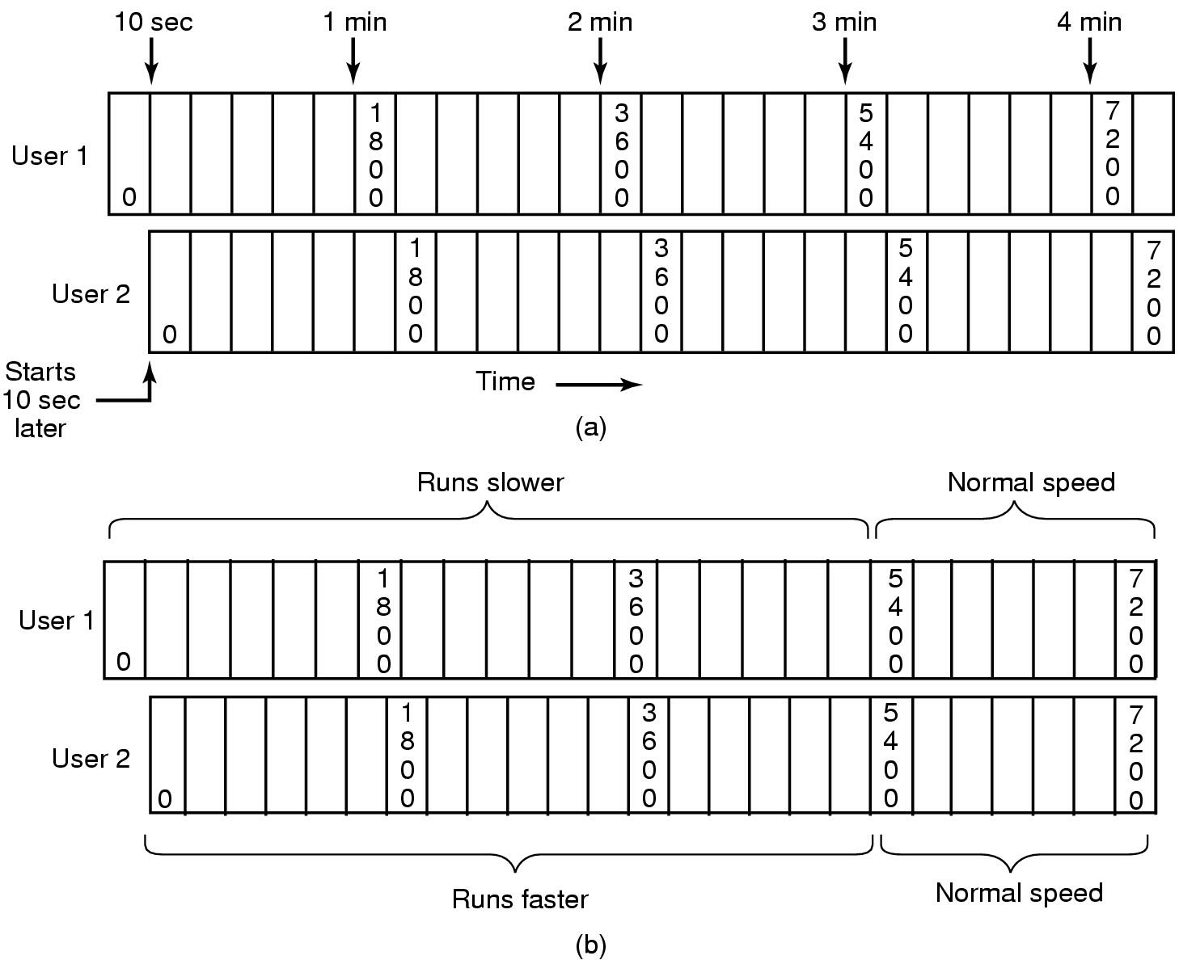
Caching: will LRU still work?
Block Caching
(a) Two users, same movie 10 sec out of sync
(b) Merging two streams into one

Slide 20
File Caching
Most movies stored on DVD or tape
  copy to disk when needed
  results in large startup time
  keep most popular movies on disk
Can keep first few min. of all movies on disk
  start movie from this while remainder is fetched

Slide 21
Disk Scheduling Algorithms
Goal of scheduling in traditional file systems
  reduce cost of seek time
  achieve high throughput
  provide fair disk access;
Goal of scheduling in multimedia file systems:
  meet deadlines of all time-critical tasks
  keep the necessary buffer requirements low
  serve many streams concurrently
  find balance between time constraints and efficiency.

Slide 22
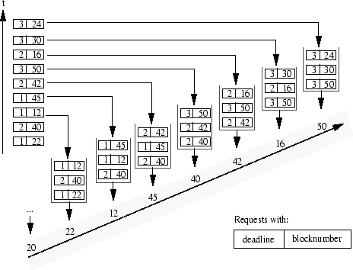
EDF Scheduling Algorithm
Earliest Deadline First
Problem: poor throughput and excessive seek time.
  It is a preemptive scheduling algorithm, hence it has high overhead.

Slide 23
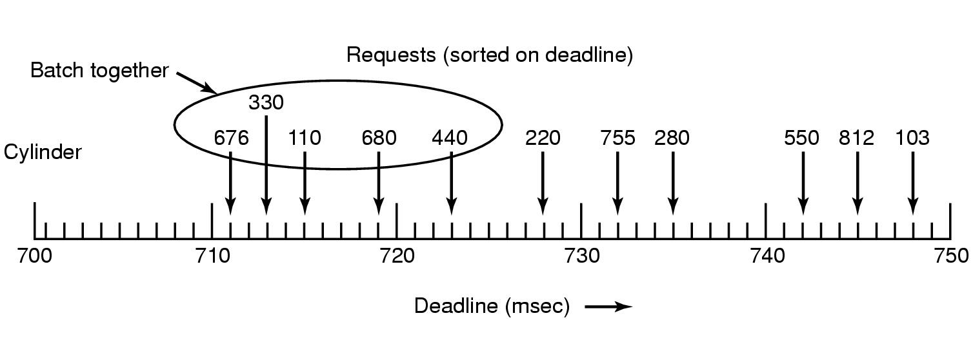
Dynamic Disk Scheduling
Scan-EDF algorithm
  uses deadlines & cylinder numbers for scheduling

