Slide 1
CS323 Operating Systems
Multi-Computers/Distributed Systems
Yuanyuan Zhou
Lecture 32
4/16/2003

Slide 2
Content of this lecture
Reminder:
  Midterm 4/21, no class in the morning
  Conflict exam signup: 4/16 noon
    Exam data: Wed 4/23 5-6pm, room TBA
Network
  Motivation
  Network Categories
  Packet Switching
  Datagrams vs Virtual Circuits
  Topology

Slide 3
Motivation
Share: workstation, PC, Cray, database, radio telescope, work
resource sharing
computation speed up
reliability
communication

Slide 4
Network Category
Resource Sharing Networks.
  Communication is typically between a user process on one host and a resource manager process on another host.
  Examples:
    Access remote files
    Transfer files between hosts
    Database distributed among hosts
    Access peripheral device (e.g., printer) on remote host
Distributed Computation Networks.
  A group of processes cooperating in one activity are distributed over several hosts throughout a network.
  Examples:
    Large database systems
    Real time process-control systems

Slide 5
Network Categories Continued
Remote Communication Networks.
  Typically a batch system with most facilities in one or a few central locations, accessed from many remote locations.
  Examples:
    Bank ATMs

Slide 6
Requirements
Sharing of link costs
Time versus space division multiplexing
Reliability and Robustness
Latency
Scalability

Slide 7
Network Topology: criteria
Basic cost
  Expense.
Communication cost
  Latency.
Reliability
  What happens when a link or node fail.

Slide 8

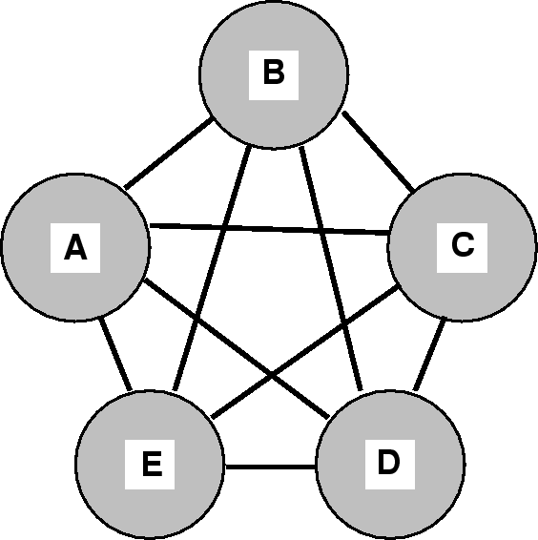
Fully Connected
Basic cost:
  high links
Communication cost:
  low (single hop)
Reliable
  not likely to partition

Slide 9
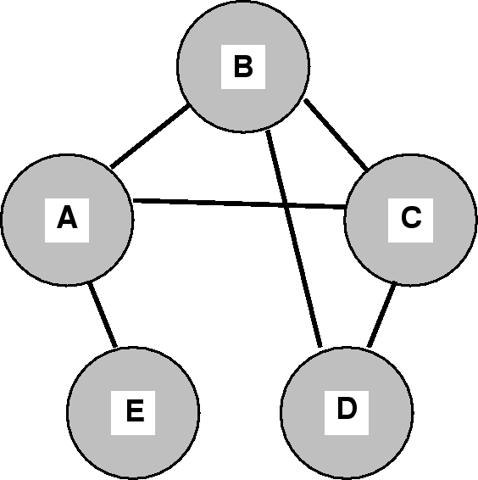
Partially Connected
Basic cost:
  Lower
Communication cost:
  Higher (multiple hops)
Reliable
  single failure may partition

Slide 10
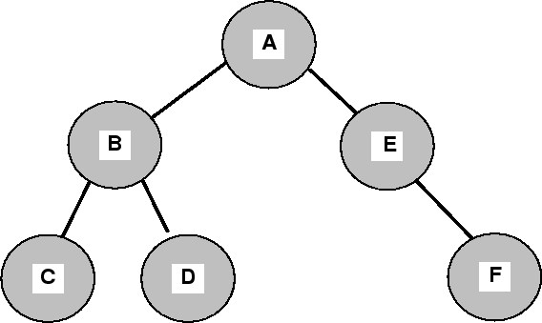
Hierarchical
Basic cost:
  Low, n-1 links
Communication cost:
  multiple hops
  but organized to accommodate likely traffic flows (subtrees represent localities)
  Root may become bottleneck.
Reliable
  single failure likely to partition

Slide 11
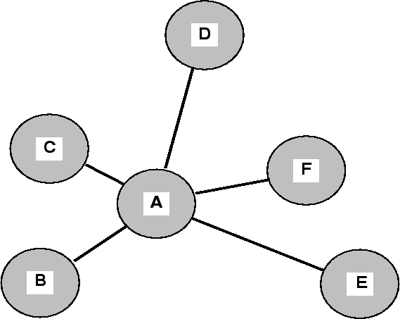
Star-Connected Network
Basic cost:
  ?
Communication cost:
  ?
Reliable
  ?
Notes:
Basic cost n-1 links linear
Communication cost -- max two hops, but central site may become bottleneck
Less reliable -- central node failure may partition network completely. Single link failure causes a node to be partitioned
Improved reliability by making central node dedicated

Slide 12
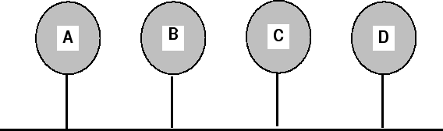
Bus-Connected Network
Basic cost:
  ?
Communication cost:
  ?
Reliable
  ?
Notes:
Basic cost n linear
Communication cost -- single hops until bus bottleneck
Less reliable -- simpler components, but node failure does not partition network like star (unless it jams the bus). If link fails, network is partitioned.

Slide 13
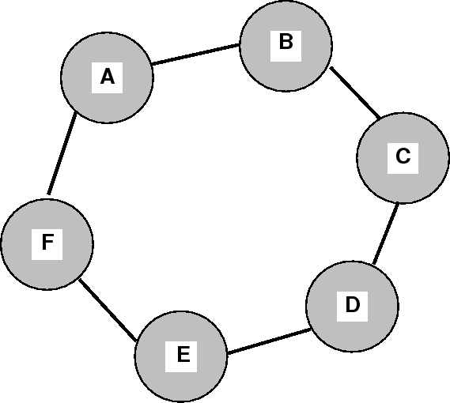
Ring-Connected Network
Basic cost:
  ?
Communication cost:
  ?
Reliable
  ?
Notes:
Basic cost n links linear
Communication cost -- multiple hops. Average hops n/2
Less reliable -- two node or link failure partitions network

Slide 14
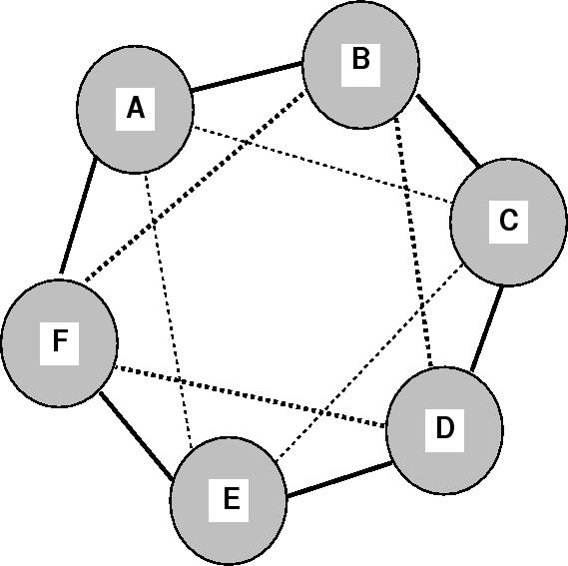
Double Connected Network
Basic cost:
  ?
Communication cost:
  ?
Reliable
  ?
Notes:
Basic cost 2n links linear
Communication cost -- multiple hops. Reduces max hops
More reliable – two node failure will not partition network

Slide 15
Grid Connected Network
All nodes connected via a mesh
  a two-dimensional design. It is highly regular and easy to scale up to large sizes.
It has a diameter
  the longest path between any two nodes
  increases only as the square root of the number of nodes.
A variant of grid is the double torus
  a grid with the edges connected
  more fault tolerant than grid and the diameter is also less.
Further enhancement of the regular grid structure is cube and hypercube topology being used in parallel computers.

Slide 16
Packet Switching
Messages are divided into packets, variable-length blocks of characters.
Each packet is check-summed.
Has a packet identification.
Routing information.
Origin and destination.

Slide 17
Packet Switching-- Advantages
Advantages
  Packet switching allows many users to share the same communication line.
  Data communications are bursty in nature. Packets allow bandwidth to be shared for bursty traffic.
  Small and large amounts of information are easy to transmit.
  Latency is delay to send packet, not to establish communication circuit.
Example Services:
  1967 ARPAnet
  1975 Telenet

Slide 18
Datagrams vs Virtual Circuits
Virtual Circuit: The network provides a channel which the user can assume is perfect: transmission will be completely error free, and packets will be received in the order sent. If a packet arrives out of order, it is held until its predecessors arrive.
  Virtual circuit follows the pattern of circuit switching scheme.
  Does more of the work of transmission; less burden on hosts.
  In some circumstances, order is less important than speed (order may even be unimportant in some applications).
Datagram: Packets are transported to their destinations as isolated units (no ordering). A message distributed over several packets must be assembled by the host. The network does no error checking; that is done by the hosts.
  Datagrams use store-and forward packet switching scheme.
  Messages may arrive at their destination faster, since they will not be held up if out of order.
  Requires more work from the host computers.

Slide 19
Network Hardware for Single Machine
Network Interface Card
  includes some RAM to hold incoming and outgoing packets
Before a packet is transmitted to a network switch, the packet must be copied from the main RAM to interface RAM.
  The reason is that interconnection networks are synchronous, so that once the packet transmission has started, the bits must continue flowing at constant rate. The same applies to incoming packets.
Network Interface cards also have one or more DMA channels or even a complete CPU.
  The DMA channels can copy packets between the interface board and the main RAM at high speeds.
  If network board has a CPU, the main CPU can offload some work to the network board, such as handling reliable transmission, multicasting, and protection.

Slide 20
Network Hardware for Distributed Systems
Local-Area Network (LAN)
  Low latency for short messages
  High bandwidth for long messages
  Bus, Crossbar, ring, or star
  10, 100 Mbps(Ethernet), 100 Mbps (FDDI), 155 622 Mbps (ATM), 622Mbps 1 Gbps (HiPPI)
  Client server configurations
  Broadcast easy
  Connects hosts, bridges, routers
Metropolitan-Area Network (MAN)
  100 Mbps FDDI, 155, 622 Mbps (ATM)
  Low latency, high bandwidth, scalable
Wide-Area Network (WAN)
  Point to point (T1 (1.2Mbps), T3 (45Mbps), packet switched (ATM (155Mbps-10Gbps))
  Broadcast may use repeated message sends
  High latency (speed of light and buffer sizes), medium/high-bandwidth.
  Connects Routers

Slide 21
Specialized Network Nodes
Gateways
  Route between one kind of network and another or between networks with different administration. Example, interconnecting IP networks over T1 trunks and Ethernets or entry way to UIUC.
Routers
  Switch packets between subnets.
Bridges
  Overcome difficulties of joining Ethernets/physical networks together.
Intelligent Hubs
  On a star Ethernet, filters out traffic not destined for host down link.
Passive Hubs
  On a star Ethernet, broadcasts every packet down each link.
Firewall
  Filter on link that removes/transfers selected packets based on IP numbers, applications, or port addresses.

Slide 22
Requirements of Types of Networks
Wide Area Networks
  Widely dispersed sites.
  High latency: milli-secs apart
  Communication processors
  Links like telephone, radio, fiber-- reliability.
Local Area Networks
  On one site or location.
  Low latency: micro-secs apart
  Ethernet, FDDI, over broadband coax, twisted pair, fiber
  Links like telephone, radio, fiber.
  Usually, each LAN is limited in size by physics.
  Large networks build by piecing LANS together with gateways.

Slide 23
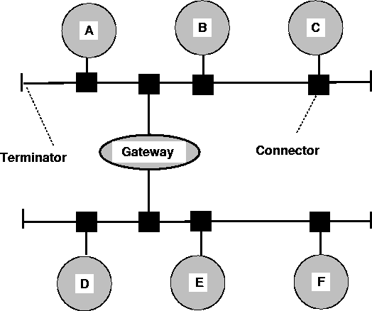
Gateway

Slide 24
Low-Level Communication Software
One big problem for high-performance communication in networked systems is excess copying of packets.
If copies to and from RAM dominate the performance, the extra copies to and from the kernel may double the end-to-end delay and cut the bandwidth in half.
To avoid this performance hit, some multicomputers map the interface board directly into the user space (no involvement of kernel), and allow the user process to put packets directly onto the board. However this approach has two problems:
  What if several processes are running on the node and need network access to send packets? Which one gets the interface board in its address space?
  Solution: Map the interface board into all processes that need it, but avoid race conditions, which needs synchronization mechanisms. Difficult!!! Hence, use this approach only if only one process needs the network board at the node.
  Kernel might need access to the network itself (e.g., to access file system). Having the kernel share the interface board with user is not a good idea. Solution: have two network interface boards, one mapped to user space for application traffic, one mapped to kernel space for OS traffic only.

Slide 25
User-Level Communication Software
Message passing paradigm is used : send and receive methods
  send(dest, &mptr) - sends message, pointed to by mptr, to destination dest. The sender blocks until the mesage is sent.
  receive(addr, &mptr) - receives message, pointed to by mptr. The receiver listens at the address addr (consisting of CPU number and a process or port number) for incoming messages. The receiver blocks until the message arrives.
Two types of calls
  blocking, also called synchronous calls. It means that while the message is being sent, the sending process is blocked (ie suspended). Similarly, a call to receive does not return control until a message has actually been received and put in the message buffer pointed by the parameter.
  nonblocking calls, also called asynchronous calls. It means if send is nonblocking, it returns control to the caller immediately, before the message is sent.
There are couple of choices on the sending side:
  Blocking send (CPU idle during message transmission)
  Nonblocking send with copy (CPU time wasted for the extra copy)
  Nonblocking send with interrupt ( programming difficult)
  Copy on write (extra copy probable needed eventually)

