Slide 1
CS323 Operating Systems
Multi-Computers/Distributed Systems
Yuanyuan Zhou
Lecture 34
4/23/2003

Slide 2
Content of this lecture
Reminder
  Conflict exam: Wed 5:30-6:30pm, DCL 2501
  Doctor’s notes
Distributed Systems vs. Network OS
RPC vs. RMI
Multi-processor (read textbook)

Slide 3
Distributed vs. Network Operating System
Network Operating System (NOS): a collection of software and associated protocols that allows a set of autonomous computers, which are interconnected by a computer network, to be used together in a convenient and cost-effective manner. Each host runs its own non-network operating system; the network is controlled by user programs running on each host.
  Typically used to interconnect large, architecturally diverse, and geographically dispersed autonomous systems.
  Analogy: United Nation
Distributed Operating System: A single, homogeneous operating system controls all hosts on the network, and the network itself; each host does not have an individual operating system of its own. The hosts are not ``autonomous'', as in an NOS.
  Typically used for local networks of mini- and micro-computers.
  Analogy: Federated Government

Slide 4
Network Operating Systems
Allow users to access the various resources (e.g., programs and data) on each network host.
Limit access to authorized users of each particular resource.
Make the network and the eccentricities of the host computers transparent to the users.
Make the use of remote resources appear to be identical to the use of local resources.
Provide uniform accounting procedures throughout the network.
Provide current network documentation on-line.
Provide more reliable operation than would be possible on a single host, especially over a group of equivalent hosts.

Slide 5
Distributed-Operating System
Users access remote resources as if they were local resources
  location transparency
Data Migration
  data moved to system needing it
Computation Migration
  program moved to system with appropriate data
Process Migration
  a process moves from one machine to another
Job Migration
  Job moves so as to balance load.
Control execution of multi-step jobs in which the several steps can be executed on different hosts.
Balance network load by moving jobs to underutilized hosts (assuming equivalent hosts).
Move jobs to the host best suited to each task (assuming non-equivalent hosts).

Slide 6
Distributed Communication - Sockets
Socket - endpoint for communication. A pair of processes or threads communicating over a network employs a pair of sockets.
Socket is made up of
  IP address
  port number.
Examples
  telnet server listens on port 23
  ftp server listens on port 21
  web server listens on port 80.
All ports below 1024 are well-known. Other applications can assign a port with an arbitrary number larger than 1024.
All connections must be unique, i.e., if another process on the same host wishes another connection with the same web server, it must be assigned a new port number larger than 1024. This ensures that all connections consist of a unique pair of sockets.

Slide 7
Java Sockets
Three different types of sockets:
  connection-oriented (TCP) sockets
    implemented with the Socket class
  connection-less (UDP) sockets
    implemented with the DatagramSocket class
  multicast socket
    implemented as MulticastSocket class

Slide 8
Socket Communication
Sockets use a client-server architecture.
  The server waits for an incoming client requests by listening to a specified port.
  Once a request is received, the server accepts a connection from the client socket to complete the connection.
Client socket
(146.86.5.2/1625)
Web server socket
(161.25.19.9/80)

Slide 9
Servers and Threads
Incoming requests
Server
Req 1
Req 2
Req 3
Req 4
Create a thread for each request to avoid blocking in a single thread

Slide 10
Time-of-Day Server
Try {
s = new ServerSocket(5155);
}

Slide 11
Time-of-Day Server
Try {
while (true) {
client = s.accept();
c = new Connection(client);
c.start();
} }

Slide 12
Client
Public class Client() {
try {
Socket s = new Socket(“127.0.0.1”,5155);
InputStrm in = s.getInputStrm();

Slide 13
Remote Procedure Call
RPC
  Parameters of RPC are marshaled into message
  Message sent and local process waits
  Remote machine receives message, spawns remote process
  Remote process assumes same protection domain as local process
  Remote process assembles parameters and makes procedure call
  Remote process marshals return parameters into message
  Message sent and remote process dies
  Local process resumes and unpacks result
Implementation: Client program must be bound with a small library procedure, called client stub that represents the server procedure in the client's address space. Similarly, the server is bound with a procedure, called the server stub. These procedures hide the fact that the procedure call from client to server is not local.

Slide 14
Java Remote Method Invocation
RPC with objects
Includes objects as parameters
Java Program
Remote invocation
Remote Object

Slide 15
RMI
Client has stub for remote object – proxy for the remote object
    Parcel - marshalling
Server has skeleton
  Unmarshals parameters
  Invokes method on remote machine

Slide 16
Parameter Passing Behavior
Local objects – object serialization (passed by copy)
Remote objects passed by reference
Local objects must implement java.io.Serializable

Slide 17
Finding Objects
Rmiregistry
  Remote object registers using Naming.rebind()
  Client obtains reference to a remote object using Naming.lookup()

Slide 18
Discussion
Advantage and disadvantage of RMI

Slide 19
Shared Object-Based Middleware
Desire to distribute systems written in C, C++, and other languages.
CORBA (Common Object Request Broker Architecture)
  Convenient mechanism to allow object communication over heterogeneous platforms
  allows applications written in different languages to communicate
Interface Definition Language (IDL)
  allows a distributed object to describe an interface to the services provided
  Independent of any specific programming languages
  The client obtains a reference for the remote object, and communicates with the interface specified with the IDL.
Object Request Broker (ORB).
  the client' stub communicates with the client's ORB. ORBs at the client and server communicate via the Internet InterORB Protocol (IIOP).
  The server ORB allows the server to register new CORBA objects and it is responsible for accepting requests from client ORBs.
  The server's skeleton is called, once the request arrives and the implementation of the remote method on the server is invoked.

Slide 20
CORBA MODEL
Reference to
CORBA object
CORBA object
Stub
Skeleton
ORB
ORB
IIOP

Slide 21
Distributed Shared Memory
What is DSM?
  Provide shared memory to applications on a cluster of machines each with their own memory
How?
  When a CPU does a LOAD or STORE on a page not in memory, trap to OS occurs.
  The OS locates the page, and asks the CPU currently holding it to unmap the page and send it over the interconnection network.
  When it arrives, the page is mapped in and the faulting instruction is restarted.
DSM might use large page sizes.
  Advantage: prefetching effect
  Disadvantage: Too large page sizes can cause false sharing.
Consistency: sequential vs. relaxed

Slide 22
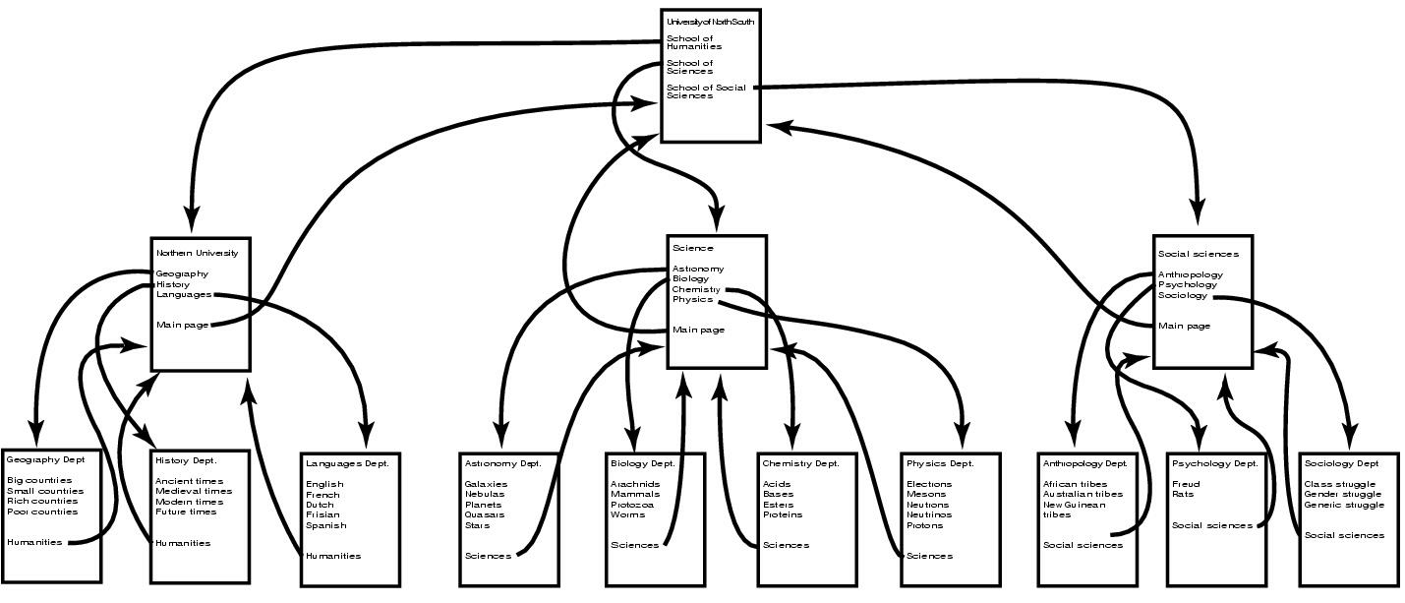
Document-Based Middleware (1)
The Web
  a big directed graph of documents

Slide 23
Document-Based Middleware (2)
How the browser gets a page
  Asks DNS for IP address
  DNS replies with IP address
  Browser makes connection
  Sends request for specified page
  Server sends file
  TCP connection released
  Browser displays text
  Browser fetches, displays images

Slide 24
Coordination-based Middleware
Linda System: Independent processes communicate via abstract tuple space.
  The tuple space is global to the entire system, and to the user, the tuple space looks like a global shared memory. The tuple space represents a shared information space which can be used for coordination.
Publish/Subscribe: This system consists of number of processes connected by a broadcast network.
  Each process can be producer or consumer of information. When a process has a new information, it publishes the information, ie, it broadcasts the information as a tuple on the network. Each tuple contains the hierarchical subject line containing multiple fields separated by periods. Processes which want to receive information, subscribe to certain subjects.
Jini: This system consists of a large number of self-contained Jini devices, each can offer one or more services.
  This system has lookup service and discovery protocol to find devices. If a new device wants to register, the lookup service responds with a piece of code in JVM. The registration is done for a fixed amount of time - this concept is called lease.

