Slide 1
CS323 Operating Systems
Security
Yuanyuan Zhou
Lecture 36
4/28/2003

Slide 2
Lessons from Midterm 2
What are the difference between
  Virtual memory
  Physical memory
  Disk
  File cache
Memory address translation vs. page faults
Memory accesses vs. I/O operations
  Is Inode related to Virtual memory?
  What’s the meaning of “memory space in disks”?

Slide 3
Content
9.1 The security environment
9.2 Basics of cryptography
9.3 User authentication
9.4 Attacks from inside the system
9.5 Attacks from outside the system
9.6 Protection mechanisms
9.7 Trusted systems

Slide 4


Question
How many Hollywood movies about security?
Notes:
A beautiful mind
Net
Mission Impossible

Slide 5
Total Approach to Security
External Security
User Interface Security -- Establishing user identification and access rights.
Internal Security -- Controls built into the hardware and software to ensure:
  Reliable and uncorrupted operation of the system.
  Integrity of programs and data

Slide 6
External Security
Physical Security --
  Protection against disasters
  Protection against intruders
Operational Security -- Policies and procedures implemented by the management of a particular computer installation.
  Authorization -- what access is allowed to what entities.
  Classification -- parcels the problem into subproblems.
  Data and users are divided into classes to which particular authorizations are granted.
  Personnel selection and assignment.
  Division of responsibilities.
  Built in controls -- checks and balances.
  Personnel should be unaware of the nature of the controls, but aware of the fact that the controls are present.

Slide 7
Internal Threats/Security
Data Confidentiality
  have secret data remain secret.
Data Integrity
  unauthorized used should not be able modify any data without the owner's permission.
System Availability
  nobody can disturb the system to make it unusable (e.g., make sure that denial of service does not occur).
Privacy
  the system protects individuals from misuse of information
The security system needs to protect against
  intruders (adversaries)
  accidental data loss

Slide 8
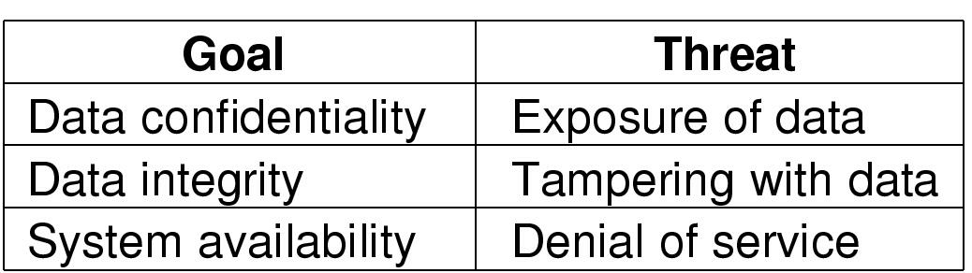
Internal Threats
Security goals and threats

Slide 9
Intruders
Common Categories
  Casual prying by nontechnical users
  Snooping by insiders
  Determined attempt to make money
  Commercial or military espionage

Slide 10
Accidental Data Loss
Common Causes
  Acts of God
    fires, floods, wars
  Hardware or software errors
    CPU malfunction, bad disk, program bugs
  Human errors
    data entry, wrong tape mounted

Slide 11
Encryption
A common method of protecting information transmitted over unreliable links.
Clear text Encryption Ciphertext
Ciphertext Decryption Clear text

Slide 12
Encryption
Encrypted M
D_{k}(E_{k}(M))
E_{k}(M)
M
E - Encryption Algorithm
D - Decryption Algorithm
k - key(s)
M- Message (clear text)
Alternative notation (public, private keys)
Encrypted M
D (k”,E (k’,M))
E (k’,M)
M

Slide 13
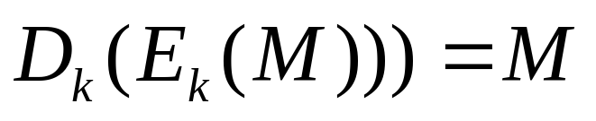
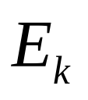
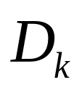
Encryption
An encryption algorithm satisfies:
  Both and can be computed efficiently.
  The security of the system depends only on the security of the key, and not on the security of the algorithms E and D.

Slide 14
Encryption Systems
Public Key Systems
Secure Secret Key Systems

Slide 15

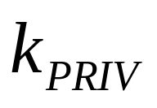
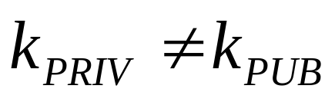
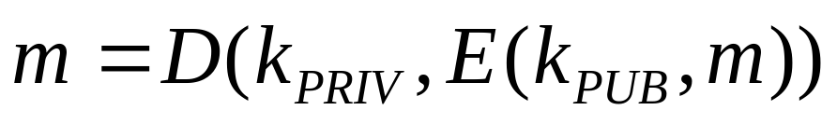
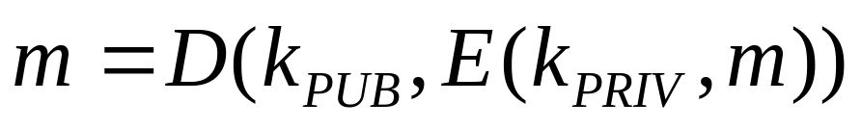
Public Key Systems
Use two keys:
  public key which is published by the user
  private key
The holder of can send an authenticated message to anyone because they can read the message using .
or

Slide 16
Public Key Systems
Example:
  B, C, D can all encrypt message for A using A's public key.
  If B encrypted message with A's public key
    A can read the message using A’s private key
    But C cannot decrypt it even if C knew that it was encrypted with A's public key.

Slide 17
Alternative: Secure Secret Key Systems
Use single key, called secret key which is shared between encryptor and decryptor (shared key).
These systems are called Symmetric Systems.
Example: Data Encryption Standard DES is an example of a shared key.

Slide 18
Symmetric Systems
Advantages:
  Symmetric systems provide a two-way channel to their users;
    Is public key system symmetric?
  As long as the key remains secret, the system also provides authentication.
Problems:
  If the key is revealed, then interceptor can immediately decrypt and encrypt information.

Slide 19
Symmetric Systems Challenges
Distribution of keys
  Before communication takes place, the secret keys must be sent securely to both the sender and receiver.
  Couriers are used to distribute keys
  Split key in pieces and distribute pieces under separate channels (Clipper program uses a 2 pieces key distribution).
Number of keys increases in square with number of people
  Why in square?
  Solution: Use Clearing house or forwarding office

Slide 20
DES: Data Encryption Standard
Lucifer algorithm from IBM - 1974
It uses two main operations:
  Substitution
  Permutation (Transposition).
It derives its strength from repeated application of these two techniques - total 16 cycles.
Plaintext is encrypted as blocks of 64 bits
  Key is 64 bits long, however in effect it is only 56 bits long because of 8 parity bits.

Slide 21
DES
Algorithm is derived from two concepts of Shannon's theory of information secrecy:
  Confusion: a piece of information is changed, so that the output bits have no obvious relationship to the input bits.
  Diffusion: attempts to spread the effect of one plaintext bit to other bits in the ciphertext,
Substitution provides confusion by systematically substituting some bit patterns for others.
  “Hello” → “Ifmmp”
Permutations provide diffusion by reordering bits.
  “Hello” → “elloH”

Slide 22
Questions about DES
Number of Iterations (do we need 16?)
Key length (In original Lucifer the key was 128 bits long)
Attack: brute force, then to test all keys (2^56 ) one needs:
  228 million years if one test of the ciphertext takes 100 ms., 2,280 years if one test takes 1 ms., 2 years if one test takes 1 ns.

Slide 23
Questions about DES
Parallel attack:
  need 106 chips working in parallel at the rate of one key per 1 microsecond, then it takes 1 day. However, the cost of such a machine 50 Million dollars.
  Use spare cycles in the Internet?
    Peer-to-peer computing
    Grid computing

Slide 24
Distribution of Keys using Symmetric Keys
S1K
S1K
SK
SK

Slide 25
Distribution of Keys using Symmetric Keys
S1K
S1K
SK
SK, MK
E(SK,MK)

Slide 26
Distribution of Keys using Symmetric Keys
S1K
E(S1K,MK)
S1K
SK
MK
SK, MK

Slide 27
Distribution of Keys using Symmetric Keys
S1K, MK
S1K
E(MK,M)
SK
MK
SK, MK

Slide 28
Asymmetric Keys
Advantages:
  Authentication –knowledge of private key
  Privacy – use public key of recipient
  Key distribution easy
Problems:
  Slower than symmetric keys

Slide 29
Rivest-Shamir-Adelman (RSA) Encryption
RSA uses two keys: d and e with integer n.
  pair (e,n) will be the public encryption key;
  pair (d,n) will be the private key.
Message m is encrypted as follows: E(m) = (m^e) mod n = C,
Message m will be decrypted as follows: D(C) = (C^d) mod n

Slide 30
RSA Encryption
Goal: ((m^e)^d)mod n = m
n is computed as product of two large primes n = p * q (100 or larger)
d is random integer such that: greatest common divisor gcd(d, (p-1)*(q-1))=1
e satisfies e*d mod (p-1)*(q-1) = 1
Key n is publicly known, its factors are difficult to calculate.
  What are p and q for 10403

Slide 31
RSA Encryption
Example: e=11, n=35, and let assume m=3;
Assume p=5, q = 7. Then gcd(d,24)= 1 and 11*d mod 24 = 1 are satisfied if d=11
E(m) = m^11 mod 35, D(C) = C^11 mod 35.
E(3) = 12 = C, D(12) = 3.
Another example: D(5) = 10, E(10) = 5.

Slide 32
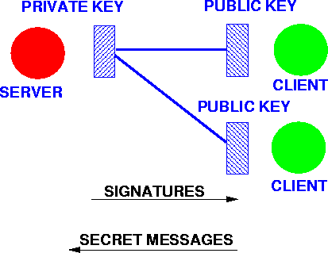
Private and Public Keys
Given the public key system, if a trusted server exists in the system, then it can be can be used to provide access to other services securely.
The server can receive secure messages from clients by publishing its ``public key''.
The clients encrypt using the public key, but no other client can decrypt the message.

Slide 33
Private and Public Keys
  The server can sign messages to the clients by encrypting the message with its private key. No other client can send such a message. All clients can decrypt the signed message and know it comes from the server.
  The server can sign a message in the clear by sending a check sum of the message encrypted with its private key. Clients can authenticate the message by computing its checksum and comparing it with the encrypted value received.

Slide 34
Key Exchange using Asymmetric Keys
Given the public key system, if a trusted server exists in the system, then it can be used to provide access to other services securely.
Send an encrypted message to the trusted server TS using its public key and include a public key for the client requesting access to service.
Similarly for servers S, send a message to the trusted TS server including an S server public key
The TS trusted server encrypts the S server public key with the clients key and sends a message containing it back to the client

Slide 35
Encryption and Authentication
Only the client can decrypt the message to get the public key of the S server. It knows it came from the TS trusted server
The client can now encrypt a message and send it directly to the S server with the S server's public key, only known to the client and TS trusted server

Slide 36
Key Exchange
Server
E1K’
(E1K’,E1K”)
Exchange
Client

Slide 37
Key Exchange
E1K’
Server
E1K’
(E1K’,E1K”)
Exchange
Client

Slide 38
Key Exchange
(SK’,SK”), E1K’
Server
(E1K’,E1K”)
Exchange
Client

Slide 39
Key Exchange
(SK’,SK”), E1K’
Server
E(E1K’,SK’)
(E1K’,E1K”)
Exchange
Client

Slide 40
Key Exchange
(SK’,SK”), E1K’
Server
(E1K’,E1K”)
Exchange
(EK’,EK”)
SK’
Client

Slide 41
Key Exchange
Server
(E1K’,E1K”)
Exchange
(EK’,EK”)
EK’
Client

Slide 42
Key Exchange
Server
(E1K’,E1K”)
Exchange
(EK’,EK”)
CK’, SK’
Client
E(EK’, CK’)
(CK’, CK”), EK’

Slide 43
Key Exchange
(SK’,SK”), E1K’
Server
(E1K’,E1K”)
Exchange
(EK’,EK”)
E(CK’,SK’)
CK’, SK’
Client
(CK’, CK”), EK’

Slide 44
Key Exchange
(SK’,SK”), E1K’
Server
(E1K’,E1K”)
Exchange
E(SK’,CK’)
(EK’,EK”)
CK’, SK’
Client
(CK’, CK”), EK’,SK’

Slide 45
Key Exchange
(SK’,SK”), E1K’
Server
(E1K’,E1K”)
Exchange
E(CK’,M)
E(SK’,M)
(EK’,EK”)
CK’, SK’
Client
(CK’, CK”), EK’,SK’

Slide 46
Issues
Any client can replay an earlier communication, even if the client cannot decode the message in the communication.
  Some mechanism is needed to make sure communications are fresh! A signed timestamp or message count is often used.
The server has no way of knowing who a client is.
  The client needs to have some password or secret it can show to the server. A signed message indicating who the client is and using a different public key for the signature is often used. See CS423.

Slide 47
Distribution of Shared Keys Using Public Keys
A client may have a two way secure communication with a trusted server if the trusted server publishes a public key.
The client sends a shared key to the server, encrypted with the public key.
The client and server may exchange secret messages using the shared key.

Slide 48
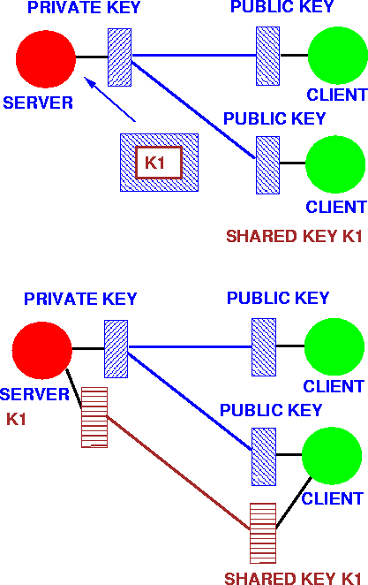

Slide 49
Issues
Once again freshness and client identification is an issue.
Also, using the same key over and over again may allow other clients to decode the messages.

Slide 50
Setting up private communications between Clients
  A client may establish two way secure communication with another client through a server
  The client sends a shared key to the server using the server's public key
  The other client sends a shared key to the server using the server's public key
  If the first client wants to talk to the second client, the server sends the first client's shared key to the second client

Slide 51
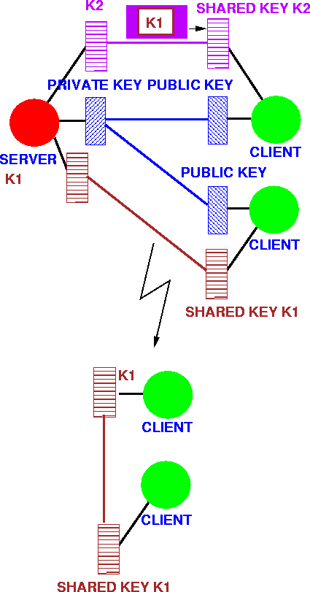

Slide 52
Issues
Once again, freshness and client identification is an issue.
Also, both the server and the other client know the key.
It is better to use a third key for the communication rather than the two shared keys used to communicate with the server.

Slide 53
Summary
Symmetric
Asymmetric
Authentication
Privacy
Key Exchange

