Slide 1
CS323 Operating Systems
Security
Yuanyuan Zhou
Lecture 38
5/2/2003

Slide 2
Reminder
Conflict exam signup
Graduate students 1-unit project
Senior thesis, under-graduate research, independent study

Slide 3
Content of this lecture
Security Flaws in Operating Systems
Attacks on O/S Security
Viruses and Worms

Slide 4
Discussion
How do you break into the machine in DCL 1320?

Slide 5
Security Flaws in Operating Systems
Authentication
  E.g., a dummy program, pretending to be the signon program, asking for the user's password and then storing it.
Line disconnect
  When a line is disconnected with a user logged in over it, the system must either log the user out, or at least put the line in a state in which the user must re-authenticate his identity after reconnecting before proceeding with the session.
Operator carelessness
  E.g., tricking the operator into mounting a counterfeit operating system disk..
Residue
  Interesting information often turns up in wastebaskets; use paper shredders! Information is often left in central memory from a previous user, possibly a system routine; variables that contain sensitive information should be overwritten before they are deallocated!
Shielding
  One can inductively ``tap'' a cable, phone line, or in fact any wire over which information passes, without making physical connection to it. Electrical shielding can protect against this.
Passwords
  Password guessing, etc.

Slide 6
Bugs
Legality checking
  The system may fail to check parameters supplied by the user in calling system procedures.
Implicit trust
  One routine assumes that parameters passed to or shared with another routine are correct; each routine ought to check parameters supplied by another.
Prohibitions
  Features which are advertised not to work, or not to work correctly, but which are still executable, with ``interesting'' results.
Implementation
  An improper implementation of a well thought out design for a security mechanism.

Slide 7
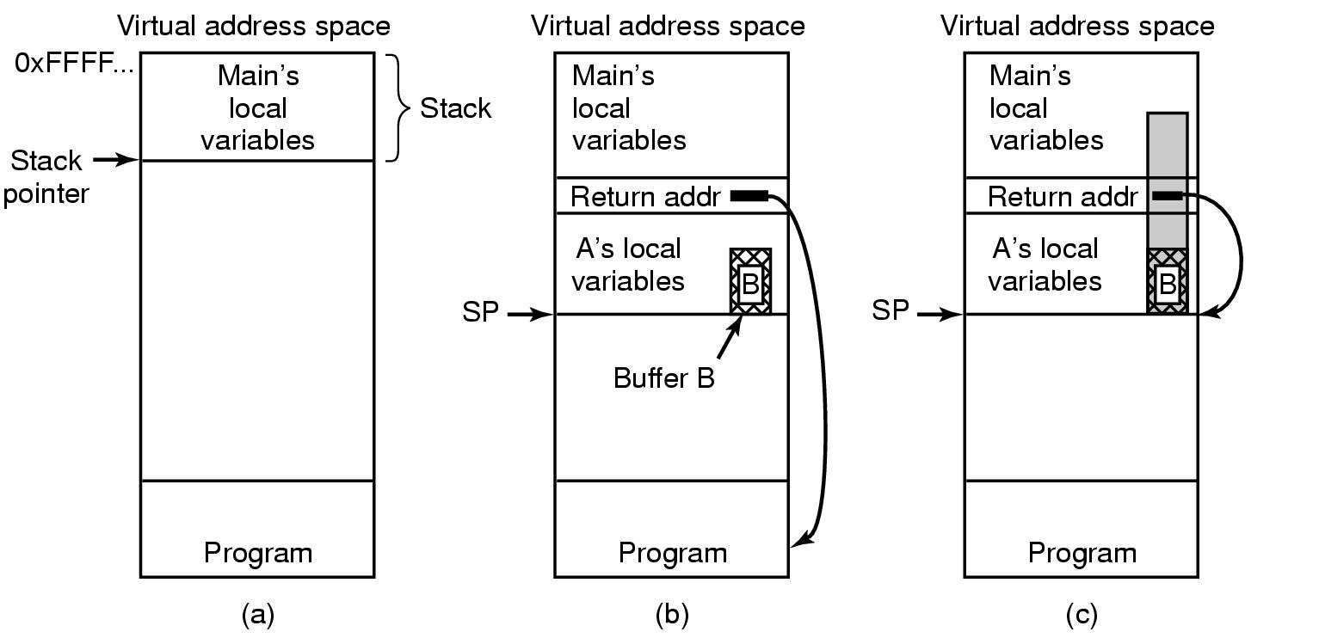
Buffer Overflow
(b) After program A called
(a) Situation when main program is running
(c) Buffer overflow shown in gray

Slide 8
Design Weaknesses
Encryption
  Lack of encryption of the password file or other security codewords.
Implied sharing
  The system may deposit critical information in a user's space.
Parameter passing
  by reference or by value. Passing by reference offers the possibility that the user may present valid arguments for checking, and then modify them just before their use by the system.
Inter-process communication
  Use of a send / receive mechanism to test possibilities, e.g., to test for a correct password.

Slide 9
Classic Problems
Privilege
  Systems may give programs and/or users more privilege than they need. Principle of Least Privilege
Trojan Horse
  Executing a program written by someone else could use the executor's privileges to send information to the penetrator, or to damage the executor's files, or to open a hole into which the penetrator may later enter.

Slide 10
Attacks from Inside of the System
Trojan Horse
  seemingly innocent program contains code to perform an unexpected and undesirable function.
Examples
  Modifying, deleting or encrypting the user file; copying them into a place where cracker can retrieve them later, or even sending them to the cracker via email of FTP.
One approach to do this is to place the program as a free, exciting new game, MP3 viewer, or something that attracts attention.
The Trojan horse approach does not require the user to break into the computer.

Slide 11
Other Inside Attacks
Login Spoofing
  attacker writes a false login program that displays on the screen login prompt. This program asks for name, password, user types in login name and password. The false information is written to a file and the phony login program sends a signal to kill the shell. This action logs the attacker out and triggers the real login program. The user assumes that he.she wrote the wrong password and repeats the steps.
Logic Bombs
  build in bad behavior (e.g., erase a disk) into operating system if certain action is not taken. For example, as long the programmer feeds in a password every day, the behavior is not visible. When a programmer is fired, the password is not given and the bad behavior is triggered.
Trap Doors
  code is inserted into the system by the system programmer to bypass some normal check. For example, a login program could be written which allows a user to login independent of what password he/she types. The trap-door bypasses the whole authentication process.

Slide 12
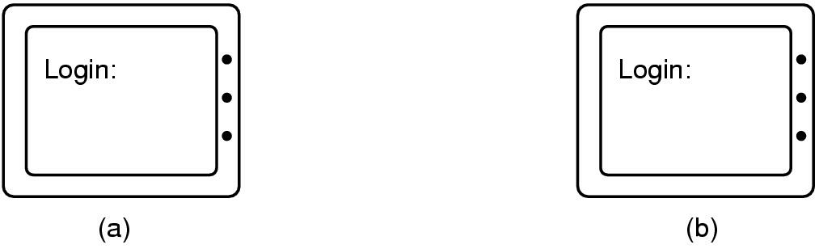
Login Spoofing
(a) Correct login screen
(b) Phony login screen

Slide 13
Logic Bombs
Company programmer writes program
  potential to do harm
  OK as long as he/she enters password daily
  if programmer fired, no password and bomb explodes

Slide 14
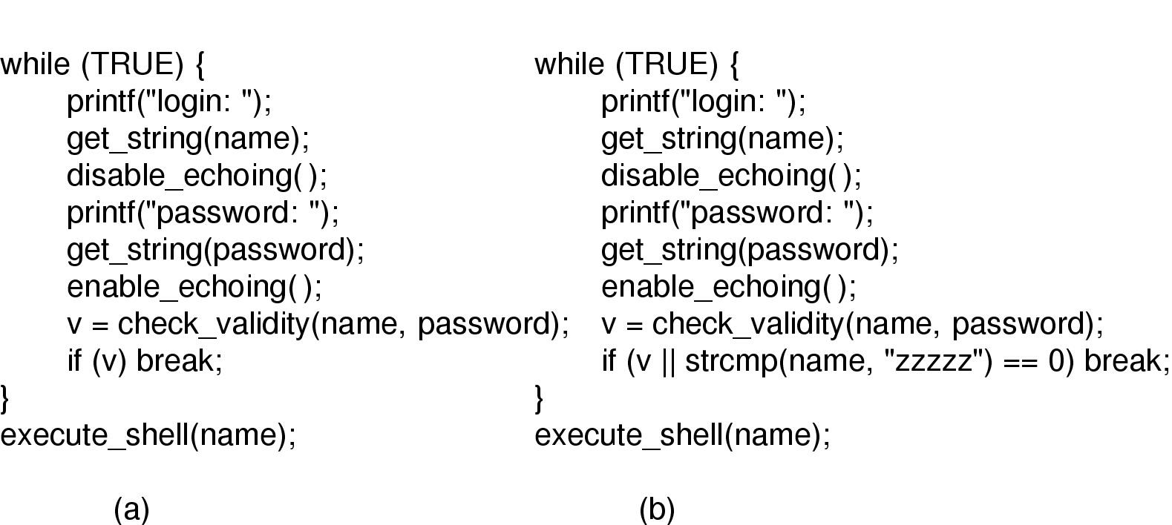
Trap Doors
(a) Normal code.
(b) Code with a trapdoor inserted

Slide 15
Other Inside Attacks on O/S Security
Asynchronism
  One process modifies the arguments another process has passed to an operating system procedure after they have been tested for validity but before they have been used.
Browsing
  A user searches the system simply trying things, looking for privileged information.
Between lines
  A user taps into a line being used by an inactive but logged-in terminal.
Clandestine code
  A patch is made to the system which, instead of or in addition to doing what it is supposed to do, provides a hole that a penetrator can use later.

Slide 16
Other Inside Attacks on O/S Security
Denial of access
  A user writes a program to deliberately crash the system, send it into an infinite loop, or otherwise disrupt use of it by legitimate users.
Disconnected lines
  A penetrator tries to find an incoming line that disconnected while someone was logged in using it.
Masquerade
  A penetrator assumes another user's identity, typically by stealing his password.
NAK attack
  The system may be vulnerable when a running process is interrupted (NAK, Negative Acknowledgment, Û, sometimes used as the interrupt key).
  A penetrator might be able to catch the system in an unprotected state during interruption, and thus seize control.

Slide 17
Network Security
External threat
  code transmitted to target machine
  code executed there, doing damage
Goals of virus writer
  quickly spreading virus
  difficult to detect
  hard to get rid of
Virus = program can reproduce itself
  attach its code to another program
  additionally, do harm

Slide 18

Virus Damage Scenarios
Blackmail
Denial of service as long as virus runs
Permanently damage hardware
Target a competitor's computer
  do harm
  espionage
Intra-corporate dirty tricks
  sabotage another corporate officer's files

Slide 19
How Viruses Work (1)
Virus written in assembly language
Inserted into another program
  use tool called a “dropper”
Virus dormant until program executed
  then infects other programs
  eventually executes its “payload”

Slide 20
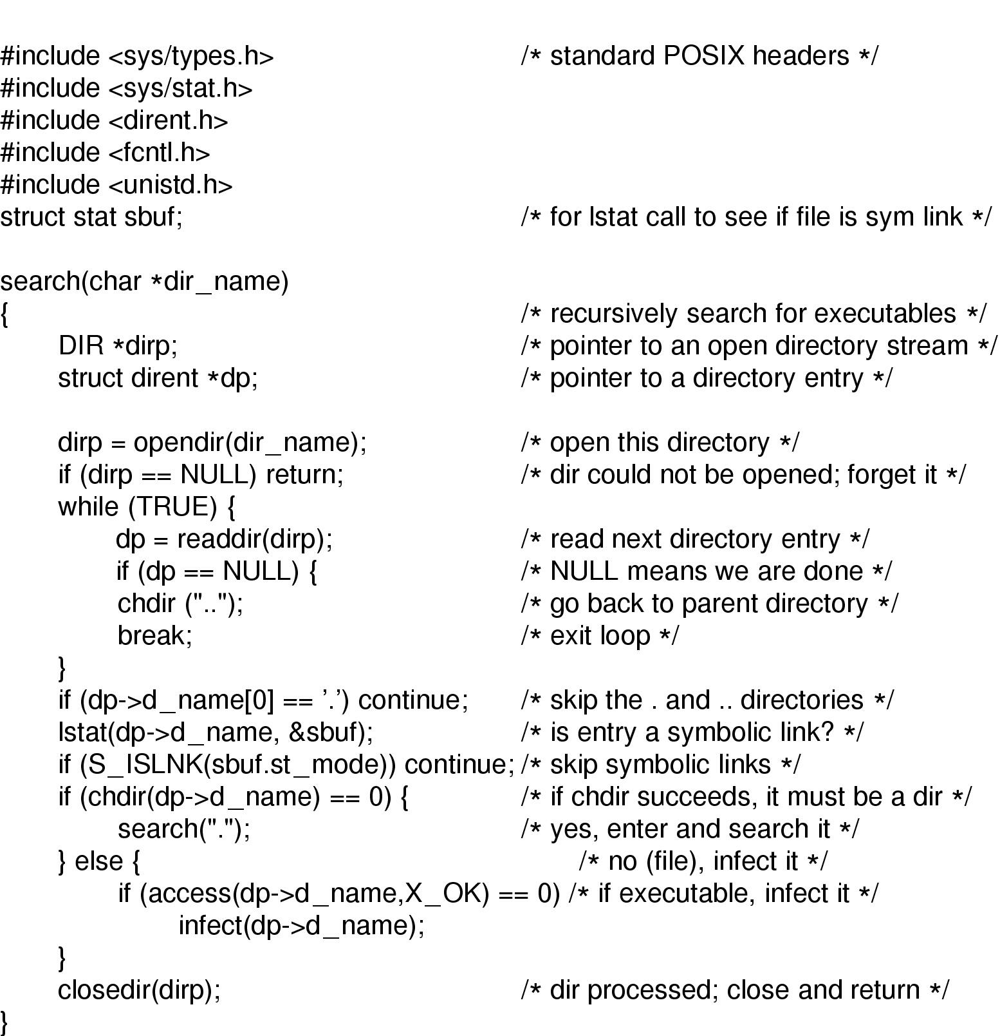
How Viruses Work (2)
Recursive procedure that finds executable files on a UNIX system
Virus could
infect them all

Slide 21
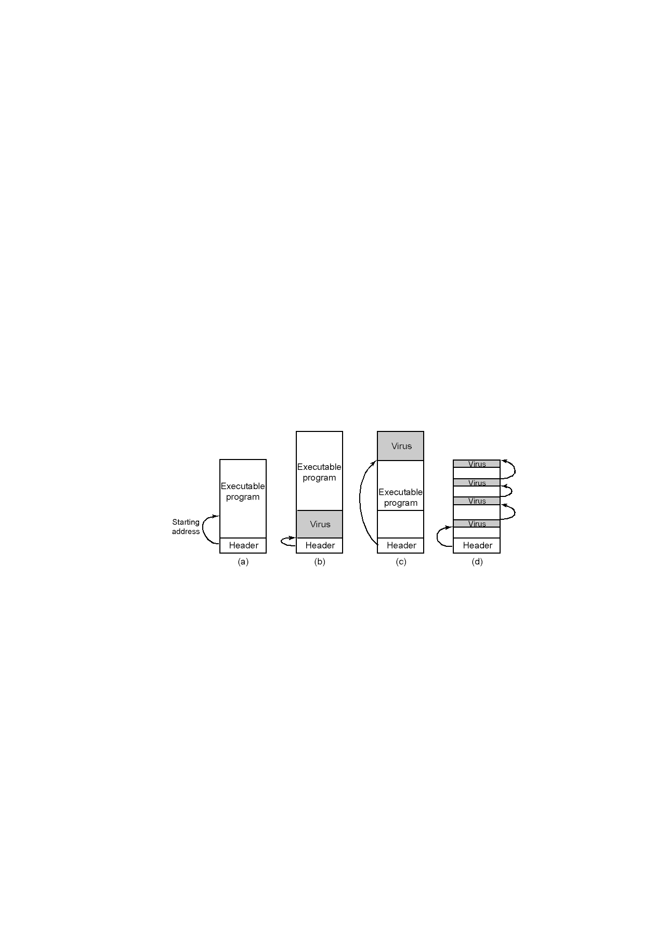
How Viruses Work (3)
An executable program
With a virus at the front
With the virus at the end
With a virus spread over free space within program

Slide 22
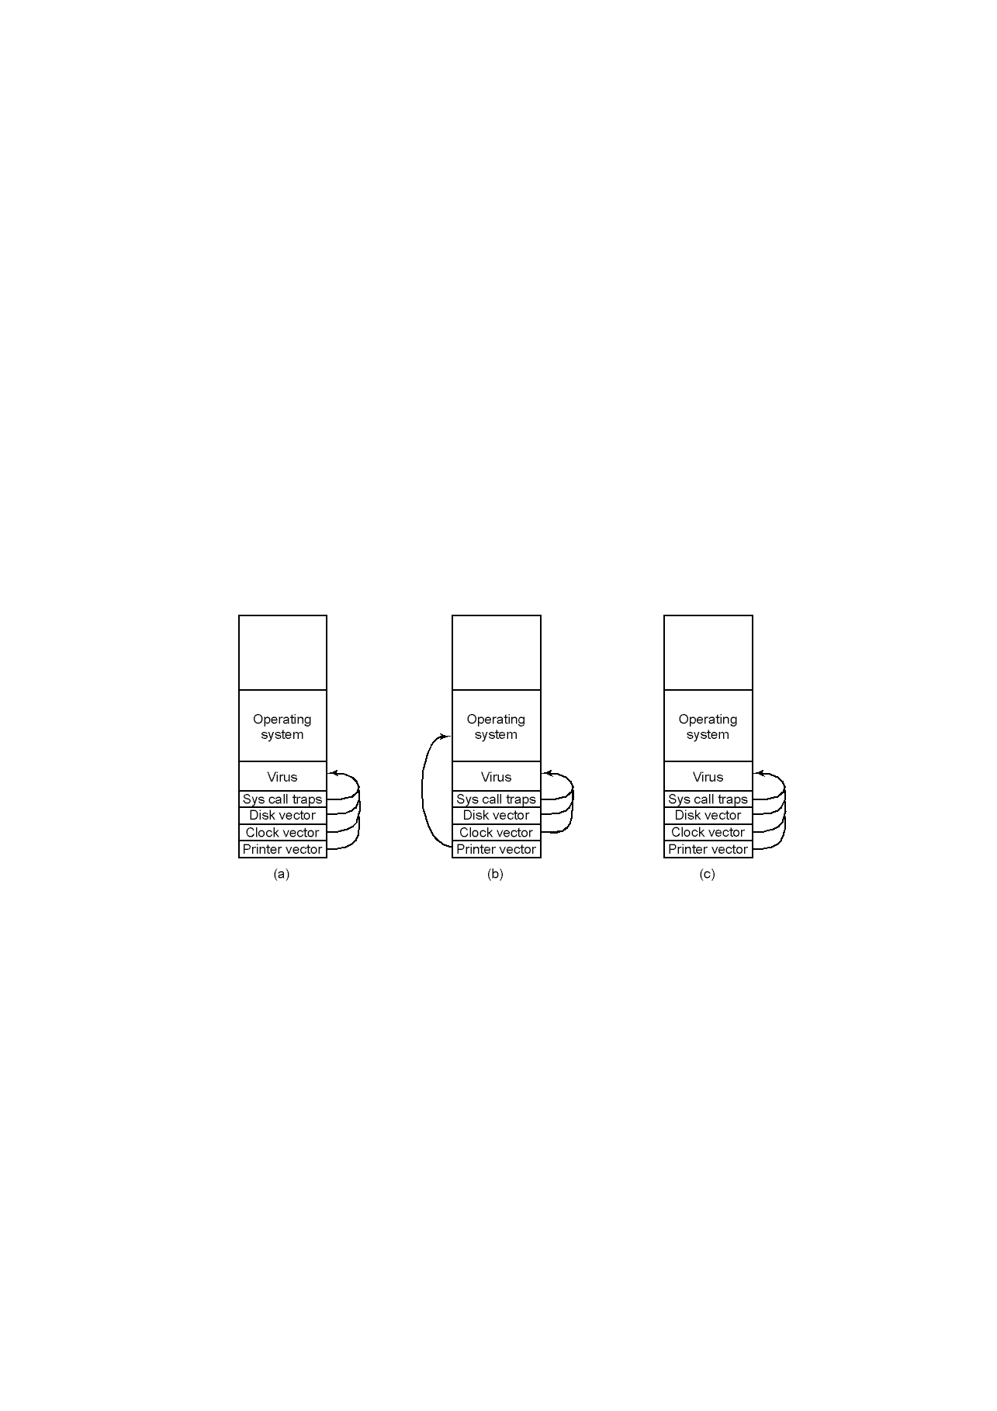
How Viruses Work (4)
After virus has captured interrupt, trap vectors
After OS has retaken printer interrupt vector
After virus has noticed loss of printer interrupt vector and recaptured it

Slide 23
How Viruses Spread
Virus placed where likely to be copied
When copied
  infects programs on hard drive, floppy
  may try to spread over LAN
Attach to innocent looking email
  when it runs, use mailing list to replicate

Slide 24
Antivirus and Anti-Antivirus Techniques
Integrity checkers
Behavioral checkers
Virus avoidance
  good OS
  install only shrink-wrapped software
  use antivirus software
  do not click on attachments to email
  frequent backups
Recovery from virus attack
  halt computer, reboot from safe disk, run antivirus

Slide 25
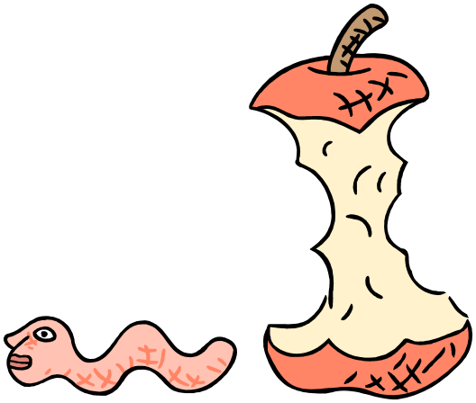
The Internet Worm
Free-standing program designed to travel between systems for some particular purpose.
Consisted of two programs
  bootstrap to upload worm
  the worm itself
Worm first hid its existence
Next replicated itself on new machines

