Slide 1
CS323 Operating Systems
Security
Yuanyuan Zhou
Lecture 39
5/5/2003

Slide 2
Reminder
Conflict exam signup: by noon
Graduate students 1-unit project
Last lecture
  Very condensed brief review: main taken-aways from this class
  Graduate student 1-unit project demo/presentation
    Survey/code is due the same day

Slide 3
Content
Goals of Protection
Mechanisms and Policies
Protection Domain
Access Matrix
Implementation of the Access Matrix
Access Lists
Capability Lists
Mixed Approaches: Locks and Keys
Summary

Slide 4
Protection Domain
A computer system is a set of processes and objects
Processes and objects have unique names
Objects are abstract data types with well-defined operations
A process operates within a protection domain
A protection domain specifies the resources a process may access and the types of operations that may be invoked on the objects.
The Principle of Least Privilege Need to know: The protection domain of a process should be as small as possible consistent with the need of that process to accomplish its assigned task.

Slide 5
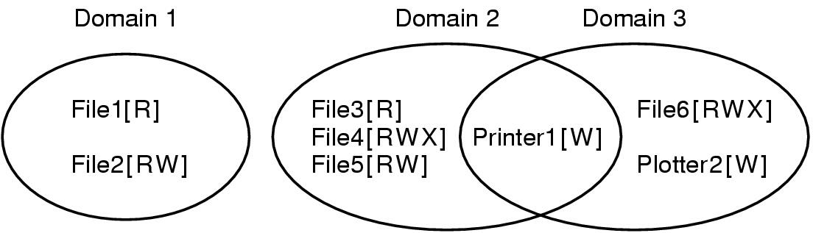
Protection Mechanisms
Protection Domains
Examples of three protection domains

Slide 6
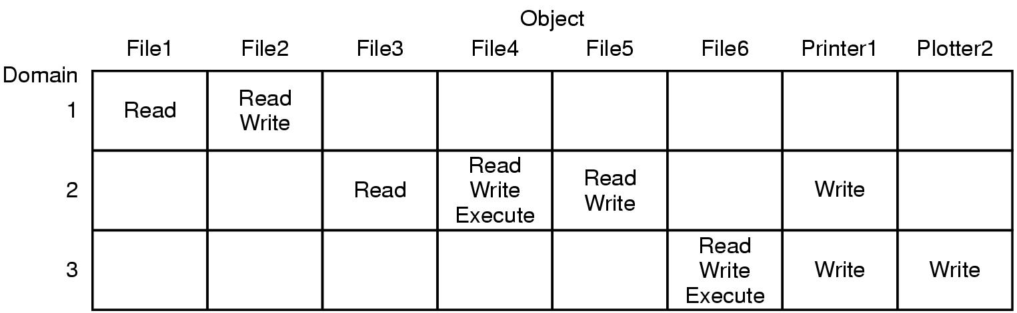
Access Matrix

Slide 7
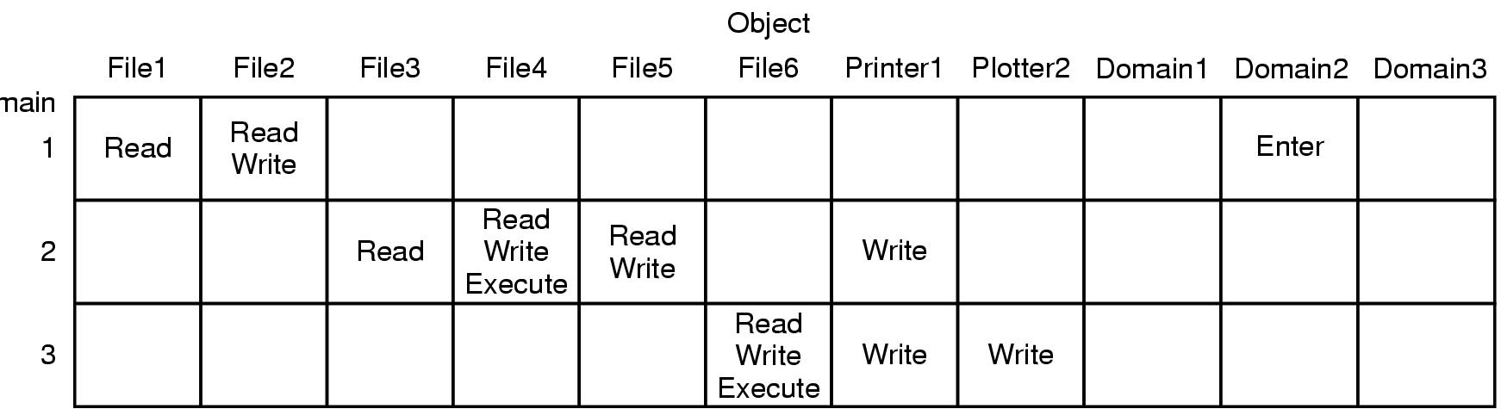
Access Matrix with Domains as Objects

Slide 8
Implementation of the Access Matrix
Global Table - assume <D, O, R>
  On invocation of a method R on an object O by a process P running in a domain D , the table Domain column is searched for D,
  the Object row is searched for an entry O,
  the entry at the intersection* of the row and column is searched for the method R.
Table may be Sparse
Table may be too large to store in main memory (use virtual memory - overhead)
Objects that may be accessed from every Domain need to be entered in every row
Needs a searching operation
In parallel or distributed system, access to table may be bottleneck

Slide 9
Copy Rights
The access matrix is an object that can be changed
The copy right allows an access right to be copied into the same column of other rows in the matrix.
Variants:
  copy: the right and copy right is copied
  transfer: when a right is copied from one Domain to another, the old Domain loses the right.
  limited copy: a right can be copied, but not the right to copy.
  copy right: the right to copy a copy right is a separate right

Slide 10
Access Lists
Each column in the access matrix is implemented as an access list for one Object.
  On invocation of a method R on an object O by a process P running in a domain D,
  the access is dereferenced to the Object O
  the access list is searched for D,
  the methods are searched for an entry R.
Empty entries in Access Matrix can be discarded.
Storage for access lists is proportional to the number of Objects
A default can be associated with an access list so that any Domain not specified in the list can access the Objects using default methods.
It is easy for the owner of the Object to grant access to another Domain or revoke access.
It is easy to determine which processes can access an object.
However, all processes can find out that the Object exists.
ACL entries can be for individual users or for a group of users.

Slide 11
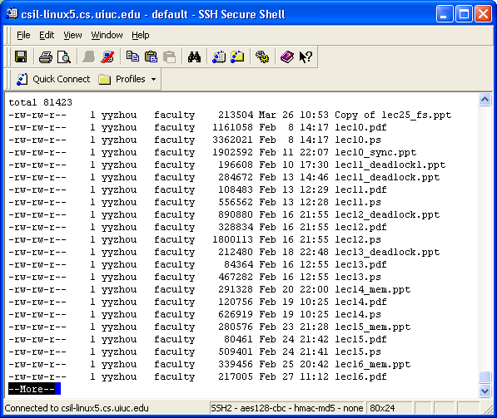
Access List Example

Slide 12
Implementations of Access Lists
File Systems
  Opening a file is checked against an access list to determine if a process may open the file with a given set of access methods.
Login Shells
  The login to a system is checked against an access list (usually the password file owned by root).
  Rlogins are checked against an .rhost file that contains the names of machines from which a rlogin is permitted.

Slide 13
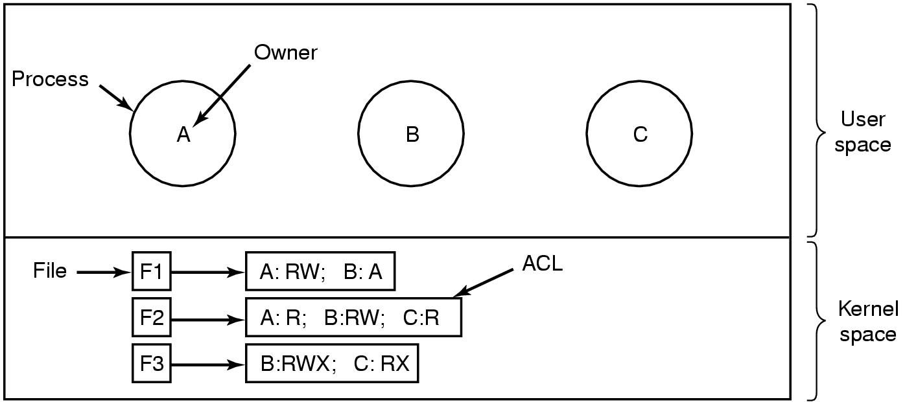
Access Control Lists (1)
Use of access control lists of manage file access

Slide 14
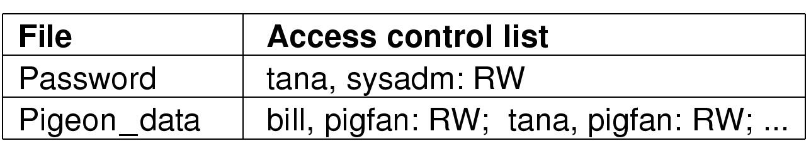
Access Control Lists (2)
Two access control lists

Slide 15
Capability Lists / C-Lists
Each row in the access matrix is implemented as a capability list for each Domain.
  On invocation of a method R on an object O by a process running P in a domain D,
  the capability list C is searched for O ,
  the methods are searched for an entry R .
Empty entries in Access Matrix can be discarded.
Rather than search, a reference to an object can be treated as an index operation into the capability list.
A capability is then just a "protected pointer".

Slide 16
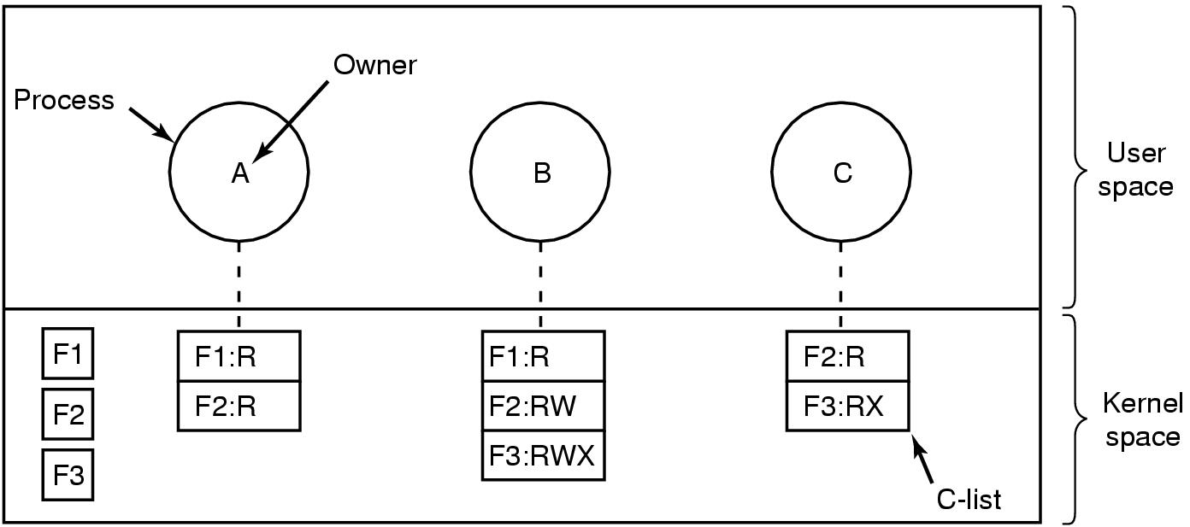
Capabilities
Each process has a capability list

Slide 17
More on Capability Lists
Having a capability to an Object is equivalent to having access permission for that object.
A process executing in a Domain cannot modify the Domain's capability list because of security integrity.
An application executing in a Domain can be provided just the capabilities it needs to execute its intended task - enforcing the Principle of Least Privilege.
Processes cannot "look around" the system and see Objects they cannot access.
Once granted, a capability is more difficult to revoke.
Capabilities can be transmitted from one Domain to another in a distributed manner, without the owners permission, and without having to access the Object

Slide 18
Capability Implementations
Virtual Memory
  A segment is a capability
  It is protected from the user and can only be changed by the kernel running in supervisor state
  It defines an object that can be accessed
  Having the segment permits access.
UNIX File System
  Each entry in the per process open file descriptor table is a capability.
  It is protected and can only be changed by the kernel.
  Having an open file descriptor permits access.
  This example shows how access lists can be used to achieve simple management of protection and capabilities used to provide efficient access methods.

Slide 19
Capability Machines
Tagged Architectures
  All data items are tagged
  A capability has a capability tag
  A process running in a Domain may not change the contents of a capability.
  The capability contains a pointer to the Object to which it refers
Segmented Architectures
  A read-only segment is used to store capabilities
  Capabilities are pointers to segments
Architectures with Segment Registers
  The kernel keeps a capability list consisting of segments (can use either approach 1 or 2 above.)
  When a capability is exercised, a segment register is loaded with the segment to be accessed.

Slide 20
Discussion
Tradeoff between Access-list and capability list
  Give an example for which an access-list should be used
  Give an example for which an capability-list should be used
Hints:
  In what cases, access-list takes more space
  Which one is easier to delete an object?
  Which one is easier to delete a domain?
  Access-list is faster for what operations? Similarly, capability-list is faster for what operations?

Slide 21
Revocation
Removing access rights to objects from users.
Immediate/delayed.
  Can revocation take place or is it delayed? For example, removing a UNIX file in a directory.
Selective/general.
  When an access right is removed, does it effect all users. In UNIX file system, for example, it effects either others or group or both?
Partial/total.
  Can a subset of rights associated with an object be revoked\? For example, login
Temporary/permanent.
  Can access be removed for a short while and then returned? If root breaks a hard link in the UNIX file system, it cannot be repaired.

Slide 22
Implementation of Revocation with Capabilities
Re-acquisition.
  Capabilities expire. The Domain must re-acquire them after a period, allowing delayed revocation.
Back-pointers.
  Objects keep back pointers to the capabilities that point to them. Costly.
Indirection.
  Capabilities go indirect through a global table. The entry in the global table can be removed, invalidating the capability. It does not allow selective revocation.
Keys.
  A key is kept with the capability and compared with a key stored with the object. On access, if the keys match, the access is permitted. The key in the object can be changed.

