Slide 1
CS323 Operating Systems
Process
Yuanyuan Zhou
Lecture 3
1/27/2003

Slide 2
Content of this lecture
Administrative announcements
What is a process?
Information in a process
Summary

Slide 3
Administrative
Nacho tutorial tonight, same room, 7pm (double check the newsgroup)
Test quiz available
Read Chapter 2
  Wednesday: threads
  Friday to next Wed: CPU Scheduling
  Next Friday: Process Synchronization

Slide 4
Mid-term Reschedule (conflict with 321)
1/27-1/31, 5pm CDT | Quiz0 (test quiz)
2/3-2/7,5pm CDT | Quiz1
2/24-2/28, 5pm CDT | Quiz2
3/10, Monday, 7-7:50pm, 1320 & 1310 DCL | Mid-exam1
3/17-3/21, 5pm CDT | Quiz3
4/7-4/11,5pm CDT | Quiz4
4/21, Monday, 7-7:50pm, 1320 & 1310 DCL | Mid-exam2
4/28-5/2 5pm CDT | Quiz5
5/10, 11:59pm CDT | Final-exam
Sorry, no more future
reschedule!!
No class on 3/10 (9-10am)
No class on 4/21 (9-10am)

Slide 5
OS: A Friendly Deception
A simple extended machine
Manage resources
Drawback? Maybe lots of extra work
Benefit: makes life easier for user

Slide 6
Users, Programs, Processes
Users have accounts on the system
Users launch programs
  Many users may launch same program
  One user may launch many instances of the same program
Processes: an executing program

Slide 7
Analogy
Program: steps for attending the lecture
  Step1: walk to DCL
  Step2: enter 1320
  Step3: find a seat
  Step4: listen and take notes (or sleep)
Process: attending the lecture
  Action
  You are all in the middle of a process

Slide 8
Programs As Process Collections
Netscape (output of “ps x”)
  7253 p0 S 0:19.26 /usr/local/lib/netscape/communicator-4.75.bin -irix-s
  7280 p0 I 0:00.15 (dns helper) (communicator-4.7)
gcc (via “gcc –pipe –v”)
  /usr/libexec/cpp |
  /usr/libexec/cc1 |
  /usr/libexec/as, followed by
  /usr/libexec/elf/ld

Slide 9
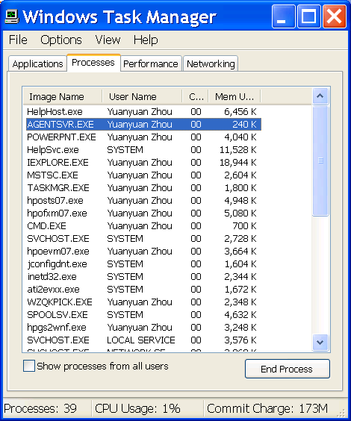
Windows Task Manager

Slide 10
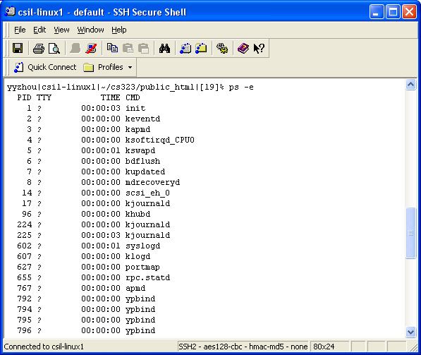
Unix Example: ps

Slide 11
Process Creation
System initialization
  reboot
Execution of a process creation system call
  Fork()
User request to create a new process
  Command line or click an icon
Initiation of a batch job
  cron

Slide 12
Process Termination
Normal exit (voluntary)
  End of main()
Error exit (voluntary)
  exit(2)
Fatal error (involuntary)
  Divide by 0, core dump
Killed by another process (involuntary)
  Kill procID, end task

Slide 13
Process Hierarchies
Parent creates a child process, a child process can create its own processes
Forms a hierarchy
  UNIX calls this a "process group"
Windows has no concept of process hierarchy
  all processes are created equal

Slide 14
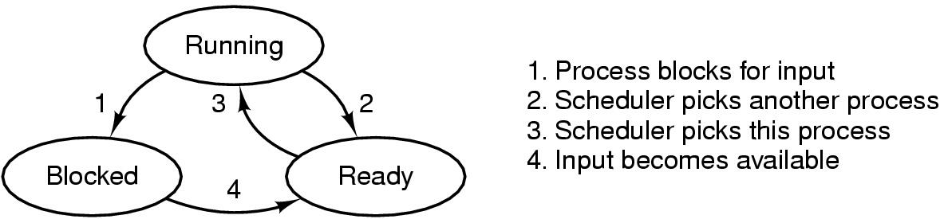
Process States
Possible process states
  Running (occupy CPU)
  Blocked
  Ready (does not occupy CPU)
  Other states: suspended, terminated
Transitions between states
Question: in a single processor machine, how many process can be in running state?

Slide 15
Group Discussion (2 minutes)
Using “working on a MP” as an example
  What corresponds to “running”?
  What corresponds to “blocked”?
  What corresponds to “ready”?
Why not the following transitions
  Ready to blocked
  Blocked to running

Slide 16
So What Is A Process?
It’s one executing instance of a “program”
It’s separate from other instances
It can start (“launch”) other processes
It can be launched by them

Slide 17

The Process Model
Multiprogramming of four programs
Conceptual model of 4 independent, sequential processes
Only one program active at any instant
Real life analogy?
  A daycare teacher of 4 infants

Slide 18
So What’s In A Process? And Why?
Process State
  new, ready, running, waiting, halted;
Program Counter
  the address of the next instruction to be executed for this process;
CPU Registers
  index registers, stack pointers, general purpose registers;
CPU Scheduling Information
  process priority and pointer;
Memory Management Information
  base/limit information;
Accounting Information
  time limits, process number; owner
I/O Status Information
  list of I/O devices allocated to the process;

Slide 19
What Does This Program Do?
int myval;
int main(int argc, char *argv[])
{
myval = atoi(argv[1]);
while (1)
printf(“myval is %d, loc 0x%lx\n”,
myval, (long) &myval);
}
Now simultaneously start two instances of this program
Myval 5
Myval 6
What will the outputs be?

Slide 20
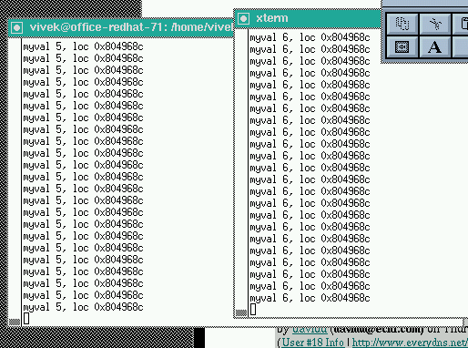
Here’s The Output

Slide 21
Instances Of Programs
The address was always the same
The values were different
  Implies that the programs aren’t seeing each other
  But they think they’re using the same address
Conclusion: addresses are not absolute
Implication: memory mapping
What’s the benefit?

Slide 22
Remember This?
Application
Libraries
User space/level
Portable OS Layer
Kernel space/level
Machine-dependent layer

Slide 23
Address Space
One (common) approach
  Kernel is high memory
  User is low memory
What restrictions apply?
read(f, buf, nbytes)
0xffff….
Kernel space
User space
0x0000…

Slide 24
More Address Space
Program segments
  Text
  Data
  Stack
  Heap
What is stack?
What is heap?
What is data?
What is text?
0xffff….
Kernel space
User space
0x0000…

Slide 25
One Common Layout
Lots of flexibility
  Allows stack growth
  Allows heap growth
  No predetermined division
0xffff….
Kernel space
Stack
Heap
Code & Data
0x0000…

Slide 26
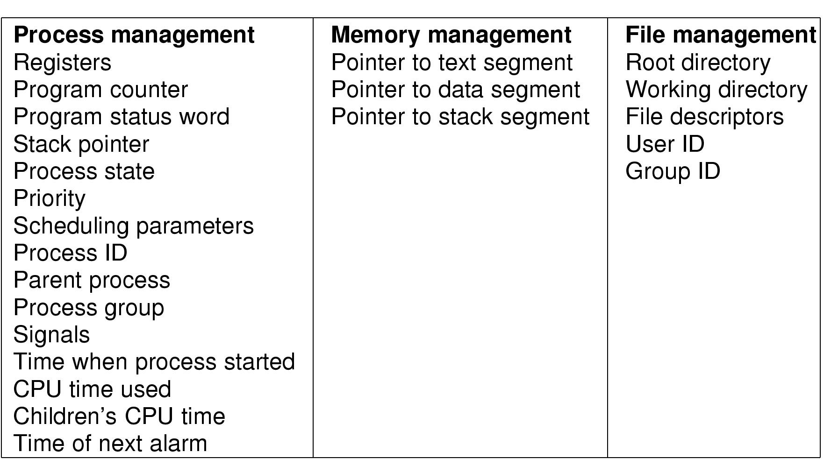
Process Control Block (PCB)
Fields of a process table entry

Slide 27
Context Switch
Switch CPU from one process to another
Performed by scheduler (chapter 2.5)
It includes:
  save PCB state of the old process;
  load PCB state of the new process;
  Flush memory cache;
  Change memory mapping (TLB);
Context switch is expensive(1-1000 microseconds)
  No useful work is done (pure overhead)
  Can become a bottleneck
  Real life analogy?
Need hardware support

Slide 28
Summary
What is process
Process states and model
What information in a process
Process address space
Context switch
Next lecture: thread

Slide 29
Question for the next lecture
What is the similarity and difference between process and thread?
Reminders:
  Test quiz
  Nacho tutorial

