Slide 1
CS323 Operating Systems
Threads
Yuanyuan Zhou
Lecture 4
1/29/2003

Slide 2
Content of this lecture
Administrative announcements
What is a thread?
Examples of using threads
Thread implementations
Summary

Slide 3
Administrative
Test quiz due Friday

Slide 4
Process Review
So What Is A Process?
  It’s one executing instance of a “program”
  It’s separate from other instances
  It can start (“launch”) other processes
  It can be launched by them
What’s in a process?
  Code (text), data, stack, heap
  Process control block
    Process state, priority, accounting
    Program counter, register variables, stack pointers, etc
    Open files and devices

Slide 5

Threads: Lightweight Processes
(a) Three processes each with one thread
(b) One process with three threads

Slide 6
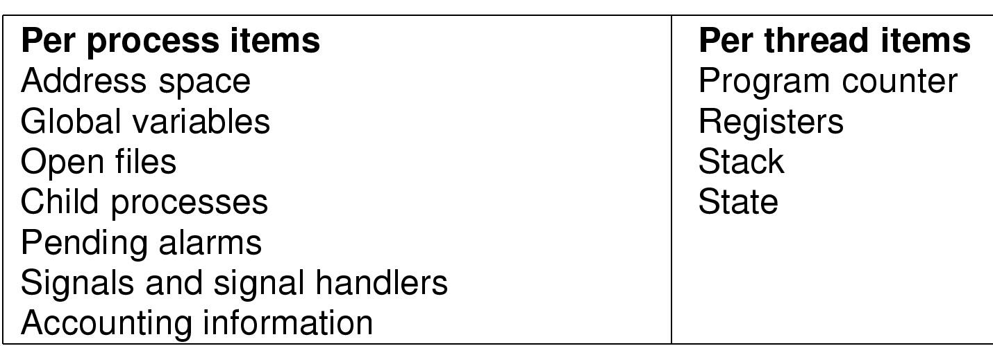
The Thread Model
Threads in the same process share resources
Each thread execute separately

Slide 7

Why each thread has its own stack?

Slide 8
A example program
#include ``csapp.h''
void *thread(void *vargp);
int main() {
phtread_t pid; // stores the new thread ID
Pthread_create(&tid, NULL, thread, NULL); //create a new thread
Pthread_join(tid, NULL); //main thread waits for the other thread to terminate
exit(0); /* main thread exits */
}
void *thread(void *vargp) /*thread routing*/
{
printf(``Hello, world! \n'');
return NULL;
}

Slide 9
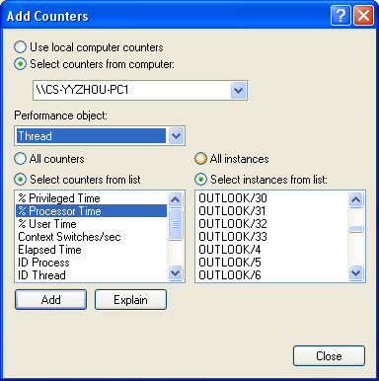
Windows Thread Lists from Performance Monitor

Slide 10
Group discussions (3 minutes)
Similarity between processes and threads
Difference between processes and threads
  Threads share a single address space
Real life examples?

Slide 11
Real Life Example
Process
  CS323 MP
  Different from CS321’s MP
Thread
  CS323 MP1, MP2, MP3, MP4, MP5
  Each is different
  Share
    Nacho
    Textbook
    Personnel (TAs, instructors)
  Affect each other

Slide 12

Thread Usage: word processor
What if it is single-threaded?

Slide 13

Thread Usage: Web Server

Slide 14
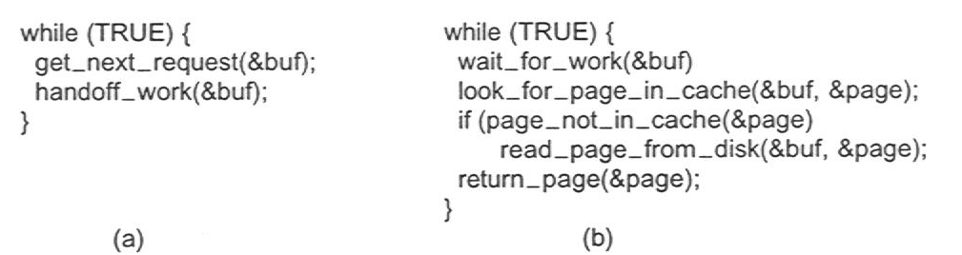
Web Server
Rough outline of code for previous slide
  (a) Dispatcher thread
  (b) Worker thread

Slide 15
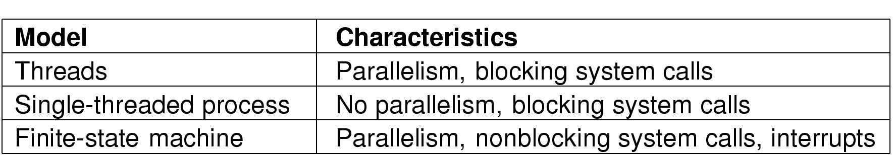
Tradeoffs
Three ways to construct a server

Slide 16
Blocking Vs. non-blocking System Calls
Blocking system call
  Usually I/O related: read(), fread(), getc(), write()
  Doesn’t return until the call completes
  The process/thread is switched to blocked state
  When the I/O completes, the process/thread becomes ready
  Simple
  Real life example: attending a lecture
Using non-blocking system call for I/O
  Asynchronous I/O
  Complicated
  The call returns once the I/O is initiated, and the caller continue
  Once the I/O completes, an interrupt is delivered to the caller
  Real life example: apply for job

Slide 17
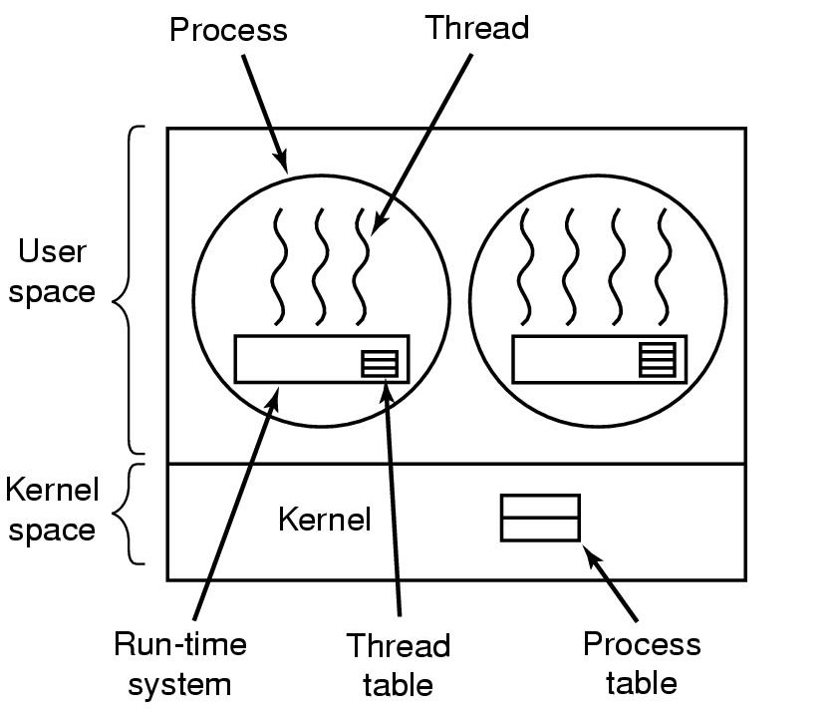
Implementing Threads in User Space
(old Linux)
A user-level threads package

Slide 18
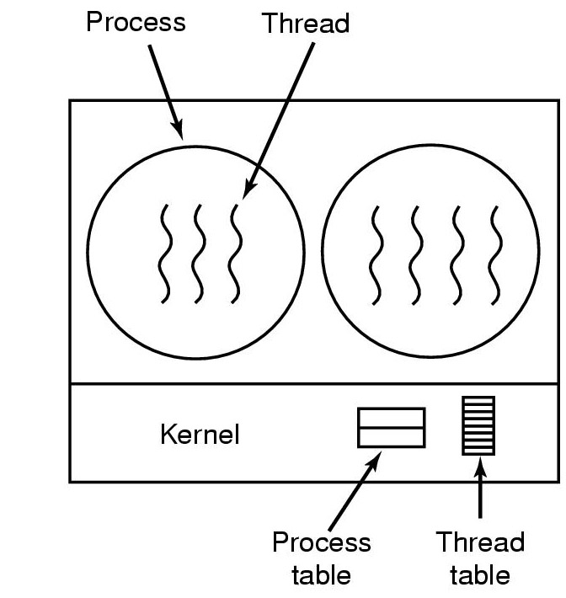
Implementing Threads in the Kernel (Windows 2000/XP)
A threads package managed by the kernel

Slide 19
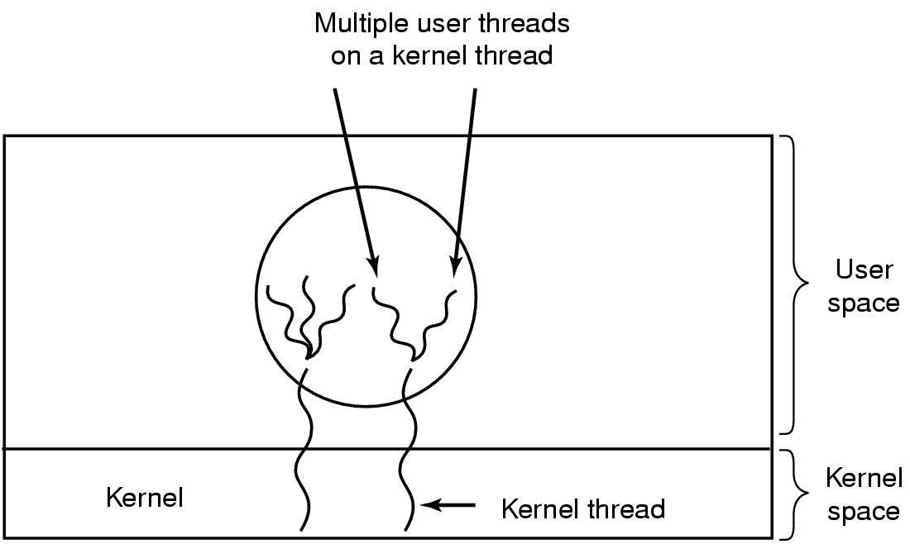
Hybrid Implementations (Solaris)
Multiplexing user-level threads onto kernel- level threads

Slide 20
Scheduler Activations
User-level
Goal – mimic functionality of kernel threads
  gain performance of user space threads
Avoids unnecessary user/kernel transitions
Kernel assigns virtual processors to each process
  lets runtime system allocate threads to processors
Problem:
Fundamental reliance on kernel (lower layer)
calling procedures in user space (higher layer)

Slide 21
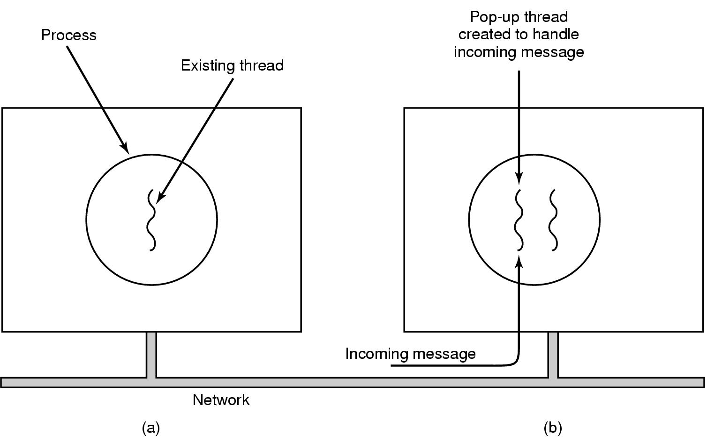
Pop-Up Threads
Creation of a new thread when message arrives
  (a) before message arrives
  (b) after message arrives

Slide 22
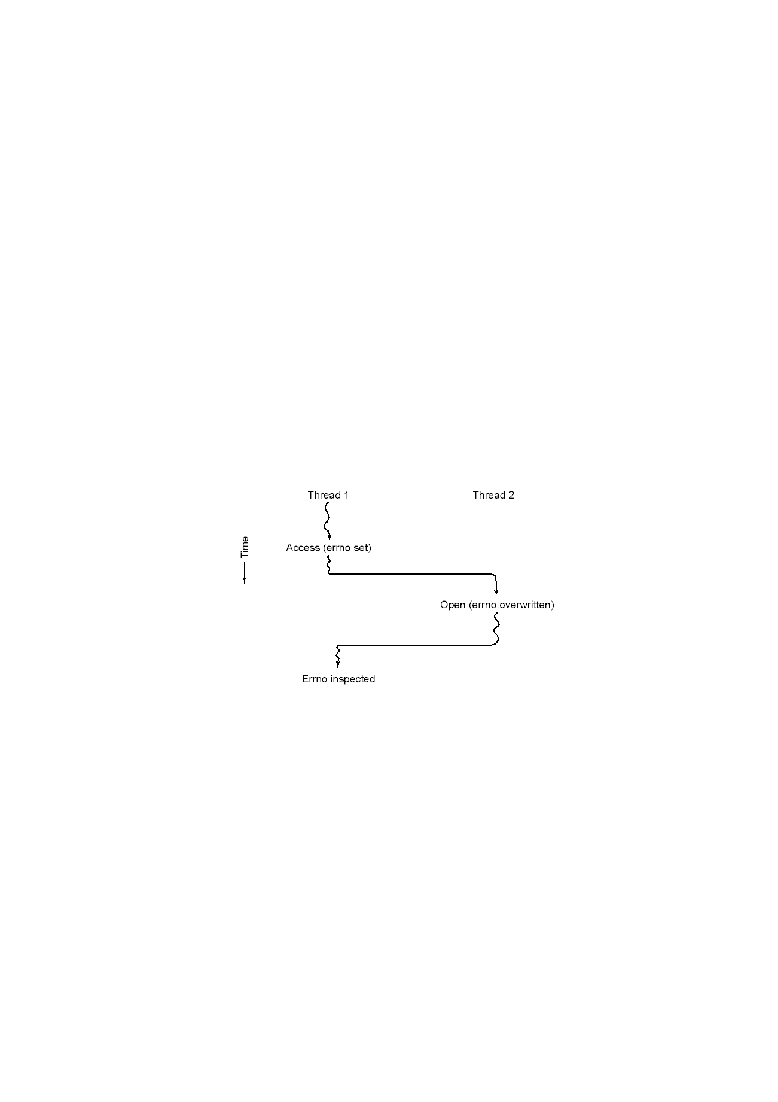
A Challenge: Making Single-Threaded Code Multithreaded
Conflicts between threads over the use of a global variable

Slide 23
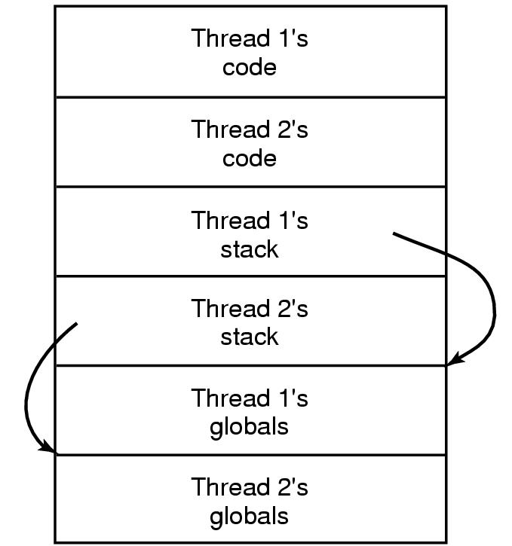
A solution: Private Global Variables

Slide 24
Summary
What is thread? Why need threads?
Difference between process and thread
Thread Implementations and their tradeoffs
  User-level
  Kernel-level
  Hybrid
  Service activation
  Pop-up threads
More details on threads will be discussed in “distributed system” (CS318) class
Next lecture: Scheduling

Slide 25
Reminders:
Test quiz will be closed on 1/31 5pm
Get familiar with Nacho
Read 2.5, 2.3 and 2.4
Utilize the newsgroup uiuc.class.cs323
MP1 released

