Slide 1
CS323 Operating Systems
CPU Scheduling
Yuanyuan Zhou
Lecture 5
1/31/2003

Slide 2
Content of this lecture
Administrative announcements
Why Scheduling?
Scheduling Levels
Basic Scheduling Algorithm (FCFS)
Summary

Slide 3
Administrative
Test quiz due today
Quiz1 will start next Monday, due Friday 5pm
MP1(thread scheduling) starts now

Slide 4
Process Review
So What Is A Process?
  It’s one executing instance of a “program”
  It’s separate from other instances
  It can start (“launch”) other processes
  It can be launched by them
What’s in a process?
  Code (text), data, stack, heap
  Process control block
    Process state, priority, accounting
    Program counter, register variables, stack pointers, etc
    Open files and devices

Slide 5
Threads: Lightweight Processes
A thread is a single execution
  Stack
  Program counters
  Registers
All threads in a process share resources
  Address space
  Text, data, heap
  Open files
Implementations of threads
  User-level, kernel-level, Hybrid, Service activation, pop-up

Slide 6


Scheduling
Deciding which process/thread should occupy the resource (CPU, disk, etc)
(CPU (horsepower))
I want to ride it
Whose turn is it?
Process 1
Process 2
Process 3

Slide 7
When to schedule?
A new process starts
The running process exits
The running process is blocked
I/O interrupt (some processes will be ready)
Clock interrupt (every 10 milliseconds)

Slide 8
Preemptive vs. Non-preemptive
Non-preemptive scheduling:
  The running process keeps the CPU until it voluntarily gives up the CPU
    process exits
    switches to blocked state
    1and 4 only (no 3)
Preemptive scheduling:
  The running process can be interrupted and must release the CPU (can be forced to give up CPU)
Running
4
Terminated
3
1
Ready
Blocked

Slide 9
What are the scheduling objectives?
Group discussion (2 minutes)
(CPU (horsepower))
I want to ride it
Whose turn is it?
Process 1
Process 2
Process 3

Slide 10
Scheduling Objectives
Fair (nobody cries)
Priority (lady first)
Efficiency (make best use of equipment)
Encourage good behavior (good boy/girl)
Support heavy loads (degrade gracefully)
Adapt to different environments (interactive, real-time, multi-media)

Slide 11
Performance Criteria
Fairness
Efficiency: keep resources as busy as possible
Throughput: # of processes that completes in unit time
Turnaround Time (also called elapse time)
  amount of time to execute a particular process from the time its entered
Waiting Time
  amount of time process has been waiting in ready queue
Response Time
  amount of time from when a request was first submitted until first response is produced.
  predictability and variance
Policy Enforcement:
  seeing that stated policy is carried out
Proportionality:
  meet users' expectation
Meeting Deadlines: avoid losing data

Slide 12
Different Systems, Different Focuses
For all
  Fairness, policy enforcement, resource balance
Batch Systems
  Max throughput, min turnaround time, max CPU utilization
Interactive Systems
  Min Response time, best proportionality
Real-Time Systems
  predictability, meeting deadlines

Slide 13
Program Behaviors Considered in Scheduling
I/O
I/O
Is it I/O bound? Example?
Is it CPU bound? Example?
Batch or interactive environment
Urgency
Priority
Frequency of page faults
Frequency of preemption
How much execution time it has already received
How much execution time it needs to complete
I/O
compute
compute

Slide 14
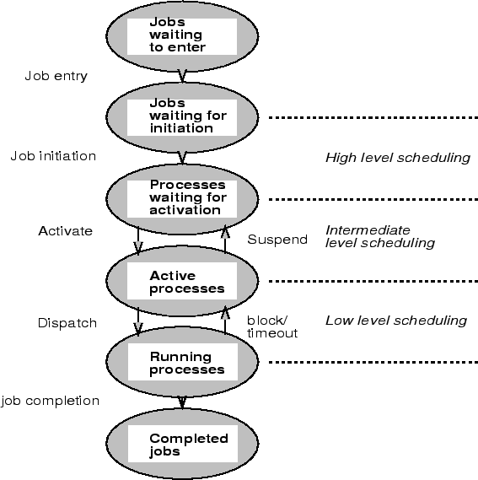
Scheduling Level
  Which jobs should be allowed to compete for the CPU and other resources
  Which jobs to temporarily suspend or resume to smooth fluctuations in system load.
  Assigning a cpu to a ready process.

Slide 15
CPU Scheduler
Proc 1: 14 time units
Proc2: 8 time units
Proc3: 8 time units
Dispatcher
Preemptive vs.
non-preemptive
CPU
Dispatcher
Proc 1
Proc 10
Proc 2
Proc 11
Proc 3
Proc 12
Ready queue
blocked queue

Slide 16
Dispatcher
Gives the control of the CPU to the process, scheduled by the short-term scheduler.
Functions:
  switching context
  switching to user mode
  jumping to the proper location in the user program.
Dispatch Latency :time to stop process and start another one.
  Pure overhead
  Needs to be fast

Slide 17
Single Processor Scheduling Algorithms
Batch systems
  First Come First Serve (FCFS)
  Short Job First
Interactive Systems
  Round Robin
  Priority Scheduling
  Multi Queue & Multi-level Feedback
  Shortest process time
  Guaranteed Scheduling
  Lottery Scheduling
  Fair Sharing Scheduling

Slide 18
First Come First Serve (FCFS)
Process that requests the CPU FIRST is allocated the CPU FIRST.
Also called FIFO
Non-preemptive
Used in Batch Systems
Real life analogy: Fast food restaurant
Implementation: FIFO queues
  A new process enters the tail of the queue
  The schedule selects from the head of the queue.
Performance Metric: Average Waiting Time.
Given Parameters:
  Burst Time (in ms), Arrival Time and Order

Slide 19
FCFS Example
Process | Duration | Order | Arrival Time
P1 | 24 | 1 | 0
P2 | 3 | 2 | 0
P3 | 4 | 3 | 0
The final schedule:
P1 (24)
P2 (3)
P3 (4)
0
24
27
P1 waiting time: 0
P2 waiting time: 24
P3 waiting time: 27
The average waiting time:
(0+24+27)/3 = 17

Slide 20
Problems with FCFS
Non-preemptive
Not optimal AWT
Cannot utilize resources in parallel:
  Assume 1 process CPU bounded and many I/O bounded processes
  result: Convoy effect, low CPU and I/O Device utilization
  Why?

Slide 21
Why Convoy Effects?
Consider n-1 jobs in system that are I/O bound and 1 job that is CPU bound.
I/O bound jobs pass quickly through the ready queue and suspend themselves waiting for I/O.
CPU bound job arrives at head of queue and executes until complete.
I/O bound jobs rejoin ready queue and wait for CPU bound job to complete.
I/O devices idle until CPU bound job completes.
When CPU bound job complete, other processes rush to wait on I/O again.
CPU becomes idle.

Slide 22
Queuing Theory
ARRIVAL RATE λ
Server
Input Queue
SERVICE RATEμ

Slide 23
Queueing Theory
Steady state
Poisson arrival with λ constant arrival rate (customers per unit time) each arrival is independent.
P( τ≤t ) = 1- e^{–λt}

Slide 24
Analysis of Queueing Behavior
Probability n customers arrive in time interval t is:
e^{–λt} (λt) ^{n}/ n!
Assume random service times (also poisson): μ constant service rate (customers per unit time)

Slide 25
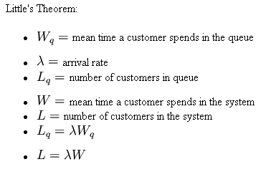
Useful Facts from Queuing Theory

Slide 26
Example
Example
  Arrival 2 jobs/sec
  Service 3 jobs/sec
  Utilization 66.66%
  Time in system 1 sec
  Time in queue .6666 sec
  Length of queue 1.3333

Slide 27
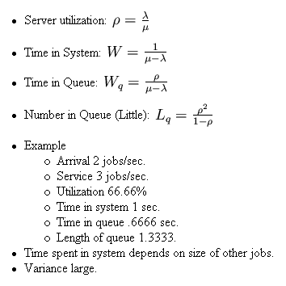
Analysis of FCFS

Slide 28
Summary
What is scheduling
Scheduling objectives
CPU Scheduling
FCFS
Queuing theory
Next lecture: other scheduling algorithms
  Short Job First
  Round Robin
  Priority
  Multi-Queue
  Multi-level Feedback

Slide 29
Reminder
Quiz next week
MP1 starts next week

