Slide 1
CS323 Operating Systems
CPU Scheduling II
Yuanyuan Zhou
Lecture 6
2/3/2003

Slide 2
Content of this lecture
Administrative announcements
Scheduling algorithms
  Batch systems
    Shortest job first
  Interactive systems
    Round-robin
    Priority scheduling
  Multi Queue & Multi-level Feedback
  Shortest process time
  Guaranteed Scheduling
  Lottery Scheduling
  Fair Sharing Scheduling
Summary

Slide 3
Administrative
Quiz1starts today, due Friday 5pm
MP1(thread scheduling) starts

Slide 4
Review: Scheduling
Deciding which process/thread should occupy the resource (CPU, disk, etc)
Preemptive vs. non-preemptive
Scheduling objectives
Scheduling performance criteria
First-come-first-serve (FCFS)
  Process that requests the CPU FIRST is allocated the CPU FIRST.
  Used in batch systems

Slide 5
Shortest Job First (SJF)
Schedule the job with the shortest elapse time first
Scheduling in Batch Systems
Two types:
  Non-preemptive
  Preemptive
Requirement: the elapse time needs to know in advance
Optimal if all the jobs are available simultaneously (provable)
  Gives the best possible AWT (average waiting time)

Slide 6
Non-preemptive SJF: Example
Process | Duration | Order | Arrival Time
P1 | 6 | 1 | 0
P2 | 8 | 2 | 0
P3 | 7 | 3 | 0
P4 | 3 | 4 | 0
P4 (3)
P1 (6)
P3 (7)
P2 (8)
0
3
9
16
24
P4 waiting time: 0
P1 waiting time: 3
P3 waiting time: 9
P2 waiting time: 16
The total time is: 24
The average waiting time (AWT):
(0+3+9+16)/4 = 7

Slide 7
Comparing to FCFS
Process | Duration | Order | Arrival Time
P1 | 6 | 1 | 0
P2 | 8 | 2 | 0
P3 | 7 | 3 | 0
P4 | 3 | 4 | 0
P1 (6)
P2 (8)
P3 (7)
P4 (3)
0
6
14
21
24
The total time is the same.
The average waiting time (AWT):
(0+6+14+21)/4 = 10.25
(comparing to 7)
P1 waiting time: 0
P2 waiting time: 6
P3 waiting time: 14
P4 waiting time: 21

Slide 8
SJF is not always optimal
Is SJF optimal if all the jobs are not available simultaneously?
Process | Duration | Order | Arrival Time
P1 | 10 | 1 | 0
P2 | 2 | 2 | 2
P1 (10)
P2 (2)
0
2 (p2 arrives)
10
12
The average waiting time (AWT):
(0+8)/2 = 4
P1 waiting time: 0
P2 waiting time: 8

Slide 9
What if the scheduler waits for 2 time units? (Do it yourself)
Process | Duration | Order | Arrival Time
P1 | 10 | 1 | 0
P2 | 2 | 2 | 2
P2 (2)
P1 (10)
0
2
4
14
The average waiting time (AWT):
(0+4)/2 = 2
However: waste 2 time units of CPU
P1 waiting time: 4
P2 waiting time: 0

Slide 10
Preemptive SJF
Also called Shortest Remaining Time First
  Schedule the job with the shortest remaining time required to complete
Requirement: the elapse time needs to be known in advance

Slide 11
Preemptive SJF: Same Example
Process | Duration | Order | Arrival Time
P1 | 10 | 1 | 0
P2 | 2 | 2 | 2
P1 (2)
P2 (2)
P1 (8)
0
2
4
12
The average waiting time (AWT):
(0+2)/2 = 1
No CPU waste!!!
P1 waiting time: 4-2 =2
P2 waiting time: 0

Slide 12
A Problem with SJF
Starvation
  In some condition, a job is waiting for ever
  Example: SJF
    Process A with elapse time of 1 hour arrives at time 0
    But ever 1 minute, a short process with elapse time of 2 minutes arrive
    Result of SJF: A never gets to run

Slide 13
Interactive Scheduling Algorithms
Usually preemptive
  Time is sliced into quantum (time intervals)
  Scheduling decision is also made at the beginning of each quantum
Performance Criteria
  Min Response time
  best proportionality
Representative algorithms:
  Priority-based
  Round-robin
  Multi Queue & Multi-level Feedback
  Shortest process time
  Guaranteed Scheduling
  Lottery Scheduling
  Fair Sharing Scheduling

Slide 14
Priority Scheduling
Each job is assigned a priority.
FCFS within each priority level.
Select highest priority job over lower ones.
Rational: higher priority jobs are more mission-critical
  Example: DVD movie player vs. send email
Problems:
  May not give the best AWT
  indefinite blocking or starvation a process

Slide 15
Set Priority
Two approaches
  Static (for system with well known and regular application behaviors)
  Dynamic (otherwise)
Priority may be based on:
  Cost to user.
  Importance of user.
  Aging
  Percentage of CPU time used in last X hours.

Slide 16
Priority Scheduling: Example
Process | Duration | Priority | Arrival Time
P1 | 6 | 4 | 0
P2 | 8 | 1 | 0
P3 | 7 | 3 | 0
P4 | 3 | 2 | 0
P2 (8)
P4 (3)
P3 (7)
P1 (6)
0
8
11
18
24
P2 waiting time: 0
P4 waiting time: 8
P3 waiting time: 11
P1 waiting time: 18
The average waiting time (AWT):
(0+8+11+18)/4 = 9.25
(worse than SJF)

Slide 17
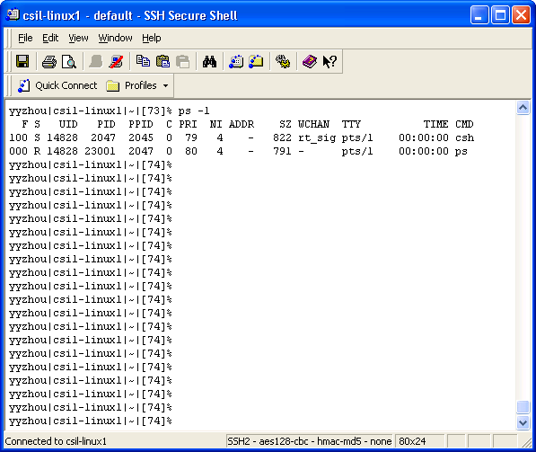
Priority in Unix

Slide 18
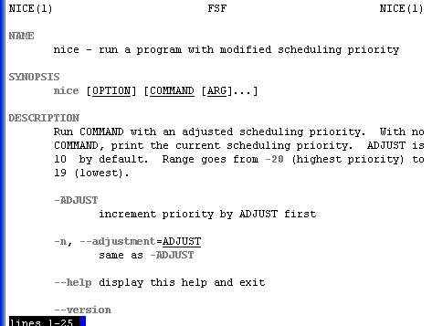
Be “nice” in Unix
Nobody wants to

Slide 19
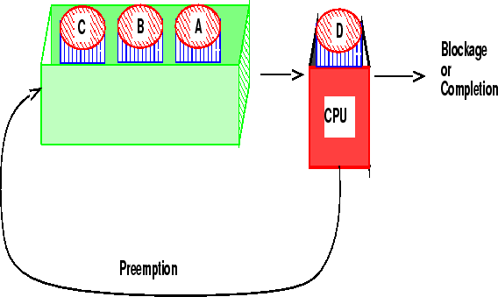
Round-robin
One of the oldest, simplest, most commonly used scheduling algorithm
Select process/thread from ready queue in a round-robin fashion (take turns)
Problem:
Do not consider priority
Context switch overhead

Slide 20
Round-robin: Example
Process | Duration | Order | Arrival Time
P1 | 3 | 1 | 0
P2 | 4 | 2 | 0
P3 | 3 | 3 | 0
Suppose time quantum is: 1 unit, P1, P2 & P3 never block
P1
P2
P3
P1
P2
P3
P1
P2
P3
P2
0
10
P1 waiting time: 4
P2 waiting time: 6
P3 waiting time: 6
The average waiting time (AWT):
(4+6+6)/3 = 5.33

Slide 21
Time Quantum
Time slice too large
  FIFO behavior
  Poor response time
Time slice too small
  Too many context switches (overheads)
  Inefficient CPU utilization
Heuristic: 70-80% of jobs block within time-slice
Typical time-slice 10 to 100 ms
Time spent in system depends on size of job.

Slide 22
Bag-of-envelop Calculation (1 minute)
Suppose a context switch takes 1 msec
Suppose the scheduling quantum is 100 msec
What is the percentage overhead of context switches in round-robin scheduling?
What if the scheduling quantum is 10 msec?

Slide 23
Multi-Queue Scheduling
Hybrid between priority and round-robin
Processes assigned to one queue permanently
Scheduling between queues
  Fixed Priorities
  % CPU spent on queue
Example
  System processes
  Interactive programs
  Background Processes
  Student Processes
Address the starvation and infinite blocking problems

Slide 24
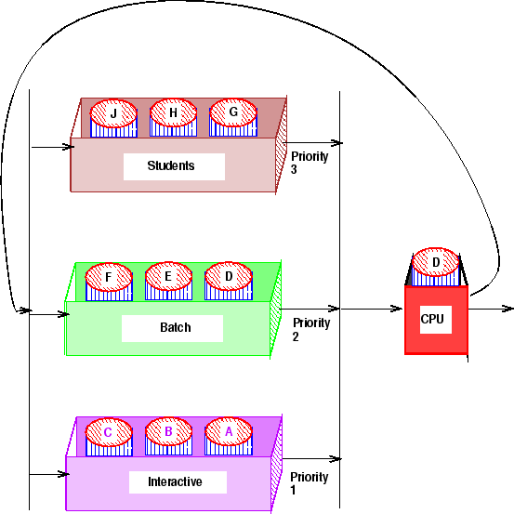
Multi-Queue Scheduling: Example
20%
30%
50%

Slide 25
Real Life Analogy
Tasks (to-do list) for poor Bob
  Class 1 priority (highest) : tasks given by his boss
    Finish the project (50%)
  Class 2 priority: tasks for his wife
    Buy a valentine present (30%)
  Class 3 priority (lowest): Bob’s tasks
    Watch TV (20%)

Slide 26
A Variation: Multi-level Feedback Algorithm
Multi-Level Queue with priorities
Processes move between queues
Each queue represents jobs with similar CPU usage
Jobs in a given queue are executed with a given time-slice
Rational:
  Once an I/O process completes an I/O request, it should have higher CPU priority.

Slide 27
Multi-level Feedback Algorithm (Details)
Example: Queue_{i} has time-slice t 2^{i}
  If a job in Queue_{i} doesn't block by end of time-slice, it is moved to Queue_{i} +1
Lowest priority Queue is FIFO
Problem:
  Starvation: Aging may move Process to higher priority queue

Slide 28
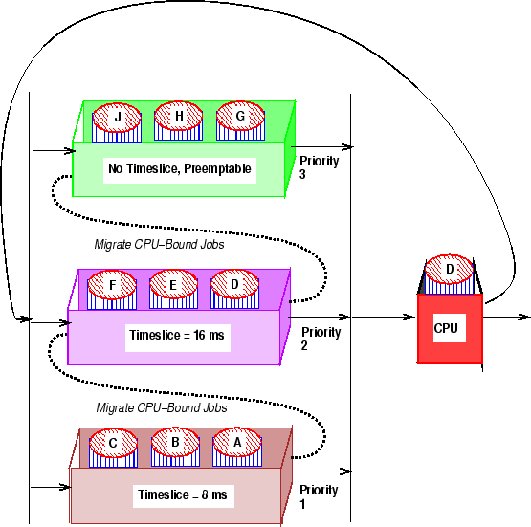
Multi-level Feedback Algorithm: Example

Slide 29
Summary
Shortest job first (SJF)
Priority
Round-robin
Multi-Queue
Multi-level Feedback

Slide 30
Reminder
Next lecture: scheduling for
  Real-time systems
  Multiple processors
  Threads
Quiz1 due Friday 5pm
MP1

