Slide 1
CS323 Operating Systems
CPU Scheduling III
Yuanyuan Zhou
Lecture 7
2/5/2003

Slide 2
Content of this lecture
Administrative announcements
Scheduling algorithms
  Shortest process time
  Guaranteed Scheduling
  Lottery Scheduling
  Fair Sharing Scheduling
Scheduling for
  Multiple processors
  Threads
  Real-time systems
Summary

Slide 3
Administrative
Quiz1due Friday 5pm
MP1(thread scheduling)

Slide 4
Review: Scheduling Algorithms
Batch systems
  First come first serve
  Shortest job first
Interactive systems
  Round-robin
  Priority scheduling
  Multi-Queue & Multi-level feedback

Slide 5
Shortest Process Time
Based on shortest job first
Changed for interactive systems
  Consider the average response time for each user input/command
  Estimated based on past response
    Average time in previous runs: T₀, T₁, T₂, T₃
    The average time for the next run is predicted to be
    T₀ /8 + T₁ /8 + T₂ /4 + T₃ /2
What problem does it have?
Notes:
Problem: starvation, inaccurate prediction (requests are different)

Slide 6
Guaranteed Scheduling (QoS)
Make real promises to the users about performance and then live up to them
Example:
  with n processes running, the scheduler makes sure that each one gets 1/n of the CPU cycles.
Scheduling:
  compute the ratio of actual CPU time consumed to CPU time entitled
  Select the one with the lowest ratio
Can it lead to starvation?

Slide 7
Lottery Scheduling
More commonly used
Probability-based:
  Give processes lottery tickets. At scheduling time, a lottery ticket is chosen at random, and the process holding that ticket gets that resource.
Give more tickets for higher priority processes
Advantages:
  Simple
  Highly responsive
  Can support cooperation between processes
  Easy to support priority and proportion requirement

Slide 8
Fair-Share Scheduling
Is Round-robin fair?
  Yes, it is (from process point of view)
  No, it may be not (from user point view)
User-based fair share scheduling
  Each user gets fair share
Example:
  Alice has 4 processes: A1, A2, A3, A4
  Bob has 1 process: B1
  Then A1, A2, A3, A4 are entitled only to 50% CPU, while B1 alone is entitled to 50%

Slide 9


Multi-Processor Scheduling: Load Sharing
Decides
  Which process to run?
  How long does it run
  Where to run it?
(CPU (horsepower))
I want to ride it
…
Process 1
Process 2
Process n

Slide 10
Multi-Processor Scheduling Choices
Self-Scheduled
  Each CPU dispatches a job from the ready queue
Master-Slave
  One CPU schedules the other CPUs
Asymmetric
  One CPU runs the kernel and the others runs the user applications.
  One CPU handles network and the other handles applications

Slide 11
Gang Scheduling for Multi-Processors
A collection of processes belonging to one job
All the processes are running at the same time
  If one process is preempted, all the processes of the gang are preempted.
Helps to eliminate the time a process spends waiting for other processes in its parallel computation.

Slide 12
Why Gang Scheduling?
Process 1
Process 2
Switched off
What’s the point of scheduling this process?
Send Data
Receive Data

Slide 13
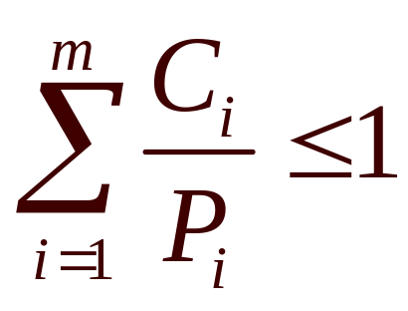
Scheduling in Real-Time Systems
Schedulable real-time system. Given
  m periodic events
  event i occurs within period P_{i} and requires C_{i} seconds
Then the load can only be handled if

Slide 14
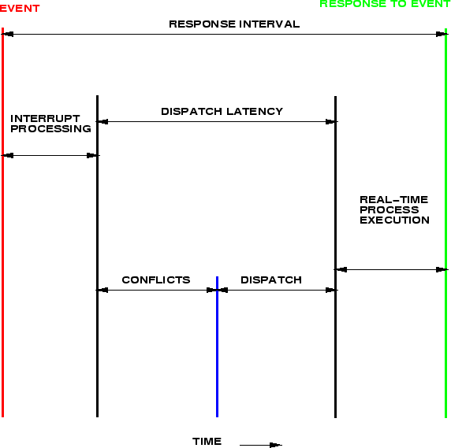
Latency in Dispatching

Slide 15
Dispatching Latency
Goal: keep dispatch latency
Problem: system call
  small OS may enforce process to wait either for a system call to complete or for an I/O block to take place
Solution: need preemptible system calls
  insert preemption points (can be placed at safe location where kernel structures are not modified)
  make the kernel preemptible (all kernel structures must be protected through the use of various synchronization mechanisms)

Slide 16
Priority Inversion and Inheritance
Priority inversion
  When a higher priority process needs to read or modify kernel data that are currently being accessed by a lower priority process.
  The higher priority process must wait!
  But the lower priority cannot proceed quickly due to scheduling.
Solution: priority inheritance
  When a lower-priority process accesses a resource, it inherits high-priority until it is done with the resource in question. And then its priority reverses to its natural value.

Slide 17
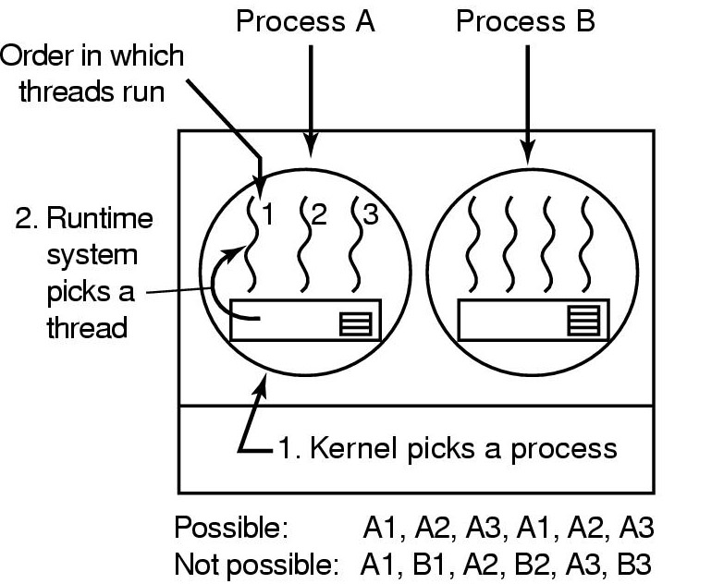
User-level Thread Scheduling
Possible Scheduling
50-msec process quantum
run 5 msec/CPU burst

Slide 18
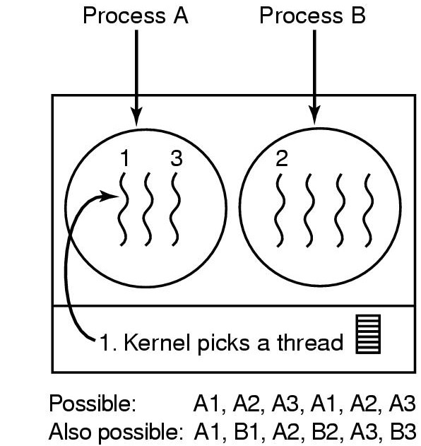
Kernel-level Thread Scheduling
Possible scheduling
50-msec process quantum
threads run 5 msec/CPU burst

Slide 19
Thread Scheduling Examples
Solaris 2
  priority-based process scheduling with four scheduling classes: real-time, system, time sharing, interactive.
  each process starts with one LWP and generates new LWPs as needed.
  A set of priorities within each class.
  The scheduler converts the class-specific priorities into global priorities and selects to run the thread with the highest global priority. The thread runs until (1) it blocks, (2) it uses its time slice, or (3) it is preempted by a higher priority threads.
JVM
  schedules threads using a preemptive, priority-based scheduling algorithm.
  schedules the ``runnable'' thread with the highest priority. If two threads have the same priority, JVM applies FIFO.
  schedules a thread to run if (1) other thread exits the ``runnable state'' due to block(), exit(), suspend() or stop() methods; (2) a thread with higher priority enters the ``runnable''state.

Slide 20
Reminder
Next lecture: Synchronization (chapter 2.3 & 2.4)
Quiz1 due Friday 5pm (only 1 try)
MP1

