Slide 1
CS323 Operating Systems
Process Synchronization
Yuanyuan Zhou
Lecture 8
2/7/2003

Slide 2
Content of this lecture
Administrative announcements
Data Races
  A simple game
Critical region and mutual exclusion
Mutual exclusion using busy waiting
  Disabling Interrupts
  Lock Variables
  Strict Alternation
  Peterson’s solution
  TSL
  Sleep and Wakeup
Summary

Slide 3
Administrative
Quiz1 due Today 5pm
MP1(thread scheduling)
1 unit project proposal due 2/24
Hidden slides
  Print out another version 1 day after the class

Slide 4
Review
Process: a program in execution
Threads: a light weight process
Scheduling:
  Which process/thread should run?

Slide 5
Inter-Process Communication (IPC)
Communication
  Pass information to each other
Mutual exclusion & Synchronization
  Keep each other’s hair
  Proper sequencing
The last one also applies to threads

Slide 6
A simple game
Two volunteers
  Producer: produce 1 card per iteration
    Step1: increment the counter
    Step2: put the card on the table
  Consumer:
    Step1: check the counter to see if it is zero
    Step2a: if the counter is zero, go back to step1
    Step2b: if the counter is nonzero, take a card from the table
    Step3: decrement counter
I am the OS
  I decide who should go, who should stop

Slide 7
First Round
Stop Producer before step2 and let Consumer go.
What happens?
Two volunteers
  Producer: produce 1 card per iteration
    Step1: increment the counter
    Step2: put the card on the table
  Consumer:
    Step1: check the counter to see if it is zero
    Step2a: if the counter is zero, go back to step1
    Step2b: if the counter is nonzero, take a card from the table
    Step3: decrement the counter
switch

Slide 8
Second Round
Stop Producer before step2 and let Consumer go.
What happens?
Two volunteers
  Producer: produce 1 card per iteration
    Step1: put the card on the table
    Step2: increment the counter
  Consumer:
    Step1: check the counter to see if it is zero
    Step2a: if the counter is zero, go back to step1
    Step2b: if the counter is nonzero, take a card from the table
    Step3: decrement the counter

Slide 9
Data Races
Reason: data sharing
Previous game: producer and consumer
  Share the counter
  Share the cards
Examples
  Thread:
  Process:

Slide 10
Spooling Example: Correct
Process 1
Shared memory
Process 2
int next_free;
int next_free;
…
out
1
next_free = in;
4
abc
Stores F1 into
next_free;
Prog.c
2
5
6
Prog.n
3
in=next_free+1
in
7
F1
4
next_free = in
F2
5
Stores F2 into
next_free;
…
in=next_free+1
6

Slide 11
Spooling Example: Races
Process 1
Shared memory
Process 2
int next_free;
int next_free;
…
out
1
next_free = in;
4
abc
5
Prog.c
2
next_free = in
/* value: 7 */
Stores F1 into
next_free;
Prog.n
3
6
F1
in
7
F2
4
in=next_free+1
5
Stores F2 into
next_free;
…
in=next_free+1
6

Slide 12
Critical Region (Critical Section)
Process {
while (true) {
ENTER CRITICAL SECTION
Access shared variables; // Critical Section; LEAVE CRITICAL SECTION
Do other work
}
}

Slide 13
Critical Region Requirement
  Mutual Exclusion: No other process must execute within the critical section while a process is in it.
  Progress: If no process is waiting in its critical section and several processes are trying to get into their critical section, then entry to the critical section cannot be postponed indefinitely.
  Bounded Wait: A process requesting entry to a critical section should only have to wait for a bounded number of other processes to enter and leave the critical section.
  Speed and Number of CPUs: No assumption may be made about speeds or number of CPUs.

Slide 14

Critical Regions (2)
Mutual exclusion using critical regions

Slide 15
Mutual Exclusion With Busy Waiting
Possible Solutions
  Disabling Interrupts
  Lock Variables
  Strict Alternation
  Peterson’s solution
  TSL
  Sleep and Wakeup

Slide 16
Disabling Interrupts
How does it work?
  Disable all interrupts just after entering a critical section and re-enable them just before leaving it.
Why does it work?
  With interrupts disabled, no clock interrupts can occur. (The CPU is only switched from one process to another as a result of clock or other interrupts, and with interrupts disabled, no switching can occur.)
Problems:
  What if the process forgets to enable the interrupts?
  Multiprocessor? (disabling interrupts only affects one CPU)
Only used inside OS

Slide 17
Lock Variables
While (lock);
lock = 1;
EnterCriticalSection;
access shared variable;
LeaveCriticalSection;
Lock = 0;
Does the above code work?

Slide 18
Strict Alternation
Thread Me; /* For two threads */
{
while (true)
{ while ( turn != my_thread_id) { };
Access shared variables; // Critical Section;
turn = other_thread_id;
Do other work
}
}
Satisfies mutual exclusion but not progress.
Why?

Slide 19
Using Flags
int flag[2]= {false, false};
Thread Me;
{
while (true)
{ flag[my_thread_id] = true;
while (flag[other_thread_id] ) { };
Access shared variables; // Critical Section;
flag[my_thread_id] = false;
Do other work
}
}
Can block indefinitely
Why?

Slide 20
Peterson’s Solution
int flag[2]={false, false};
int turn;
Thread Me;
{
while (true)
{ flag[my_thread_id] = true;
turn = other_thread_id;
while (flag[other_thread_id]
and turn == other_thread_id ) { };
Access shared variables; // Critical Section;
flag[my_thread_id] = false;
Do other work
}
}
It works!!!
Why?

Slide 21
Test & Set (TSL)
Requires hardware support
Does test and set atomically
char Test_and_Set ( char* target);
\\ All done atomicall
{ char temp = *target;
*target = true;
return(temp)
}

Slide 22
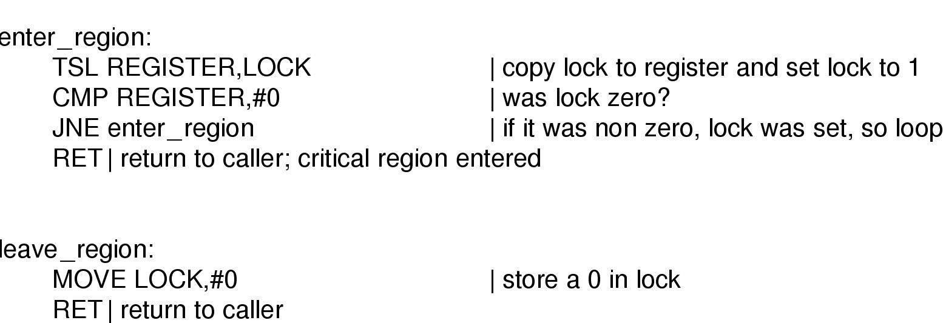
TSL instruction

Slide 23
Other Similar Hardware Instruction
Swap = TSL
void Swap (char* x,* y);
\\ All done atomically
{ char temp = *x;
*x = *y;
*y = temp
}

Slide 24
Sleep and Wakeup
Problem with previous solutions
  Busy waiting
  Wasting CPU
  Priority Inversion:
    a high priority waits for a low priority to leave the critical section
    the low priority can never execute since the high priority is not blocked.
Solution: sleep and wakeup
  When blocked, go to sleep
  Wakeup when it is OK to retry entering the critical section

Slide 25
Reminder
Next lecture: Synchronization (chapter 2.3 & 2.4)
Quiz1 due today at 5pm(only 1 try)
MP1

