Slide 1
CS323 Operating Systems
Process Synchronization
Yuanyuan Zhou
Lecture 9
2/10/2003

Slide 2
Content of this lecture
Administrative announcements
TSL
Sleep and Wakeup
Semaphores
Monitor
Barrier
Summary

Slide 3
Administrative
MP1 is due Friday, 11:59pm CST.

Slide 4
Review: Critical Regions
What are Data Races
Critical region and mutual exclusion
Mutual exclusion using busy waiting
  Disabling Interrupts
  Lock Variables
  Strict Alternation
  Peterson’s solution

Slide 5
Test & Set (TSL)
Requires hardware support
Does test and set atomically
char Test_and_Set ( char* target);
\\ All done atomicall
{ char temp = *target;
*target = true;
return(temp)
}

Slide 6
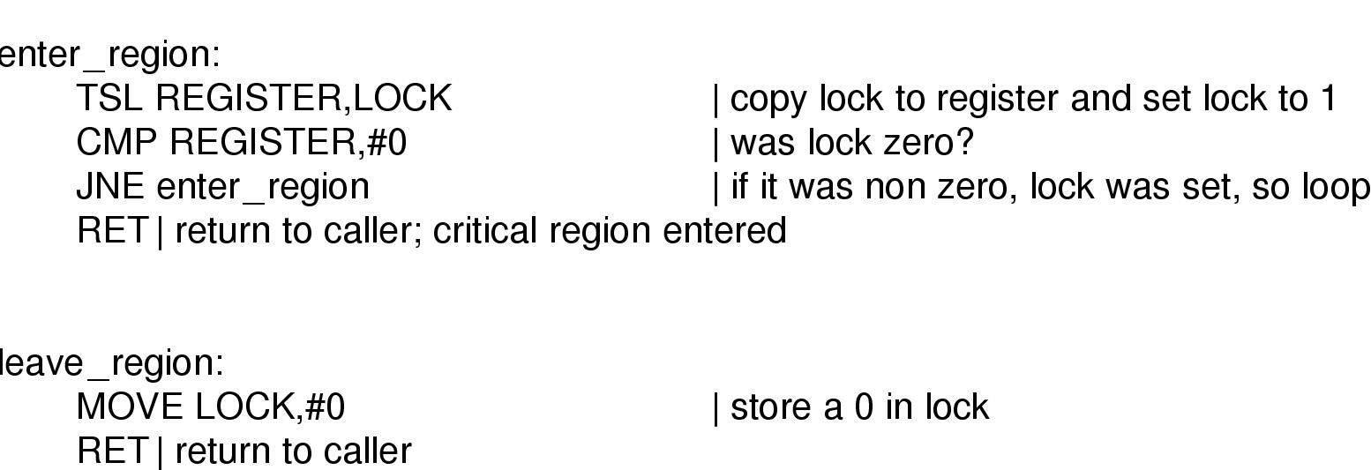
TSL instruction

Slide 7
Other Similar Hardware Instruction
Swap = TSL
void Swap (char* x,* y);
\\ All done atomically
{ char temp = *x;
*x = *y;
*y = temp
}

Slide 8
Sleep and Wakeup
Problem with previous solutions
  Busy waiting
  Wasting CPU
  Priority Inversion:
    a high priority waits for a low priority to leave the critical section
    the low priority can never execute since the high priority is not blocked.
Solution: sleep and wakeup
  When blocked, go to sleep
  Wakeup when it is OK to retry entering the critical section

Slide 9
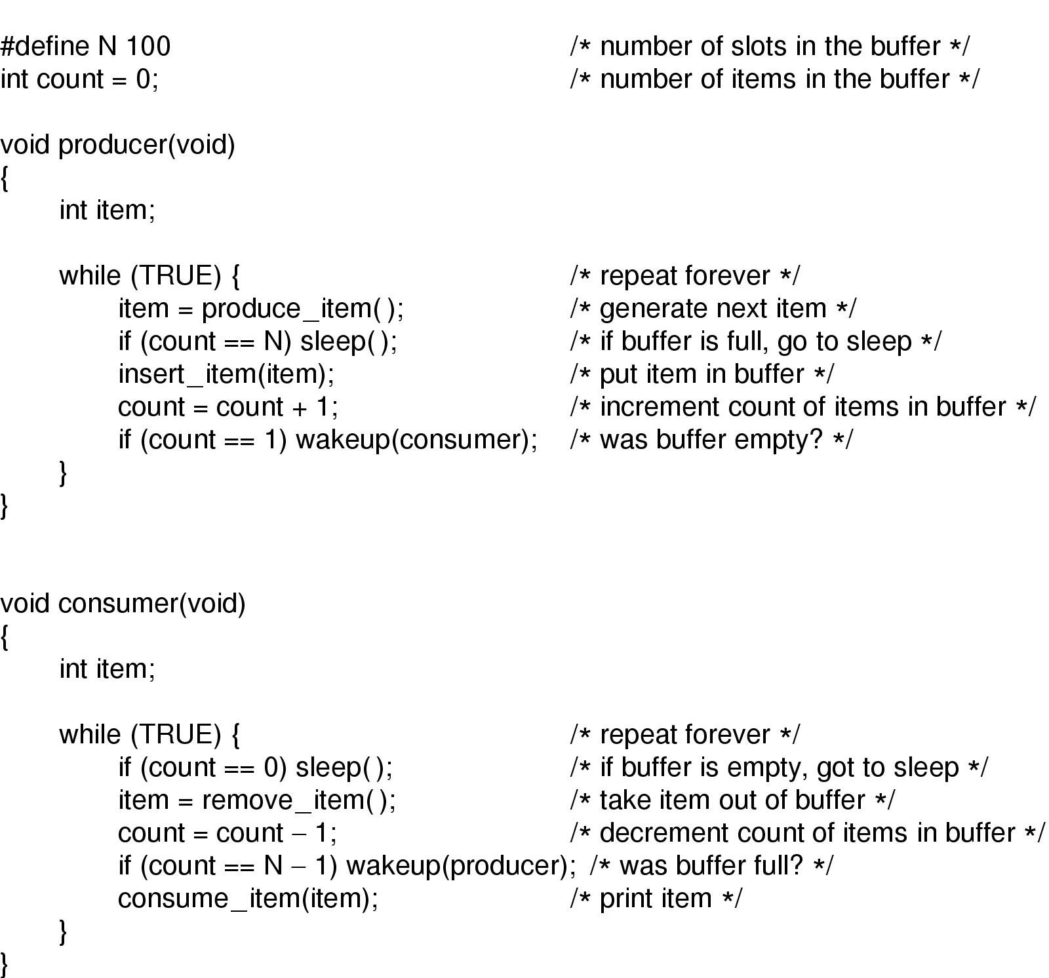
Producer-Consumer Problem (Problem?)

Slide 10
Semaphores
A semaphore count represents count number of abstract resources.
New variable having 2 operations
  The Down (P) operation is used to acquire a resource and decrements count.
  The Up (V) operation is used to release a resource and increments count.
Any semaphore operation is indivisible (atomic: what else we have talked before is atomic?)
Semaphores solve the problem of the wakeup-bit

Slide 11
What’s Up? What’s Down?
Definitions of P and V:
  Down(S) {
    while (S <= 0) { }; // no-op
    S= S-1;
    }
  Up(S) {
  S++;
  }
Counting semaphores: 0..N
Binary semaphores: 0,1

Slide 12
Mutex: Binary Semiphore
Variable with only 2 states
  Lock
  Unlock
Simplified version of semaphore
Mutex is used for mutual exclusion

Slide 13
Mutex Implementation using TSL
2-3 person group discussion (2 minutes)
Using Test_and_Set (TSL) instruction to implement
  Mutex_lock
  Mutex_unlock

Slide 14
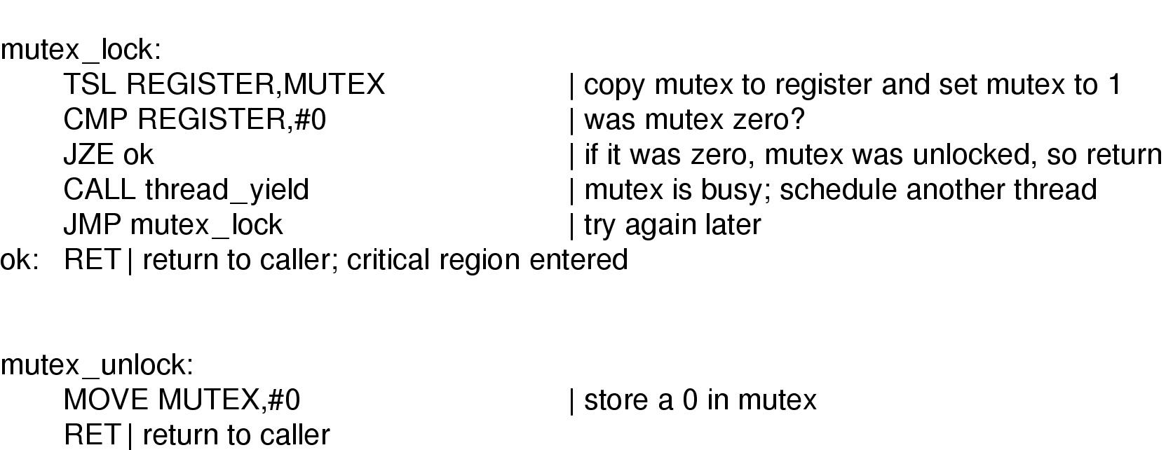
Mutex Implementation using TSL
Implementation of mutex_lock and mutex_unlock

Slide 15
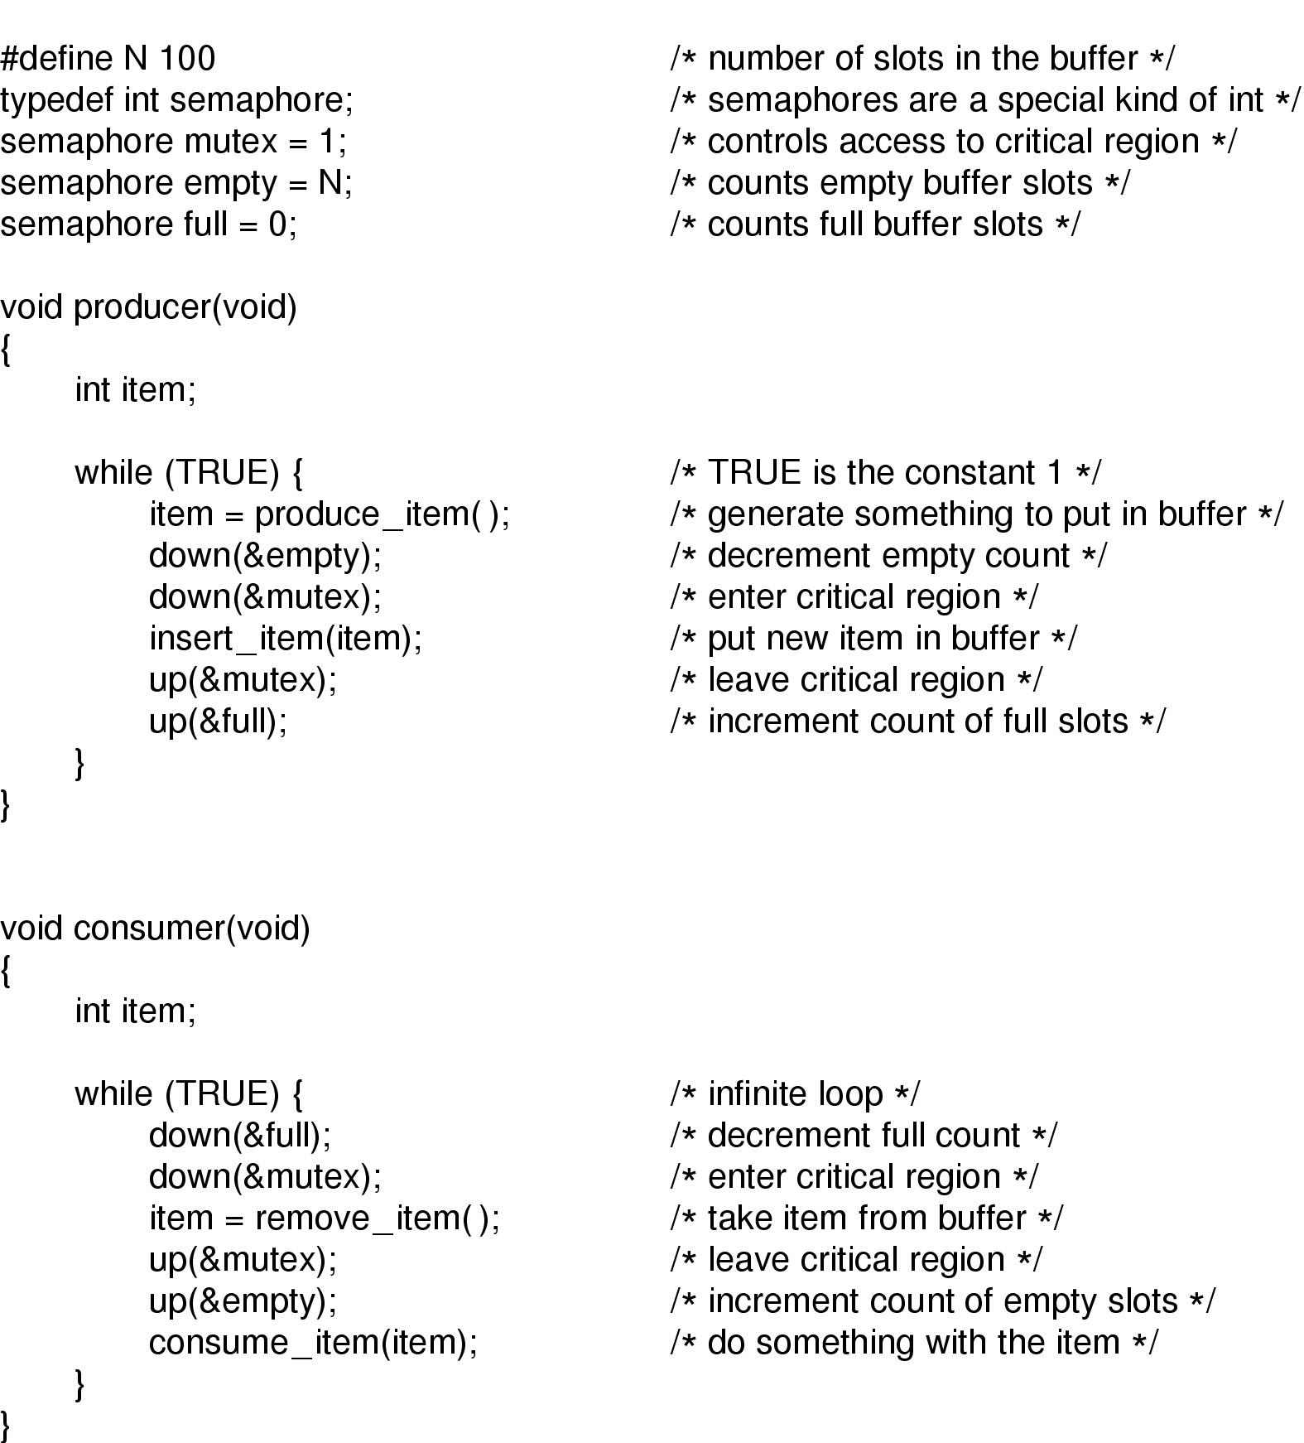
Producer-Consumer Problem using Semaphores

Slide 16
Using Mutex to Implement Semaphores
2-3 person group discussion (2 minutes)
Using mutex_lock and mutex_unlock to implement a counter semaphore
  Up
  Down

Slide 17
Busy Wait Semaphore Implementation (1)
class Semaphore {
Mutex m; // Mutual exclusion.
int count; // Resource count.
public:
Semaphore( int count );
void Up();
void Down();
};
static inline Semaphore::Semaphore( int count )
{
count = count;
}

Slide 18
Busy Wait Semaphore Implementation(2)
void
Semaphore::Down()
{ mutex_lock(m);
while ( count == 0 )
{
mutex_unlock(m);
yeild();
mutex_lock(m);
}
count--;
mutex_unlock(m);
}
void
Semaphore::Up()
{
mutex_lock(m);
count++;
mutex_unlock(m);
}

Slide 19
Implementations of Semaphore using Sleep & Wakeup
type Semaphore = record
value:integer;
L: list of processes;
Semaphore S;
Down(S):
S.value:= S.value - 1;
if S. value < 0 then
{
add this process to the S.L;
block;
};
Up(S):
S.value:= S.value + 1;
if S.value > 0 then
{
remove process P from S.L;
wakeup(P);
}
Does it work?

Slide 20
Tradeoffs
Busy waiting (spinlock)
  Waste CPU cycles
Sleep&Wakeup (blocked lock)
  Context switch overhead
Hybrid competitive solution (spin-block)
  Apply spinlocks if the waiting time is shorter than the context switch time
  Use sleep & wakeup if the waiting time is longer than the context switch time

Slide 21
Possible Deadlocks with Semaphores
Example:
P0 P1
share two semaphores S and Q
S:= 1; Q:=1;
wait(S); // S=0 ------------> wait(Q); //Q=0
wait(Q); // Q= -1 <--------
--------------------> wait(S); // S=-1
// P0 blocked // P1 blocked
DEADLOCK
signal(S); signal(Q);
signal(Q); signal(S);

Slide 22
Be Careful When Using Semaphores
// Violation of Mutual Exclusion
signal(mutex); mutexUnlock();
critical section criticalSection();
wait(mutex); mutexLock();
// Deadlock Situation
wait(mutex); mutexLock();
critical section criticalSection();
wait(mutex); mutexLock(P);
// Violation of Mutual Exclusion (omit wait(mutex)/mutexLock())
critical section critical Section();
signal(mutex); mutexUnlock();
// Deadlock Situation (omit signal(mutex)/mutexUnlock())
wait(mutex); mutexLock();
critical section criticalSection();

Slide 23
Monitor
A simpler way to synchronize
A set of programmer defined operators
monitor monitor-name
{
// variable declaration
public entry P1(..);
{... };
......
public entry Pn(..);
{...};
begin
initialization code
end

Slide 24
Monitor Properties
The internal implementation of a monitor type cannot be accessed directly by the various threads.
The encapsulation provided by the monitor type limits access to the local variables only by the local procedures.
Monitor construct does not allow concurrent access to all procedures defined within the monitor.
Only one thread/process can be active within the monitor at a time.
Synchronization is built in.

Slide 25
Barriers
Use of a barrier
  processes approaching a barrier
  all processes but one blocked at barrier
  last process arrives, all are let through
Problem:
  Waste CPU if workloads are unbalanced

Slide 26
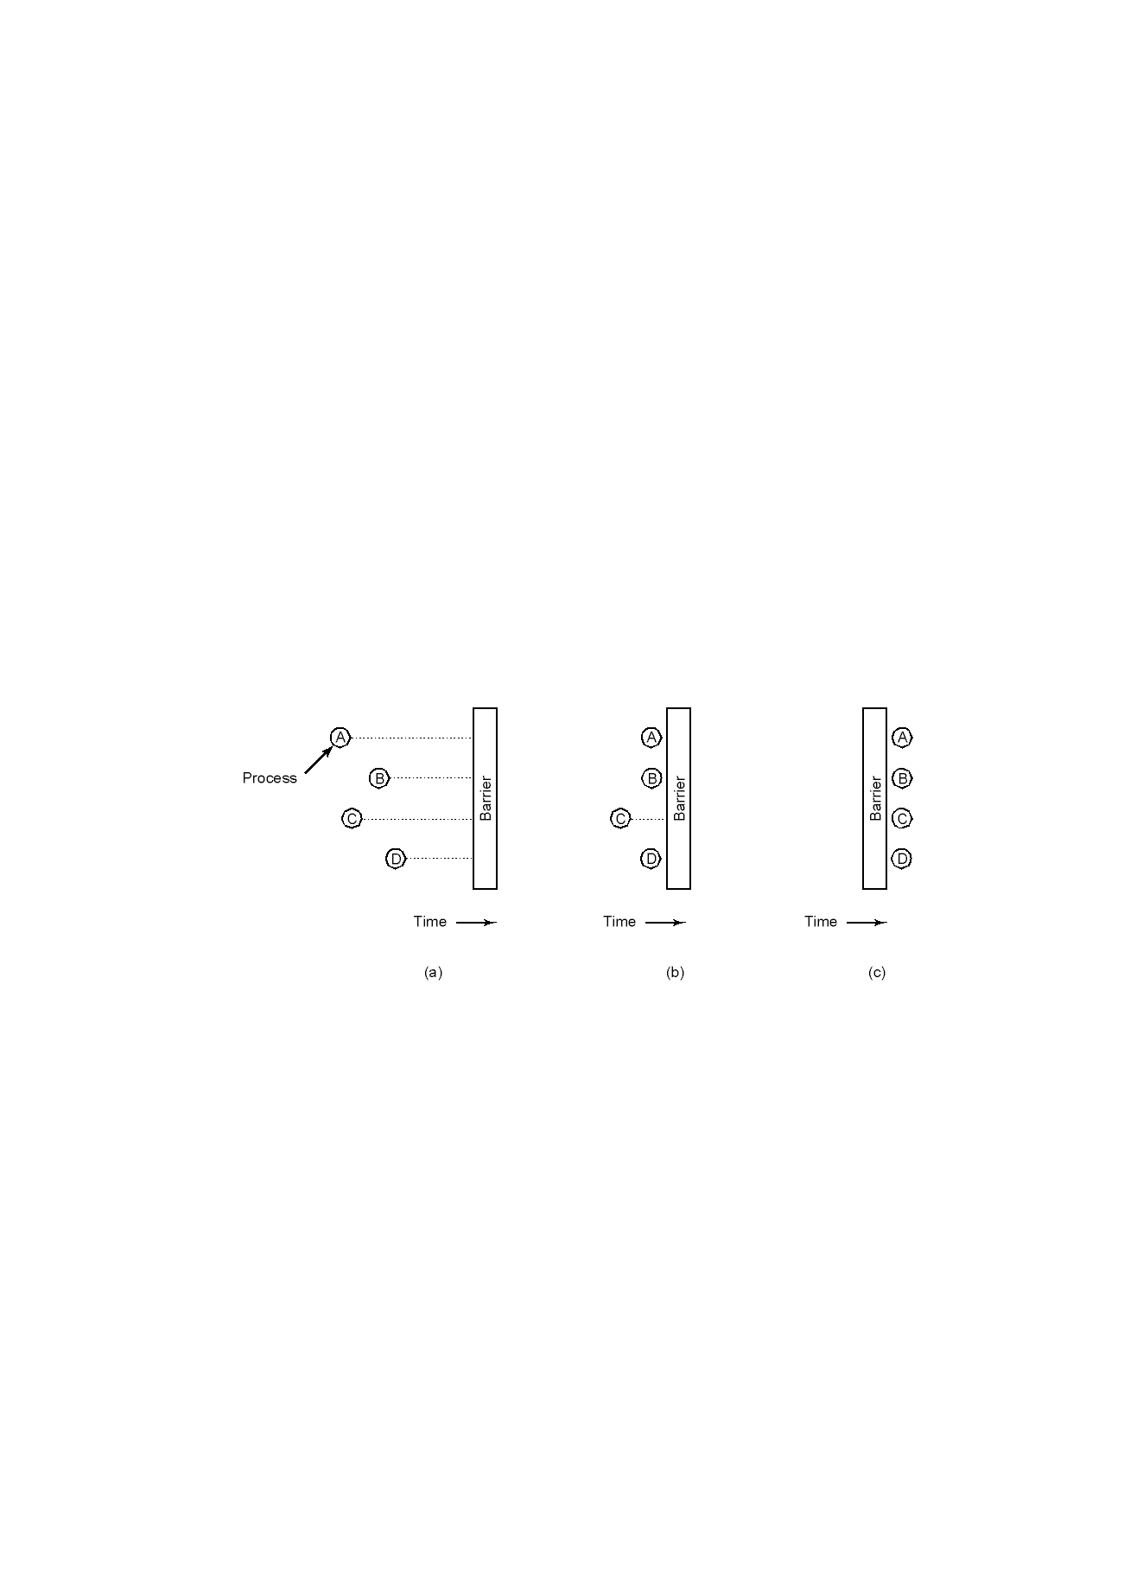
Barriers

Slide 27
Next lecture: Classic Problems
Producer-Consumer problem
Bounded buffer problem
First Reader-writer problem
Dining philosophers problem

Slide 28
Reminder
MP1 due this Friday

