Slide 1
ECE291
Lecture 1
All about computers

Slide 2
Lecture outline
Top-down view of computers
Processor architecture
Registers
Memory
Peripherals
Assembly primer
Assignments

Slide 3

Computers from 50,000 feet
Basic components
  Mouse
  Keyboard
  Monitor
  Printer
  Scanner
  Joystick
  “The box”

Slide 4
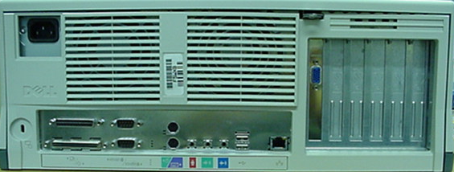
Computers from 10,000 feet
Power
Keyboard/Mouse
USB
VGA
Expansion
Parallel
SCSI
Serial
Sound card
Network

Slide 5
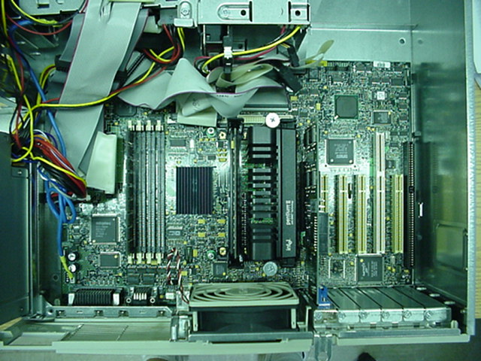
Computers from 100 feet
IDE and SCSI cables and devices
Motherboard
Memory
Processor
Power supply
Expansion bus
Cooling fan

Slide 6
Computers from 10 feet
Motherboard
Memory
CPU
Expansion
Bus
Control
Address
Data
Peripherals

Slide 7
Computers from 10 feet
Motherboard
Processor
8088
8086
80286
80386dx
80486
80586/Pentium (Pro)
Data Bus
8
16
16
32
32
64
Address Bus
20
20
24
32
32
32
Max Addressable Memory
1,048,576 (1Mb)
1,048,576 (1Mb)
16,777,21 (16Mb)
4,294,976,296 (4Gb)
4,294,976,296 (4Gb)
4,294,976,296 (4Gb)

Slide 8
Computers from 1 micron
Central Processing Unit – The Processor
Control
registers
ALU
BIU
Control
General
purpose
registers
Control
Address
Data
Special
(floating-point,
flag, sse)

Slide 9
The processor
It’s a state machine
Has a set of hard-coded operations
  Each operation has an associated code;
  an “opcode”
  Some examples are MOV, ADD, SUB, AND
All it can do is move data or perform some calculation on data
Very simple, right?

Slide 10
The processor - components
CPU Registers
  Special memory locations constructed from flip-flops and implemented on-chip
  E.g., accumulator, count register, flag register
Arithmetic and logic Unit (ALU)
  Where most of the action takes place inside the CPU
Bus Interface Unit (BIU)
  Responsible for controlling the address and data busses when accessing main memory and data in the cache
Control Unit and Instruction Set
  CPU has a fixed set of instructions
  E.g. MOV, CMP, ADD, JMP

Slide 11
The registers
Small memory locations that are quickly accessible by the processor
Hold data and results for operations
Point to memory locations
Contain status information about the results of operations

Slide 12
80x86 registers
General Purpose
Special Registers
Accumulator
AH
AL
Index Registers
AX
Instr Pointer
IP
EAX
EIP
Stack Pointer
SP
Base
BH
BL
Flags
FLAG
ESP
BX
EFLAG
Base Pointer
EBX
BP
EBP
Count
CH
CL
Segment Registers
Dest Index
CX
DI
ECX
EDI
CS
Code Segment
Source Index
SI
Data
DH
DL
DX
DS
Data Segment
ESI
EDX
ES
Extra Segment
SS
Stack Segment
FS
GS

Slide 13
Register specifics
Accumulator (AL, AH, AX, EAX)
  Usually stores results from the ALU
  It “accumulates” totals from math operations
  General purpose
Base (BL, BH, BX, EBX)
  Usually holds addresses – points to memory locations

Slide 14
Register specifics
Count (CL, CH, CX, ECX)
  Counting and looping
  Certain instructions automatically decrement the count register
Data (DL, DH, DX, EDX)
  Usually contains data for instructions
  Contain the most significant bytes of 16-bit Mul/div’s

Slide 15
Register specifics
Stack pointer (SP, ESP)
  Used by stack operations
  Usually you don’t want to mess with this one
Base pointer (BP, EBP)
  Addresses stack memory
  Can be used to read subroutine arguments

Slide 16
Register specifics
Source index (SI, ESI)
  Often used to address a source array or string data type
Destination index (DI, EDI)
  Often used to address a destination array or string data type

Slide 17
Register specifics
Code segment (CS)
  Points to the area in memory where instructions are stored
Instruction pointer (IP)
  An index into the code segment that points to the next instruction to be executed
Data segment (DS)
  Points to the area in memory where data needed by a program is stored

Slide 18
Register specifics
Stack segment (SS)
  Points to the area in memory containing the system’s FIFO stack. We’ll have a whole lecture on this.
ES, FS, GS
  Extra segment registers available to point to additional data segments should that be necessary.

Slide 19
Memory
System memory or RAM holds data and instruction opcodes that are being used by the CPU
Organized in banks, usually even and odd
Always byte addressable
More on all this tomorrow

Slide 20
Memory access example
CPU wants to read memory at address 12345h
CPU
Memory
Read Signal
12345h
Data

Slide 21
Memory organization
Odd Bank
Even Bank
F
90
87
E
D
E9
11
C
B
F1
24
A
9
01
46
8
7
76
DE
6
5
14
33
4
3
55
12
2
1
AB
FF
0
Data Bus (15:8)
Data Bus (7:0)

Slide 22
Memory organization
In Real Mode:
  The address bus is 20-bits for memory operations.
  2²⁰ = 1MB = how much memory an x86 processor can address in real mode
  The data bus is 16-bits which means it can transfer two bytes in one operation
  Limited to 16-bit registers

Slide 23
Memory organization
In Protected Mode:
  The memory address bus is 32-bits
  2³² = 4GB = the maximum addressable amount of memory in modern x86 processors
  Data bus is also 32-bits meaning four bytes can be transferred in a single operation
  Gain access to the 32-bit extended registers

Slide 24
Peripherals
In our context, things like printers, joysticks, and scanners aren’t peripherals
Some examples are parallel, serial and USB ports, the internal timers, interrupt controllers, network interface cards
Many helper devices inside the processor, on the mother board, or in expansion slots

Slide 25
Peripheral I/O bus
There is a separate set of address/data busses commonly used for communication with peripheral devices
In reality, they’re the same busses, just different signals in the control bus cause different things to happen
The I/O address bus is 16-bits wide, meaning you can address 65,535 different I/O ports.
The I/O data bus is 16-bits

Slide 26
Peripheral I/O
Peripheral devices don’t have to use the I/O bus. They can be memory mapped.
Video cards are an example
They have a large amount of memory (VRAM) and that is typically mapped to a range of addresses in the memory space

Slide 27
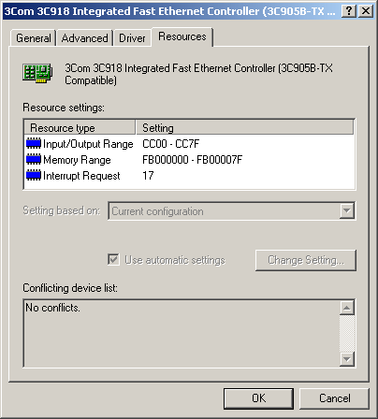
Peripheral example
Network card
Input/Output Range CC00-CC7F
Memory Range FB000000-FB00007F
This one is both memory mapped and I/O mapped

Slide 28
Peripherals
All this really means to you is that sometimes you’ll use one set of instructions to access a device, and sometimes you’ll use a different set.
We’ll talk about this again when we cover serial/parallel ports, timers, interrupts, and the video graphics adapter.

Slide 29
Instruction processing
Processing of an instruction by the microprocessor consists of three basic steps
  fetch instruction from the memory
  decode the instruction
  execute (usually involves accessing the memory for getting operands and storing results)
Operation of an early processor like the Intel 8085
Fetch
1
Decode
1
Execute
1
Fetch
2
Decode
2
Execute
2
…...
Microprocessor
Busy
Idle
Busy
Busy
Idle
Busy
…...
Bus

Slide 30
Instruction processing
Modern microprocessors can process several instructions simultaneously at various stages of execution
  this ability is called pipelining
Operation of a pipelined microprocessor like the Intel 80486
Modern microprocessors can process several instructions simultaneously at various stages of execution
  this ability is called pipelining
Operation of a pipelined microprocessor like the Intel 80486
Fetch
1
Fetch
2
Fetch
3
Fetch
4
Store
1
Fetch
5
Fetch
6
Read
2
Fetch
7
Bus Unit
Decode
1
Decode
2
Decode
3
Decode
4
Idle
Decode
5
Decode
6
Idle
Instruction Unit
Execute
1
Execute
2
Execute
3
Execute
4
Idle
Execute
5
Execute
6
Execution Unit
Generate
Address
1
Generate
Address
2
Address Unit

Slide 31
Assembly primer
Everything in your assembly file is one of the following:
  A comment
  A label
  An instruction or directive
  Data

Slide 32
Assembly primer - comments
; Comments are denoted by semi-colons.
; These are comments!!! Yeah!!!.
; Please comment your MP’s thoroughly.
; It helps us figure out what you were doing
; It also helps you figure out what you were
; doing when you look back at code you
; wrote more than two minutes ago.

Slide 33
Assembly primer
You might be asking, “What about variables? Why aren’t they on the bulleted list?”
Variables are nothing more than labels that mark specific memory locations
Labels can also mark the beginning of procedures or “jump to” locations in your code

Slide 34
Assembly primer - labels
; Labels can be global
MyGlobalLabel:
MyOtherGlobalLabel
; They can be local too
.MyLocalLabel
; Local labels are good only back to the previous un-dotted label

Slide 35
Assembly primer - labels
MyBigGlobalLabel
.local_label1
.local_label2
MyNextBigGlobalLabel
.local_label1 ; these are distinct
.local_label2 ; to the ones above

Slide 36
Assembly primer - variables
; Let’s do something with labels now
VAR1 DB 255
VAR2 DB 0FFh
VAR3 DW 1234h
ARR1 DB 12, 34, 56, 78, 90
ARR2 DW 12, 34, 56, 78, 90
STR1 DB ‘291 is awesome!!!’, 0
BUF1 RESB 80
labels
directives
data

Slide 37
Assembly primer - directives
EXTERN – allows you to declare external procedures so you can use them in your program.
SEGMENT – lets you declare the beginning of a memory segment. We’ll talk in detail about memory segments tomorrow.
EQU – lets you define pre-processor constants.

Slide 38
Assembly primer - directives
; Let’s declare some external functions
EXTERN kbdine, dspout, dspmsg, dosxit
; Let’s begin our code segment
SEGMENT code
; I’d normally put my variables right here
..start ; This is a special label that
; denotes the execution starting
; point. The next instruction
; after ..start will be the first
; to run when you execute your program

Slide 39
Assembly primer - instructions
; Here are some simple instructions
mov ax, [VAR1] ; notice the brackets
mov dx, STR1 ; notice the not brackets
call dspmsg
jmp done
mov bx, [VAR2] ; this will never happen
done

Slide 40
Example
SEGMENT code
var1 db 55h ; 55
var2 db 0AAh ; AA
var3 db 12h ; 12
str1 db "Hello", 0 ; 48 65 6C 6C 6F 00
..start
mov al, [var1] ; A0 00 00
mov bx, var3 ; BB 02 00
inc bx ; 43
mov al, [bx] ; 8A 07

Slide 41
Assignments
Keep working on MP0 and HW0

