Slide 1
ECE291
Lecture 11
Text mode video

Slide 2
Lecture outline
Comments on the exam
Video display hardware
Text video mode
Controlling and accessing video display using DOS and BIOS functions
Accessing the video memory directly

Slide 3
Video output
Video is the primary form of communication between a computer and a human.
The monochrome (single color) monitor uses one wire for video data, one for horizontal sync, and one for vertical sync.
A color video monitor uses three video signals: red, green, & blue
  these monitors are called RGB monitors and convert the analog RGB signals to an optical image.
The RGB monitor is available as either an analog or TTL (digital) monitor.

Slide 4
TTL RGB monitor
Uses TTL level signals (0 or 5V) as video inputs (RGB) and an extra signal called intensity to allow change in intensity
Used in the CGA (Color Graphics adaptor) system found in older computers
Can display a total of 16 different colors (eight are generated at high intensity and eight at low intensity)
Example:
Intensity Red Green Blue Color
0 0 0 0 Black
1 0 0 0 Gray
1 0 1 0 Light green
1 1 0 0 Light red
1 1 1 1 Bright white

Slide 5
The analog RGB monitor
Uses analog signals - any voltage between 0.0 V and 0.7 V
This allow an infinite number of colors to be displayed
In practice a finite number of levels is generated (16K, 256K, 16M, colors depending on the standard)
Analog displays use a digital-to-analog converter (DAC) to generate each color video voltage
A common standard uses a 6-bit DAC to generate 64 different video levels between 0 V and 0.7 V
  this allows 64x64x64 colors to be displayed, or 262,144 (256 K) colors
8-bit DACs allow 256x256x256 or 16M colors

Slide 6
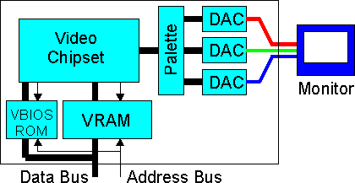
The analog RGB monitor
The Video Adapter converts digital information from the CPU to analog signals for the monitor.
VRAM/DRAM Video/Dynamic Random Access Memory
  Stores screen content
Video BIOS
  Stores character mappings
Palette registers
  Defines R/G/B color values
Graphic accelerator
  Hardware implemented
  graphic routines
DAC
  Generates analog Red/Green/Blue signals

Slide 7
The analog RGB monitor
Example: video generation used in video standards such as EGA (enhanced graphic adapter) and VGA (variable graphics array)
A high-speed palette SRAM (access time less than 40ns) stores 256 different codes that represent 256 different hues (18-bit codes)
This 18-bit code is applied to the DACs
The SRAM is addressed by 8-bit code that is stored in the computer VRAM to specify color of the pixel
Once the color code is selected, the three DACs convert it to three video voltages for the monitor to display a picture element (pixel)

Slide 8
The Analog RGB Monitor
Example of Video Generation (cont.)
Any change in the color codes is accomplished during retrace (moving the electron beam to the upper left-hand corner for vertical retrace and to the left margin of the screen for horizontal retrace)
The resolution and color depth of the display (e.g., 640x400) determines the amount of memory required by the video interface card
640x400 resolution with 256 colors (8 bits per pixel) 256K bytes of memory are required to store all the pixels for the display

Slide 9
Text mode video
There is not a single common device for supporting video displays
There are numerous display adapter cards available for the PC
Each supports several different display modes
We’ll discuss the 80x25 text display mode which is supported by most of display adapters
The 80x25 text display is a two dimensional array of words with each word in the array corresponding a character on the screen
Storing the data into this array affects the characters appearing on the display

Slide 10
Text mode video
Each text page occupies under 4K bytes of memory
80(columns) x 25 (rows) x 2 (bytes) = 4000 bytes
The LO byte contains the ASCII code of the character to display
The HO byte contains the attribute byte
Display adapters provide 32 K for text displays and let you select one of eight different pages
Each display begins on a 4K boundary, at address:
  B800:0000, B800:1000, B800:2000, …. B800:7000

Slide 11
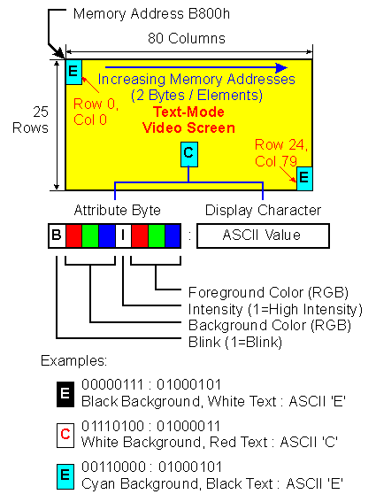
Text mode video
The attribute byte controls underlying background and foreground colors, intensity and blinking video
Choose your colors with care
(some combinations of foreground and background colors are not readable)
Do not overdo blinking text on the screen

Slide 12
The cursor
A pointer to the “insertion point” on the screen
When you use DOS/BIOS functions to display a character, it displays where the cursor points
The cursor then moves to the next column
Other functions let you move backwards or up/down

Slide 13
DOS/BIOS functions revisited
Recall INT 21h functions
  02h, 06h output characters to screen at current cursor position
  09h output ‘$’ terminated string to screen beginning at current cursor position
Recall INT 10h functions
  02h sets cursor position (including page)
  03h reads cursor position (including page)
  05h set active display page

Slide 14
Writing characters directly
Since the VRAM is memory mapped, you can use MOV instructions to write data directly to the display
Typically, we set the ES register to B800h so that the extra segment can be used to address the VRAM
Now video display can be accessed just like a 2D word array

Slide 15
Example
Calculate the offset from the beginning of the VRAM segment (B8000h) for an arbitrary page (P), row (Y) and column (X) in an 80x25 text display mode
  Offset = 1000h * page + 160 * Y + 2*X

Slide 16
String instructions
Idea: Setup a data transfer and go
Do an operation on source [DS:SI] and destination [ES:DI] and change SI and DI depending on the direction flag
Transfer data much more quickly than loops and movs
Think of the following instructions in terms of their equivalents
  You can’t do memory to memory operations with other opcodes.
  The add’s at the end of the equivalent code don’t affect the flags.

Slide 17
String instructions
MOVS – Move source to destination
Mov byte [es:di], byte [ds:si]
add si, 1 ; if CLD
add di, 1
CMPS – Compare source to destination and set ZF if [ES:DI] = [DS:SI]
cmp byte [es:di], byte [ds:si]
add si, 1 ; If CLD
add di, 1

Slide 18
String instructions
STOS – Store AL/AX/EAX into destination
mov byte [es:di], al
add di, 1 ; If CLD
LODS – Load destination into AL/AX/EAX
mov al, byte [ds:si]
add si, 1 ; If CLD
SCAS – Compare destination to AL… and set ZF if [ES:DI] = AL…
cmp byte [es:di], al
add di, 1 ; If CLD

Slide 19
String instructions
Each of the instructions should be appended with B, W or D for byte, word, or double word sized transfers.
REP – What makes all this useful
  This is a prefix to the above opcodes
  REP/REPE/REPZ
    DEC CX
    LOOP until CX = 0 while ZF = 1
  REPNE/REPNZ
    DEC CX
    Loop until CX = 0 while ZF = 0

Slide 20
String instructions
; Example: Copying a display buffer to the screen
CLD ; clear dir flag so we go up
; setup source
MOV SI, DisplayBuffer ; offset with respect to DS
; setup destination
MOV AX, VidGrSeg ; B800
MOV ES, AX ; set destination segment as ES
MOV DI, 0 ; start of screen
; setup counter
MOV CX, (320*200 / 4) ; moving 4 bytes at a time
REP MOVSD ; this takes awhile

