Slide 1
ECE291
Lecture 12
Mode 13h Graphics

Slide 2
Lecture outline
Color theory
Video Hardware
Mode 13h
Graphics File Formats

Slide 3
Color theory
TV’s, Computer Monitors, Projectors…
It’s all Red, Green, Blue
Why RGB? These are the primary colors for visible light. You can get all the colors by mixing them.
Red + Green = Yellow
Green + Blue = Cyan
Blue + Red = Purple

Slide 4
Color Theory - Biology
How can mixing a Low Frequency with High Frequency make Really High Frequency?
It can’t. Remember your ECE 210. It’s all biological.
Our eyes have red, green, and blue sensors. These are the colors we can see best (ie, the frequencies for which we have color receptors)
The people who invented color photography and color TV used this fact.

Slide 5
Color Theory - Biology
If three-eyed aliens with different color receptors visited us, they’d “see” the same three frequencies coming from the monitor, but they wouldn’t be able to see any pictures.
The same goes for your dog that wonders why you spend hours looking at a blank screen.

Slide 6
Full Color Images
Each pixel has a Red, Green, and Blue value.
24-bit color means 1 red byte, 1 green byte, 1 blue byte. Each determines the color intensity (0 = none, 255 = full) of their respective color components.
16-bit color means 5 bits red, 5 bits green, 5 bits blue. The extra bit is sometimes a green bit depending on the system.
Full color is when we use a given number of bits to specify the intensity of each color component.

Slide 7
24-bit Full Color Images
24-bit color allows 256 different intensities for each color component. This allows for 2²⁴ or 16,777,216 different colors.
That’s way more than our eyes can distinguish.
This 24-bit color is sometimes called Full or True color.
True color requires 3 bytes for every pixel.

Slide 8
16-bit Full Color Images
16-bit color allows 32 different intensities for each color component. This allows for 2¹⁵ or 32,768 different colors (assuming 5 bits green)
Not quite as good as True color, 16-bit color is also referred to as High color.
High color requires 2 bytes for every pixel.

Slide 9
Full Color Images
Positives of high and true color images
  More colors means higher quality pictures
  Easier to do image manipulation (math)
    Make everything a little redder
    Blur an image by averaging RGB values of adjacent pixels
Negatives of high and true color images
  Take up a lot more memory
    Ex: A 320x200 pixel image with 24-bit color needs
    320 x 200 x 3 = 192,000 bytes of memory

Slide 10
Color Palettes
While we’d like to do everything in full color, in real mode we need to reduce the amount of memory our images use.
The color palette contains the 3-byte RGB values of 256 different colors.
The image data is then just a bunch of indexes into this palette. It’s a look-up table!

Slide 11
Color Palettes
Positives of palettes
  Less memory and bandwidth needed to store and move pictures
  You can do some cool stuff with palettes
    Invisible pixels – assign one palette entry to be “clear” and when you’re copying one image over another, don’t copy the “clear” pixels.
    You can cycle the palette for 60’s psychedelic effects.
    You can fade out a screen just by subtracting from each entry in the palette table until they’re all zero

Slide 12
Color Palettes
Negatives of palettes
  Fewer colors (at most 256) mean lower quality pictures
  Harder to do manipulation
    Average blurring is harder because new color isn’t in palette
  All “real” images come in full color and have to be converted
    This is hard because you have to choose a good palette
    For each “full color” pixel, find closest palette entry
  When you put images together, they share same palette

Slide 13
Text Mode Video Revisited
Text mode video is kind of like a form of palette
Each ASCII byte is an index into a font table with a bitmap for each character
Each Mode Byte is an index into a type of palette
Or you can think of the mode byte as 3-bit full color (kind of)

Slide 14
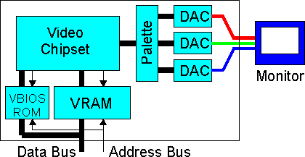
Video Hardware
You’ve got a chunk
of memory
You write to the
memory through
memory mapped
I/O (MP3)
In a analog RGB monitor, three electron beams sweep across all rows 60 to 85 times a second to zap the phosphor elements to make them glow
The video card adjusts the intensity of the three electron beams in real time as they are sweeping to correspond to the intensities specified in the VRAM

Slide 15
Video Hardware
To do this, the
video card reads
out a whole row of
RGB values in the
VRAM and shifts
them “out” in a big
shift register.
The byte that “falls off the edge” gets converted into an intensity for the electron beam.
With a palette, there is an additional step. Before data shifts out, it looks up the “real” RGB value in palette memory.

Slide 16
Mode 13h
Mode 13h is a 320 x 200 x 256-color graphics display mode that was very popular for DOS programming due to its relatively high number of colors (256 vs 16 for other VGA modes) and simple addressing.
320 x 200 = 64000 pixels. With 1 byte per pixel this easily fits in a single real-mode segment.
It’s linear just like text mode. The pixels increase in memory as you go from left to right, while each row immediately follows the previous one.
Offset = row*320 + col

Slide 17
Mode 13h - How to get there
The following instructions get you into Mode 13h video
mov ah, 0 ; int 10h’s set mode subfunction
mov al, 13h ; The aptly named Mode 13h
int 10h ; Call the Video BIOS interrupt

Slide 18
Mode 13h
How to draw a pixel
The following instructions draw a pixel on the screen
VidGrSeg equ 0A000h
Location dw (200/2)*320+(320/2) ; Center
Color db 98 ; Some random palette index
mov ax, VidGrSeg
mov es, ax ; Use extra segment to address VRAM
mov bx, [Location] ; Offset to center of screen
mov al, [Color] ; Palette Entry Number
mov [es:bx], al ; Write it to the screen

Slide 19
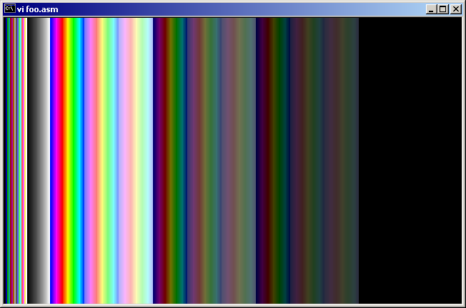
Mode 13h
The Default Palette

Slide 20
Mode 13h
How to change the palette
Method 1: Load an entire palette
  Write 0 to port 3C7h
  Write red, green, blue bytes to port 3C9h for all 256 colors
Method 2: Change just one palette entry using VBIOS call
  BX = Palette Number (0 – 255)
  CH = Green (0 – 63)
  CL = Blue (0 – 63)
  DH = Red (0 – 63)
  AX = 1010h ; Set VGA Palette Registers command
  INT 10h ; vBIOS call

Slide 21
Mode 13h
How to change the palette
; Change a palette entry to light purple
Red db 39
Green db 0
Blue db 63
Mov bx, 0 ; changing palette entry 0
Mov ch, [Green]
Mov cl, [Blue]
Mov dh, [Red]
Mov ax, 1010h
Int 10h

Slide 22

Graphics File Formats
Raster Formats
  Arrays of pixels (what we’ve been talking about)
  Raw pixels (.bmp)
  Run-Length encoding (.pcx)
  LZW encoding (.gif)
  Transform encoding (.jpg)
  Deflate (zip) compression (.png)

Slide 23
Graphics File Formats
Vector Formats
  Like PostScript or CorelDraw
  A vector file might have something like:
    “Draw line from (24, 56) to (87, 12)”
    “Here’s what an ‘A’ looks like….”
    “Not draw an ‘A’ at (75, 96)”
  Eventually converte to raster format by using a rasterizer
    Printers are very high resolution rasterizers (for example)

Slide 24
Graphics File Formats
Included in image files…
  Header: Most file formats start out with some kind of info about the image. For graphics files this info could be:
    Size (horizontal and vertical pixels)
    Color depth (bits per pixel)
    Version (makes life difficult…GIF89A, GIF97A, …)
    Compression Technique
  Palette: If you’re not using true color, you must include a palette for the image in the image file
  Data: Raw or compressed, raster or vector information.

Slide 25
Graphics File Formats
Bitmap (.bmp)
Included in image files…
  Header: Most file formats start out with some kind of info about the image. For graphics files this info could be:
    Size (horizontal and vertical pixels)
    Color depth (bits per pixel)
    Version (makes like difficult…GIF89A, GIF97A, …)
    Compression Technique
  Palette: If you’re not using true color, you must include the palette for the image in the image file
  Data: Raw or compressed, raster or vector information.

Slide 26
Graphics File Formats
Discussion of various graphics file formats. Go to
http://courses.ece.uiuc.edu/ece291/lecture/lockwood/l15.html

Slide 27
Announcement
Sandia National Labs Visit (HKN)
For more information visit
www.iansteiner.com/sandia.html

