Slide 1
ECE291
Lecture 16
Fun with graphics

Slide 2
Lecture outline
Bresenham’s Line Drawing Algorithm
Bresenham’s Circle Drawing Algorithm
Alpha blending

Slide 3
Drawing Lines Basic Algorithm
We want to draw line Y = m * X + b
m = Slope of line
b = Displacement
X = independent coordinate
Choose X so as to plot large number of points
Y = Dependent coordinate
Plot to nearest Y when fractions occur
Draw Line from (X1,Y1) to (X2,Y2)
m = dy/dx; dy = (Y2-Y1); dx = (X2-X1)
b = Y1 – m*X1
Plot(X, m*X+b) for X=X1... X2
This algorithm requires slow floating point math

Slide 4
Derivation of Bresenham’s Line Algorithm
Eliminates floating point calculations
Given two line endpoints, we are trying to find the “in-between” points on a pixel grid
The Bresenham’s line algorithm determines subsequent points from the start point by making a decision between the two next available points and selecting one that is closer to the ideal point
Start point (X1, Y1)
End point (X2, Y2)
Slope m = dy/dx
Current Point (X, Y)

Slide 5
Derivation of Bresenham’s Line Algorithm
(X + 1, Y + 1)
(X2, Y2)
T
S
(X1, Y1)
(X, Y)
(X + 1, Y)

Slide 6
Derivation of Bresenham’s Line Algorithm
If we restrict the slope for now to (0 <= slope <= 1) and assume (X1 < X2)
  step through x one pixel at a time to the right and determine what y value to choose next
  given current point (X, Y), next ideal point would be between
  (X + 1, Y) and (X + 1, Y + 1)
  must choose between (X + 1, Y) or (X + 1, Y + 1)
How do we decide between these points?
  must choose the closet point to the ideal

Slide 7
Derivation of Bresenham’s Line Algorithm
Determine S and T
S = (X + 1) * m - Y
T = 1 - S = 1 - (X + 1) * m + Y
Then S - T = 2 * (X + 1) * m - 2 * Y - 1
Select the next point:
if S < T go horizontal - next point (X + 1, Y)
if S > T go diagonal - next point (X + 1, Y + 1)

Slide 8
Derivation of Bresenham’s Line Algorithm
We want to develop a FAST algorithm; we create a decision variable (error) that can be used to quickly determine which point to use
E = (S -T)*dx
= 2*(X+1)*dy - 2*Y*dx - 1*dx
= 2*X*dy - 2*Y*dx + 2*dy - dx
NOTE, that m=dy/dx ; the quantity dx is non-zero positive

Slide 9
Derivation of Bresenham’s Line Algorithm
Let E be a function of X and Y -- E(X,Y) and assume our line passes through the origin (0,0)
E(0,0) = 2*dy - dx
E(X+1, Y+1) - E(X,Y) = Additive error for a diagonal move
Diagonal Move: E(X+1,Y+1) - E(X,Y) = 2*dy - 2*dx
E(X+1, Y) - E(X,Y) = Additive error for a horizontal
Horizontal Move: E(X+1,Y) - E(X,Y) = 2*dy

Slide 10
Algorithm for Drawing Lines in the First Octant
Draw_Line (X1, Y1, X2, Y2)
dx = X2 - X1
dy = Y2 - Y1
E = 2dy - dx
HoriMove = 2dy
DiagMove = 2dy - 2dx
Y = Y1
for X from X1 to X2
  set_pixel (X, Y)
  if E < 0 then (S < T)
  E = E + HoriMove
  else
  E = E + DiagMove
  Y = Y + 1
  end if
end for
end Draw_Line

Slide 11
Algorithm for Drawing Lines in the First Octant
The code should not use
  floating point numbers
  multiplication
  division
  comparison to any number other than zero (they are slower
It should be sufficient to use
  additions
  bit-shifts
  comparison to zero

Slide 12
Example (first octant)
(6, 2)
-6
E
-2
-6
-2
+2
-2
+2
(0, 0)
(X1,Y1) = (0,0)
(X2,Y2) = (6,2)
dx=6
dy=2
E = 4-6 = -2
HoriMove = 4
DiagMove = -8
X Y E
0 0 4-6 = -2
1 0 -2+4 = +2
2 1 +2-8 = -6
3 1 -6+4 = -2
4 1 -2+4 = +2
5 2 +2-8 = -6
6 2 -6+4 = -2

Slide 13
Example (Seventh Octant)

Slide 14
Example (Seventh Octant)
(0, 0)
Swap X1, Y1
and X2, Y2
INC X by -1
(X will change
from 0 to -6)
-2
(Y1,X1) = (0,0)
(Y2,X2) = (-6,2)
dx=6
dy=2
HoriMove = 4
DiagMove = -8
+2
X Y E
0 0 4 - 6 = -2
-1 0 -2+4 = +2
-2 1 +2- 8 = -6
-3 1 -6+4 = -2
-4 1 -2+4 = +2
-5 2 +2- 8 = -6
-6 2 -6+4 = -2
-6
-2
+2
-6
E
Set pixel
(Y, X)
-2
(2, -6)

Slide 15
Drawing Lines in All Eight Octants
There are eight regions (octants) in which the algorithm should work
Swap X1, Y1
Swap X2, Y2
set_pixel(Y,X)
Swap X1, Y1
Swap X2, Y2
set_pixel(Y,X)
INC X by -1
set_pixel(X,Y)
INC Y by -1
INC X by -1
set_pixel(X,Y)
INC Y by -1
set_pixel(X,Y)
Swap X1, Y1
Swap X2, Y2
INC Y by -1
INC X by -1
set_pixel(Y,X)
Swap X1, Y1
Swap X2, Y2
INC X by -1
set_pixel(Y,X)

Slide 16
Drawing circles
Circles are symmetric about the x and y axes, as well as their 45º lines
We only have to figure out the pixels for one octant of the circle!
Bresenham has an algorithm for doing this

Slide 17
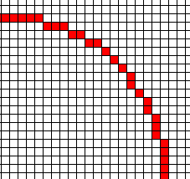
Drawing circles
e = 3 - (2 * r)
x = 0
y = RADIUS
Do Until x = y
PutPixel(CenterX + X, Center Y + Y)
PutPixel(CenterX + X, Center Y - Y)
PutPixel(CenterX - X, Center Y + Y)
PutPixel(CenterX - X, Center Y - Y)
PutPixel(CenterX + Y, Center Y + X)
PutPixel(CenterX + Y, Center Y - X)
PutPixel(CenterX - Y, Center Y + X)
PutPixel(CenterX - Y, Center Y - X)
if e < 0 then
e = e + (4 * x) + 6
else
e = e + 4 * (x - y) + 10
y = y - 1
end
x = x + 1
End do
Start here
End here
Center

Slide 18
Drawing circles
http://www.gamedev.net/reference/articles/article767.asp
http://www.rpi.edu/dept/ecse/graphics-f99/Classes/24/

Slide 19
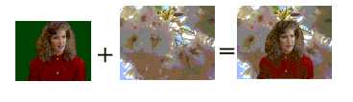
Overlaying images

Slide 20

Overlaying images
X1 = green
X2 != green
X3 = green
X4 != green
……….
pcmpeqw
green
green
green
green
Bitmask
4pixel/cycle
FFFF
0000
FFFF
0000

Slide 21



Overlay of the Image
pandn
pand
FFFF
0000
FFFF
0000
FFFF
0000
FFFF
0000
X1
X2
X3
X4
Y1
Y2
Y3
Y4
0000
X2
0000
X4
por
Y1
0000
Y3
0000
Y1
X2
Y3
X4

Slide 22
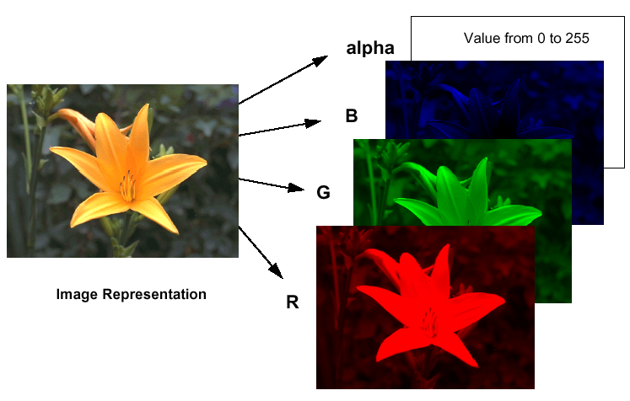
Image Dissolve Using
Alpha Blending

Slide 23
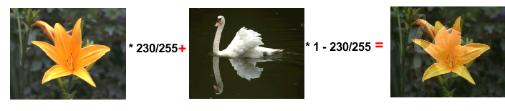
Image Dissolve Using
Alpha Blending
MMX instructions speed up image composition
A flower will dissolve a swan
Alpha determines the intensity of the flower
The full intensity, the flower’s 8-bit alpha value is FFh, or 255
The equation below calculates each pixel:
Result_pixel =Flower_pixel *(alpha/255) + Swan_pixel * [1-(alpha/255)]
For alpha 230, the resulting pixel is 90% flower and 10% swan

Slide 24
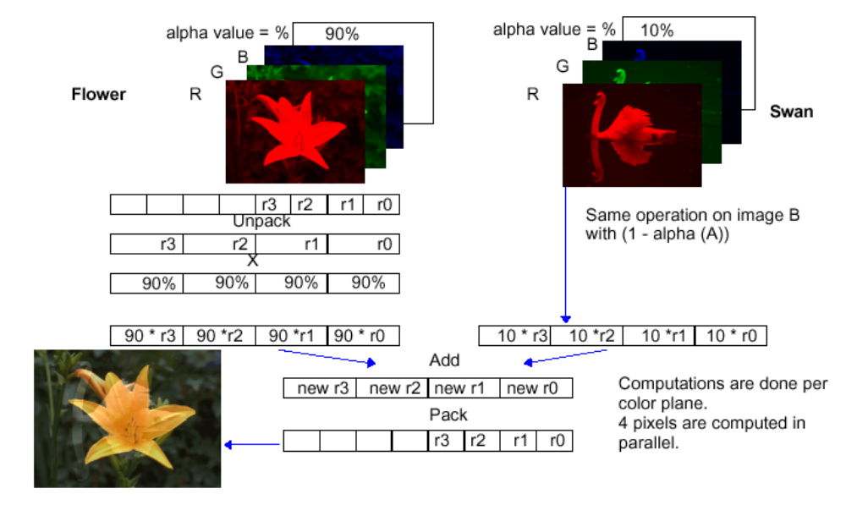
Image Dissolve Using
Alpha Blending

Slide 25
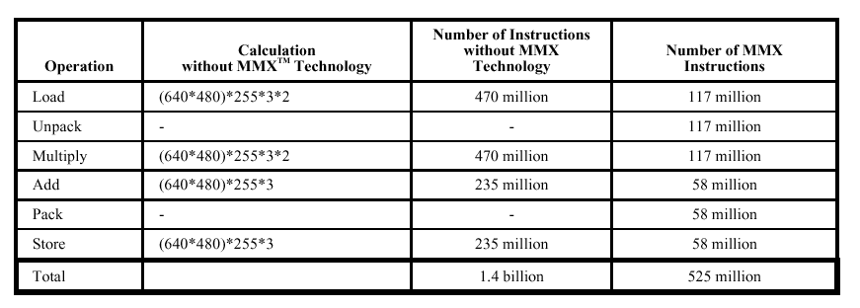
Instruction Count with/without MMX Technology
Operation cost for fading from flower to swan by single-stepping the alpha value from 1 to 255

