Slide 1
DMA and DSP
Michael Urman
University of Illinois at Urbana-Champaign

Slide 2
Introduction
Hardware to help the CPU
The CPU is in control
But other hardware can do the repetitive work

Slide 3
Agenda
Direct Memory Access (DMA)
Digital Signal Processing (DSP)

Slide 4
Overview of DMA
DMA transfers large blocks of data
Reading sectors from Harddrives
Writing PCM data to the DSP

Slide 5
Reading Memory
CPU executes: mov eax, [ds:esi]
  Provides address
  Requests data
Waits
  Minimum of one bus clock cycle
Memory returns data
CPU
Memory

Slide 6
Writing to a Device
CPU executes: out dx, al
Data transfers across the ISA bus
  1 to 4 bus clock cycles
Transfer complete
CPU
ISA Bus

Slide 7
Waiting Is Slow
A 300MHz CPU on a 66MHz bus
  4.5 CPU cycles per bus cycle
  5 CPU cycles reading
  5 CPU cycles writing
Wastes 8 cycles, or 80%

Slide 8
Direct Memory Access
CPU programs DMA and device
CPU releases data bus
DMA transfers data
CPU
Memory
DMA
ISA Bus

Slide 9
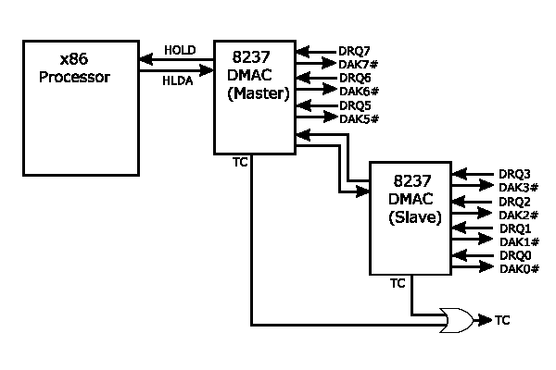
CPU ⬄ DMA Interaction
Master DMA asserts HOLD
CPU acknowledges with HLDA

Slide 10
DMA Transfer Modes
DMA has four modes
  Single
  Block
  Demand
  Cascade
And two options for each mode
  Single cycle
  Auto-initialized

Slide 11
DMA Transfer Modes (cont)
Master DMAC does 16bit transfers
Slave DMAC does 8bit transfers
Minimum of 1 byte
Maximum of 64KB * transfer size
DMA can sustain max 4.166MB/s
  Contrast to 2.77MB/s with PIO
  16bit 44KHz PCM data requires 88KB/s

Slide 12
DMA Page Register
DMA addresses memory by Page:Offset
  16 64KB pages
  All below 1MB
  Transfer buffer cannot
  cross page boundary
Allocating such memory can be difficult
See Appendix A for sample DMA code
Offset
Segment
Linear Address
Page
Offset
7 3 0 15 0

Slide 13
Summary of DMA
DMA can transfer large blocks of data
  From memory to device
  Or from device to memory
Saves CPU time when accessing
  Hard drives
  Floppy drives
  Soundcards

Slide 14
Overview of the DSP
Soundcards come in ISA, PCI, and onboard formats
They play and record PCM sounds
10
4

Slide 15
Interface to the DSP
By default, the 16bit DSP has
  I/O Base 0220h
  IRQ 5
  DRQ 1
  DRQ 5
Held in BLASTER environment variable
  A220 I5 D1 H5

Slide 16
Interface to the DSP (cont)
I/O port registers
Port | Function
BASE + 06h | Reset
BASE + 0Ah | Read Data
BASE + 0Ch | Write Data
BASE + 0Ch | Status
BASE + 0Eh | Data Available
BASE + 0Fh | ACK (SB16)

Slide 17
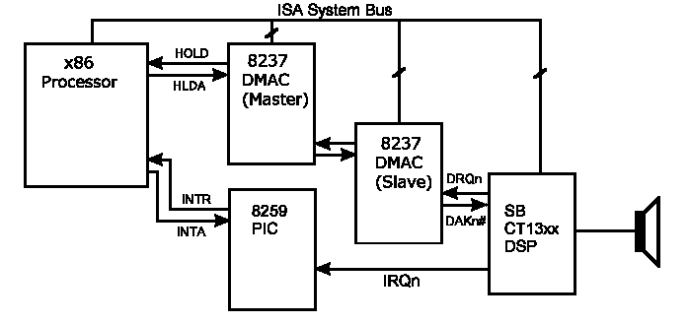
Programming the DSP
Step 1: Reset the DSP
Step 2: Set timing constant
Step 3: Program a DMA transfer

Slide 18
Reset the DSP
Verifies the DSP is installed
Returns DSP to known state
Sequence (see Appendix B for code)
  Write 1 to Reset port, and wait
  Write 0 to Reset port, and wait longer
  Verify data is available
  Read data and verify reset code

Slide 19
Set the Timing Constant
Controls playback and recording speed
TC = 256–(1,000,000/Frequency)
  165 for 11KHz
  242 for 44KHz
Sequence
  Write 040h to the write port, wait
  Write TC to write port

Slide 20
SB16 Uses Sample Rate
Sequence
  Write 041h to the base port, wait
  Write the high byte of the rate
  Write the low byte of the rate
    E.G., 41h, 56h, 22h for 22050Hz
    (5622h = 22050)

Slide 21
Program a DMA Transfer
Take the load off the CPU
Support simultaneous Play and Record
  Requires capable sound card
  And twice as many DMA channels
Requires a known block of DMA addressable memory

Slide 22
Program a DMA Transfer
Sequence (see Appendix C for code)
  Program the DMA
  Install an ISR on the SB Interrupt
    Triggered whenever the DSP finishes an operation
  Program DSP with DMA mode
  Program DSP with sound format
  Program data length of operation

Slide 23
Hardware Mixer
The mixer allows balancing
Left
Right
Channel | Value
Master | 022h
Microphone | 00Ah
CD-ROM | 028h
DSP | 004h
FM | 026h
Line in | 02Eh

Slide 24
Pmodelib: DMA.asm SB16.asm
SB16.asm
Contains functions to do the dirty work
  No more IN/OUTs
  Use functions like DMA_Start, SB16_Start to play (or record) sounds
    See sequence in Appendix D
  Leaves you free to do mixing

Slide 25
Audio Mixing
Two sound streams
One speaker
Average each sample together
  MMX
  Watch out for degenerate edge cases
Lowers sound quality
  Bad for 8bit; not so bad for 16bit

Slide 26
Caveat: No Sound Blaster
Our lab is running Windows 2000
And some non SB compatible card
Our (current) answer: VDMSound
  Emulates a 16-bit SoundBlaster
  Allows us to program sound under Win2k

Slide 27
VDMSound
Using VDMSound
  V:\> set BLASTER=A220 I5 D1 H5
  V:\ece291\utils\Vdms_110> VDMS
Refer to SoundLib291 (asm code)
  V:\ece291\utils\SoundLib\
  Soon to be obsoleted by pmodelib
Creative’s reference (C code)
  V:\ece291\utils\SoundBlaster Development\Samples\

Slide 28
Summary of DSP
The DSP uses DMA for low-overhead playback or recording of PCM sound
Sound is a very popular feature in ECE291 final projects
Protected Mode vs. Real Mode?

Slide 29
More Information
Sound Blaster lecture
DMA lecture
SoundLib – Real mode library
VDMSound – SoundBlaster emulation
http://members.nbci.com/ntvdm/ – VDMSound Homepage

Slide 30
Appendix A: DMA Code
; Note: this code should be treated as pseudocode
; Code to convert segment:offset to page:page_offset
;
; SI contains offset,
; DX contains segment :
mov ax,dx
mov cl, 4
shl ax, cl ; shift segment left 4
shr dx, cl ; shift segment right 12
add si, ax ; add shifted segment to offset
adc dh, 0
; Now SI contains the offset within the page,
; the low 4-bits of DH contain the page #
; Disable the DMA channel so we can set it
mov ax, [channel]
and ax, 3 ; channel mod 4
or ax, MODE ; set mode bits
out MASKREG, al ; write DMA mode
; Clear byte ptr F/F
out BYTEREG, al ; any value to reset
; write mode to mode register
mov al, mode
out MODEREG, al

Slide 31
Appendix A (cont)
; write page offset to address reg.
mov ax, si ; get offset in ax
out ADDRREG, al ; write LSB of DMA offset
mov al, ah
out ADDRREG, al ; write MSB of DMA offset
; write length (-1) to count reg.
mov ax, length ; ax=length-1
dec ax
out COUNTREG, al ; write LSB of size
mov al, ah
out COUNTREG, al ; write MSB of size
; write page# to page register
mov al, dh
out PAGEREG, al ; write page
; re-enable the channel
mov ax, [channel]
and al, 3 ; channel mod 4
out MASKREG, al ; enable sound card DMA
; now set up the target device...

Slide 32
Appendix B: DSP Reset
; Note: this code is in real mode, not protected
; Reset SoundBlaster
; return value (AL):
; 0 - reset unsuccessful, wrong port?/no card found?
; AA - card found and reset successfully
;
dsp_reset
mov dx, [sb_addr]
add dx, RESET
mov al, 1 ; send 1 to reset reg.
out dx, al
mov dx, [sb_addr]
add dx, AVAIL-RESET
mov cx, 8
.burn1: in al, dx ;wait 3 us
loop .burn1
mov dx, [sb_addr]
add dx, RESET
mov al, 0 ; send 0 to reset
out dx, al

Slide 33
Appendix B (cont)
mov dx, [sb_addr]
add dx, AVAIL-RESET
mov cx, 400
.burn2: in al, dx ;wait 100+ us
loop .burn2
in al, dx
test al, 80h ; test data available
mov al, 0
jz .rstdn
mov dx, [sb_addr]
add dx, READ
in al, dx
.rstdn: ret

Slide 34
Appendix C: DMA → DSP (generic ISR for transfer)
; Generic Real Mode ISR to acknowledge sound interrupt to PIC
dsp_irqdone
push ax
push dx
mov dx, cs:[sb_addr] ; sb_addr is port address
add dx, AVAIL ; AVAIL=0Eh, data available port
cmp byte cs:[dma_type],8
je .ack
add dx, INT16-AVAIL ; INT16=0Fh, 16-bit acknowledge(SB16 only)
.ack: in al, dx ; ack interrupt for DSP with dummy read
mov al, 20h
out 20h, al ; write EOI to 8259A
cmp byte cs:[sb_irq], 8 ; do we need to ack slave PIC? (IRQ>7)
jb .idone
out 0A0h, al ; write EOI to 8259B
.idone:
pop dx
pop ax
iret

Slide 35
Appendix D: Pmodelib Support
Initialization
  DMA_Alloc_Mem (int Size, short*Sel, long *Address)
  DMA_Lock_Mem ()
  SB16_Init (void(*)() Callback)
  SB16_GetChannel ()
  SB16_SetFormat (int Bits, int Rate, bool Stereo)
  SB16_SetMixers (long Master, long Wav, … (4 more) )
  DMA_Start (int Channel, long Address, long Size, bool AutoInit, bool Write)
  SB16_Start (long size, bool AutoInit, bool Write)
  SB16_Stop ()
  DMA_Stop (int Channel)
  SB16_Exit ()

