Slide 1
ECE291
Lecture 8
Peripheral devices

Slide 2
Lecture outline
Hardware I/O with ports
8253 timer
PC speaker
Serial port
Parallel port

Slide 3
Port input and output
Used to communicate with many peripheral devices built into the processor, motherboard or expansion cards
IN instruction transfers data from a device on the I/O bus to AL, AX, or EAX
OUT instruction transfers data from AL, AX, or EAX to a device connected to the I/O bus

Slide 4
Port input and output
Two forms of port addressing
Fixed-port addressing
  Allows an 8-bit I/O port address (use if port is 0 – 255)
  port number is immediate (follows the instruction opcode)
  IN AL, 6Ah ;data from I/O address 6Ah is input to AL
Variable-port addressing
  Allows using 16-bit port address (addresses up to FFFFh)
  the I/O port number is stored in register DX
  MOV DX, 0FA64h
  OUT DX, AX ;transfers contents of AX to I/O port FA64h

Slide 5
Port I/O example
..START
  IN al, 61h ;read port 61h: PC speaker control register
  OR al, 3 ;set bits 0 and 1
  OUT 61h, al ;turn speaker on
  MOV cx, 1000h ;delay count; if the count is increased,
  ;the beep will become longer
.L1 LOOP .L1 ;time delay – spin 1000h times
  IN al, 61h
  AND al, 0fch ;clear bits 0 and 1
  OUT 61h, al ;turn speaker off
  MOV ax, 4c00h ;Normal DOS Exit
  INT 21h

Slide 6
Keyboard control
The keyboard is connected to the 8255 Programmable Peripheral Interface (PPI) chip, a simple self-contained or embedded microprocessor
  Contains three registers A, B, and C which are accessed on ports 60h-62h using the in/out instructions
When a key is pressed or released two events take place:
  an 8-bit scan code is deposited in register A of the PPI
  an INT 09h hardware interrupt is generated
    Default ISR gets the scan code in A, acknowledges the hardware interrupt, and passes information to the keyboard buffer (a memory buffer in BIOS data area)

Slide 7
Keyboard control
Each key action is stored in the buffer as a word
  normal characters are stored with ASCII code for the character, and the scan code for the key
  extended codes corresponding to special keys e.g., cursor keys, shift
The keyboard buffer is a circular buffer, when it gets full and a new key is pressed:
  INT 09 ISR generates a “bell” character, which causes the speaker to beep
  The data from the new key press is discarded
Keyboard buffer holds keystrokes until read by an int 16

Slide 8
8253 Programmable Timer
Intel 8253 contains 3 independent 16-bit programmable counters
Operate on a clock frequency of 14.31818 MHz
This frequency is divided by 12 before being sent to the timer so the pulses arrive at frequency 1.19318 MHz
Each timer can be loaded with a sixteen bit starting count (0 – 65535)
Once enabled, timers repeatedly count down to 0 from the starting count and generate an output signal
The rate of the output signal is (1193180 / starting count) outputs per second

Slide 9
8253 Programmable Timer
Timer 0
  Generates and INT 08h when the timer expires. Can be used to trigger regularly recurring events in your programs.
  Counts down from as high as 65535 to zero
  The output signal occurs each (1.19318 * 10⁶)/ 65535 = 18.2 Hz
Timer 1
  Causes the DRAM memory system to be refreshed
  If you interfere with this function, the entire contents of the system memory could be lost
Timer 2
  General purpose, and optionally connected to the PC speaker for generating simple tones

Slide 10
Timer control registers
8253 has four byte-sized control registers which are mapped to I/O ports 40h-43h
Port Description
40h Timer 0 Count Register
41h Timer 1 Count Register
42h Timer 2 Count Register
43h Timer Control Register

Slide 11
Timer
The Control Register allows the programmer to select the counter, mode of operation, and type of operation
Bits Description
7,6 Counter ID (00,01,10)
5,4 00: latch count for reading
01: Read/Set least significant byte
10: Read/Set most significant byte
11: Read/Set least significant byte then most significant byte
3,2,1 Count Mode (011=Square Wave)
0 Count Method: 0=Binary, 1=BCD

Slide 12
Speaker control
Timer 2 output from 8253 can be enabled as an analog input to the PC speaker
Enable timer input to speaker (port 61h, bit 1)
Enable speaker (port 61h, bit 0)
Write to Timer Control Port
mov al,10110110b
out 43h, al
10: Control timer 2
11: Load Low Byte then High Byte
011: Select Square wave output
0: Count in binary

Slide 13
Speaker Control
Enable Speaker
  IN al, 61h
  OR al, 00000011b
  OUT 61h, al
Bit 1: Enable Timer
Bit 0: Enable Speaker
Don't change other bits
Write count to timer
  OUT 42h, al
  MOV al, ah
  OUT 42h, al
    AX=count (ticks) = 1193180 (ticks/sec) / Freq (1/sec)

Slide 14
Example
CR EQU 13
LF EQU 10
extrn dosxit, kbdin, dspmsg, binasc
; Define stack segment
stkseg SEGMENT stack
RESB 512
stktop
; Define code segment
cseg SEGMENT CODE
; Variable declarations
pbuf RESB 7
crlf db CR,LF,'$'
freq_msg db ' Freq = $'
count_msg db ' Hz, Count = $'

Slide 15
Example
..start
main
mov ax, cs ; Initialize DS register
mov ds, ax
mov al,10110110b ; Timer2, Load L+H, square wave, ; binary
out 43h,al ; Write timer control byte
in al,61h
or al,00000011b ; Enable Timer2 & Turn on speaker
out 61h,al
.mloop
call kbdin
cmp al,'0' ; 0 to quit
je .mdone
sub al,'0'
mov ah,0

Slide 16
Example
mov cl,8 ; Freq * 256 (Hz)
shl ax,cl
mov dx, freq_msg
call dspmsg
mov bx, pbuf
call binasc
mov dx, pbuf
call dspmsg ; Print Freq
mov bx,ax
mov ax,34DCh ;DX:AX=1,193,180 (tics/sec)
mov dx,12h ;AX = ----------------------
div bx ;BX=Freq (1/sec)
mov dx, count_msg
call dspmsg
mov bx, pbuf
call binasc

Slide 17
Example
mov dx, pbuf
call dspmsg ; Print count
mov dx, crlf
call dspmsg
out 42h,al ; Write Low byte to Timer Channel 2
mov al,ah
out 42h,al ; Write High byte to Timer Channel 2
jmp .mloop
.mdone
in al,61h
and al,11111100b ; Turn off speaker
out 61h,al
call dosxit ; Exit to DOSmain

Slide 18
Serial communication
One of the oldest, simplest, and most widely used forms of communication in the world.
  Smoke signals
  Morse code
  Early computer mice
  Classical mainframe/terminal computing
  USB printers, keyboards, scanners, cameras
  Ethernet
  The Internet
  Digital cell phones
  Digital satellites

Slide 19
Serial communication
Can be implemented with as few as two (unidirectional) or three (bidirectional) wires
  Common ground
  Transmit line (Tx)
  Receive line (Rx)
One bit transferred at a time
  Takes numerous transfers to move a single byte, but that’s okay
  Data must be broken down into chunks to transfer
  Maybe we want some error checking too

Slide 20
Serial communication
Serial or communications ports are nothing more than shift registers connected to specific I/O ports
  For transmitting, write data to the port corresponding to the shift register
    Shift register moves data out one bit at a time over a serial cable
  For receiving, the shift register accepts bits as they come in, shifting them into the register.
    Read the data from the shift register using the appropriate port address

Slide 21
Serial communication
Start bit indicates when a communication frame begins
Next 5-8 bits are the actual data
  Number of data bits is configurable
  8-bits is very popular because of its obvious correspondence with the size of a byte
Stop Bit(s)
Start Bit
5-8 Data Bits
Parity Bit

Slide 22
Serial communication
The parity bit indicates if the number of ones was even (0) or odd (1). Helpful with error checking.
Stop bits (1, 1.5 or 2) indicate the end of a data frame
Stop Bit(s)
Start Bit
5-8 Data Bits
Parity Bit

Slide 23
Serial communication
Bit or baud rate determines how quickly the bits are shifted out of the serial port
  Can be as low as 110 bits per second
  Can be as high as 115000 bits per second with standard serial ports (USB is much faster)
Actual rate of data transfer depends port settings
  8 data bits, no parity, one stop bit means that 8 of every 10 bits that transfer contain useful data
  5 data bits, parity, 2 stop bits means that only 5 of every 9 bits contain useful data

Slide 24
Serial communication
For serial ports to work, both ends must agree on all the previous settings
Once that’s done, the hardware takes care of the messy details
From the programming side of things, you have to configure the port, then know how to write data properly

Slide 25
Serial communication
Programming the serial port
  First you should configure the port
    Stop bits, data bits, parity, bit rate
  To read, check status register until a byte is ready to be read, then read it
  To write, check status register until serial port is ready, then write the byte
This particular paradigm is called polling
Serial ports also generate hardware interrupts when they receive data, but we won’t be going that far in MP2

Slide 26
Serial communication - regs
For configuring the port
  Line control (LCR) – Specifies the data frame (word length, number of stop bits, and type of parity) for transmitting and receiving
  Divisor latch low (DLL) – Stores lower 8 bits of the baud-rate generator divisor
  Divisor latch high (DLH) – Stores the upper 8 bits of the baud-rate generator divisor
For transferring data
  Line status (LSR) – Contains the transmitter empty, transmit buffer empty, receive buffer full, and receive error flags
  Receive buffer (RBR) – Holds the byte received
  Transmit buffer (TBR) – Holds the byte to transmit

Slide 27
Serial communication - regs
Each serial port has a unique Port I/O address
Device Serial port base address
COM0: 03F8h
COM1: 02F8h
COM2: 03E8h
COM3: 02E8h
The serial port base addresses are stored at 0000:0400 – 0407. You can view these addresses directly using debug or td.
  At the command prompt, type “debug” to get the “-” debug prompt
  type d0:0400 (and hit return)
  you get : 0000:0400 F8 03 F8 02 E8 03 E8 02
  the first four words are addresses of the installed comm ports

Slide 28
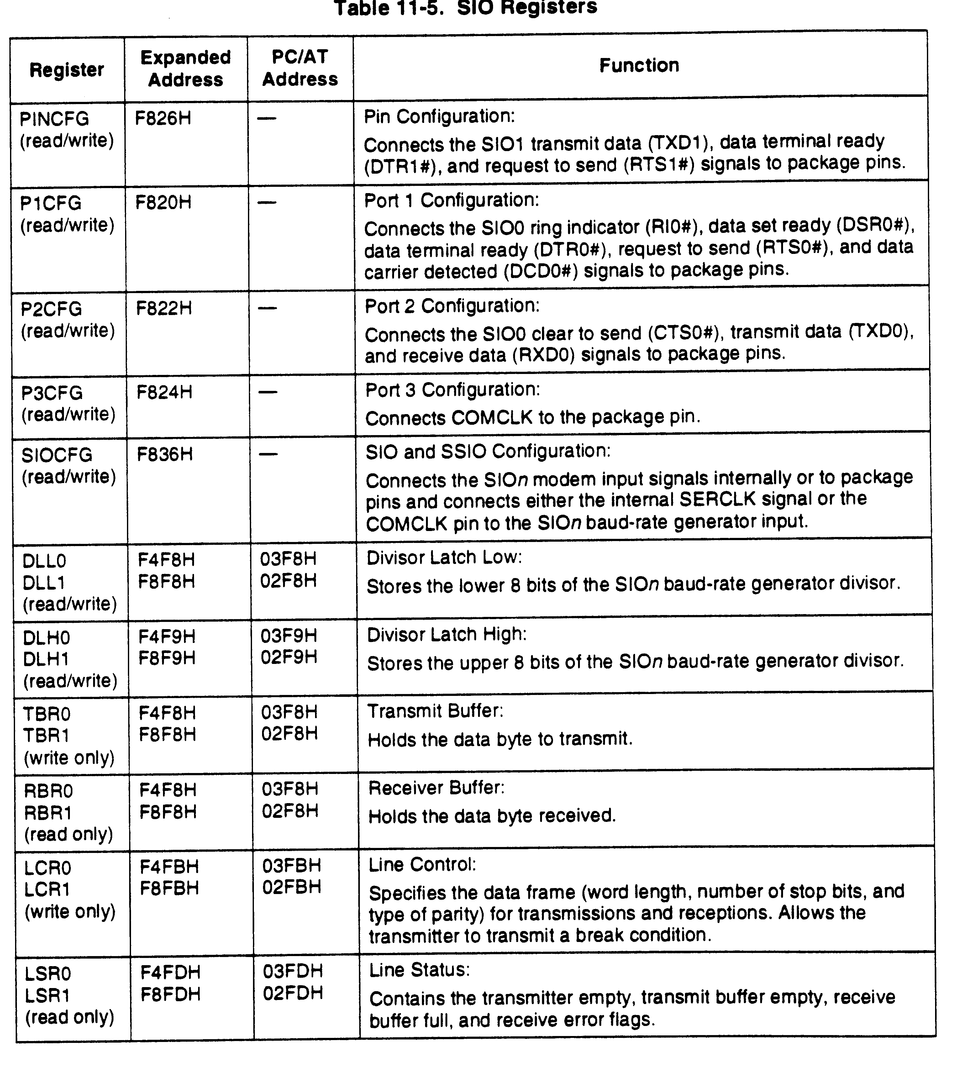
Register addresses
DLL = Base + 0
  Depends on a setting in LCR
TBR = Base + 0
  Write only
RBR = Base + 0
  Read only
DLH = Base + 1
LCR = Base + 3
LSR = Base + 5

Slide 29
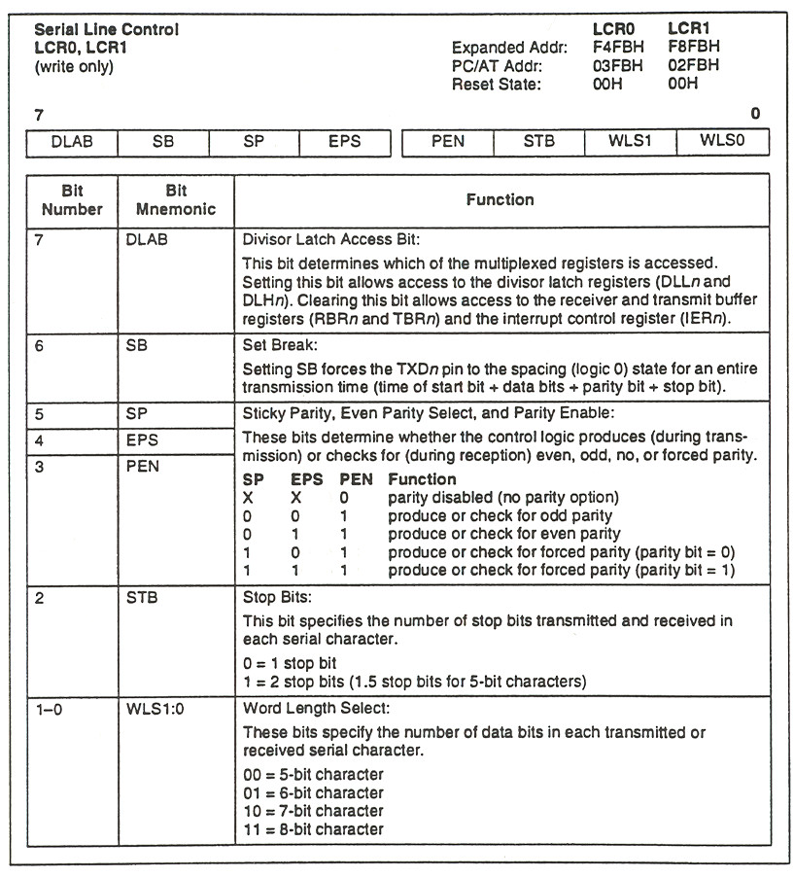
Line control register
Must set DLAB to access DLL and DLH

Slide 30
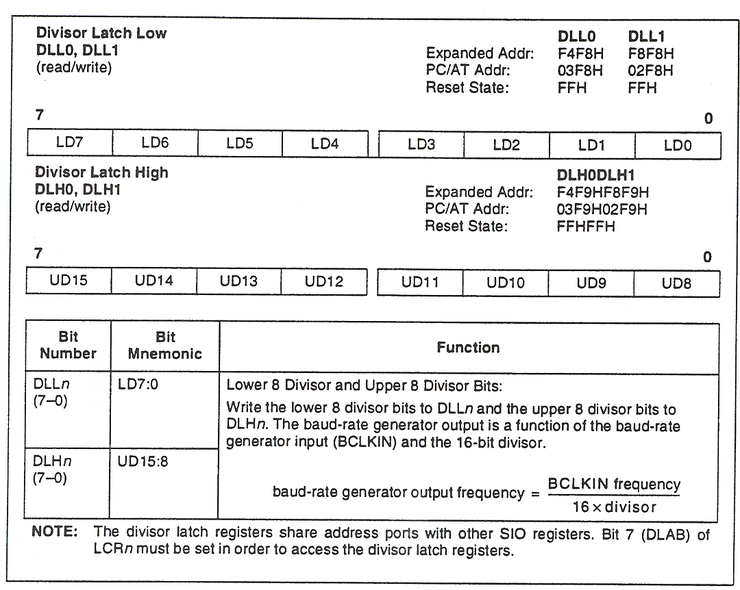
Baud rate divisor
Setting the baud rate
  Based off 1.8432 MHz clock frequency
  Baud rate = frequency / (16 x divisor)
  You set the divisor in a special control register within the serial port
Divisor Baud Rate
1 115200
2 57600
3 38400
4 28800
6 19200
8 14400
12 9600
24 4800
384 300

Slide 31
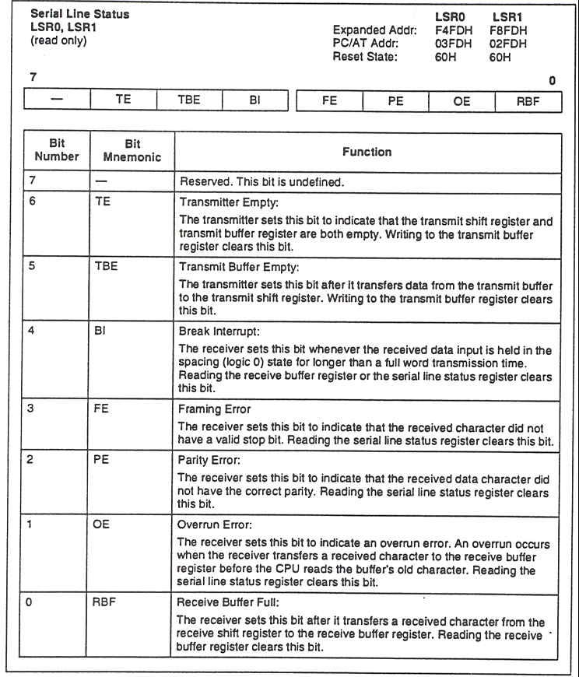
Line status register
Check RBF to see if a byte has been received
Check TE or TBE to see of a byte has been transmitted

Slide 32
Parallel interface
Originally designed for use with printers only
Provides 8-bit data transfer (originally output only, now bi-directional)
Provides TTL (5V) external I/O
When the computer boots it detects any parallel ports and assigns ‘logical’ port names to them (LPT1, LPT2, LPT3)
Each parallel port uses three processor I/O ports
  data output (to send a byte of data to a printer you send the data to the output data register)
  status signals from the printer
  control/commands to the printer

Slide 33
Parallel interface
Each logical device has a unique Port I/O address
Device Data Port Status Port Control Port
LPT0: 3BCh 3BDh 3BEh
LPT1: 378h 379h 37Ah
LPT2: 278h 279h 27Ah
The parallel port base addresses are stored at 40:0008h, and can be viewed by using debug or td
  At the command prompt, type “debug” to get the “-” debug prompt
  type d40:0008 (and hit return)
  you get : 0040:0008 BC 03 78 03 78 02 …
  the first six bytes are addresses of the installed printer adapters

Slide 34
Parallel interface major signals
Signal(s) Input/Output Notes
Data[7:0] Bi-directional Byte-wide data bus
Strobe To device Write signal
Busy From device Don't send more data
Ack From device Acknowledge interrupts
Initialize To device Initialize external device
Out of Paper From device Status signal

Slide 35
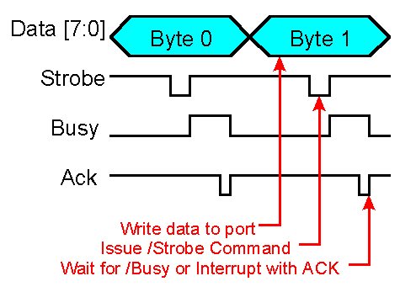
Writing to the parallel interface

Slide 36
Control & Status Ports
Control Port
Bit Description
7-5 Unused
4 IRQ Enable
3 Select [inverted]
2 Initialize
1 AutoFeed [inverted]
0 Strobe [inverted]
Status Port
Bit Description
7 Busy [inverted]
6 Ack
5 Out-of-Paper
4 Selected
3 I/O Error
2-0 Unused

