Slide 1
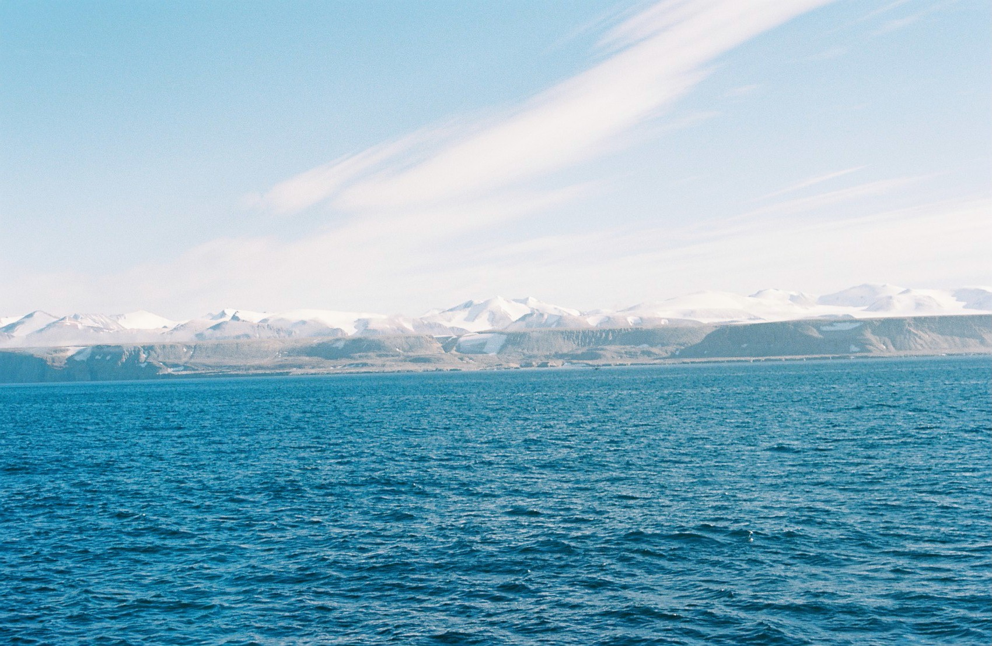
Air-Sea-Ice Feedbacks in DMS production in the Arctic Ocean
(A model work in progress)
Tereza Jarníková
EOSC 511
Final Project Presentation
November 19, 2015

Slide 2
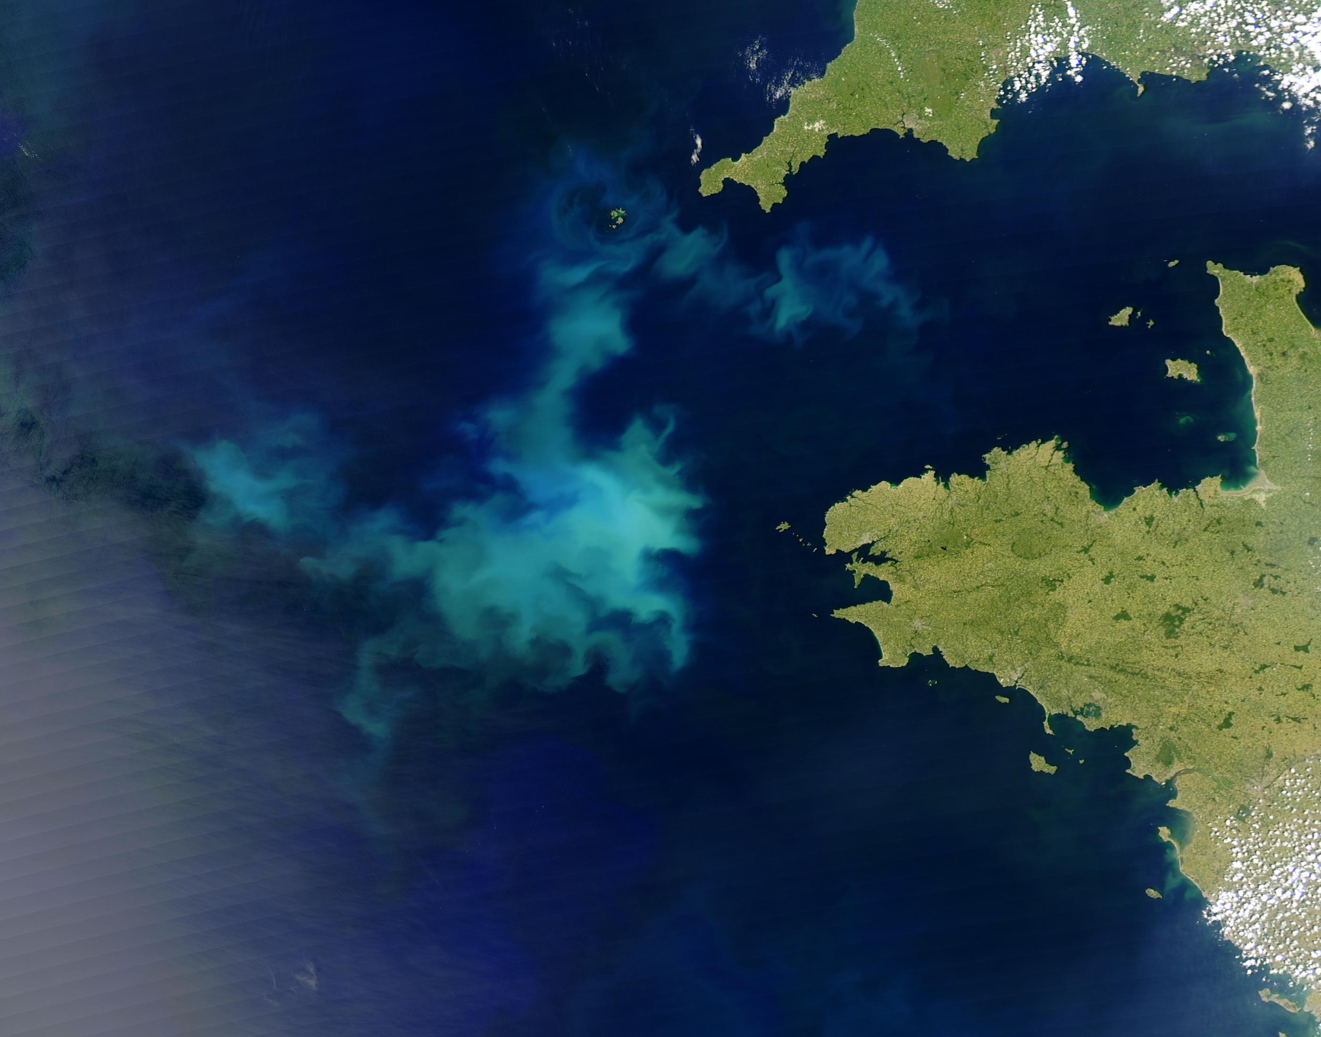
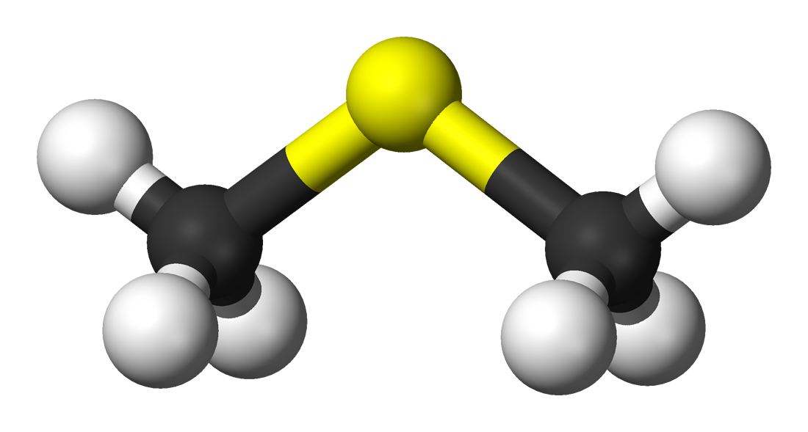
What is DMS?
-a very smelly gas
-a biogenic compound produced
by certain phytoplankton
-an important part of the marine sulphur cycle

Slide 3
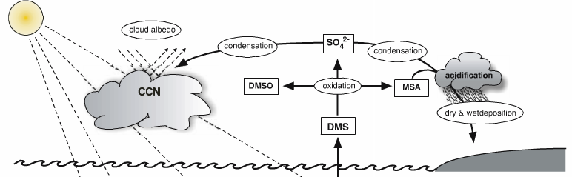
Why do we study it?
-up to 80% of global biogenic sulphur budget
-Oceans: 95% of DMS emissions to atmosphere
-component of some global climate models
-global cooling/ potential climate feedbacks
oceanic DMS
Stefels et al 2007
Notes:
I study the oceanic cycle of dimethylsulfide. Dimethylsulfide is a biogenic climate active gas produced by several species of phytoplankton in the surface ocean. The

Slide 4
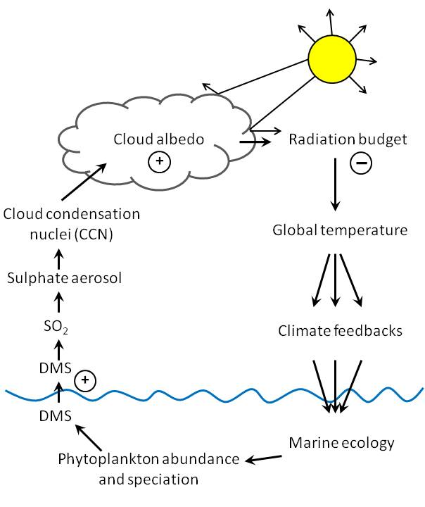
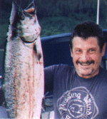
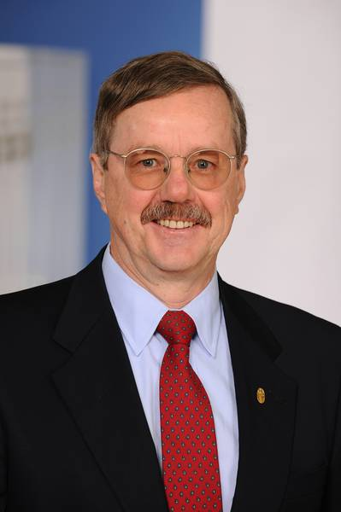
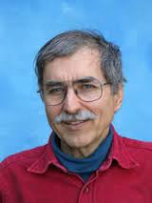
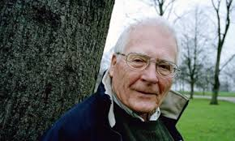
C.L.A.W. HYPOTHESIS
Notes:
I study the oceanic cycle of dimethylsulfide. Dimethylsulfide is a biogenic climate active gas produced by several species of phytoplankton in the surface ocean. The

Slide 5
My goal in this project:
To create a simple model that asks:
In the Arctic,
do DMS emissions actually affect
subsequent DMS production?
If so, how much?

Slide 6
2 main questions in the model:
-How much DMS is produced?
-How much does it change the radiative forcing?
General Approach:
-ODE describing primary productivity
-ODE describing radiative forcing
(seasonally dependent) links between the two
3 ‘domains’: SEA, ICE, SKY

Slide 7
The Arctic Environment
-permanent presence of
frozen water (ice)
-large watershed (freshwater flux)
-low sea surface temperature
-large seasonal
variation in radiation
-seasonal nutrient
limitation
-salinity stratification
-polar bears
Environmental
Variables in Model
(monthly resolution)
-ice cover
-windspeed
-PAR (ie. sunlight)
-sea surface temperature
-albedo
-cloud cover

Slide 8
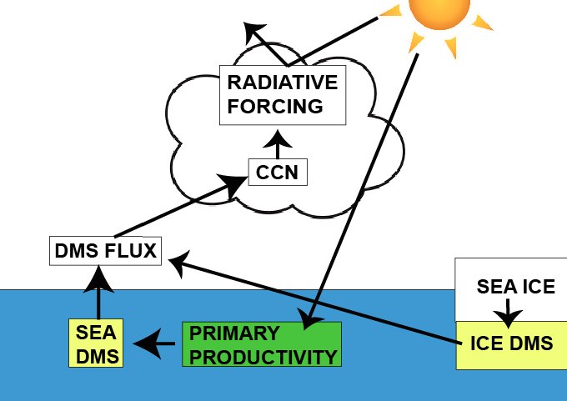
THE BOX MODEL

Slide 9
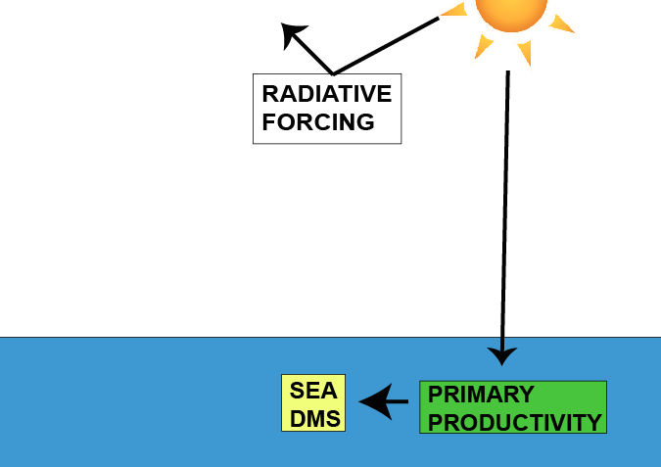
SEA

Slide 10
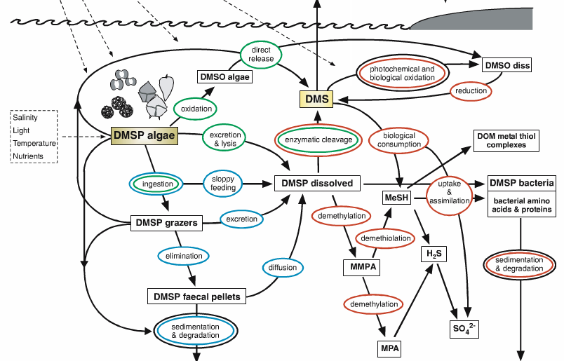
Stefels et al 2007
Notes:
This is the bottom half of the diagram I just showed. It’s taken from a schematic figure from Stefels 2007, & shows an overview of
DMSP – an important precursor
What controls rates of production?
Iron? Light? Bacterial metabolism?
Phytoplankton assemblage?

Slide 11
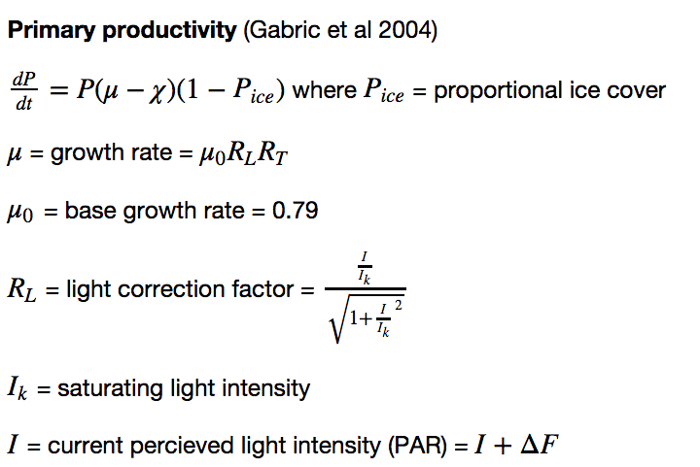

SEA EQUATIONS

Slide 12
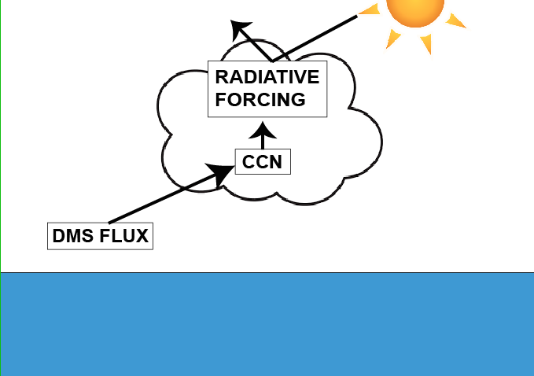
SKY

Slide 13
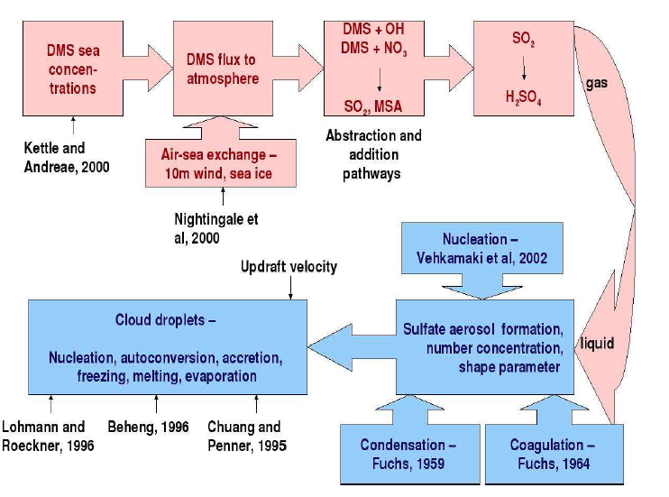
SKY

Slide 14
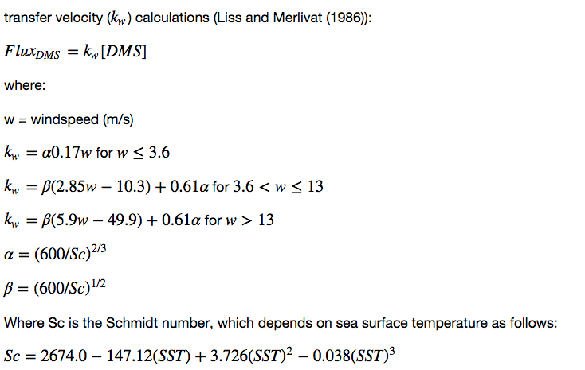
SKY EQUATIONS pt 1

Slide 15

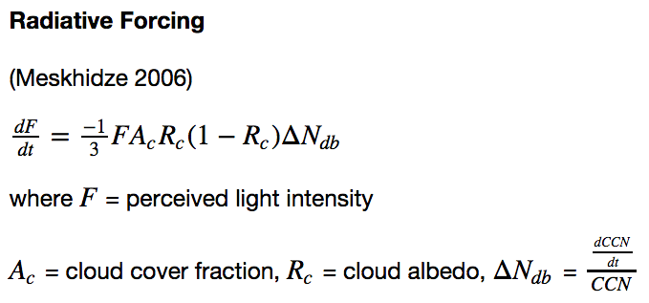
SKY EQUATIONS pt 2

Slide 16
My model: SEA ICE

Slide 17
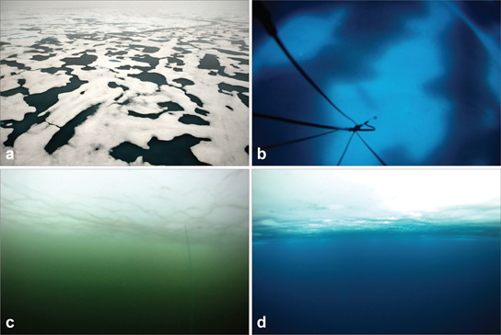
ICE EQUATIONS …to be determined

Slide 18
Model construction
-fixed step-size Runge-Kutta
-model length: 1 year, model step size: 1 day
-adaptation of Integrator class
-environmental forcing at monthly resolution
(stored in nested dictionaries)
-spline interpolation of critical variables (eg. ice!)

Slide 19
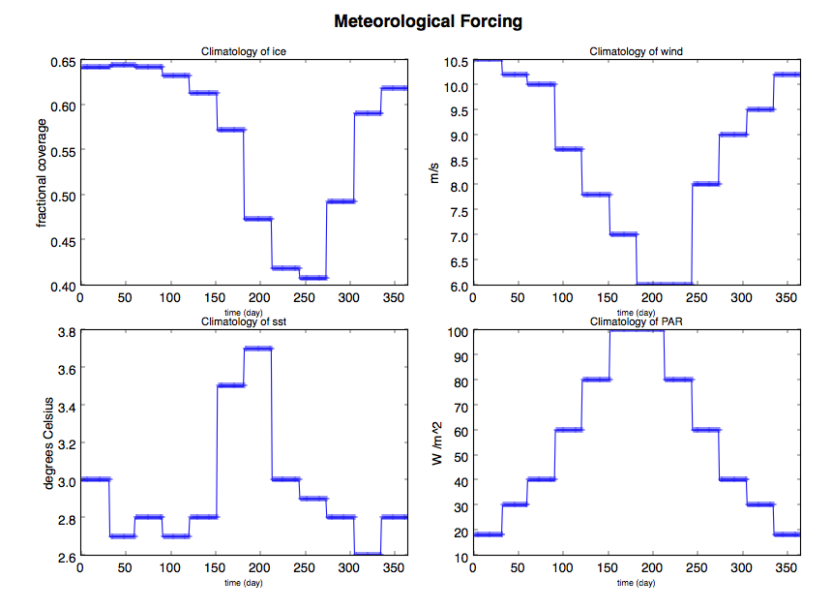

Slide 20
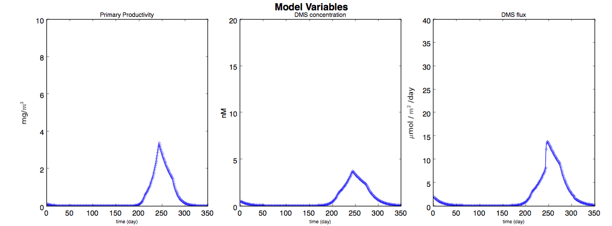

Slide 21
THANK YOU FOR YOUR TIME! COMMENTS? SUGGESTIONS?

