Slide 1


The Evolving Relative Role of Stratospheric Ozone and Greenhouse Gasses in Modifying the Southern Ocean Carbon Sink from 1950 to 2100
Tereza Jarníková, Corinne Le Quéré, Colin Jones, Steven Rumbold

Slide 2
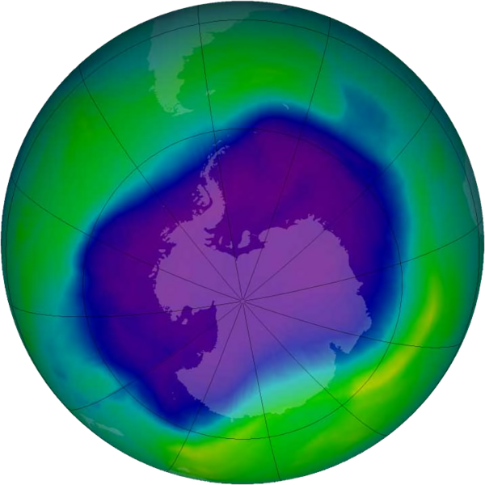
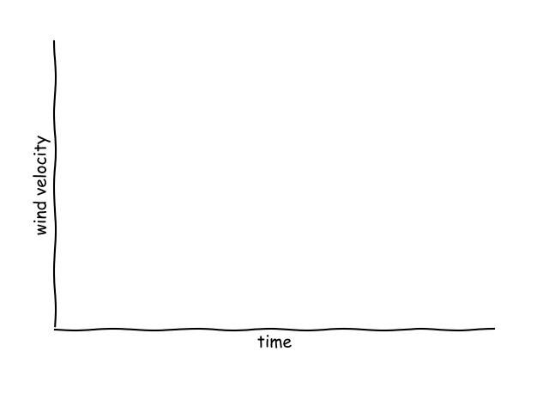
Changing polar climate due to ozone depletion and greenhouse gas emissions
Notes:
/Users/terezajarnikova/Desktop/CODE/zaznam/Untitled.ipynb

Slide 3
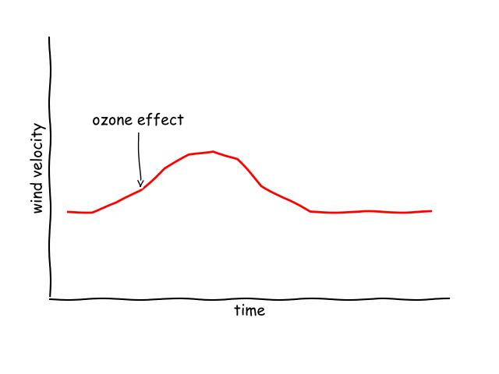
Changing polar climate due to ozone depletion and greenhouse gas emissions
Historically, ozone depletion increased the SAM index →
stronger and more southerly winds, especially in summer

Slide 4
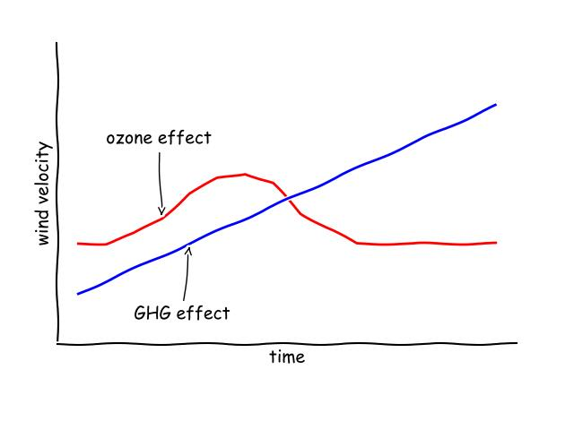
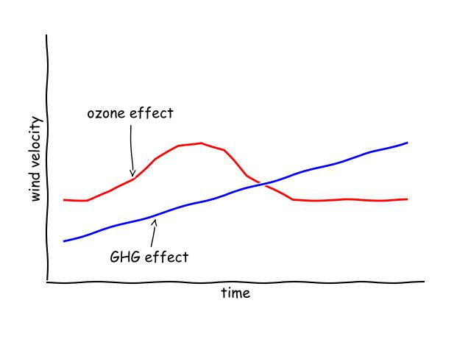
Changing polar climate due to ozone depletion and greenhouse gas emissions
Historically, ozone depletion increased the SAM index →
stronger and more southerly winds, especially in summer
Ozone is recovering, but GHG emissions are expected to continue increasing winds, year-round

Slide 5
Changing polar climate due to ozone depletion and greenhouse gas emissions
How are the Southern Ocean wind patterns projected to change over the coming century under different ozone and SSP scenarios?
2. What are the effects of
changing wind patterns
on the physical ocean sea state?
3. What are the relative controls
on the carbon flux?

Slide 6
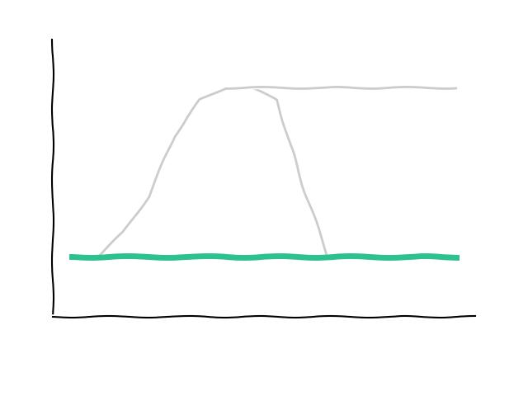
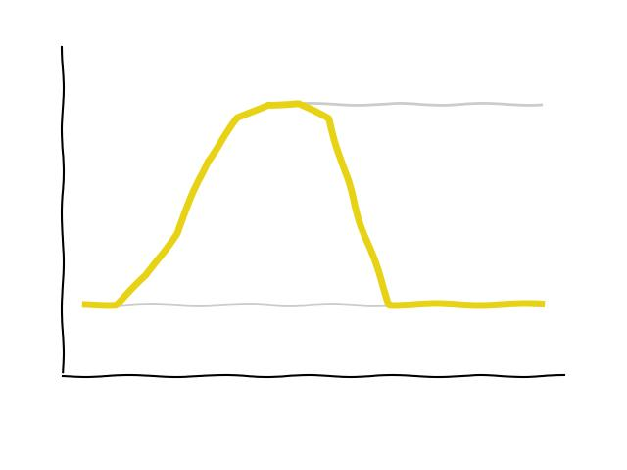
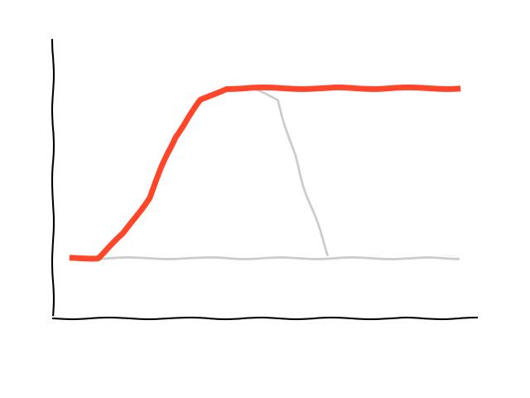

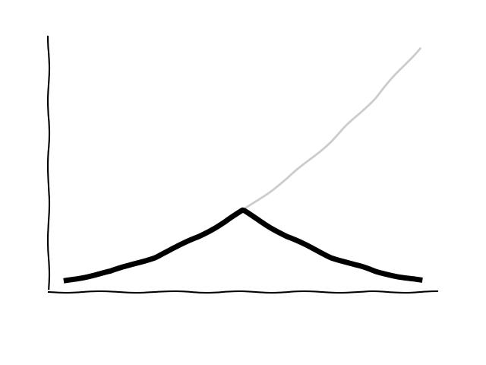
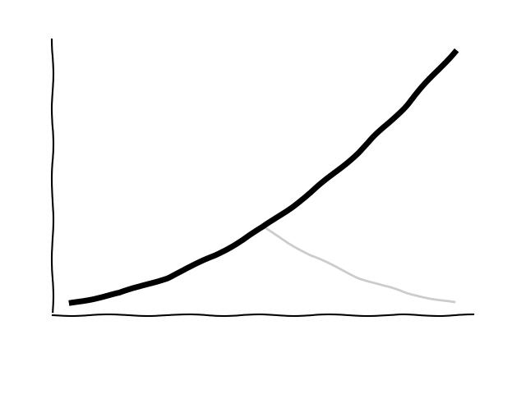
Experimental Design
3 ozone scenarios, 2 GHG scenarios
no
ozone hole
historical ozone hole
permanent ozone hole
SSP 1-2.6
SSP 3-7.0
1950-2100

Slide 7

What are the major physical controls on the Southern Ocean carbon sink, and how will they change due to GHG emissions and ozone depletion?
sea surface temperature
(SST)
solubility decrease with increasing SST

Slide 8

What are the major physical controls on the Southern Ocean carbon sink, and how will they change due to GHG emissions and ozone depletion?
sea surface temperature
(SST)
mixed layer
depth
(MLD)
MLD deepening brings up
high-carbon water
and nutrients
solubility decrease with increasing SST

Slide 9

What are the major physical controls on the Southern Ocean carbon sink, and how will they change due to GHG emissions and ozone depletion?
sea surface temperature
(SST)
mixed layer
depth
(MLD)
overturning
(OT)
MLD deepening brings up
high-carbon water
and nutrients
enhanced OT brings up high-carbon water
and nutrients
solubility decrease with increasing SST

Slide 10
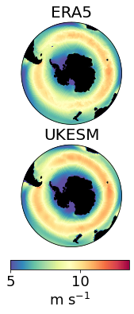
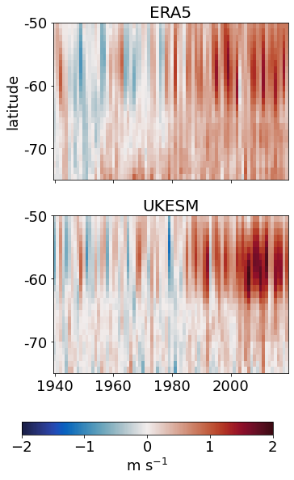
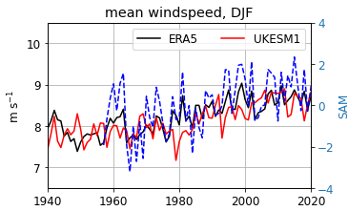
Can we learn from the UKESM1 winds? Yes, they perform well against the ERA5 reanalysis

Slide 11
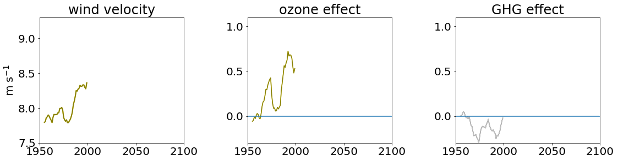
Ozone and GHG effect on wind speed,1950-2100
austral summer, DJF
Notes:
SOZONE/windAnalyis/wspdComponents/Fig-line-windeffect.ipynb

Slide 12
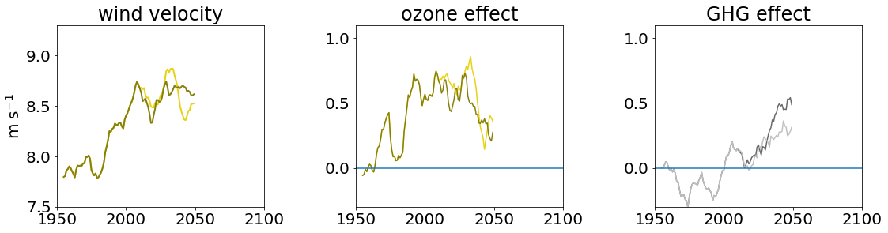
Ozone and GHG effect on wind speed,1950-2100
austral summer, DJF
Notes:
SOZONE/windAnalyis/wspdComponents/Fig-line-windeffect.ipynb

Slide 13
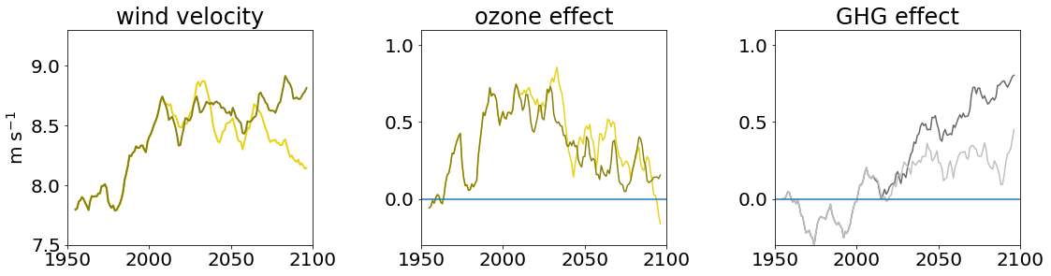
Ozone and GHG effect on wind speed,1950-2100
austral summer, DJF
Notes:
SOZONE/windAnalyis/wspdComponents/Fig-line-windeffect.ipynb

Slide 14
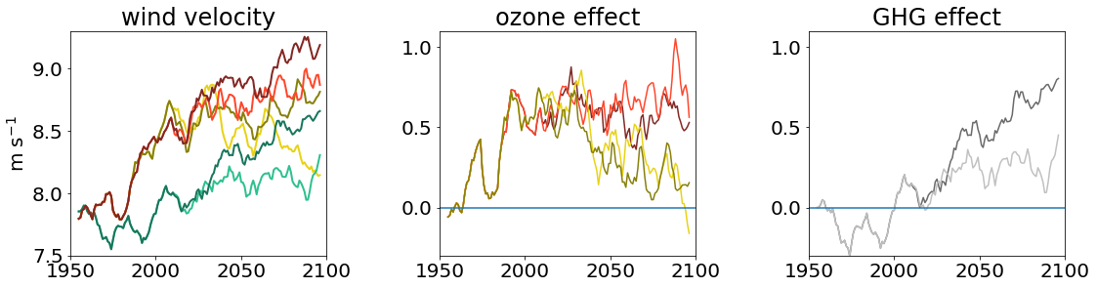
Ozone and GHG effect on wind speed,1950-2100
austral summer, DJF
Notes:
SOZONE/windAnalyis/wspdComponents/Fig-line-windeffect.ipynb

Slide 15
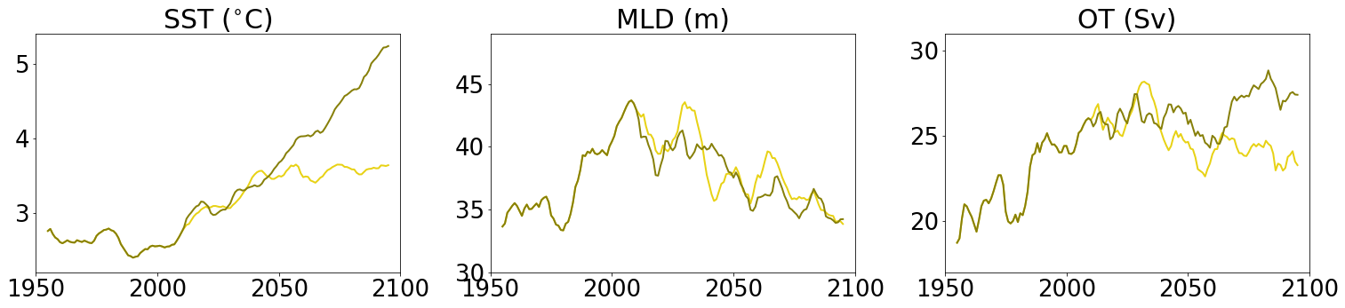
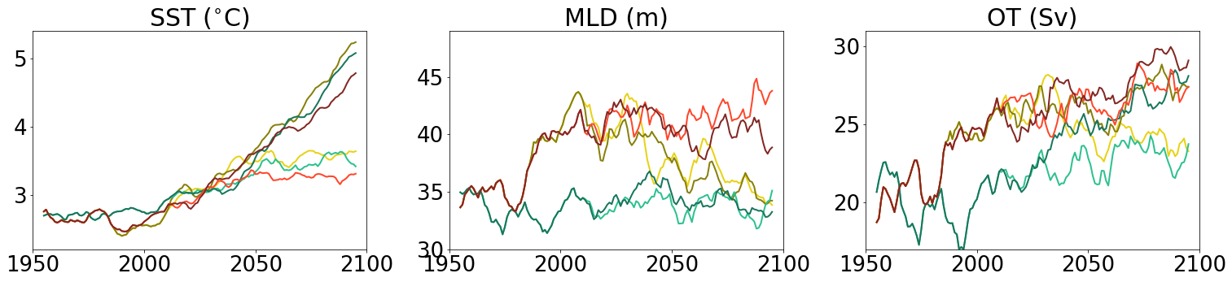
Results: Physical Sea State
austral summer, DJF
Notes:
windAnalyis/oceanFields/bargraph-streamlined-2.ipynb

Slide 16
Results: Physical Sea State
austral summer, DJF
Notes:
windAnalyis/oceanFields/bargraph-streamlined-2.ipynb

Slide 17
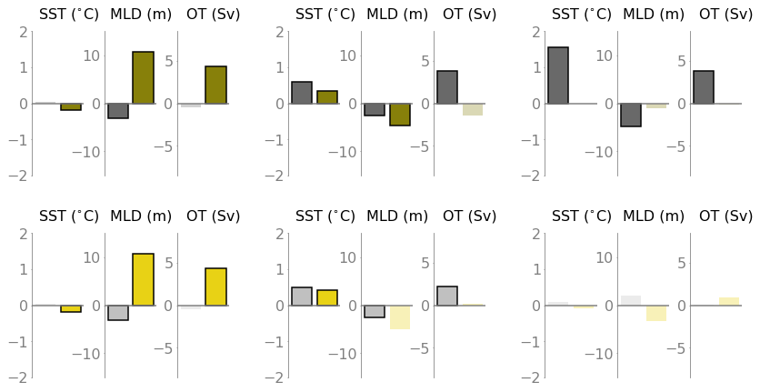
Results: Physical Sea State
SSP3
2050-2100
historical
1950-2000
SSP1
2050-2100
year average
Notes:
windAnalyis/oceanFields/bargraph-streamlined-2.ipynb

Slide 18
Ok, but what does it mean for the CO₂ sink?

Slide 19
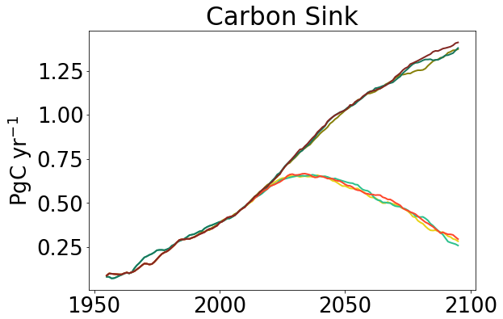
Ok, but what does it mean for the CO₂ sink?
year average
Notes:
/wspdComponents/FigMAP-HOV.ipynb

Slide 20
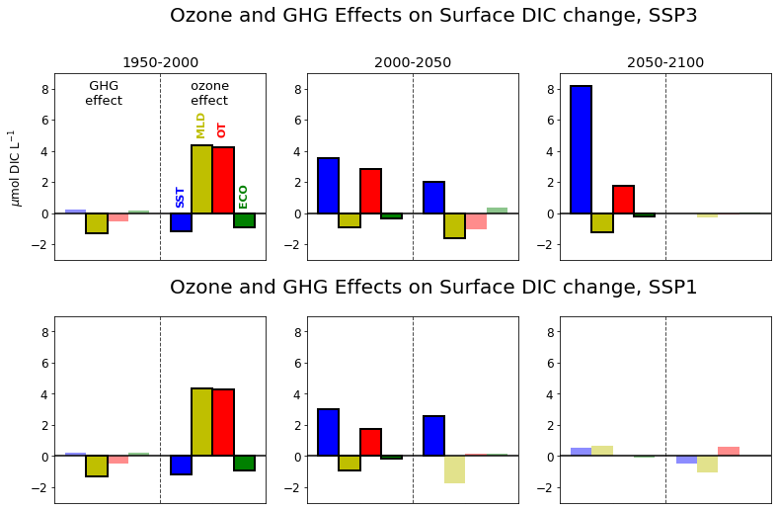
Ok, but what does it mean for the CO₂ sink?
SSP3
2050-2100
historical
1950-2000
SSP1
2050-2100
year average
Notes:
notebooks/scratch/BOE-SOcarbon/BOE-concentration-based.ipynb

Slide 21
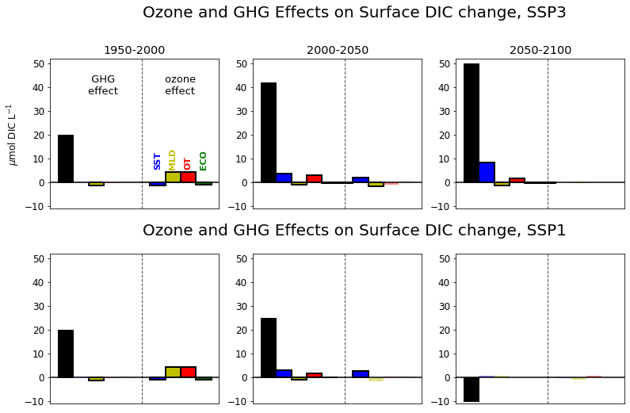
Ok, but what does it mean for the CO₂ sink?
SSP3
2050-2100
historical
1950-2000
SSP1
2050-2100
year average
Notes:
notebooks/scratch/BOE-SOcarbon/BOE-concentration-based.ipynb

Slide 22
Ok, but what does it mean for the CO₂ sink?
Both ozone and GHG act to modulate the winds and physical oceanographic conditions
Controls shift from ozone to GHG dominance over the course of the 21st century
Climate feedbacks, especially temperature, are important, but for the CO2 sink are secondary to the atmospheric CO2 effect
SSP3
2050-2100
historical
1950-2000
SSP1
2050-2100
year average
Notes:
notebooks/scratch/BOE-SOcarbon/BOE-concentration-based.ipynb

Slide 23
RANDOM OTHER SLIDES BEGIN HERE

Slide 24
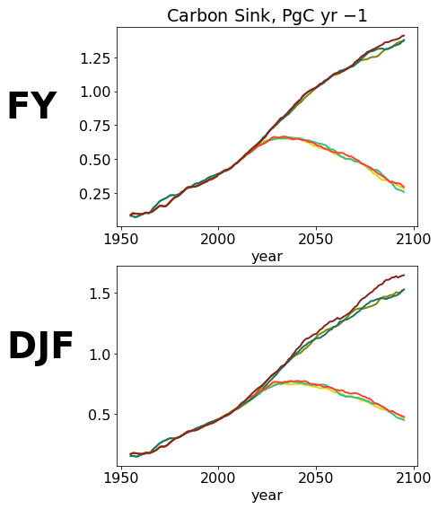
Ok, but what does it mean for the CO₂ sink?
Both ozone and GHG act to modulate the winds and physical oceanographic conditions
Controls shift from ozone to GHG dominance over the course of the 21st century
Climate feedbacks, especially temperature, are important, but for the CO2 sink are secondary to the atmospheric CO2 effect
SSP3
2050-2100
SSP1
2050-2100
historical
1950-2000
Notes:
notebooks/scratch/BOE-SOcarbon/BOE-concentration-based.ipynb

Slide 25
Ok, but what does it mean for the CO₂ sink?

Slide 26
Summary
Both ozone and GHG act to modulate the winds and physical oceanographic conditions
Controls shift from ozone to GHG dominance over the course of the 21st century
Climate feedbacks, especially temperature, are important, but for the CO2 sink are secondary to the atmospheric CO2 effect

Slide 27
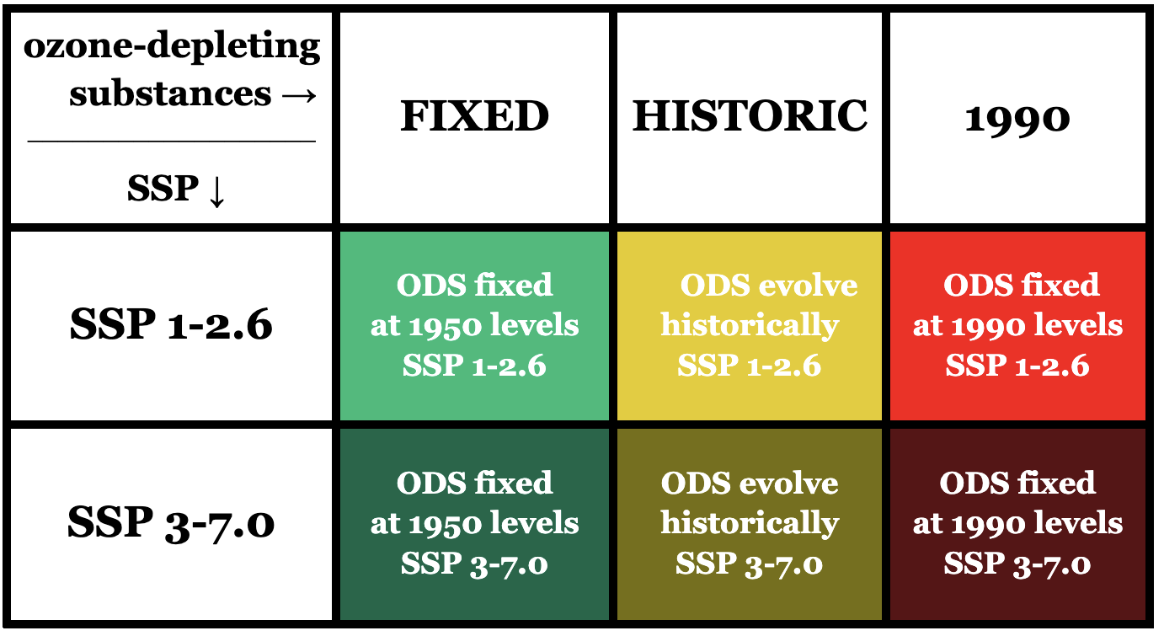
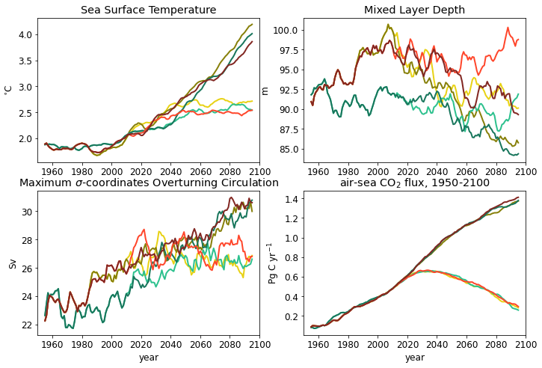
RANDOM OTHER SLIDES BEGIN HERE
Both ozone and GHG act to modulate the winds and physical oceanographic conditions
There is a shift controls from ozone dominance to GHG dominance over the course of the 21st century
Non-CO2 effects are important, especially the thermal effect, but for the CO2 sink are secondary to the atmospheric CO2 effect

Slide 28
Summary
Both ozone and GHG act to modulate the winds and physical oceanographic conditions
There is a shift controls from ozone dominance to GHG dominance over the course of the 21st century
Non-CO2 effects are important, especially the thermal effect, but for the CO2 sink are secondary to the atmospheric CO2 effect

Slide 29
Ok, but what does it mean for the CO₂ sink?
quantity | Mechanism of change
sea surface temperature (SST) | CO₂ solubility change with temperature (~4% pCO2 / degree)
mixed layer depth (MLD) | Changes in near-surface DIC gradient
overturning (OT) | Changes in delivery of deep DIC to surface

Slide 30
Experimental Design
UKESM1, 1950-2100

Slide 31
What are the major physical controls on the Southern Ocean carbon sink, and how will they change due to GHG emissions and ozone depletion?
quantity | expected effect of ozone depletion on quantity | expected effect of atmo. GHG increase on quantity | expected effect of quantity change on CO2 sink (↓: sink decrease)
wind velocity (WINDS) | ↑ | ↑ | ↓(↑)
sea surface temperature (SST) | ↓(↑) | ↑ | ↓(↑)
mixed layer depth (MLD) | ↑ | ↓ | ↓↑
overturning (OT) | ↑ | ↑(↓) | ↓

Slide 32
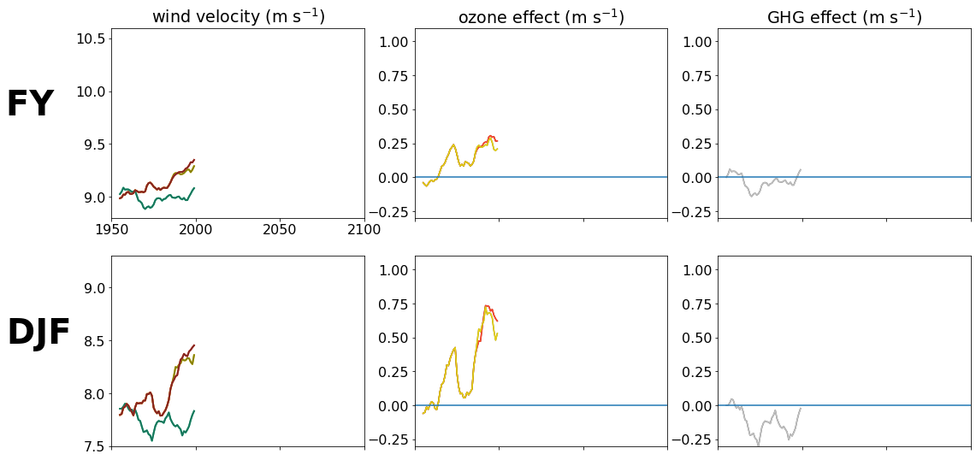
Ozone and GHG effect on wind speed,1950-2100
Notes:
SOZONE/windAnalyis/wspdComponents/Fig-line-windeffect.ipynb

Slide 33
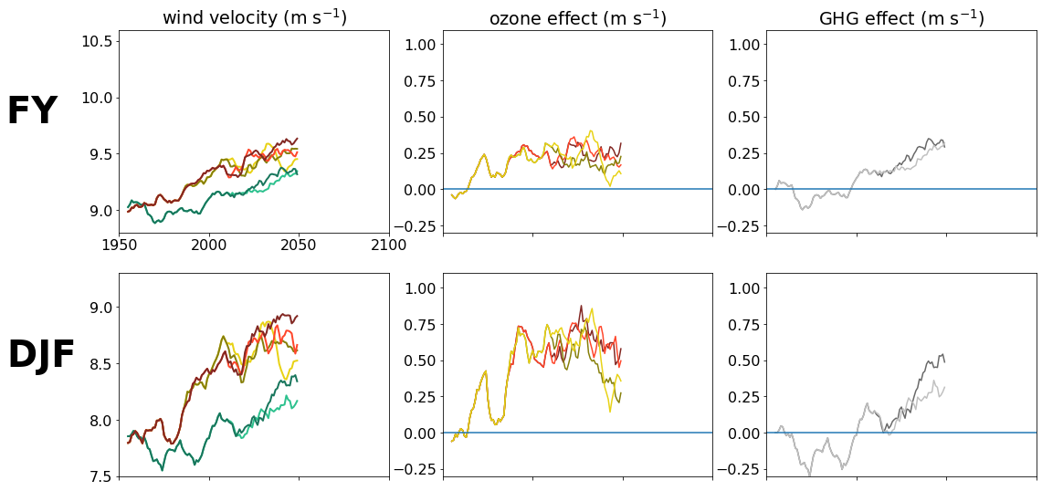
Ozone and GHG effect on wind speed,1950-2100

Slide 34
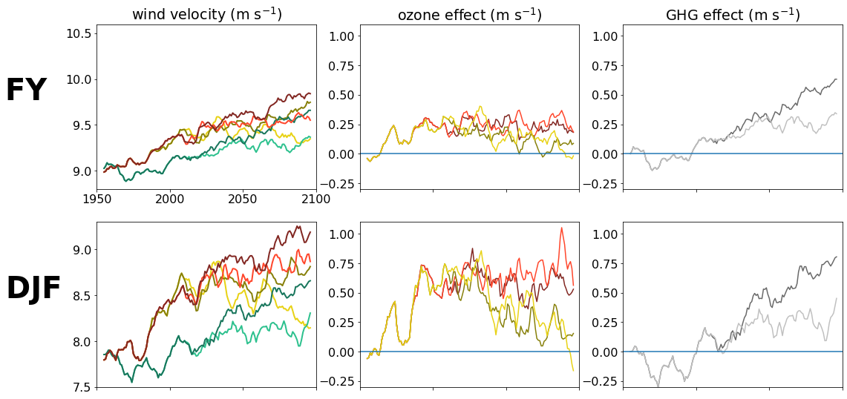
Ozone and GHG effect on wind speed,1950-2100
Notes:
SOZONE/windAnalyis/wspdComponents/Fig-line-windeffect.ipynb

Slide 35
What are the major physical controls on the Southern Ocean carbon sink, and how will they change due to GHG emissions and ozone depletion?
quantity | expected effect of ozone depletion on quantity | expected effect of atmo. GHG increase on quantity | expected effect of quantity change on CO2 sink (↓: sink decrease)
wind velocity (WINDS) | ↑ | ↑ | ↓(↑)
sea surface temperature (SST) | ↓(↑) | ↑ | ↓(↑)
mixed layer depth (MLD) | ↑ | ↓ | ↓↑
overturning (OT) | ↑ | ↑(↓) | ↓

Slide 36
A back of the envelope calculation: of non-CO₂ effects the thermal effect is most important, but non-CO₂ effects are dwarfed by the atmospheric carbon signal.

