Slide 1

Cross-Query Optimization for WCOJ
CSE 214: Principles of Database Systems
Thomas Banghart

Slide 2
Motivation
Binary join engines process joins in pairs
No join ordering avoids intermediate blowup for cyclic queries
Triangle: R(a,b) JOIN S(b,c) JOIN T(c,a) can produce O(|E|^2) intermediates
WCOJ algorithms solve this for single queries
Process one variable at a time, intersect across all relations
Runtime bounded by AGM bound, not intermediate sizes
But batches of similar queries still redundantly build identical data structures
No prior work combines WCOJ with multi-query optimization
Notes:
Simple motivation
I was familiar with an open-source project called Calcite and wanted to do something to contribute to that
At the same time, it is a general purpose adapter and didn’t touch on any of the underlying storage systems
So, had to find something where Calcite was used in -
Saw that Flink’s SQL api is all calcite based and decided to look at that
Some limitations of Calcite require the flink community to make a lot of changes
All that said, main motivation and goal is to improve the Flink SQL optimizer in some small way
Flink has a higher level DAG that makes optimization difficult
Calcite can’t optimize a full graph - but really subtrees of that graph
With a lofty goal of bringing full optimization to Flink streaming plan
And hopefully bring this back to Calcite.

Slide 3

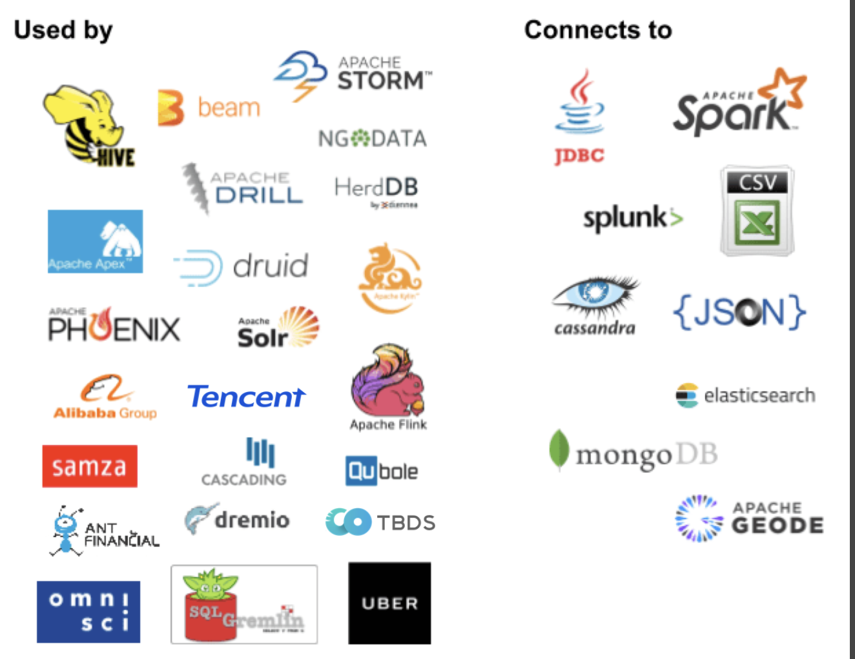
“Everything a database does except storage”
(Query plan + SQL Generation)
SQL
SQL parser
Pluggable parser, lexical rules
SQL validator
Pluggable catalog, conformance, operators
Relational algebra
Query planner
Pluggable rewrite rules
Adapter
Pluggable stats / cost
Physical operators
Storage
Notes:
Calcite is SQL engine with no storage system
Relies on adapters for access to storage systems
Can perform query federation between multipl storage systems
In memory execution
JVM with only a few common external dependencies

Slide 4
Notes:
Image: https://nightlies.apache.org/flink/flink-docs-master/docs/concepts/flink-architecture/
Originates from the Stratosphere research project at TU Berlin
Flink treats all data as streams, enabling seamless analysis of both real-time and historical data using the same APIs and programming model.
Offers robust fault-tolerant state management, ensuring accurate results even in the face of failures.
Guarantees that each event is processed exactly once across the entire pipeline, avoiding duplicates or missed data.
Proven to scale to massive datasets and provides low-latency processing capabilities for real-time applications.
Quick note on architecture: Several client types (SQL client is just one of them)
Key Components:
JobManager: Coordinates distributed execution.
ResourceManager: Manages resources (task slots) within the cluster
Dispatcher: Accepts jobs, provides REST interface, runs WebUI
JobMaster: Manages execution of a specific job
TaskManager: Executes tasks, buffers data, and manages task slots (units of resource allocation).
Red arrow points to the component of Flink we are interested in

Slide 5
Thank you!

Slide 6
The Problem: Cyclic Joins
Triangle query: find all (a,b,c) where edges a->b, b->c, c->a exist
Binary join: R JOIN S on b produces all 2-hop paths O(|E|^2)
Then filter with T -- final output may be orders of magnitude smaller
WCOJ: process variables one at a time
At each level, intersect candidates across ALL participating relations
Backtrack when a binding has no valid continuations
Runtime bounded by AGM bound -- worst-case optimal

Slide 7
WCOJ in Calcite
Automatic cyclic detection
GYO reduction on join hypergraph
Only fires for alpha-cyclic queries
Hash-based multi-level tries
Built at query time, no pre-sorting
O(|R| * d) build, O(d) probe
Integrated into Volcano optimizer
EnumerableWCOJRule: MultiJoin -> EnumerableWCOJ
JoinToMultiJoinRule flattens binary tree first
Backtracking enumerator
One variable per level
Cross-product of matching rows at leaves

Slide 8
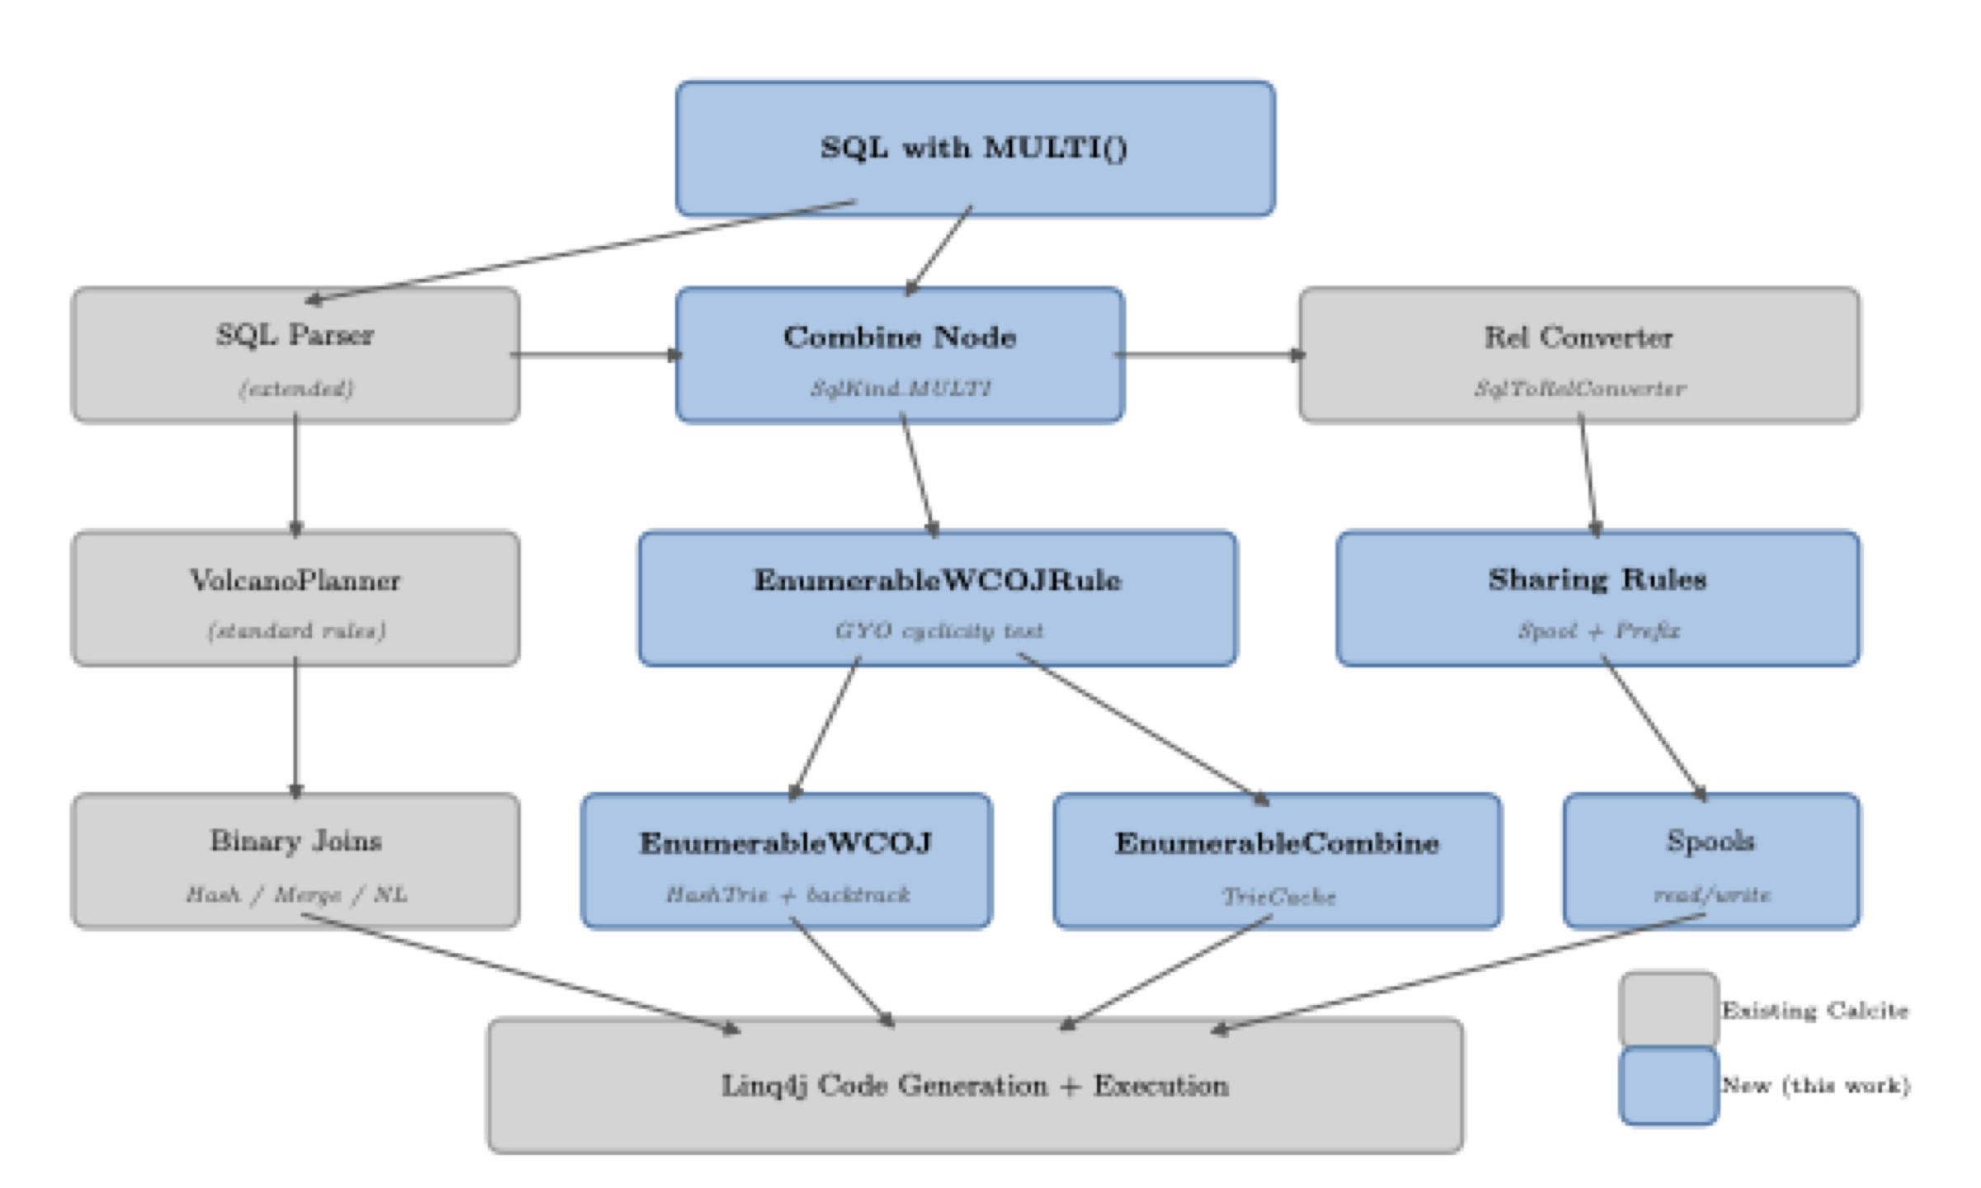
System Architecture

Slide 9
The Combine Operator & MULTI() Syntax
MULTI() SQL extension declares a batch of queries
Parser produces SqlCall with SqlKind.MULTI
Each sub-query independently converted, wrapped in Combine node
Combine: new relational operator holding N sub-queries
Single output row = struct of per-query result lists
Optimizer sees all queries simultaneously
EnumerableCombine creates shared TrieCache
Bridge for cross-query trie sharing

Slide 10
Cross-Query Optimizations
1. Trie Caching -- share hash trie data structures
Identity-based cache: same input object = same trie
Intra-operator (self-joins): always active
Cross-operator: requires spooling for object identity
2. Sub-Expression Sharing via Spools
Identify identical sub-plans across Combine children
First occurrence -> spool; duplicates -> spool read
3. Shared-Prefix Execution
Fingerprint join variables to find shared prefixes
Compute prefix once, distribute to per-query suffix executors

Slide 11
Experimental Results

Slide 12
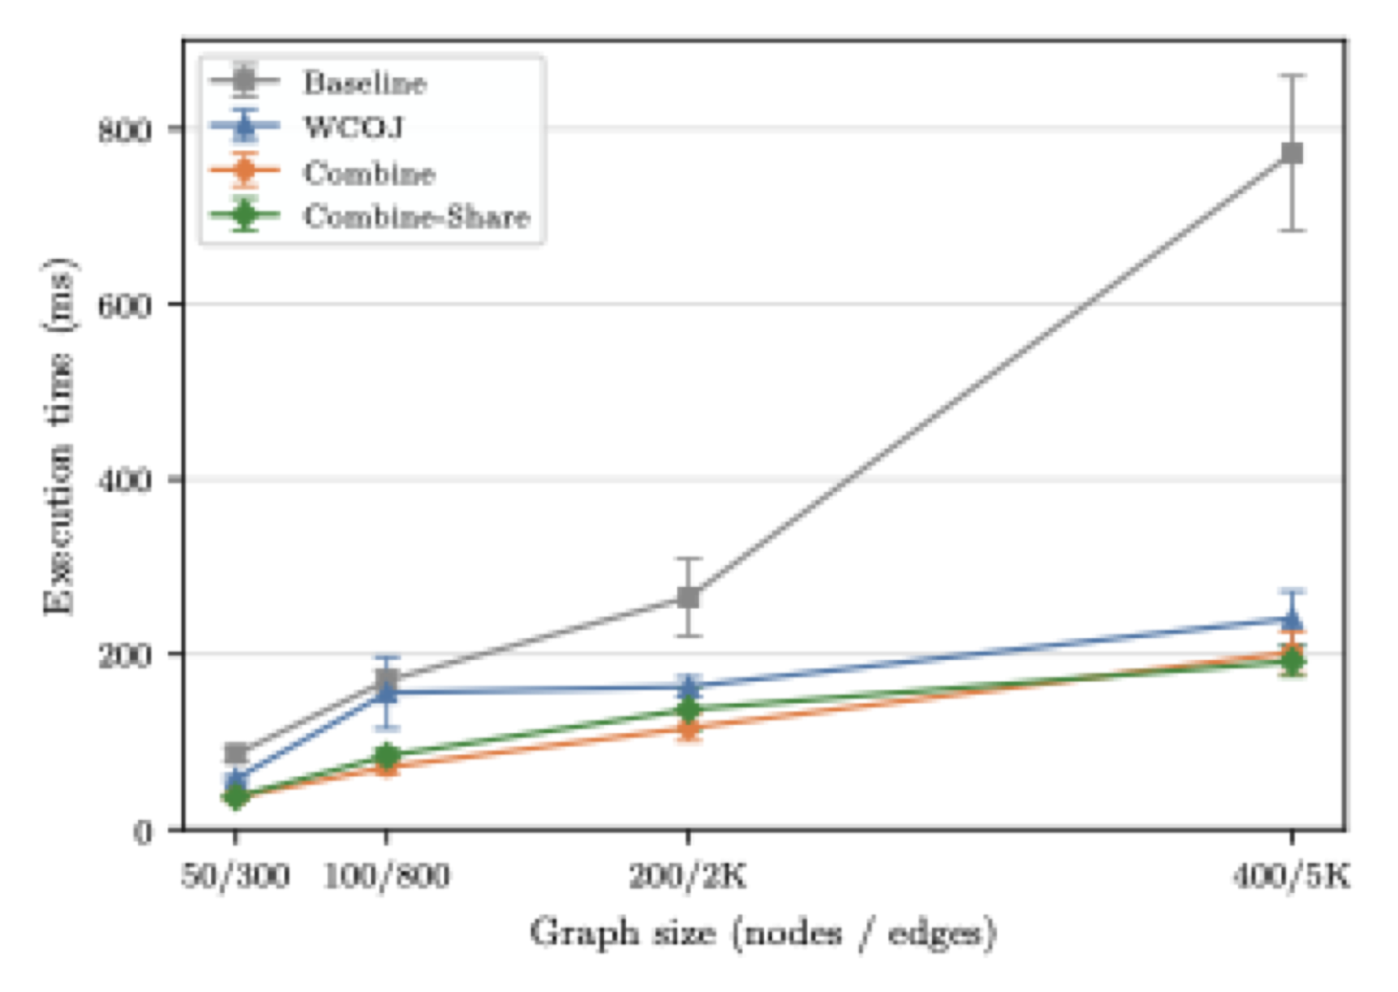
Scalability with Graph Size (N=5 queries)

Slide 13
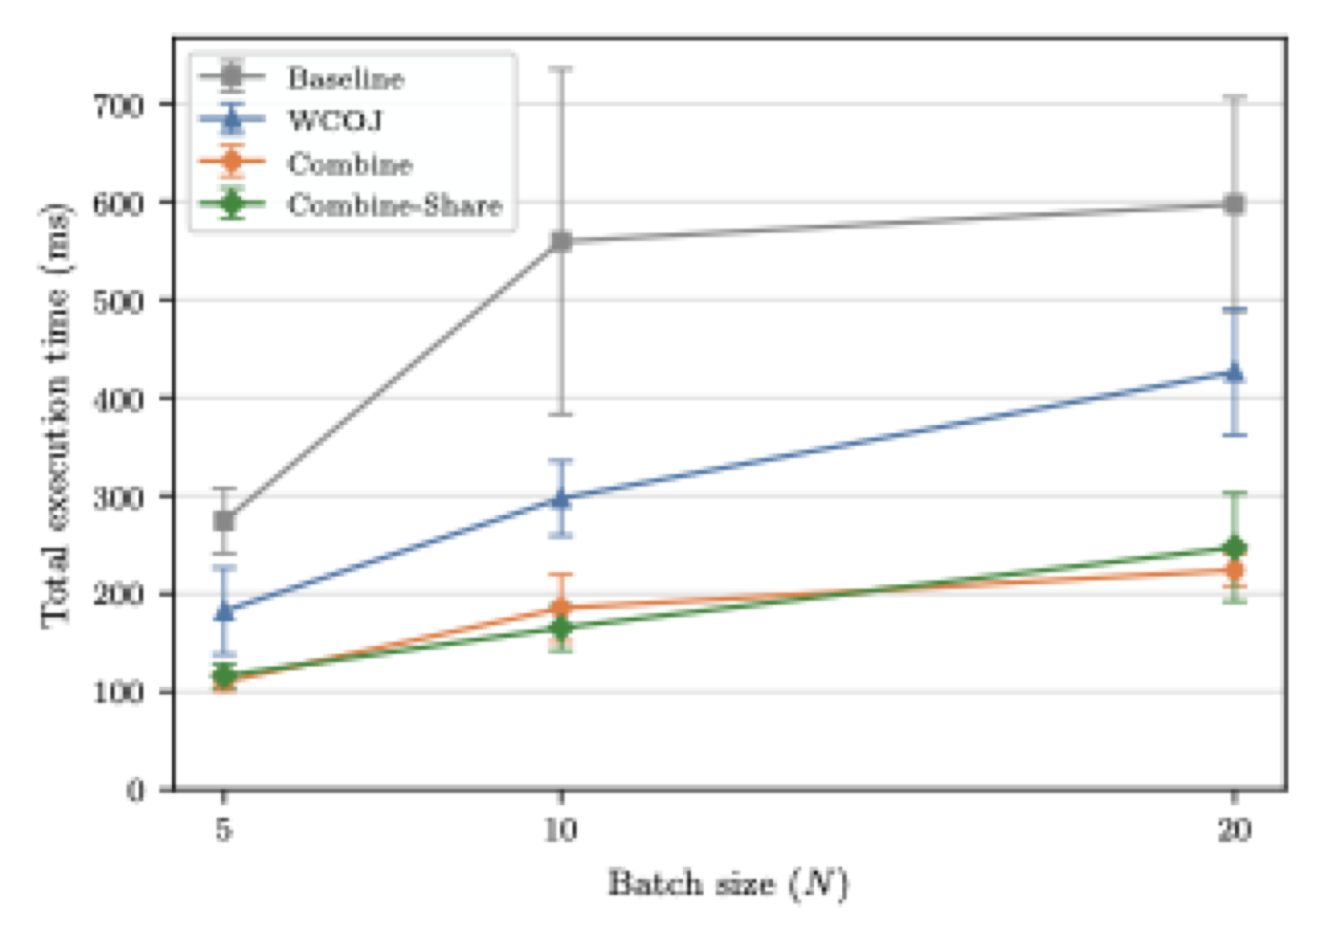
Multi-Query Speedup (|V|=200, |E|=2000)

Slide 14
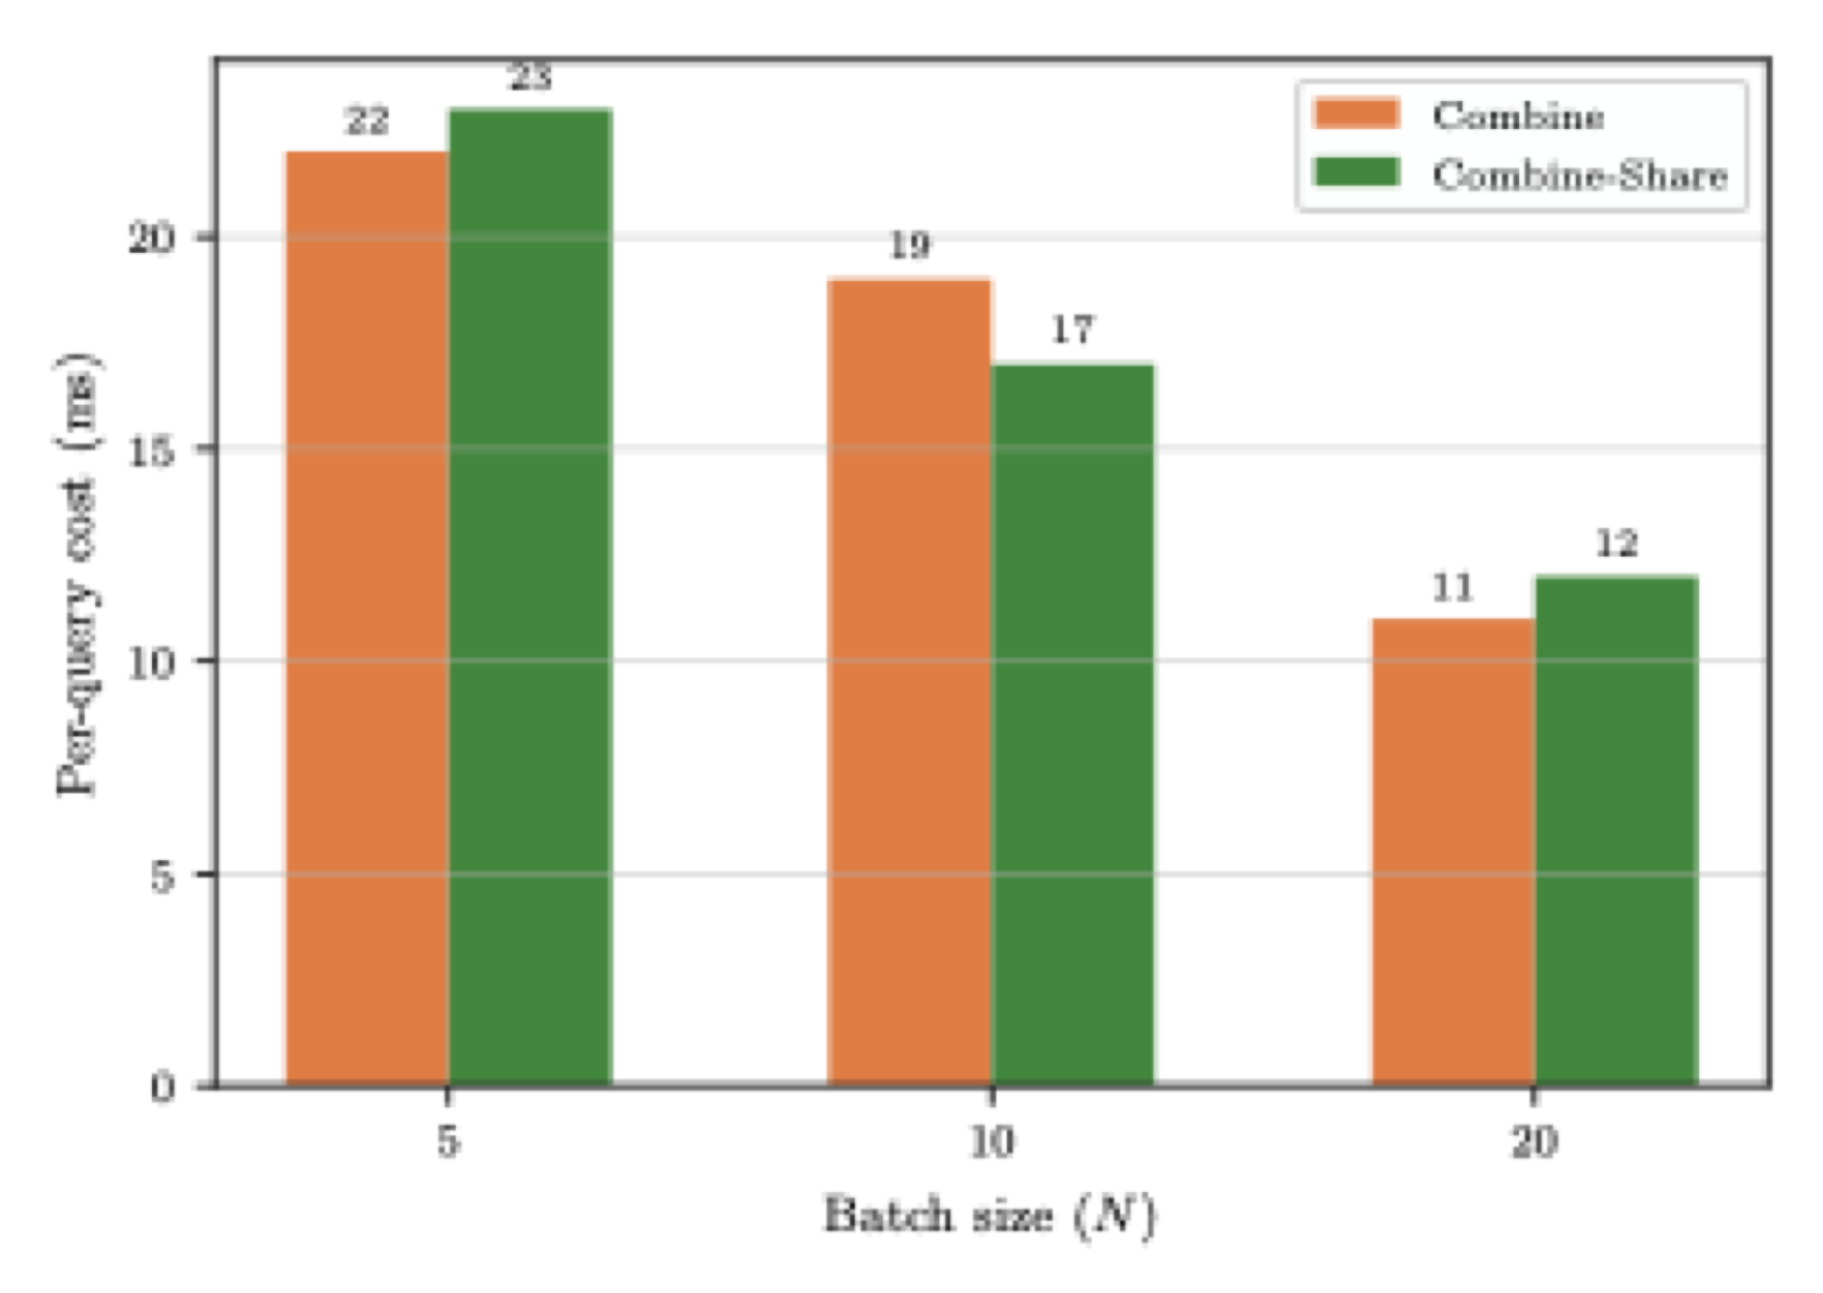
Per-Query Amortized Cost

Slide 15
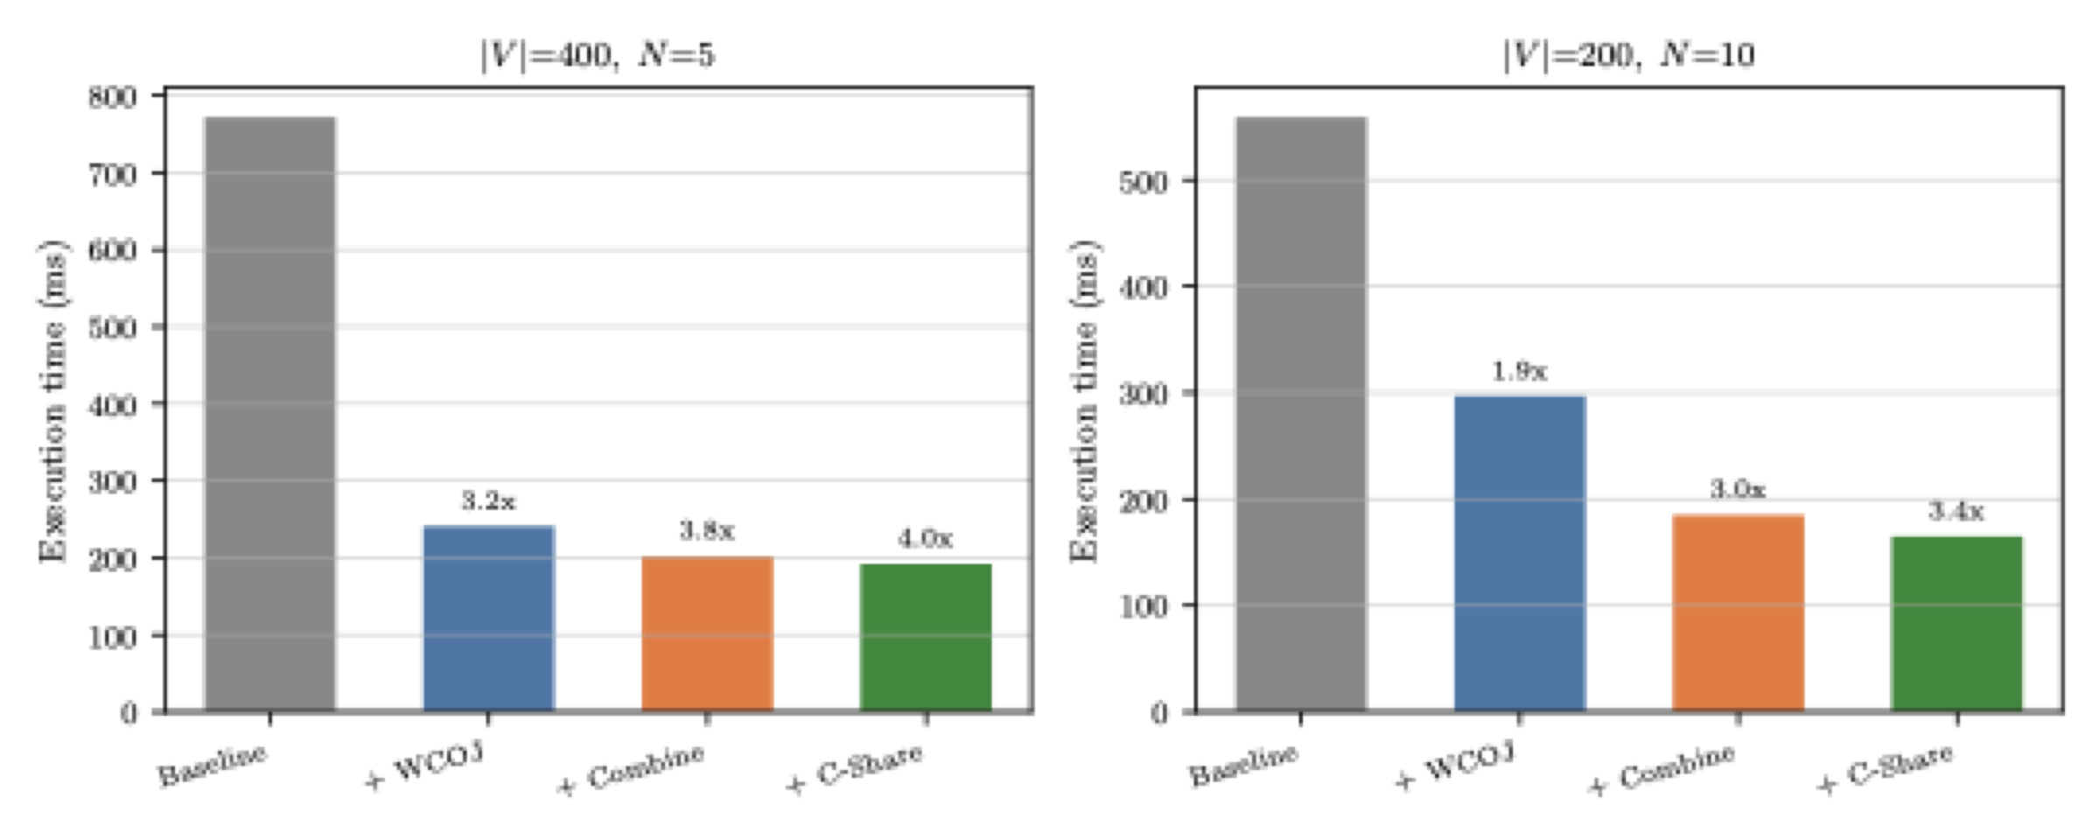
Optimization Contributions

Slide 16
TPC-H: Self-Join Cyclic Queries
Lineitem self-joins at SF=0.01, N=5 projection variations
Self-join triangle (2.9M rows):
Baseline: 4023 ms, WCOJ: 2267 ms (1.8x), Combine: 2120 ms (1.9x)
Self-join 4-cycle (6.0M rows):
Baseline: 109,443 ms, WCOJ: 46,529 ms (2.4x)
Binary joins OOM on this query; WCOJ completes in 47s
Combine-binary: OOM (4 GB heap)

Slide 17
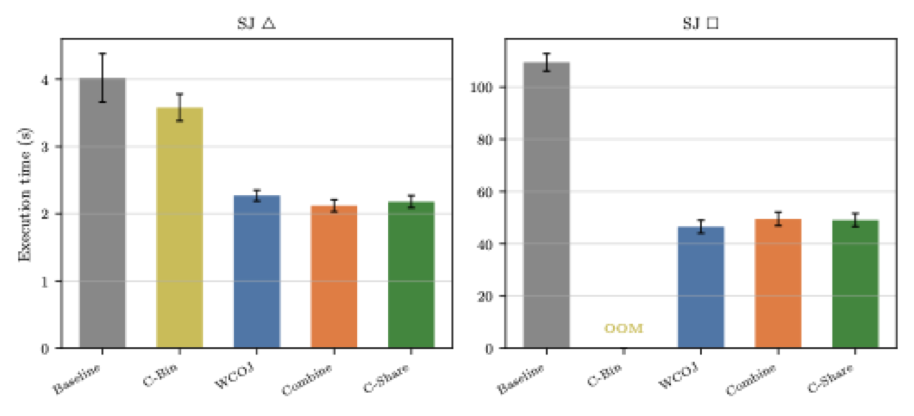
TPC-H Self-Join Performance

Slide 18
TPC-H: FK Cyclic Queries (WCOJ Loses)
FK cycles closed by low-cardinality nationkey (25 values)
FK rectangle -- customer-orders-lineitem-supplier (11.7K rows):
Baseline: 902 ms, WCOJ: 1381 ms (1.5x slower)
FK diamond -- c-o-l-s-nation (11.7K rows):
Baseline: 2096 ms, WCOJ: 8141 ms (3.9x slower)
Combine: 15.8s, Combine-Share: 13.2s (materialization overhead)
Why? Binary joins prune early via selective FK constraints
WCOJ pays intersection cost at every level regardless

Slide 19
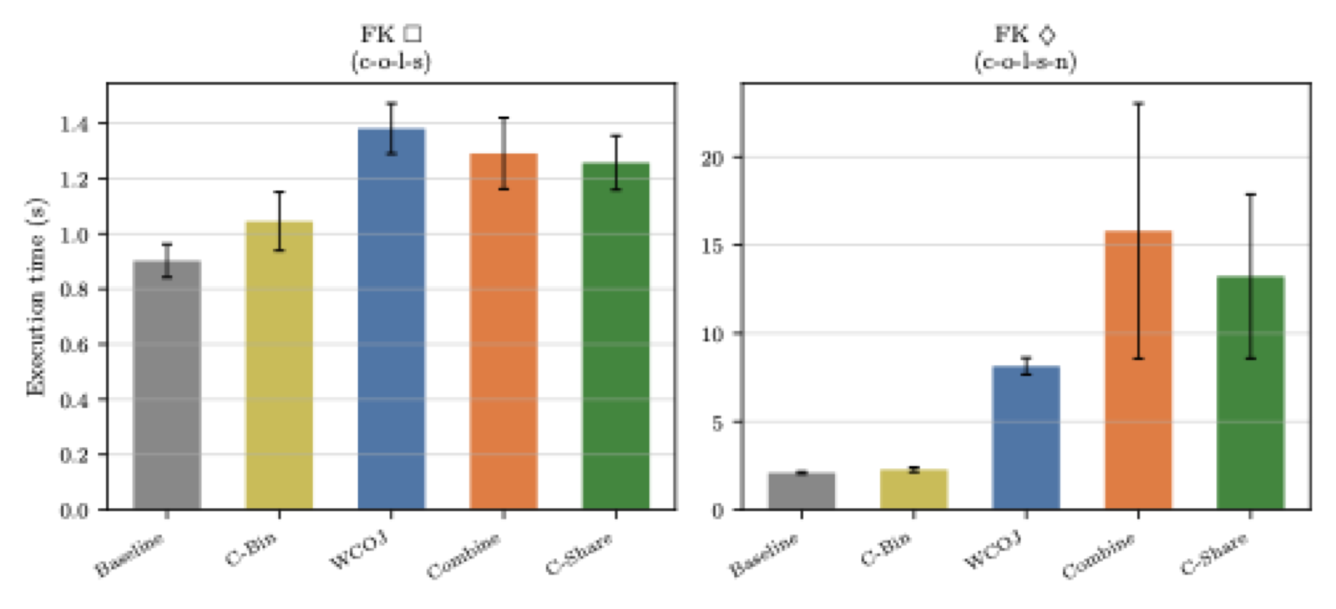
TPC-H FK Cycle Performance

Slide 20
When to Use WCOJ
WCOJ wins when:
Query is cyclic (GYO reduction)
Intermediates >> final output
Self-joins with high fan-out
Closing predicate is not highly selective
WCOJ loses when:
FK cycles with selective closing predicates
Low-cardinality keys (e.g., nationkey)
Binary joins can prune early
Asymmetric table sizes favor chain execution

Slide 21
Conclusion & Future Work
First system combining WCOJ with multi-query optimization
Up to 1.9x on self-join triangles, 2.4x on 4-cycles
Enables queries that binary joins cannot complete (OOM)
WCOJ is not universally beneficial
FK cycles: 1.5x-3.9x slower -- GYO detection avoids these
Future directions:
Adaptive variable ordering for better prefix sharing
Disk-spillable spools for large intermediates
Hybrid plans: WCOJ for cyclic components, binary for acyclic
Integration with Calcite's materialized view subsystem

