Slide 1

Cross-Query Optimization for WCOJ
CSE 214: Principles of Database Systems
Thomas Banghart

Slide 2
Motivation
How do we optimize a single conjunctive query?
Join ordering, access path selection, predicate pushdown
What about optimizing multiple queries at a time?
Shared sub-expressions, common intermediate results
This is generally known as the view selection problem (VSP)
VSP is NP-Hard -- many heuristics, many real-world systems
Not a new problem: Finkelstein (1982), Sellis (1988)
Shortly after System R optimizer, people started thinking about this
Modern systems: SparkCruise, Amazon Athena fusion, QPipe
Notes:
Simple motivation
I was familiar with an open-source project called Calcite and wanted to do something to contribute to that
At the same time, it is a general purpose adapter and didn’t touch on any of the underlying storage systems
So, had to find something where Calcite was used in -
Saw that Flink’s SQL api is all calcite based and decided to look at that
Some limitations of Calcite require the flink community to make a lot of changes
All that said, main motivation and goal is to improve the Flink SQL optimizer in some small way
Flink has a higher level DAG that makes optimization difficult
Calcite can’t optimize a full graph - but really subtrees of that graph
With a lofty goal of bringing full optimization to Flink streaming plan
And hopefully bring this back to Calcite.

Slide 3

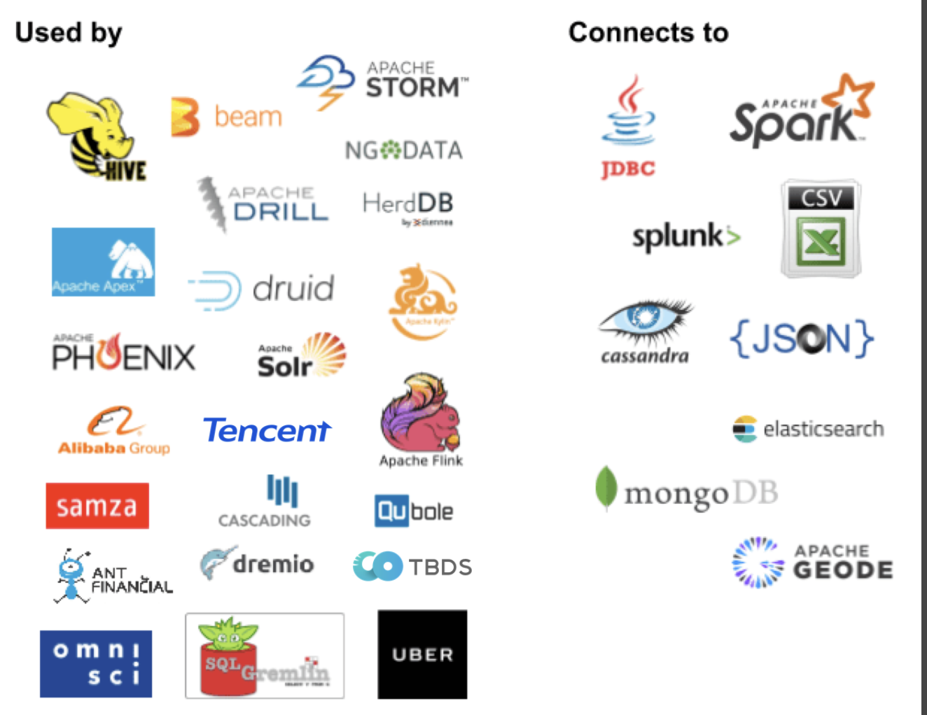
“Everything a database does except storage”
(Query plan + SQL Generation)
SQL
SQL parser
Pluggable parser, lexical rules
SQL validator
Pluggable catalog, conformance, operators
Relational algebra
Query planner
Pluggable rewrite rules
Adapter
Pluggable stats / cost
Physical operators
Storage
Notes:
Calcite is SQL engine with no storage system
Relies on adapters for access to storage systems
Can perform query federation between multipl storage systems
In memory execution
JVM with only a few common external dependencies

Slide 4
Notes:
Image: https://nightlies.apache.org/flink/flink-docs-master/docs/concepts/flink-architecture/
Originates from the Stratosphere research project at TU Berlin
Flink treats all data as streams, enabling seamless analysis of both real-time and historical data using the same APIs and programming model.
Offers robust fault-tolerant state management, ensuring accurate results even in the face of failures.
Guarantees that each event is processed exactly once across the entire pipeline, avoiding duplicates or missed data.
Proven to scale to massive datasets and provides low-latency processing capabilities for real-time applications.
Quick note on architecture: Several client types (SQL client is just one of them)
Key Components:
JobManager: Coordinates distributed execution.
ResourceManager: Manages resources (task slots) within the cluster
Dispatcher: Accepts jobs, provides REST interface, runs WebUI
JobMaster: Manages execution of a specific job
TaskManager: Executes tasks, buffers data, and manages task slots (units of resource allocation).
Red arrow points to the component of Flink we are interested in

Slide 5
Thank you!

Slide 6
Problem Statement
Not much has been done to cross MQO with worst-case optimal joins
WCOJ creates new structures to share -- not just the classic VSP
Hash tries, search-space traversals, variable-prefix bindings
This is a systems problem, not just an optimization problem
How do you construct and reliably share data structures at runtime?
What would it look like integrated into a real query engine?
Open questions:
How would one implement this in an existing optimizer?
Is there a theoretical backing for cost estimates?
When does sharing actually help vs. hurt?

Slide 7
MULTI() Syntax & the Combine Operator
New SQL syntax: MULTI((query1), (query2), ...)
Parser produces a SqlCall with SqlKind.MULTI
Each sub-query is independently converted to a RelNode
The Combine operator: a trivial way to hold multiple RelNodes
Single output row = struct of per-query result lists
Optimizer sees all queries simultaneously
Sub-queries can use WCOJ, binary joins, or anything else
This work is actually in Calcite today
Modular, opt-in -- doesn't change existing behavior

Slide 8
MULTI(): SQL to Calcite Plan
SQL:
MULTI(
(SELECT e1.src, e1.dst, e2.dst
FROM edges e1, e2, e3
WHERE e1.dst=e2.src
AND e2.dst=e3.src
AND e3.dst=e1.src),
(SELECT e1.src, e2.src, e3.src
FROM edges e1, e2, e3
WHERE ...same predicates...)
)
Calcite plan (after WCOJ rule):
EnumerableCombine
EnumerableCalc(proj=[src,dst,dst])
EnumerableWCOJ(variables=
[Var0[(0,1),(2,1)],
Var1[(0,0),(1,0)],
Var2[(1,1),(2,0)]])
EnumerableTableScan([edges])
EnumerableTableScan([edges])
EnumerableTableScan([edges])
EnumerableCalc(proj=[src,src,src])
EnumerableWCOJ(...same...)
Same WCOJ, different projections
=> trie cache, spool, prefix share

Slide 9
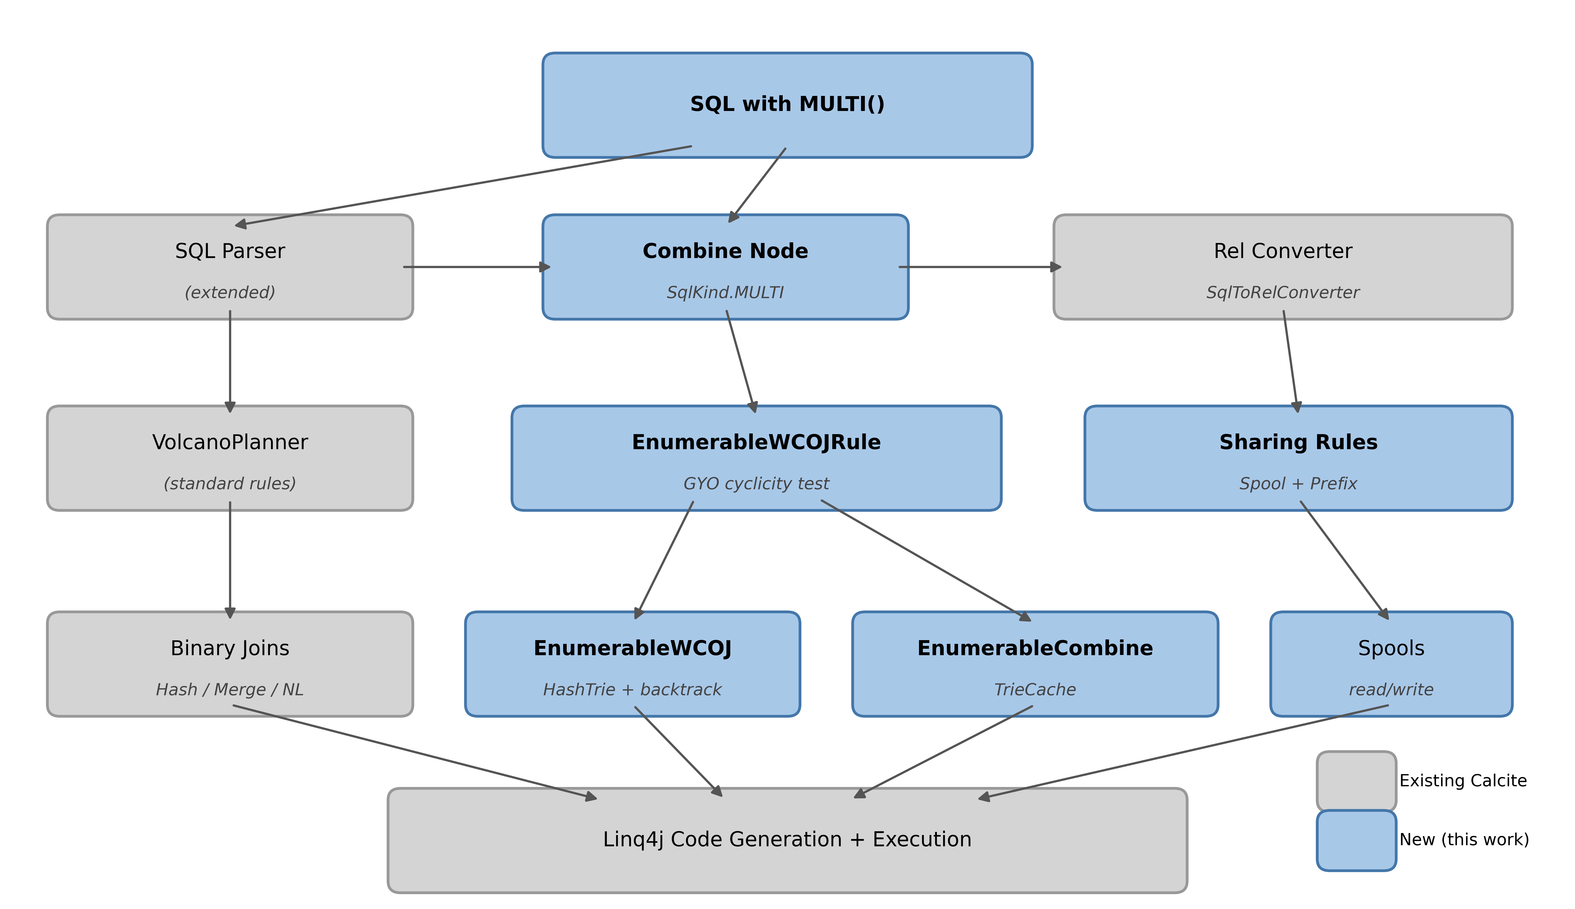
System Architecture

Slide 10
WCOJ: Three Ways to Share

Slide 11
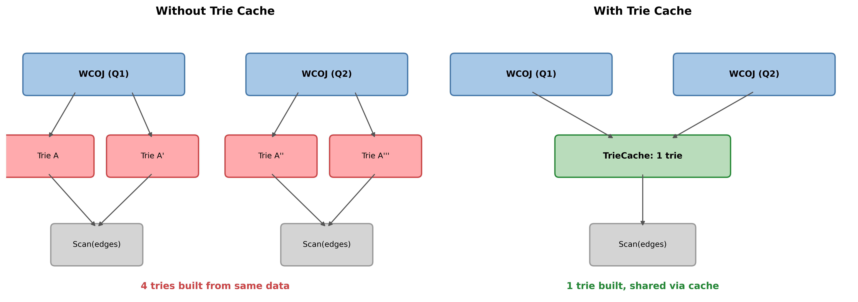
1. Cached Hash Tries

Slide 12
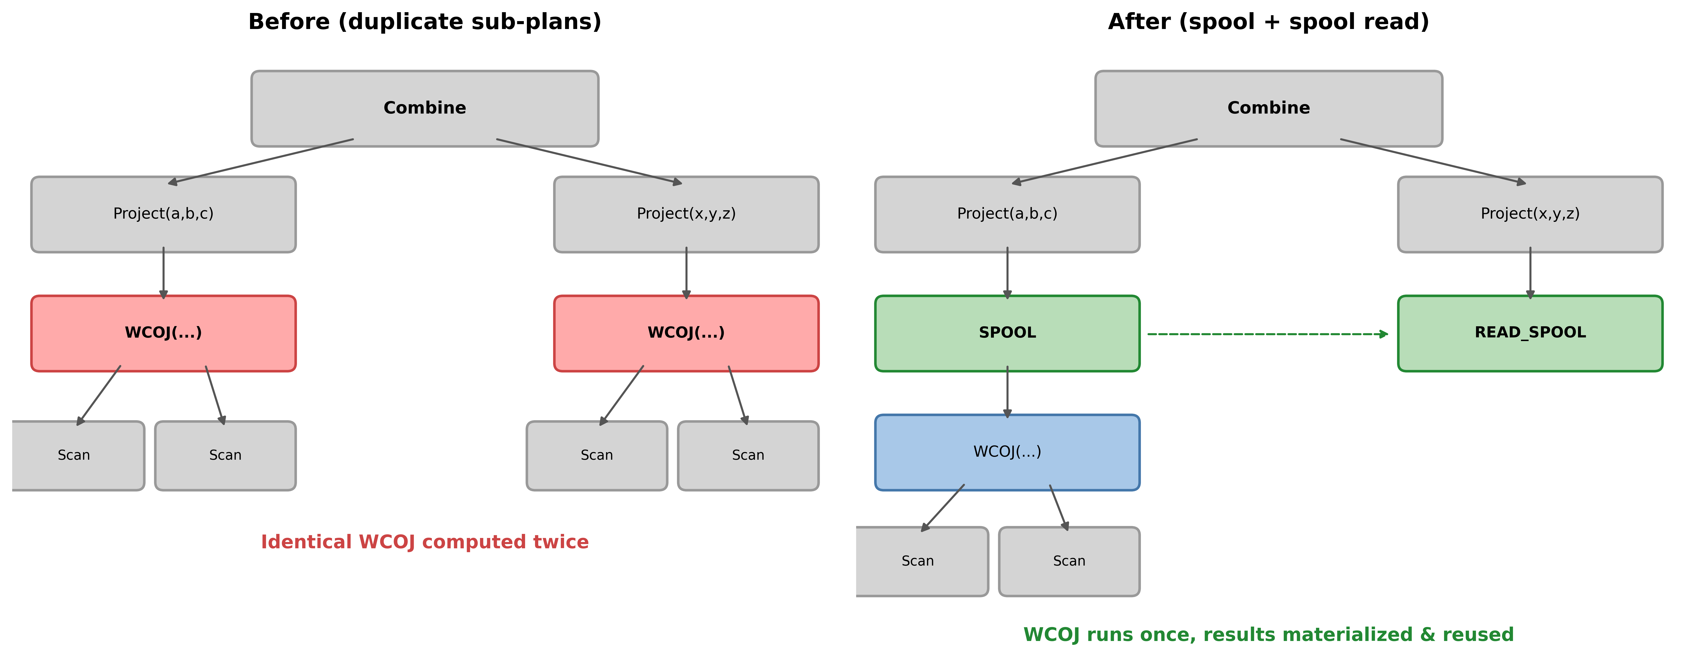
2. Sub-Expression Sharing via Spools

Slide 13
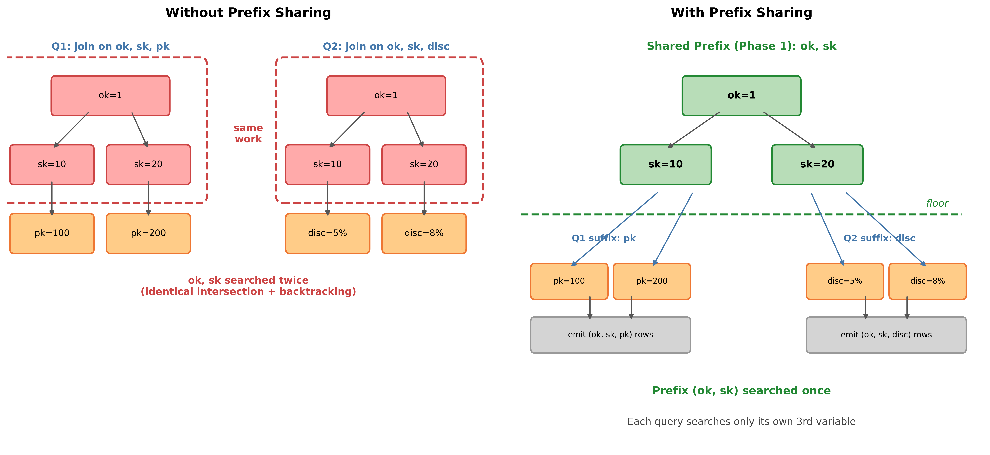
3. Shared-Prefix Execution

Slide 14
Experimental Results

Slide 15
What We Tested
Synthetic graphs (best case for WCOJ)
Random directed graphs with a few popular hub nodes
Hub nodes have lots of connections, most nodes don't
Like a social network: a few celebrities, many regular users
Query: find all triangles (A knows B, B knows C, C knows A)
Binary joins blow up because hubs create huge intermediates
Run the same triangle query 5-20 times with different output columns
TPC-H (realistic data, ~60 MB)
Self-join: take the lineitem table (order line items)
and join it against itself on different columns
"find items in the same order from the same supplier
for the same part" -- 2.9M matches
FK joins: chain across real tables
customer -> orders -> lineitem -> supplier
"which customers bought from suppliers in the
same country?" -- cycle closes on nationkey
Only 25 countries, so binary joins prune fast
Hardware: M4 Pro, 48 GB, JDK 21, 2 GB heap

Slide 16
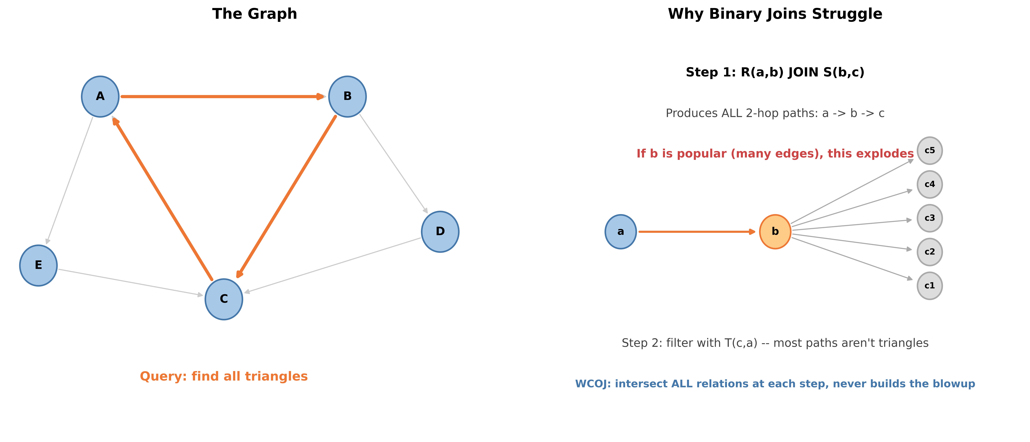
Synthetic: Triangle Query on a Graph

Slide 17
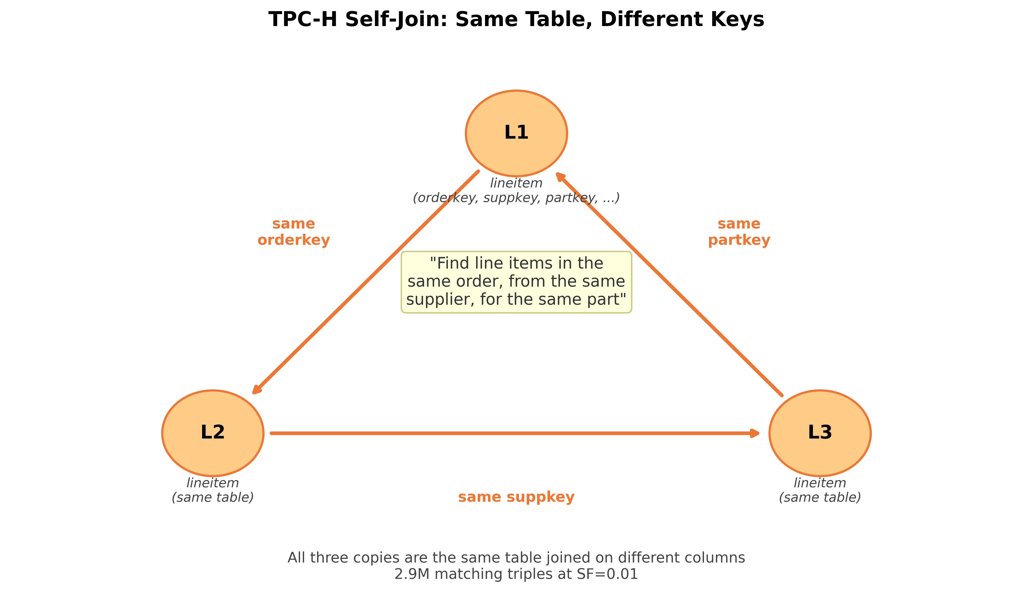
TPC-H: Self-Join Triangle

Slide 18
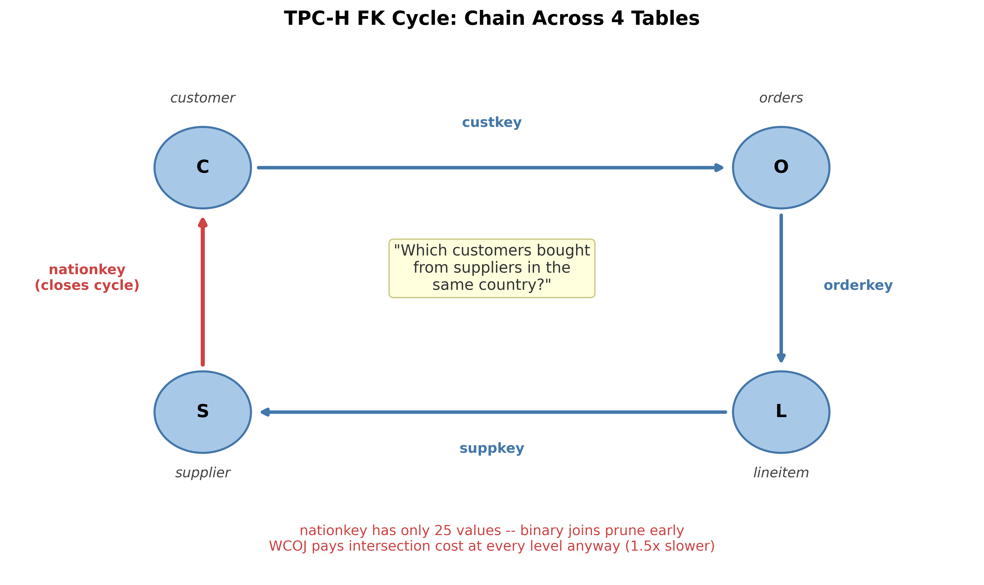
TPC-H: FK Cycle Across Tables

Slide 19
Benchmark Modes: What Are We Comparing?
Baseline: standard Calcite with binary hash joins, queries run one at a time
This is what Calcite does today without our changes
WCOJ: replace binary joins with our WCOJ operator, still one query at a time
Tests whether WCOJ alone helps, independent of batching
Combine: batch N queries with MULTI(), WCOJ + trie caching
Tests whether running queries together and sharing tries helps
Combine-Share: same as Combine + sub-expression spooling + prefix sharing
Tests whether the full sharing machinery adds value
Combine-Binary: batch N queries with MULTI() but use binary joins (no WCOJ)
Isolates the contribution of batching from WCOJ -- TPC-H only

Slide 20
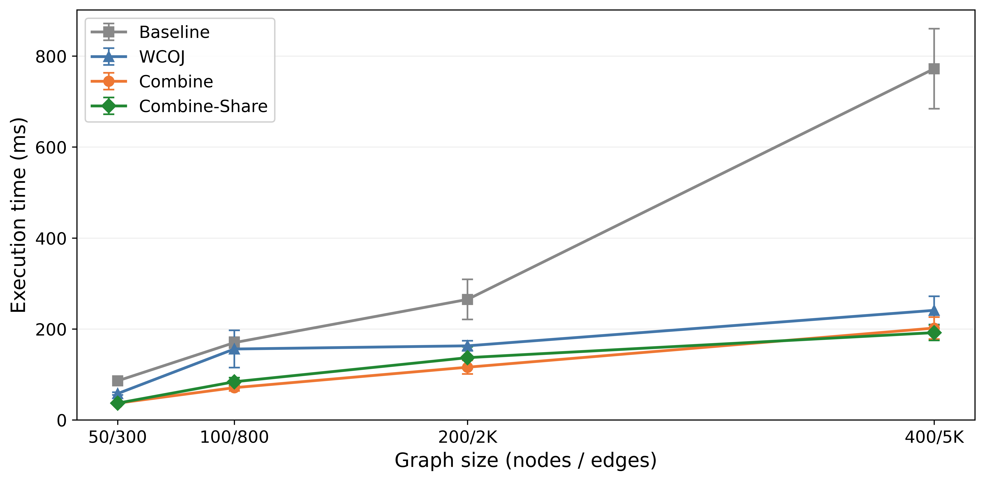
Scalability with Graph Size
Test: how does performance change as
the graph gets bigger?
Fix batch at N=5 triangle queries
Grow graph: 50 to 400 nodes
Result:
Baseline grows super-linearly
(bigger graph = worse intermediate blowup)
WCOJ stays flat -- scales with output
Speedup widens: 1.5x to 4.0x

Slide 21
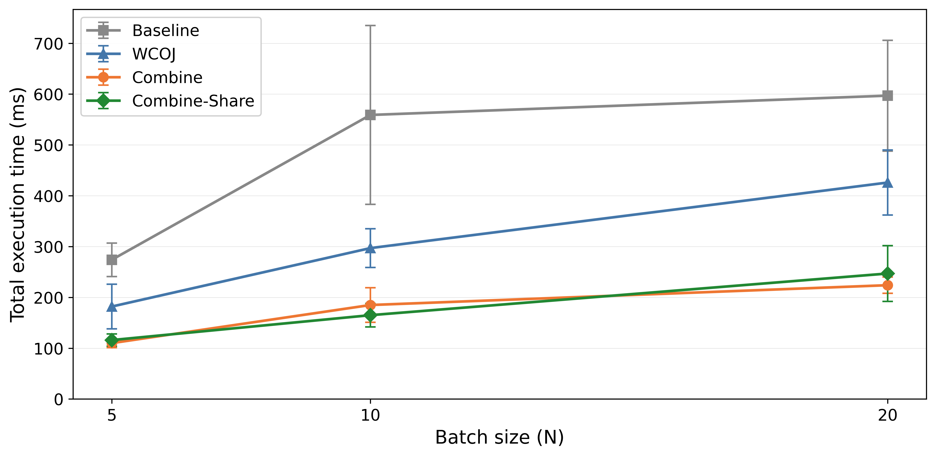
Multi-Query Speedup
Test: does batching more queries
together help?
Fix graph at 200 nodes, 2000 edges
Grow batch: N=5 to N=20 queries
Result:
Baseline scales linearly (more queries = more time)
Combine/C-Share scale sub-linearly
C-Share best at N=10 (3.4x) where
each query appears twice (real duplicates)
At N=20, sharing overhead > savings

Slide 22
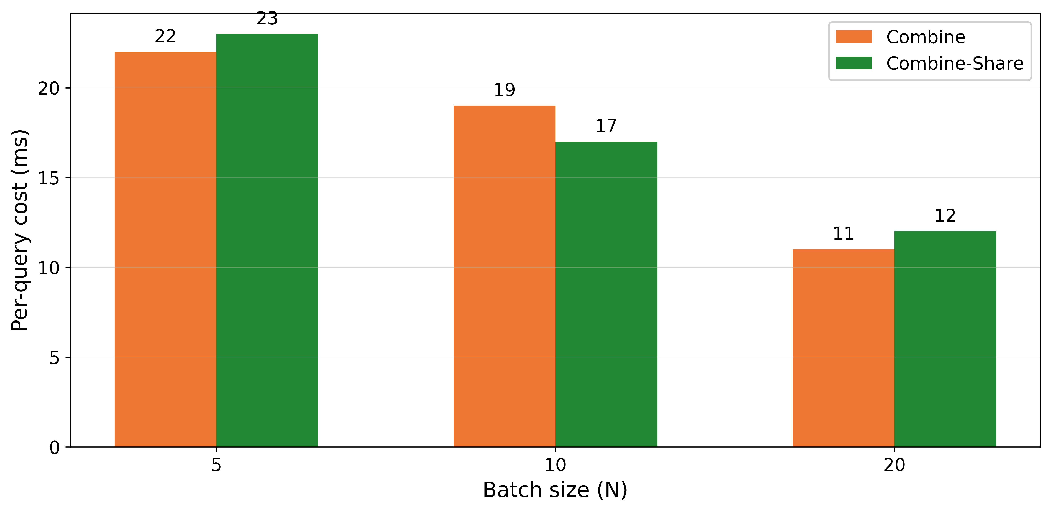
Per-Query Amortized Cost
Test: what does each additional query
cost in a batch?
Same setup, but divide total time by N
Result:
22 ms/query at N=5
11 ms/query at N=20
Fixed costs get amortized:
plan compilation: once per batch
trie construction: once per input
Adding queries gets cheaper

Slide 23
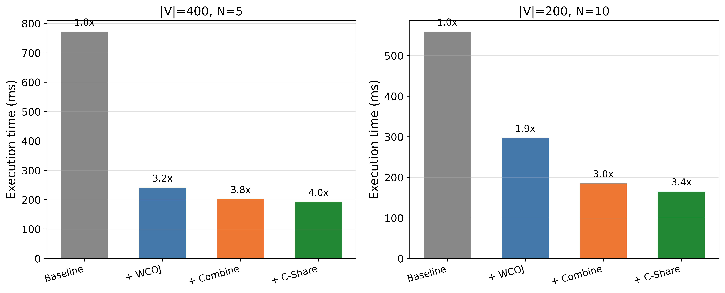
Optimization Contributions
Test: how much does each optimization
layer add?
Each mode builds on the previous one
Two configurations to show different regimes
Result:
WCOJ is the big win (3.2x at V=400)
Combine adds +0.6x from batching
C-Share adds +0.2x from sharing
WCOJ does the heavy lifting;
Combine/C-Share are incremental gains

Slide 24
TPC-H Cyclic Joins
Standard TPC-H queries are acyclic, but the schema supports cycles
lineitem self-joins on orderkey/suppkey/partkey
FK cycles: customer-orders-lineitem-supplier closed by nationkey
Self-join triangle (2.9M rows):
WCOJ: 2267 ms (1.8x over baseline 4023 ms)
Combine: 2120 ms (1.9x) -- best mode
Self-join 4-cycle (6.0M rows):
WCOJ: 46,529 ms (2.4x over baseline 109,443 ms)
Binary joins OOM on this query; WCOJ completes in 47s

Slide 25
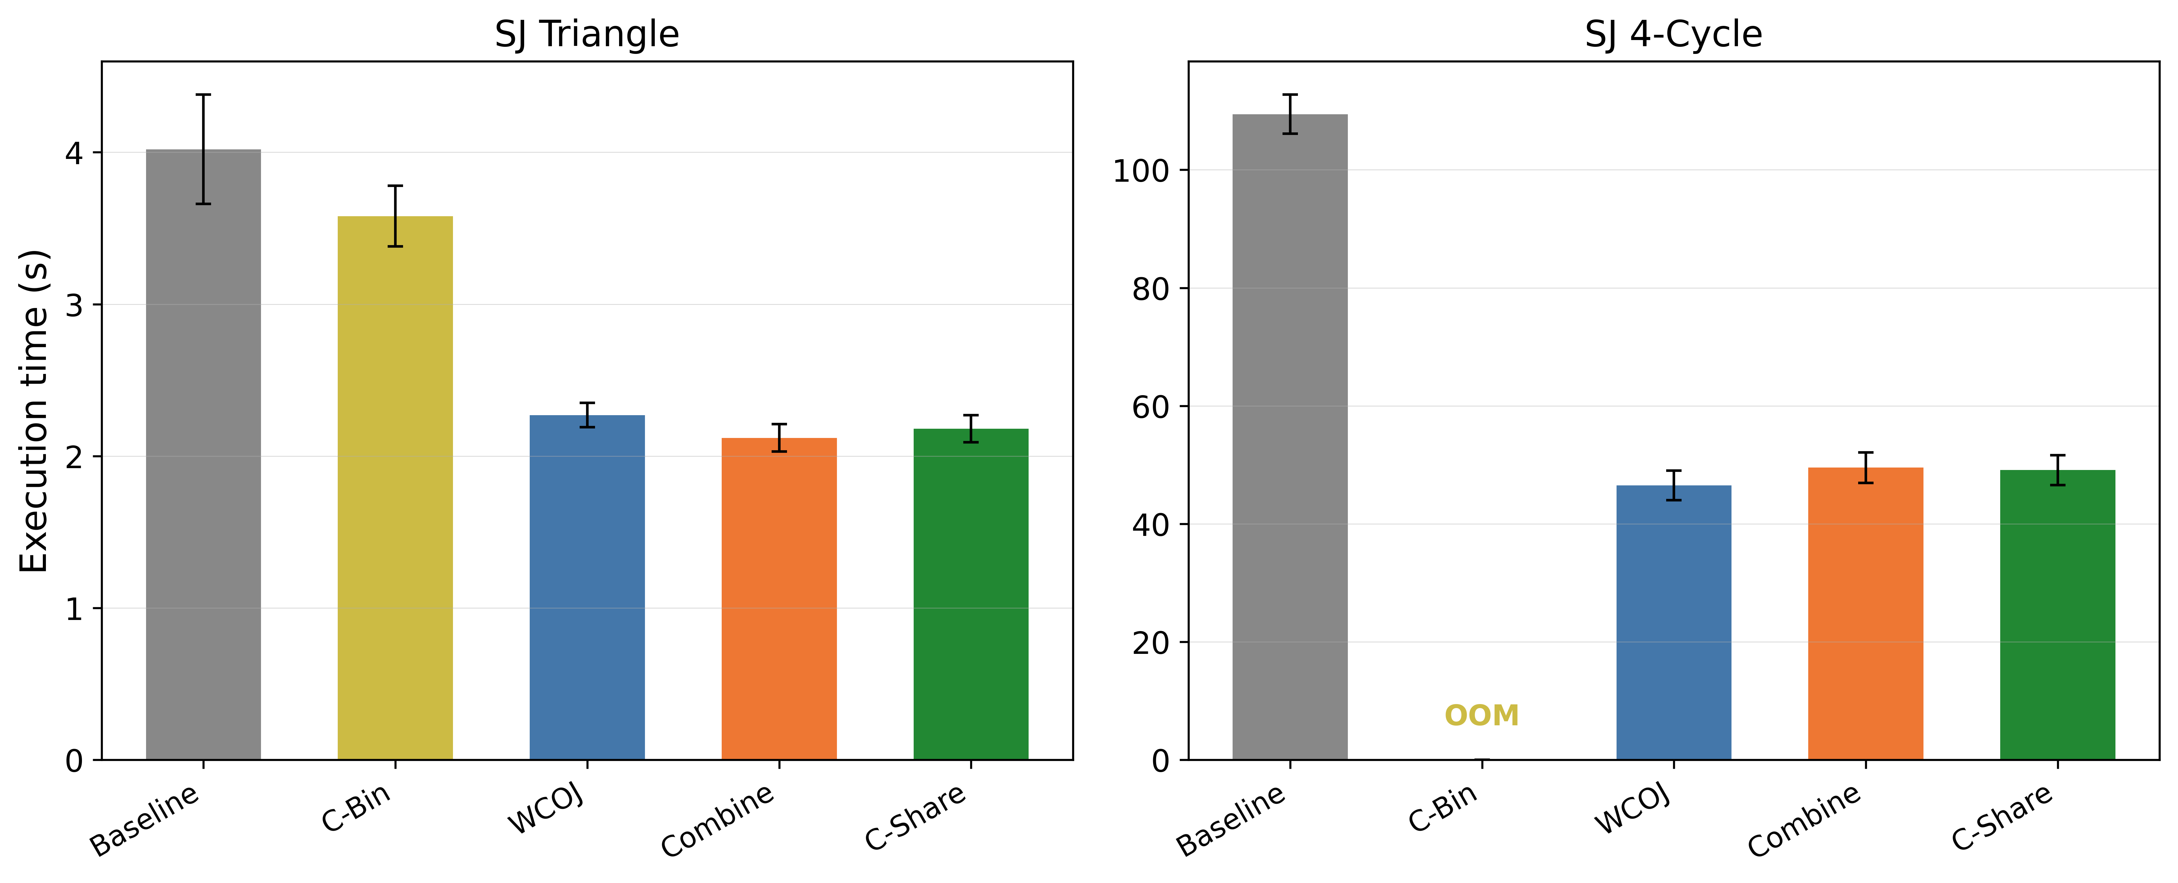
TPC-H Self-Join Performance
Test: does WCOJ help on realistic
self-join cycles over TPC-H lineitem?
Same table joined on different columns
C-Binary added to isolate batching vs WCOJ
Result:
Triangle: Combine 1.9x, WCOJ 1.8x
C-Binary only 1.1x -- batching alone
barely helps; WCOJ does the real work
4-Cycle: WCOJ 2.4x (46.5s vs 109s)
Binary joins OOM at 4 GB heap
WCOJ enables queries binary can't run

Slide 26
TPC-H: FK Cycles (WCOJ Loses)
FK rectangle (c-o-l-s, 11.7K rows): WCOJ 1.5x slower
Baseline 902 ms vs WCOJ 1381 ms
FK diamond (c-o-l-s-n, 11.7K rows): WCOJ 3.9x slower
Baseline 2096 ms vs WCOJ 8141 ms
Why? Low-cardinality closing predicate (nationkey, 25 values)
Binary joins prune early via selective FK constraints
WCOJ pays intersection cost at every level regardless
Combine makes it worse on the diamond (15.8s)
Materialization overhead on top of already-slow WCOJ

Slide 27
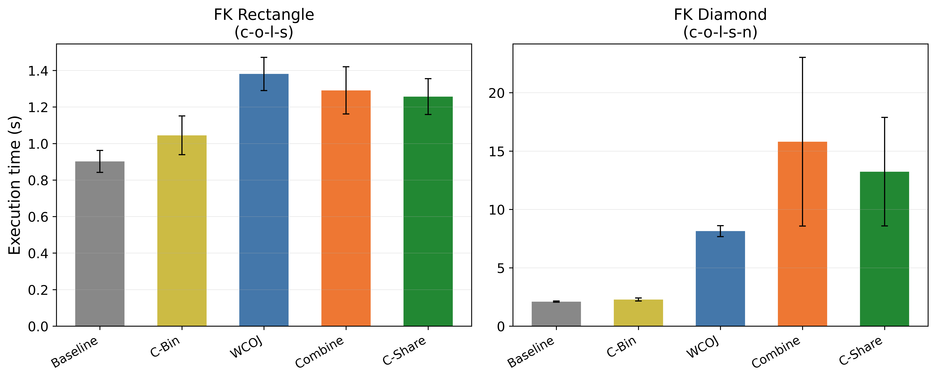
TPC-H FK Cycle Performance
Test: what happens when the cycle
crosses different tables via FK?
customer -> orders -> lineitem -> supplier
Closed by nationkey (only 25 values)
Result: WCOJ loses
Rectangle: 1.5x slower (1381 vs 902 ms)
Diamond: 3.9x slower (8.1s vs 2.1s)
Combine makes it even worse (15.8s)
Why?
Binary joins prune early on selective FK
WCOJ pays intersection cost at every level
Longer cycle = more wasted intersection

Slide 28
Summary

Slide 29
Contributions to Calcite
Multi-query infrastructure (in Calcite today):
Combine operator: holds N sub-queries as one plan
MULTI() SQL syntax: declares a batch for joint optimization
Sub-expression spooling: materializes shared sub-plans once
Single-query WCOJ algorithm:
Hash-based worst-case optimal join operator
GYO cyclicity detection -- only fires on genuine cycles
Integrated into Volcano optimizer via planner rules
All modular, opt-in, backward compatible
Existing queries are unaffected

Slide 30
Lessons Learned & Open Problems
Cyclic != use WCOJ
Need a way to identify cycles where binary joins still win
Selective closing predicates (e.g., nationkey) let binary joins prune early
Freitag et al. saw the same in Umbra -- cost-based routing is the real answer
Calcite's execution engine is the wrong place to benchmark
Most systems use Calcite for planning, not execution
Better case: export plans to Flink, Trino, or another engine
Could also work for streaming queries or materializing frequently-used structures
MULTI() requires knowing the workload ahead of time
You have to declare the batch up front
This is still the candidate selection problem -- NP-hard in general
A real system would need workload analysis or online detection

