Slide 1
Phenotype Ratios and Epistasis
Edward Lue

Slide 2
Basic Mendelian Genetics

Slide 3
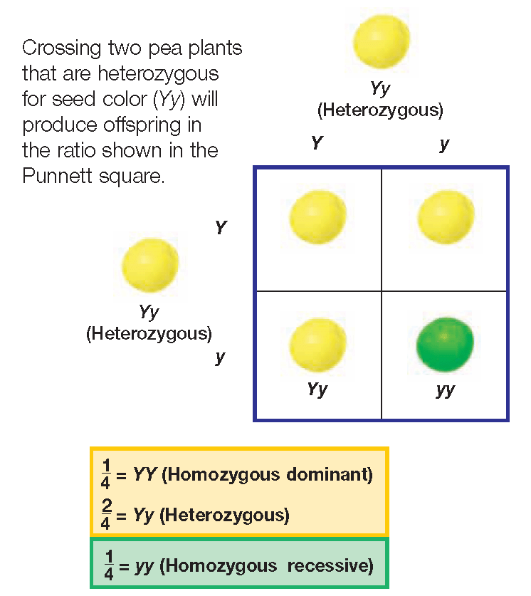
Monohybrid Cross
Genotype Ratio- 1:2:1
Phenotype Ratio- 3:1

Slide 4
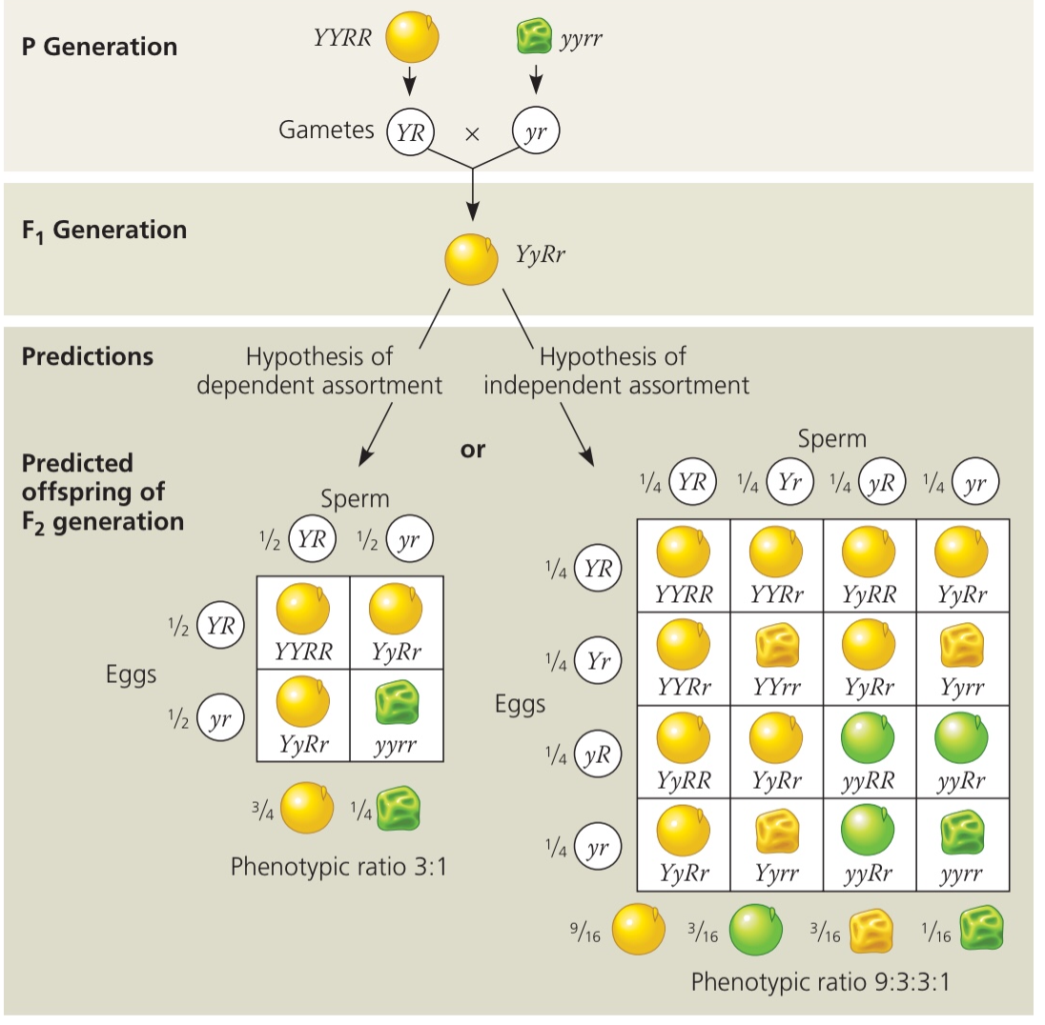
Dihybrid Cross
Genotype Ratio- 1:2:1:2:4:2:1:2:1
Phenotype Ratio- 9:3:3:1

Slide 5
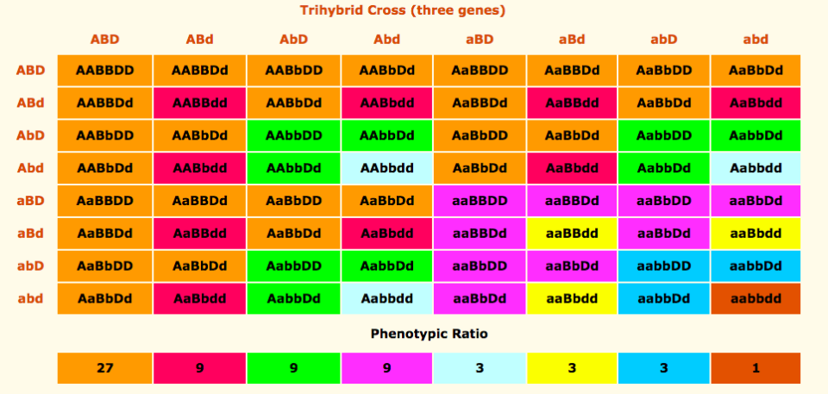
N-hybrid Crosses

Slide 6
Some Probability Questions
Given the cross AaBbCc x AaBbCc, what is the probability of an individual with the genotype AaBbCc?
What about if the cross was instead: aaBBCc x AabbCC?
For both crosses, calculate the probability of an individual expressing the dominant B and C genes along with the recessive a gene.

Slide 7
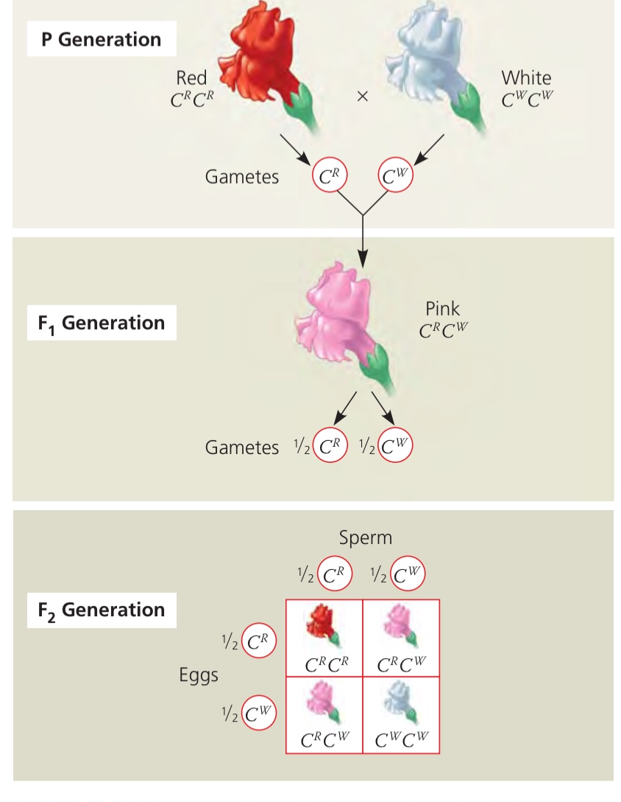
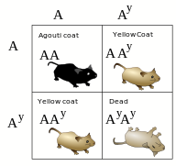
Other Phenotype Ratios

Slide 8
Other Ratios
2:1
1:2:1

Slide 9
Epistasis
When different genes contribute to the same phenotype

Slide 10
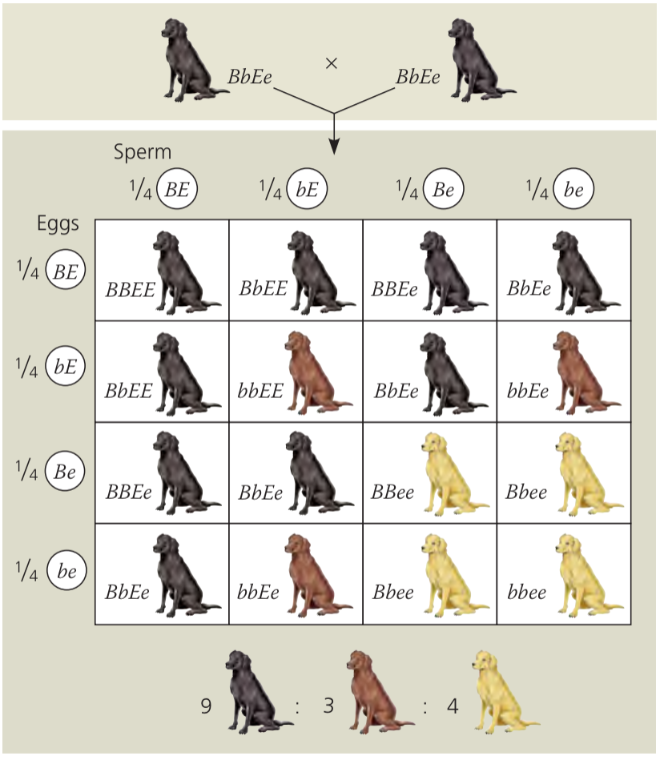
A Common Example

Slide 11
Other Epistasis Patterns
Recessive Epistasis: White-->Pink-->Blue
Dominant Epistasis: White--|Grey-->Black
Suppressors: Red--->Purple--->Red
A B

Slide 12
Gene Pathways and Regulation
Let’s say there was a gene pathway involving two genes, A and B, that produce product C. A mutation in gene A (producing nonfunctional A) increases product C. Is A a positive or negative regulator in this pathway?
A B C
B A C
?
?
?
?

Slide 13
Gene Pathways and Regulation
Let’s say there was a gene pathway involving two genes, A and B, that produce product C. A mutation in gene A (producing nonfunctional A) increases product C. Is A a positive or negative regulator in this pathway?
A B C
B A C
?
?
?
?

Slide 14
Gene Pathways and Regulation
Let’s say there was a gene pathway involving two genes, A and B, that produce product C. A mutation in gene A (producing nonfunctional A) decreases product C. Is A a positive or negative regulator in this pathway?
A B C
B A C
B A C

Slide 15
Gene Pathways and Regulation
What if I now told you that an organism with mutant B caused an increase in C? Testing with an organism mutant in both A and B leads to an increase in C. Do you now have enough information?
A B C
B A C
B A C

Slide 16
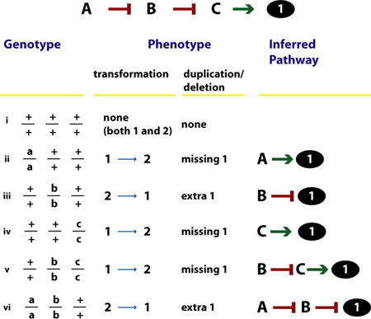
Genes A, B, and C form a pathway that produces product 1. Given the chart to the left, what is the pathway and how do the genes A, B, and C interact (positive or negative)?

