Slide 1
Pedigree Analysis
Dhanush S. Banka

Slide 2
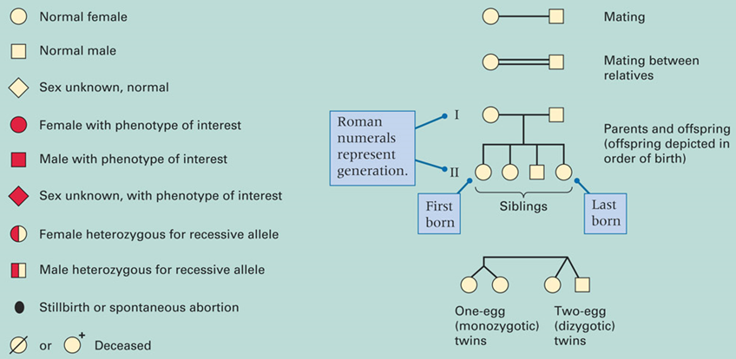
Pedigree Tree
Pedigree analysis is used to determine individual genotypes and to predict the mode of transmission in single gene traits.

Slide 3
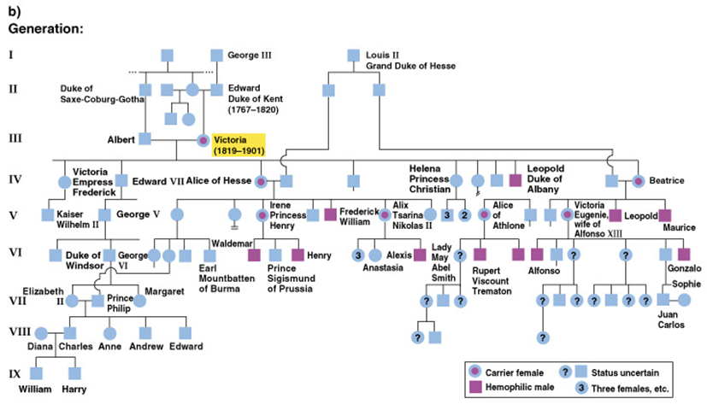
Applications for Pedigree Analysis
Important for studying inherited diseases
Used to find genetic basis of a trait
Can be used to predict risk of disease in future offspring
Genetic counseling

Slide 4
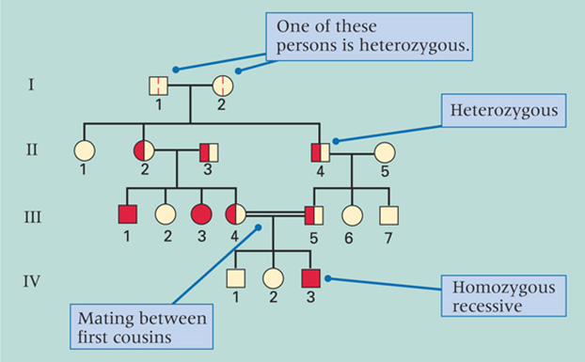
Autosomal Recessive
Trait often skips generations
Most affected people have parents who are carriers
Diseases include:
Albinism
Sickle Cell Anemia

Slide 5
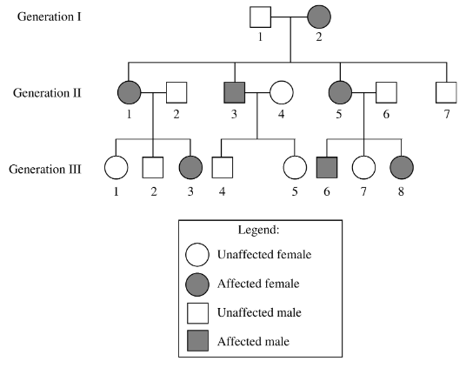
Autosomal Dominant
Trait will be found in every generation
Every affected person will have an affected parent
Diseases include:
Huntington’s Disease
Achondroplasia

Slide 6
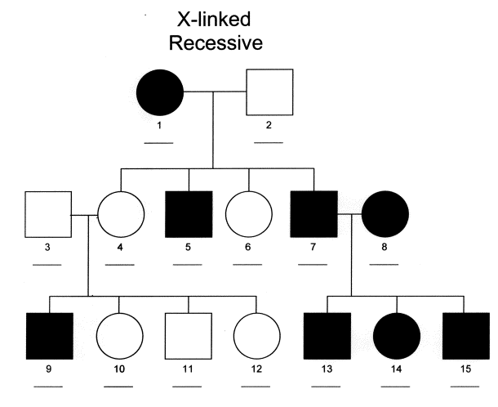
X-linked Recessive
Trait skips generations
Affected fathers DO NOT pass onto their sons
Males are affected more often than females
Diseases include:
Hemophilia

Slide 7
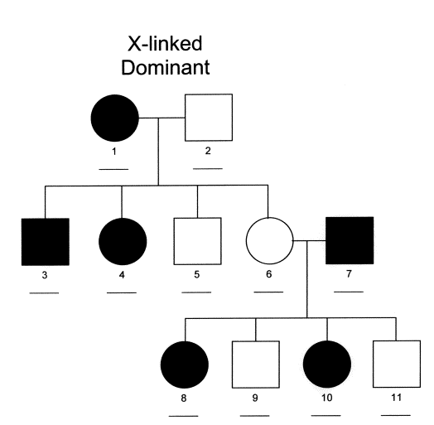
X-linked Dominant
Affected fathers pass trait to all daughters
Diseases are usually lethal before birth in males and are only seen in females
Diseases include:
X-linked rickets
Incontinentia Pigmenti

Slide 8
Dominant vs. Recessive
When two affected parents have at least one child who is unaffected, the trait is dominant
When two unaffected parents have at least one affected child, the trait is recessive
If the trait is recessive, then two affected parents will only have affected children
If every affected person has an affected parent, the trait is dominant

Slide 9
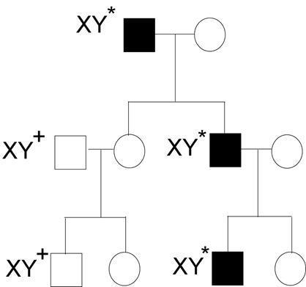
Y-linked Genes
Traits on the Y chromosome are only found in males, never in females
The father’s traits are all passed to the son
Dominance is irrelevant as there is only 1 copy of the gene

Slide 10
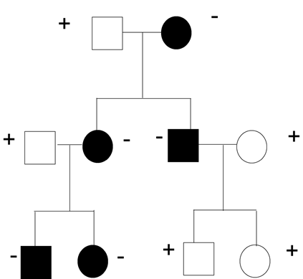
Mitochondrial Genes
Mitochondria are only inherited from the mother
All offspring inherit trait from the mother
Dominance is irrelevant as there is only one copy of the gene

Slide 11
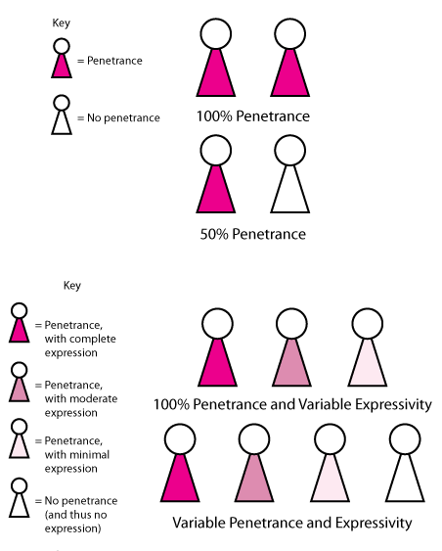
Complications
Incomplete penetrance of expressed traits
Having the genotype does NOT mean it will be expressed
Sex-limited expression
Only found in males OR females

Slide 12
Coefficient of Relatedness
The coefficient of relationship is a measure of the degree of consanguinity (or biological relationship) between two individuals
Equals the probability that if two individuals share a common ancestor, a particular gene present in one individual will also be present in the other
Siblings - 0.50
Aunt/Uncle - 0.25
Cousins - 0.125

Slide 13
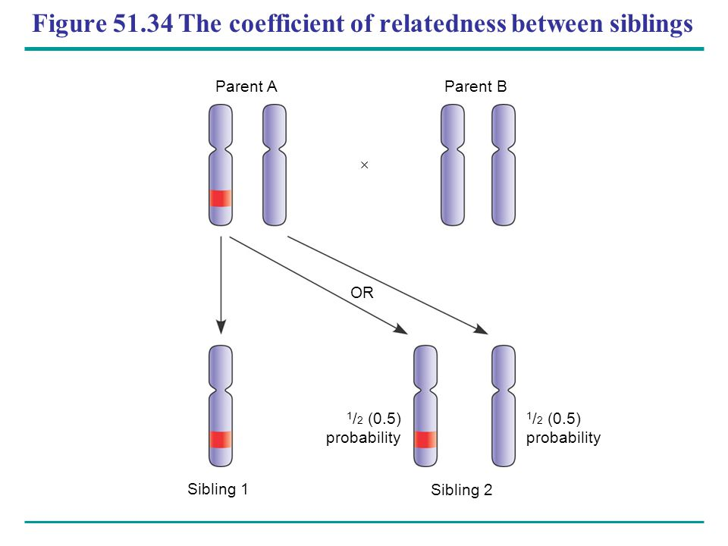

Slide 14
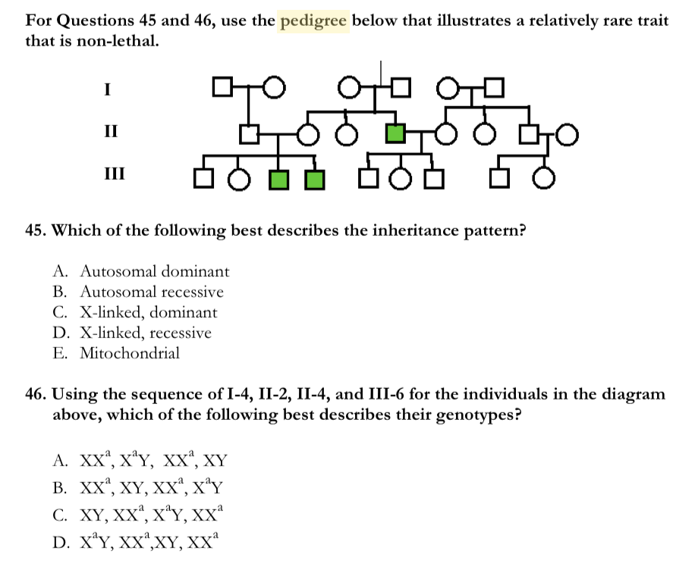

Slide 15
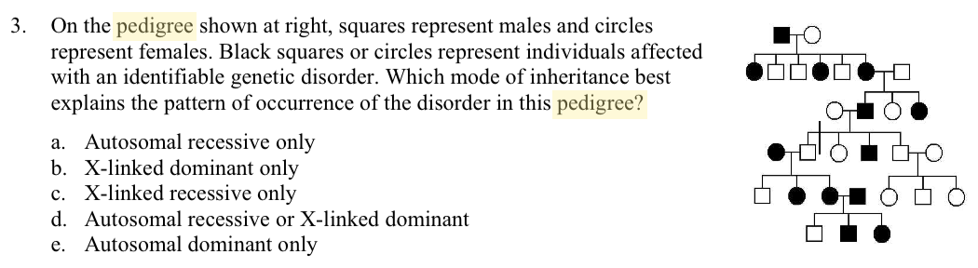

Slide 16
