Slide 1
Biochemistry/Cell Bio
Campbell Biology 7th/9th Editions
Chapters 5 and 6

Slide 2
Macromolecules

Slide 3
Overview
Organic molecules: contain carbon/hydrogen
Macromolecules are polymers (chains of monomer subunits)
Formed by polymerization (dehydration synthesis, hydrolysis breaks apart)
Hydrophilic: polar, dissolve in water
Hydrophobic: nonpolar, insoluble in water
Oxidation: losing electrons; Reduction: gaining electrons
Macromolecule | Elements contained
Carbohydrates | C, H, O
Lipids | C, H, O
Proteins | C, H, O, N, S
Nucleic Acids | C, H, O, N, P

Slide 4
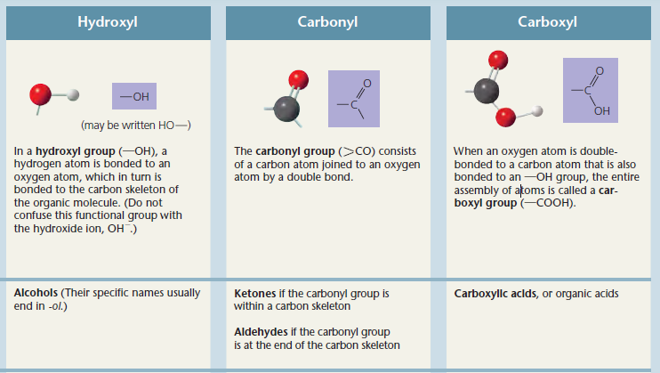
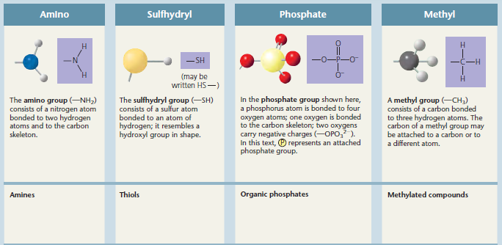
Functional Groups
Functional groups: attachments to carbon skeleton which gives the molecule additional properties

Slide 5
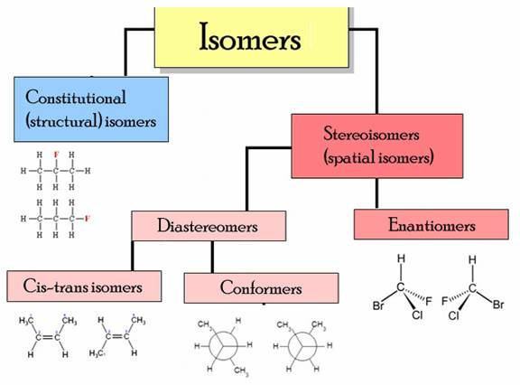
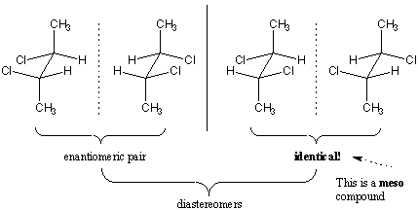
Isomers/Chirality
Structural isomers: differ in covalent bonding arrangement
Geometric isomers: differ in attachments to carbon-carbon double bond
Enantiomers: mirror images
Chiral: carbon is asymmetric (4 different groups attached)
L and D, L is biologically active
Cool site to look at:
http://www.chem.ucalgary.ca/courses/351/Carey5th/Ch07/ch7-1.html

Slide 6
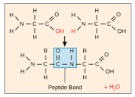
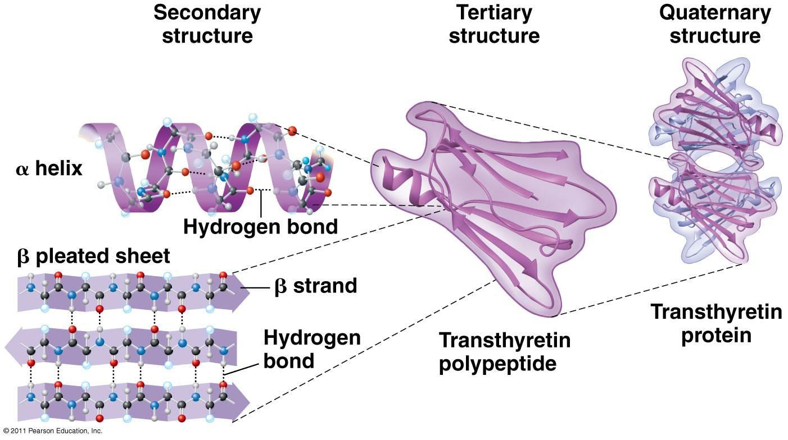
Proteins
Proteins: polypeptide chains of amino acids (covalent peptide bonds)
Amino/carboxyl groups (N and C termini), and R group (side chain with different chemical properties)
Levels of protein structure:
Primary: sequence of polypeptide chain
Secondary: alpha helices/beta sheets, formed by hydrogen bonding within peptide backbone
Tertiary: side chain interactions (H-bonding, ionic bonds, disulfide bridges, etc.)
Quaternary: multiple tertiary structures interacting
Fibrous proteins: have mainly secondary structure; globular proteins: have tertiary structure
Chaperones: help proteins fold
Denaturation: loss of all levels of protein structure/activity except for primary (pH, high temperatures)

Slide 7
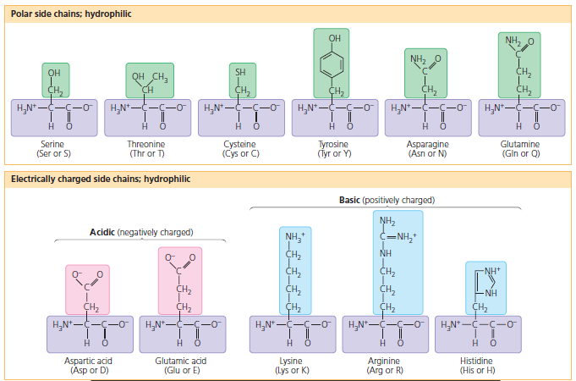
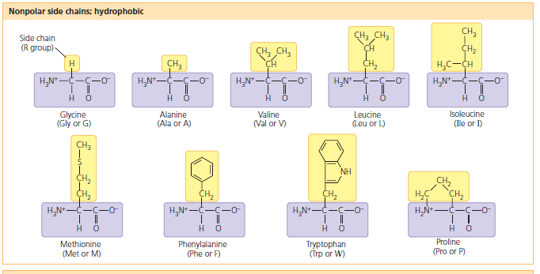
Amino Acids
Aromatic amino acids (tyrosine, phenylalanine, tryptophan) absorb UV radiation and fluoresce
Glycine is achiral
Proline and glycine: found in beta turns, are alpha-helix-breakers

Slide 8
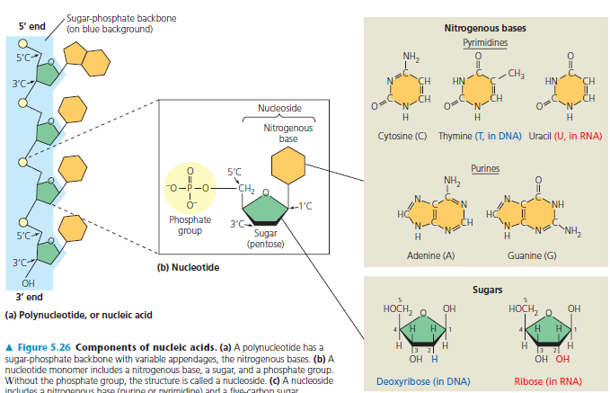
Nucleic Acids
Serve as genetic material, specifies primary structure of proteins
Monomers are nucleotides (5 carbon sugar, phosphate, nitrogenous base)
RNA has ribose (more oxygen, more reactive), DNA has deoxyribose (more stable)
Sugar-phosphate backbone, 2 antiparallel complementary strands held by H bonds
Random note: mutations called thymine dimers form as a result of exposure to UV radiation

Slide 9
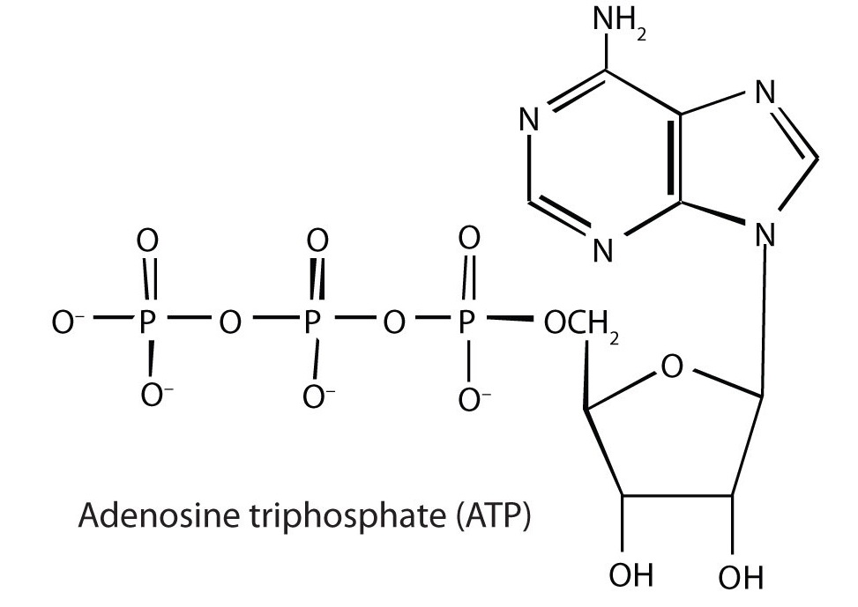
Important Molecules
Enzymes are protein catalysts
Speed up reactions by lowering the activation energy required for reaction to occur
Act upon substrate molecules, which fit into active site of enzyme (so mutations to active site amino acids affect enzyme greatly)
ATP (adenosine triphosphate) is important in energy storage
ATP- high energy form
ADP- low energy
Cells maintain high ATP/ADP ratio so that reaction converting ATP → ADP more favorable

Slide 10
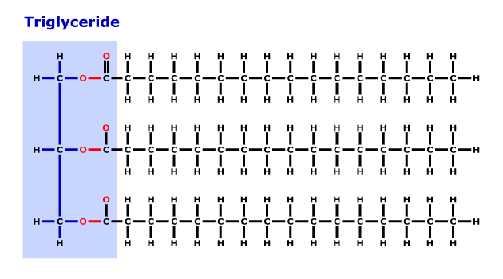
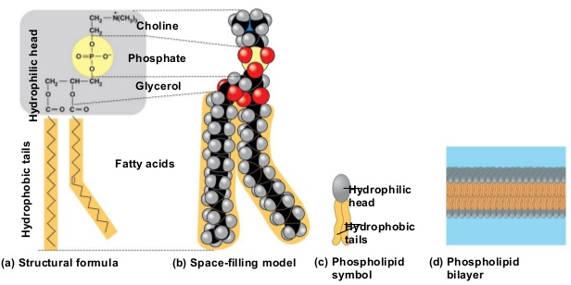
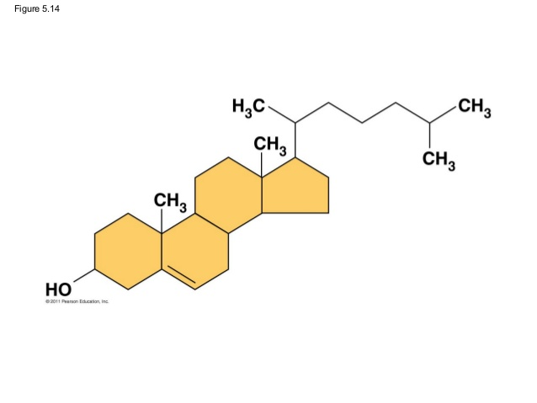
Lipids
Triglycerides (fats and oils) are for energy storage (hydrophobic)
Glycerol bonded to 3 fatty acid chains
Saturated fats have single bonds and are solid
Unsaturated fats have double/triple bonds, are more liquid
Phospholipids
Negatively charged phosphate group attached to
glycerol makes one end of molecule hydrophilic
Forms phospholipid bilayers
Steroids
4 hydrocarbon rings
Function as membrane stabilizers (cholesterol) and hormones

Slide 11
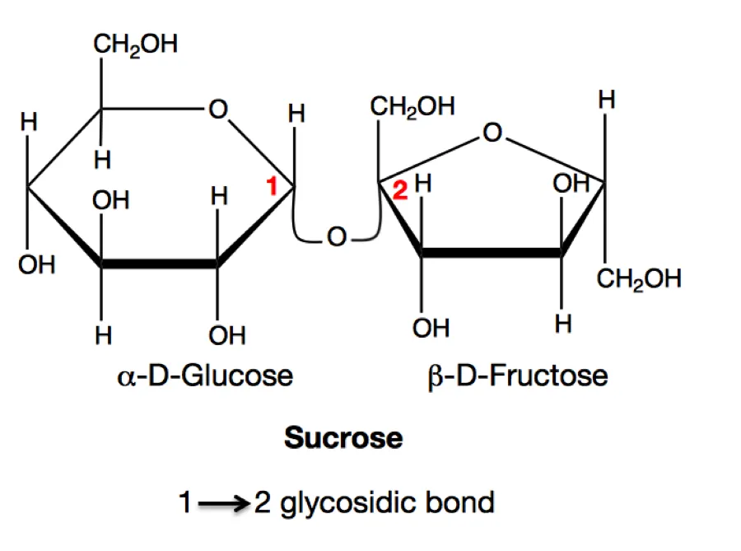
Carbohydrates
Energy storage (store less energy than fats) or structural
Monosaccharides, disaccharides, polysaccharides
Glucose (monosaccharide) transported in animals, sucrose (disaccharide) in plants (from production in leaves → other parts)
Different forms of monosaccharides:
Linear vs. chain form
Alpha- hydroxyl group on carbon 1 below plane of ring; beta- above ring
Reducing sugars: exist in linear form(have exposed oxygen to reduce neighboring molecules)
All monosaccharides are reducing sugars
Sucrose is not reducing because it is stuck in ring form
Some disaccharides:
Sucrose 1,2-linkage of glucose/fructose
Maltose 1,4-linkage of 2 glucoses

Slide 12
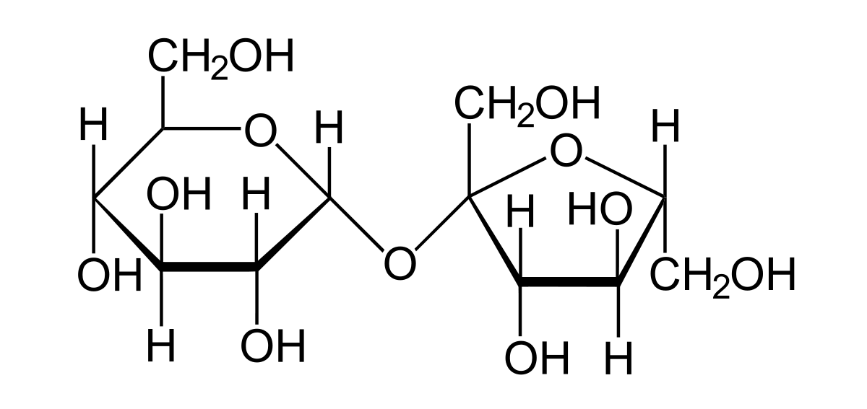
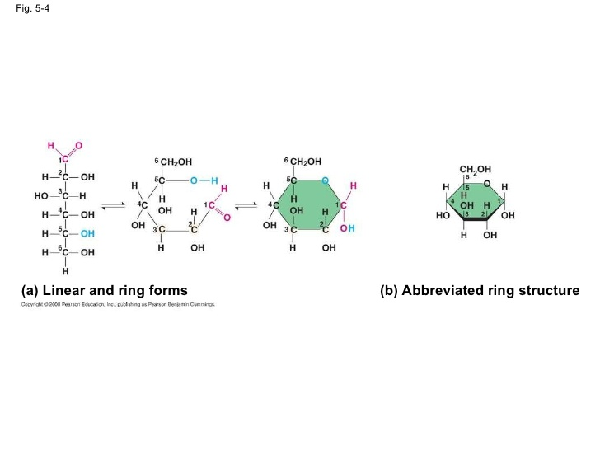
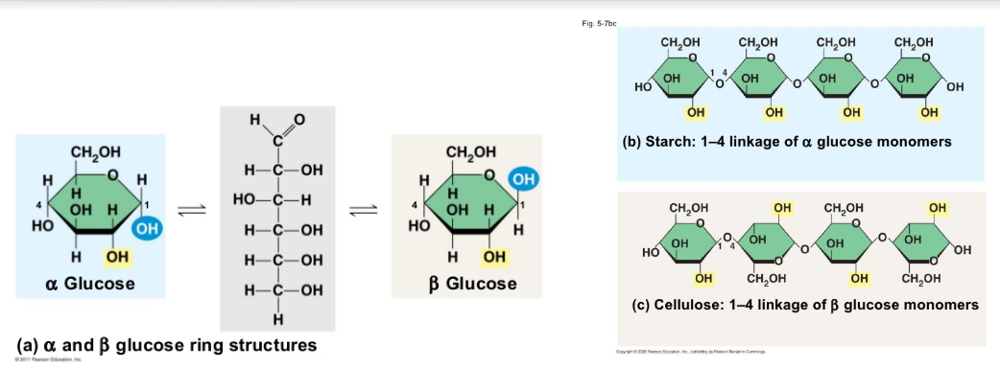
Carbohydrates

Slide 13
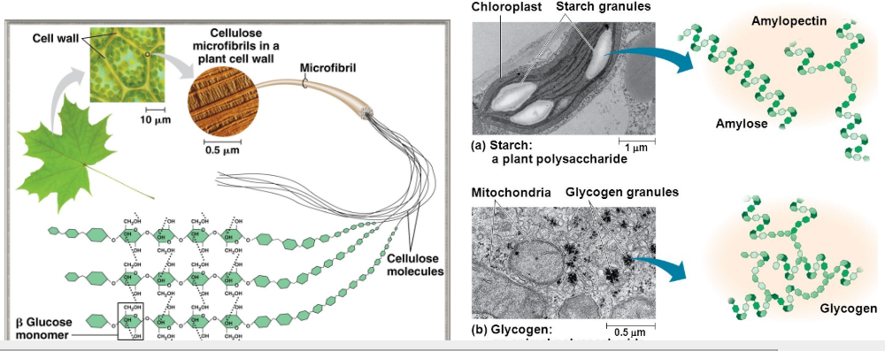
Polysaccharides
Sugars linked in chains of glycosidic bonds (covalent)
Most are glucose polymers, fructans is fructose polymers
Most glycosidic linkages are 1,4 except in branches (1,6)
Unique to plants: cellulose microfibrils (with H-bonding between cellulose chains) with pectins

Slide 14
Polysaccharides
Characteristics of Common Polysaccharides
Name | Produced by | Function | Chemical structure | Type of monosaccharide subunit | Can be digested by animals? *only ɑ-linkages can be digested by animals
Starch | Plants | Storage (i.e. energy generation) | Amylose: unbranched | Glucose (ɑ-linkages) Helical chains | Yes
 |  |  | Amylopectin: somewhat branched
Glycogen | Animals, stored in liver/muscles | Storage (i.e. energy generation) | More branched than amylopectin | Glucose (ɑ-linkages) Helical chains | Yes
Cellulose | Plant cell walls | Structure | Long chains, unbranched | Glucose (𝛃-linkages) | No
Chitin | Fungal cell walls, arthropod exoskeletons | Structure | Chains | N-acetyl-D-glucosamine (𝛃-linkages) | No

Slide 15
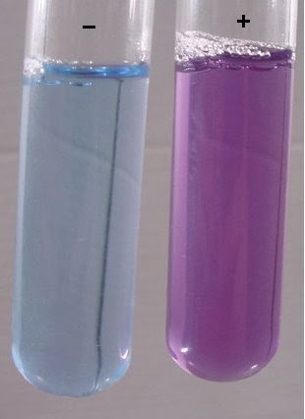
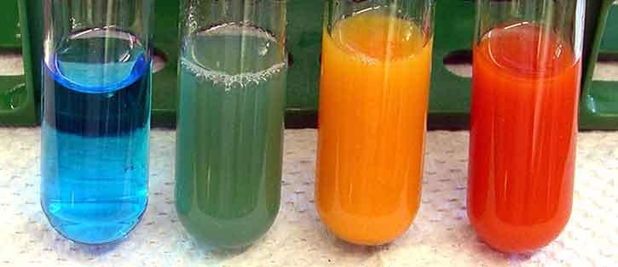
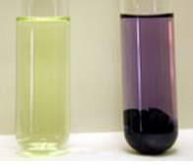
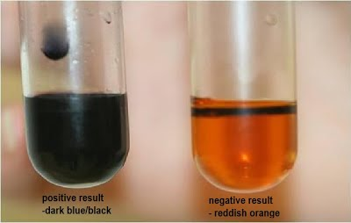
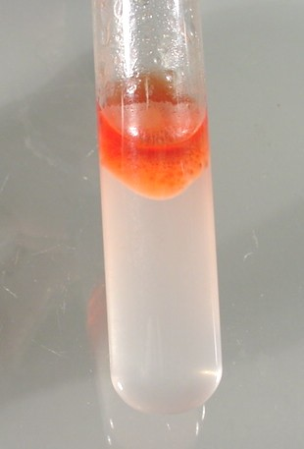
Biological Stains/Tests
Assay | Type | Results | Image
Biuret | Protein | Unreacted: deep blue Peptide bonds: purple
Benedict | Carbo- hydrates | Unreacted: turquoise Reducing sugars (e.g. glucose): yellow/orange Nonreducing sugars (e.g. sucrose): green
Ninhydrin | Amines/ amino acids | Amino acids: blue-purple Proline: yellow
Iodine/ Lugol’s | Starch (amylose) | Unreacted/amylopectin/other carbohydrates: yellow-orange Starch (amylose): blue-black
Sudan | Lipids | Lipids: yellow-orange

