Slide 1
Osmoregulation and Excretion
Chapter 44 Campbell Biology
Sid K

Slide 2
Definitions of Osmoregulation and Excretion
Process in which animals control solute concentrations
Balancing water gain and loss
Different animals use different osmoregulation strategies to maintain homeostasis
Osmoconformers do not osmoregulate.
Process that removes nitrogenous metabolites and metabolic waste products from the animal.

Slide 3
Osmoregulation in fish
Water moves from higher concentration to lower concentrations in osmosis.
If an organism lives in freshwater, water naturally diffuses into it, so it needs to excrete lots of water to maintain homeostasis. It also need to take in salt actively to maintain salt balance.
If an organism lives in saltwater, water naturally diffuses out of it, so it needs to drink lots of water to maintain homeostasis. It also needs to excrete salt ions to maintain salt balance.
Stenohaline → Can not tolerate changes in external osmolarity. Euryhaline → Can survive changes in external osmolarity.

Slide 4
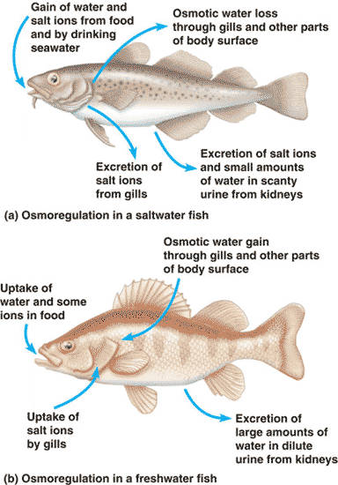

Slide 5
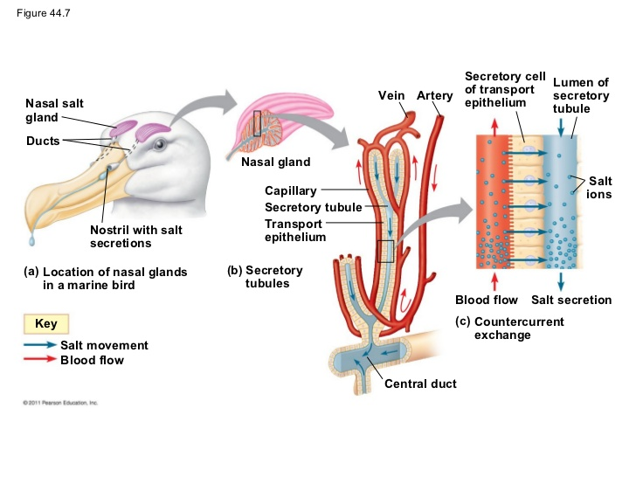
Transport Epithelia
Marine birds use them to drink saltwater
Layer of epithelial cells that move certain solutes in specific directions.
The bird drinks saltwater, which reaches the blood. The transport epithelia helps to move the salt from the blood to a secretory tubule, and the bird releases a highly concentrated salt solution.

Slide 6
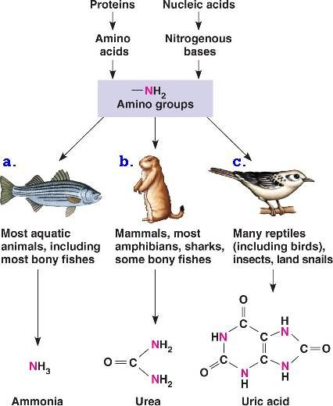
Nitrogenous wastes
Breakdown of Proteins and Nucleic acids release Nitrogen in the form of Ammonia.
Fish excrete Ammonia directly because it has lots of water to dissolve it
Mammals excrete urea, which has low toxicity but takes more energy to produce.
Birds excrete uric acid, which can be excreted as a paste with no need for water.

Slide 7
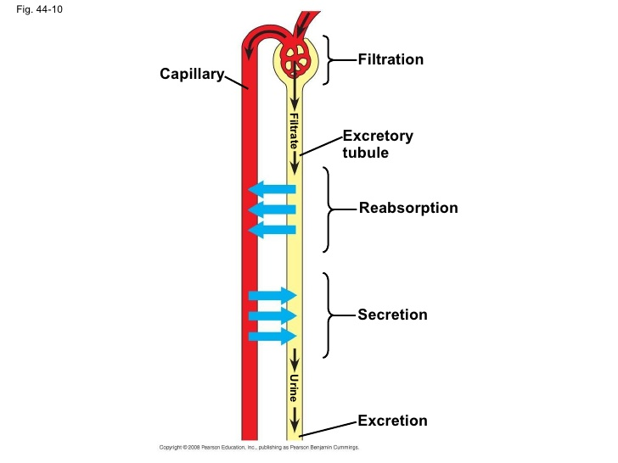
Process of Excretion

Slide 8
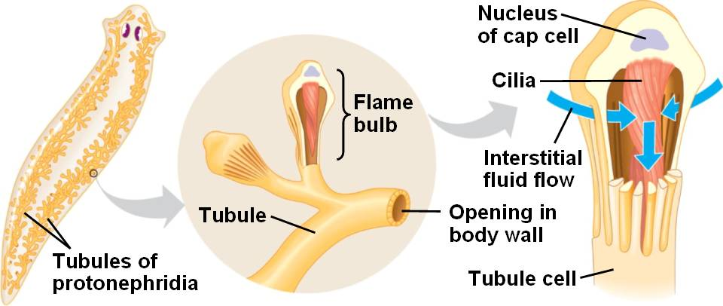
Protonephridia
Protonephridia are excretory systems in flatworms.
Beating of cilia draws water through flame bulb
Filtrate is released back into the tubule network

Slide 9
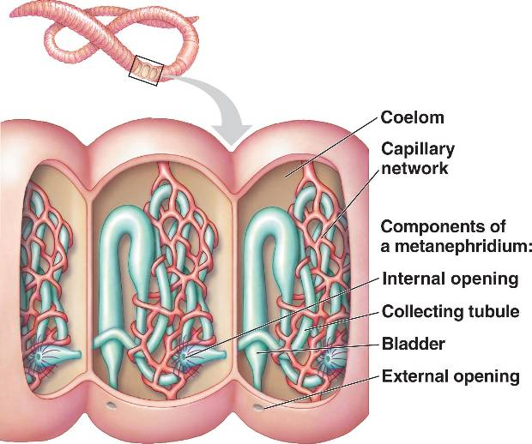
Metanephridia
Present in Annelids
Each segment has 2 metanephridia
Cilia draws coelom fluid into collecting tubule
Absorbs solutes and returns them to blood
Nitrogenous wastes excreted to outside

Slide 10
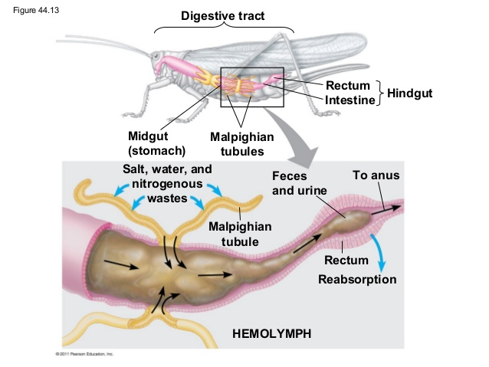
Malpighian Tubules
Present in insects and arthropods
Immersed in hemolymph
Remove salts and nitrogenous wastes
Water follows salts by osmosis
Fluid passes into the rectum

Slide 11
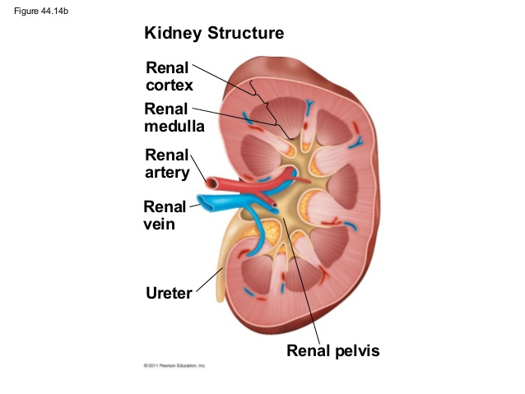
Kidney

Slide 12
Nephron
Basic unit of the kidney
The filtrate goes from the glomerulus to bowman's capsule
5 parts to the nephron
Proximal tubule is where reabsorption and secretion of ions occurs.
Descending limb of the loop of henle is where water is diffused out
Ascending limb is where salt is diffused or actively transported out
Distal Tubule → secretion of K+ and reabsorption of HCO3- and NaCl.
Collecting duct → Reabsorption of lots of H2O and urea. Urine becomes concentrated

Slide 13
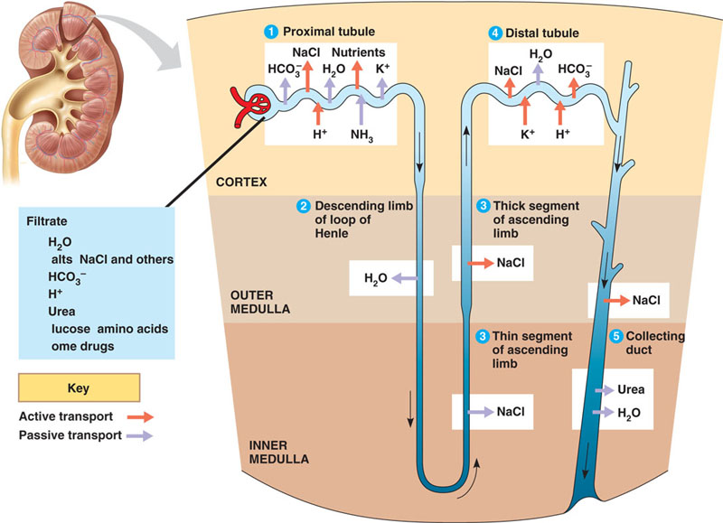

Slide 14
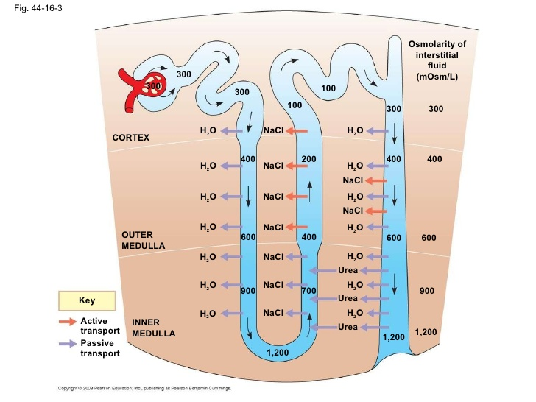

Slide 15
Adaptations
Mammals and Birds → Juxtamedullary nephron, which is longer so more urine concentration. Birds have juxtamedullary nephrons that are shorter
Reptiles → Only cortical nephrons. Isoosmotic urine.
Freshwater fish → Many nephrons to help excrete lots of water
Marine fish → Less nephrons, shorter nephrons, no distal tubule

Slide 16
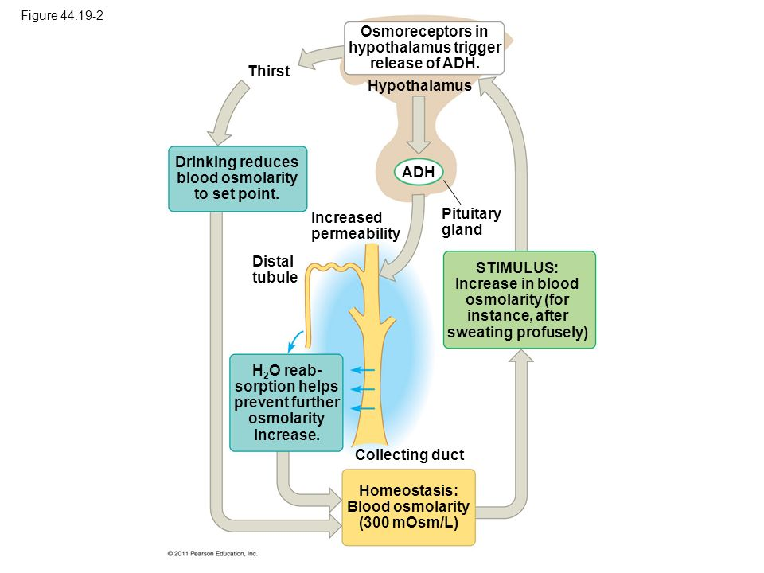
ADH
Also called vasopressin
Made in hypothalamus
Released when blood osmolarity is high
ADH acts on the collecting duct
More vesicles with aquaporin come in
More water reabsorbed

Slide 17
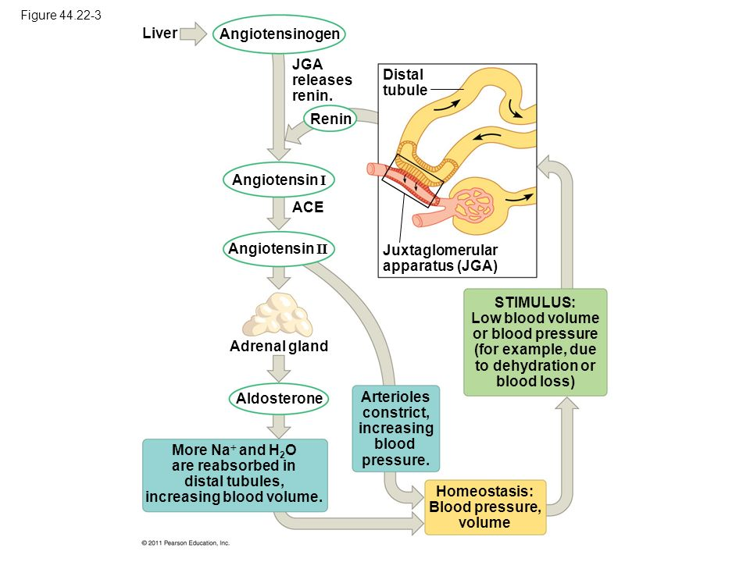
RAAS
Low blood pressure causes renin release
Angiotensin 1 activated due to renin
Angiotensin 2, then Aldosterone formed
Blood pressure goes up as arterioles constrict
More Na+ and water reabsorption
ANP inhibits renin release if pressure is high

