Slide 1
Endocrine System
(Campbell Chapter 45)
Edward Lue

Slide 2
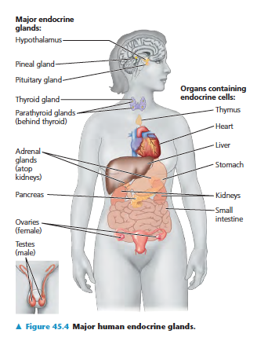
Purpose of the Endocrine System
One of the main two systems for regulation and communication
Compared with nervous system, the endocrine system is slower and more long-term
Involves many glands that secrete hormones

Slide 3
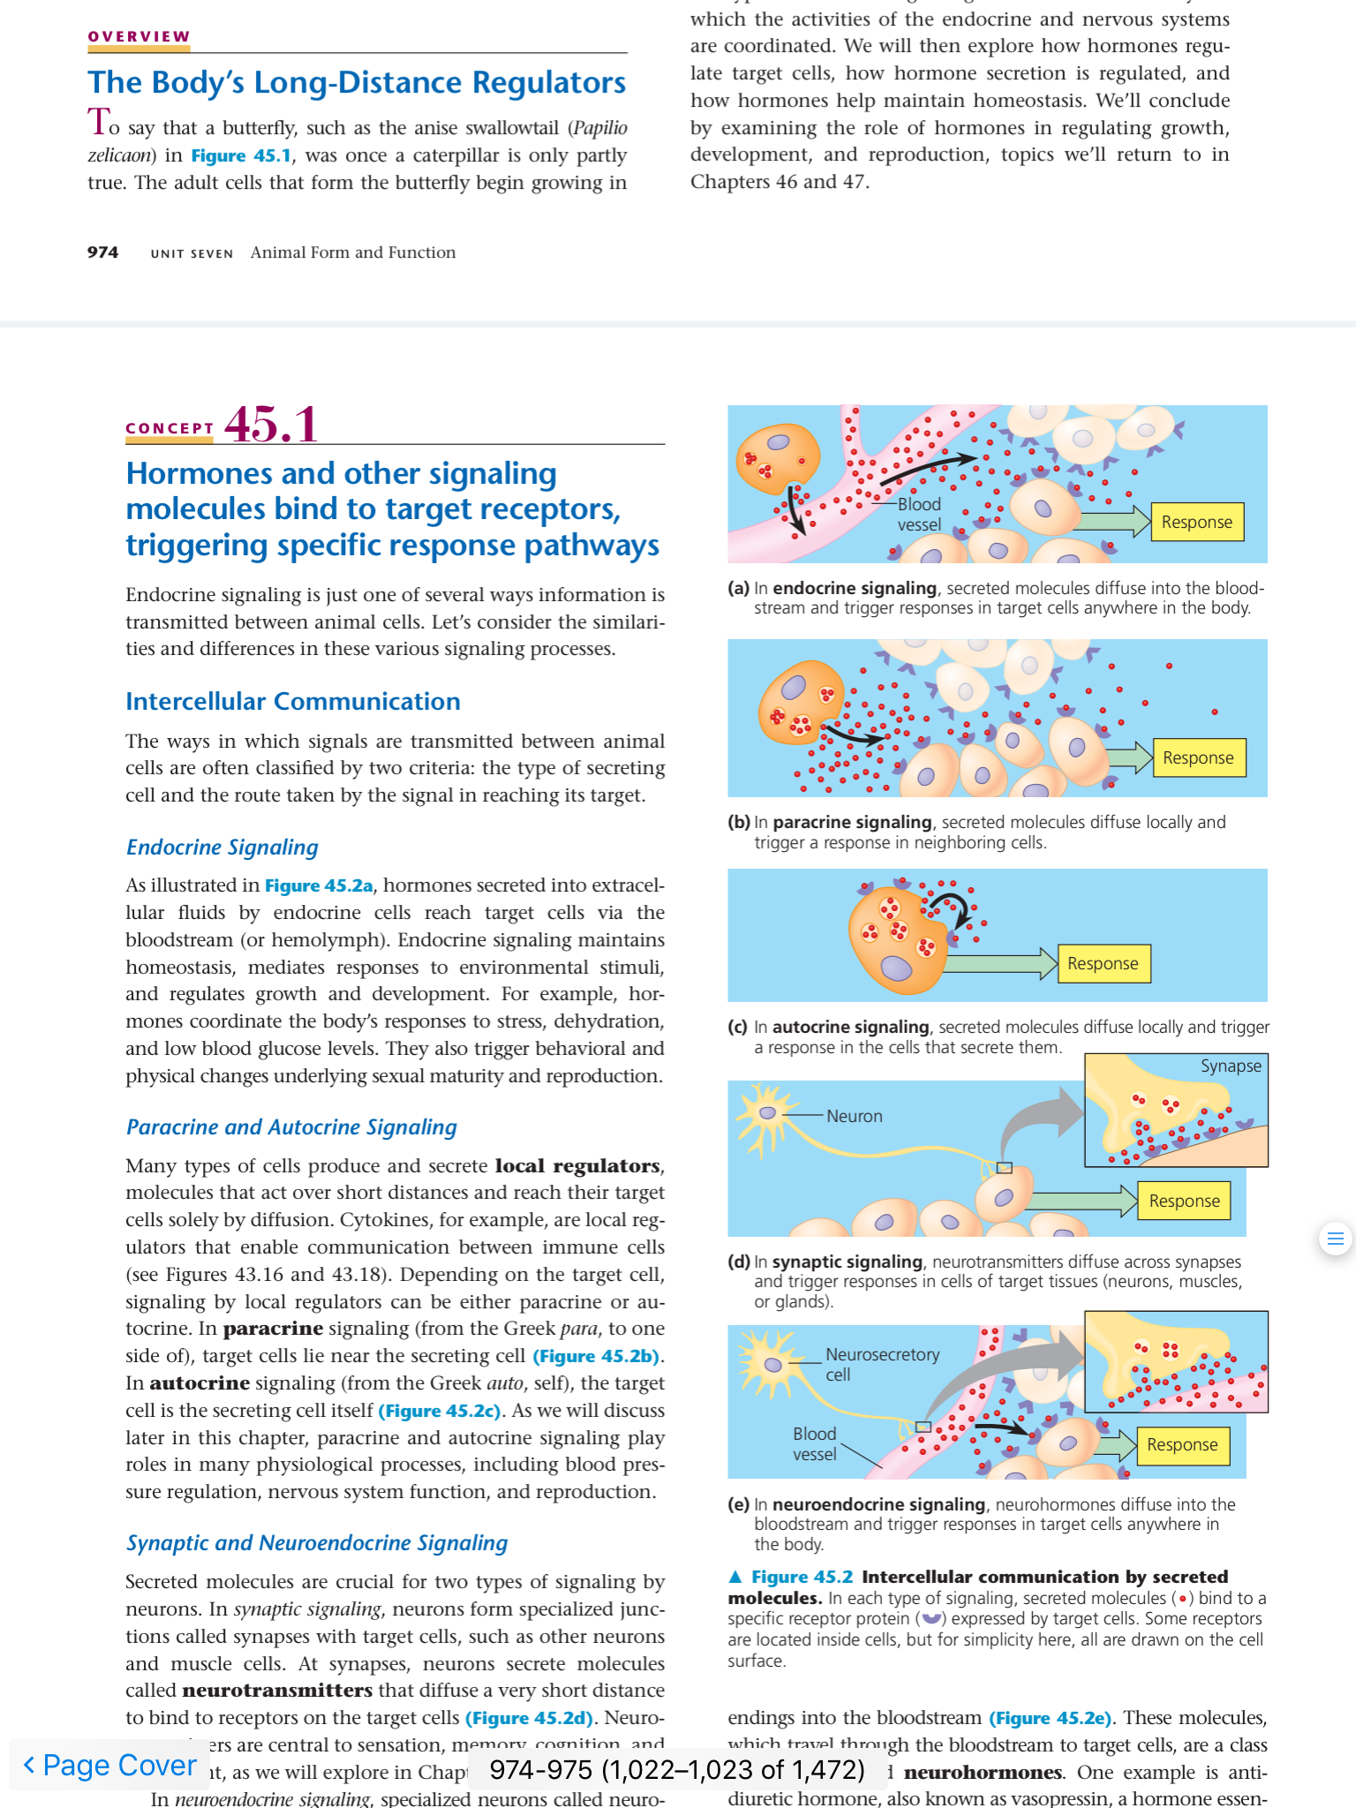
Types of Signaling
Endocrine Signaling
Autocrine Signaling
Paracrine Signaling

Slide 4
Types of Signaling
Neuroendocrine Signaling
Pulsed release of hormone
Synaptic Signaling
Pheromones
Released into environment
Act on other members of the same species

Slide 5
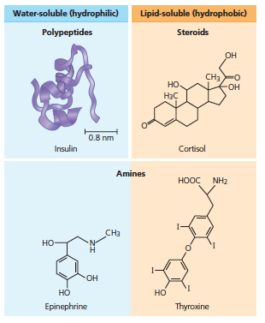
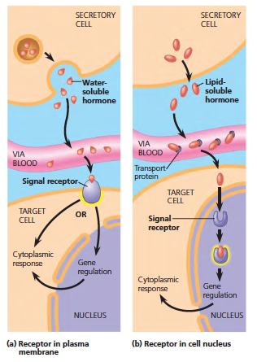
Classes of Hormones

Slide 6
Let’s now look at the first question in the handout

Slide 7
Hormone Effects

Slide 8
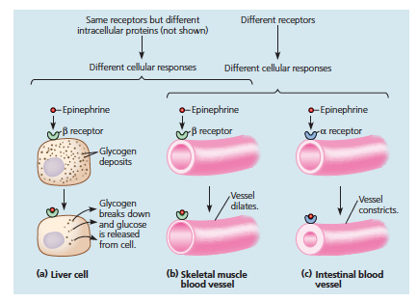
Receptors

Slide 9
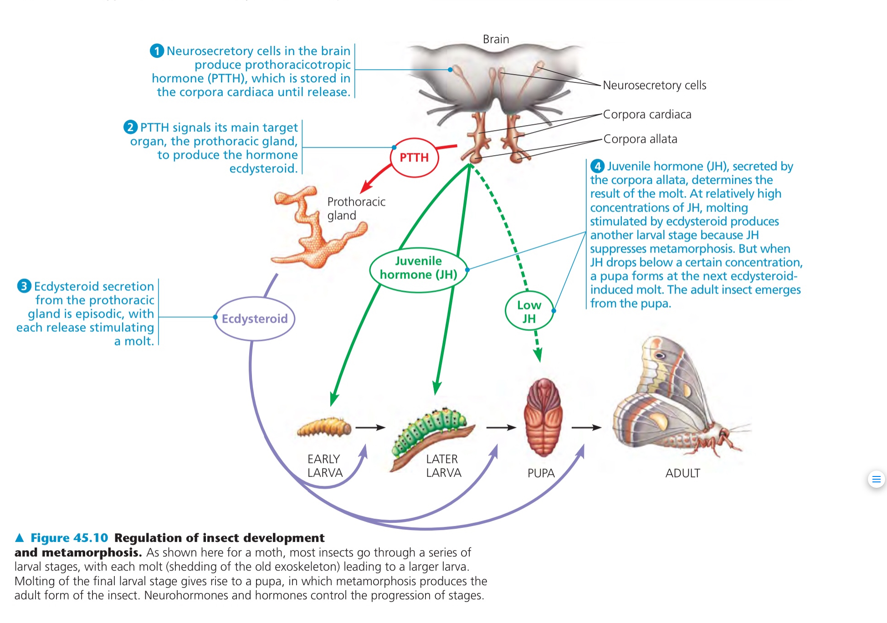
Regulation of Insect Development

Slide 10
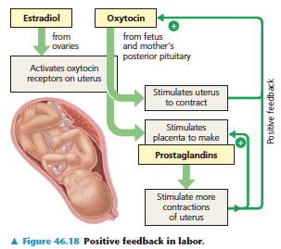
Feedback Loops
Positive Feedback
Feedback that continues to grow
Negative Feedback
Characteristic of stable systems
Maintain homeostasis

Slide 11
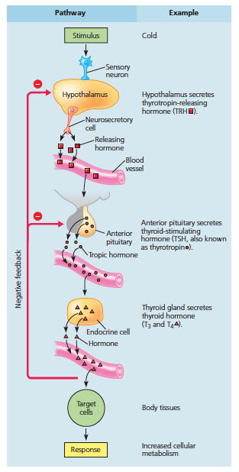
A representative hormone pathway
Releasing hormones
Tropic hormones

Slide 12
Common Conditions Involving Endocrine System
Grave’s Disease
Hyperthyroidism
Hashimoto’s Disease
Hypothyroidism
Diabetes
Type I
Type II
Goiter
Enlargement of thyroid due to overstimulation
Can accompany both hyper and hypothyroidism
Gigantism
Tumor in pituitary secretes excess growth hormone

Slide 13
How can Goiter Result from Hyperthyroidism and Hypothyroidism?

Slide 14
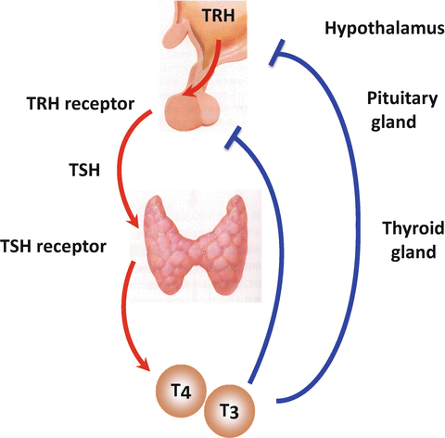
The Thyroid Feedback Loop

