Slide 1
Sensory and Motor Mechanisms Chapter 49
Adele Peng

Slide 2
Sensory Mechanisms
Sensations: action potentials of sensory neurons, give perception of stimuli
Sensory receptors: cells that detect stimuli
Exteroreceptors: outside body
Interoreceptors: within body

Slide 3
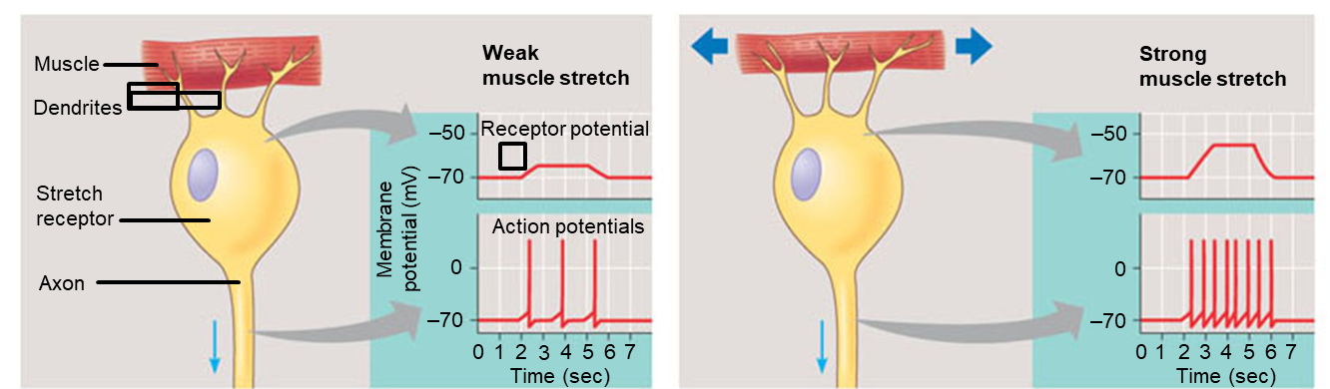
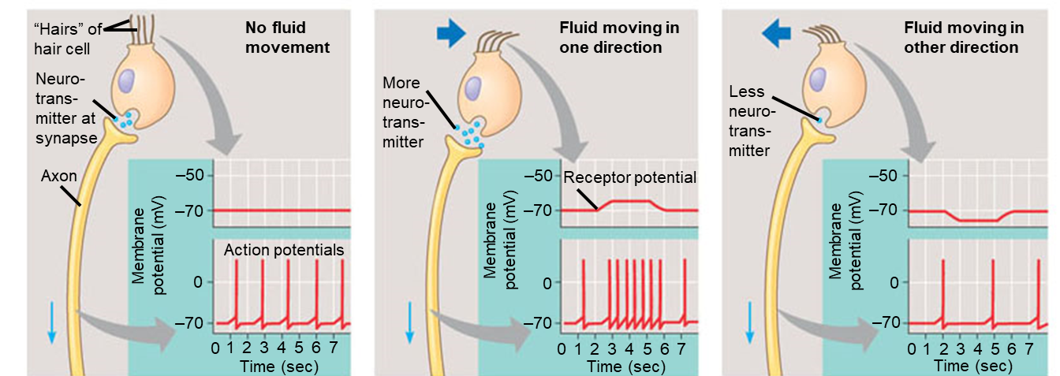
Sensory Receptors
Sensory transduction → amplification → transmission → integration

Slide 4
Types of Sensory Receptors
Mechanoreceptors: sense physical changes such as motion, sound, stretch, touch, pressure
Chemoreceptors: sense chemical concentrations
Electromagnetic receptors: sense light, electric, or magnetic fields
Thermoreceptors: sense temperature
Pain receptors (nociceptors): sense painful stimuli that may indicate danger

Slide 5
Mechanoreceptors: Hearing, Equilibrium

Slide 6
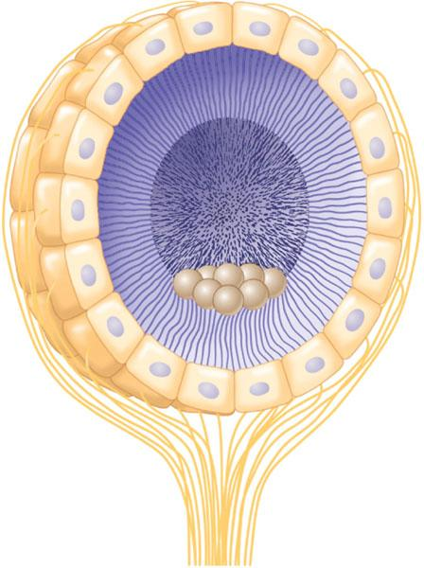
Invertebrate Mechanoreceptors
Statocysts: specialized sensory organs with ciliated receptors and statoliths
Statoliths: dense granules that allow the invertebrate to perceive direction of gravity
Vibrating hairs/tympanic membrane to hear sounds
Ciliated receptor cells
Statolith
Cilia
Sensory nerve fibers

Slide 7
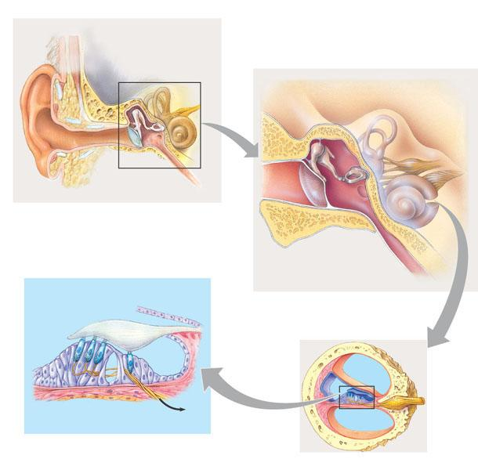
Mammalian Hearing
1
Overview of ear structure
2
The middle ear and inner ear
Incus
Skull bones
Semicircular canals
Middle ear
Stapes
Outer ear
Inner ear
Malleus
Auditory nerve, to brain
Pinna
Tympanic membrane
Eustachian tube
Cochlea
Auditory canal
Tympanic membrane
Oval window
Eustachian tube
Hair cells
Tectorial membrane
Round window
Cochlear duct
Bone
Vestibular canal
Auditory nerve
Basilar membrane
Axons of sensory neurons
To auditory nerve
Tympanic canal
4
The organ of Corti
3
The cochlea
Organ of Corti

Slide 8
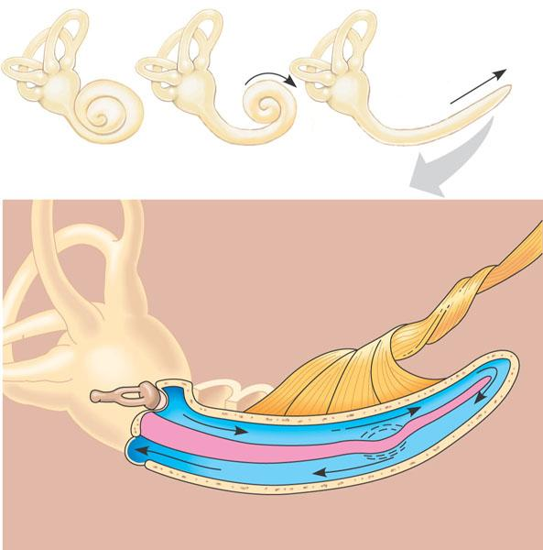
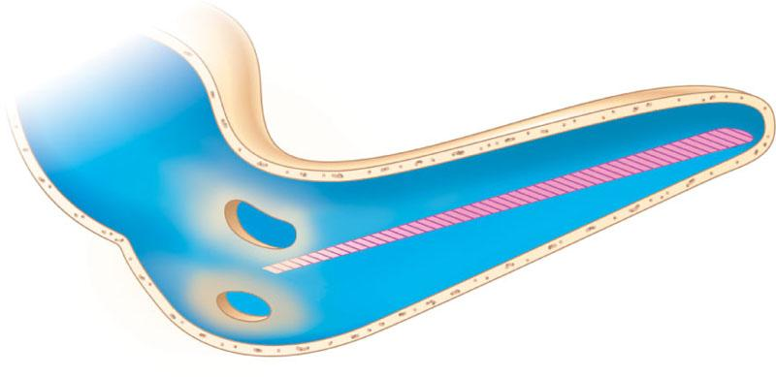
The Mammalian Cochlea
Cochlea (uncoiled)
Apex (wide and flexible)
Cochlea
Basilar membrane
Stapes
Axons of sensory neurons
Oval window
500 Hz (low pitch)
Vestibular canal
1 kHz
Perilymph
Apex
2 kHz
4 kHz
8 kHz
16 kHz (high pitch)
Frequency producing maximum vibration
Base
Base (narrow and stiff)
Round window
Tympanic canal
Basilar membrane

Slide 9
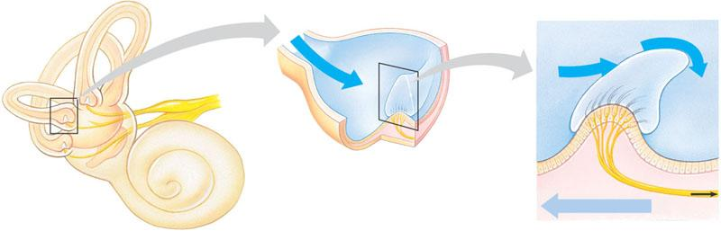
Equilibrium in Mammals
The semicircular canals, arranged in three spatial planes, detect angular movements of the head.
Each canal has at its base a swelling called an ampulla, containing a cluster of hair cells.
When the head changes its rate of rotation, inertia prevents endolymph in the semicircular canals from moving with the head, so the endolymph presses against the cupula, bending the hairs.
Flow of endolymph
Flow of endolymph
Vestibular nerve
Cupula
Hairs
Hair cell
Vestibule
Nerve fibers
Utricle
Body movement
Saccule
The utricle and saccule tell the brain which way is up and inform it of the body’s position or linear acceleration.
The hairs of the hair cells project into a gelatinous cap called the cupula.
Bending of the hairs increases the frequency of action potentials in sensory neurons in direct proportion to the amount of rotational acceleration.

Slide 10
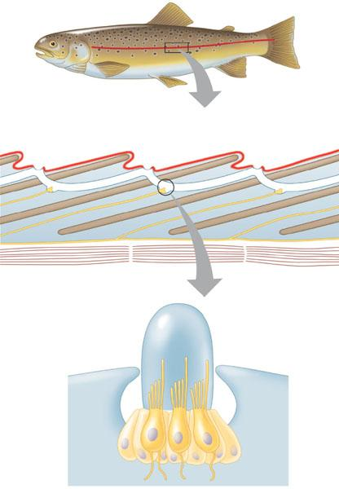
Mechanoreceptors in Other Vertebrates
Lateral line
Lateral line canal
Opening of lateral line canal
Scale
Epidermis
Neuromast
Segmental muscles of body wall
Lateral nerve
Cupula
Sensory hairs
Supporting cell
Hair cell
Nerve fiber

Slide 11
Chemoreceptors: Smell, Taste

Slide 12
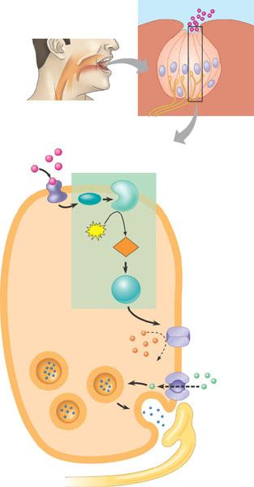
Taste (Gustation)
Taste pore
Sugar molecule
Taste bud
Sensory receptor cells
Tongue
Sensory neuron
Saltiness/sourness: Na+ and H+ ions directly flow in to depolarize taste receptors
Umami/monosodium glutamate: glutamate binds to Na+ ions, causing them to open
Bitterness: bitter substance binds K+ channels and closes them
Sweetness: G protein-coupled signaling cascade
1 A sugar molecule binds to a receptor protein on the sensory receptor cell.
Sugar
Sugar receptor
G protein
Adenylyl cyclase
2 Binding initiates a signal transduction pathway involving cyclic AMP and protein kinase A.
ATP
cAMP
Protein kinase A
3 Activated protein kinase A closes K⁺ channels in the membrane.
SENSORY RECEPTOR CELL
K⁺
4 The decrease in the membrane’s permeability to K⁺ depolarizes the membrane.
Synaptic vesicle
—Ca²⁺
5 Depolarization opens voltage-gated calcium ion (Ca²⁺) channels, and Ca²⁺ diffuses into the receptor cell.
Neurotransmitter
Sensory neuron

Slide 13
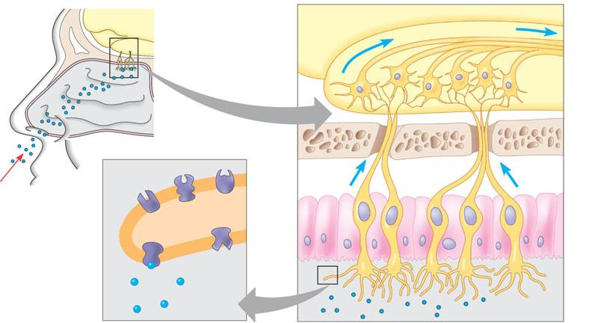
Smell (Olfaction)
Brain
Action potentials
Odorant
Olfactory bulb
Nasal cavity
Bone
Epithelial cell
Odorant receptors
Chemoreceptor
Plasma membrane
Cilia
Figure 49.15
Odorant
Mucus
MANY odorant receptors (one for each type of substance)

Slide 14
Photoreceptors: Vision

Slide 15
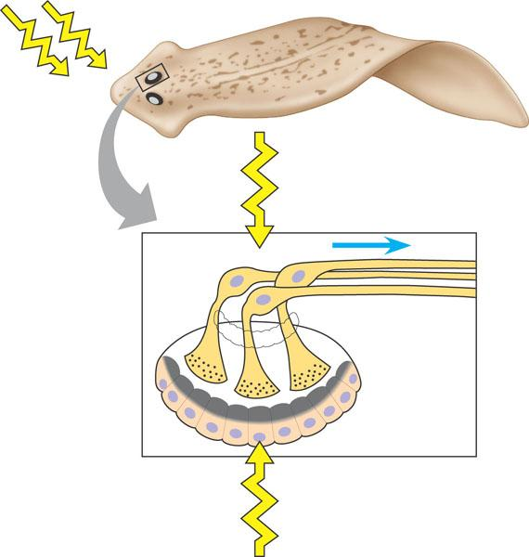
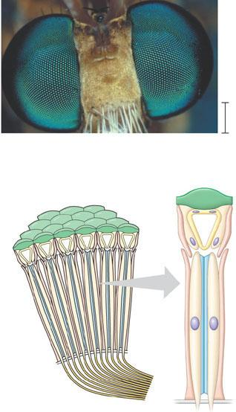
Invertebrate Vision
(a) The faceted eyes on the head of a fly,
photographed with a stereomicroscope.
Light
Light shining from the front is detected
2 mm
(b) The cornea and crystalline cone of each ommatidium function as
a lens that focuses light on the rhabdom, a stack of pigmented
plates inside a circle of photoreceptors. The rhabdom traps light and guides it to photoreceptors. The image formed by a compound eye is a mosaic of dots produced by different intensities of light entering the many ommatidia from different angles.
Cornea
Photoreceptor
Nerve to brain
Crystalline cone
Lens
Visual pigment
Screening pigment
Ocellus
Rhabdom
Light shining from behind is blocked by the screening pigment
Photoreceptor
Axons
Ommatidium

Slide 16
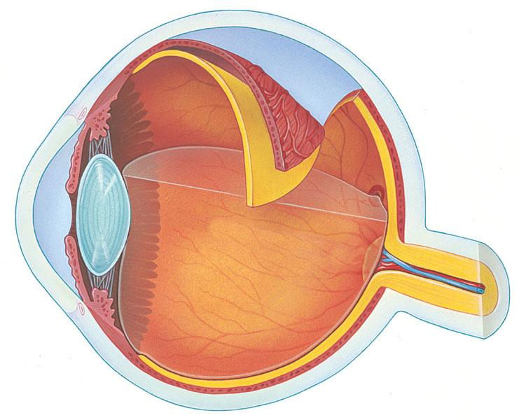
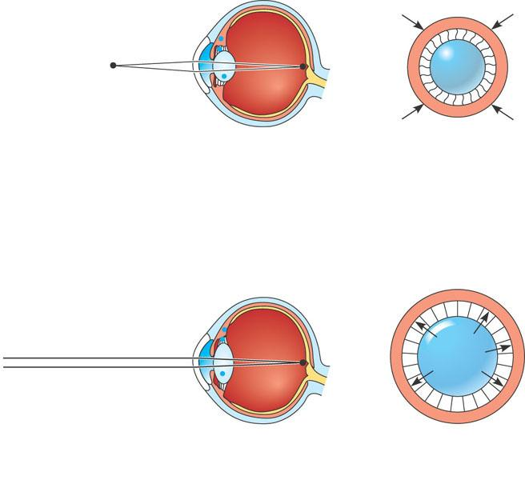
Vertebrate Eye
Sclera
Choroid
Front view of lens and ciliary muscle
Ciliary muscles contract, pulling border of choroid toward lens
Ciliary body
Retina
Choroid
Lens (rounder)
Fovea (center of visual field)
Suspensory ligaments relax
Retina
Suspensory ligament
Ciliary muscle
Cornea
Lens becomes thicker and rounder, focusing on near objects
Suspensory ligaments
Iris
Optic nerve
(a) Near vision (accommodation)
Pupil
Ciliary muscles relax, and border of choroid moves away from lens
Lens (flatter)
Aqueous humor
Lens
Suspensory ligaments pull against lens
Vitreous humor
Central artery and
vein of the retina
Optic disk (blind spot)
Lens becomes flatter, focusing on distant objects
(b) Distance vision
Rods: sense light
Cones: sense color

Slide 17
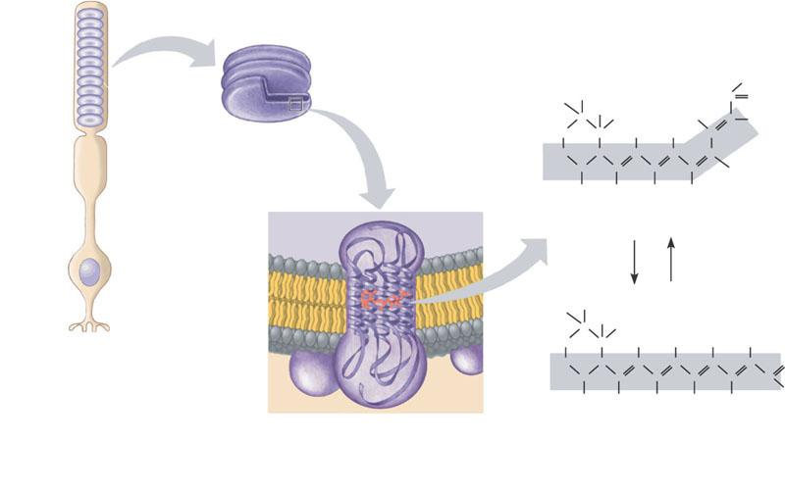
Retinal and Opsins
Rods: have only retinal (vitamin A derivative) and one type of opsin (rhodopsin)
Cones: have 3 types of opsins: red, green, blue
Rod
Outer segment
H
H
H
CH₃
C
O
H₂C
C
C
CH₃
H₃C
C
C
H
H₂C
H
H
Disks
C
C
C
C
C
C
C
C
H
CH₃
H
CH₃
H
Cell body
Inside of disk
cis isomer
Light
Enzymes
Synaptic terminal
H
H
C
CH₃
H₂C
C
CH₃
H
H
H
H₂C
C
H
C
C
C
C
C
C
C
C
C
C
O
Cytosol
CH₃
H
CH₃
CH₃
CH₃
H
Rhodopsin
Retinal
trans isomer
Opsin
(b) Retinal exists as two isomers. Absorption of light converts the cis isomer to the trans isomer, which causes opsin to change its conformation (shape). After a few minutes, retinal detaches from opsin. In the dark, enzymes convert retinal back to its cis form, which recombines with opsin to form rhodopsin.
(a) Rods contain the visual pigment rhodopsin, which is embedded in a stack of membranous disks in the rod’s outer segment. Rhodopsin consists of the light-absorbing molecule retinal bonded to opsin, a protein. Opsin has seven  helices that span the disk membrane.
Figure 49.20a, b

Slide 18
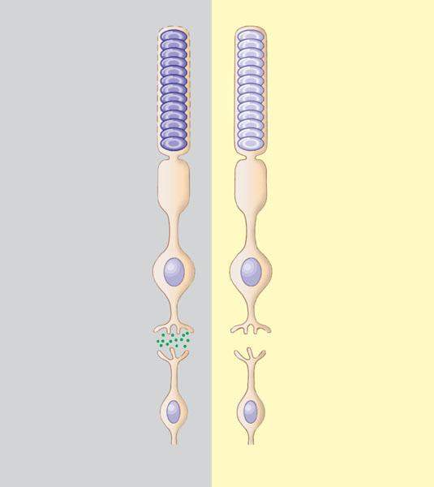
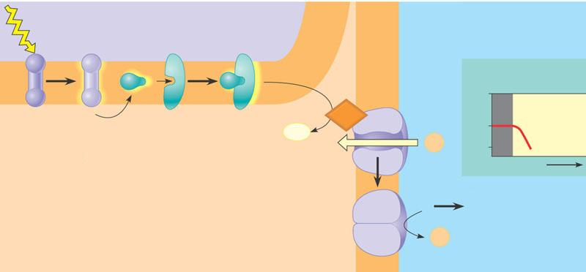
Signal Transduction in Photoreceptors
Dark Responses
Light Responses
Rhodopsin inactive
Rhodopsin active
Light
INSIDE OF DISK
EXTRACELLULAR FLUID
Active rhodopsin
PDE
Na⁺ channels open
Na⁺ channels closed
Membrane potential (mV)
CYTOSOL
Plasma membrane
0
Dark Light
Inactive rhodopsin
Transducin
Disk membrane
cGMP
– 40
GMP
– Hyper- polarization
Na⁺
– 70
1 Light isomerizes retinal, which activates rhodopsin.
2 Active rhodopsin in turn activates a G protein called transducin.
3 Transducin activates the enzyme phos-phodiesterae(PDE).
4 Activated PDE detaches cyclic guanosine monophosphate (cGMP) from Na⁺ channels in the plasma membrane by hydrolyzing cGMP to GMP.
Time
Rod depolarized
Rod hyperpolarized
5 The Na+ channels close when cGMP detaches. The membrane’s permeability to Na+ decreases, and the rod hyperpolarizes.
Glutamate
released
No glutamate
released
Na⁺
Bipolar cell either
depolarized or
hyperpolarized,
depending on
glutamate receptors
Bipolar cell either
hyperpolarized or
depolarized, depending on glutamate receptors

Slide 19
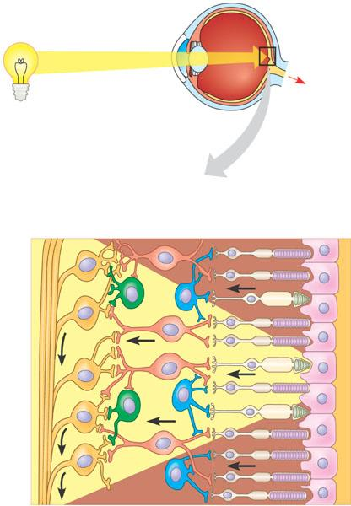
Visual Circuits
Retina
Optic nerve
To brain
Vertical pathway: photoreceptor → bipolar cell→ ganglion cells (optic nerve)
Lateral pathway: signals integrated by horizontal cells (between photoreceptor/bipolar) and amacrine cells (between bipolar/ganglion)
Lateral inhibition: horizontal/amacrine cells inhibit signals from non-illuminated receptors/cells
Receptive field: the photoreceptors feeding to a ganglion cell (smaller field = more acute; field smallest at fovea)
Retina
Neurons
Photoreceptors
Cone
Rod
Amacrine cell
Horizontal cell
Optic nerve fibers
Ganglion cell
Bipolar cell
Pigmented epithelium

Slide 20
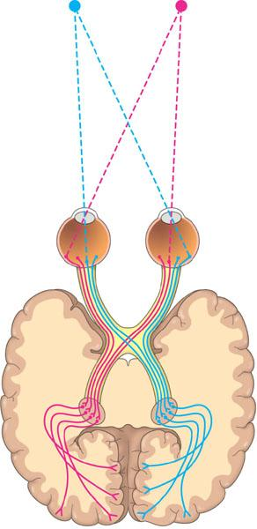
Integration of Visual Information
Left
visual
field
Right
visual
field
Left
eye
Right
eye
Optic nerve
Optic chiasm
Lateral geniculate nucleus
Primary visual cortex

Slide 21
Skeletons

Slide 22
Types of Skeletons
Hydrostatic skeleton: formed by pressurized fluid (cnidarians, flatworms, nematodes, annelids)
Exoskeleton: hardened exterior skeleton of either calcium carbonate or cuticle of chitin cross-linked to protein (molluscs, arthropods, crustaceans)
Endoskeleton: supports within animal’s soft tissues (chordates, echinoderms)
Axial and appendicular skeletons

Slide 23
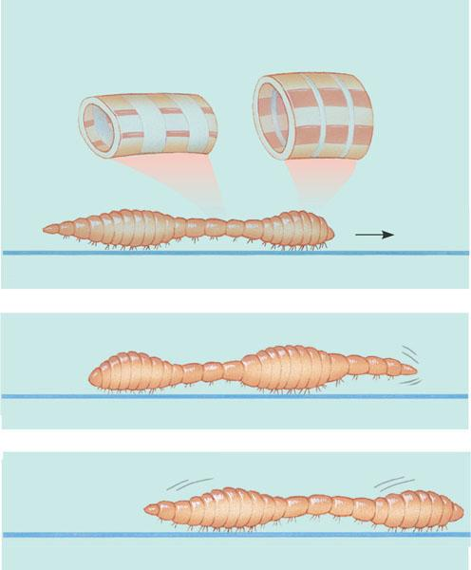
Hydrostatic Skeleton
Longitudinal
muscle relaxed
(extended)
Circular
muscle
contracted
Circular
muscle
relaxed
Longitudinal
muscle
contracted
(a) Body segments at the head and just in front of the rear are short and thick (longitudinal muscles contracted; circular muscles relaxed) and anchored to the ground by bristles. The other segments are thin and elongated (circular muscles contracted; longitudinal muscles relaxed.)
Bristles
Head
(b) The head has moved forward because circular muscles in the head segments have contracted. Segments behind the head and at the rear are now thick and anchored, thus preventing the worm from slipping backward.
(c) The head segments are thick again and anchored in their new positions. The rear segments have released their hold on the ground and have been pulled forward.

Slide 24
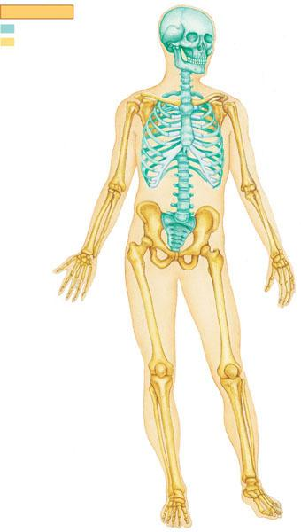
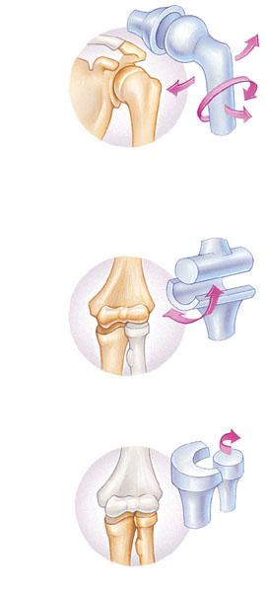
Endoskeleton
key
Head of humerus
Axial skeleton
Examples of joints
Appendicular skeleton
Skull
Scapula
1
Shoulder girdle
Clavicle
Scapula
Sternum
1 Ball-and-socket joints, where the humerus contacts the shoulder girdle and where the femur contacts the pelvic girdle, enable us to rotate our arms and legs and move them in several planes.
Rib
2
Humerus
Vertebra
3
Radius
Ulna
Humerus
Pelvic girdle
Carpals
Phalanges
Ulna
Metacarpals
2 Hinge joints, such as between the humerus and the head of the ulna, restrict movement to a single plane.
Femur
Patella
Tibia
Fibula
Ulna
Radius
Tarsals
Metatarsals
3 Pivot joints allow us to rotate our forearm at the elbow and to move our head from side to side.
Phalanges

Slide 25
Muscles

Slide 26
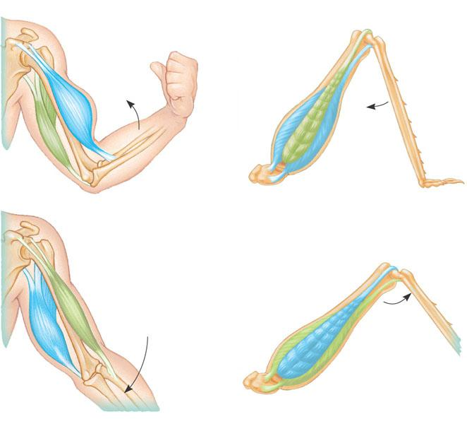
Muscle Interactions in Movement
Human
Grasshopper
Extensor muscle relaxes
Biceps contracts
Tibia flexes
Flexor muscle contracts
Triceps relaxes
Forearm flexes
Extensor muscle contracts
Biceps relaxes
Tibia extends
Forearm extends
Flexor muscle relaxes
Triceps
contracts

Slide 27
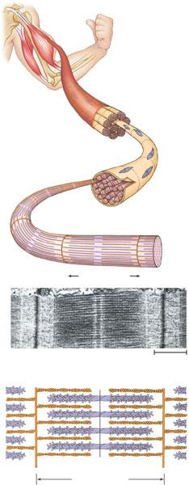
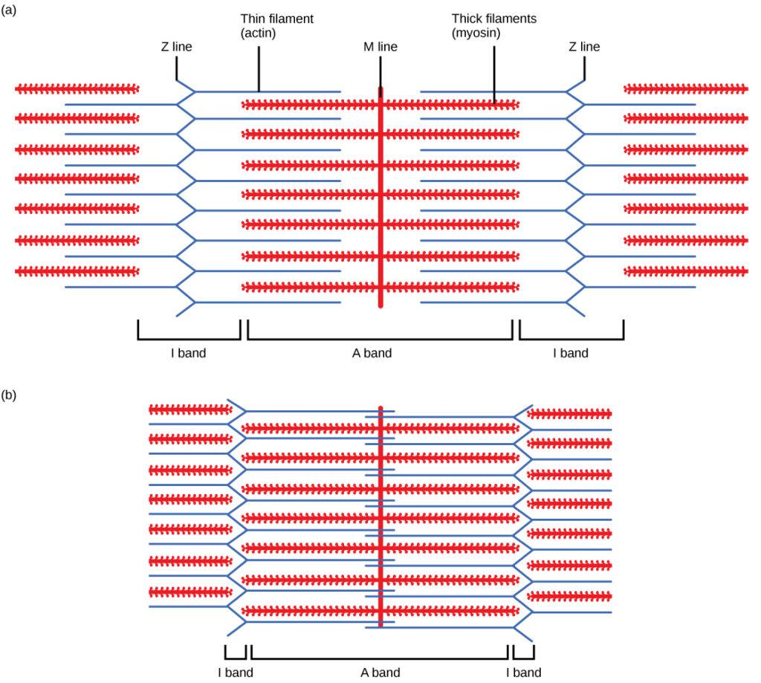
Sliding Filament Model
Muscle
Bundle of muscle fibers
Nuclei
Single muscle fiber
(cell)
Plasma membrane
Myofibril
Z line
Light band
Dark band
Sarcomere
TEM
A band
0.5 m
I band
I band
M line
Thick filaments (myosin)
Thin filaments (actin)
Z line
H zone
Z line
Sarcomere

Slide 28
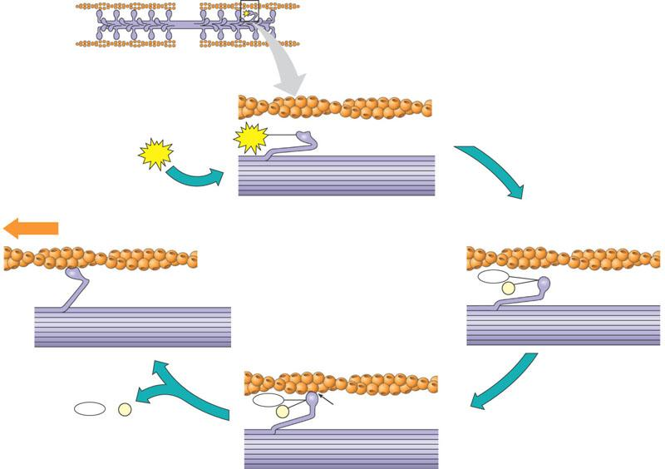
Muscle Contraction
Thick filament
Thin filaments
Thin filament
ATP
Myosin head (low- energy configuration)
ATP
Thick filament
Cross-bridge binding site
Thin filament moves toward center of sarcomere.
Actin
Myosin head (low- energy configuration)
ADP
Myosin head (high- energy configuration)
P _{i}
ADP
+
P _{i}
ADP
Cross-bridge
P _{i}
ATP supplied by glycogen/creatine phosphate stored in muscles

Slide 29
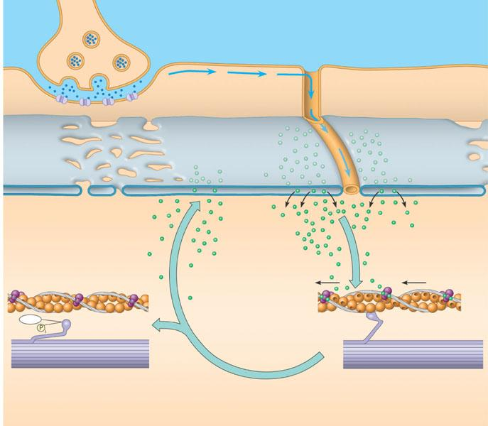
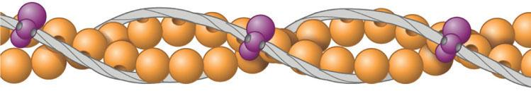
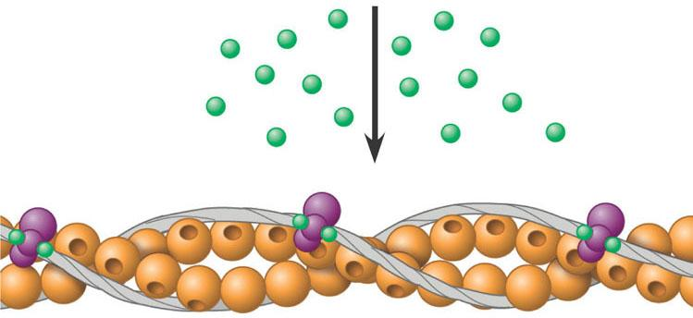
Signaling of Muscle Contraction
Synaptic terminal of motor neuron
1
Acetylcholine (ACh) released by synaptic terminal diffuses across synaptic cleft and binds to receptor proteins on muscle fiber’s plasma membrane, triggering an action potential in muscle fiber.
Tropomyosin
Ca²⁺-binding sites
Actin
Troponin complex
Synaptic cleft
T TUBULE
PLASMA MEMBRANE
ACh
2
Action potential is propa-
gated along plasma
membrane and down
T tubules.
SR
3
Action potential
triggers Ca²⁺
release from sarco-
plasmic reticulum
(SR).
Ca^{2}
(a) Myosin-binding sites blocked
Ca²⁺
Tropomyosin blockage of myosin-
binding sites is restored; contraction
ends, and muscle fiber relaxes.
7
4
Calcium ions bind to troponin;
troponin changes shape,
removing blocking action
of tropomyosin; myosin-binding
sites exposed.
Myosin- binding site
Ca^{2}
CYTOSOL
6
Cytosolic Ca²⁺ is
removed by active
transport into
SR after action
potential ends.
ADP
P₂
(b) Myosin-binding sites exposed
5
Myosin cross-bridges alternately attach
to actin and detach, pulling actin
filaments toward center of sarcomere;
ATP powers sliding of filaments.

Slide 30
Muscle Diseases
Amyotrophic lateral sclerosis (ALS): motor neurons synapsing to the skeletal muscles degenerate, causing paralysis
Botulism toxin: inhibits acetylcholine release from the motor neurons, causing flaccid paralysis
Myasthenia gravis: autoimmune antibodies are produced against skeletal muscle acetylcholine receptors

Slide 31
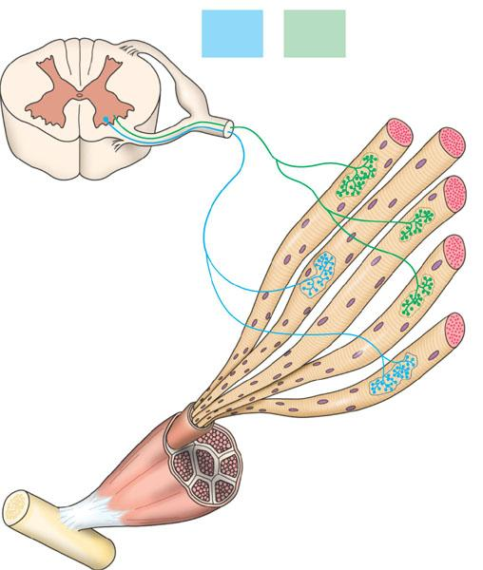
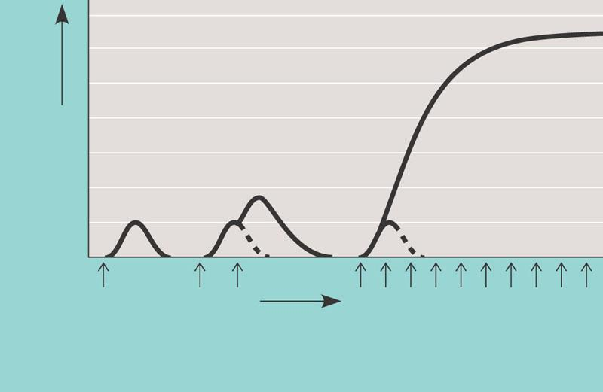
Nervous Control of Muscles
Whole muscle contraction is graded
Motor unit: a single motor neuron and all the muscle fibers it controls
Recruitment: as more motor neurons are activated, more motor units are recruited to contract
Tetanus: high frequency of action potentials cause summation of muscle twitches
Motor unit 1
Motor unit 2
Spinal cord
Synaptic terminals
Nerve
Tetanus
Motor neuron cell body
Tension
Summation of two twitches
Motor neuron axon
Single twitch
Muscle
Action potential
Time
Pair of action potentials
Series of action potentials at high frequency
Muscle fibers
Tendon

Slide 32
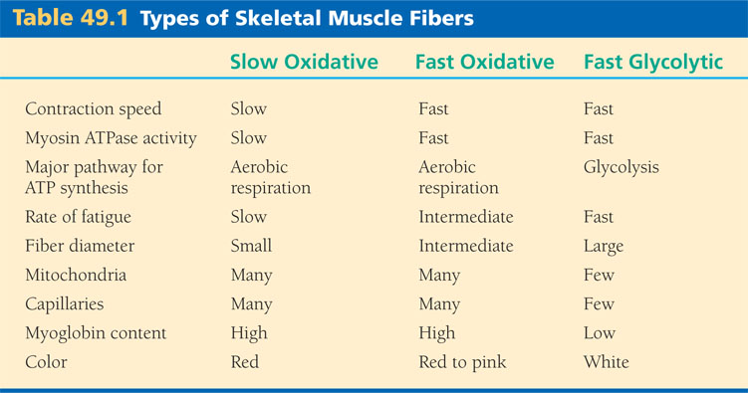
Types of Muscle
Skeletal muscle: striated, controlled by motor neurons
Myoglobin: stores oxygen more efficiently than hemoglobin
Cardiac muscle: striated, action potentials propagated by intercalated disks (gap junctions)
Smooth muscle: not striated (filaments scattered)
No troponin complex/T tubule/developed sarcoplasmic reticulum
Ca2+ ions enter plasma membrane, bind calmodulin, which causes cascade that phosphorylates myosin heads

Slide 33
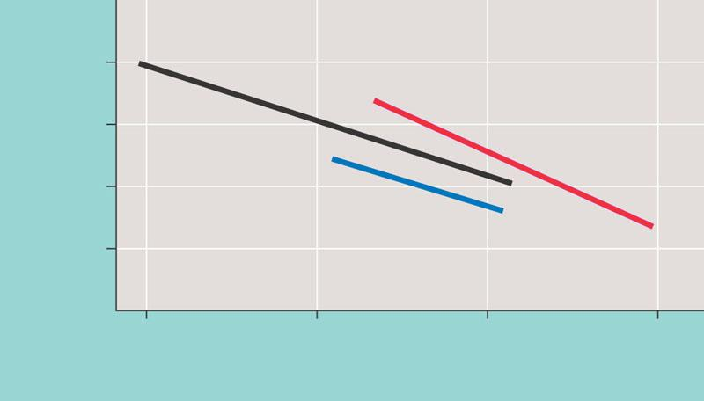
Locomotion
Locomotion in water (swimming): must overcome drag (water is viscous) but not gravity
Locomotion on land (walking/running): must overcome gravity but not much air resistance
Locomotion in air (flying): animals relatively light, must reduce drag and also overcome gravity
Flying
Running
10²
10
Energy cost (J/Kg/m)
1
Swimming
10^{–1}
10^{–3}
1
10³
10⁶
Body mass(g)

