Slide 1
Animal Behavior
Sid K

Slide 2
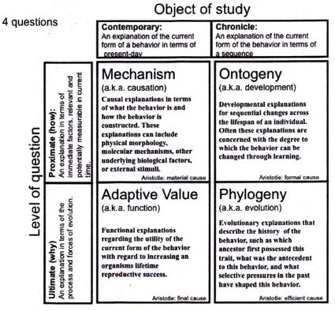
Tinbergen’s 4 questions
Proximate = how it works currently
Ultimate = why it developed from an evolutionary viewpoint

Slide 3
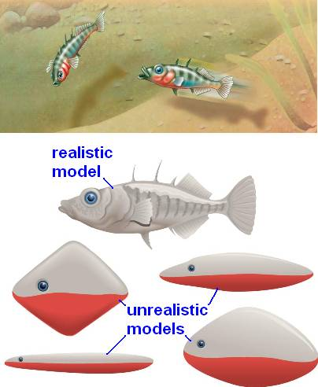
Fixed Action Patterns
Triggered by a sign stimulus
A sign stimulus is some cue that causes an action to be completed
A supernormal stimulus leads to a larger response

Slide 4
Migration and Behavioral rhythms
Various species use different environmental cues to guide migration
Circadian rhythms represent daily cycles while circannual rhythms are yearly cycles

Slide 5
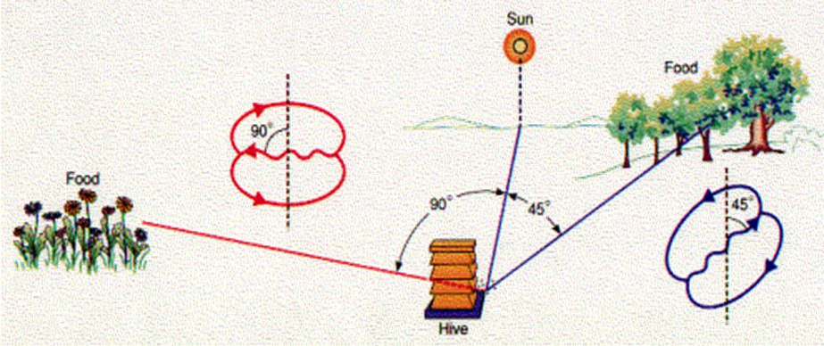
Waggle Dance
When Bees identify food nearby, they move in a circle(round dance)
If not, they perform a waggle dance.

Slide 6
Learning and Evidence of Learning
Learning - the modification of behavior as a result of specific experiences
Cross fostering study - Raising the young of one species under the care of another species
Twin study- Comparing identical twins raised in different conditions, measure the effect of nature vs nurture

Slide 7
Imprinting
Imprinting is the formation of a long lasting response towards a certain object
It has a sensitive period, which is a period of time where an imprint must be formed
The stimulus to imprint on is provided by the outside world

Slide 8
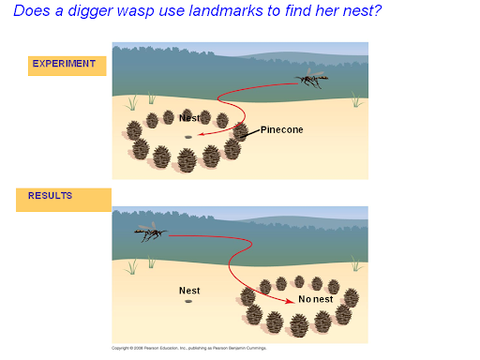
Spatial Learning and Cognitive Maps
The formation of memories that utilize geographic features
A cognitive map is a mental representation of relationships between objects in an animal’s surroundings

Slide 9
Associative Learning
Association of one environmental feature with another
Classical Conditioning is the association of an arbitrary stimulus with another stimulus
Operant Conditioning is trial-and-error conditioning

Slide 10
Cognition, Problem Solving
Cognition - Most complex form of learning, involves awareness and reasoning
Mammals, Birds and Insects exhibit cognition
Bees recognize similarities in patterns and how this impacts chances of getting food
Problem solving - Cognitive ability to devise solutions to overcome obstacles

Slide 11
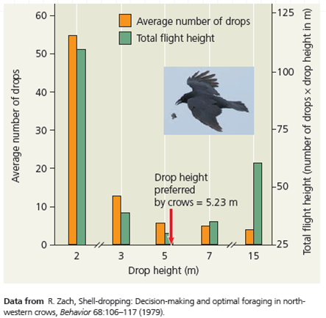
Fitness and Foraging
Fitness is the ability for an organism to successfully reproduce
Foraging is the acquisition of food
The optimal foraging model states that individuals want to maximize costs and minimize benefits while foraging.

Slide 12
Mating systems
Promiscuous - switching of mating pairs
Polygamy - One sex mates with several of other
Sexual Dimorphism - Secondary sex characteristics
Polygyny is one male mates with many females and males are ornamented
Polyandry is one female mates with many males and females are ornamented

Slide 13
Parental Care
Needs of young
Males can either leave the female and try to maximize the number of mates, or help ensure that the offspring grows successfully
Precocious - offspring are mobile, open eyes, large brains, have hair/down
Altricial - offspring require care; opposite of above
Certainty of paternity - chance that the male is actually the father
Internal fertilization - low certainty, since mating and egg laying/birth are temporally separated —> low paternal care
External fertilization - high certainty, since eggs are directly fertilized (mating and egg laying are linked) —> high paternal care

Slide 14
Sexual Selection
Intersexual - choosing mates (female choice, usually)
Mate-choice copying - social learning; pick males whom other females find attractive, since then our male offspring will also be attractive (guppies)
Handicap hypothesis - pick males with showy characteristics that may even be harmful, since that means they are able to survive in spite of that handicap, meaning they must have good gene

Slide 15
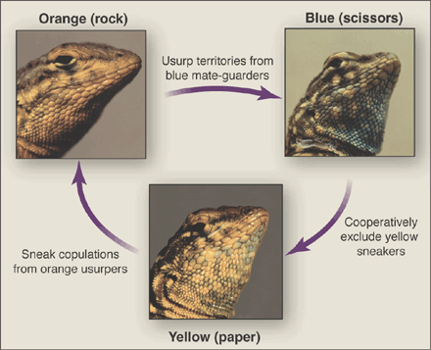
Game Theory

Slide 16
Altruism
Reduces individual fitness, but raises the fitness of others in the population
Belding’s ground squirrels alert others while drawing attention to themselves
Hamilton's rule= rB>C
R is coefficient of relatedness, B is benefit to the altruist, and C is cost

Slide 17
What is the coefficient of relatedness between first cousins?

Slide 18
Hamilton’s rule example
Joe and his fraternal twin brother are going swimming on a beach. Joe’s brother goes too far into the water and he begins to drown. He has a 100% chance of death if nobody helps him. If Joe helps his brother, Joe has a 40% chance of death while his brother is guaranteed to survive. Is it advantageous for Joe to help his brother? Assume both individuals will have the same number of children in the future if they both survive.

Slide 19
Answer
Yes
rb>c
.5(x)>(x*.4)

