Slide 1
Ecology
Sid K

Slide 2
What is Ecology?
Ecology: The scientific study of the interactions between organisms and the environment
Global Ecology: How the regional exchange of energy influences distribution of organisms around the earth.
Landscape Ecology: A landscape is a series of connected ecosystems. Landscape ecology focuses on factors controlling energy exchange across ecosystems.
Ecosystem Ecology: Emphasizes energy flow between organisms and the environment
Community Ecology: Interactions between species, such as predation and competition
Population Ecology: Analyzes factors that impact population size
Organismal Ecology: How an organism’s structure and behavior help combat challenges from its environment

Slide 3
Climate
Climate: Long term weather conditions in an area. temperature, precipitation, sunlight, and wind are important components of climate.
Microclimate: Localized climate patterns, like patterns encountered by a community
Macroclimate: Patterns on the global, regional, and landscape level

Slide 4
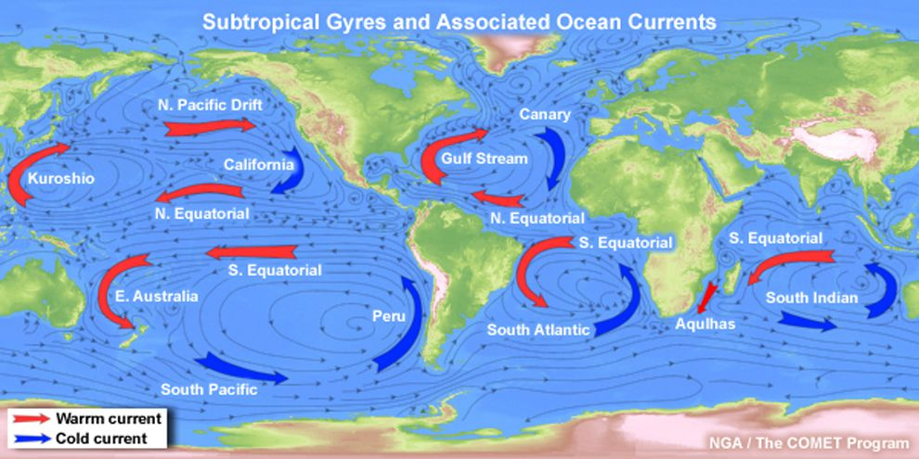
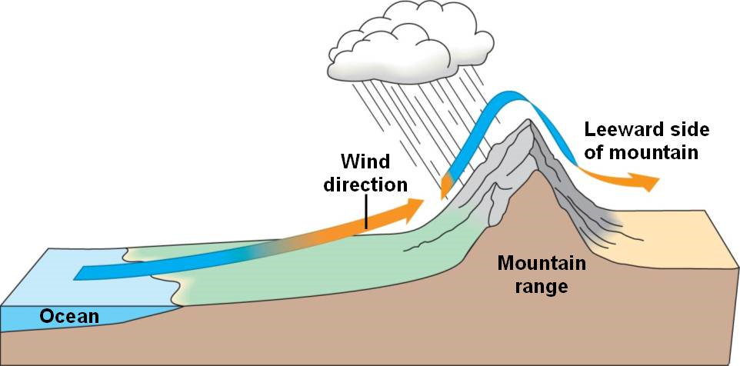
Factors that impact macroclimate

Slide 5
Factors that Impact Microclimate:
Trees moderate microclimate below them.
A log and stone can help protect organisms from extreme temperature.

Slide 6
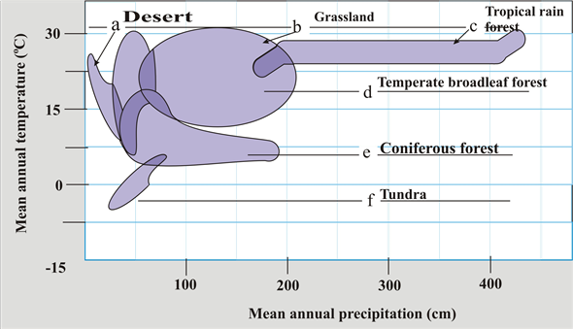
Climograph

Slide 7
Biome terminology
Ecotone: The area of transition between 2 biomes.
Layers of forests: Canopy, Low-tree layer, Understory, Ground level.
Disturbance: Event such as a storm, fire, or human activity that changes a community

Slide 8
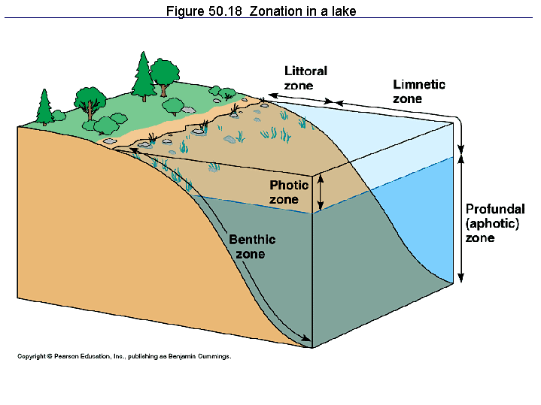
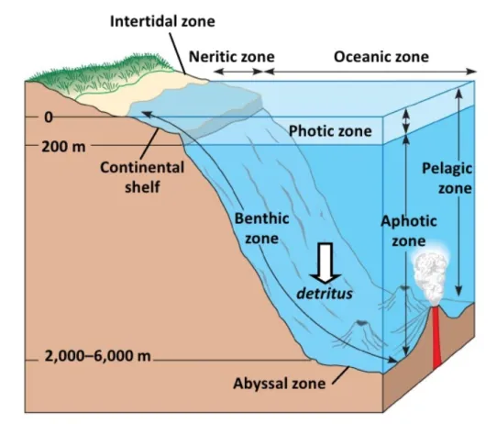
Zonation

Slide 9
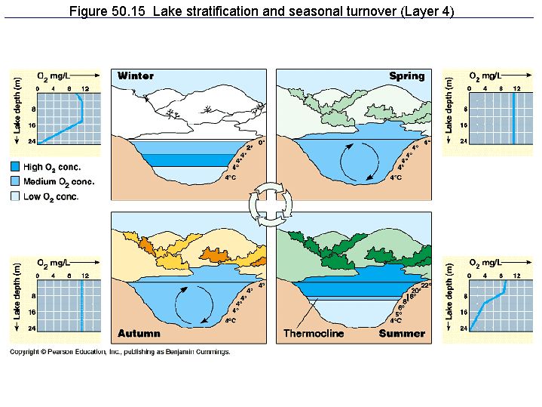
Turnover

Slide 10
Dispersal and Density
Dispersal is the movement of individuals or gametes away from their area of origin.
Density is the number of individuals per unit area

Slide 11
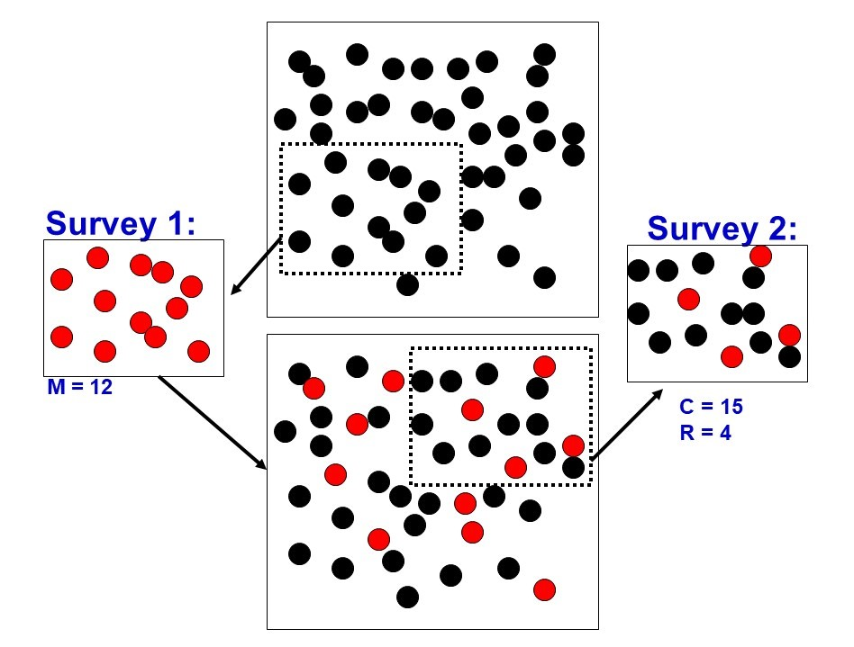
Mark and Recapture

Slide 12
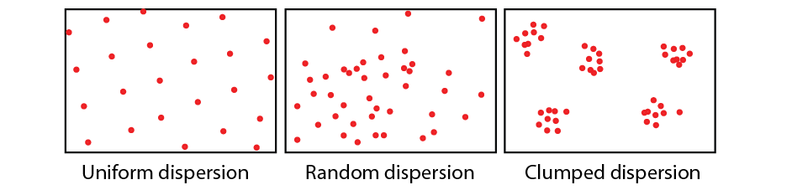
Dispersion

Slide 13
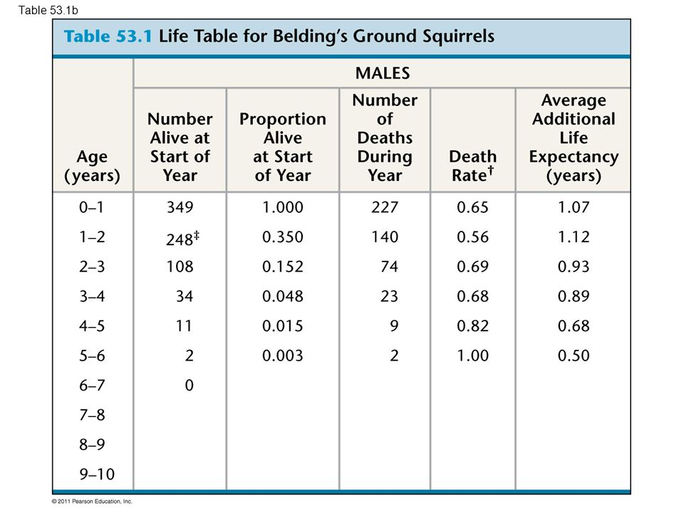
Life table
Cohort - a group of individuals of the same age.

Slide 14
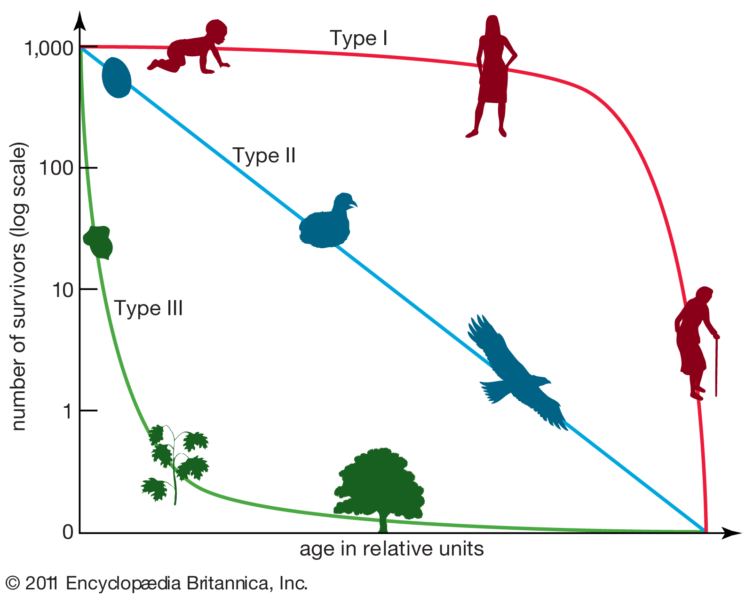
Survivorship curves

Slide 15
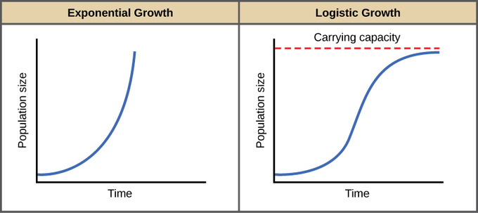
Growth types

Slide 16
Vocabulary
Semelparity is where organisms reproduce only once.
Iteroparity is repeated reproduction.
Metapopulation is where immigration and emigration link local populations together
Ecological footprint is the land and water area required by each person to produce the resources they acquire

Slide 17
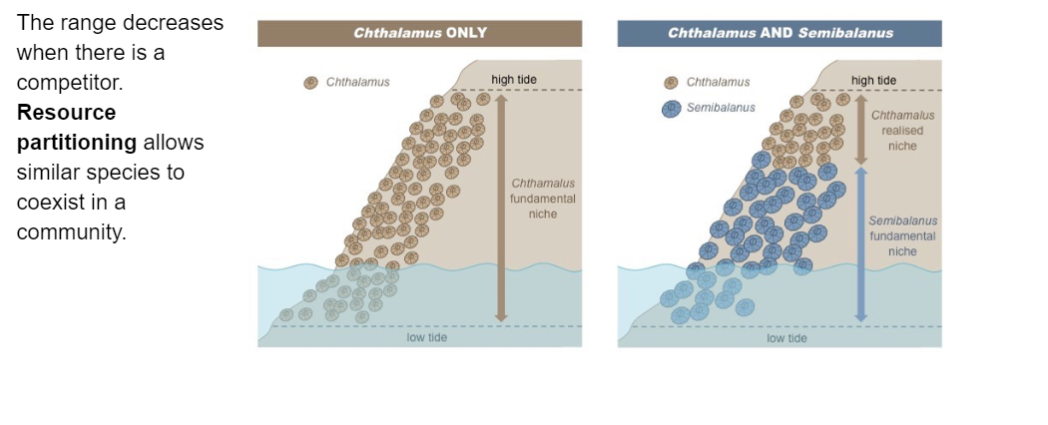
Fundamental & Realized Niche

Slide 18
Mimicry and Coloration
Cryptic coloration makes prey difficult to see
Aposematic coloration, like that of the poison dart frog, warns predators through bright colors
Batesian mimicry is where a harmless species mimics a harmful one. Predators avoid the harmful one, and since the harmless one mimics the harmful one in appearance, predators will avoid them.
Mullerian mimicry is where 2 harmful species mimic each other. The more harmful organisms there are of a particular appearnce, the quicker predators will learn to avoid the organisms.

Slide 19
Symbiosis and Energy transfer
Parasitism is +/-
Mutualism is +/+
Commensalism is +/0
Energetic hypothesis suggests that the length of a food chain is limited by the inneficiency of energy transfer between one level to the next level. Only 10 percent of energy is transmitted from one level to the next.

Slide 20
Succession
Ecological succession is where a disturbed area(one affected by a natural disaster) is gradually replaced by other species.
If this process occurs in a lifeless area where soil has not yet formed, it is called primary succession.
If this process occurs when the soil is still intact after a disturbance, it is called secondary succession.

Slide 21
GPP and NPP
Gross primary production is the amount of light energy converted into chemical energy in organic molecules per unit time.
Net primary production is the Gross primary production - the energy used for respiration.
NPP=GPP-R

