Slide 1
DNA Repair
*All pathways describe eukaryotes (or vertebrates/humans) unless otherwise noted
DNA repair pathways mentioned not comprehensive!!
Adele Peng 5.4.2020

Slide 2
Main Takeaways
Polymerases are unsung heroes of DNA repair
DNA repair is a complex and universal process
Proteins can be shared by multiple pathways and are often redundant in function
DNA synthesis & repair is not as smooth as Campbell depicts and can often be blocked by many factors

Slide 3
Nucleotide Excision Repair
Repairs bulky/destabilizing (increased ssDNA structure) DNA lesions by removing short oligonucleotides, then gap filled by repair synthesis
Repairs adducts formed by UV irradiation
Defects lead to xeroderma pigmentosum (elevated skin cancer risk)
NER defects also cause Cockayne syndrome and trichothiodystrophy (leading to developmental abnormalities)
Notes:
https://www.ncbi.nlm.nih.gov/pmc/articles/PMC3783044/

Slide 4
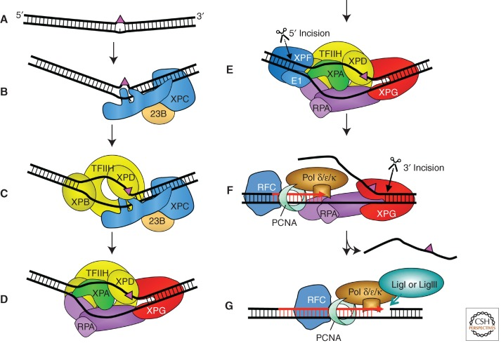
NER Mechanisms
Global genome NER (GG-NER) occurs in whole genome, transcription coupled NER (TC-NER) repairs transcribed strand of active genes
GG-NER: XPC-RAD23B + UV-damaged DNA-binding protein
TC-NER: RNA pol + CSA, CSB, and XAB2
Notes:
Model for the core NER reaction. (A) Bulky DNA lesions that destabilize duplex DNA are induced by a number of damaging agents. (B) In global genome NER, strongly distorting lesions are directly recognized by XPC-RAD23B, which binds the nondamaged strand opposite the lesion. (C) TFIIH interacts with XPC-RAD23B and pries the DNA open with its XPB subunit allowing XPD to track along DNA until stalls at the damage and verifies the chemical modification (bulkiness) of the lesion. (D) Stalling of XPD at the lesion allows for the formation of the preincision complex by recruitment of XPA, RPA, and XPG. The endonuclease XPG does not make an incision at this point. (E) Recruitment of ERCC1-XPF by interaction with XPA to the complex leads to incision 5′ to the lesion. (F) Initiation of repair synthesis by Pol δ and Pol κ or Pol ε and associated factors, followed by 3′ incision by XPG. (G) Completion of repair synthesis and sealing of the nick by DNA ligase IIIα/XRCC1 or DNA ligase I completes the process.

Slide 5
NER mechanism specifics
XPC:
Sequence unspecific DNA binding domain (transglutamase homology + β-hairpin, BHD1)
BHD2/3 binds 2 nt opposite damaged strand→ nondamaged strands allow broad substrate specificity
RAD23A/B redundant, stabilize XPC, RAD23B damage recognition→ brings XPC to UV damage sites
XPC-RAD23B + centrin 1 (calmodulin type Ca binding protein)
TFIIH : 10 subunits, cyclin-activated kinase (CAK) + core connected by XPD, CAK not required
XPB/XPD helicases, XPB is ATPase/helicase, anchors protein to DNA after opening TFIIH (RecA domains from SF2 helicases); facilitates XPD binding
XPD translocates along DNA, verifying damage, 2 RecA domains, FeS cluster + arch domain that is tunnel for ssDNA
Preincision complex: XPA, RPA, and XPG recruited, XPC-RAD23B leaves
XPA binds kinked DNA, regulated by histone deacetylase SIRT1, circadian rhythm (transcriptional→ cryptochrome; posttranslational→ HERC2 ubiquitin ligase)
RPA interacts XPA, binds 30 nt nondamaged ssDNA, positions ERCC1-XPF and XPG nucleases on damaged strands
XPG recruited by TFIIH, nuclease cuts leaves 5’ phosphate for ligation
Dual incision/repair synthesis:
ERCC1-XPF incises, generates 3’ OH, TFIIH binds ATP, releases oligo, RPA binds oligo, oligo degraded
Multiple synthesis pathways: Pol δ recruited by RFC + PCNA, Pol κ by ubiquitinated PCNA + XRCC1, Pol ε by modified RFC (important in dividing cells? high dNTP levels and open DNA structures)
Nick ligation depends on cell cycle status: queiscent/replicating→ DNA ligase IIIα/Pol δ; replicating→ DNA ligase I/Pol ε

Slide 6
NER in chromatin
Modify histone tails to decrease histone DNA affinity, ATP chromatin remodeling enzymes to move histones along DNA
UV-DDB (damage-binding DDB2 + adaptor DDB1) + CUL4A/ROC1 binds chromatin after UV, ubiquitinates histone H2A, H3, H4, destabilizing nucleosomes/XPC, stabilizing it/DDB2, degrading it
DDB2 binds damage, releasing COP9 signalosome (CSN) subunit to form ubiquitination zone
poly(ADP-ribose) polymerase (PARP) posttranslationally modifies DDB2, recruits chromatin-remodeling enzyme ALC1, a SNF2/SWI superfamily ATPase
Other chromatin remodeling complexes:
XPC recruits other chromatin remodelling enzymes (e.g. SWI/SNF proteins, BRG1 and hSNF5) after DNA damage recognition for chromatin decompaction
DDB1 recruits INO80
Chromatin restructured after NER by histone chaperone CAF-1 (chromatin assembly factor)
CAF-1 interacts PCNA, results in histone recycling + incorporation of histone variant H3.1

Slide 7
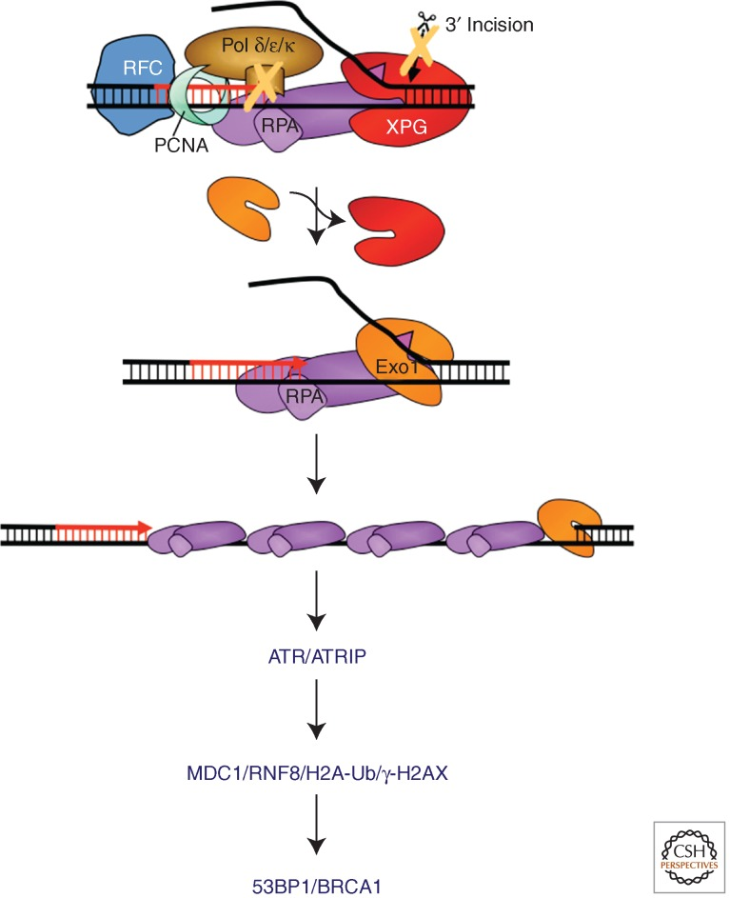
NER in UV damage signaling
Long ssDNA stretch covered by RPA triggers ATR-ATRIP complex activating the ATR kinase activity
During NER, RPA covered ssDNA formed by EXO1 nuclease during incomplete repair synthesis

Slide 8
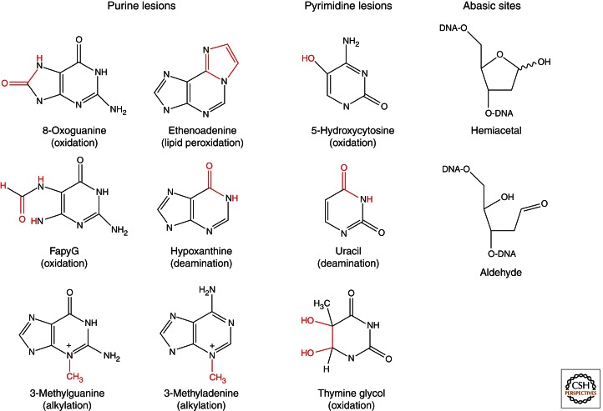
Base Excision Repair
Corrects small lesions, e.g. those caused by deamination, oxidation, or methylation
Initiated by 11 different glycosylases specific to damage type, pathway varies based on initiating enzyme (thymine DNA glycosylase also regulates methylation)
Notes:
https://www.ncbi.nlm.nih.gov/pmc/articles/PMC3683898/

Slide 9
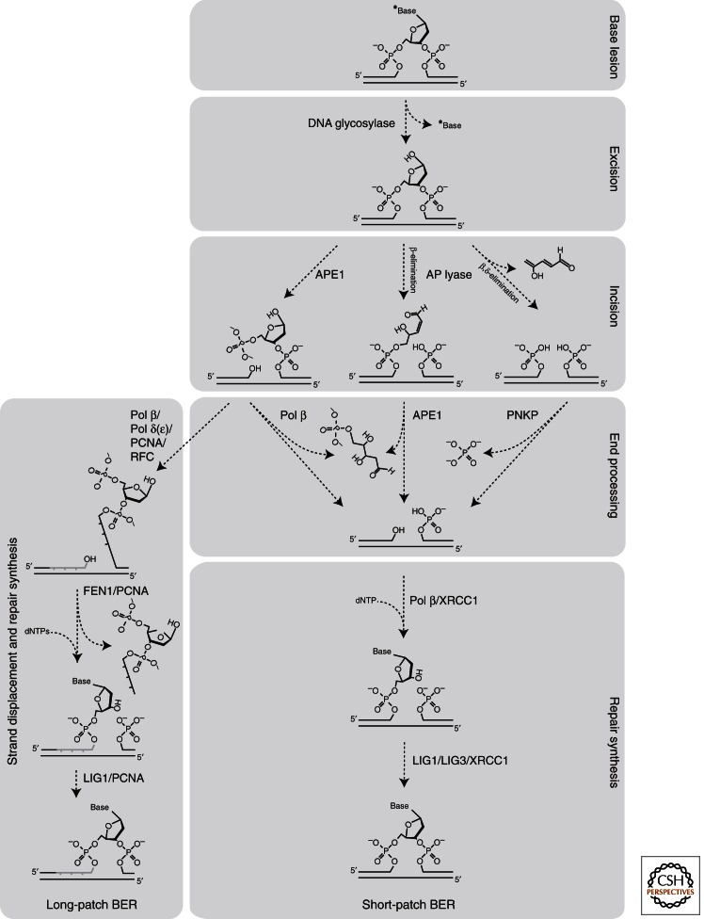
BER pathways
Damage-specific glycosylase removes base, leaving abasic site
APE1 is AP-endonuclease/protects against oxidative stress/activates transcription factors
PARP1 may recognize damage, protects against single stranded breaks during BER
Chromatin remodeling by SWI/SNF complex needed for 8-oxoG repair

Slide 10
BER mechanisms
DNA glycosylases can be monofunctional (produce AP site only), bifunctional (β-lyase, β-elimination cleavage; β,δ-lyase activity, β/δ-elimination) → uracil glycosylases mono only
May perform base flipping to expose major groove bases into minor groove
Mono: APE1 cleaves 5′ of abasic site, generating 3′OH and 5′deoxyribose phosphate (5′dRP) ends, Pol β inserts nt, dRPase removes 5’dRP to produce 5’phosphate for ligation
Β-lyase: unsaturated hydroxyaldehyde linked to 3′ end (3′dRP) and phosphate at 5′; APE1 replaces 3’dRP with OH
Β,δ-lyase: cleaves both sides of AP site, releasing trans-4-hydroxy-2,4-pentadienal, generating 3’/5’ phosphates removed by polynucleotide kinase/phosphatase (5′kinase /3′phosphatase)
Short patch BER: 1 nt removed (more common); long patch: 2-10 nt removed (initiated by glycosylases expressed in S phase)
Short: efficient in both proliferating/nonproliferating cells, involve DNA glycosylase, APE1, DNA polymerase β (Pol β), DNA ligase I or III (LIG1/3), sometimes PARP or XRCC1
Long: mainly in proliferating, involves pol δ/ε (Pol β in nonproliferating), PCNA, FEN1, LIG1; HMGB1 interacts FEN1/APE1 to regulate BER
Pol β main gap-filling; also X family Pol λ recruited to oxidative damage
Lig3 main mitochondrial ligase (stabilized by XRCC1); Lig1 (long patch, main repair for short patch, interacts PCNA)/Lig4 nuclear

Slide 11
Mismatch repair
Repairs base-base mismatches and insertion/deletion mispairs
Defects cause hereditary non-polyposis colorectal cancer, resistance to certain chemotherapeutic agents, and abnormalities in meiosis and sterility
Key takeaways:
MMR directs recognition via strand specific nick (in E. coli, occurs by hemimethylation of a dGATC sequence)
MMR is bidirectional
MMR highly conserved between E. coli and humans
Notes:
https://www.nature.com/articles/cr2007115#Sec6

Slide 12
Mismatch repair mechanisms
Mismatch recognition:
hMSH2 heterodimerizes with hMSH6 or hMSH3 to form hMutSα (base/base mismatches/1-2 bp indels) or hMutSβ (large indels) ATPases
hMLH1 heterodimerizes with hPMS2, hPMS1, or hMLH3 to form hMutLα (ATPase, PCNA/replication factor C (RFC)-dependent endonuclease activity involved in EXO1 nuclease 3’ nick activity), hMutLβ, or hMutLγ
PCNA interacts MSH2, MLH1, MSH6, MSH3
localize MutSα and MutSβ to mispairs in newly replicated DNA, required in 3’ but not 5’ nick directed MMR
EXO1: 3′ nick-directed repair
Recognition of 3’ nick, MutLα endonuclease makes PCNA/RFC-dependent incision 5’ to mismatch
RPA binds to nicked heteroduplex DNA before MutSα and MutLα, stimulates mismatch-provoked excision, protects the ssDNA gapped region generated during excision, and facilitates DNA resynthesis (unphosphorylated promots excision, phosphorylated promotes DNA synthesis after pol delta)
HMGB1 is a mismatch-binding protein and has a DNA-unwinding activity, can interact MSH2 and MSH6

Slide 13
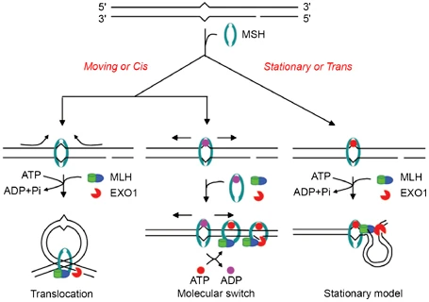
MMR mechanisms are not well characterized

Slide 14
MMR roles in drug resistance, apoptosis
MMR deficient cells become resistant to alkylating agents
Methotrexate resistance:
Co-amplification of region encoding both dihydrofolate reductase (MTX target) + hMSH3
hMSH3 overexpression causes all hMSH2 to form hMutSβ instead of hMutSα, and the unused hMSH6 from the hMutSα unit is degraded, causing hypermutability
hMutSα- and hMutLα-deficient cells are defective in cell cycle arrest in response to multiple types of DNA damaging agents
hMutSα and hMutLα interact physically with ATM, ATR-ARTIP, c-Abl, and p73 in cells treated with DNA damaging agents/drugs (in their absence, p53 and p73 are not phosphorylated in response to DNA damage)

Slide 15
Overview of Double strand break repair
Initial resection step that generates ssDNAs
HR + NHEJ most common
NHEJ, aEJ, SSA all mutagenic (NHEJ least mutagenic)
aEJ/SSA require long 3’-ssDNA tails
nonhomologous DNA end joining (NHEJ)
alternate end joining (a-EJ)
homologous recombination (HR)
single-strand annealing (SSA)
Notes:
https://www.jbc.org/content/293/27/10500.full.pdf

Slide 16
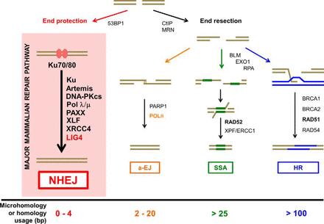
Non-homologous end joining
Main DSB repair pathway outside of S and G₂ phases, S/G₂ phase lesions distal from replication fork
Pathway commitment not complete until ligation
Amount of end resection specifies HR repair pathway; Ku prevents long end resections
Repairs blunt end DSBs from ionizing radiation/chemo/ROS
Repair in lymphocyte recombination + CRISPRko
Notes:
https://www.jbc.org/content/293/27/10512.full

Slide 17
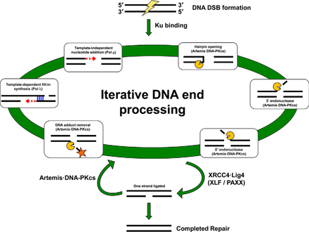
NHEJ is an iterative process

Slide 18
NHEJ mechanisms
DNA-PKcs + Artemis nuclease recruited to Ku-bound ends, DNA-PKcs autophosphorylated, activate Artemis (metallo-β-lactamase/β-CASP domains) by phosphorylation, recognizes ss-dsDNA boundaries; Artemis has 5’/3’ DNA-PKcs dependent endonuclease activity, DNA-PKcs independent 5’ exonuclease activity (possibly activation by Lig4?), Artemis cleaves overhangs (at 3’ overhangs/hairpins, forms 4-nt 3′ overhangs)
MRN complex (consisting of MRE11, RAD50, NBS1) creates 3′-terminated ssDNA overhangs through C-terminal-binding protein interacting protein (CtIP), regulates BLM/DNA2-induced end resection
Pol X family, μ (template independent, promotes ligation of incompatible 3′ overhangs)/λ (fills in gaps) has N-terminal BRCA1 C terminus (BRCT) domain that binds Ku, incorporates either dNTPs/rNTPs in template-dependent or -independent manner
Lig4 interacts X-ray repair cross-complementing 4 (XRCC4) enzyme; XRCC4 N terminus interacts XRCC4-like factor N terminus (XLF, anneals incompatible 3’ overhangs); interacts Ku to stabilize ends; Paxx is other protein that promotes annealing of 5’ overhangs
tyrosyl DNA phosphodiesterase 1 (TDP1) removes 3’PG adducts, PNK/aprataxin recruited to unrepaired ends
Without TDP1, Artemis removes adducted strands
Ligation improved by microhomology
XRCC4·Lig4 can ligate while immediately reversed by Artemis·DNA-PKcs
Ku needed for ligation of ends with no homology (C terminus of Lig4 has 2 BRCT domains to bind Ku, binds XRCC4 homodimer)
Notes:
X family: Pol β has no BRCT domain, not involved → terminal deoxynucleotidyltransferase in V(D)J recombination

Slide 19
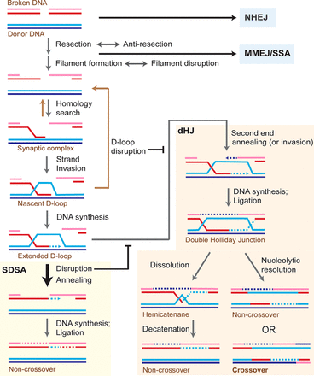
Homologous Recombination
Repairs double stranded DNA breaks and DNA damage affecting both strands, interstrand crosslinks, involved in meiotic recombination
DSB is resected 5′ to 3′ on one strand of the DSB ends producing terminal 3′-OH single-stranded DNA (ssDNA) tails
HR preferred with sister chromosome to preserve heterozygosity
Notes:
https://www.jbc.org/content/293/27/10524.full

Slide 20
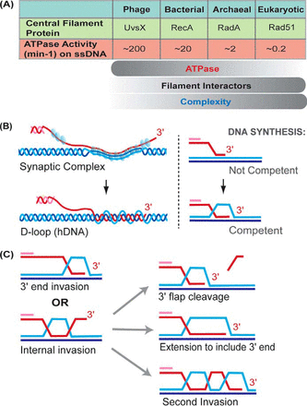
HR mechanisms
DSB resection needs Fun30 chromatin–remodeling factor, initiated by nuclease Mre11-Rad50-Xrs2/Sae2, completed by 5′–3′ exonuclease Exo1, Sgs1–Top3–Rmi1 complex/Dna2 nuclease
Rad51 filament displaces RPA (mediated by BRCA2–DSS1 complex/Rad52) active Rad51-ATP filaments elongate, stabilized by SWI5–MEI5 heterodimer; Ca allows Rad51 to bind ssDNA, Rad51-ssDNA stabilized by Rad54
Rad51 searches DNA duplex for matches with ssDNA through base flipping (BRCA1–BARD1 possibly involved)
When homology found, synaptic complex forms
3’ of invading strand pairs with donor to form primer–template junction, forming heteroduplex DNA/D-loop formation in process, Rad54 promotes D-loop formation (invades linear donor DNA)
Supercoiling affects unwinding of donor for HR, may be mediated by Sgs1–Top3–Rmi1 complex (3′–5′ DNA helicase, type 1A topoisomerase + cofactor)
Pol δ, PCNA, RFC1-5 extend invading strand, causing supercoils; supercoils relieved by helicases/topoisomerases/possibly 5’ peeling of D-loop

Slide 21
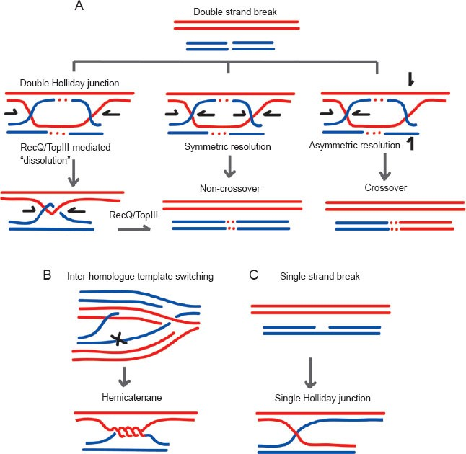
HR mechanisms (continued)
D-loop disrupted by Srs2, Sgs1 (RecQ family), and Mph1 are 3′ to 5′ ssDNA translocases in synthesis-dependent strand annealing (SDSA) pathway, unwinds invading strand/releases to ss state to be RPA bound
Prevents multiple strand invasion, crossovers, invasion with partial homology
Rad52 may mediate second end annealing, or second-end DNA invasion may happen instead
SDSA preferred but double Holliday junction may form instead
second resected DSB end anneals to displaced strand of D-loop, or both DSB ends invade D-loop, nicked complexes ligated to form 4 way branched DNA molecule
dHJ resolution to avoid CO:
Resolvase nucleases e.g. Mus81–Mms4, Slx1–Slx4, and Yen1 cut HJ via different mechanisms
By Sgs1–Top3–Rmi1 complex: Sgs1 helicase promotes branch migration of the two HJs toward each other to converge into a hemicatenane (Top3 allows topology to work out)

Slide 22
Nuclei & other organelles
Mitochondria lack NER but have multiple BER mechanisms
Mitochondria have only one DNA polymerase, pol γ, which can be error prone for NER repaired adducts, causing mutagenesis
Error prone DNA repair mechanisms compensated by many copies of DNA in mitochondria + multiple mitochondria per cell
Short patch BER would use glycosylase, APE1, Pol γ, and LIG3, but long patch BER also documented
FEN1 may interact nuclease/helicase DNA2 in this process

Slide 23
DNA damage
UV-induced DNA damage primarily due to UV-B radiation
Cyclobutane pyrimidine dimers, 4-6 photoproducts and their Dewar isomers are classical NER substrates
Photolyases in E. coli able to photoreactivate using blue light/flavin cofactor
Thymine glycols recognized by Uvr ABC complex in E. coli
Alkylating agents → interstrand cross links
Common DNA adducts:
Benzo[a]pyrene-induced BPDE adducts
Environmental carcinogens → activation by cytochrome p450 → ultimate carcinogens (detoxification by glutathione-S-transferase?) → DNA adduct formation at tumor suppressor/oncogene hotspots (repair?)→ mutagenesis (accumulation leads to apoptosis?)→ cancer

