Slide 1
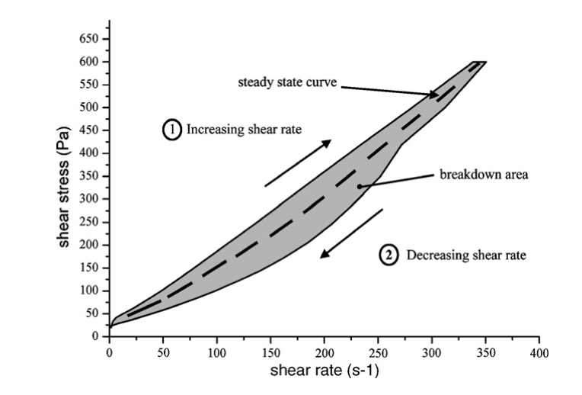
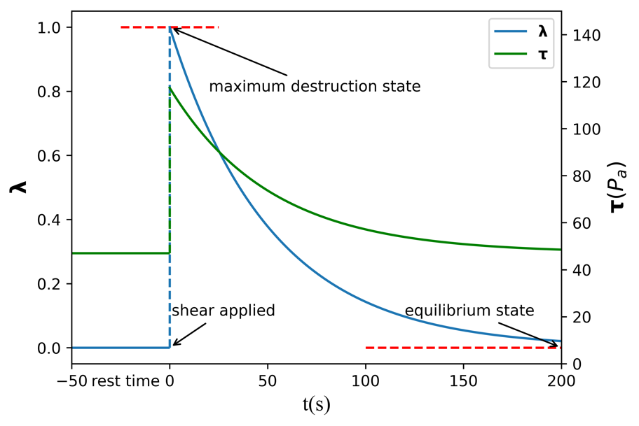

Slide 2
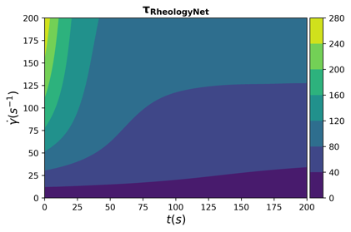
(b)
When shear rate = 100 s-1
(a)
(c)
Increasing shear rate
Decreasing shear rate

Slide 3
(b)
When shear rate = 100 s-1
(a)
(c)
Increasing shear rate
Decreasing shear rate

Slide 4
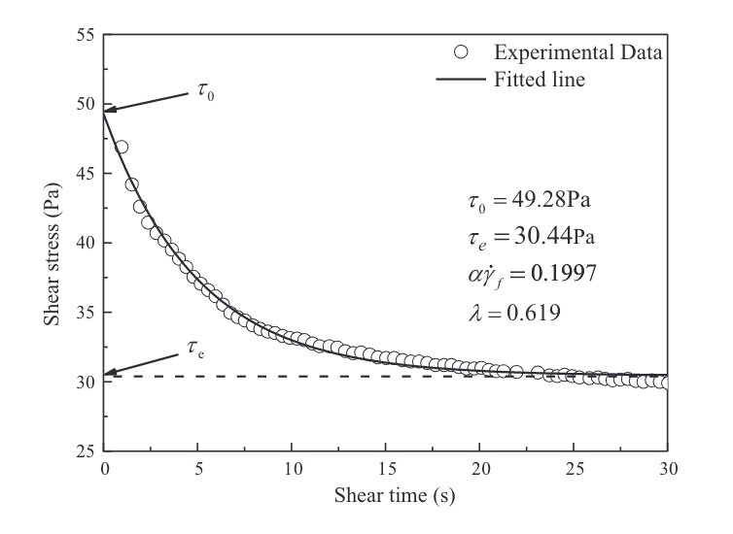
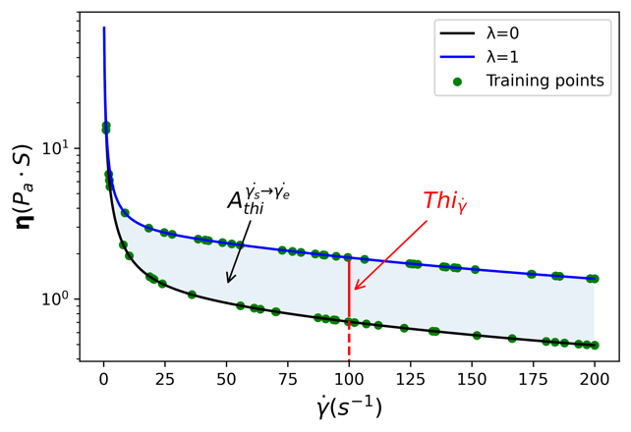
(b)
When shear rate = 100 s-1
(a)
(c)

Slide 5
(a)
When shear rate = 100 s-1
(b)
When shear rate = 100 s-1
(c)

Slide 6
(1)
(2)
When shear rate = 100 s-1
(3)
(4)
Increasing shear rate
Decreasing shear rate

Slide 7
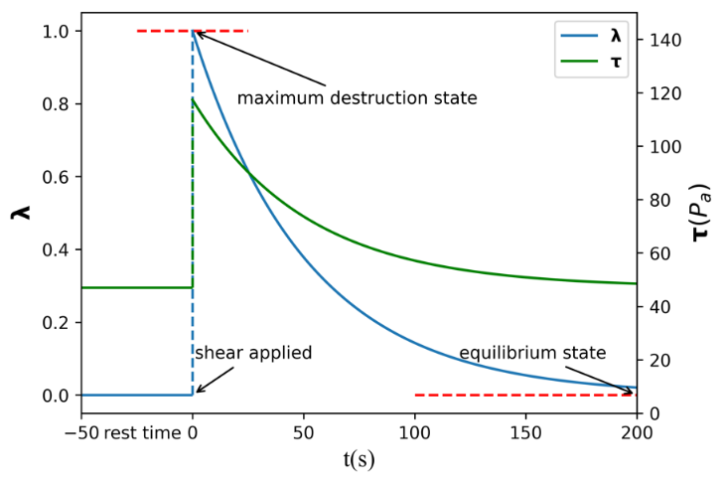
When shear rate = 100 s-1

Slide 8









Generator
Conv2D (256@4$×$4)
Conv2DTranspose (256@4$×$4)
BatchNormalization (0.7)
ReLU
ReLU
GBlock(256@4$×$4)
UpSampling2D
GBlock(128@4$×$4)
GBlock(64@3$×3$)
GBlock(32@3$×3$)
GBlock(16@3$×3$)
Conv2D (8@3$×3$)
ReLU
UpSampling2D
Conv2D (3@3$×3$)
Sigmoid

Slide 9
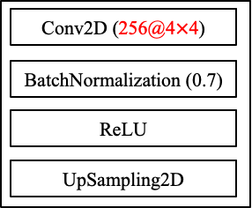









Conv2DTranspose (4$×$4)
Conv2D (4$×$4)
Generator
ReLU
BatchNormalization (0.7)
G-Block(4$×$4)
ReLU
G-Block(4$×$4)
UpSampling2D
G-Block(3$×3$)
G-Block(3$×3$)
G-Block(3$×3$)
Conv2D 3$×3$)
ReLU
UpSampling2D
Conv2D (3$×3$)
Sigmoid

Slide 10







Conv2D (3$×3$)
GaussianNoise (0.2)
BatchNormalization (0.7)
Conv2D (3$×3$)
LeakyReLU (0.2)
LeakyReLU (0.2)
Dropout (0.25)
AveragePooling2D
Discriminator
Dropout (0.25)
AveragePooling2D
D-Block(3$×3$)
D-Block(3$×3$)
D-Block(3$×3$)
D-Block(3$×3$)
D-Block(3$×3$)
Flatten
Dense(128)
LeakyReLU (0.2)
Dense(1)

Slide 11








Discriminator
Conv2D (16@3$×3$)
GaussianNoise (0.2)
BatchNormalization (0.7)
Conv2D (8@3$×3$)
LeakyReLU (0.2)
LeakyReLU (0.2)
Dropout (0.25)
Dropout (0.25)
AveragePooling2D
AveragePooling2D
DBlock(16@3$×3$)
DBlock(32@3$×3$)
DBlock(64@3$×3$)
DBlock(128@3$×3$)
UpSampling2D
DBlock(256@3$×3$)
Conv2D (3@3$×3$)
Flatten
Sigmoid
Dense(128)
LeakyReLU (0.2)
Dense(1)

Slide 12
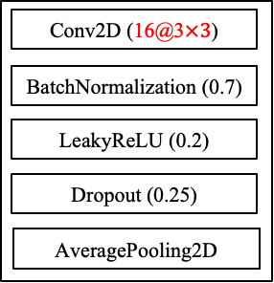
Discriminator
GaussianNoise (0.2)
Conv2D (8@3$×3$)
LeakyReLU (0.2)
Dropout (0.25)
AveragePooling2D
DBlock(16@3$×3$)
DBlock(32@3$×3$)
DBlock(64@3$×3$)
DBlock(128@3$×3$)
DBlock(256@3$×3$)
Flatten
Dense(128)
LeakyReLU (0.2)
Dense(1)

Slide 13
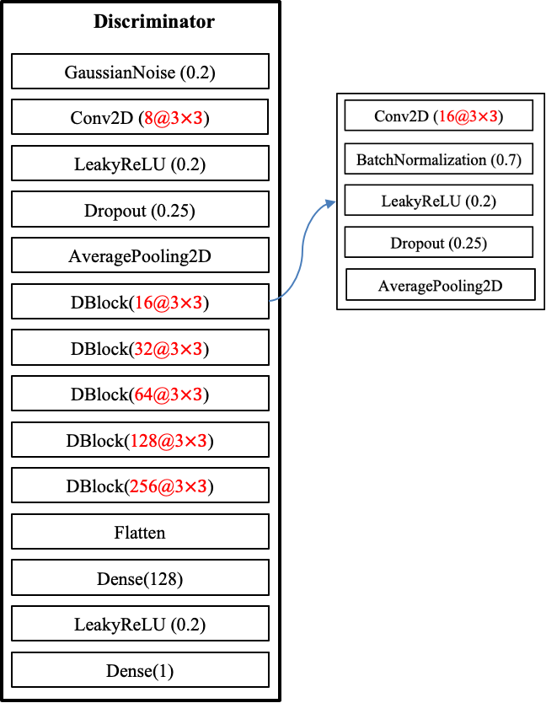
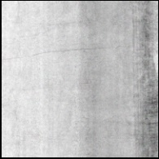
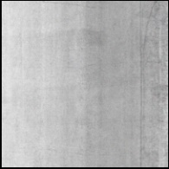
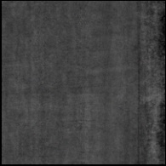
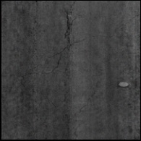
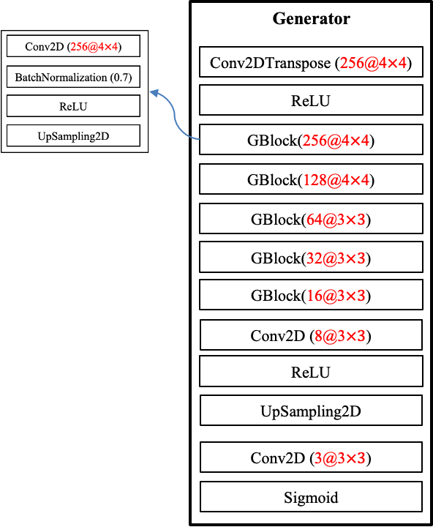
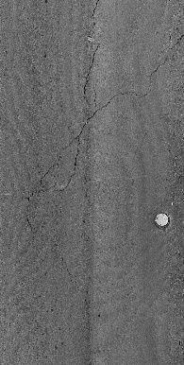
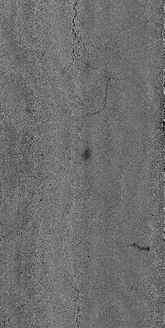
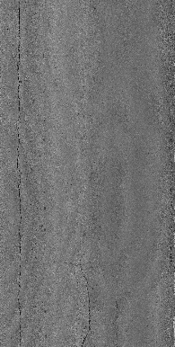
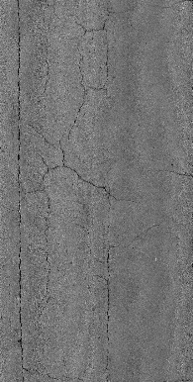
Random input vector (4096)
Update
model
Fake images
Real/fake
Real images
Update model

Slide 14
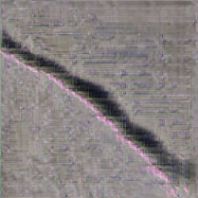
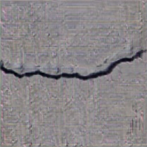
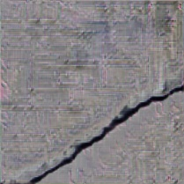
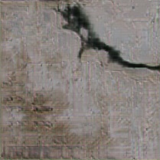
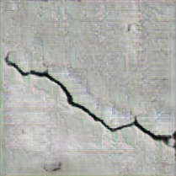
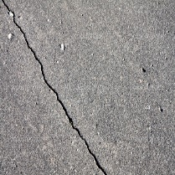
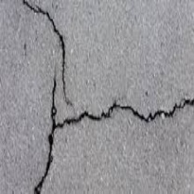
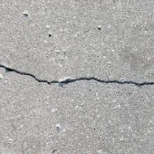
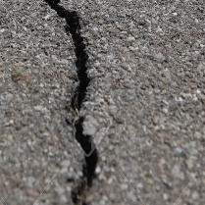
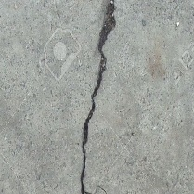
















Random input vector (4096)
Conv2DTranspose (4$×$4)
GaussianNoise (0.2)
ReLU
Fake images
Conv2D (3$×3$)
G-Block
G-Block(4$×$4)
LeakyReLU (0.2)
Conv2D (4$×$4)
G-Block(4$×$4)
Dropout (0.25)
BatchNormalization (0.7)
G-Block(3$×3$)
AveragePooling2D
ReLU
G-Block(3$×3$)
D-Block(3$×3$)
UpSampling2D
G-Block(3$×3$)
D-Block(3$×3$)
Conv2D(3$×3$)
D-Block(3$×3$)
D-Block
ReLU
D-Block(3$×3$)
Conv2D (3$×3$)
UpSampling2D
D-Block(3$×3$)
BatchNormalization (0.7)
Conv2D (3$×3$)
Flatten
LeakyReLU (0.2)
Sigmoid
Dense(128)
Dropout (0.25)
Real images
LeakyReLU (0.2)
AveragePooling2D
Dense(1)
Real/fake
Update model
Update model

Slide 15
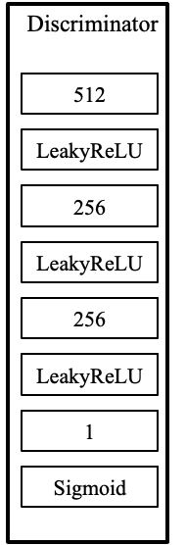
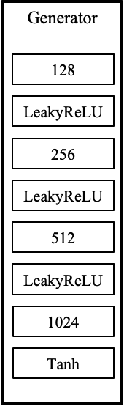
Random input vector
Fake images
Update
model
Real images
Real/fake
Update model

Slide 16
Discriminator
512
LeakyReLU
256
LeakyReLU
256
LeakyReLU
1
Sigmoid

Slide 17
class AttU_Net(nn.Module):
"""
Attention Unet implementation
Paper: https://arxiv.org/abs/1804.03999
"""
def __init__(self, img_ch=3, output_ch=1):
super(AttU_Net, self).__init__()
n1 = 64
filters = [n1, n1 * 2, n1 * 4, n1 * 8, n1 * 16]
self.Maxpool1 = nn.MaxPool2d(kernel_size=2, stride=2)
self.Maxpool2 = nn.MaxPool2d(kernel_size=2, stride=2)
self.Maxpool3 = nn.MaxPool2d(kernel_size=2, stride=2)
self.Maxpool4 = nn.MaxPool2d(kernel_size=2, stride=2)
self.Conv1 = conv_block(img_ch, filters[0])
self.Conv2 = conv_block(filters[0], filters[1])
self.Conv3 = conv_block(filters[1], filters[2])
self.Conv4 = conv_block(filters[2], filters[3])
self.Conv5 = conv_block(filters[3], filters[4])
self.Up5 = up_conv(filters[4], filters[3])
self.Att5 = Attention_block(F_g=filters[3], F_l=filters[3], F_int=filters[2])
self.Up_conv5 = conv_block(filters[4], filters[3])
self.Up4 = up_conv(filters[3], filters[2])
self.Att4 = Attention_block(F_g=filters[2], F_l=filters[2], F_int=filters[1])
self.Up_conv4 = conv_block(filters[3], filters[2])
self.Up3 = up_conv(filters[2], filters[1])
self.Att3 = Attention_block(F_g=filters[1], F_l=filters[1], F_int=filters[0])
self.Up_conv3 = conv_block(filters[2], filters[1])
self.Up2 = up_conv(filters[1], filters[0])
self.Att2 = Attention_block(F_g=filters[0], F_l=filters[0], F_int=32)
self.Up_conv2 = conv_block(filters[1], filters[0])
self.Conv = nn.Conv2d(filters[0], output_ch, kernel_size=1, stride=1, padding=0)
#self.active = torch.nn.Sigmoid()
def forward(self, x):
e1 = self.Conv1(x)
e2 = self.Maxpool1(e1)
e2 = self.Conv2(e2)
e3 = self.Maxpool2(e2)
e3 = self.Conv3(e3)
e4 = self.Maxpool3(e3)
e4 = self.Conv4(e4)
e5 = self.Maxpool4(e4)
e5 = self.Conv5(e5)
#print(x5.shape)
d5 = self.Up5(e5)
#print(d5.shape)
x4 = self.Att5(g=d5, x=e4)
d5 = torch.cat((x4, d5), dim=1)
d5 = self.Up_conv5(d5)
d4 = self.Up4(d5)
x3 = self.Att4(g=d4, x=e3)
d4 = torch.cat((x3, d4), dim=1)
d4 = self.Up_conv4(d4)
d3 = self.Up3(d4)
x2 = self.Att3(g=d3, x=e2)
d3 = torch.cat((x2, d3), dim=1)
d3 = self.Up_conv3(d3)
d2 = self.Up2(d3)
x1 = self.Att2(g=d2, x=e1)
d2 = torch.cat((x1, d2), dim=1)
d2 = self.Up_conv2(d2)
out = self.Conv(d2)
# out = self.active(out)
class Attention_block(nn.Module):
"""
Attention Block
"""
def __init__(self, F_g, F_l, F_int):
super(Attention_block, self).__init__()
self.W_g = nn.Sequential(
nn.Conv2d(F_l, F_int, kernel_size=1, stride=1, padding=0, bias=True),
nn.BatchNorm2d(F_int)
)
self.W_x = nn.Sequential(
nn.Conv2d(F_g, F_int, kernel_size=1, stride=1, padding=0, bias=True),
nn.BatchNorm2d(F_int)
)
self.psi = nn.Sequential(
nn.Conv2d(F_int, 1, kernel_size=1, stride=1, padding=0, bias=True),
nn.BatchNorm2d(1),
nn.Sigmoid()
)
self.relu = nn.ReLU(inplace=True)
def forward(self, g, x):
g1 = self.W_g(g)
x1 = self.W_x(x)
psi = self.relu(g1 + x1)
psi = self.psi(psi)
out = x * psi
return out

Slide 18
class Attention_block(nn.Module):
"""
Attention Block
"""
def __init__(self, F_g, F_l, F_int):
super(Attention_block, self).__init__()
self.W_g = nn.Sequential(
nn.Conv2d(F_l, F_int, kernel_size=1, stride=1, padding=0, bias=True),
nn.BatchNorm2d(F_int)
)
self.W_x = nn.Sequential(
nn.Conv2d(F_g, F_int, kernel_size=1, stride=1, padding=0, bias=True),
nn.BatchNorm2d(F_int)
)
self.psi = nn.Sequential(
nn.Conv2d(F_int, 1, kernel_size=1, stride=1, padding=0, bias=True),
nn.BatchNorm2d(1),
nn.Sigmoid()
)
self.relu = nn.ReLU(inplace=True)
def forward(self, g, x):
g1 = self.W_g(g)
x1 = self.W_x(x)
psi = self.relu(g1 + x1)
psi = self.psi(psi)
out = x * psi
return out
g
x
Conv2D (g, t, 1, 1)
Conv2D (x, t, 1, 1)
BatchNormalization
BatchNormalization
+
ReLU
Conv2D (t, 1, 1, 1)
BatchNormalization
Sigmoid
+

Slide 19



class Attention_block(nn.Module):
"""
Attention Block
"""
def __init__(self, F_g, F_l, F_int):
super(Attention_block, self).__init__()
self.W_g = nn.Sequential(
nn.Conv2d(F_l, F_int, kernel_size=1, stride=1, padding=0, bias=True),
nn.BatchNorm2d(F_int)
)
self.W_x = nn.Sequential(
nn.Conv2d(F_g, F_int, kernel_size=1, stride=1, padding=0, bias=True),
nn.BatchNorm2d(F_int)
)
self.psi = nn.Sequential(
nn.Conv2d(F_int, 1, kernel_size=1, stride=1, padding=0, bias=True),
nn.BatchNorm2d(1),
nn.Sigmoid()
)
self.relu = nn.ReLU(inplace=True)
def forward(self, g, x):
g1 = self.W_g(g)
x1 = self.W_x(x)
psi = self.relu(g1 + x1)
psi = self.psi(psi)
out = x * psi
return out
g
x
Conv2D ($1×1$)
Conv2D ($1×1$)
BatchNormalization
BatchNormalization
+
ReLU
Conv2D ($1×1$)
BatchNormalization
Sigmoid
+

Slide 20
























class AttU_Net(nn.Module):
"""
Attention Unet implementation
Paper: https://arxiv.org/abs/1804.03999
"""
def __init__(self, img_ch=3, output_ch=1):
super(AttU_Net, self).__init__()
n1 = 64
filters = [n1, n1 * 2, n1 * 4, n1 * 8, n1 * 16]
self.Maxpool1 = nn.MaxPool2d(kernel_size=2, stride=2)
self.Maxpool2 = nn.MaxPool2d(kernel_size=2, stride=2)
self.Maxpool3 = nn.MaxPool2d(kernel_size=2, stride=2)
self.Maxpool4 = nn.MaxPool2d(kernel_size=2, stride=2)
self.Conv1 = conv_block(img_ch, filters[0])
self.Conv2 = conv_block(filters[0], filters[1])
self.Conv3 = conv_block(filters[1], filters[2])
self.Conv4 = conv_block(filters[2], filters[3])
self.Conv5 = conv_block(filters[3], filters[4])
self.Up5 = up_conv(filters[4], filters[3])
self.Att5 = Attention_block(F_g=filters[3], F_l=filters[3], F_int=filters[2])
self.Up_conv5 = conv_block(filters[4], filters[3])
self.Up4 = up_conv(filters[3], filters[2])
self.Att4 = Attention_block(F_g=filters[2], F_l=filters[2], F_int=filters[1])
self.Up_conv4 = conv_block(filters[3], filters[2])
self.Up3 = up_conv(filters[2], filters[1])
self.Att3 = Attention_block(F_g=filters[1], F_l=filters[1], F_int=filters[0])
self.Up_conv3 = conv_block(filters[2], filters[1])
self.Up2 = up_conv(filters[1], filters[0])
self.Att2 = Attention_block(F_g=filters[0], F_l=filters[0], F_int=32)
self.Up_conv2 = conv_block(filters[1], filters[0])
self.Conv = nn.Conv2d(filters[0], output_ch, kernel_size=1, stride=1, padding=0)
#self.active = torch.nn.Sigmoid()
def forward(self, x):
e1 = self.Conv1(x)
e2 = self.Maxpool1(e1)
e2 = self.Conv2(e2)
e3 = self.Maxpool2(e2)
e3 = self.Conv3(e3)
e4 = self.Maxpool3(e3)
e4 = self.Conv4(e4)
e5 = self.Maxpool4(e4)
e5 = self.Conv5(e5)
#print(x5.shape)
d5 = self.Up5(e5)
#print(d5.shape)
x4 = self.Att5(g=d5, x=e4)
d5 = torch.cat((x4, d5), dim=1)
d5 = self.Up_conv5(d5)
d4 = self.Up4(d5)
x3 = self.Att4(g=d4, x=e3)
d4 = torch.cat((x3, d4), dim=1)
d4 = self.Up_conv4(d4)
d3 = self.Up3(d4)
x2 = self.Att3(g=d3, x=e2)
d3 = torch.cat((x2, d3), dim=1)
d3 = self.Up_conv3(d3)
d2 = self.Up2(d3)
x1 = self.Att2(g=d2, x=e1)
d2 = torch.cat((x1, d2), dim=1)
d2 = self.Up_conv2(d2)
out = self.Conv(d2)
# out = self.active(out)
class conv_block(nn.Module):
"""
Convolution Block
"""
def __init__(self, in_ch, out_ch):
super(conv_block, self).__init__()
self.conv = nn.Sequential(
nn.Conv2d(in_ch, out_ch, kernel_size=3, stride=1, padding=1, bias=True),
nn.BatchNorm2d(out_ch),
nn.ReLU(inplace=True),
nn.Conv2d(out_ch, out_ch, kernel_size=3, stride=1, padding=1, bias=True),
nn.BatchNorm2d(out_ch),
nn.ReLU(inplace=True))
def forward(self, x):
x = self.conv(x)
return x
$$256×32×32×3$$
$$512×32×32×3$$
$$64×128×128×3$$
$$128×128×128×3$$
$$512×16×16×3$$
$$1×256×256×3$$
$$64×256×256×3$$
$$128×64×64×3$$
$$256×64×64×3$$
$$128×128×128×3$$
$$256×64×64×3$$
$$128×128×128×3$$
$$128×128×128×3$$
$$1024×16×16×3$$
$$512×32×32×3$$
$$512×32×32×3$$
$$256×64×64×3$$
$$256×64×64×3$$
$$512×32×32×3$$
class up_conv(nn.Module):
"""
Up Convolution Block
"""
def __init__(self, in_ch, out_ch):
super(up_conv, self).__init__()
self.up = nn.Sequential(
nn.Upsample(scale_factor=2),
nn.Conv2d(in_ch, out_ch, kernel_size=3, stride=1, padding=1, bias=True),
nn.BatchNorm2d(out_ch),
nn.ReLU(inplace=True)
)
def forward(self, x):
x = self.up(x)
return x
$$1×256×256×3$$
$$64×256×256×3$$
$$64×256×256×3$$
$$64×256×256×3$$
Conv ($3×3$)
ReLU
MaxPool(2)
Upsample(2)

Slide 21

























$$64×256×256×3$$
$$N_{c}×256×256×3$$
$$64×256×256×3$$
$$64×256×256×3$$
$$1×256×256×3$$
$$64×256×256×3$$
$$64×128×128×3$$
$$128×128×128×3$$
$$128×128×128×3$$
$$128×128×128×3$$
$$128×128×128×3$$
$$128×64×64×3$$
$$256×64×64×3$$
$$256×64×64×3$$
$$256×64×64×3$$
$$256×64×64×3$$
$$256×32×32×3$$
$$512×32×32×3$$
$$512×32×32×3$$
$$512×32×32×3$$
$$512×32×32×3$$
$$1024×16×16×3$$
$$512×16×16×3$$
Conv ($3×3$) + ReLU + Conv (3$×3$) + ReLU
MaxPool (2)
Upsample (2) + Conv($3×3$) + ReLU
Attention module

Slide 22
























$$64×256×256×3$$
$$1×256×256×3$$
$$64×256×256×3$$
$$N_{c}×256×256×3$$
$$64×256×256×3$$
$$64×256×256×3$$
$$64×128×128×3$$
$$128×128×128×3$$
$$128×128×128×3$$
$$128×128×128×3$$
$$128×128×128×3$$
$$256×64×64×3$$
$$256×64×64×3$$
$$128×64×64×3$$
$$256×64×64×3$$
$$256×64×64×3$$
$$512×32×32×3$$
$$512×32×32×3$$
$$256×32×32×3$$
$$512×32×32×3$$
$$512×32×32×3$$
Conv ($3×3$) + ReLU + Conv (3$×3$) + ReLU
$$1024×16×16×3$$
$$512×16×16×3$$
MaxPool (2)
Upsample (2) + Conv($3×3$) + ReLU
Conv ($1×1$)
Attention module

Slide 23


























$$1×256×256×3$$
$$64×256×256×3$$
$$64×128×128×3$$
$$128×128×128×3$$
$$128×64×64×3$$
$$512×32×32×3$$
$$512×32×32×3$$
$$512×32×32×3$$
$$256×64×64×3$$
$$128×128×128×3$$
$$64×256×256×3$$
$$64×256×256×3$$
$$64×256×256×3$$
$$256×64×64×3$$
$$N_{c}×256×256×3$$
$$256×32×32×3$$
$$512×32×32×3$$
$$512×16×16×3$$
$$1024×16×16×3$$
$$256×64×64×3$$
$$256×64×64×3$$
$$128×128×128×3$$
$$128×128×128×3$$
Conv ($3×3$) + ReLU + Conv (3$×3$) + ReLU
MaxPool (2)
Upsample (2) + Conv($3×3$) + ReLU
Conv ($1×1$)
Attention module

Slide 24






class BottleNeck(nn.Module):
def __init__(self, in_channels, out_channels=None, activation=None, dilation=1, downsample=False, proj_ratio=4,
upsample=False, asymetric=False, regularize=True, p_drop=None, use_prelu=True):
super(BottleNeck, self).__init__()
self.pad = 0
self.upsample = upsample
self.downsample = downsample
if out_channels is None: out_channels = in_channels
else: self.pad = out_channels - in_channels
if regularize: assert p_drop is not None
if downsample: assert not upsample
elif upsample: assert not downsample
inter_channels = in_channels//proj_ratio
# Main
if upsample:
self.spatil_conv = nn.Conv2d(in_channels, out_channels, 1, bias=False)
self.bn_up = nn.BatchNorm2d(out_channels)
self.unpool = nn.MaxUnpool2d(kernel_size=2, stride=2)
elif downsample:
self.pool = nn.MaxPool2d(kernel_size=2, stride=2, return_indices=True)
# Bottleneck
if downsample:
self.conv1 = nn.Conv2d(in_channels, inter_channels, 2, stride=2, bias=False)
else:
self.conv1 = nn.Conv2d(in_channels, inter_channels, 1, bias=False)
self.bn1 = nn.BatchNorm2d(inter_channels)
self.prelu1 = nn.PReLU() if use_prelu else nn.ReLU(inplace=True)
if asymetric:
self.conv2 = nn.Sequential(
nn.Conv2d(inter_channels, inter_channels, kernel_size=(1,5), padding=(0,2)),
nn.BatchNorm2d(inter_channels),
nn.PReLU() if use_prelu else nn.ReLU(inplace=True),
nn.Conv2d(inter_channels, inter_channels, kernel_size=(5,1), padding=(2,0)),
)
elif upsample:
self.conv2 = nn.ConvTranspose2d(inter_channels, inter_channels, kernel_size=3, padding=1,
output_padding=1, stride=2, bias=False)
else:
self.conv2 = nn.Conv2d(inter_channels, inter_channels, 3, padding=dilation, dilation=dilation, bias=False)
self.bn2 = nn.BatchNorm2d(inter_channels)
self.prelu2 = nn.PReLU() if use_prelu else nn.ReLU(inplace=True)
self.conv3 = nn.Conv2d(inter_channels, out_channels, 1, bias=False)
self.bn3 = nn.BatchNorm2d(out_channels)
self.prelu3 = nn.PReLU() if use_prelu else nn.ReLU(inplace=True)
self.regularizer = nn.Dropout2d(p_drop) if regularize else None
self.prelu_out = nn.PReLU() if use_prelu else nn.ReLU(inplace=True)
def forward(self, x, indices=None, output_size=None):
# Main branch
identity = x
if self.upsample:
assert (indices is not None) and (output_size is not None)
identity = self.bn_up(self.spatil_conv(identity))
if identity.size() != indices.size():
pad = (indices.size(3) - identity.size(3), 0, indices.size(2) - identity.size(2), 0)
identity = F.pad(identity, pad, "constant", 0)
identity = self.unpool(identity, indices=indices)#, output_size=output_size)
elif self.downsample:
identity, idx = self.pool(identity)
'''
if self.pad > 0:
if self.pad % 2 == 0 : pad = (0, 0, 0, 0, self.pad//2, self.pad//2)
else: pad = (0, 0, 0, 0, self.pad//2, self.pad//2+1)
identity = F.pad(identity, pad, "constant", 0)
'''
if self.pad > 0:
extras = torch.zeros((identity.size(0), self.pad, identity.size(2), identity.size(3)))
if torch.cuda.is_available(): extras = extras.cuda(0)
identity = torch.cat((identity, extras), dim = 1)
# Bottleneck
x = self.conv1(x)
x = self.bn1(x)
x = self.prelu1(x)
x = self.conv2(x)
x = self.bn2(x)
x = self.prelu2(x)
x = self.conv3(x)
x = self.bn3(x)
x = self.prelu3(x)
if self.regularizer is not None:
x = self.regularizer(x)
# When the input dim is odd, we might have a mismatch of one pixel
if identity.size() != x.size():
pad = (identity.size(3) - x.size(3), 0, identity.size(2) - x.size(2), 0)
x = F.pad(x, pad, "constant", 0)
x += identity
x = self.prelu_out(x)
if self.downsample:
return x, idx
return x
input
Conv2D (3$×3$)
MaxPool
Conv2D (1$×1$)
Conv2D (1$×5$)
BatchNorm2d
BatchNorm2d
+
Prelu
Prelu
Conv2D (5$×1$)
Conv2D (3$×3$)
BatchNorm2d
BatchNorm2d
Prelu
Prelu
Conv2D (1$×1$)
BatchNorm2d
Prelu
x = self.conv1(x)
x = self.bn1(x)
x = self.prelu1(x)
x = self.conv2(x)
x = self.bn2(x)
x = self.prelu2(x)
x = self.conv3(x)
x = self.bn3(x)
x = self.prelu3(x)

Slide 25





Ext_conv2
Ext_conv1
Ext_conv3
Conv2D(1$×1$)
Conv2D(1$×1$)
Conv2D(1$×1$)
BatchNormalization
BatchNormalization
BatchNormalization
ReLU
ReLU
ReLU
Ext_conv2 if asymmetric
Conv2D(3$×1$)
Ext_conv1
BatchNormalization
Ext_conv2
ReLU
Ext_conv3
Conv2D(1$×3$)
BatchNormalization
Dropout (0)
+
ReLU

Slide 26
Ext_conv2
Ext_conv1
Ext_conv3
Conv2D(1$×1$)
Conv2D(1$×1$)
Conv2D(1$×1$)
BatchNormalization
BatchNormalization
BatchNormalization
ReLU
ReLU
ReLU
Ext_conv2 if asymmetric
Conv2D(3$×1$)
Ext_conv1
BatchNormalization
Ext_conv2
ReLU
Ext_conv3
Conv2D(1$×3$)
BatchNormalization
Dropout (0)
+
ReLU

Slide 27




















































Conv2D ($3×3$) + ReLU + Conv (3$×3$) + ReLU
$$1×256×256×3$$
Upsample (2) + Conv($3×3$) + ReLU
$$64×256×256×3$$
$$64×128×128×3$$
$$128×128×128×3$$
$$128×64×64×3$$
$$512×32×32×3$$
$$512×32×32×3$$
$$512×32×32×3$$
$$256×64×64×3$$
$$128×128×128×3$$
$$64×256×256×3$$
$$64×256×256×3$$
$$64×256×256×3$$
$$256×64×64×3$$
$$N_{c}×256×256×3$$
$$256×32×32×3$$
$$512×32×32×3$$
$$512×16×16×3$$
$$1024×16×16×3$$
$$256×64×64×3$$
$$256×64×64×3$$
$$128×128×128×3$$
$$128×128×128×3$$
$$15×128×128×1$$
$$1×256×256×1$$
$$1×128×128×1$$
$$16×128×128×1$$
$$64×64×64×1$$
$$64×64×64×1$$
$$64×64×64×1$$
$$64×64×64×1$$
$$128×32×32×1$$
$$128×32×32×1$$
$$128×32×32×1$$
$$128×32×32×1$$
$$64×64×64×1$$
$$128×32×32×1$$
$$128×32×32×1$$
$$64×64×64×1$$
$$128×32×32×1$$
$$128×32×32×1$$
$$64×64×64×1$$
$$16×128×128×1$$
$$16×128×128×1$$
$$128×32×32×1$$
Prelu
Conv2D (1$×1$)
BatchNorm2d(2)
BatchNorm2d
Conv2D ($3×3$)
Prelu
Maxpool(2)
Conv2D (3$×3$)
BatchNorm2d
Conv2D (1$×1$)
Conv2D (1$×1$)
Prelu
Conv2D (1$×1$)
BatchNorm2d
Prelu

Slide 28

























+
Conv2D (1$×1$)
$$15×128×128×1$$
+
$$1×256×256×1$$
$$1×128×128×1$$
$$16×128×128×1$$
$$64×64×64×1$$
$$64×64×64×1$$
$$64×64×64×1$$
+
$$64×64×64×1$$
$$64×64×64×1$$
$$128×32×32×1$$
$$128×32×32×1$$
+
$$64×64×64×1$$
Conv2D (3$×3$)
$$128×32×32×1$$
$$128×32×32×1$$
$$64×64×64×1$$
$$128×32×32×1$$
$$128×32×32×1$$
$$128×32×32×1$$
$$128×32×32×1$$
$$64×64×64×1$$
$$64×64×64×1$$
ConvTranspose2d (1$×1$)
ConvTranspose2d (2$×2$)
$$128×32×32×1$$
$$64×64×64×1$$
$$1×256×256×1$$
Prelu
Conv2D (1$×1$)
BatchNorm2d(2)
BatchNorm2d
Conv2D ($3×3$)
Prelu
Maxpool(2)
Conv2D (3$×3$)
BatchNorm2d
Conv2D (1$×1$)
Conv2D (1$×1$)
Prelu
Conv2D (1$×1$)
BatchNorm2d
$$16×128×128×1$$
$$16×128×128×1$$
Prelu

Slide 29
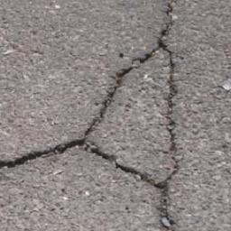



















Conv2D (1$×1$)
$$15×128×128×1$$
+
$$1×256×256×1$$
$$1×128×128×1$$
$$16×128×128×1$$
$$64×64×64×1$$
$$64×64×64×1$$
$$64×64×64×1$$
+
$$64×64×64×1$$
$$64×64×64×1$$
$$128×32×32×1$$
$$128×32×32×1$$
+
$$64×64×64×1$$
Conv2D (3$×3$)
$$128×32×32×1$$
$$128×32×32×1$$
$$64×64×64×1$$
$$128×32×32×1$$
$$128×32×32×1$$
$$128×32×32×1$$
$$128×32×32×1$$
$$64×64×64×1$$
$$64×64×64×1$$
ConvTranspose2d (1$×1$)
ConvTranspose2d (2$×2$)
$$128×32×32×1$$
$$64×64×64×1$$
$$1×256×256×1$$
Conv2D (3$×3$)
MaxPool2d(2)
BatchNorm (0.7)
Conv2D (1$×1$)
BatchNorm2d
Prelu
ConvTranspose2d (2$×2$)
Prelu
ESC-Block(4$×$4)
MaxPool2d(2)
Conv2D (3$×3$)
+
ConvTranspose2d (1$×1$)
ESC-Block(4$×$4)
BatchNorm2d
ESC-Block(4$×$4)
Conv2D (3$×3$)
Prelu
ESC-Block(4$×$4)
ESC-Block(4$×$4)
Conv2D (1$×1$)
ESC-Block(4$×$4)
BatchNorm2d
ESC-Block(4$×$4)
Prelu
ESC-Block(4$×$4)
MaxPool2d(2)
ESC-Block(4$×$4)
Conv2D (1$×1$)
ESC-Block(4$×$4)
ESC-Block(4$×$4)
ESC-Block(4$×$4)
ESC-Block(4$×$4)
ESC-Block(4$×$4)
ESC-Block(4$×$4)

Slide 30
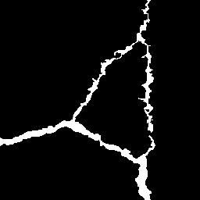






























MaxPool2d(2)
MaxPool2d(2)
Conv2D (1$×1$)
MaxunPool2d(2)
Conv2D (3$×3$)
$×$4
ESC-Block(1$×1, 0.01$)
ESC-Block(1$×1, 0.01$)
ESC-Block(2$×2, 0.1$)
Conv2D (1$×1$)
ESC-Block(1$×1, 0.01$)
ESC-Block(1$×1, 0.1$)
PReLU(1)
Conv2D (1$×1$)
ESC-Block(2$×2, 0.01$)
ESC-Block(1$×1, 0.01$)
Conv2D (1$×5$)
+
ESC-Block(1$×1, 0.1$)
PReLU(1)
Conv2D (5$×1$)
PReLU(1)
PReLU(1)
Conv2D (1$×5$)
PReLU(1)
Conv2D (5$×1$)
Conv2D (1$×1$)
PReLU(1)
ConvTranspose2d (2$×2$)
PReLU(1)
ESC-Block(1$×1, 0.1$)
Conv2D (1$×1$)
ConvTranspose2d (2$×2$)
Dropout (0.01)
ESC-Block(1$×1, 0.1$)
MaxPool2d(2)
PReLU(1)
ESC-Block(1$×1, 0.1$)
PReLU(1)
Dropout (0.01)
PReLU(16)
PReLU(1)
ESC-Block(1$×1, 0.1$)
ESC-Block(1$×1, 0.1$)
ESC-Block(1$×1, 0.1$)
ESC-Block(1$×1, 0.1$)
Conv2D (3$×3$)
ReLU
ReLU
Conv2D (1$×1$)
Conv2D (1$×1$)
BatchNorm2d
PReLU(1)
PReLU(0.01)
Conv2D (3$×3$)
Conv2D (3$×3$)
PReLU(1)
BatchNorm2d
Conv2D (1$×1$)
PReLU(0.01)
PReLU(1)
Conv2D (1$×1$)
Dropout (0.01)
BatchNorm2d
PReLU
Dropout (0.01)

Slide 31
























Conv2D (3$×3$)
MaxPool2d(2)
c
PReLU(16)
ESC-Block(2$×2, 0.01$)
MaxPool2d(2)
+
ESC-Block(1$×1, 0.01$)
$×$3
ESC-Block(1$×1, 0.01$)
MaxPool2d(2)
+
ESC-Block(2$×2, 0.1$)
ESC-Block(1$×1, 0.1$)
$×$2
Conv2D (1$×1$)
PReLU(1)
Conv2D (1$×5$)
PReLU(1)
Conv2D (5$×1$)
PReLU(1)
$×$2
Conv2D (1$×1$)
PReLU(1)
Dropout (0.01)
PReLU(1)
ESC-Block(1$×1, 0.1$)
+
ESC-Block(1$×1, 0.1$)
Conv2D (1$×1$)
MaxunPool2d(2)
+
ESC-Block(1$×1, 0.1$)
ESC-Block(1$×1, 0.1$)
Conv2D (1$×1$)
Conv2D (1$×1$)
PReLU(1)
Conv2D (3$×3$)
PReLU(1)
Conv2D (3$×3$)
ReLU
PReLU(1)
ConvTranspose2d (2$×2$)
Conv2D (1$×5$)
PReLU(1)
Conv2D (1$×1$)
ReLU
Conv2D (5$×1$)
PReLU(1)
ConvTranspose2d (2$×2$)
PReLU(1)
Dropout (0.01)
Conv2D (1$×1$)
PReLU(1)
Conv2D (1$×1$)
Dropout (0.01)
BatchNorm2d
PReLU(1)
$×$2
PReLU(0.01)
ESC-Block(1$×1, 0.1$)
Conv2D (3$×3$)
BatchNorm2d
PReLU(0.01)
Conv2D (1$×1$)
BatchNorm2d
PReLU
Dropout (0.01)

Slide 32

















$×$2
MaxPool2d(2)
MaxPool2d(2)
MaxPool2d(2)
$×$3
MaxunPool2d(2)
$×$2
Conv2D (1$×1$)
c
+
+
+
PReLU(16)
ConvTranspose2d (2$×2$)
Conv2D (3$×3$)
ReLU
ConvTranspose2d (2$×2$)
ESC-Block(1$×1, 0.1$)
ReLU
ESC-Block(1$×1, 0.01$)
ESC-Block(2$×2, 0.1$)
PReLU(1)
Conv2D (5$×1$)
ESC-Block(1$×1, 0.1$)
ESC-Block(1$×1, 0.1$)
Conv2D (1$×1$)
PReLU(1)
Conv2D (1$×5$)
Conv2D (1$×1$)
ESC-Block(1$×1, 0.1$)
PReLU(1)
PReLU(1)
PReLU(1)
Dropout (0.01)
Conv2D (3$×3$)
ESC-Block(2$×2, 0.01$)
ESC-Block(1$×1, 0.01$)
ESC-Block(1$×1, 0.1$)
ESC-Block
Conv2D (1$×1$)
c
: concatenate
PReLU(1)
Conv2D (3$×3$)
+
: add
PReLU(1)
: repeat two times
Conv2D (1$×1$)
$×$2
$×$3
: repeat three times
PReLU(1)
Dropout (0.01)

Slide 33
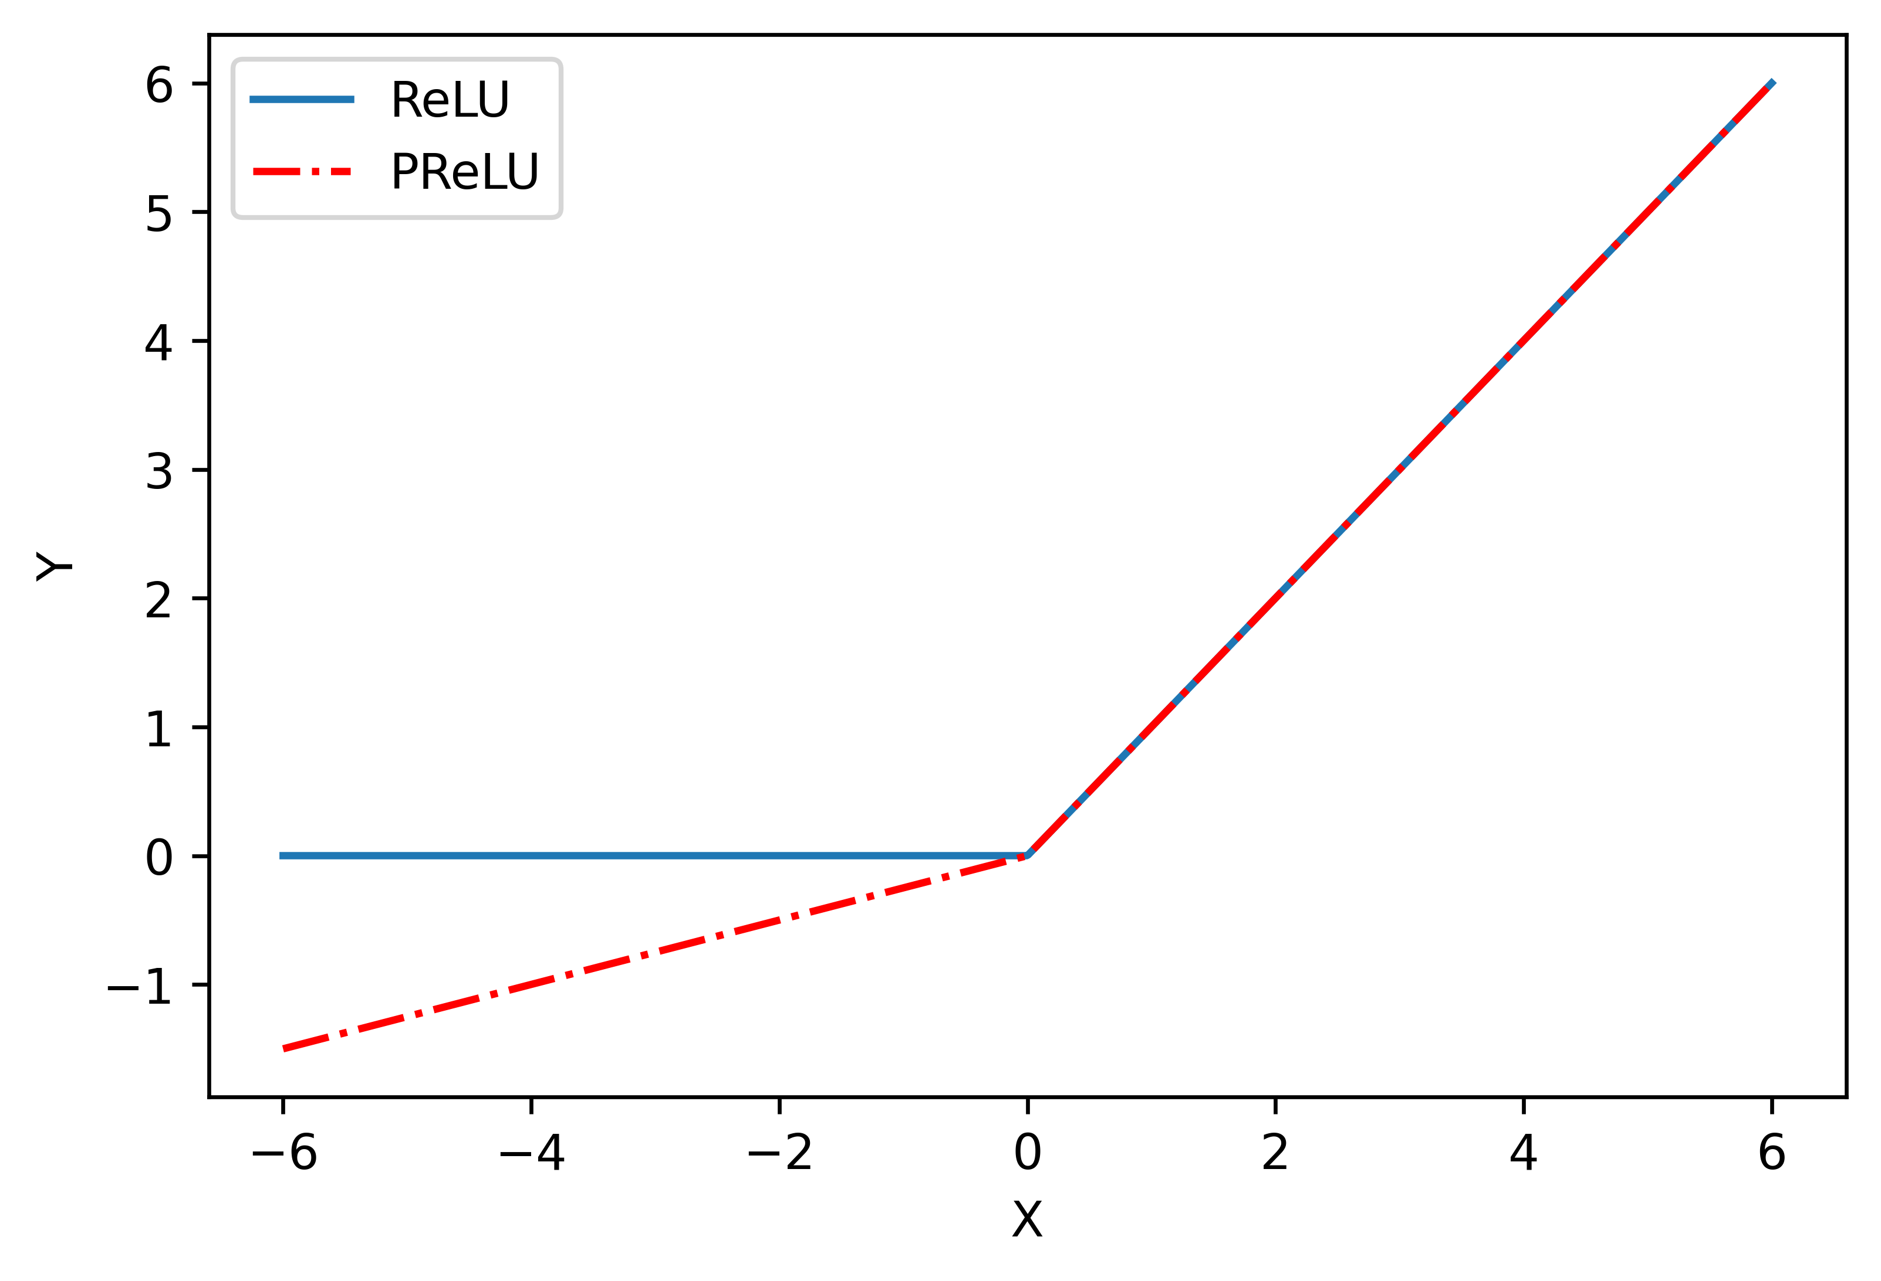


(a)
$×$2
MaxPool2d(2)
MaxPool2d(2)
MaxPool2d(2)
$×$3
MaxunPool2d(2)
$×$2
Conv2D (1$×1$)
c
+
+
+
PReLU(16)
ConvTranspose2d (2$×2$)
Conv2D (3$×3$)
PReLU(1)
ConvTranspose2d (2$×2$)
ESC-Block(1$×1, 0.1$)
PReLU(1)
ESC-Block(1$×1, 0.01$)
ESC-Block(2$×2, 0.1$)
PReLU(1)
Conv2D (5$×1$)
ESC-Block(1$×1, 0.1$)
ESC-Block(1$×1, 0.1$)
Conv2D (1$×1$)
PReLU(1)
Conv2D (1$×5$)
Conv2D (1$×1$)
ESC-Block(1$×1, 0.1$)
PReLU(1)
PReLU(1)
PReLU(1)
Dropout (0.01)
Conv2D (3$×3$)
ESC-Block(2$×2, 0.01$)
ESC-Block(1$×1, 0.01$)
ESC-Block(1$×1, 0.1$)
(b)
(c)
ECS-Block
c
: concatenate
Conv2D (1$×1$)
+
: summation
PReLU(1)
Conv2D (3$×3$)
$×$2
: repeat two times
PReLU(1)
$×$3
: repeat three times
Conv2D (1$×1$)
PReLU(1)
Dropout (0.01)

Slide 34
Random input vector (4096)
Conv2DTranspose (4$×$4)
GaussianNoise (0.2)
ReLU
Fake images
Conv2D (3$×3$)
G-Block
G-Block(4$×$4)
LeakyReLU (0.2)
Conv2D (4$×$4)
G-Block(4$×$4)
Dropout (0.25)
BatchNormalization (0.7)
G-Block(3$×3$)
AveragePooling2D
ReLU
G-Block(3$×3$)
D-Block(3$×3$)
UpSampling2D
G-Block(3$×3$)
D-Block(3$×3$)
Conv2D(3$×3$)
D-Block(3$×3$)
D-Block
ReLU
D-Block(3$×3$)
Conv2D (3$×3$)
UpSampling2D
D-Block(3$×3$)
BatchNormalization (0.7)
Conv2D (3$×3$)
Flatten
LeakyReLU (0.2)
Sigmoid
Dense(128)
Dropout (0.25)
Real images
LeakyReLU (0.2)
AveragePooling2D
Dense(1)
Real/fake
Update model
Update model

Slide 35
Dataset
Training set
Augmentation
Testing set
Evaluate
Model
+
+
Deep Learning Models
Preprocess
LRASPP
Evaluate
DeepLabv3
FCN
Accuracy
Efficiency
Enet
Unet
ECSNet
DeepCrack

Slide 36
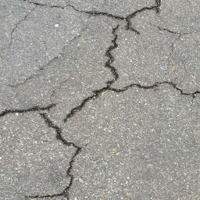
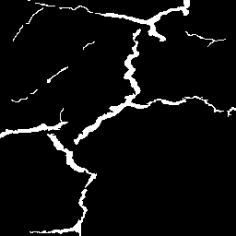
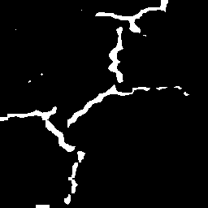
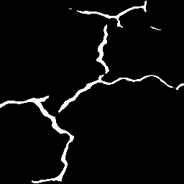
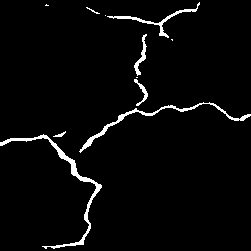


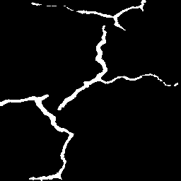
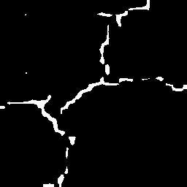
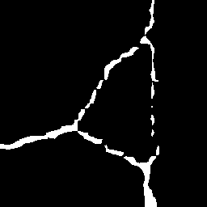
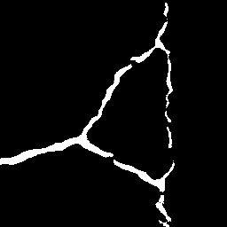
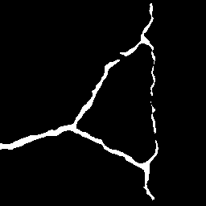
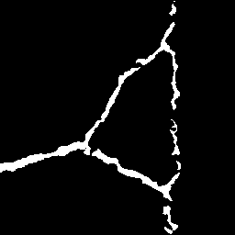
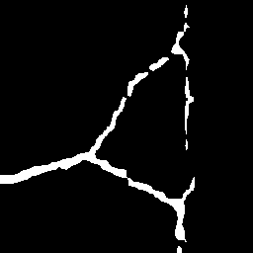
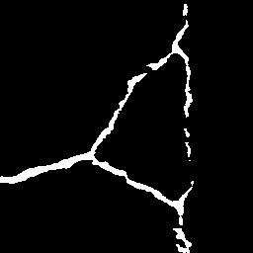
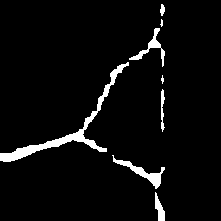
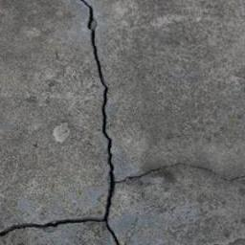
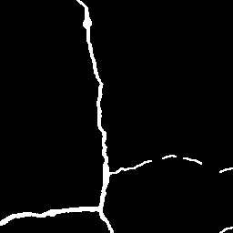
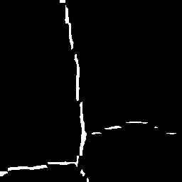
























image
GT
FCN
ESCNet
ESCNet-m
Deepcrack
deeplabv3
enet
lraspp

Slide 37









image
GT
FCN
ESCNet
ESCNet-m
Deepcrack
deeplabv3
enet
lraspp

Slide 38
image
GT
FCN
Deepcrack
deeplabv3
enet
lraspp
ESCNet
(a)
(b)
(c)
(d)
(e)
(f)
(g)
(h)

Slide 39
image
GT
Deepcrack
FCN
ESCNet
enet
deeplabv3
lraspp
(a)
(b)
(c)
(d)
(e)
(f)
(g)
(h)

Slide 40
(a)
(b)
(c)
(d)
(e)
(f)
(g)
(h)

Slide 41
(a)
(b)
(c)
(d)
(e)
(f)
(g)
(h)
(i)

Slide 42









image
GT
FCN
ESCNet
ESCNet-m
Deepcrack
deeplabv3
enet
lraspp

Slide 43
(a)
(b)
(c)
(d)
(e)
(f)
(g)
(h)
(i)

