Slide 1
Question Bank Project Figures

Slide 2
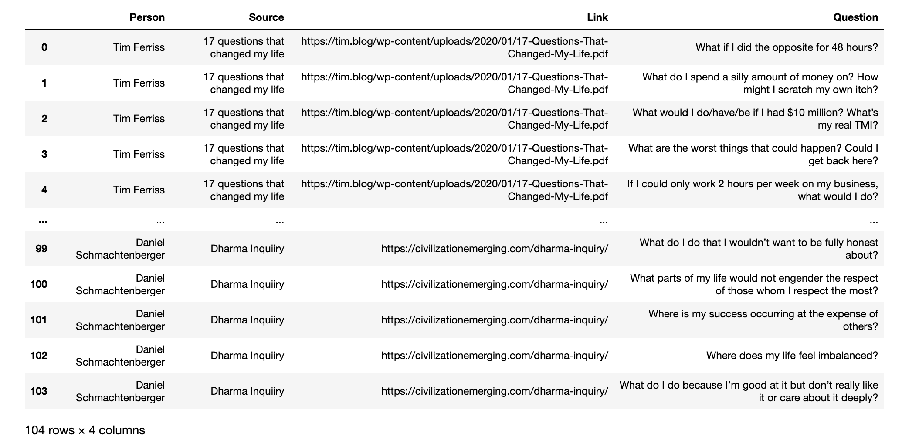
What the input data look like.

Slide 3
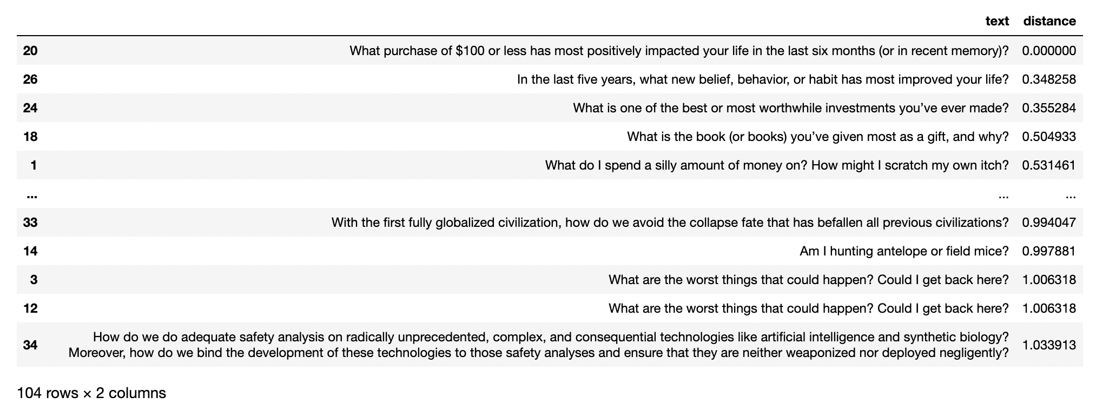
Example questions and their cosine distance from the top question

Slide 4
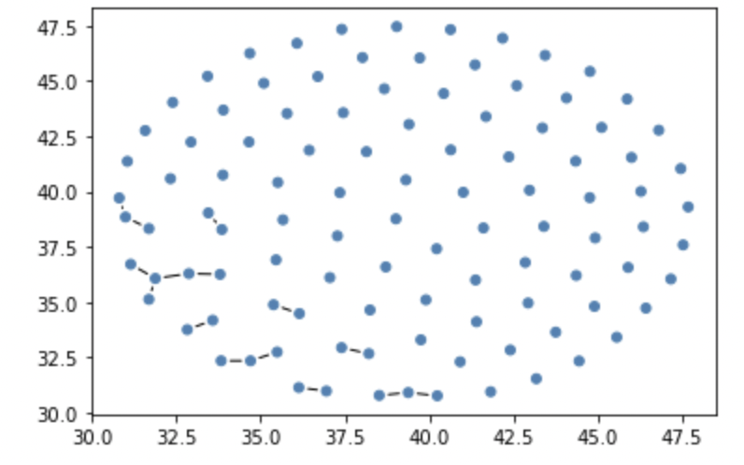
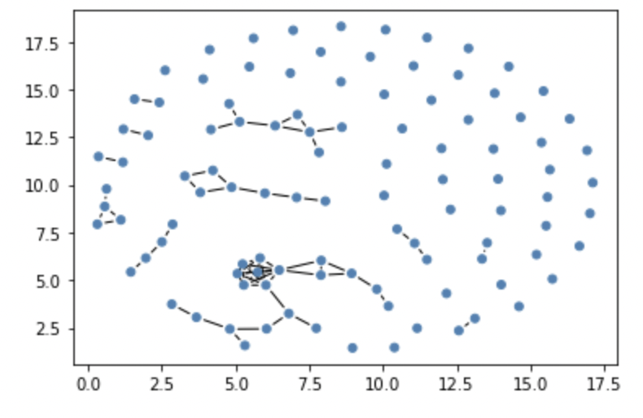
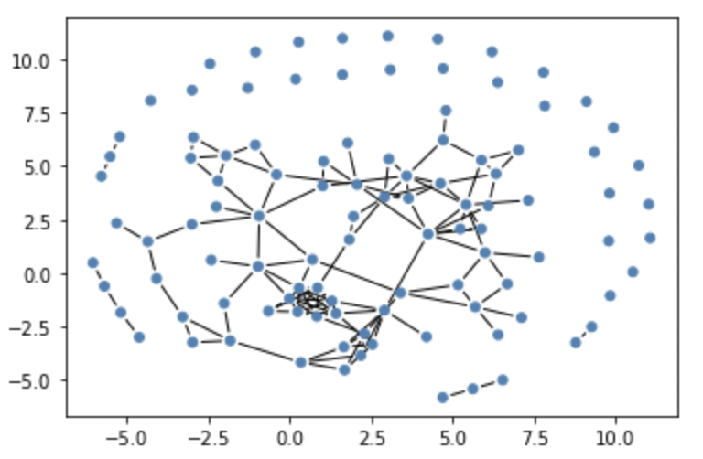
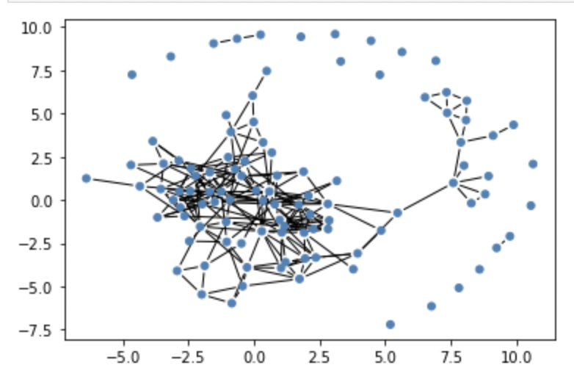
Distance < 0.4
Distance < 0.5
Distance < 0.55
Distance < 0.6
Network of questions. Each question is a point. A link is made if
the distance between two questions are less than the cutoff.

Slide 5
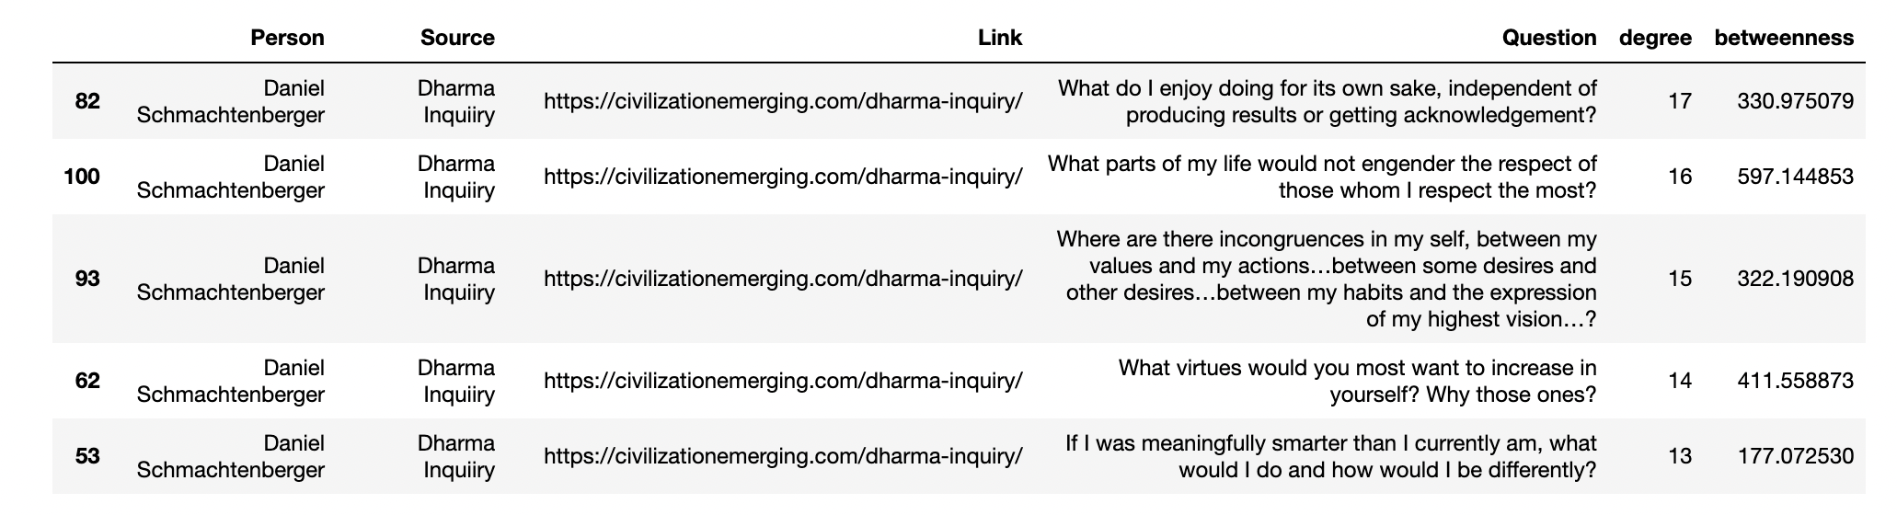
Top questions in the 0.6 (hairball) cutoff. These questions are most central to the
dataset at large. Degree means number of friends the question has.

Slide 6
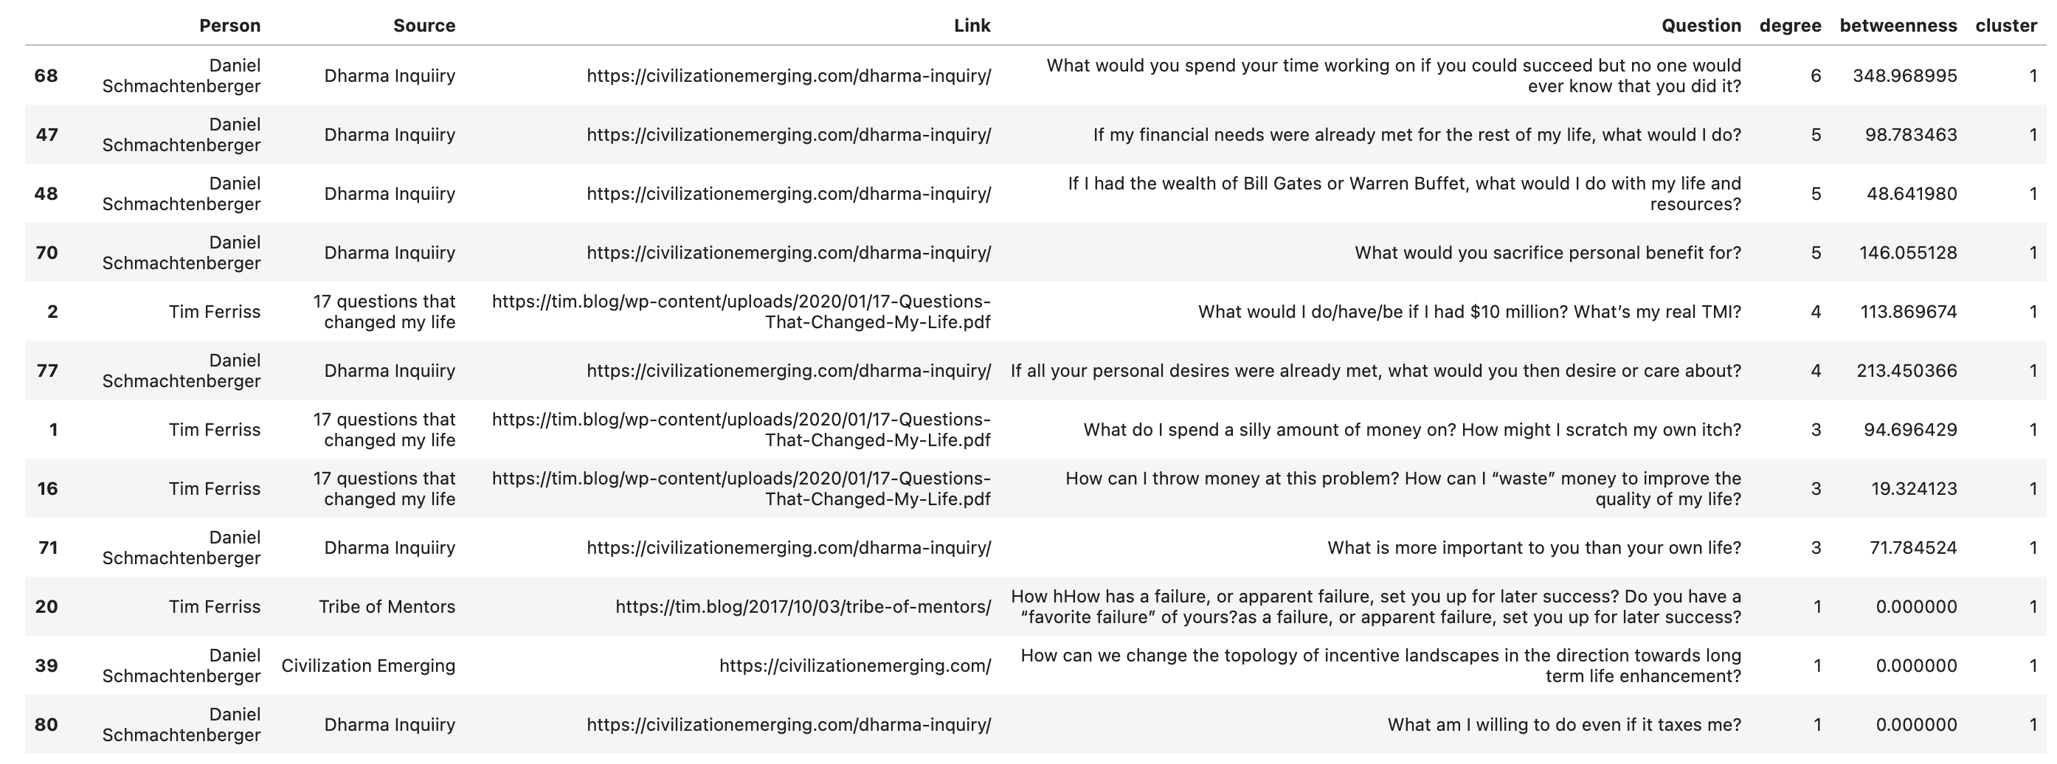
Cluster of questions with cutoff 0.55. These appear to have the theme
“if I had perfect resources, what meaningful activities would I do?”

Slide 7
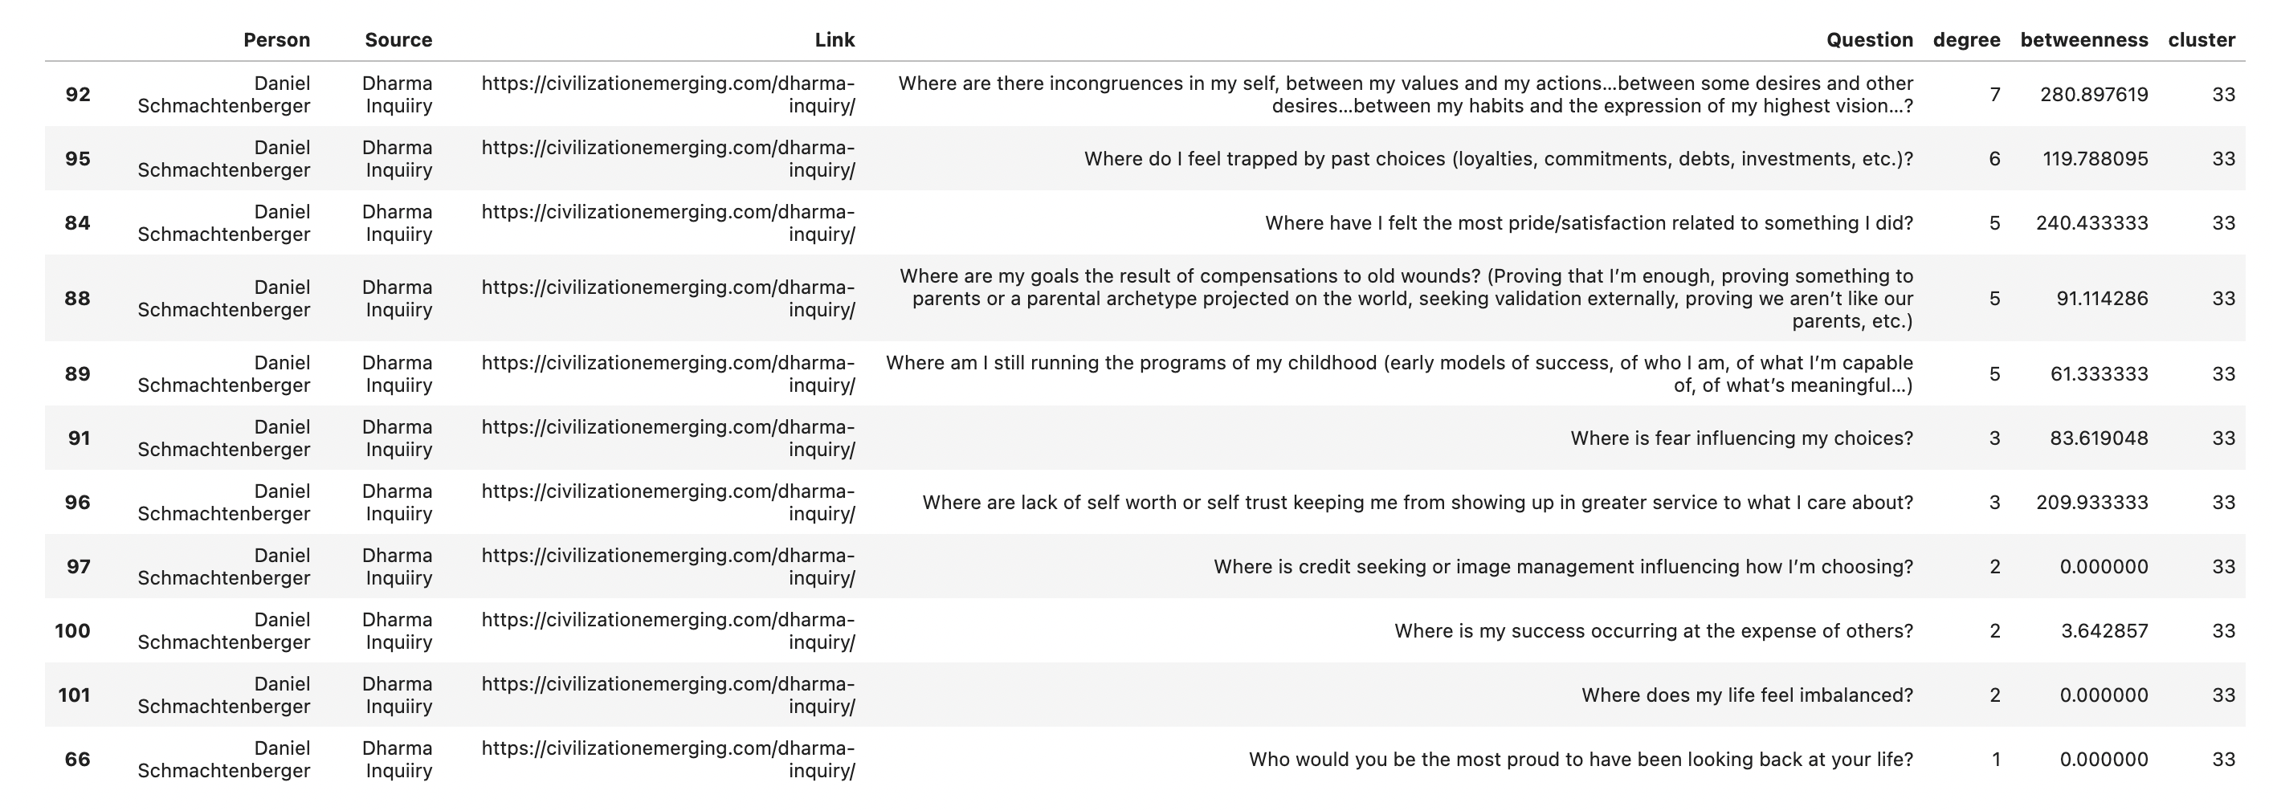
Cluster of questions with cutoff 0.55. These appear to have the theme
“where is past baggage affecting the present?”

