Slide 1
Gradient Descent
PGD Class B2

Slide 2
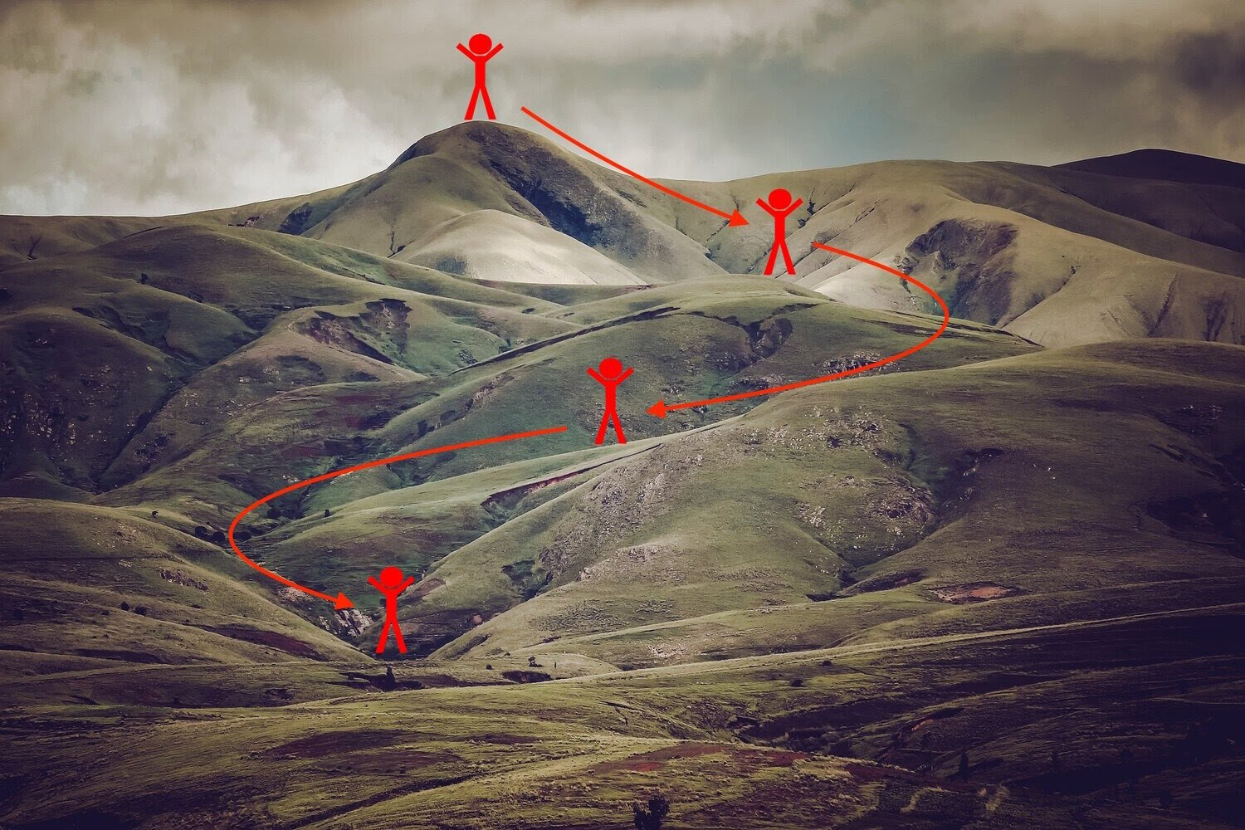
Analogous to Steep hill descent

Slide 3
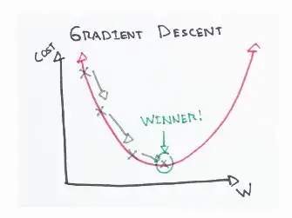
What is this cost function?
The cost function is a measure of how good our model is at making predictions. The shape of a cost function defines our goal of optimization.

Slide 4



Optimization Iteration
Gradient Descent we compute the gradient of the cost function w.r.t every parameter. This means that we calculate how much the cost function varies when either of the parameters changes. This is called a partial derivative.
The above steps are repeated until the cost function converges. Now, by the convergence we mean, the gradient of the cost function would be equal to 0.

Slide 5
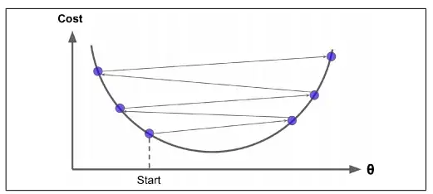
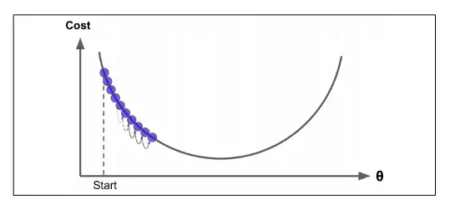
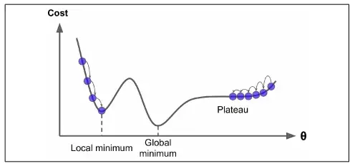
Learning Rate Impact
The most commonly used learning rates are : 0.3, 0.1, 0.03, 0.01, 0.003, 0.001.

Slide 6
Types
* Batch GD
- G is calculated based on entire dataset.
max mamory, best accuracy, LR fixed
* Stochatic GD
- G is calculated based on a single sample taken at random.
faster, less mem, noisy, computationaly expensive, LR can be scheduled
* mini-batch GD
combines best of both. Good accuracy,

Slide 7
Algorithms
Adam - rmsprop with momentum
Adagrad - Adaptiv Grad, lr is aadjusted as per learning behaviour
Adadelta
RMSProp - most widely used

