Slide 1
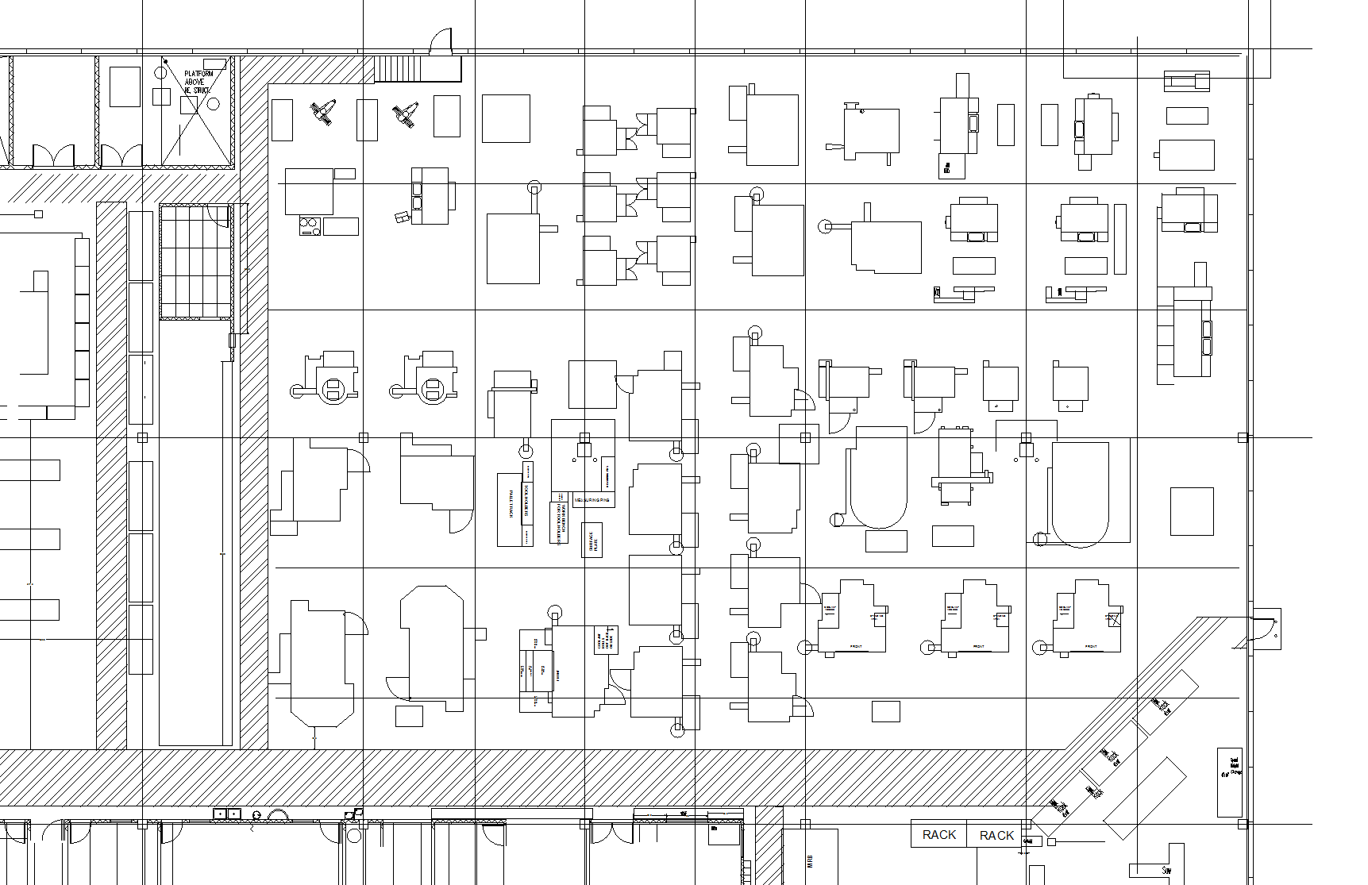
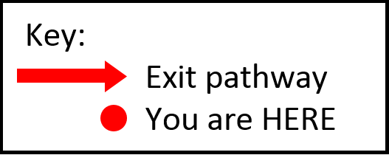
EMERGENCY EGRESS MAP – DO NOT REMOVE
#105
W
105
201
260
218
215
231
222
112
113
106
600
206
248
243
115
233
111
114
239
247
238
244
116
252
251
292
242
220
221
241
240
S
232
291
N
268
269
271
250
290
237
270
242
235
NORTH EMERGENCY
EXIT DOOR
236
267
266
274
272
273
280
234
293
E
CHECK IN WITH SUPERVISOR BEFORE LEAVING PREMISES

Slide 2
EMERGENCY EGRESS MAP – DO NOT REMOVE
#106
W
105
201
260
218
215
231
222
112
113
106
600
206
248
243
115
233
111
114
239
247
238
244
116
252
251
292
242
220
221
241
240
S
232
291
N
268
269
271
250
290
237
270
242
235
NORTH EMERGENCY
EXIT DOOR
236
267
266
274
272
273
280
234
293
E
CHECK IN WITH SUPERVISOR BEFORE LEAVING PREMISES

Slide 3
EMERGENCY EGRESS MAP – DO NOT REMOVE
#111
W
105
201
260
218
215
231
222
112
113
106
600
206
248
243
115
233
111
114
239
247
238
244
116
252
251
292
242
220
221
241
240
S
232
291
N
268
269
271
250
290
237
270
242
235
NORTH EMERGENCY
EXIT DOOR
236
267
266
274
272
273
280
234
293
E
CHECK IN WITH SUPERVISOR BEFORE LEAVING PREMISES

Slide 4
EMERGENCY EGRESS MAP – DO NOT REMOVE
#114
W
105
201
260
218
215
231
222
112
113
106
600
206
248
243
115
233
111
114
239
247
238
244
116
252
251
292
242
220
221
241
240
S
232
291
N
268
269
271
250
290
237
270
242
235
NORTH EMERGENCY
EXIT DOOR
236
267
266
274
272
273
280
234
293
E
CHECK IN WITH SUPERVISOR BEFORE LEAVING PREMISES

Slide 5
EMERGENCY EGRESS MAP – DO NOT REMOVE
#115
W
105
201
260
218
215
231
222
112
113
106
600
206
248
243
115
233
111
114
239
247
238
244
116
252
251
292
242
220
221
241
240
S
232
291
N
268
269
271
250
290
237
270
242
235
NORTH EMERGENCY
EXIT DOOR
236
267
266
274
272
273
280
234
293
E
CHECK IN WITH SUPERVISOR BEFORE LEAVING PREMISES

Slide 6
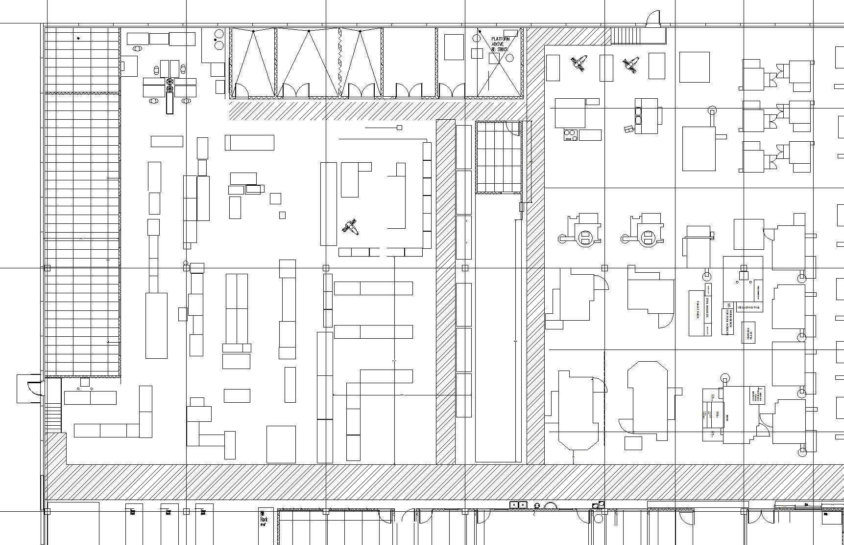
EMERGENCY EGRESS MAP – DO NOT REMOVE
W
201
600
206
`
252
251
S
N
268
269
SOUTH
EMERGENCY
EXIT DOOR
267
266
`
`
E
CHECK IN WITH SUPERVISOR BEFORE LEAVING PREMISES

Slide 7
EMERGENCY EGRESS MAP – DO NOT REMOVE
W
201
600
206
252
251
S
N
268
269
SOUTH
EMERGENCY
EXIT DOOR
267
266
`
E
CHECK IN WITH SUPERVISOR BEFORE LEAVING PREMISES

Slide 8
EMERGENCY EGRESS MAP – DO NOT REMOVE
W
201
600
206
252
251
S
N
268
269
SOUTH
EMERGENCY
EXIT DOOR
267
266
`
E
CHECK IN WITH SUPERVISOR BEFORE LEAVING PREMISES

Slide 9
EMERGENCY EGRESS MAP – DO NOT REMOVE
E
`
SOUTH
EMERGENCY
EXIT DOOR
`
N
S
W
CHECK IN WITH SUPERVISOR BEFORE LEAVING PREMISES

Slide 10
EMERGENCY EGRESS MAP – DO NOT REMOVE
#234
W
105
201
260
218
215
231
222
112
113
106
600
206
248
243
115
233
111
114
239
247
238
244
116
252
251
292
242
220
221
241
240
S
232
291
N
268
269
271
250
290
237
270
242
236
235
267
266
274
272
273
280
234
293
`
TO LOBBY FRONT EXIT DOORS
E
CHECK IN WITH SUPERVISOR BEFORE LEAVING PREMISES

Slide 11
EMERGENCY EGRESS MAP – DO NOT REMOVE
#266
E
TO LOBBY FRONT EXIT DOORS
293
234
266
267
273
272
274
235
236
242
270
237
290
N
271
269
268
S
250
291
232
240
241
221
220
292
242
251
252
116
238
247
244
239
114
111
233
115
243
248
206
600
106
218
201
113
112
222
231
215
260
105
W
CHECK IN WITH SUPERVISOR BEFORE LEAVING PREMISES

Slide 12
EMERGENCY EGRESS MAP – DO NOT REMOVE
#267
W
105
201
260
218
215
231
222
112
113
106
600
206
248
243
115
233
111
114
239
247
238
244
116
252
251
292
242
220
221
241
240
S
232
291
N
268
269
271
250
290
237
270
242
236
235
267
266
274
272
273
280
234
293
`
TO LOBBY FRONT EXIT DOORS
E
CHECK IN WITH SUPERVISOR BEFORE LEAVING PREMISES

Slide 13
EMERGENCY EGRESS MAP – DO NOT REMOVE
#268
W
105
201
260
218
215
231
222
112
113
106
600
206
248
243
115
233
111
114
239
247
238
244
116
252
251
292
242
220
221
241
240
S
232
291
N
268
269
271
250
290
237
270
242
236
235
267
266
274
272
273
280
234
293
`
TO LOBBY FRONT EXIT DOORS
E
CHECK IN WITH SUPERVISOR BEFORE LEAVING PREMISES

Slide 14
EMERGENCY EGRESS MAP – DO NOT REMOVE
#290
W
105
201
260
218
215
231
222
112
113
106
600
206
248
243
115
233
111
114
239
247
238
244
116
252
251
292
242
220
221
241
240
S
232
291
N
268
269
271
250
290
237
270
242
236
235
267
266
274
272
273
280
234
293
`
TO LOBBY FRONT EXIT DOORS
E
CHECK IN WITH SUPERVISOR BEFORE LEAVING PREMISES

Slide 15
EMERGENCY EGRESS MAP – DO NOT REMOVE
W
201
600
206
252
251
S
N
268
269
267
266
EAST HALLWAY
TO LOBBY
FRONT DOORS
E
CHECK IN WITH SUPERVISOR BEFORE LEAVING PREMISES

Slide 16
EMERGENCY EGRESS MAP – DO NOT REMOVE
#235
E
TO EAST EMERGENCY EXIT DOOR
293
234
266
267
273
272
274
235
236
242
270
237
290
N
271
269
268
S
250
291
232
240
241
221
220
292
242
251
252
116
238
247
244
239
114
111
233
115
243
248
206
600
106
218
201
113
112
222
231
215
260
105
W
CHECK IN WITH SUPERVISOR BEFORE LEAVING PREMISES

Slide 17
EMERGENCY EGRESS MAP – DO NOT REMOVE
#237
E
TO EAST EMERGENCY EXIT DOOR
293
234
266
267
273
272
274
235
236
242
270
237
290
N
271
269
268
S
250
291
232
240
241
221
220
292
242
251
252
116
238
247
244
239
114
111
233
115
243
248
206
600
106
218
201
113
112
222
231
215
260
105
W
CHECK IN WITH SUPERVISOR BEFORE LEAVING PREMISES

Slide 18
EMERGENCY EGRESS MAP – DO NOT REMOVE
#250
W
105
201
260
218
215
231
222
112
113
106
600
206
248
243
115
233
111
114
239
247
238
244
116
252
251
292
242
220
221
241
240
S
232
291
N
268
269
271
250
290
237
270
242
236
235
267
266
274
272
273
280
234
293
`
E
TO EAST EMERGENCY EXIT DOOR
CHECK IN WITH SUPERVISOR BEFORE LEAVING PREMISES

Slide 19
EMERGENCY EGRESS MAP – DO NOT REMOVE
#271
W
105
201
260
218
215
231
222
112
113
106
600
206
248
243
115
233
111
114
239
247
238
244
116
252
251
292
242
220
221
241
240
S
232
291
N
268
269
271
250
290
237
270
242
236
235
267
266
274
272
273
280
234
293
`
E
TO EAST EMERGENCY EXIT DOOR
CHECK IN WITH SUPERVISOR BEFORE LEAVING PREMISES

Slide 20
EMERGENCY EGRESS MAP – DO NOT REMOVE
#293
E
TO EAST EMERGENCY EXIT DOOR
293
234
266
267
273
272
274
235
236
242
270
237
290
N
271
269
268
S
250
291
232
240
241
221
220
292
242
251
252
116
238
247
244
239
114
111
233
115
243
248
206
600
106
218
201
113
112
222
231
215
260
105
W
CHECK IN WITH SUPERVISOR BEFORE LEAVING PREMISES

Slide 21
EMERGENCY EGRESS MAP – DO NOT REMOVE
WEST EMERGENCY EXIT DOOR
W
`
105
201
`
260
218
215
231
222
112
113
106
600
206
248
243
115
233
111
114
239
247
238
244
116
252
251
292
242
220
221
241
240
S
232
291
N
268
269
271
250
290
237
270
242
236
235
267
266
274
272
273
280
234
293
E
CHECK IN WITH SUPERVISOR BEFORE LEAVING PREMISES

Slide 22
EMERGENCY EGRESS MAP – DO NOT REMOVE
#206
WEST EMERGENCY EXIT DOOR
W
`
105
201
260
218
215
231
222
112
113
106
600
206
248
243
`
111
114
115
239
247
233
238
244
`
116
252
251
292
242
220
221
241
240
S
232
291
N
268
269
271
250
290
237
270
242
236
235
267
266
274
272
273
280
234
293
E
CHECK IN WITH SUPERVISOR BEFORE LEAVING PREMISES

Slide 23
EMERGENCY EGRESS MAP – DO NOT REMOVE
#215
WEST EMERGENCY EXIT DOOR
W
105
201
260
218
215
231
222
112
113
106
600
206
248
243
115
233
111
114
239
247
238
244
116
252
251
292
242
220
221
241
240
S
232
291
N
268
269
271
250
290
237
270
242
236
235
267
266
274
272
273
280
234
293
E
CHECK IN WITH SUPERVISOR BEFORE LEAVING PREMISES

Slide 24
EMERGENCY EGRESS MAP – DO NOT REMOVE
#218
E
293
234
266
267
273
272
274
235
236
242
270
237
290
N
271
269
268
S
250
291
232
240
241
221
220
292
242
251
252
116
238
247
244
239
114
111
233
115
243
248
206
600
106
218
201
113
112
222
231
215
260
105
WEST EMERGENCY EXIT DOOR
W
CHECK IN WITH SUPERVISOR BEFORE LEAVING PREMISES

Slide 25
EMERGENCY EGRESS MAP – DO NOT REMOVE
#231
E
293
234
266
267
273
272
274
235
236
242
270
237
290
N
271
269
268
S
250
291
232
240
241
221
220
292
242
251
252
116
238
247
244
239
114
111
233
115
243
248
206
600
106
218
201
113
112
222
231
215
260
105
WEST EMERGENCY EXIT DOOR
W
CHECK IN WITH SUPERVISOR BEFORE LEAVING PREMISES

Slide 26
EMERGENCY EGRESS MAP – DO NOT REMOVE
#232
WEST EMERGENCY EXIT DOOR
W
`
105
201
260
218
215
231
222
112
113
106
600
206
248
243
`
111
114
115
239
247
233
238
244
116
252
251
292
242
220
221
241
240
S
232
291
N
268
269
271
250
290
237
270
242
236
235
267
266
274
272
273
280
234
293
E
CHECK IN WITH SUPERVISOR BEFORE LEAVING PREMISES

Slide 27
EMERGENCY EGRESS MAP – DO NOT REMOVE
#233
E
293
234
266
267
273
272
274
235
236
242
270
237
290
N
271
269
268
S
250
291
232
240
241
221
220
292
242
251
252
116
238
247
244
239
114
111
233
115
243
248
206
600
106
218
201
113
112
222
231
215
260
105
WEST EMERGENCY EXIT DOOR
W
CHECK IN WITH SUPERVISOR BEFORE LEAVING PREMISES

Slide 28
EMERGENCY EGRESS MAP – DO NOT REMOVE
#243
WEST EMERGENCY EXIT DOOR
W
105
201
260
218
215
231
222
112
113
106
600
206
248
243
115
233
111
114
239
247
238
244
116
252
251
292
242
220
221
241
240
S
232
291
N
268
269
271
250
290
237
270
242
236
235
267
266
274
272
273
280
234
293
E
CHECK IN WITH SUPERVISOR BEFORE LEAVING PREMISES

Slide 29
EMERGENCY EGRESS MAP – DO NOT REMOVE
#244
E
293
234
266
267
273
272
274
235
236
242
270
237
290
N
271
269
268
S
250
291
232
240
241
221
220
292
242
251
252
116
238
247
244
239
114
111
233
115
243
248
206
600
106
218
201
113
112
222
231
215
260
105
WEST EMERGENCY EXIT DOOR
W
CHECK IN WITH SUPERVISOR BEFORE LEAVING PREMISES

Slide 30
EMERGENCY EGRESS MAP – DO NOT REMOVE
#247
WEST EMERGENCY EXIT DOOR
W
105
201
260
218
215
231
222
112
113
106
600
206
248
243
115
233
111
114
239
247
238
244
116
252
251
292
242
220
221
241
240
S
232
291
N
268
269
271
250
290
237
270
242
236
235
267
266
274
272
273
280
234
293
E
CHECK IN WITH SUPERVISOR BEFORE LEAVING PREMISES

Slide 31
EMERGENCY EGRESS MAP – DO NOT REMOVE
#248
E
293
234
266
267
273
272
274
235
236
242
270
237
290
N
271
269
268
S
250
291
232
240
241
221
220
292
242
251
252
116
238
247
244
239
114
111
233
115
243
248
206
600
106
218
201
113
112
222
231
215
260
105
WEST EMERGENCY EXIT DOOR
W
CHECK IN WITH SUPERVISOR BEFORE LEAVING PREMISES

Slide 32
EMERGENCY EGRESS MAP – DO NOT REMOVE
#251
WEST EMERGENCY EXIT DOOR
W
`
105
201
260
218
215
231
222
112
113
106
600
206
248
243
115
233
111
114
`
239
247
238
244
116
252
251
292
242
220
221
241
240
S
232
291
N
268
269
271
250
290
237
270
242
236
235
267
266
274
272
273
280
234
293
E
CHECK IN WITH SUPERVISOR BEFORE LEAVING PREMISES

Slide 33
EMERGENCY EGRESS MAP – DO NOT REMOVE
#252
WEST EMERGENCY EXIT DOOR
W
`
105
201
260
218
215
231
222
112
113
106
600
206
248
243
115
233
111
114
`
239
247
238
244
116
252
251
292
242
220
221
241
240
S
232
291
N
268
269
271
250
290
237
270
242
236
235
267
266
274
272
273
280
234
293
E
CHECK IN WITH SUPERVISOR BEFORE LEAVING PREMISES

Slide 34
EMERGENCY EGRESS MAP – DO NOT REMOVE
#291
WEST EMERGENCY EXIT DOOR
W
`
105
201
260
218
215
231
222
112
113
106
600
206
248
243
`
111
114
115
239
247
233
238
244
`
116
252
251
292
242
220
221
241
240
S
232
291
N
268
269
271
250
290
237
270
242
236
235
267
266
274
272
273
280
234
293
E
CHECK IN WITH SUPERVISOR BEFORE LEAVING PREMISES

Slide 35
EMERGENCY EGRESS MAP – DO NOT REMOVE
#292
E
293
234
266
267
273
272
274
235
236
242
270
237
290
N
271
269
268
S
250
291
232
240
241
221
220
292
242
251
252
116
238
247
244
239
114
111
233
115
243
248
206
600
106
218
201
113
112
222
231
215
260
105
WEST EMERGENCY EXIT DOOR
W
CHECK IN WITH SUPERVISOR BEFORE LEAVING PREMISES

Slide 36
EMERGENCY EGRESS MAP – DO NOT REMOVE
#600
WEST EMERGENCY EXIT DOOR
W
`
105
201
260
218
215
231
222
112
113
106
600
206
248
243
`
111
114
115
239
247
233
238
244
`
116
252
251
292
242
220
221
241
240
S
232
291
N
268
269
271
250
290
237
270
242
236
235
267
266
274
272
273
280
234
293
E
CHECK IN WITH SUPERVISOR BEFORE LEAVING PREMISES

Slide 37
EMERGENCY EGRESS MAP – DO NOT REMOVE
W
WEST EMERGENCY EXIT DOOR
201
`
600
206
`
252
251
S
N
268
269
267
266
E
CHECK IN WITH SUPERVISOR BEFORE LEAVING PREMISES

Slide 38
EMERGENCY EGRESS MAP – DO NOT REMOVE
E
N
S
`
`
`
WEST
EMERGENCY
EXIT DOOR
`
W
CHECK IN WITH SUPERVISOR BEFORE LEAVING PREMISES

Slide 39
EMERGENCY EGRESS MAP – DO NOT REMOVE
E
N
S
`
`
`
WEST
EMERGENCY
EXIT DOOR
`
W
CHECK IN WITH SUPERVISOR BEFORE LEAVING PREMISES

Slide 40
EMERGENCY EGRESS MAP – DO NOT REMOVE
E
N
S
`
`
`
`
WEST
EMERGENCY
EXIT DOOR
`
W
CHECK IN WITH SUPERVISOR BEFORE LEAVING PREMISES

Slide 41
EMERGENCY EGRESS MAP – DO NOT REMOVE
E
N
S
`
`
WEST
EMERGENCY
EXIT DOOR
`
W
CHECK IN WITH SUPERVISOR BEFORE LEAVING PREMISES

Slide 42
EMERGENCY EGRESS MAP – DO NOT REMOVE
#250
W
105
201
260
218
215
231
222
112
113
106
600
206
248
243
115
233
111
114
239
247
238
244
116
252
251
292
242
220
221
241
240
S
232
291
N
268
269
271
250
290
237
270
242
236
235
267
266
274
272
273
280
234
293
`
TO LOBBY FRONT EXIT DOORS
E
CHECK IN WITH SUPERVISOR BEFORE LEAVING PREMISES

Slide 43
EMERGENCY EGRESS MAP – DO NOT REMOVE
#250
W
105
201
260
218
215
231
222
112
113
106
600
206
248
243
115
233
111
114
239
247
238
244
116
252
251
292
242
220
221
241
240
S
232
291
N
268
269
271
250
290
237
270
242
236
235
267
266
274
272
273
280
234
293
TO LOBBY FRONT EXIT DOORS
E
CHECK IN WITH SUPERVISOR BEFORE LEAVING PREMISES

Slide 44
EMERGENCY EGRESS MAP – DO NOT REMOVE
W
201
600
206
252
251
S
N
268
269
267
266
EAST HALLWAY
TO LOBBY
FRONT DOORS
E
CHECK IN WITH SUPERVISOR BEFORE LEAVING PREMISES

