Slide 1
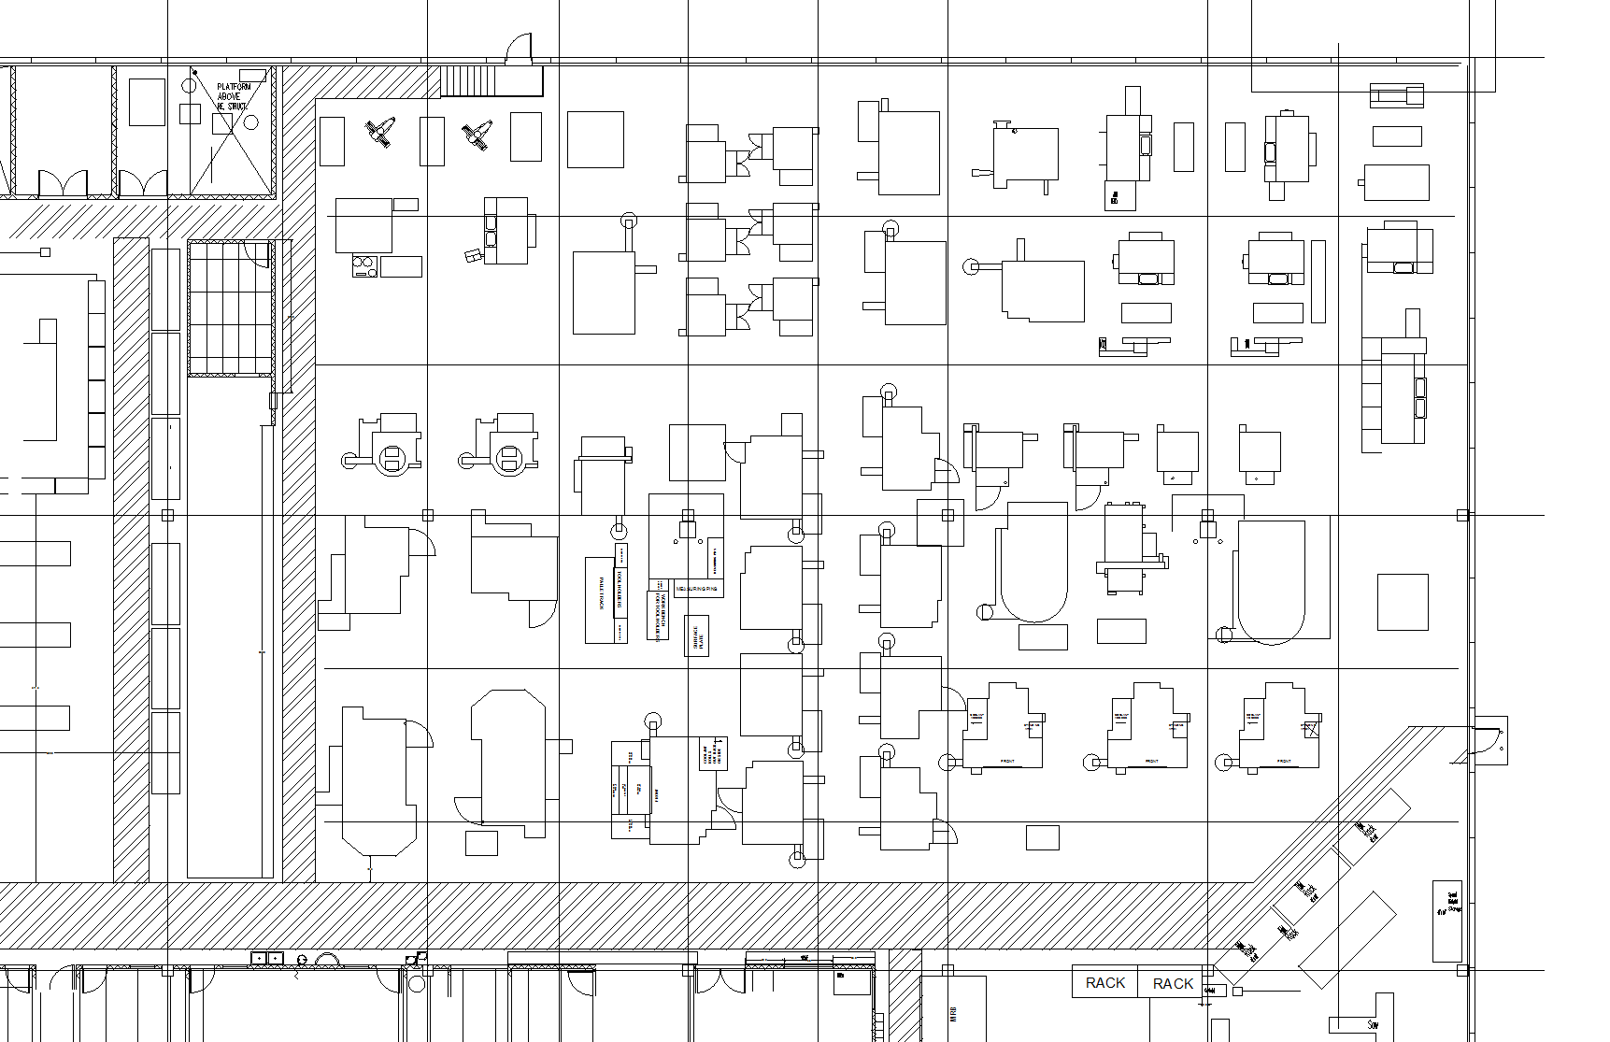

EMERGENCY EGRESS MAP – DO NOT REMOVE
#112
S
267
268
252
600
201
266
269
251
206
232
239
260
280
242
244
248
218
234
236
290
291
247
243
215
E
W
293
235
237
292
233
231
274
271
220
222
238
250
221
112
272
241
111
273
270
240
114
113
115
106
105
242
116
NORTH EMERGENCY
EXIT DOOR
N
CHECK IN WITH SUPERVISOR BEFORE LEAVING PREMISES

Slide 2
EMERGENCY EGRESS MAP – DO NOT REMOVE
#113
N
NORTH EMERGENCY
EXIT DOOR
105
242
106
115
116
113
114
240
270
273
111
241
272
112
221
250
222
238
271
220
274
W
231
233
292
237
235
293
E
215
243
247
291
290
236
234
218
248
244
242
280
260
239
232
206
251
269
266
600
252
268
267
201
S
CHECK IN WITH SUPERVISOR BEFORE LEAVING PREMISES

Slide 3
EMERGENCY EGRESS MAP – DO NOT REMOVE
#116
S
267
268
252
600
201
266
269
251
206
232
239
260
280
242
244
248
218
234
236
290
291
247
243
215
E
W
293
235
237
292
233
231
274
271
220
222
238
250
221
112
272
241
111
273
270
240
114
113
115
106
105
242
116
NORTH EMERGENCY
EXIT DOOR
N
CHECK IN WITH SUPERVISOR BEFORE LEAVING PREMISES

Slide 4
EMERGENCY EGRESS MAP – DO NOT REMOVE
#221
S
267
268
252
600
201
266
269
251
206
232
239
260
280
242
244
248
218
234
236
290
291
247
243
215
E
W
293
235
237
292
233
231
274
271
220
222
238
250
221
112
272
241
111
273
270
240
114
113
115
106
105
242
116
NORTH EMERGENCY
EXIT DOOR
N
CHECK IN WITH SUPERVISOR BEFORE LEAVING PREMISES

Slide 5
EMERGENCY EGRESS MAP – DO NOT REMOVE
#240
S
267
268
252
600
201
266
269
251
206
232
239
260
280
242
244
248
218
234
236
290
291
247
243
215
E
W
293
235
237
292
233
231
274
271
220
222
238
250
221
112
272
241
111
273
270
240
114
113
115
106
105
242
116
NORTH EMERGENCY
EXIT DOOR
N
CHECK IN WITH SUPERVISOR BEFORE LEAVING PREMISES

Slide 6
EMERGENCY EGRESS MAP – DO NOT REMOVE
#241
S
267
268
252
600
201
266
269
251
206
232
239
260
280
242
244
248
218
234
236
290
291
247
243
215
E
W
293
235
237
292
233
231
274
271
220
222
238
250
221
112
272
241
111
273
270
240
114
113
115
106
105
242
116
NORTH EMERGENCY
EXIT DOOR
N
CHECK IN WITH SUPERVISOR BEFORE LEAVING PREMISES

Slide 7
EMERGENCY EGRESS MAP – DO NOT REMOVE
#242 (north)
N
NORTH EMERGENCY
EXIT DOOR
105
242
106
115
116
113
114
240
270
273
111
241
272
112
221
250
222
238
271
220
274
W
231
233
292
237
235
293
E
215
243
247
291
290
236
234
218
248
244
242
280
260
239
232
206
251
269
266
600
252
268
267
201
S
CHECK IN WITH SUPERVISOR BEFORE LEAVING PREMISES

Slide 8
EMERGENCY EGRESS MAP – DO NOT REMOVE
#270
S
267
268
252
600
201
266
269
251
206
232
239
260
280
242
244
248
218
234
236
290
291
247
243
215
E
W
293
235
237
292
233
231
274
271
220
222
238
250
221
112
272
241
111
273
270
240
114
113
115
106
105
242
116
NORTH EMERGENCY
EXIT DOOR
N
CHECK IN WITH SUPERVISOR BEFORE LEAVING PREMISES

Slide 9
EMERGENCY EGRESS MAP – DO NOT REMOVE
#273
S
267
268
252
600
201
266
269
251
206
232
239
260
280
242
244
248
218
234
236
290
291
247
243
215
E
W
293
235
237
292
233
231
274
271
220
222
238
250
221
112
272
241
111
273
270
240
114
113
115
106
105
242
116
NORTH EMERGENCY
EXIT DOOR
N
CHECK IN WITH SUPERVISOR BEFORE LEAVING PREMISES

Slide 10
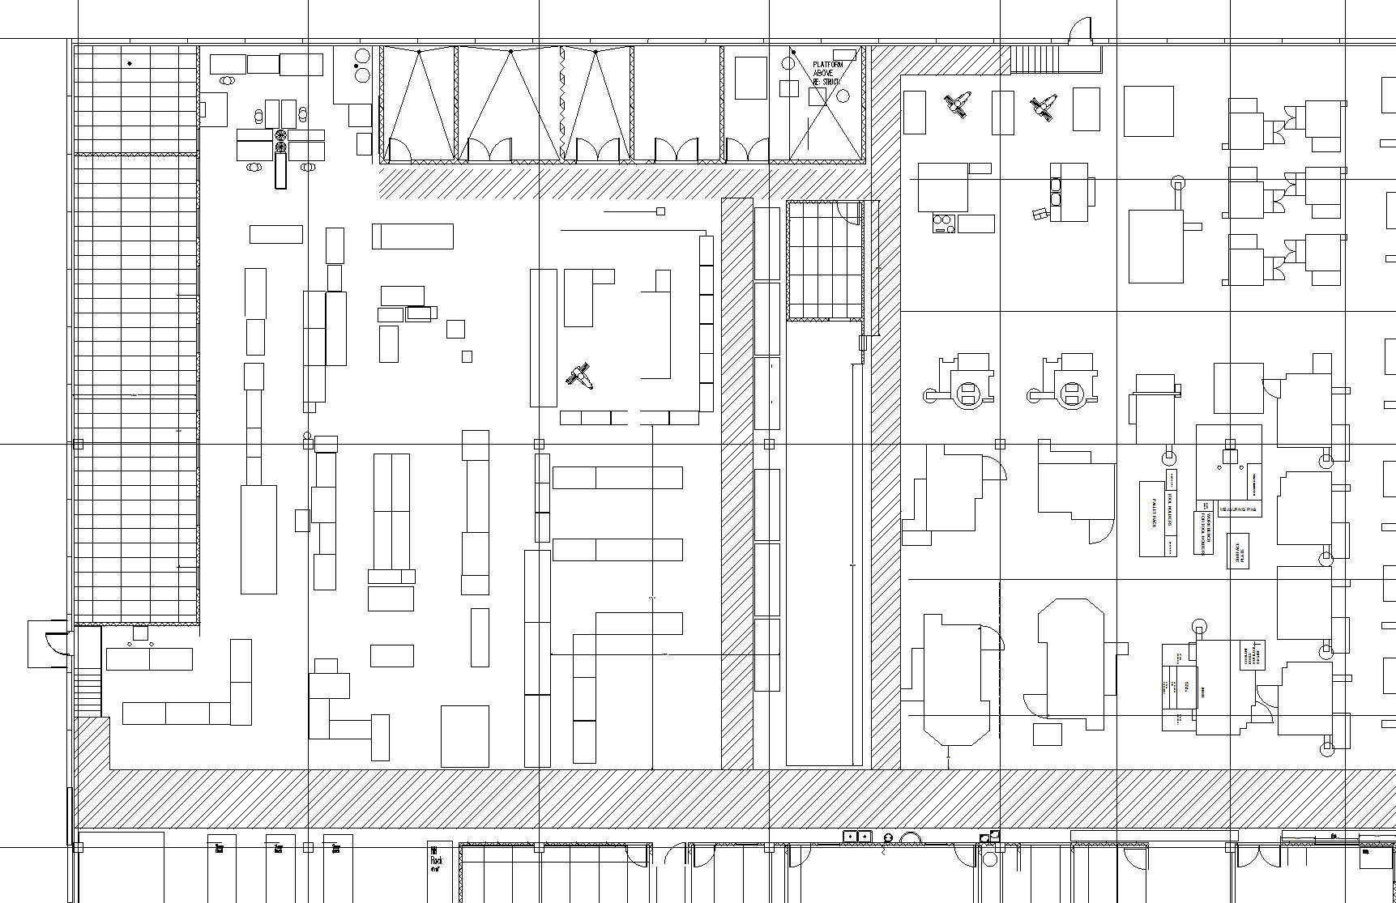
EMERGENCY EGRESS MAP – DO NOT REMOVE
N
W
E
SOUTH
EMERGENCY EXIT DOOR
S
CHECK IN WITH SUPERVISOR BEFORE LEAVING PREMISES

Slide 11
EMERGENCY EGRESS MAP – DO NOT REMOVE
N
W
E
SOUTH
EMERGENCY EXIT DOOR
S
CHECK IN WITH SUPERVISOR BEFORE LEAVING PREMISES

Slide 12
EMERGENCY EGRESS MAP – DO NOT REMOVE
N
W
E
SOUTH
EMERGENCY EXIT DOOR
S
CHECK IN WITH SUPERVISOR BEFORE LEAVING PREMISES

Slide 13
EMERGENCY EGRESS MAP – DO NOT REMOVE
S
SOUTH
EMERGENCY
EXIT DOOR
E
W
N
CHECK IN WITH SUPERVISOR BEFORE LEAVING PREMISES

Slide 14
EMERGENCY EGRESS MAP – DO NOT REMOVE
S
SOUTH
EMERGENCY
EXIT DOOR
E
W
N
CHECK IN WITH SUPERVISOR BEFORE LEAVING PREMISES

Slide 15
EMERGENCY EGRESS MAP – DO NOT REMOVE
S
SOUTH
EMERGENCY
EXIT DOOR
E
W
N
CHECK IN WITH SUPERVISOR BEFORE LEAVING PREMISES

Slide 16
EMERGENCY EGRESS MAP – DO NOT REMOVE
S
SOUTH
EMERGENCY
EXIT DOOR
E
W
N
CHECK IN WITH SUPERVISOR BEFORE LEAVING PREMISES

Slide 17
EMERGENCY EGRESS MAP – DO NOT REMOVE
S
SOUTH
EMERGENCY
EXIT DOOR
E
W
N
CHECK IN WITH SUPERVISOR BEFORE LEAVING PREMISES

Slide 18
EMERGENCY EGRESS MAP – DO NOT REMOVE
Epoxy tables
S
SOUTH
EMERGENCY
EXIT DOOR
E
W
N
CHECK IN WITH SUPERVISOR BEFORE LEAVING PREMISES

Slide 19
EMERGENCY EGRESS MAP – DO NOT REMOVE
#269
N
105
242
106
115
116
113
114
240
270
273
111
241
272
112
221
250
222
238
271
220
274
W
231
233
292
237
235
293
E
215
243
247
291
290
236
234
218
248
244
242
280
260
239
232
TO LOBBY
FRONT EXIT
DOORS
206
251
269
266
600
252
268
267
201
S
CHECK IN WITH SUPERVISOR BEFORE LEAVING PREMISES

Slide 20
EMERGENCY EGRESS MAP – DO NOT REMOVE
#280
N
105
242
106
115
116
113
114
240
270
273
111
241
272
112
221
250
222
238
271
220
274
W
231
233
292
237
235
293
E
215
243
247
291
290
236
234
218
248
244
242
280
260
239
232
TO LOBBY
FRONT EXIT
DOORS
206
251
269
266
600
252
268
267
201
S
CHECK IN WITH SUPERVISOR BEFORE LEAVING PREMISES

Slide 21
EMERGENCY EGRESS MAP – DO NOT REMOVE
#220
S
267
268
252
600
201
266
269
251
206
232
239
260
280
242
244
248
218
234
236
290
291
247
243
215
E
W
293
235
237
292
233
231
274
271
220
222
238
250
221
112
272
241
111
273
270
240
114
113
115
106
105
242
116
NORTH EMERGENCY
EXIT DOOR
N
CHECK IN WITH SUPERVISOR BEFORE LEAVING PREMISES

Slide 22
EMERGENCY EGRESS MAP – DO NOT REMOVE
#272
S
267
268
252
600
201
266
269
251
206
232
239
260
280
242
244
248
218
234
236
290
291
247
243
215
E
W
TO EAST
EMERGENCY
EXIT DOOR
293
235
237
292
233
231
274
271
220
222
238
250
221
112
272
241
111
273
270
240
114
113
115
106
105
242
116
N
CHECK IN WITH SUPERVISOR BEFORE LEAVING PREMISES

Slide 23
EMERGENCY EGRESS MAP – DO NOT REMOVE
#274
S
267
268
252
600
201
266
269
251
206
232
239
260
280
242
244
248
218
234
236
290
291
247
243
215
E
W
TO EAST
EMERGENCY
EXIT DOOR
293
235
237
292
233
231
274
271
220
222
238
250
221
112
272
241
111
273
270
240
114
113
115
106
105
242
116
N
CHECK IN WITH SUPERVISOR BEFORE LEAVING PREMISES

Slide 24
EMERGENCY EGRESS MAP – DO NOT REMOVE
S
E
W
EAST
HALLWAY
TO LOBBY
EXIT DOORS
N
CHECK IN WITH SUPERVISOR BEFORE LEAVING PREMISES

Slide 25
EMERGENCY EGRESS MAP – DO NOT REMOVE
S
E
W
EAST
HALLWAY
TO LOBBY
EXIT DOORS
N
CHECK IN WITH SUPERVISOR BEFORE LEAVING PREMISES

Slide 26
EMERGENCY EGRESS MAP – DO NOT REMOVE
N
EAST
HALLWAY
TO LOBBY
EXIT DOORS
W
E
S
CHECK IN WITH SUPERVISOR BEFORE LEAVING PREMISES

Slide 27
EMERGENCY EGRESS MAP – DO NOT REMOVE
N
EAST
HALLWAY
TO LOBBY
EXIT DOORS
W
E
S
CHECK IN WITH SUPERVISOR BEFORE LEAVING PREMISES

Slide 28
EMERGENCY EGRESS MAP – DO NOT REMOVE
N
EAST
HALLWAY
TO LOBBY
EXIT DOORS
W
E
S
CHECK IN WITH SUPERVISOR BEFORE LEAVING PREMISES

Slide 29
EMERGENCY EGRESS MAP – DO NOT REMOVE
N
EAST
HALLWAY
TO LOBBY
EXIT DOORS
W
E
S
CHECK IN WITH SUPERVISOR BEFORE LEAVING PREMISES

Slide 30
EMERGENCY EGRESS MAP – DO NOT REMOVE
S
E
W
EAST
HALLWAY
TO LOBBY
EXIT DOORS
N
CHECK IN WITH SUPERVISOR BEFORE LEAVING PREMISES

Slide 31
EMERGENCY EGRESS MAP – DO NOT REMOVE
S
E
W
EAST
HALLWAY
TO LOBBY
EXIT DOORS
N
CHECK IN WITH SUPERVISOR BEFORE LEAVING PREMISES

Slide 32
EMERGENCY EGRESS MAP – DO NOT REMOVE
S
E
W
EAST
HALLWAY
TO LOBBY
EXIT DOORS
N
CHECK IN WITH SUPERVISOR BEFORE LEAVING PREMISES

Slide 33
EMERGENCY EGRESS MAP – DO NOT REMOVE
#222
N
105
242
106
115
116
113
114
240
270
273
111
241
272
112
221
250
222
238
271
220
274
W
231
233
292
237
235
293
E
215
243
247
291
290
236
234
218
248
244
242
280
WEST EMERGENCY
EXIT DOOR
260
239
232
206
251
269
266
600
252
268
267
201
S
CHECK IN WITH SUPERVISOR BEFORE LEAVING PREMISES

Slide 34
EMERGENCY EGRESS MAP – DO NOT REMOVE
#238
S
267
268
252
600
201
266
269
251
206
WEST
EMERGENCY
EXIT DOOR
232
239
260
280
242
244
248
218
234
236
290
291
247
243
215
E
W
293
235
237
292
233
231
274
271
220
222
238
250
221
112
272
241
111
273
270
240
114
113
115
106
105
242
116
N
CHECK IN WITH SUPERVISOR BEFORE LEAVING PREMISES

Slide 35
EMERGENCY EGRESS MAP – DO NOT REMOVE
#242 (south)
N
105
242
106
115
116
113
114
240
270
273
111
241
272
112
221
250
222
238
271
220
274
W
231
233
292
237
235
293
E
215
243
247
291
290
236
234
218
248
244
242
280
WEST EMERGENCY
EXIT DOOR
260
239
232
206
251
269
266
600
252
268
267
201
S
CHECK IN WITH SUPERVISOR BEFORE LEAVING PREMISES

Slide 36
EMERGENCY EGRESS MAP – DO NOT REMOVE
#260
S
267
268
252
600
201
266
269
251
206
WEST
EMERGENCY
EXIT DOOR
232
239
260
280
242
244
248
218
234
236
290
291
247
243
215
E
W
293
235
237
292
233
231
274
271
220
222
238
250
221
112
272
241
111
273
270
240
114
113
115
106
105
242
116
N
CHECK IN WITH SUPERVISOR BEFORE LEAVING PREMISES

Slide 37
EMERGENCY EGRESS MAP – DO NOT REMOVE
N
W
E
SOUTH
EMERGENCY
EXIT DOOR
S
CHECK IN WITH SUPERVISOR BEFORE LEAVING PREMISES

Slide 38
EMERGENCY EGRESS MAP – DO NOT REMOVE
N
W
E
SOUTH
EMERGENCY
EXIT DOOR
S
CHECK IN WITH SUPERVISOR BEFORE LEAVING PREMISES

Slide 39
EMERGENCY EGRESS MAP – DO NOT REMOVE
N
W
E
SOUTH
EMERGENCY
EXIT DOOR
S
CHECK IN WITH SUPERVISOR BEFORE LEAVING PREMISES

