Slide 1
Color Theory, Part 2: Uniform Color Spaces
Stephen Huan
TJ Vision & Graphics Club, February 3, 2021
Notes:
to present: https://docs.google.com/presentation/d/1KGOiKWH8d5PEPVF3700smOwqc6q4iCkpAeJycYwdl8E/preview?rm=minimal

Slide 2
k-means

Slide 3
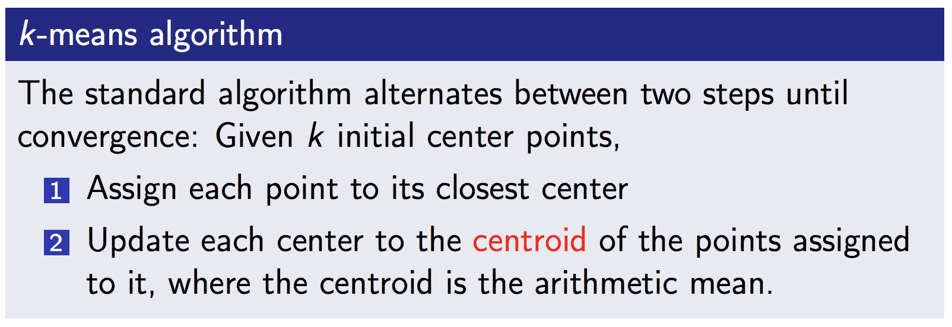
k-means

Slide 4
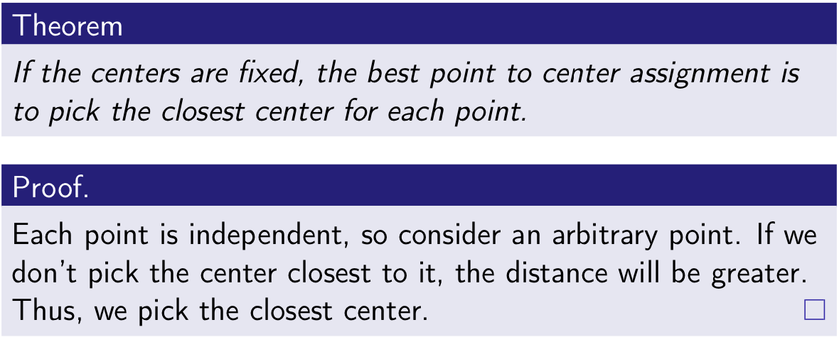
Derivation of k-means: Point Assignment

Slide 5
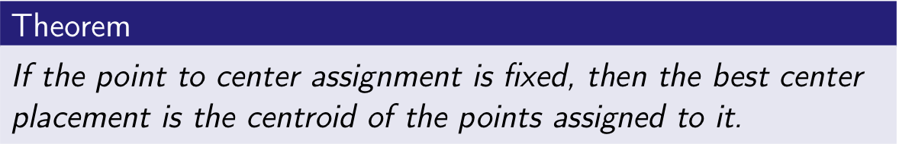
Derivation of k-means: Center Location

Slide 6
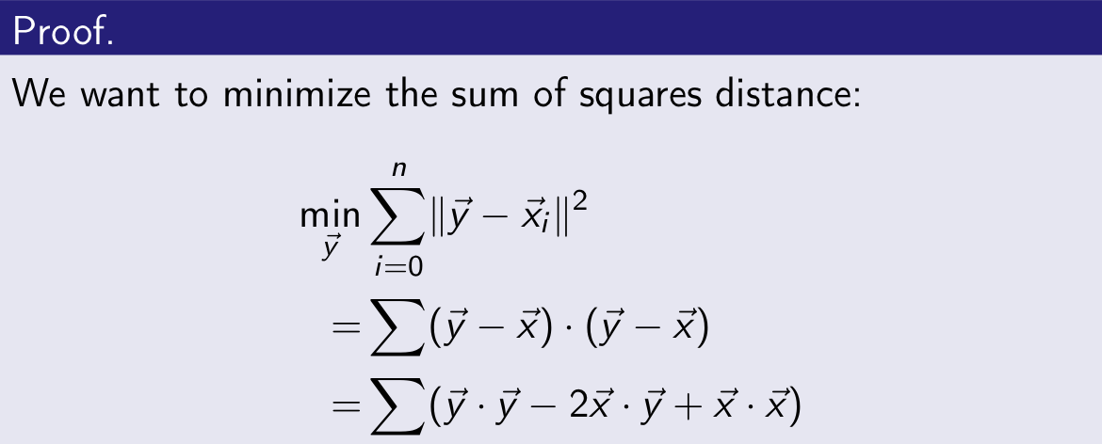
Derivation of k-means: Center Location

Slide 7
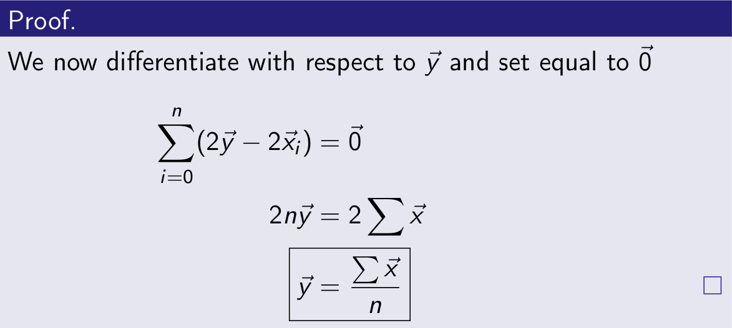
Derivation of k-means: Center Location

Slide 8
Implications
Point to center assignment relies on minimum distance
Centroid relies on Euclidean distance
  Minimize norm of y - x
Suppose we switch distance metrics
Point assignment computation trivial
Centroid computation nontrivial
  Need to differentiate, unlikely to get clean analytical solution
  Use numerical methods e.g. gradient descent
  Some metrics are very complicated/non-continuous or non-differentiable
Hence, easier to switch spaces

Slide 9
Uniform Color Spaces
Projection from RGB
Use Euclidean distance for distance
Should “just work”
Goal is perceptual uniformity i.e. MacAdam ellipses

Slide 10
Uniform Color Spaces

Slide 11
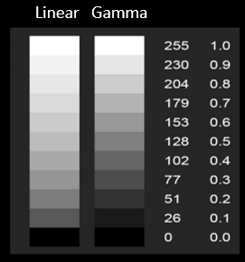
sRGB vs RGB
RGB: “linear”, e.g. adding intensities for greyscale
  Corresponds to voltage
sRGB: nonlinear, based off actual monitor
  Corresponds to brightness, L = V ^{𝛾}
  So we take V -> V ^{1/𝛾}
8-bit = only 256 colors
  Prioritize black for perceptual uniformity

Slide 12


Y’UV
Y’: brightness, U/V: color
Matrix multiplication from RGB
Which RGB?
Wait, but
In particular, catimg, scikit-image, and tensorflow do not gamma correct
No one really knows
scikit-image
tensorflow

Slide 13
Color Appearance Models
CIECAM02/CAM16 are color appearance models
That is, given XYZ (wavelengths) predict how color appears
CAM16 output: Correlates of lightness J, chroma C, hue composition H, hue angle h, colorfulness M, saturation s, and brightness Q
We want color space
Luckily, uniform color space (UCS) variants
J lightness, a red/green, b blue/yellow
  CIELAB basically

Slide 14
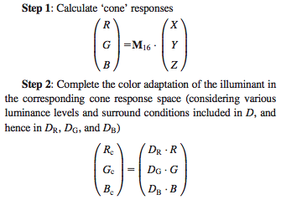

Implementing the CAMs
CIECAM02 and CAM16 have the same “body”, just a different initial “color appearance transformation” (CAT)
Thus, most efficient to subclass CAM
  Only difference is M and M ⁻¹
CAMXY inherits methods from base CAM

Slide 15
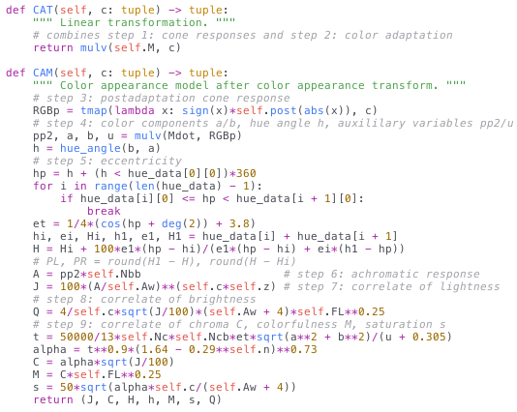
CAM Forward Implementation

Slide 16
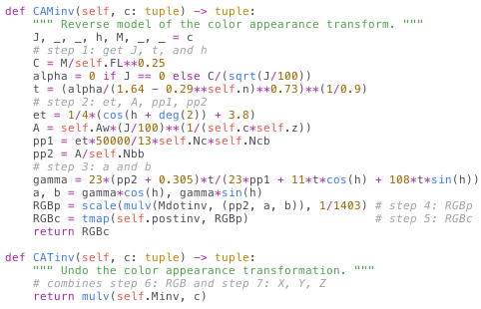
CAM Inverse Implementation

Slide 17
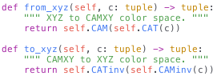
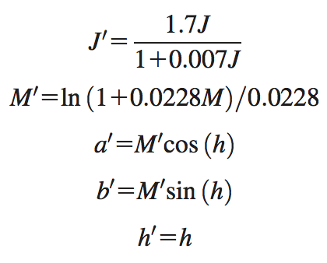
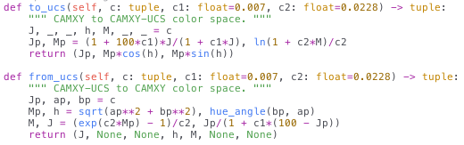
Uniform Color Space

Slide 18
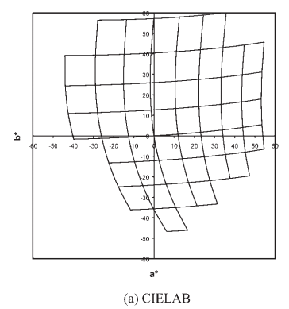
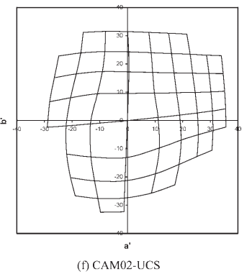
Qualitative Performance

Slide 19
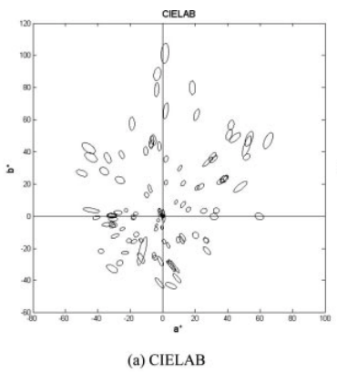
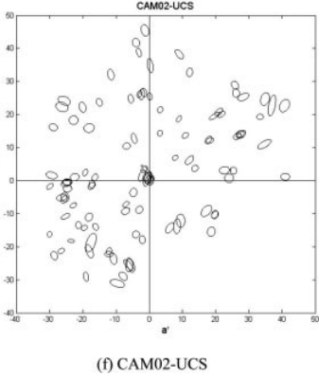
Qualitative Performance

Slide 20
Miscellaneous

Slide 21
One Weird Trick Color Scientists DON’T Want You to Know: Lower Your STRESS By 17%!
Steven’s power law: S = a I^{b}
  S: subjective magnitude, I: physical stimulus
ΔE’ = a ΔE^{b}
Kind of but not really
STRESS: measure of color difference performance, lower is better
Lowers STRESS by an average of 17%
Why does this work?
  b < 1: compresses the space (small values -> larger, larger values -> smaller)
  Raters have difficulty with small values
  Also large values asymptote

Slide 22
Color Conversion Tree
sRGB
CAM16
CAM16UCS
ANSI
RGB
XYZ
CAM02
CAM02UCS
YUV
CIELAB

Slide 23
Color Conversion API
Could hand-design
  10 choose 2 = 45
Could have “central” color, e.g. XYZ
  CAM16 -> CAM16UCS
  CAM16 -> XYZ -> CAM16 -> CAM16UCS
BFS from one space to the other
  Minimize # of functions -> faster, less numerical error

Slide 24
Color Difference
Distance parameterized by (space, metric)
e.g. (RGB, Euclidean) or (CIELAB, CIEDE2000)
8 spaces + 3 metrics = 11 possible!
Power function for 6 -> 17 possible
Can technically apply custom metrics on non-CIELAB
  Surprisingly, this kinda… works?

Slide 25
Experimental Results

Slide 26
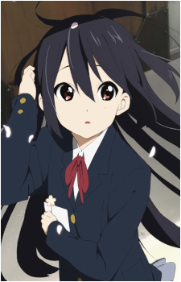
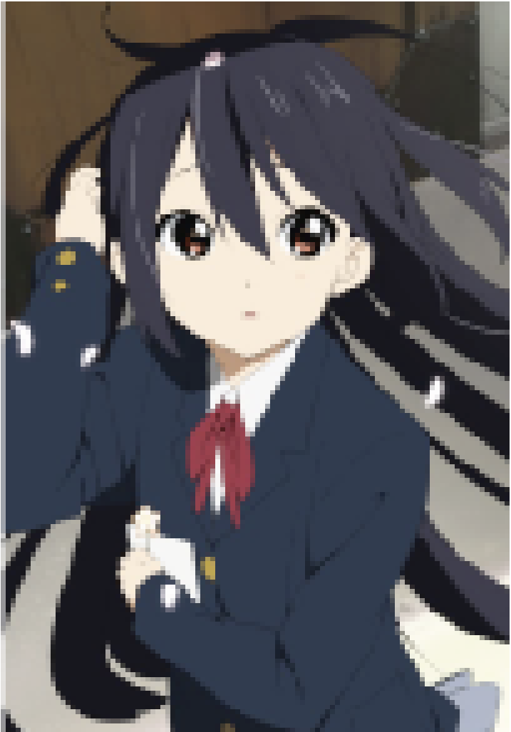
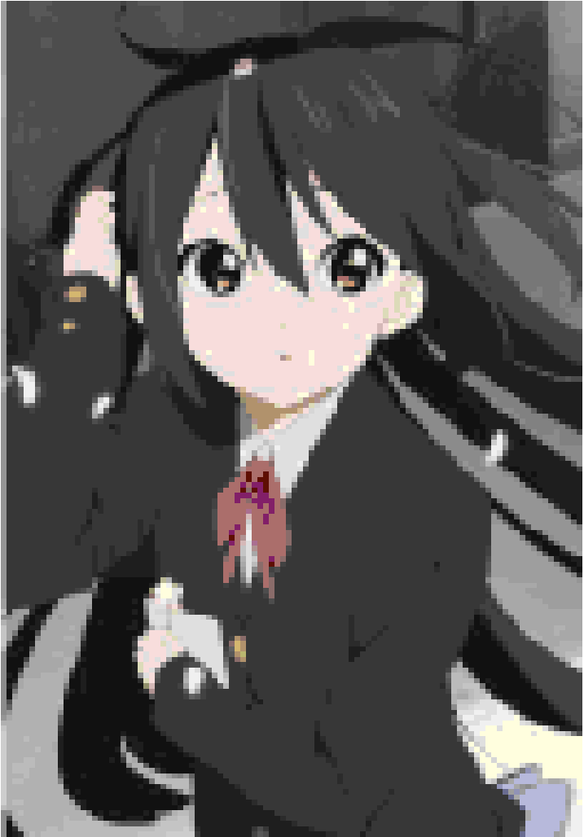
ANSI Color Codes
Image -> text
catimg
Some terminals support 3-byte “true color”
Neither Vim’s AnsiEsc nor Vim’s Colorizer can render these
Thus, have to use 255 color mode
original image
b. catimg 24-bit “true color”
c. catimg 8-bit

Slide 27
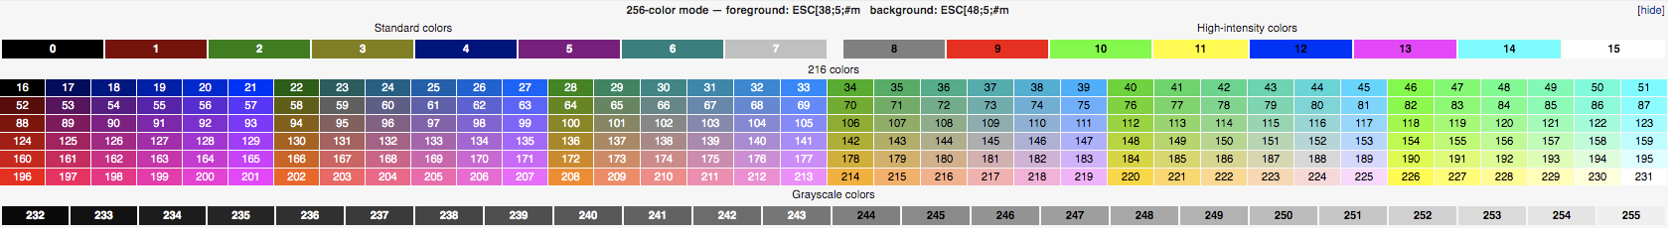
The Algorithm
Downscale image somehow (averaging window, bicubic, bilinear, etc.)
Convert color to nearest ANSI color
  Find closest color!
  catimg uses YUV color space + Euclidean which explains the poor quality

Slide 28
Downscaling
Use ffmpeg
Good
  Area (used by catimg)
  Experimental
Okay
  Bilinear
  Gauss
Bad
  Bicubic
  Neighbor
  Bicublin
  Sinc
  Lanczos
  Spline

Slide 29
Downscaling
full_chroma_int and full_chroma_inp don’t seem to do anything
Could use uniform color space for the averaging
Makes very little difference

Slide 30
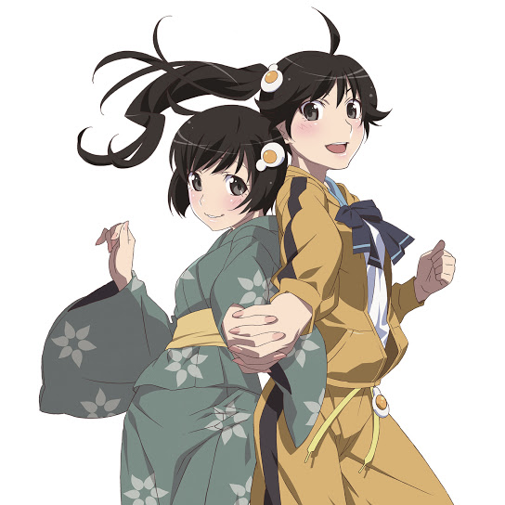
Dataset
Album cover of Nisemonogatari Gekihanongakushu (Original Soundtrack)
  Album covers are nice and square, low resolution (544x544)
Colors reveal failure points

Slide 31
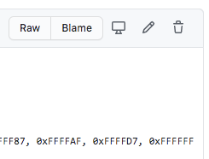
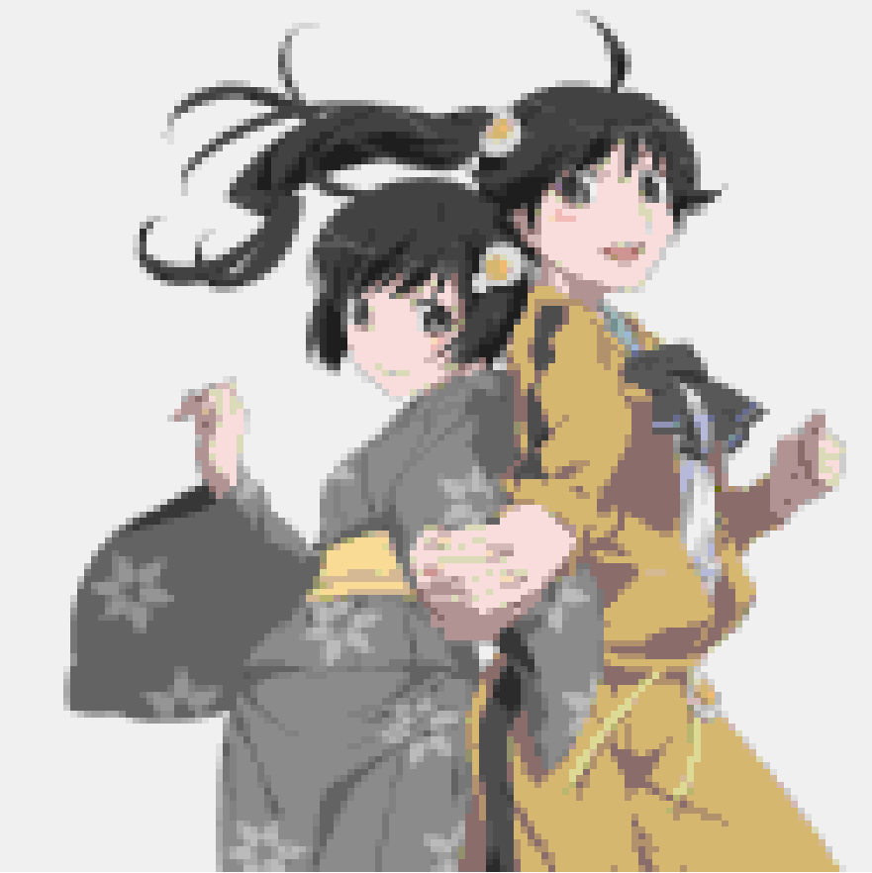
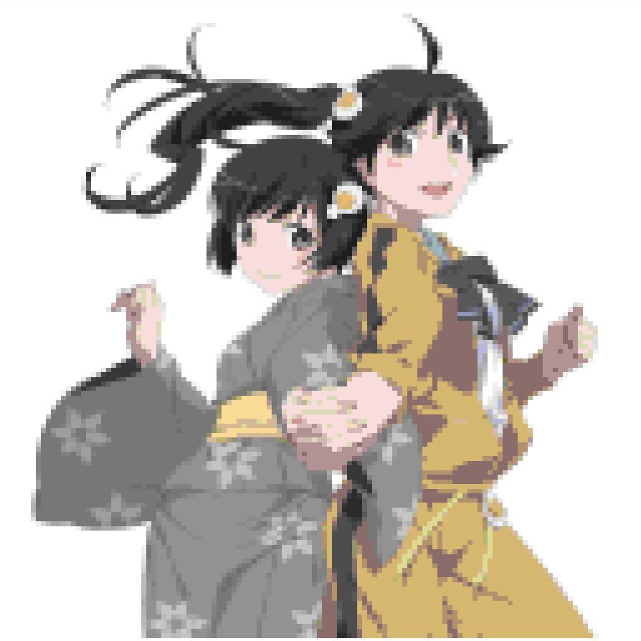
Getting Started
not sure why catimg doesn’t render white…?
original | catimg | YUV

Slide 32
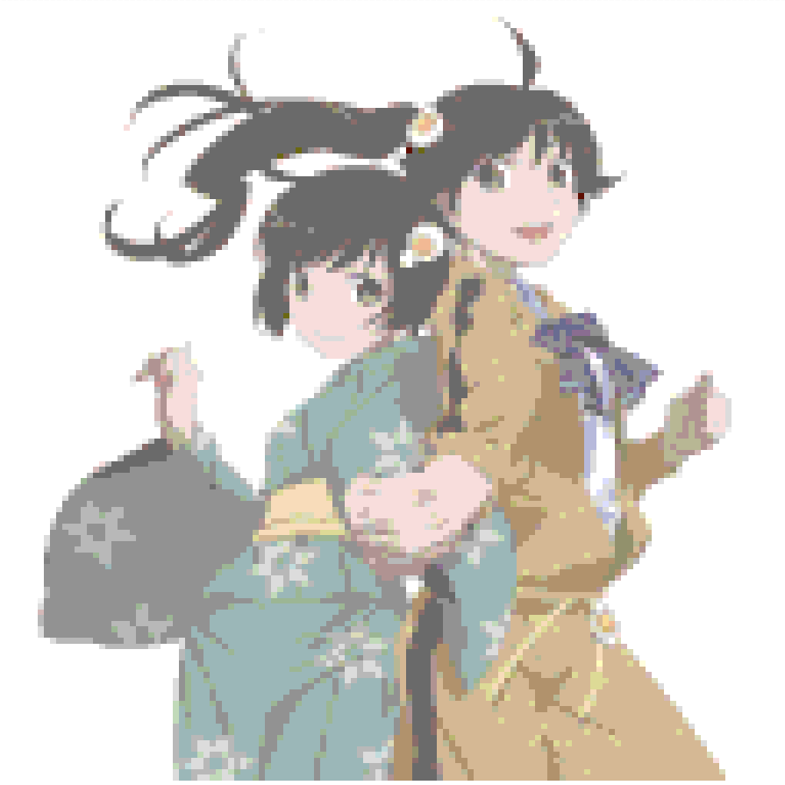
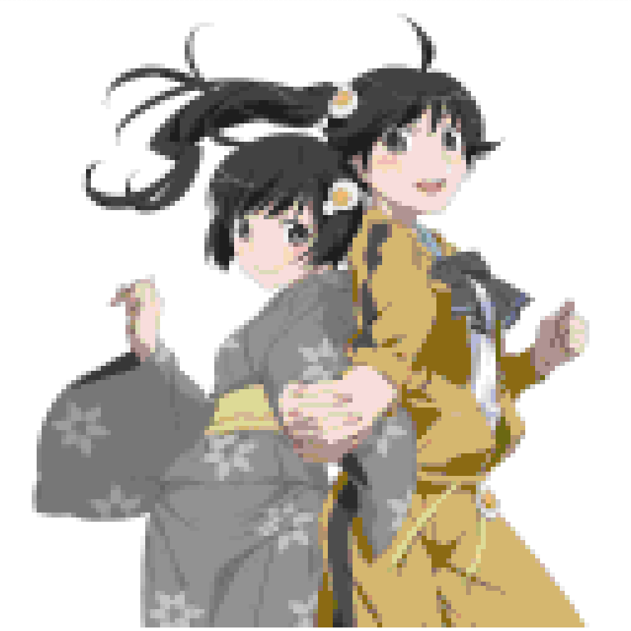
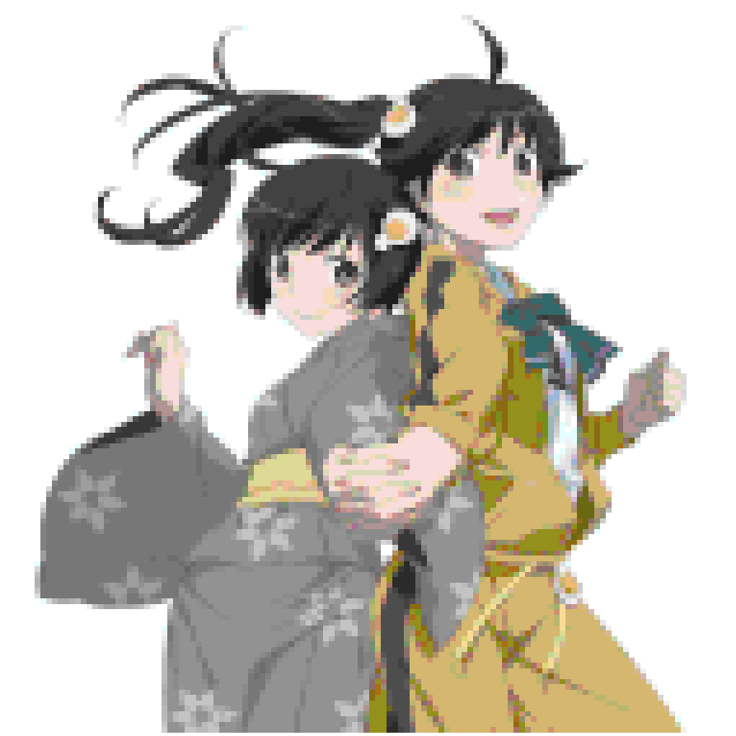
Basics
ansi256 | RGB | XYZ

Slide 33
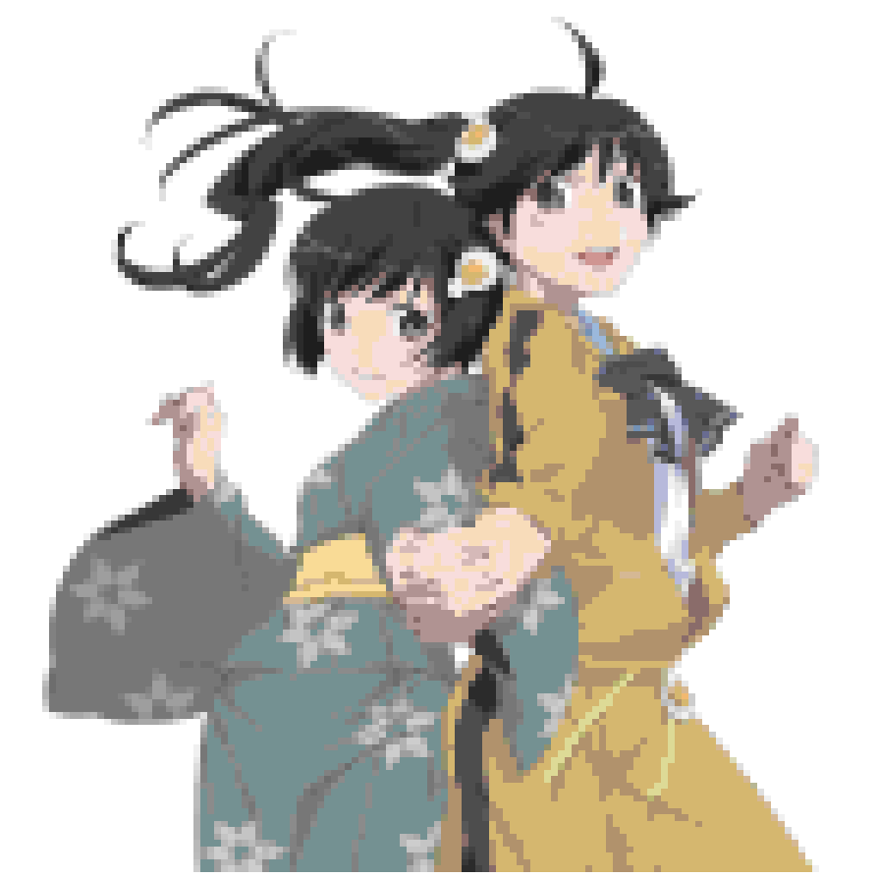
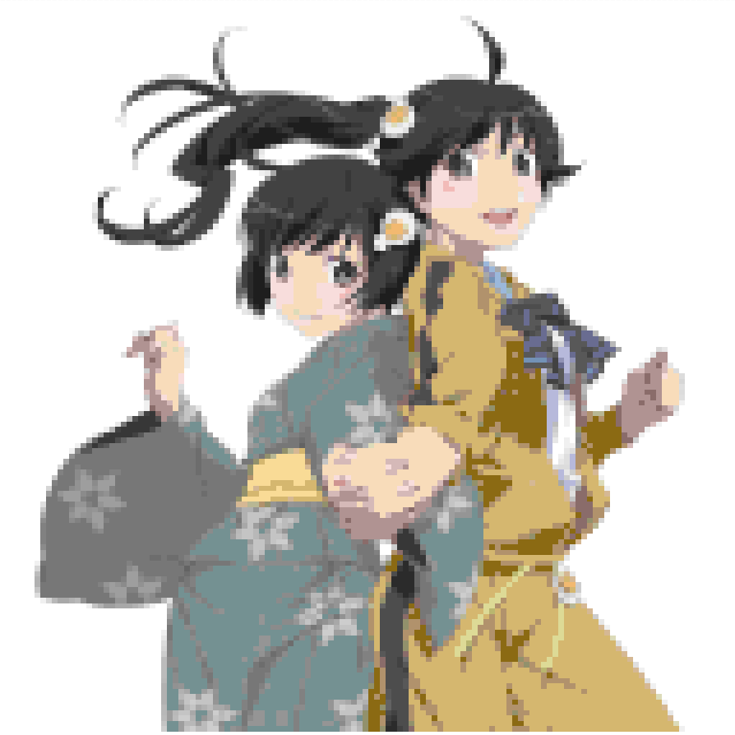

“Perceptually Uniform” Spaces
CIELAB | CIECAM02-UCS | CAM16-UCS

Slide 35
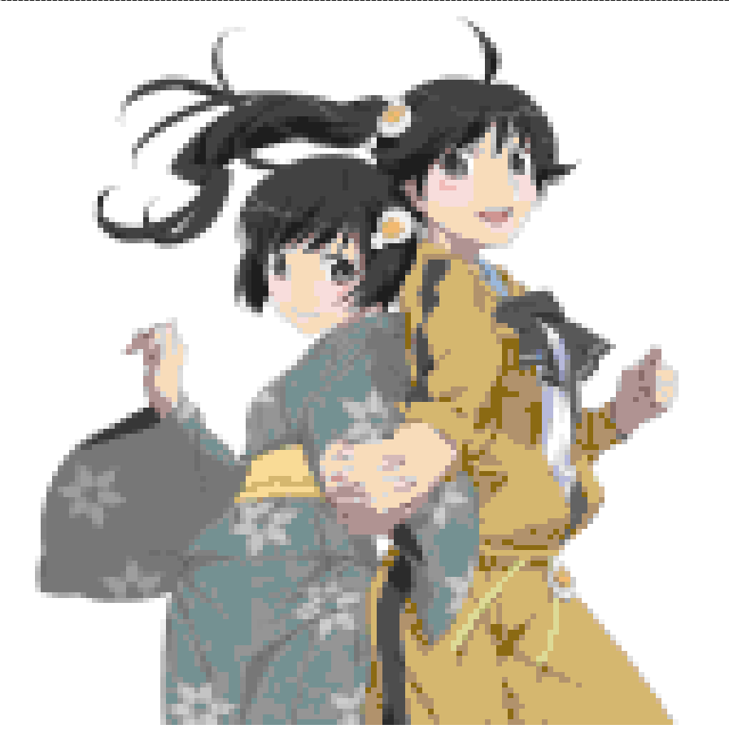
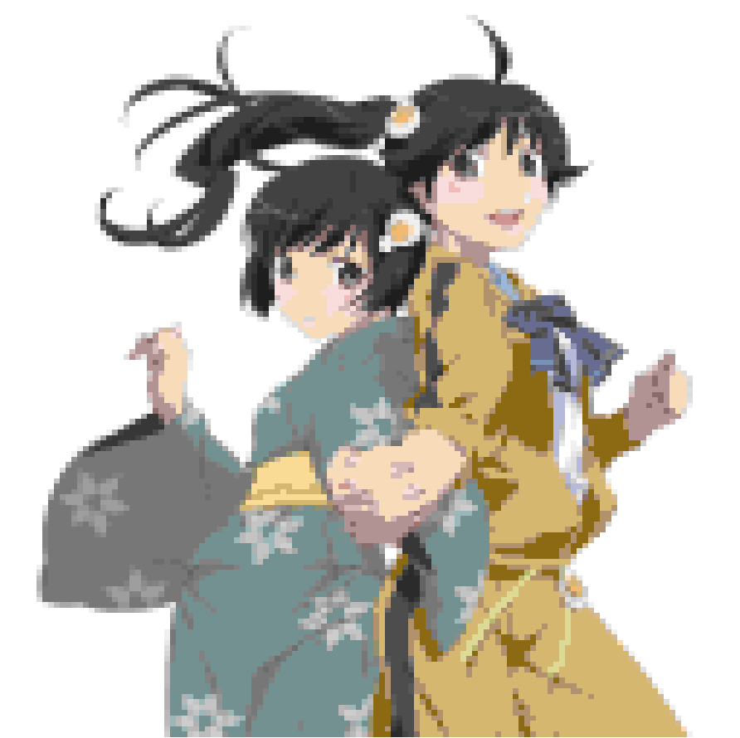
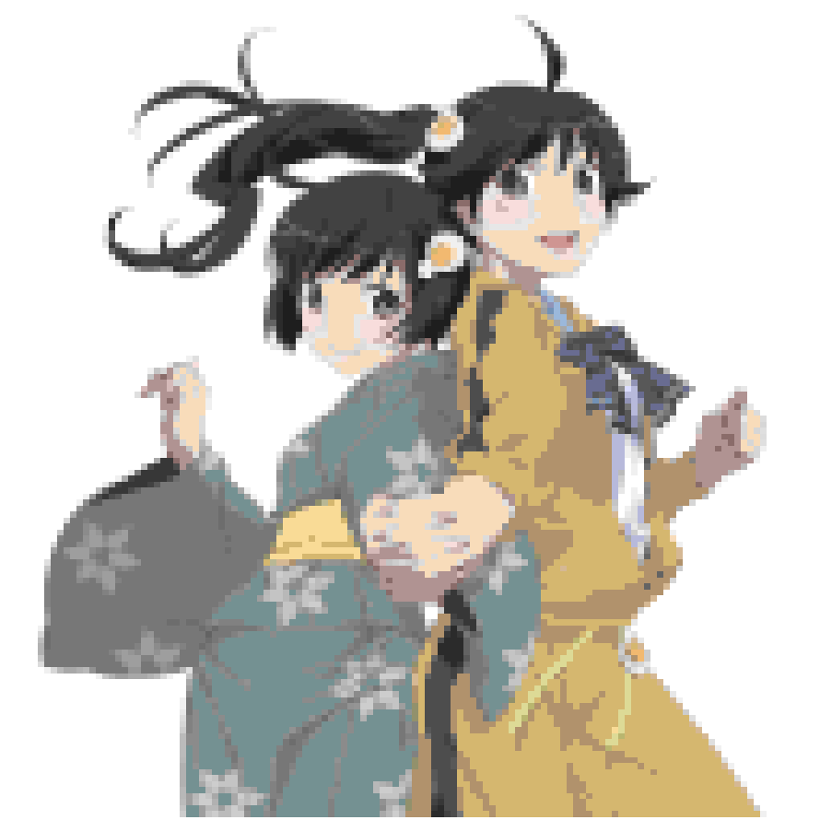
Distance Metrics
CIE94 | CIE2000 | CMC

Slide 36
k-means

Slide 37
Choosing k
If k too big, differences minor -> color space doesn’t matter
If k too small, not much able to do -> also doesn’t matter
Need k to be just right
In this case, k = 32
Anime images are too easy, real life is better
  131,707 distinct pixels versus 28,641: 4.6x difference

Slide 38
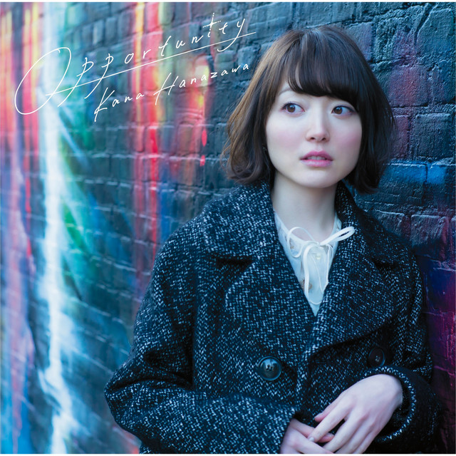
Dataset #2
Album cover of Opportunity by Kana Hanazawa

Slide 39
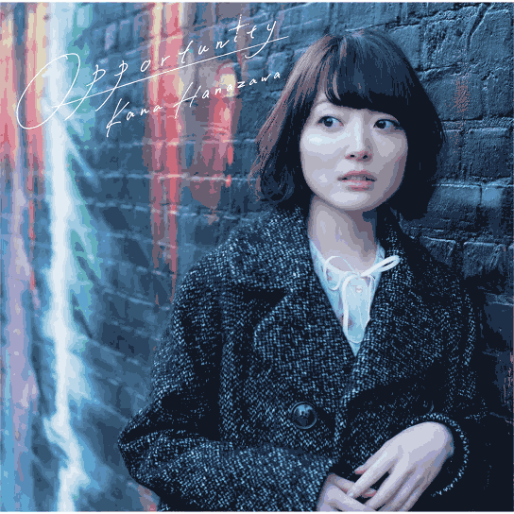
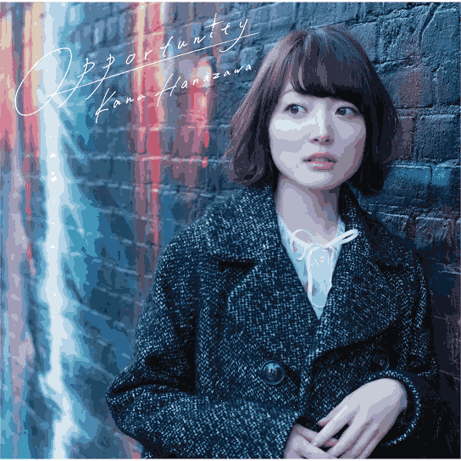
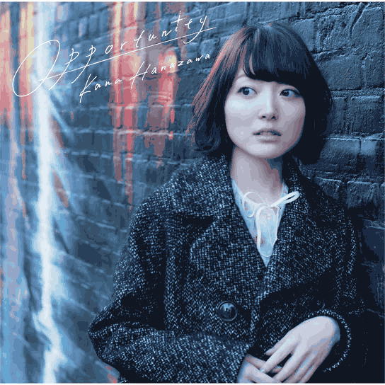
Basics
RGB | YUV | XYZ

Slide 40

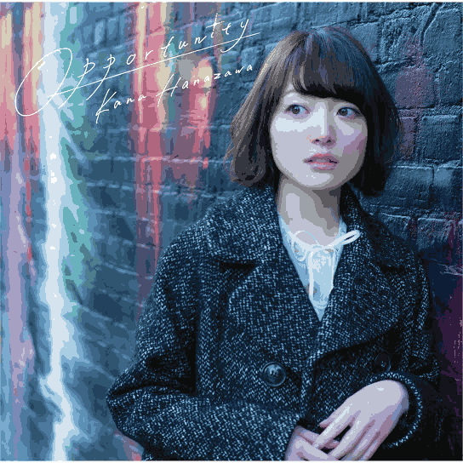
Perceptually Uniform Spaces
CIELAB | CIECAM02-UCS | CAM16-UCS

Slide 41
 | CIECAM02 | original | XYZ
Final score: | 205,064 | to | 90,872 | (CIEDE2000)

Slide 43
Conclusion
Color perception != image quality
Problems like this are really difficult
Machine learning?

Slide 44
Sources
My implementation(s)
Previous lecture: Color Theory, Part 1: Color Difference Metrics
  Check the sources in that presentation, not going to repeat!
sRGB - Wikipedia
Linear, Gamma and sRGB Color Spaces
What's wrong with 8-bit linear RGB?
YUV - Wikipedia
catimg YUV implementation
  scikit-image, tensorflow (tf.image)
Delta E (CMC)
Scaling - FFmpeg

Slide 45
Sources
Power functions improving the performance of color-difference formulas
The CIECAM02 color appearance model
Uniform Colour Spaces Based on CIECAM02 Colour Appearance Model
Comprehensive color solutions: CAM16, CAT16, and CAM16-UCS
Algorithmic improvements for the CIECAM02 and CAM16 color appearance models

