Slide 1
Accelerating Exact k-means Algorithms with Geometric Reasoning
Close reading of a paper
Stephen Huan
TJ Vision & Graphics Club, January 21, 2021
Notes:
to present: https://docs.google.com/presentation/d/1U8PiAoVIe2rvfzQ_q9tECdlYfy-mHq6HnJUC45Wy9Y4/preview?rm=minimal

Slide 2
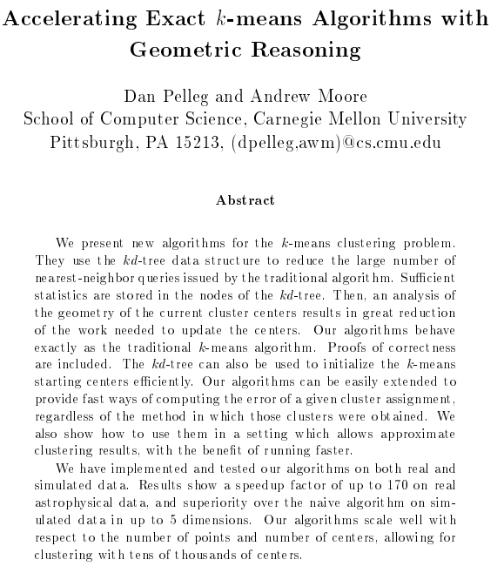
This paper:

Slide 3
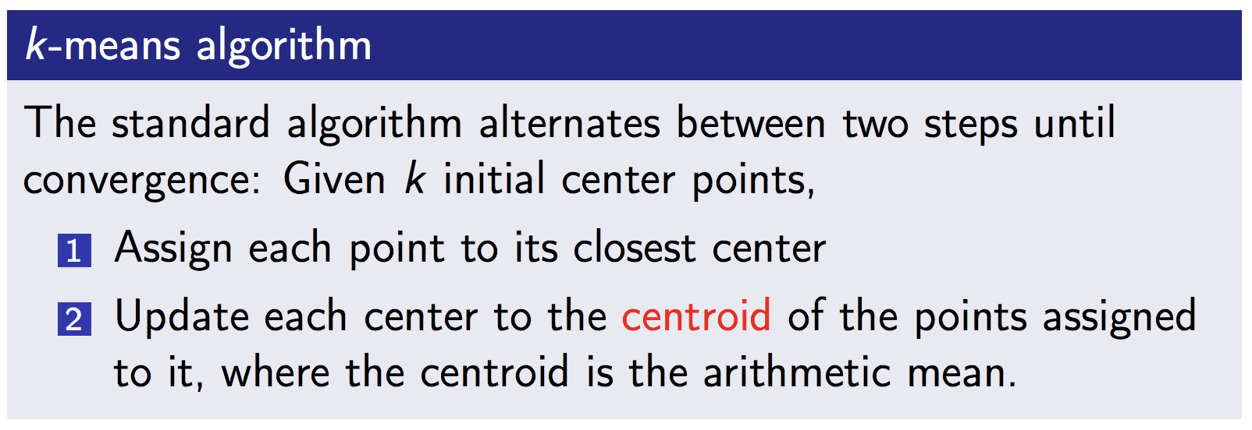
Review: k-means

Slide 4
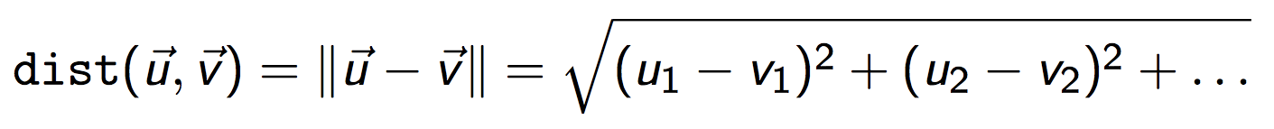
k-means analysis
K: Number of centers, N: number of points
D: Number of dimensions
I: Number of iterations (hard to know a priori)
For each iteration:
For each point:
Find its nearest center
For each center:
Compute dist(point, center)
Pick minimum distance center
= O(KD)
Compute dist(point, center)
Find its nearest center
Find its nearest center
= O(INKD), analyze per iteration -> O(NKD)

Slide 5
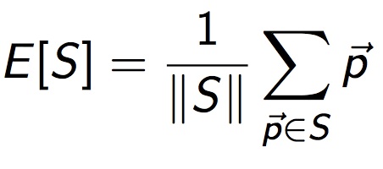
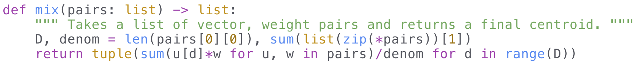
k-means analysis, cont.
Updating centers to centroid
Assume we have point -> nearest center from last slide
For each center, go through its points and average.
Note: points may be weighted (duplicates)
[(0, 1), (5, 1), (2, 3), (0, 1), (2, 3)] -> [((0, 1), 2), ((2, 3), 2), ((5, 1), 1)]
= D(S₁ + S₂ + … + S_{n}) = O(DN) -> time dominated by assignment

Slide 6

Consider the following...
N = 60,000 pixels
K = 256 (8-bit image)
I = 111 iterations
NKI = 60,000*256*111 > 1.7 billion
1.7*10⁹/1 MHz = 1700 seconds/60 = 30 minutes!

Slide 7
Can we do better?
Yes, kd-trees!

Slide 8
kd-tree, review
BST insert: compare value against root’s value
  If less, recur on the left subtree
  If greater, on the right subtree.
kd-tree: similar, but node holds point (vector), not scalar
  Need some way of comparing
  Pick an arbitrary cutting dimension to compare
  Cycle through cutting dimensions
Note: x_{cd} = k defines a hyperplane (high dimensional plane)

Slide 9
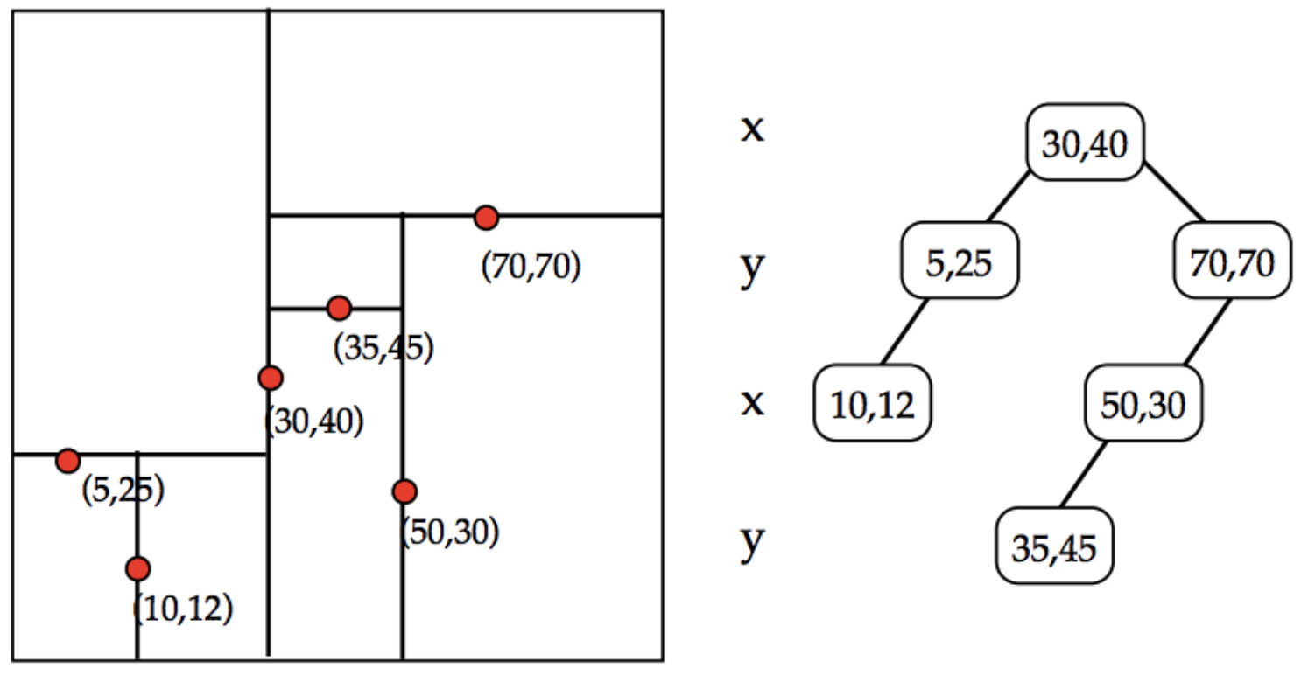

Slide 10
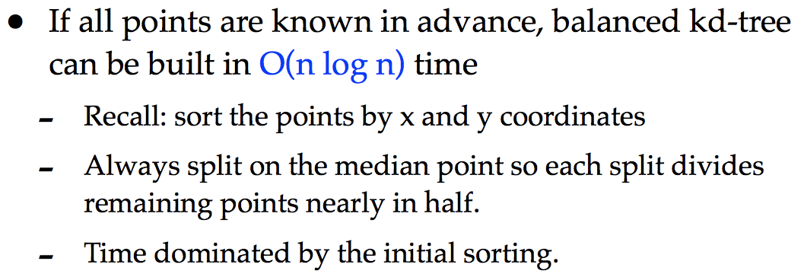
Building a kd-tree
See previous lecture
O(d² n log n) “pre-sort”
  O(d n log n) with careful representation
O(n log n) “median” if you read too much Introduction to Algorithms
  Irrespective of dimensionality!
  High constant factor, however...
tl;dr fast
Silly CMU, pre-sort is O(d n log n)!

Slide 11
mrkd-tree
“Multi-resolution kd-tree”
Additional data at each node
  Bounding box
  Number of points
  Centroid
Can we just annotate a regular kd-tree?

Slide 12
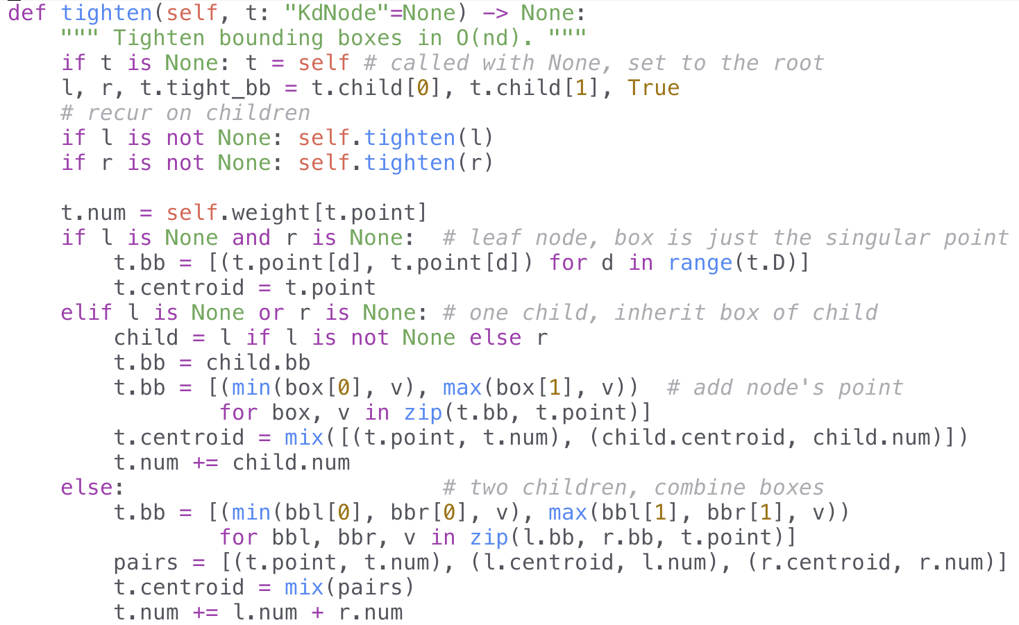

Slide 13
Using the kd-tree
Can be used to speed up nearest neighbor queries
~O(log n + 2^{d})
  log n from tree search
  2^{d} from nodes “near” the target point
Build kd-tree on centers and use for queries
Is this really the best approach?

Slide 14
Comparison
kd-tree on centers
Few points, K ≤ N
  In practice, K < 10
  Can maybe save a K factor vs log K
Dynamic, centers change every iteration
  Need to build a new kd-tree
Easily convert existing algorithm
kd-tree on points
Many points
  In practice, N > 100,000
  Can save time as it’s based on N
Static, points are the same
  Can build once and recycle
Requires a bit of adjustment
<
<
>
Clearly, we should build a kd-tree on the points, not the centers!
How?

Slide 15
This is where the paper comes in...

Slide 16
Ownership
Let C be the list of centers, len(C) = K
Center c “owns” a hyper-rectangle h (kd-node and descendants)
  Every point in h is closer to c than to any other center
  “Every point” is really “every point”; not just the ones in the kd-tree
  Obviously, all points assigned to c
If we can show c owns h, no need to check points in h
How to show ownership?

Slide 17
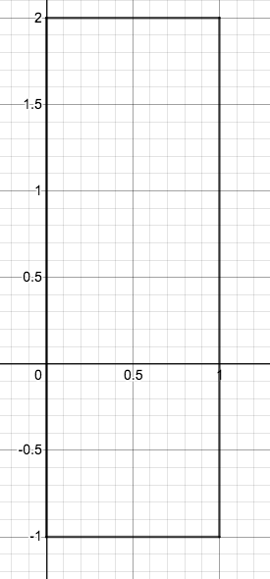
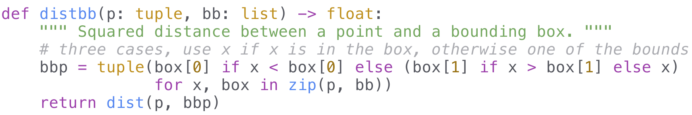
Point to Hyper-rectangle
Let bb be the bounding box
  Length is the dimensionality D
  bb[d] contains the min and max along the dth dimension
  [(0, 1), (-1, 2)]
dist(p, bb)?
  Find the closest point to p in bb, q
  dist(p, q)
p[d] < bb[d][0] -> Take bb[d][0]
p[d] > bb[d][1] -> Take bb[d][1]
bb[d][0] ≤ p[d] ≤ bb[d][1] -> Take p[d]

Slide 18
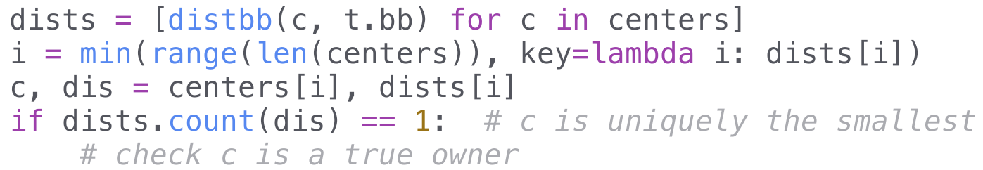
Condition #1
c must have the minimum distance to h
  If not true, contradiction!
  Suppose other center c' with dist(c', h) < dist(c, h)
  Note that dist(c, h) constructive, finds closest point
  Therefore there’s a point closer to c' than c
  Contradicts definition of owner
Must also be unique
  Can’t have two points with minimum distance
  Neither owner

Slide 19
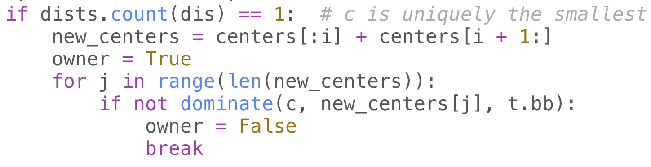
Condition #2
Condition #1 narrows down the owner candidates to either 1 or 0
If there isn’t an owner, we’re going to recur on the children
  Left and right hyper-rectangles
Let’s say we have a candidate c₁
Is c₁ a true owner?
  Check against all other centers, call one of them c₂
  Is every point in h closer to c₁ than c₂? c₁ “dominates” c₂

Slide 20
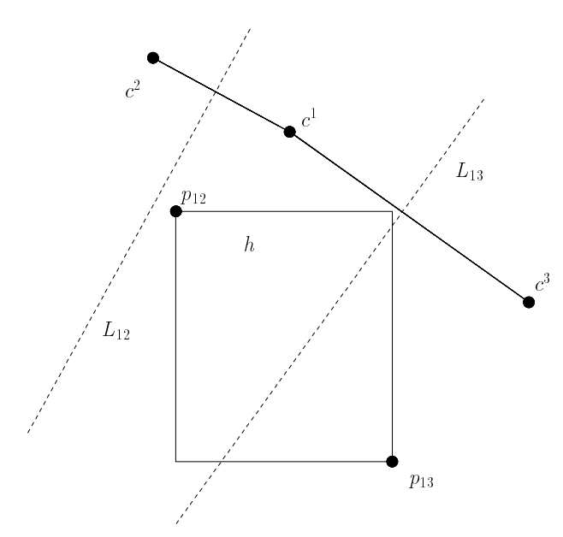
Domination
v
Line of points equidistant to c₁ and c₂ L
If there’s a point p on the wrong side of L, c₁ doesn’t dominate c₂
Optimization problem:
  Objective: Be as far in the half-space as possible (not the same as being close to c₂!)
  Constraint: Contained in h
How to measure objective?
Look at v = c₂ - c₁
v dot p
Linear programming!

Slide 21
Linear Programming
Linear objective and linear constraints
Yes! Objective v dot p, v is a constant
  = v₁ p₁ + v₂ p₂ + … + v_{D} p_{D} , linear function of p
Constraints of the form
  h[d][0] ≤ p[d] ≤ h[d][1] for d between 0 … D - 1
Algorithms for linear programming irrelevant
  Mathematical ideas relevant

Slide 22
Solving Linear Programs
Feasible value: satisfies constraints
Region of feasible values: simplex
Optimal value must be at a corner of the simplex
Proof. Start at arbitrary point and follow the gradient (vector) until we reach the exterior. From here, move along edges. All edges are orthogonal to the gradient or not. (1) If all are, then our function value can’t change, current value is optimal. Move along an edge to a corner. (2) If all aren’t, move along an edge in the right direction. Must eventually run out of edges, at which point (1) applies.
(moving in direction of gradient increases function value)
(I don’t know enough math to justify this)

Slide 23
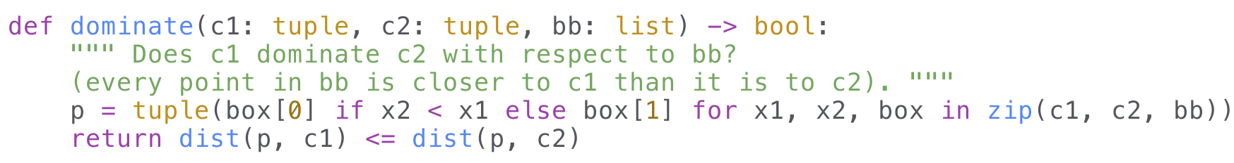
Back to Domination
Gradient is simply v = c₂ - c₁, direction towards c₂’s side of the line
Simplex is the hyper-rectangle h
Optimal value occurs at corners of simplex = corners of h
Can efficiently compute best point p
  Take max or min depending on which is in the direction of c₂ - c₁

Slide 24
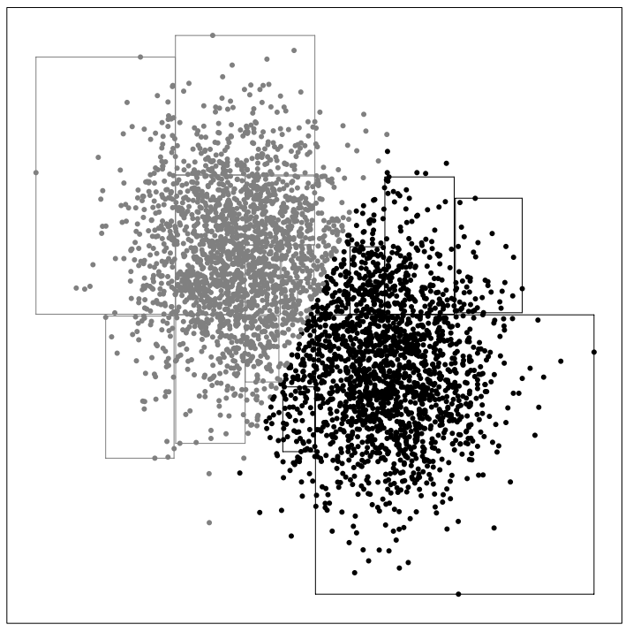
Example

Slide 25
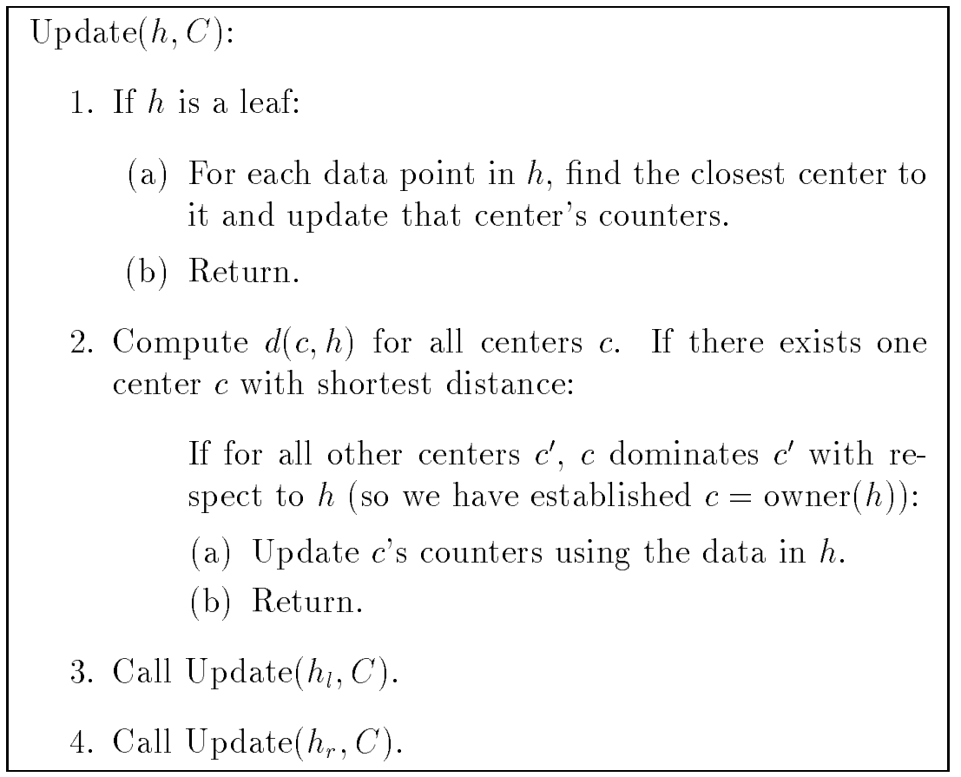
Putting it Together
base case
“For each data point in h” when h is a leaf and leaves of a kd-tree contain exactly one point?
¯\_(ツ)_/¯
condition #1
condition #2
This is where the algorithm saves time!
recursion

Slide 26
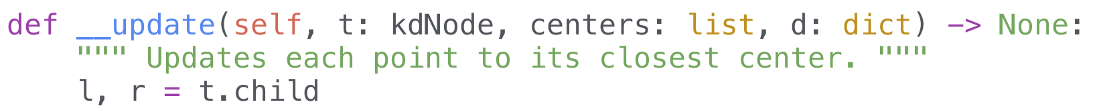

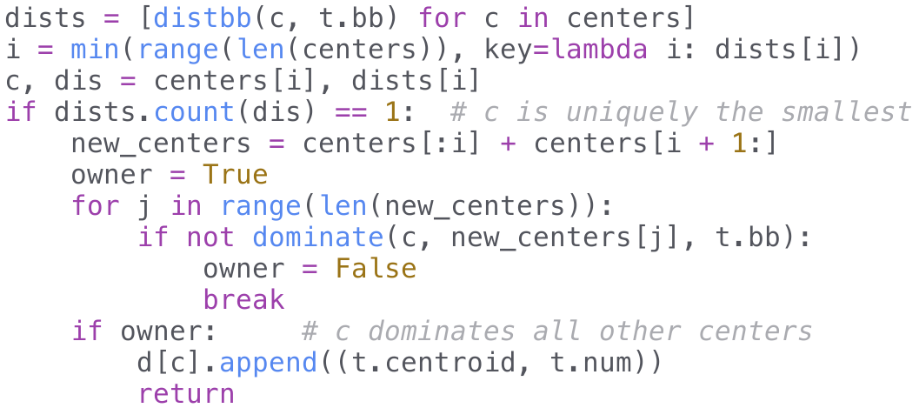
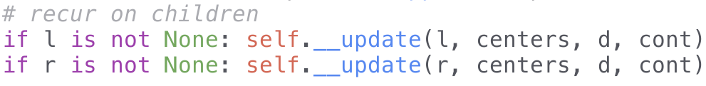
Putting it Together, Code

Slide 27
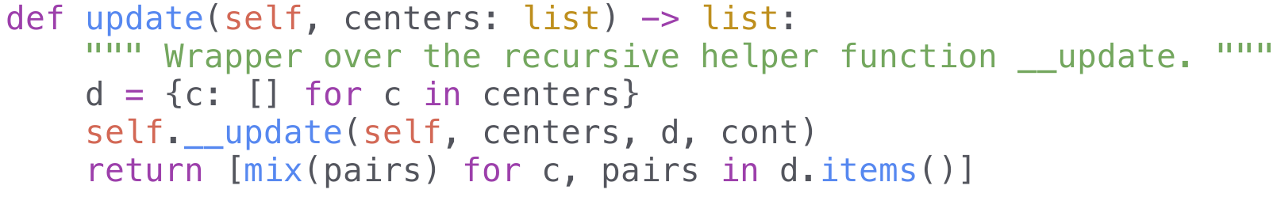
Finishing Touches

Slide 28
One Small Adjustment...
Paper’s kd-tree stores points at leaves
In our kd-tree, intermediate nodes also have points
Simply add its point with brute force before recursion

Slide 29
Blacklisting
Suppose c₁ is an owner candidate
c₁ dominates c₂ but isn’t an owner overall
Normally, recur and have to check again
But c₂ can’t be an owner anymore!
  If we recur on h', every point in h' is in h
  Thus, c₁ still dominates c₂
  c₂ can’t be an owner
Saves time in multiple ways!
  Checking ownership
  If at a leaf, less centers to check

Slide 30
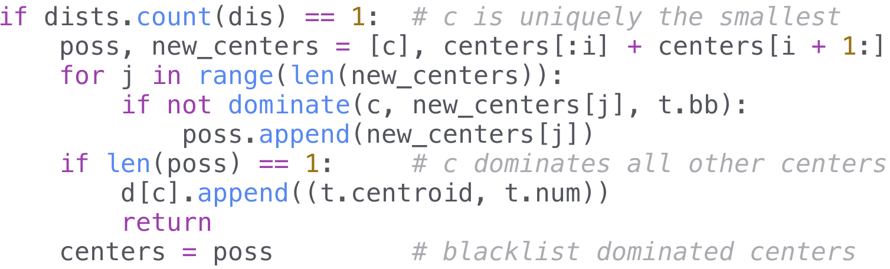
Blacklisting, code

Slide 31
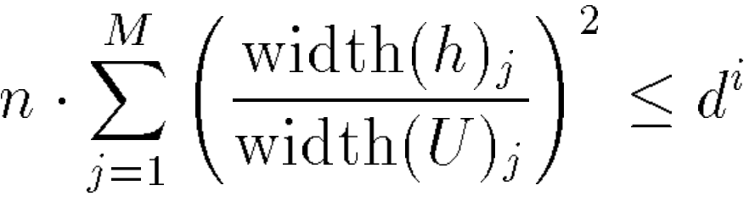
Approximate Pruning
Speed up the algorithm by cutting off recursion
Heuristic for when this is “safe”
Few points, small rectangle, early on = less error
Divide points between current centers
h: hyper-rectangle
n: number of points
U: hyper-rectangle
of all points
M: number of dimensions
i: iteration number
d: parameter, recommended 0.8

Slide 32
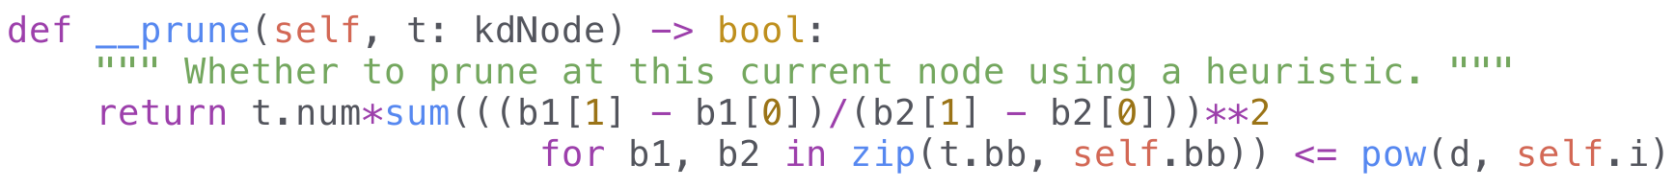
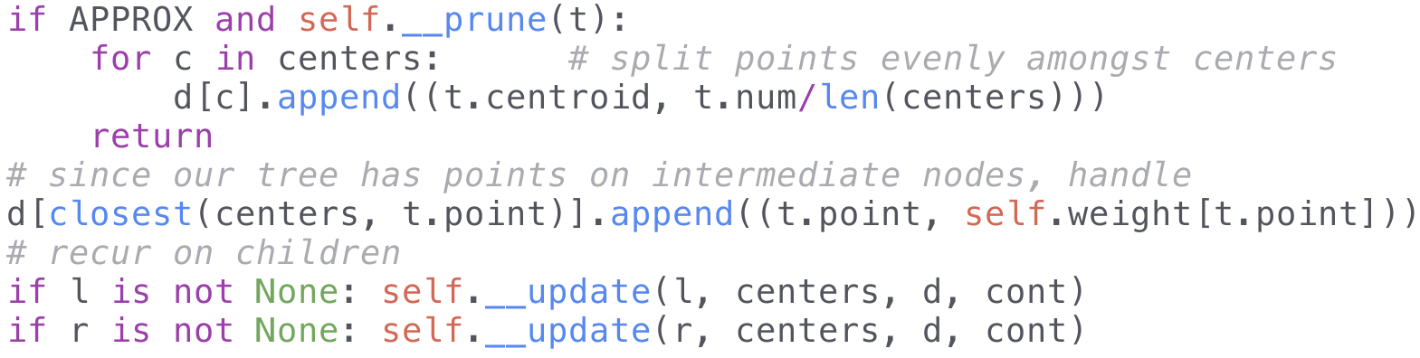
Pruning, Code

Slide 33
Paper is done!
How’s the results?

Slide 34

Benchmarks, Dataset
hanekawa.png: https://stephen-huan.github.io/assets/images/hanekawa.png
Size: 570 x 517
Pixels: 294690
Distinct pixel count: 59809
Most common pixel: (250, 228, 213) => 19377

Slide 35
Benchmarks, Result
testcases/hanekawa.png, K = 8
k-means++ initialization scheme
 | PyPy | Python
kd-tree | 5.220s | 6.420s
naive | 8.379s | 17.164s

Slide 36
Benchmarks, Results
testcases/hanekawa.png, K = 256, PyPy
naive (run on all pixels): 35m 22s073
naive (distinct pixels): 8m 38s343
kd-tree median ( n log n): 3m 52s540
kd-tree pre-sort (dn log n): 3m 48s248
kd-tree geometric reasoning: 1m 47s550
kd-tree approximate (d=0.8): 2m 18s735
Slower!
Implementation mistake? ¯\_(ツ)_/¯
Worse centers -> more iterations
Overhead in calculating prune

Slide 37
Extensions

Slide 38
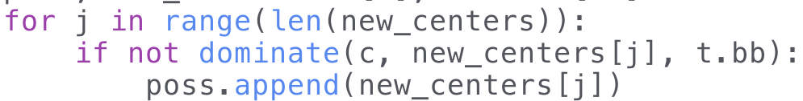
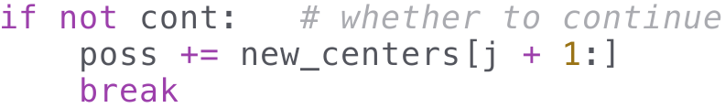
Continue Parameter
Trying to show c is an owner
If it isn’t, should we break?
  Don’t waste time comparing against other centers
  But continuing could save time if we removed them with blacklisting
Usually faster to continue than not continue
  4m 0s716 without continue vs 26s802 with continue

Slide 39
kd-tree for Leaf Nodes
O(0) if point is pruned
O(K) if it isn’t (leaf or intermediate)
Can we speed the worst case up?
Build a kd-tree on the centers again!
~ O(log K)
K needs to be large in practice; blacklisting removes many centers
  Average 1-2 centers for K = 256
  Not O(K), actually O(# of centers)
Use kd-tree if len(centers) > F(log₂ K + 2^{d}), brute force otherwise
  F = 4, see appendix for empirical justification

Slide 40
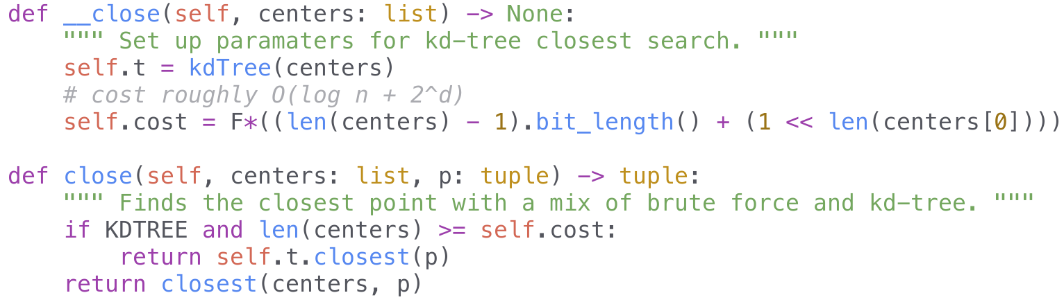
kd-tree for Leaf Nodes, Code

Slide 41
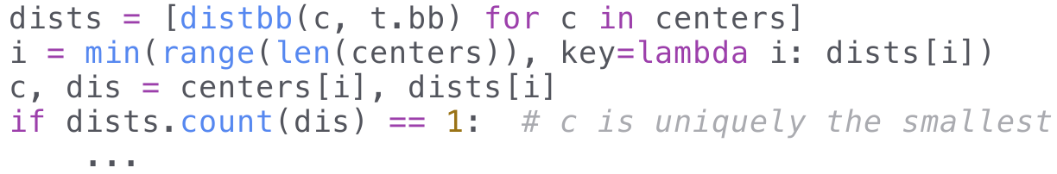
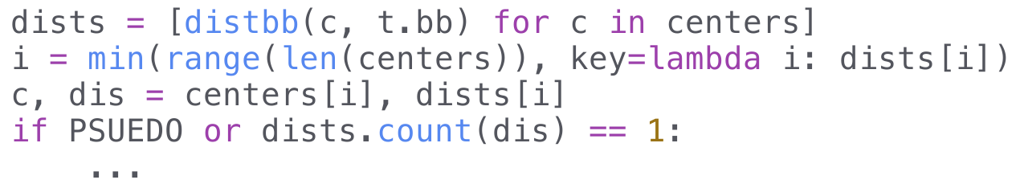
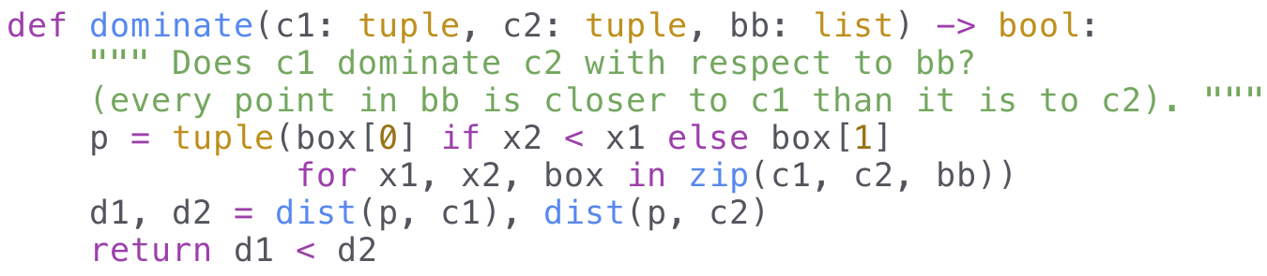
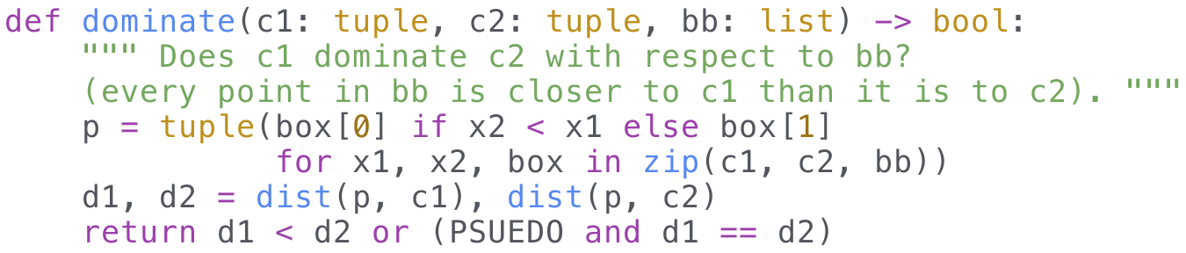
“Pseudo”-owner
Original paper restrictions seem excessive
  Does c really need to be the unique minimum?
  Does c really need to completely dominate?
No, can relax the conditions
  Allowed to arbitrarily choose between equidistant centers
  Maintains same quality and sometimes the same centers
Reduces number of candidates and improves pruning

Slide 42
Benchmarks, Results
testcases/hanekawa.png, K = 256, PyPy
naive (run on all pixels): 35m 22s073
naive (distinct pixels): 8m 38s343
kd-tree median ( n log n): 3m 52s540
kd-tree pre-sort (dn log n): 3m 48s248
kd-tree approximate (d=0.8): 2m 18s735
kd-tree geometric reasoning: 1m 47s550
w/out k-means++: 32s732
w/ pseudo owners: 26s802
4x improvement (5x less pixels)
5x improvement
3x improvement (removing k-means++)
= 60x improvement!

Slide 43
k-means++

Slide 44
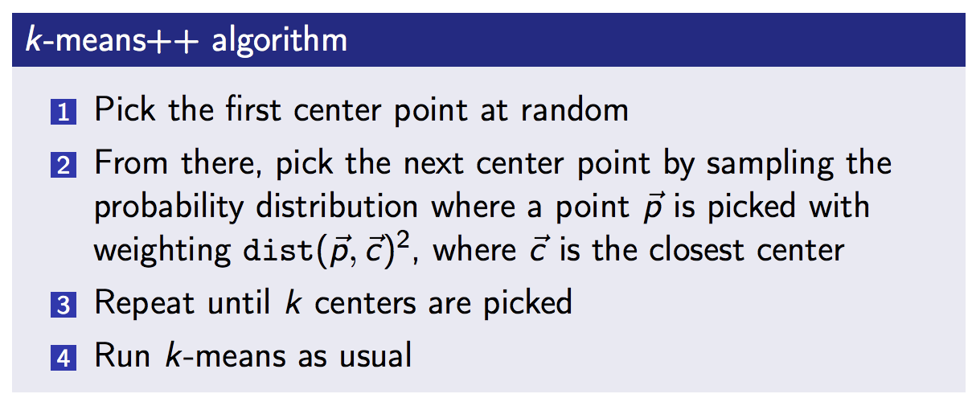
k-means++, Review
Initialization strategy
For more information, see the previous lecture

Slide 45
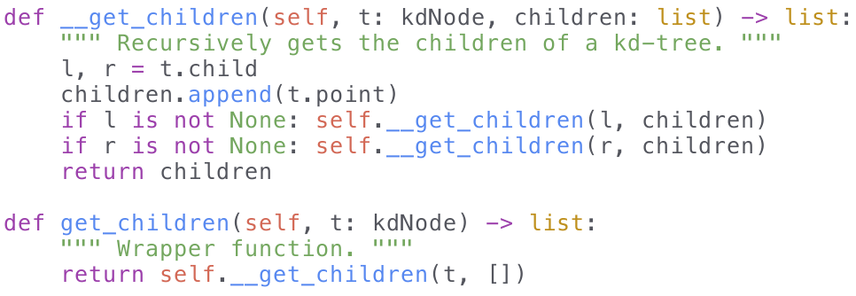
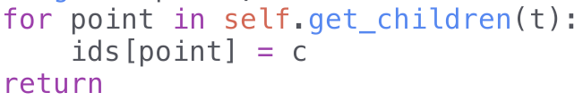
Speedup
We can apply the kd-tree algorithm
Simply change the counters
Leaf/internal node:
  D
Pruned point:

Slide 46
Speedup, Analysis
Might not seem like we’re doing much
Need to touch every point still
However, save O(K) distance checking if pruned
  Save O(average # of centers) after blacklisting for leaves
Could be up to K times faster
Can we do better?

Slide 47
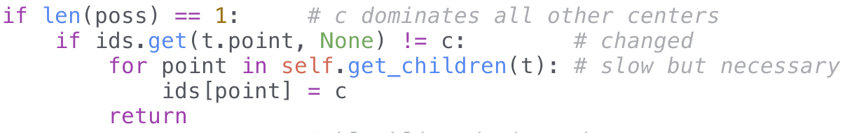
Caching IDs
Need to iterate over each point when pruned
  Original algorithm can simply skip over
Centers aren’t changing, only added
Cache IDs if the new center doesn’t change ownership
  If kd-node points to c and c owns h, then c must have owned h in the past
  If c owned h and c dominates the new center, all points already point to c
  No need to do anything

Slide 48
Caching IDs, Analysis
Expected time savings?
Assume points are split evenly among centers
  K = 1 -> need to update all points
  K = 2 -> need to update half of the points
  etc.
N + ½ N + ⅓ N + … + 1/K N = N (1 + ½ + ⅓ + … + 1/K)
= N H_{K} = O(N log K)
Very optimistic
In practice:
  108,248 for K = 8 vs NK = 480,000
  4,794,349 for K = 256 vs NK = 15,360,000

Slide 49
Probability Distribution
Still maintaining a list of distances
Need to sample from this PMF
= O(N), O(NK) over K centers
Can we speed this up?

Slide 50
BIT CMF
Maintain the cumulative mass function (CMF) instead
CMF is just the prefix sum of the PMF
Only update when a point changes
Can efficiently update with segment trees or binary indexed trees (BITs)
  My BIT and segtree implementation here
Sample by binary searching on the CMF
  Why does this work? See: my analysis of Mudae (page 9) and the previous lecture

Slide 51
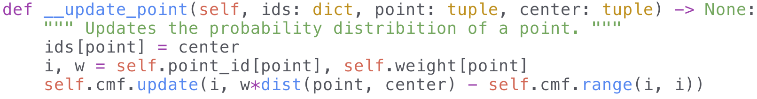
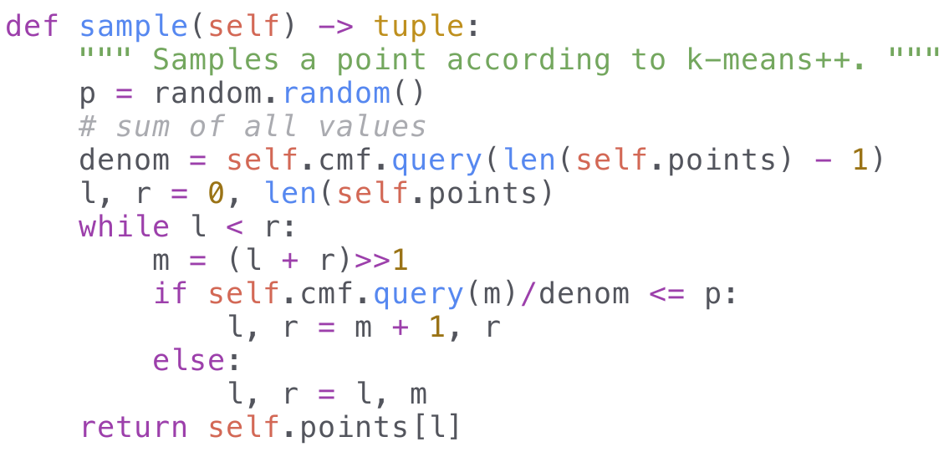
BIT CMF, Code

Slide 52
BIT CMF, Analysis
Sample runs in O(log² N)
  log N queries from the binary search, each query is log N
  = O(K log² N) over K centers
The total amount of work for updating IDs is harder
Optimistically, O(N log K) total updates
  = O(N log N log K) overall
In practice, closer to O(NK) = O(N log N K)
Naive is O(NK²)
  K iterations of finding the closest center for N points

Slide 53
Benchmarks
testcases/hanekawa.png, K = 256, PyPy
k-means++ naive: 311.600s, 111 iterations
k-means++ kd-tree: 122.594s, ---
k-means++ geometric reasoning: 75.269s, ---
k-means++ cache ids: 53.181s, ---
k-means++ BIT CMF: 44.143s, ---
random.sample(): 0.001s, 108

Slide 54
k-means++, Judgement
k-means++ has strong theoretical properties
On “real-world” datasets, irrelevant
  K iterations over N is just way too much!
  Can’t parallelize, each iteration depends on previous
Need some way of speeding up...

Slide 55

Conclusion
Build a kd-tree on the points, not the centers
Works well in practice and in theory
Many avenues for improvement
256 color image generated in less than 30 seconds

Slide 56
References
Accelerating Exact k-means Algorithms with Geometric Reasoning
k-means, kd-Trees, and Median of Medians (CV club lecture)
CMU kd-tree, kd-tree continued

Slide 57
Appendix

Slide 58
Convergence
How do we test if k-means has converged?
Centers hasn’t changed
Sort new center list, check if equal to previous
Not necessarily O(D K log K) (although this is a fairly trivial cost)
Some sorting algorithms proportional to displacement, e.g. bubble sort
Can run in nearly linear time if the centers don’t change that much

Slide 59
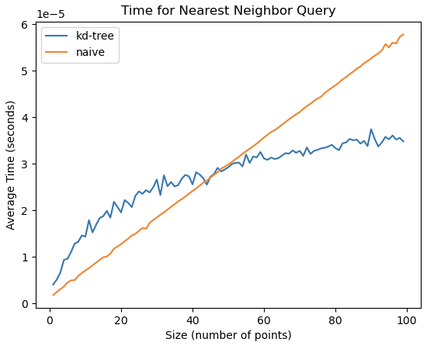
Determining F
Naive:
  T₁(x) = mx + b
  0 at x = 0, 6 at x = 100
  m = 6/100, b = 0
kd-tree:
  T₂(x) = a ln x + b
  2 at 20, 3 at 100
  a = 1/(ln(100) - ln(20)), b = 2 - a ln 20
K = 256, T₂(K) = 3.58, T₁⁻¹(K) = 59.7
  log₂ K + 2^{d} = 8 + 8 = 16
  Therefore F(log₂ K + 2^{d}) = 16F ≈ 64
  F = 4

