Slide 1
Color Theory, Part 1: Color Difference Metrics
Stephen Huan
TJ Vision & Graphics Club, January 21, 2021
Notes:
to present: https://docs.google.com/presentation/d/1XlxeFMDeSFhnE3O-h7EvX-LEPMq4O18Dc1llNjYITZI/preview?rm=minimal

Slide 2
Introduction

Slide 3
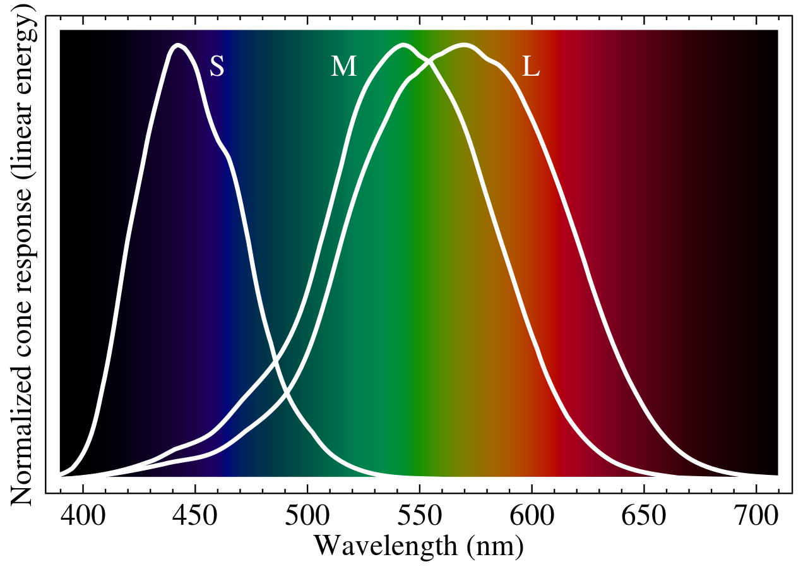
Basics: Physics & Biology
Light electromagnetic radiation
Wavelength “color”
Human eye contains cone cells
(L)ong, (M)edium, (S)hort type
  Roughly (R)ed, (G)reen, (B)lue
Hence, “RGB” color space

Slide 4
But What About RYB?
Red, Yellow, Blue taught in elementary school
If human eye roughly RGB, why?
Think of colors as vectors, “color system” = basis
  Effectiveness of system the size of span, “color gamut”
Most effective therefore RGB!
  To form color, linear combination of R (1, 0, 0) + G (0, 1, 0) + B (0, 0, 1) = (R, G, B)
  Rough correspondence with cones
But this is if we are emitting the light…
  e.g from a computer monitor
  “Additive” color system
What about printing?

Slide 5
Subtractive Color System
Paper has color, doesn’t generate its own light
Instead, reflects white light containing all colors
Remove colors by absorbing
Hence, use opposite color for basis
  Opposite in a discrete space: 0 -> 1, 1 -> 0. ~x = 1 - x
R = (255, 0, 0) -> -R = (0, 255, 255) = “cyan”
-G = (255, 0, 255) = “magenta”
-B = (255, 255, 0) = “yellow”
Thus, CMY system for “subtractive” color system

Slide 6
Basis of the Subtractive Color System
W = 2*255*(1, 1, 1)
W - [c₁ (0, 1, 1) + c₂ (1, 0, 1) + c₃ (1, 1, 0)] = (R, G, B)
W - [c₁ v₁ + c₂ v₂ + c₃ v₃] = x
c₁ v₁ + c₂ v₂ + c₃ v₃ = W - x
[v₁ v₂ v₃] [c₁ c₂ c₃]^{T} = W - x
c = M ⁻¹(W - x)
e.g. W - (319C + 191M + 64Y) = (255, 127, 0)

Slide 7
Implications
Most color spaces 3D, R³
Hence, kd-tree viable in low dimensionality
kd-tree naturally implies metric of “closeness”
Can use k-means on color space
  Assign point to “closest” center
  Assign centroid to “centroid”
Are these well defined?
How to measure “distance?”

Slide 8
Color Difference

Slide 9
Two Basic Approaches
Create a Uniform Color Space (UCS)
  Projection where Euclidean distance works well
  Distance, centroid, etc. naturally well-defined
  If Euclidean doesn’t work, centroid doesn’t work!
    More on uniform color spaces in the future....
Change distance metrics

Slide 10
Uniform Color Spaces
International Commission on Illumination, (CIE) - Commission internationale de l'éclairage
Transform RGB (more commonly CIE’s XYZ, space based off wavelengths) to some other space, use Euclidean in that space
How to measure effectiveness?
Need to ask humans to evaluate!

Slide 11
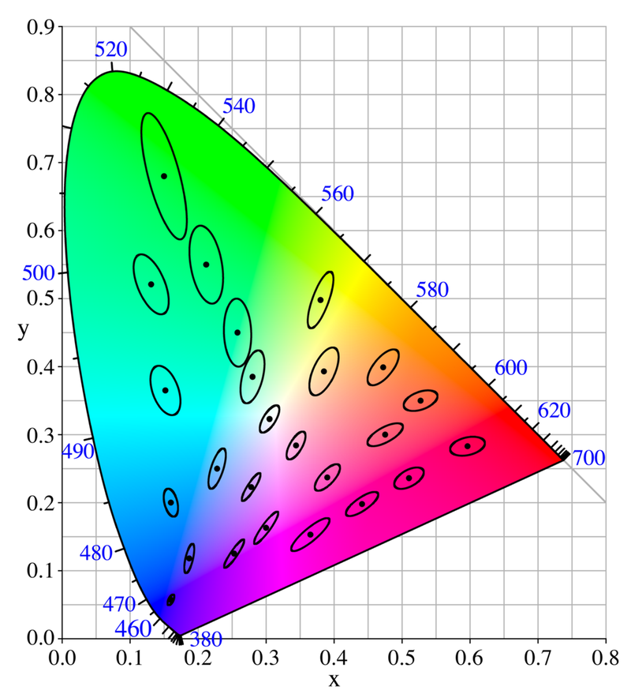
MacAdam ellipses
If uniform, points (colors) equally far away from center color define circle
Ask people to match color to target color until equal
Found matches fall into ellipses
Thus, XYZ not perceptually uniform!

Slide 12
CIELAB Color Space
“Uniform” color space designed to fix XYZ
L* = lightness, 0 = black, 100 = white
a* = green-red, negative = green, positive = red
b* = blue-yellow, negative = blue, positive = yellow
RGB -> LAB?
RGB -> XYZ
XYZ -> LAB

Slide 13
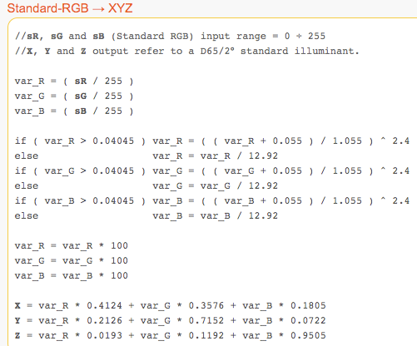
RGB -> XYZ

Slide 14
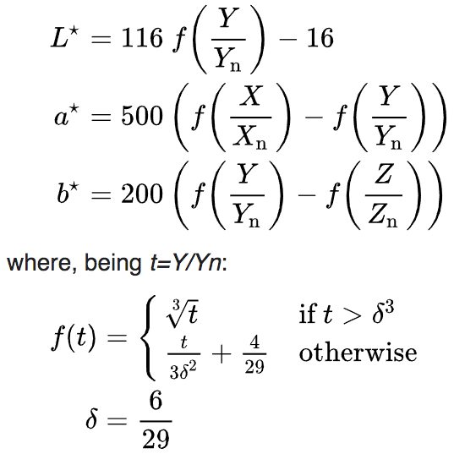
XYZ -> LAB

Slide 15

CIELAB Problems
RGB -> LAB, distance? Euclidean! (CIE76)
Has noticeable failures for two cases:
Low lightness
Sucks at blue

Slide 16
2. Distance Metric
Stick with CIELAB, “fix” it by changing distance metrics
Might have better distance calculation, but loses space...

Slide 17
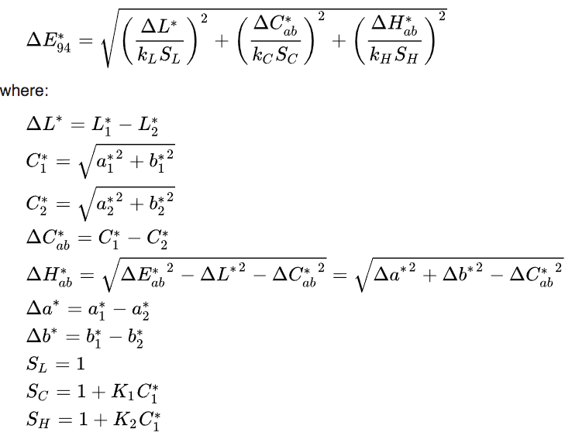
CIE94

Slide 18
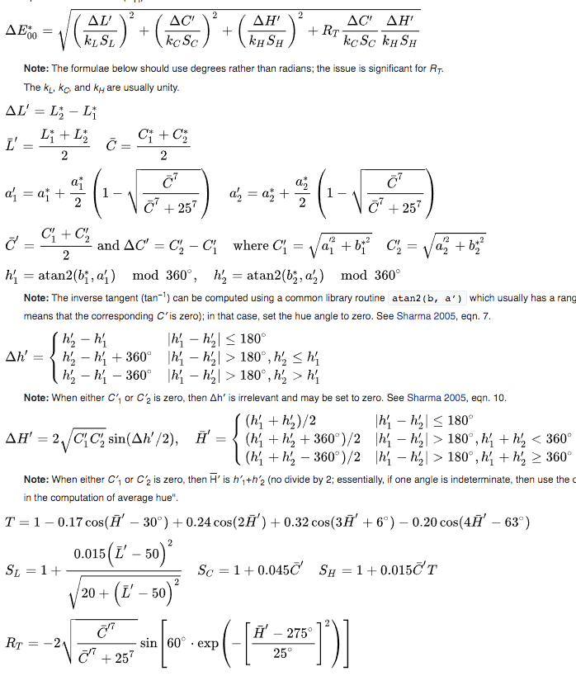
CIEDE2000

Slide 19
Summary
Take your pick of color space, then try Euclidean
  CIELAB, CAM02-UCS, CAM16-UCS
Or try an actual metric:
  CIE94, CIEDE2000
Uncountable others

Slide 20
What’s the point?

Slide 21



ANSI Color Codes
Image -> text
catimg
Some terminals support 3-byte “true color”
Neither Vim’s AnsiEsc nor Vim’s Colorizer can render these
Thus, have to use 255 color mode
original image
b. catimg 24-bit “true color”
c. catimg 8-bit

Slide 22
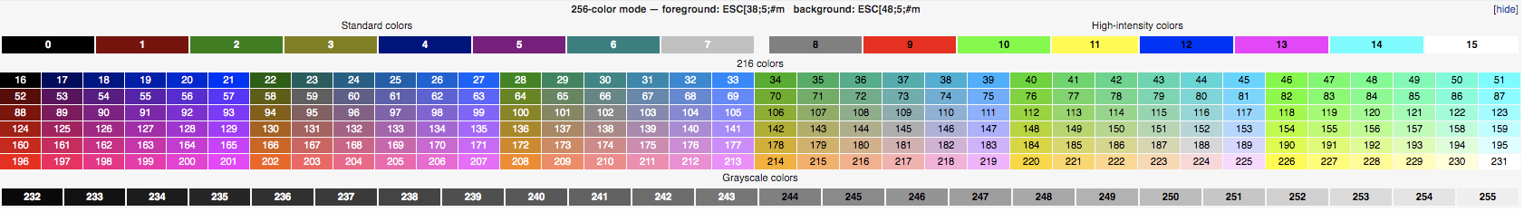
The Algorithm
Downscale image somehow (averaging window, bicubic, bilinear, etc.)
Convert color to nearest ANSI color
  Find closest color!
  catimg uses YUV color space + Euclidean which explains the poor quality
Keep this problem in mind, it’ll come back later...

Slide 23
Food for thought...

Slide 24
Sound familiar?
Ad-hoc formulas
Problem is by definition not a priori
Empirically determined
Deep learning?
Datasets of color1, color2 pairs and corresponding distance
Neural network essentially color space, project color -> vector
Backpropagate on distance
Uniform color space???
Implication of NNs modeling brain’s neural network...

Slide 25
Sources
My implementation
Color Vision - Wikipedia
Why are red, yellow, and blue the primary colors in painting but computer screens use red, green, and blue?
MacAdam ellipse
USEFUL: Color math and programming code examples - EasyRGB
  scikit-image color functions
CIELAB color space - Wikipedia

Slide 26
Sources
Color difference - Wikipedia
Color difference Delta E - A survey
The development of the CIE 2000 colour‐difference formula: CIEDE2000
VERY USEFUL: http://www2.ece.rochester.edu/~gsharma/ciede2000/
  Organized presentation of formulas, detailed testcases, a bit of mathematical analysis
Delta-E Calculator (broken for CIE2000, works for CIE76 and CIE94)
ANSI escape code - Wikipedia

Slide 27
Appendix

Slide 28
Why 2*255 in “Basis of the Subtractive Color System”?
Need coefficients to be nonnegative to make sense
Because of LP, extrema occurs at simplex
from itertools import product
import numpy as np
w = np.array([1, 1, 1])
m = np.array([[0, 1, 1],
[1, 0, 1],
[1, 1, 0]])
minv = np.linalg.inv(m)
for corner in product((0, 255), repeat=3):
u = minv@(2*255*w - np.array(corner))
print(corner, u, min(u), max(u))

