Slide 1
CMPT 120 Fall 2022 SFU, Surrey
First lecture!
Lecture 1
Welcome to CMPT 120!
What’s computer science?
What’s Python?
Administrivia

Slide 2
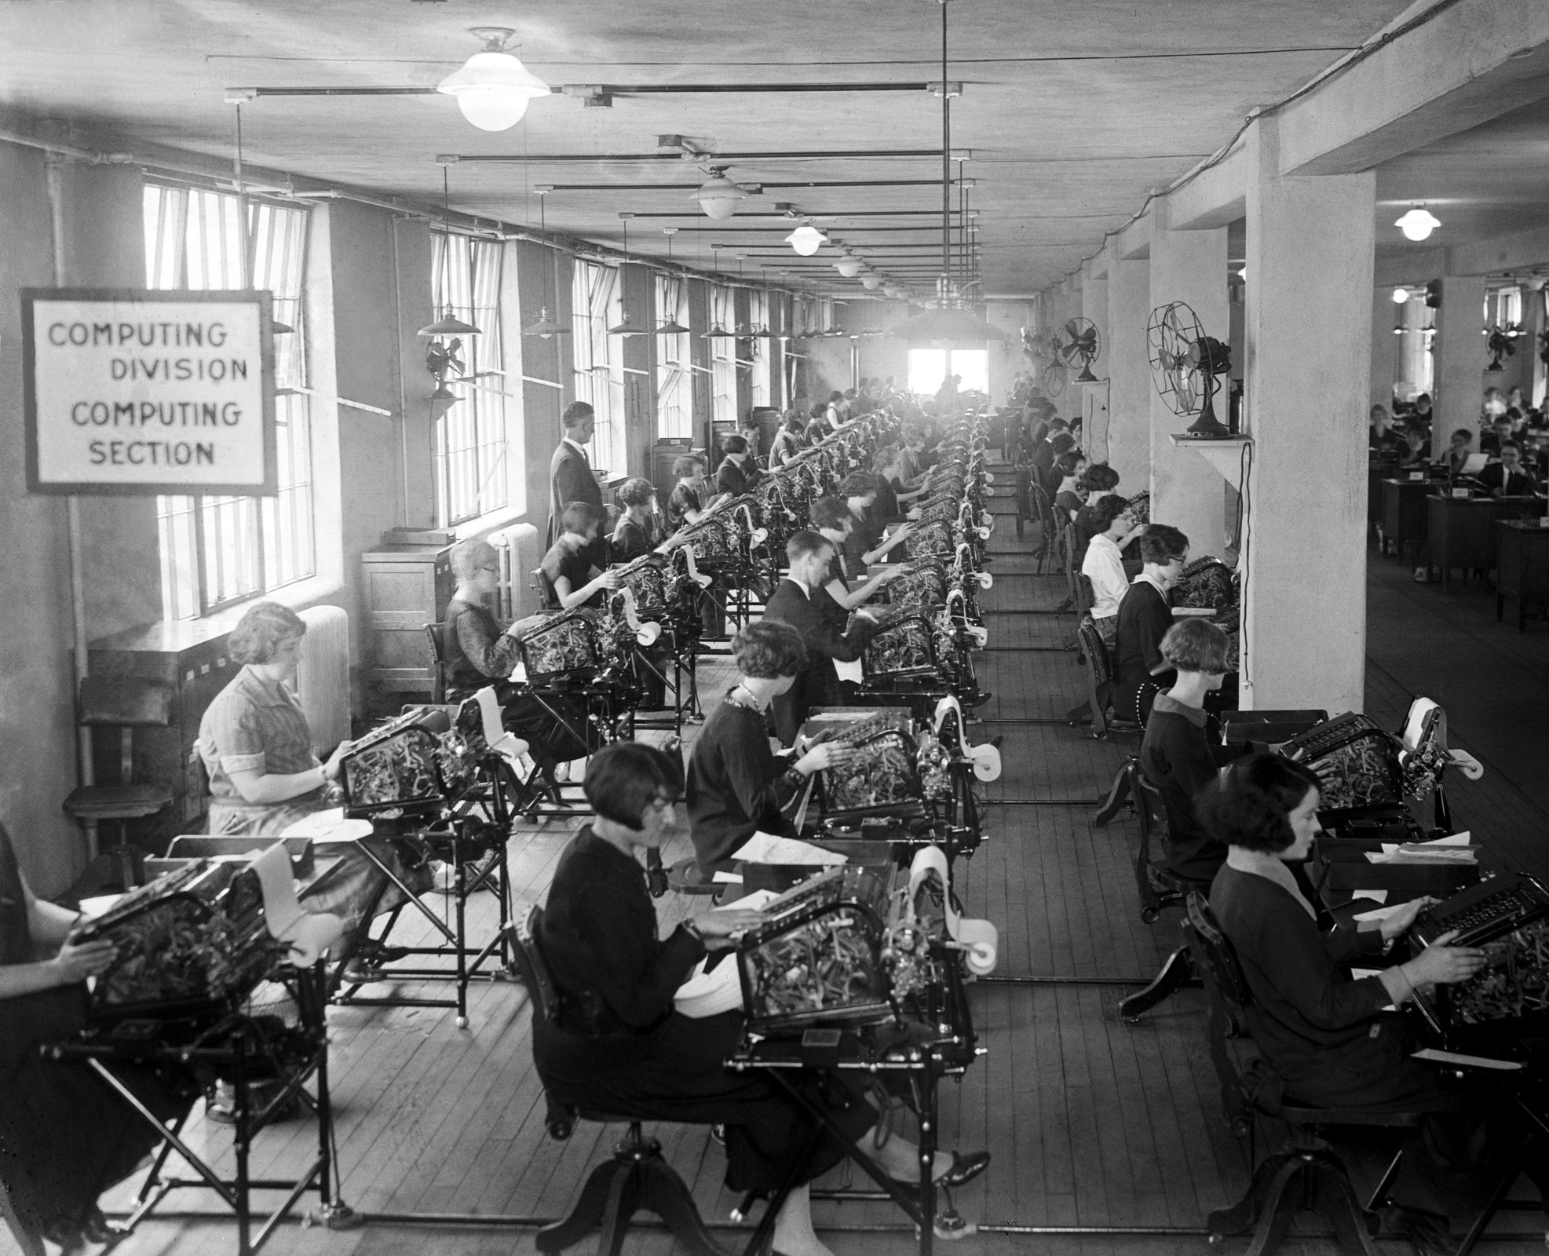
CMPT 120
What do you notice in this picture?
Human computers
US Veterans Bureau
1924
Notes:
Some things to notice:
The calculators are huge, and most likely not electronic.
There are electric lights.
There are fans … even today computers use fans to cool down.
The operators are mostly women.
Points to ponder:
How many machines do they need?
How fast does each machine go? What exactly does it compute?
How do the operators know what to do? Where do they put their results?
The idea of making calculating machines electronic was still science fiction. It wasn’t until the 1940s when automatic electronic computers became a reality.

Slide 3
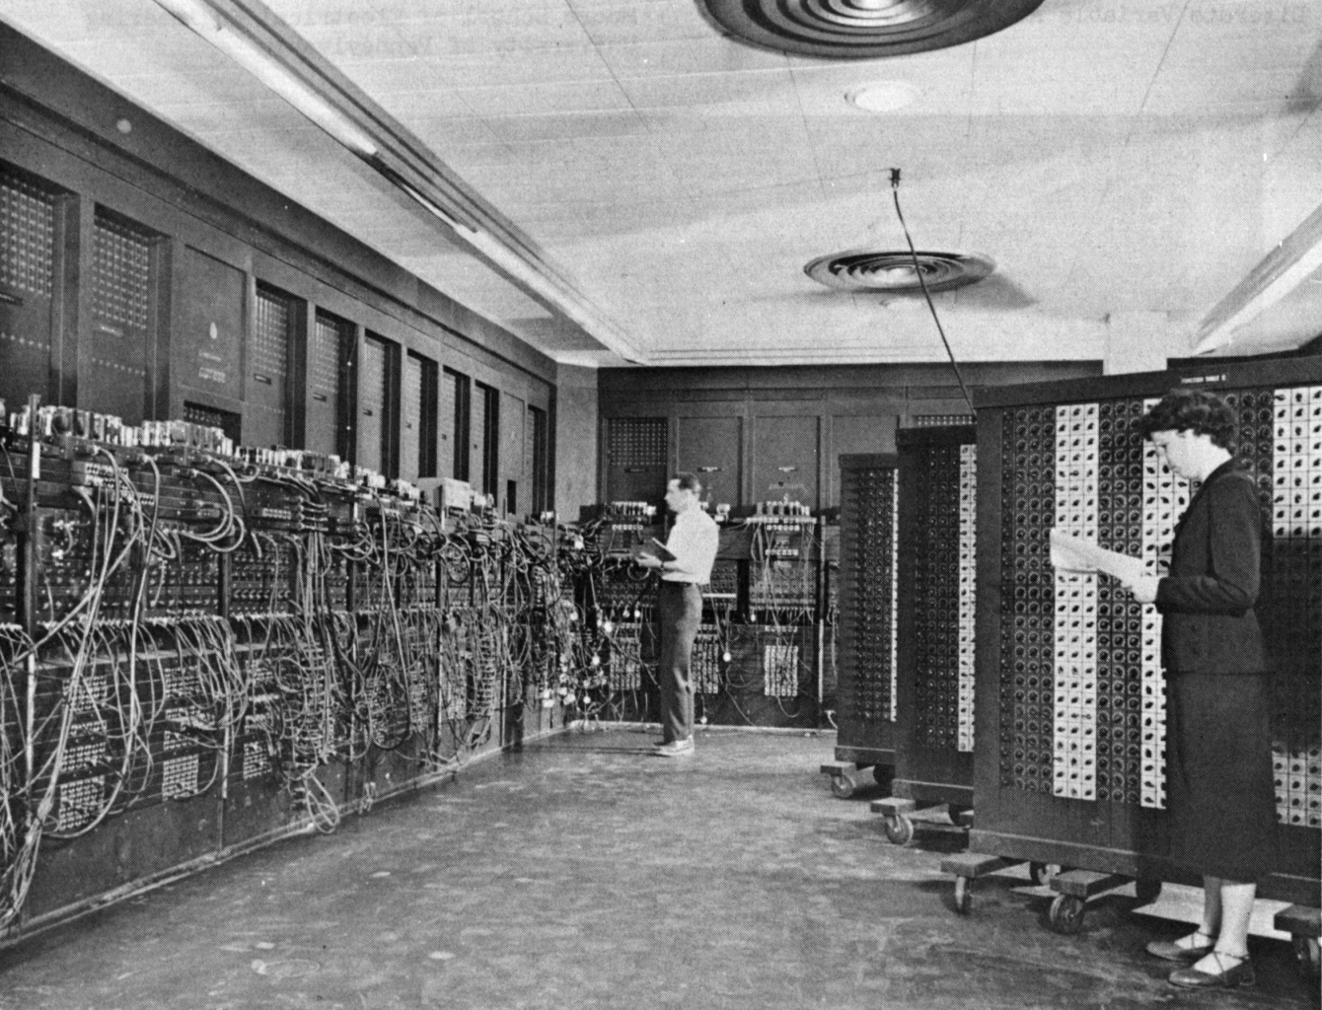
What is Computer Science (CS)?
the systematic study of computation
a precise, step-by-step process
ENIAC, 1945 1st automatic electronic computer
Glenn Beck Betty Snyder
Notes:
Things to notice:
It’s huge --- it takes up a whole room. But less hardware than the previous picture.
Programmed by plugging wires into different sockets.
You can see some of the vacuum tubes on top.
The plug boards on the right are on wheels.

Slide 4
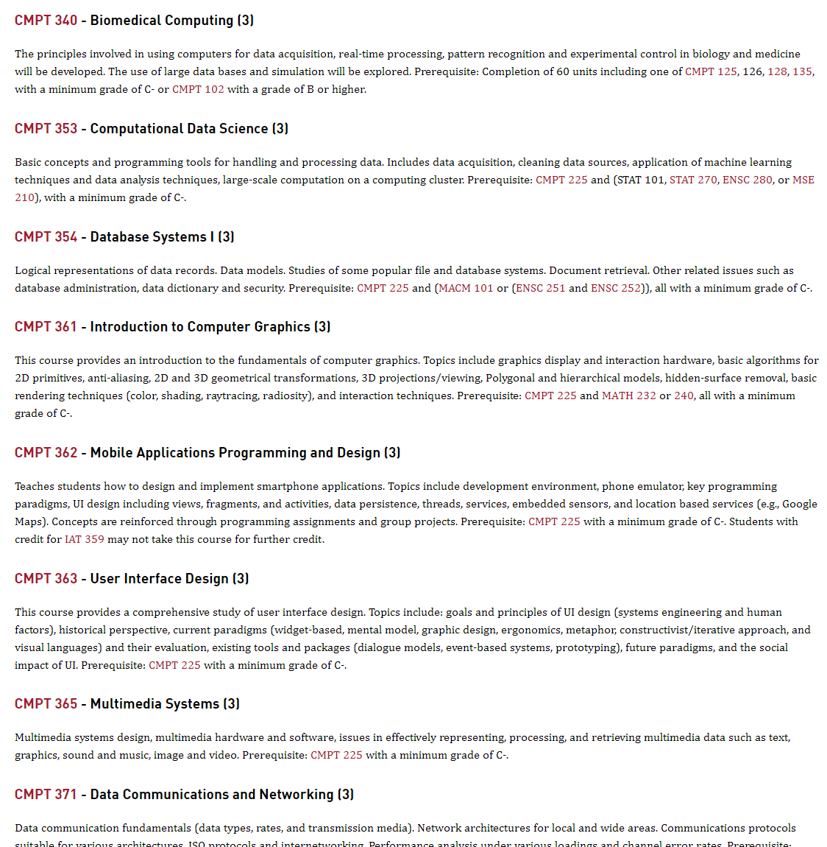
What is Computer Science?
Programming, software engineering, databases, operating systems, computer graphics, multimedia systems, data science, machine learning, programming languages, computability and complexity theory, cryptography, networking, human-computer interaction, robotics, …
http://www.sfu.ca/students/calendar/2022/fall/courses/cmpt.html

Slide 5
Welcome to CMPT 120
Who is 120 meant for?
Students with no previous programming experience
Who’s the teacher for this section of 120?
Dr. Toby Donaldson
Ask him questions! Go to his office hour!
Google “SFU CMPT 120 placement test” if you want to take a test to see if 120 is right for you. CMPT 125 might be better if you already know how to program.

Slide 6
What are the goals of CMPT 120?
1
Learn the basics of the Python programming language
Introduce some interesting computer science topics, like big data and computer graphics
2

Slide 7

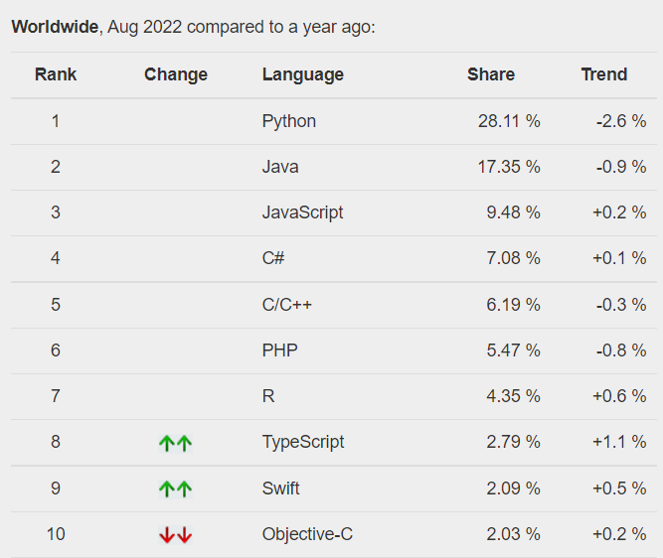
Is Python Popular?
Yes!
PYPL PopularitY of Programming Language
(based on how often language tutorials are searched for) https://pypl.github.io/PYPL.html

Slide 8
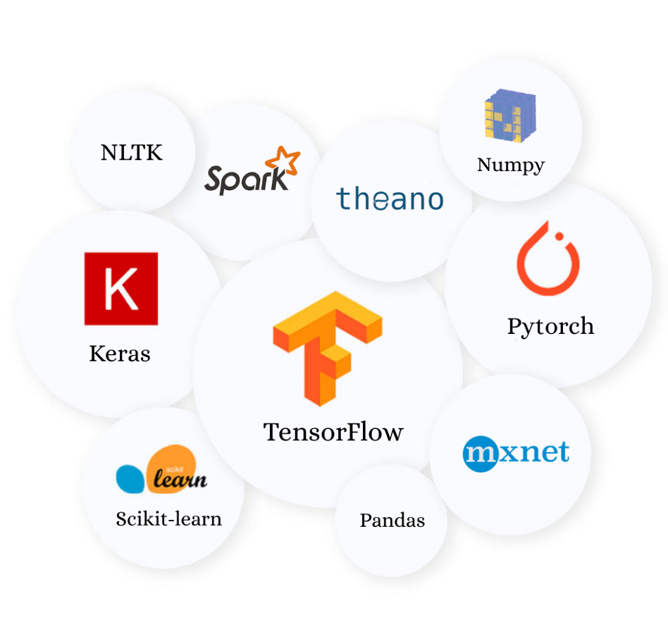
Some popular Python libraries for data science and machine learning
Is Python a popular in data science and machine learning (ML)?
Yes!

Slide 9
Python is also popular in …
Scripting
scripts are programs that “glue” together other programs, even ones written in other languages
Education
popular 1st programming language

Slide 10
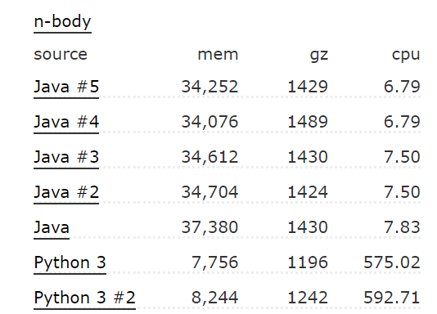
Is Python known for being an efficient programming language?
No!
Java is another popular 1st programming language
n-body is a test program that calculates planetary orbits
From the Computer Languages Benchmark Game https://benchmarksgame-team.pages.debian.net/benchmarksgame/fastest/python3-java.html

Slide 11
If it’s so slow, why is it so popular?
It’s relatively easy to learn.
Python programs are often quite readable.
It’s programmer friendly … lots of useful built-in functions and libraries to do most common programming tasks. Plus thousands more on the web.
Programs might run more slowly than other languages, but the time it takes the programmer to write them is often much less.

Slide 12

Administrivia
Course details are on Canvas: canvas.sfu.ca
All enrolled students should have permission to view the CMPT 120 Canvas page.
The course marking scheme, list of weekly assignments, discussion groups, etc. are all there.
Install Python on your own computer and play along in lectures!
I will be mostly using the Mu editor, and you should too.
Download Mu from here: https://codewith.mu/
Surf to: https://www.python.org/downloads/

