Slide 1
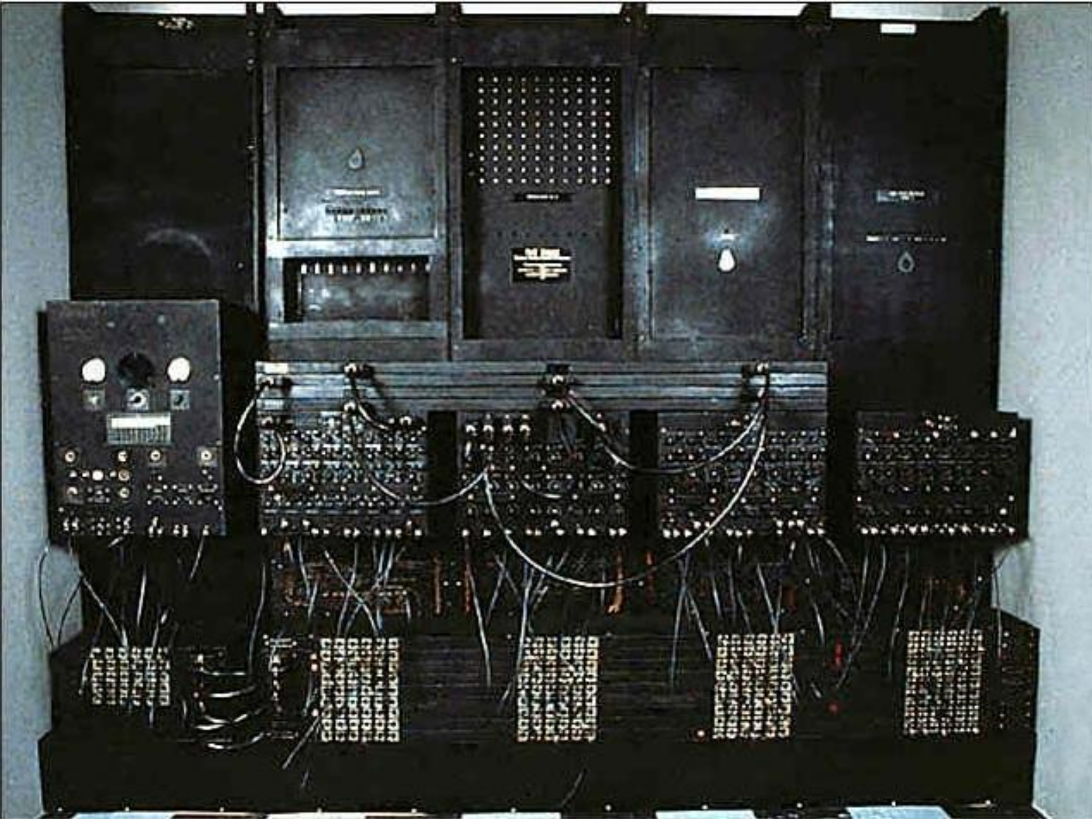
ENIAC Accumulators
Could add, subtract, and hold a 10-digit number in memory
Could add/subtract 5000 10-digit numbers per second

